Slide 1
APEX magnets/power
based on information from Jack Segal
HRS spectrometers
Septa magnet

Slide 2
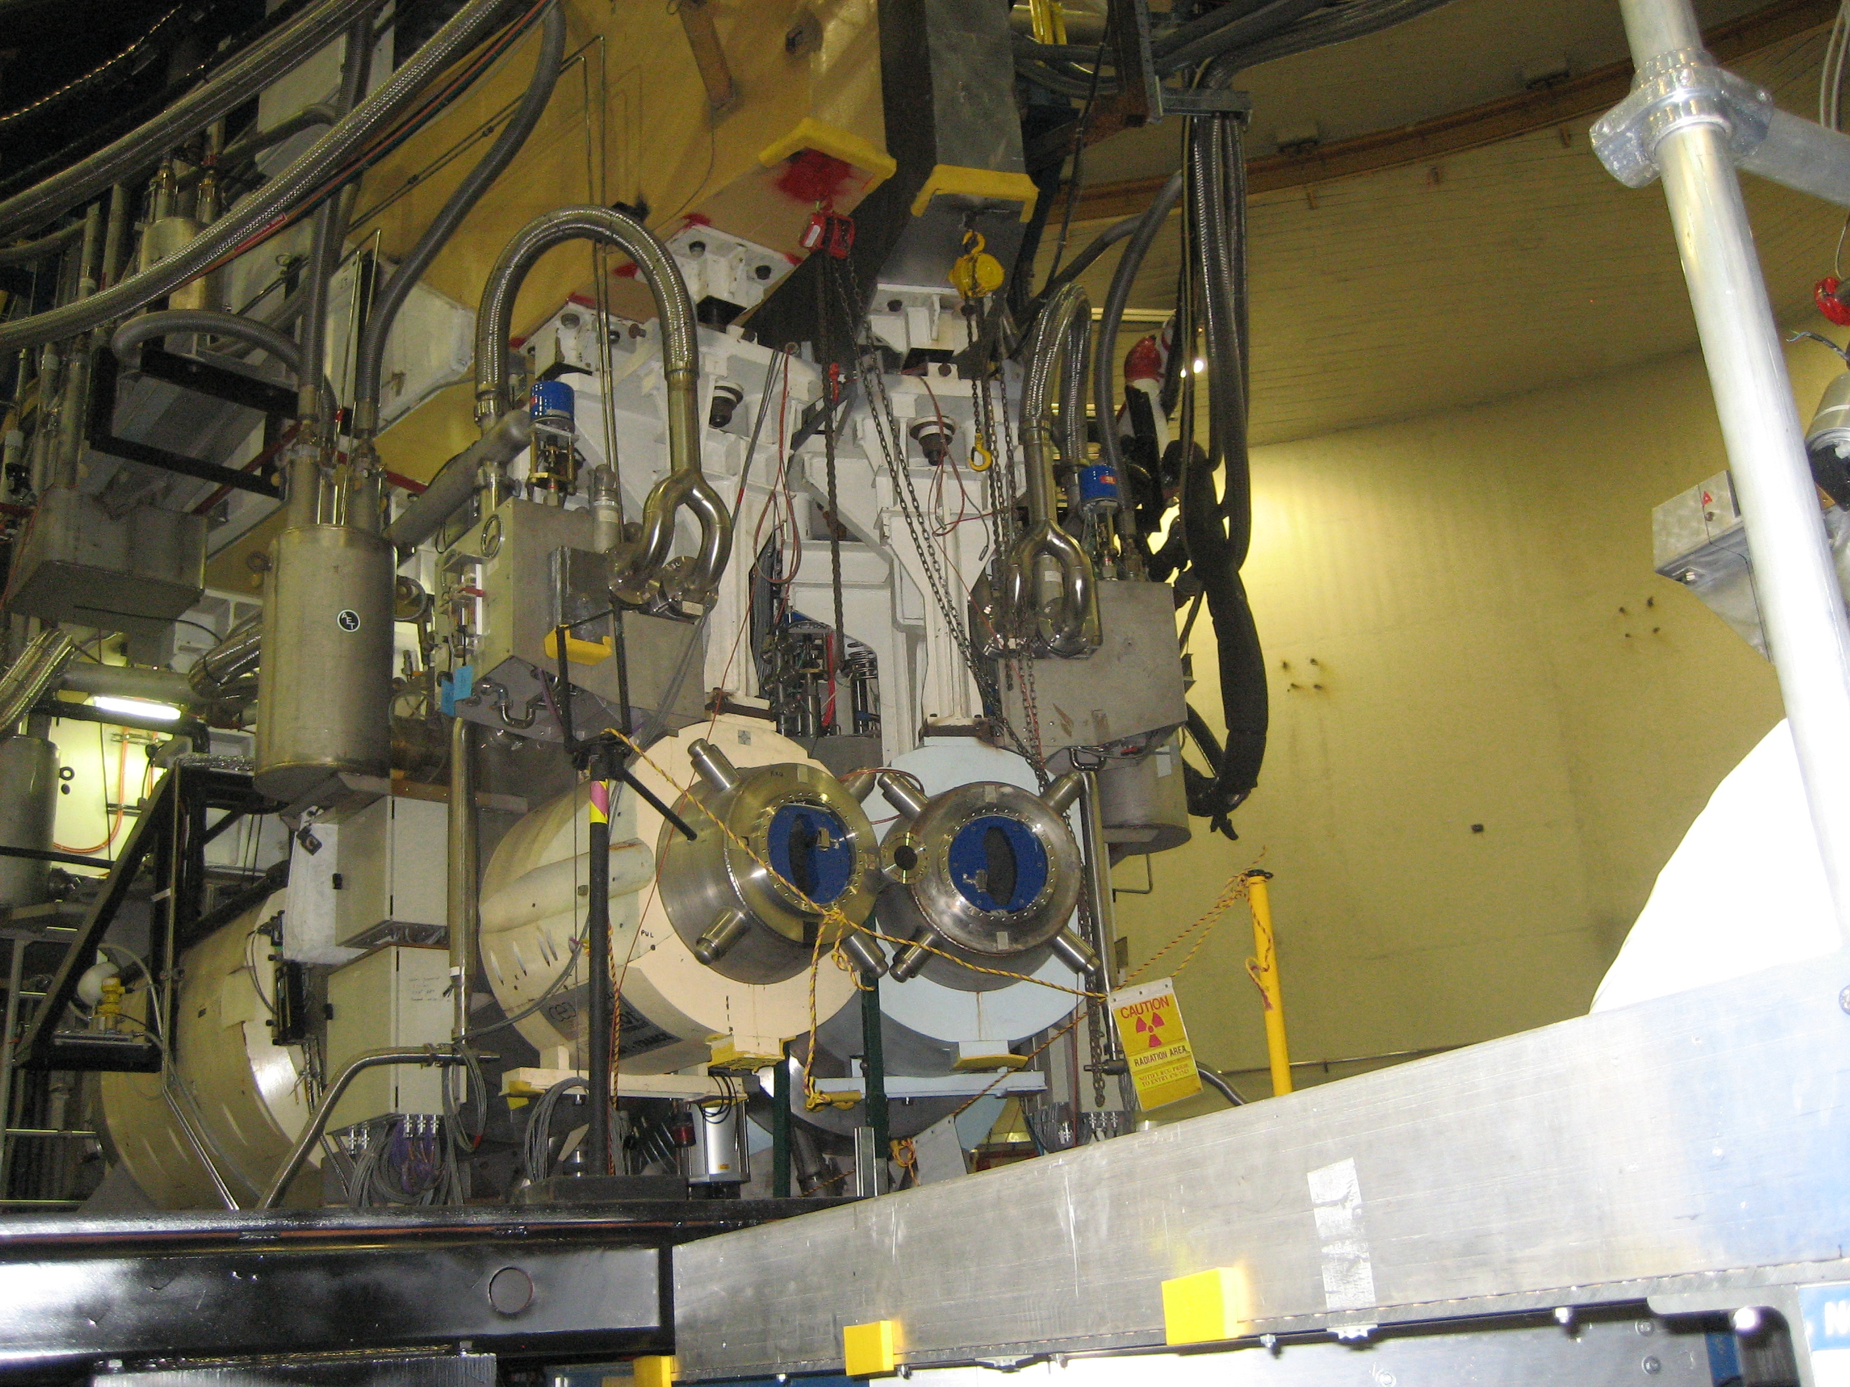
APEX magnets/power

Slide 3
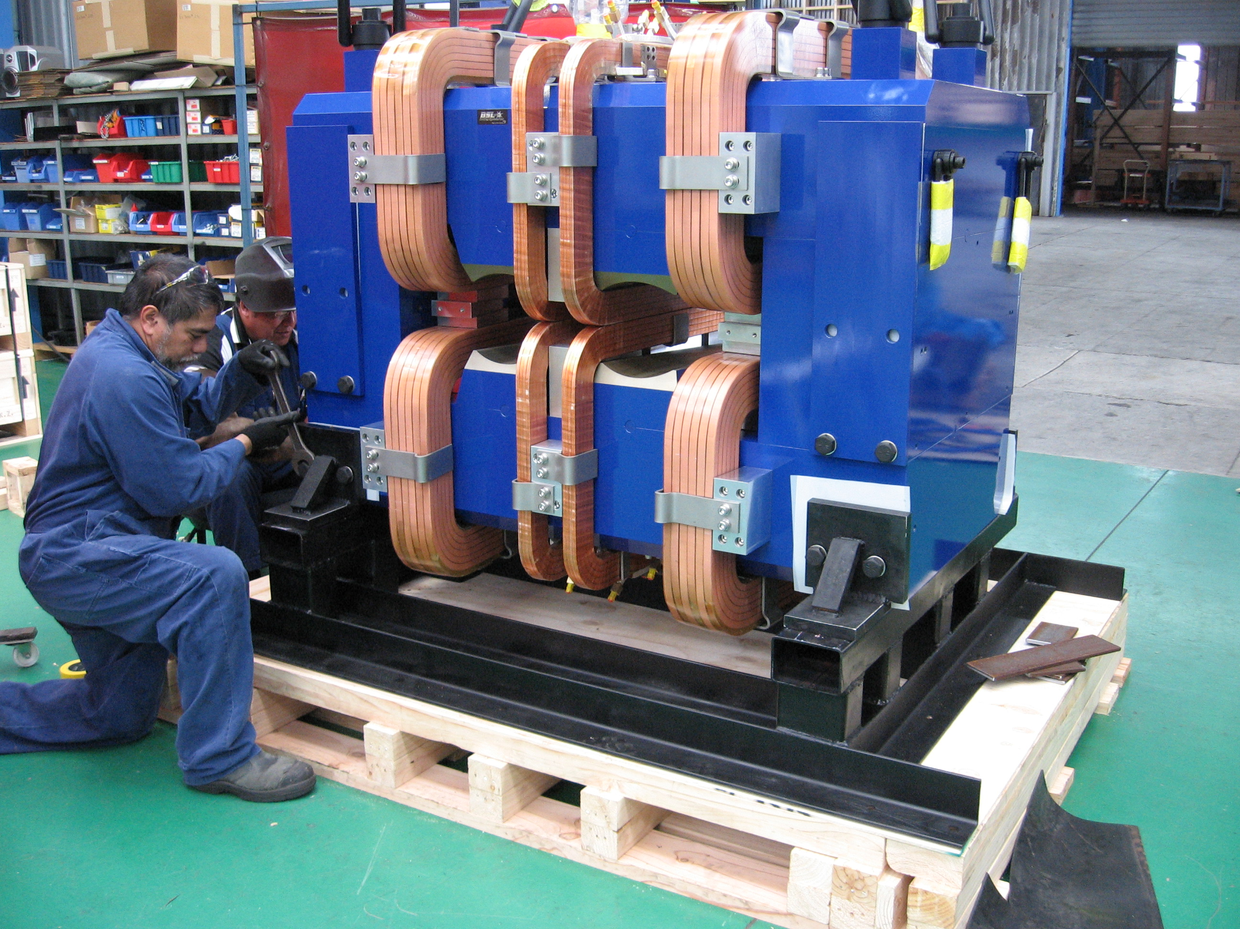
APEX magnets/power
based on information from Jack Segal

Slide 4
APEX magnets/power
based on information from Jack Segal

Slide 5
APEX magnets/power
based on information from Jack Segal

