Slide 1
Apex Target
Marco Oriunno, April 23, 2014

Slide 2
Design and fabrication by:
Marco Oriunno, Dieter Walz, Jim McDonald, Clive Field, Douglas Higginbotham, and many others…

Slide 3
Requirements
.
Beam parameters assumed
40 µA
Vertical width 400 µm
Horizontal width 400 µm
Vertical dither 5 mm
Horizontal dither 1.5 mm

Slide 4
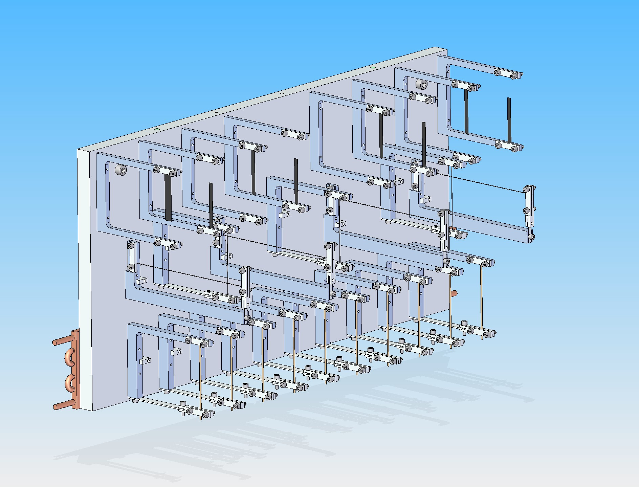
General Layout
First Row (from the top) Carbon foils 100um, calibration of the spectrometer with wide angle pion. The first foil is probably BeO.
Second Row: Wires H/V for low current beam position and angle scanner.
Third Row: Tungsten Foil 15um (more stable that Tantalum). More foils downstream increase the Rate.
Beam direction

Slide 5
Production target:
10 layers of 15 µm thick tungsten ribbons (4.3% rad length)
2.5 mm wide in X
Separated by 5.5 cm along beam
- Tracks from A´ decays produced in a ribbon, and going into the spectrometers, will not be intercepted by the next ribbon

Slide 7
Target issues:
At 40 µA, the target will become hot!
The tungsten will expand
- The frames that hold the tungsten have enough spring to maintain the ribbons under tension, even when hot.
The hot tungsten may be much weaker than at room temperature
- The temperature range and tension are selected to stay away from breaking point.
- 250 g tension (Verify the tension is still 250 g)
Cooling in the beam region is mostly by black-body radiation. Conduction becomes more important at lower temperatures closer to the supports.
Numerous calculations of thermal effects and a simulation allowing for temperature dependence of thermal properties:--

Slide 8
Temperature Transient (black body radiation only)
Steady State after 20 sec.
Peak temp
1300 K

Slide 9
Temperature Distribution
Temp. fairly uniform horizontally across ribbon
Across the beam width

Slide 10
Thermal Expansion
Elongation
130 µm

Slide 11
Alignment relative to target
Beam at < 5 µA for alignment work
A set of tungsten wires spaced along the length of the target
4 horizontal wires in 5 mm vertical steps, at -25, -10, 10, 25 cm along the beam
3 vertical wires in 0.25 mm horiz steps, at -20, 0, 20 cm along the beam
100 µm diameter tungsten
Still gets hot! But not as bad as the production target ribbons.
- Still, use similar tensioning technique as for the ribbons
- 150 g tension

Slide 12
Tungsten wire Calibration Target - Heating
Peak temp
900 K

Slide 13
Calibration Target - carbon foils
Produce copious pion signal
8 foils spaced along the length of the target
(-30, -22.5, -15, -7.5, 7.5, 15, 22.5, 30 cm)
BeO scintillator for beam diagnostics
Target frames are mounted on an aluminum plate
Plate is cooled by N2 flow through heat sinks on reverse side
Optical targets for use during installation are inserted in the back of the plate, (ruby balls)
The wire positions have been surveyed relative to the optical alignment targets.

Slide 14
Work that should be done on the target
-Visually inspect it
-Check that the target ribbons and wires are under adequate tension
-Check that the structure is clean enough for vacuum
-I believe that one or two of the target ribbons were made of
tantalum, the intention being to hedge our bets and
see if either metal survived better during special
test runs (not carried out).
The tantalum was found to be mechanically liable to
crack during flexing.
->Decide whether to replace the tantalum with tungsten.

Slide 15
