Slide 1
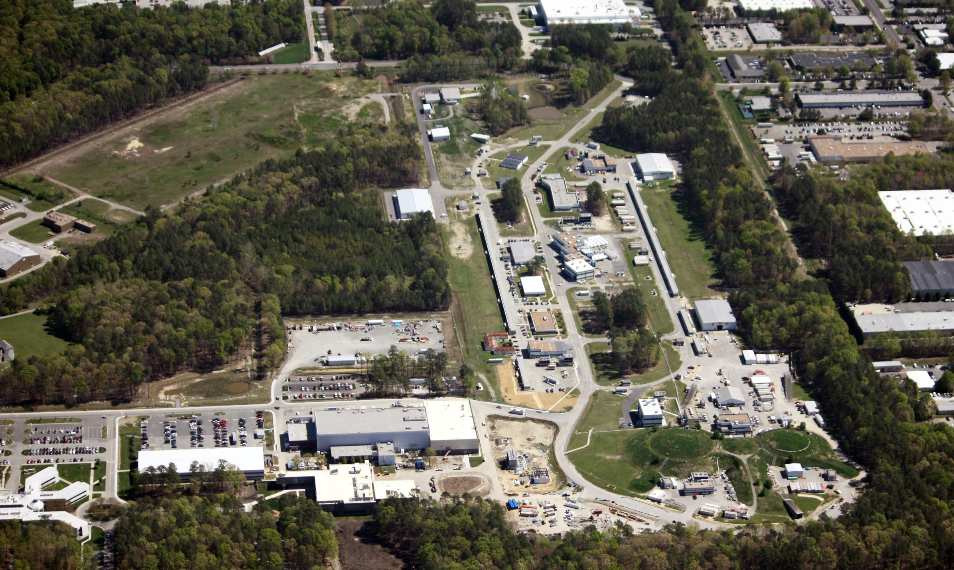
Jefferson Lab Status
R. D. McKeown
Deputy Director For Science
APEX Meeting
April 22, 2014

Slide 2
Outline
Physics Highlights
12 GeV Project Status
PAC and science program
New Projects Update
Budget Update
MEIC Planning
Summary and Outlook
Notes:
Like to give an overview of Jefferson Lab.
I can’t get going without saying something of the current status of the lab.
The dominant part of the talk will concern our 12 GeV Upgrade Project, the physics and the project status.
However, the technology which enables our nuclear physics and its enhancement also provides opportunities in the future
Photon Science
Accelerator Driven Systems
Nuclear Physics
Conclude

Slide 3
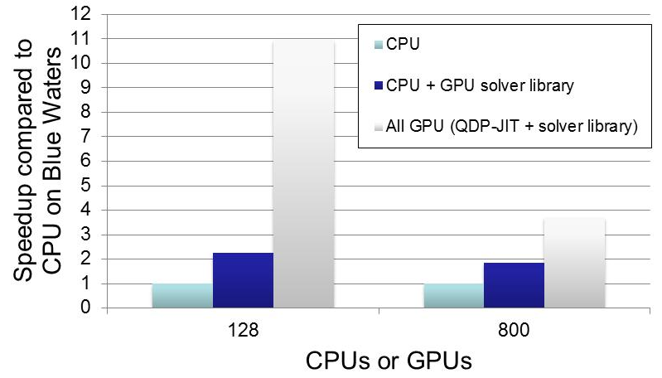
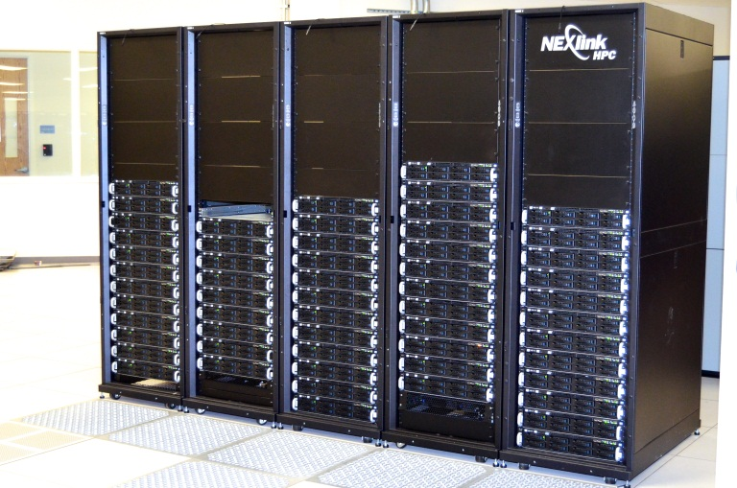
Accelerating Science with GPUs
Gauge Generation Benchmark
Before: Used CPU + GPU solver library for LQCD Analysis ( >95% work in solver )
Gauge Generation uses solvers less
- smaller gain from only accelerating solver
QDP-JIT layer moves entire calculation to GPU (+ we still use GPU solver library)
2x-5x speedup over GPU solver library alone, 3.7x-11x speedup over CPU alone
Strong (Hard) Scaling
TOP 500 (#364) Supercomputer
Data from: F. Winter (JLab), M. A. Clark (NVIDIA), B. Joo (JLab),
R. Edwards (JLab) - Accepted for IPDPS’14 conference
Applicable to leadership GPU systems
such as DOE Titan (ORNL) and
NSF Blue Waters (NCSA - University of Illinois)
(for only $750K!)

Slide 4
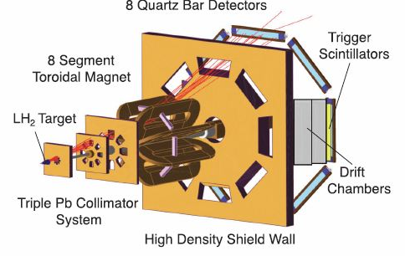
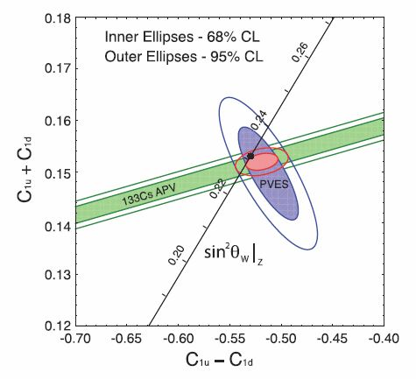
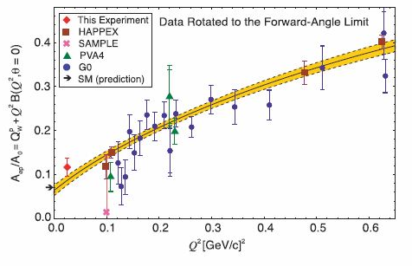
Physical Review Letter 111, 141803 (2013)

Slide 5
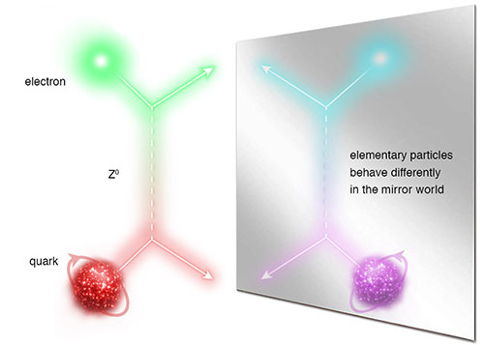
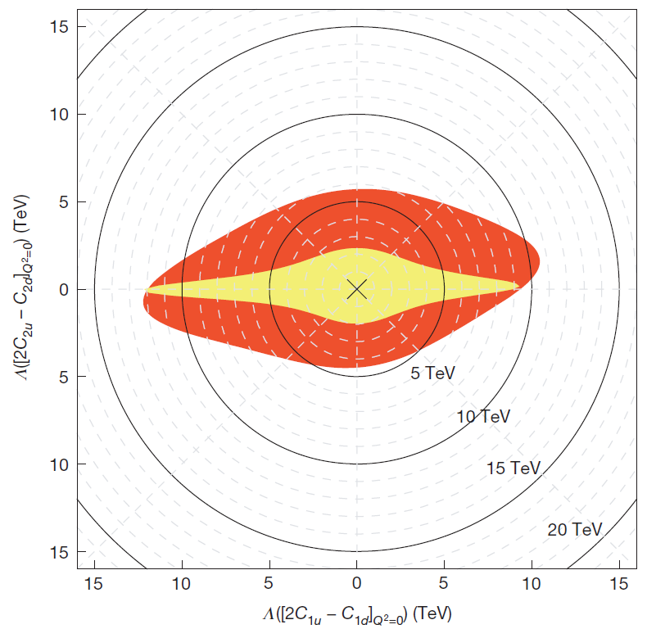
Measurement of the Parity-Violating Asymmetry in eD Deep Inelastic Scattering
Nature 506, 67–70 (06 February 2014)
The Jefferson Lab PVDIS Collaboration
See also News & Views, Nature 506, 43–44 (06 February 2014)
Longitudinally Polarized Electron Scattering from Unpolarized Deuterium
(α [2C_{1u} – C_{1d}] + β [2C_{2u} – C_{2d}])
Provides a determination of the effective electron-quark weak coupling combination 2C_{2u} – C_{2d} that is five times more precise than before.
It is the first experiment to isolate, when combined with previous experiments like Q-weak, a non-zero C_{2q} (at 95% confidence level).
This coupling describes how much of the mirror-symmetry breaking in the electron-quark weak interaction originates from the quarks' spin preference. The result provides a mass exclusion limit on the electron and quark compositeness and contact interactions of ~5 TeV.
JLab PVDIS
SLAC E122

Slide 6
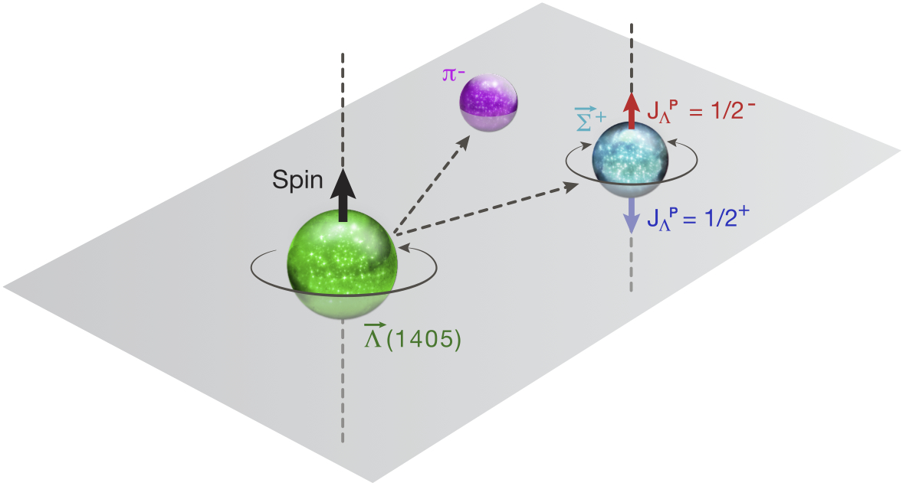
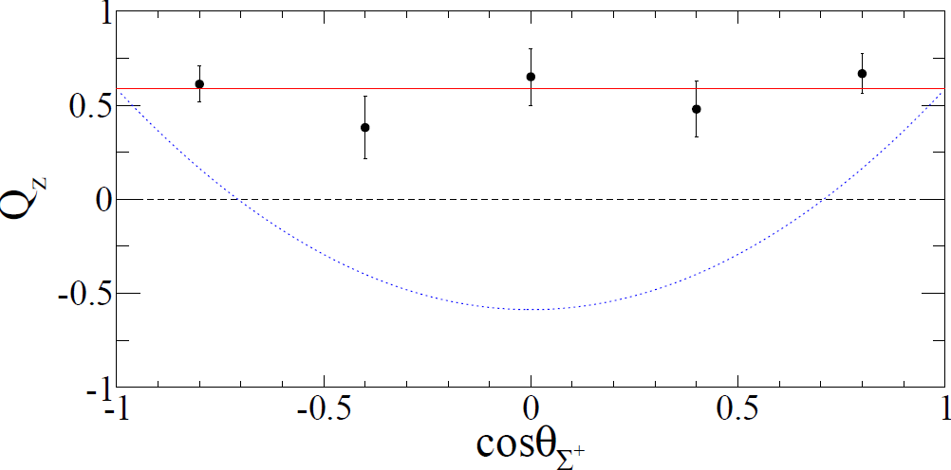
Spin and Parity of the Λ(1405) Baryon
Λ(1405) is a well‐known hyperon (PDG Status: ****)
Spin-Parity, J^{P}, has never been definitively measured
Λ(1405) created polarized via photoproduction in liquid hydrogen & detected in CLAS
$$\overset{→}{\text{L}}$$
γ + p → K⁺ + (1405),
(1405) → ⁺ + π⁻
$$\overset{→}{\text{L}}$$
$$\overset{→}{\text{S}}$$
$$\overset{→}{\text{L}}$$
$$\overset{→}{\text{S}}$$
(1405) → ⁺ + π⁻
$$\overset{→}{\text{S}}$$
⁺ → p + π⁰
$$J^{P}= {1/2}^{−}$$
Isotropic decay of $\text{L}$(1405) is consistent with spin $J=1/2$
Polarization transfer to Σ⁺ direction reveals $J^{P}= {1/2}^{−}$ vs. $J^{P}={1/2}^{+}$
Quark model expectation confirmed
Higher spins are disfavored by the data and by theoretical expectations
$$J^{P}={1/2}^{+}$$
K. Moriya, R. A. Schumacher et al. (CLAS Collaboration),
“Spin and Parity Measurement of the Λ(1405) Baryon.” Phys. Rev. Lett. 112 082004 (2014).

Slide 7
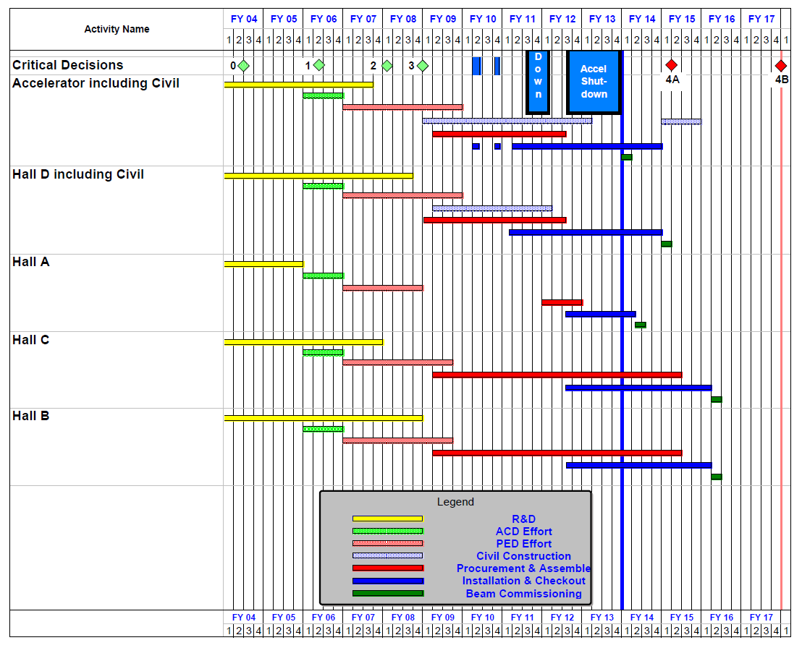
12 GeV Upgrade Project Schedule
FY12: reduction of $16M
FY13: Pres Request – no restoration
16-month installation
May 2012 - Sept 2013
Accelerator commissioning start Oct 2013
Hall A commissioning start Feb 2014
Hall D commissioning start
Oct 2014
Halls B & C commissioning start Jan/Feb 2016
Project Completion September 2017
Re-baseline Approved
September 4, 2013

Slide 8
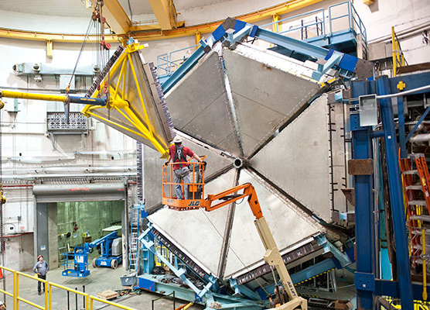
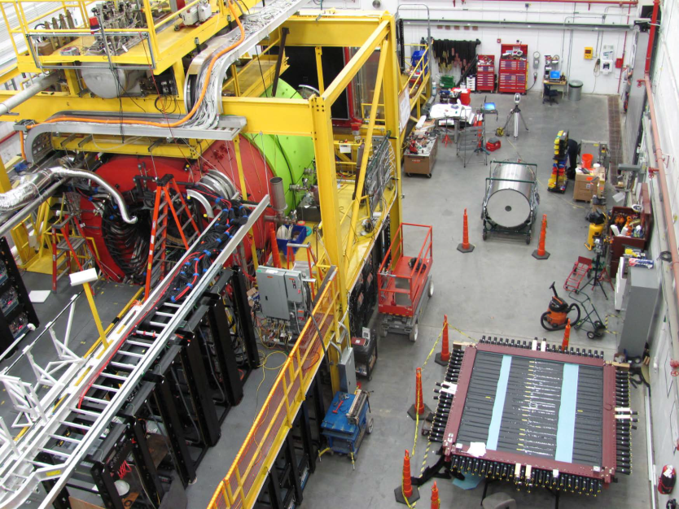
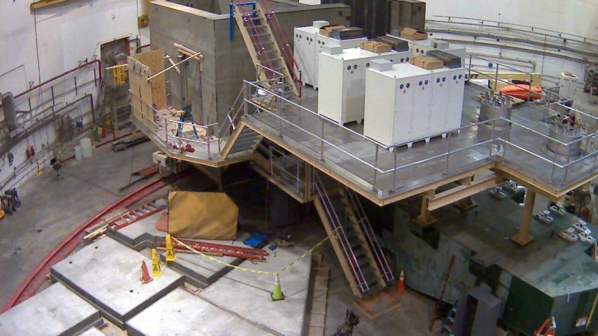
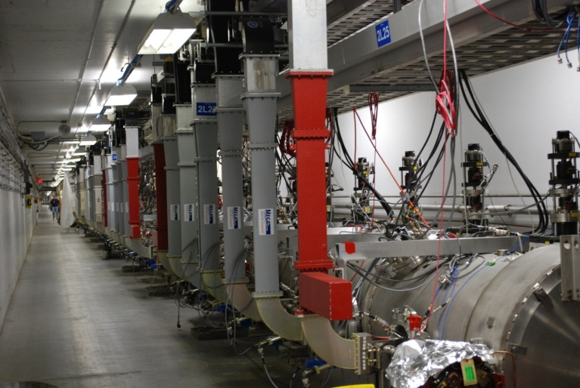
12 GeV Project Highlights
Hall D
Hall B
Hall C

Slide 9
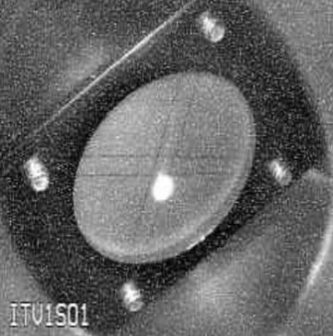
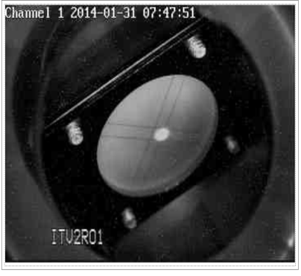
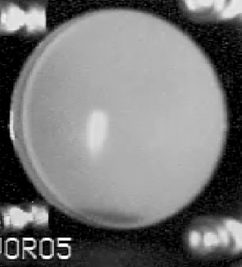
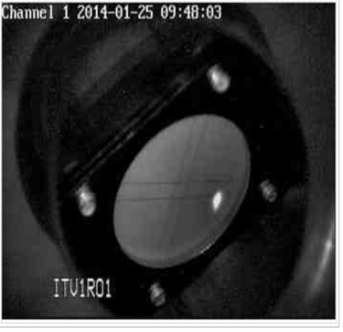
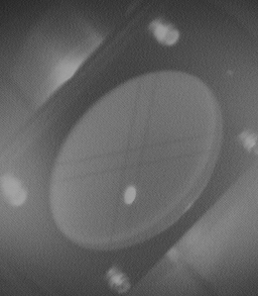
Accelerator Commissioning Progress
1S
2214 MeV
34 MeV
2R
0R
1124 MeV
CHL1, CHL2 operational
Linacs at 2K
North Linac – 1090 MeV
South LINAC – 1090 MeV
CEBAF 2.214 GeV
Optics, Magnets great
1R
2S
KPP: machine capable of 12 GeV
1 pass at 2.2 GeV/pass for 8 hours
with acceptable trip rate (50% uptime)

Slide 10
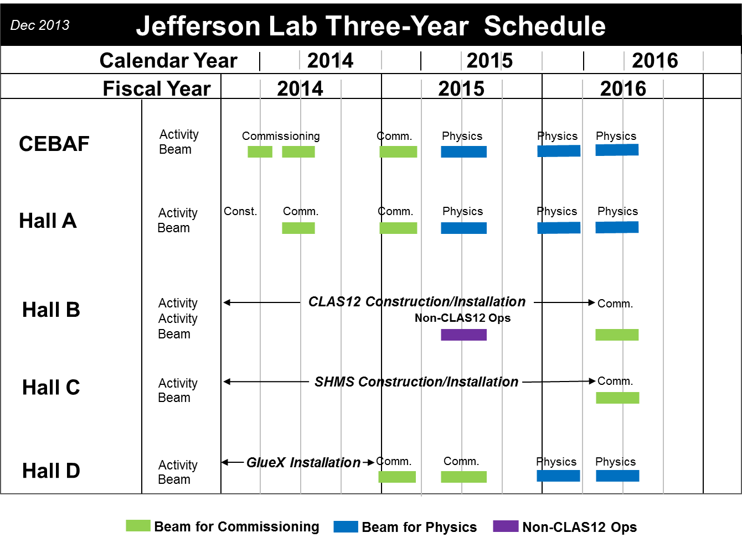
Three year plan

Slide 11
12 GeV Approved Experiments by Physics Topics
Topic | Hall A | Hall B | Hall C | Hall D | Other | Total
The Hadron spectra as probes of QCD (GluEx and heavy baryon and meson spectroscopy) |  | 1 |  | 2 |  | 3
The transverse structure of the hadrons (Elastic and transition Form Factors) | 4 | 3 | 2 | 1 |  | 10
The longitudinal structure of the hadrons (Unpolarized and polarized parton distribution functions) | 2 | 3 | 6 |  |  | 11
The 3D structure of the hadrons (Generalized Parton Distributions and Transverse Momentum Distributions) | 5 | 9 | 4 |  |  | 18
Hadrons and cold nuclear matter (Medium modification of the nucleons, quark hadronization, N-N correlations, hypernuclear spectroscopy, few-body experiments) | 4 | 2 | 6 |  | 1 | 13
Low-energy tests of the Standard Model and Fundamental Symmetries | 3 | 1 |  | 1 | 1 | 6
TOTAL | 18 | 19 | 18 | 4 | 2 | 61

Slide 12
12 GeV Approved Experiments by PAC Days
Topic | Hall A | Hall B | Hall C | Hall D | Other | Total
The Hadron spectra as probes of QCD (GluEx and heavy baryon and meson spectroscopy) |  | 119 |  | 320 |  | 439
The transverse structure of the hadrons (Elastic and transition Form Factors) | 144 | 85 | 102 | 25 |  | 356
The longitudinal structure of the hadrons (Unpolarized and polarized parton distribution functions) | 65 | 230 | 165 |  |  | 460
The 3D structure of the hadrons (Generalized Parton Distributions and Transverse Momentum Distributions) | 409 | 872 | 161 |  |  | 1442
Hadrons and cold nuclear matter (Medium modification of the nucleons, quark hadronization, N-N correlations, hypernuclear spectroscopy, few-body experiments) | 159 | 120 | 179 |  | 14 | 472
Low-energy tests of the Standard Model and Fundamental Symmetries | 547 | 205 |  | 79 | 60 | 891
TOTAL | 1324 | 1631 | 607 | 424 | 74 | 4060
More than 7 years of approved experiments

Slide 13
PAC41
PAC41 will be held during the week of May 19, 2014. This will be a special meeting to discuss the priority of already approved proposals for scheduling during the first 3-5 years of production running (beyond commissioning) in the 12 GeV era of CEBAF. The goal of this meeting is to provide input to the Lab scheduling process from the PAC in order to realize the highest impact program early in the 12 GeV running period.

Slide 14
PAC42
Scheduled for July 28-August 1
Proposals will be due early June
Charge:
Review new proposals, previously conditionally approved proposals, and letters of intent for experiments that will utilize the 12 GeV upgrade of CEBAF and provide advice on their scientific merit, technical feasibility and resource requirements.
Identify proposals with high-quality physics that, represent high quality physics within the range of scientific importance represented by the previously approved 12 GeV proposals and recommend for approval.
Also provide a recommendation on scientific rating and beamtime allocation for proposals newly recommended for approval.
Identify other proposals with physics that have the potential for falling into this category pending clarification of scientific and/or technical issues and recommend for conditional approval. Provide comments on technical and scientific issues that should be addressed by the proponents prior to review at a future PAC.

Slide 15
Budgets
FY 14 in relatively good shape.
FY15 NP budget
- $594M total, +$24M over FY14
- CEBAF ops $91.5M (vs. $90M in FY14),
~$8M less than needed to run planned 30 weeks
 only ~20 weeks - will impact physics running
Concern about operations budget in outyears
Note: New MEP Program Manager – Gulshan Rai

Slide 16
Electron Ion Collider
NSAC 2007 Long-Range Plan:
“An Electron-Ion Collider (EIC) with polarized beams has been embraced by the U.S. nuclear science community as embodying the vision for reaching the next QCD frontier. EIC would provide unique capabilities for the study of QCD well beyond those available at existing facilities worldwide and complementary to those planned for the next generation of accelerators in Europe and Asia.”
Jefferson Lab and BNL developing facility designs
Joint community efforts to develop science case ◻ white paper (2013)

Slide 17
EIC Realization Imagined
Activity Name | 2010 | 2011 | 2012 | 2013 | 2014 | 2015 | 2016 | 2017 | 2018 | 2019 | 2020 | 2021 | 2022 | 2023 | 2024 | 2025
12 GeV Upgrade
FRIB
EIC Physics Case
NSAC LRP
EIC CD0
EIC Machine Design/R&D
EIC CD1/Downsel
EIC CD2/CD3
EIC Construction
Assumes endorsement for an EIC at the next NSAC Long Range Plan
Assumes relevant accelerator R&D for down-select process done around 2016

Slide 18
EIC Developments
MEIC design review (3 external reviewers) held Jan. 2014
Initiated MEIC Cost Review Task Force ~6 months
EICAC meeting (2/28-3/1, BNL)
EIC14 Accelerator workshop at JLab (Mar. 17-21)
VA request for new $4.6M over 2 years
Site assessment
Electron cooling test hardware
Project staffing
NSAC Long Range Plan (April 2014 start?)

Slide 19
Summary
12 GeV project
- 1 pass commissioning successful
- 3 pass operation just achieved
- Delivered CW beam in Hall A
PAC
- 2 meetings in 2014
- Special prioritization meeting
FY15 budget  reduction of CEBAF operations, physics impact
Much activity to realize EIC
NSAC LRP on the horizon

