Slide 1
APEX Trigger and DAQ
Sergey Abrahamyan
Yerevan Physics Institute
APEX collaboration

Slide 2
Overview
Requirements
Trigger improvements
DAQ improvements
Summary

Slide 3
HRS Detectors
S2m
RHRS Calorimeter
LHRS Calorimeter
16 Paddles
2 segmented layers of lead glass blocks
S0
2 PMTs
VDC
Total 4 layers
368 wires each
Gas Cherenkov
10 PMTs
Central Ray
Notes:
Scintillators used for timing and triggers
Left HRS
34 blocks in each layer
15x15x30cm dimensions
Right HRS
48 blocks in preshower
10x10x35cm dimensions
75 blocks in shower
15x32.5x15cm dimensions
Used for PID
Right arm GC used as part of trigger to achieve pion rejection on trigger level

Slide 4
Detector channels
Detector | Detector Channels | DAQ channels
Gas Cherenkov | 10 | 10 time 10 amplitude
Scintillators | 17 | 17 time 17 amplitude
Calorimeter | 128 – RHRS 68 – LHRS | 128 amplitude 68 amplitude
VDC | 1472 | 1472 time
LHRS
112 amplitude channels – 2 ADC modules
1516 time channels – 16 TDC modules
RHRS
172 amplitude channels – 3 ADC modules
1516 time channels – 16 TDC modules

Slide 5
Trigger rate
Setting | A | B | C | D
Energy (GeV) | 2.2 | 4.4 | 1.1 | 3.3
e⁻ (kHz) | 4500 | 700 | 6000 | 2900
π⁻ (kHz) | 100 | 2200 | 36 | 1000
e⁺ (kHz) | 31 | 3.6 | 24 | 23
π⁺ (kHz) | 100 | 2200 | 36 | 1000
Possible Improvements
Trigger
Reduce coincidence timing
Suppress pions
DAQ
Using of sparsification

Slide 6
Trigger Logic
Electron Arm Trigger (T1)
Electron S2m
Positron Arm Trigger (T3)
Positron S2m
Coincidence Trigger (T4)
Electron S2m + Positron S2m
“Golden” Coincidence Trigger (T6)
Electron S2m + Positron S2m + Positron Gas Cherenkov

Slide 7
Timing Alignment in Hardware
Run at high rates, small timing gate is important
Must align timing of the trigger detectors
S0 counter as a reference
Inserted 1−5 ns delay cables
Spread
σ Spread
Electron S2m
0.9 ns 3.2 ns
Positron S2m
0.7 ns 2.6 ns
Positron GC
0.7 ns 2 ns

Slide 8
Coincidence Timing
Time difference between Electron S2m and trigger
Trigger Timing Diagram
Electron S2m pulse
20ns
Positron S2m pulse
10 ns coincidence peak
20ns
Positron GC pulse
40 ns timing gate
10ns
Trigger moment
Time (ns)
20 ns coincidence time easily achievable
Ideally 10ns could be used
Notes:
T6 timing defined by GC
Reason for increase in accidentals (higher rates): more targets and larger solid angle
Improvement: factor 5 from timing
factor 10 from correcting multiple target hits

Slide 9
Gas Cherenkov in Positron Arm (high rate)
30 μA on Pb Target
Positron arm rate – 765 kHz
(close to maximum expected rate)
π ⁺ + μ⁺ sample
e ⁺ sample
Electron detection eff. 0.992
Pion rejection eff. 0.970
⁺ + μ⁺ sample from LG
e ⁺ sample from LG
Meson background rejected by a factor of 30
This analysis didn’t use timing
and coordinate information
Notes:
Smaller rejection factor due to a higher rate of e+ (e+ occur same time pi+)

Slide 10
Lead Glass Particle ID in Positron Arm (high rate)
30 μA on Pb Target
Positron arm rate – 765 kHz
π ⁺ + μ⁺ sample
e ⁺ sample
Electron detection eff. 0.977
Pion rejection eff. 0.985
⁺ + μ⁺ sample from GC
e ⁺ sample from GC
Meson background rejected by a factor of 60
This analysis didn’t use coordinate information
E_{PS} – Energy deposition in 1st layer
E_{SH} – Energy deposition in 2nd layer
p – Particle momentum

Slide 11
Trigger rate
Setting | A | B | C | D
Energy (GeV) | 2.2 | 4.4 | 1.1 | 3.3
e⁻ (kHz) | 4500 | 700 | 6000 | 2900
π⁻ (kHz) | 100 | 2200 | 36 | 1000
e⁺ (kHz) | 31 | 3.6 | 24 | 23
π⁺ (kHz) | 100 | 2200 | 36 | 1000
T6 rate (kHz) 20ns window π⁺ rejection = 30 | 3.2 | 4.5 | 3.0 | 4.4
For 4 kHz DAQ dead time is 10%
APEX can run without any improvement to DAQ!

Slide 12
3 Crate configuration
LHRS
112 amplitude channels – 2 ADC modules
1516 time channels – 16 TDC modules
Crate 1: 5 TDC + 1 ADC
Crate 2: 5 TDC + 1 ADC
Crate 3: 6 TDC
RHRS
172 amplitude channels – 3 ADC modules
1516 time channels – 16 TDC modules
Crate 1: 5 TDC + 1 ADC
Crate 2: 5 TDC + 1 ADC
Crate 3: 6 TDC + 1 ADC
By reducing number of channels which go to each crate we reduce the amount of data to be recorded and improve dead time.

Slide 13
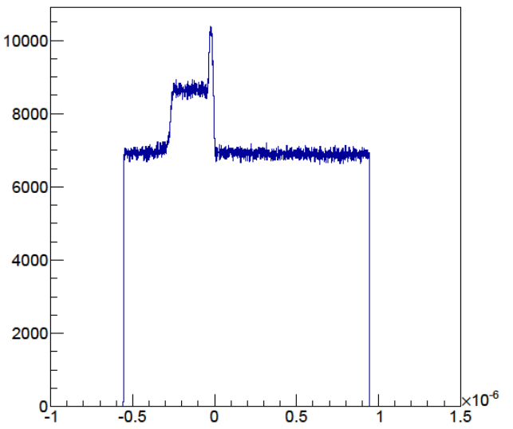
Sparsification
Typical TDC spectrum without sparsification. Only 300ns window out of 1.5µs full scale window has useful data
full- scale window
0-32 µs (8ns step)
Start from background
Common Stop
Start from signal
Sparsification
0-8µs
(0.5ns step)
Gate
Enabling of sparsification allows to significantly reduce event size. All TDC modules have been tested to work in sparsification mode.

Slide 14
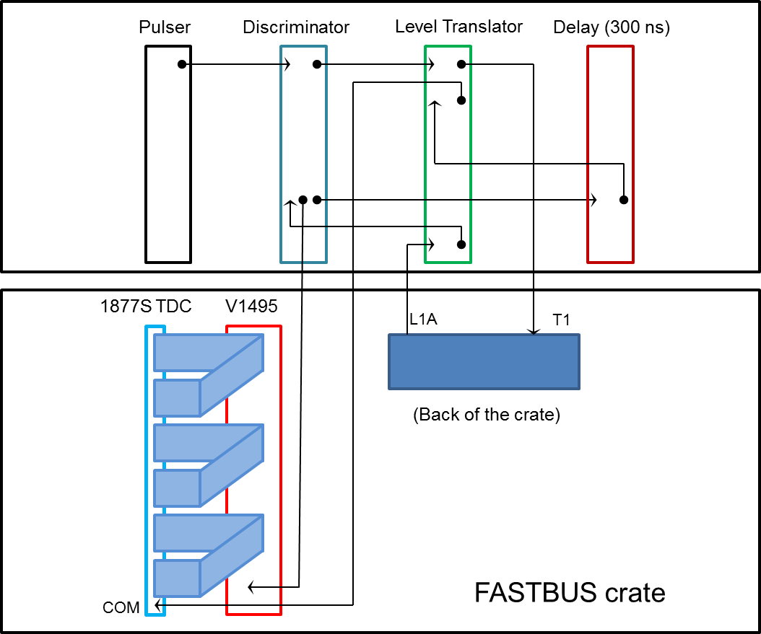
TDC test setup

Slide 15
TDC test procedure
Sparsification CRL #1
Full scale time window = 400 ns
Sparsification threshold = 0 ns
325 ns
Common stop
400 ns
0 ns
Sparsification CRL #2
Full scale time window = 400 ns
Sparsification threshold = 300 ns
325 ns
Common stop
Sparse. Thresh.
400 ns
300 ns
0 ns
325 ns
Sparsification CRL #3
Full scale time window = 496 ns
Sparsification threshold = 424 ns
Common stop
Sparse. Thresh.

Slide 16
Event Blocking
Triggers
Overhead
Readout
Overhead
Readout
Overhead
Readout
Overhead
Readout
20µs 50µs 20µs 50µs 20µs 50µs 20µs 50µs
Readout time is 50 µs + 2 µs per 16 channel.
64 channels – 58 µs
128 channels – 66 µs
For one channel readout.
4 events no EB – 280 µs
4 events with EB – 220 µs
Triggers
Overhead
Readout
Readout
Readout
Readout
20µs 50µs 50µs 50µs 50µs

Slide 17
Event Blocking test results
20 kHz rate
New TI version 3
Linux CPU
Event Blocking | Number of channels | Number of modules | Life time (%)
1 | 1 | 1 | 71
4 | 1 | 1 | 90
1 | 64 | 3 | 65
4 | 64 | 3 | 80

Slide 18
Summary
20 ns coincidence window and factor 30 online pion rejection in Right HRS should be enough to keep DAQ rate under 4.5 kHz
10 ns window and factor 50 online rejection is not impossible
DAQ can operate with 10% dead time at 4 kHz
DAQ dead time can be improved by easy steps of implementing sparsification and using 3 crate configuration (both hardware and software are ready to use)
Further improvement could be done by using event blocking

