Slide 1
APEX experiment beamline considerations
Yves R. Roblin
Center for Advanced Studies of Accelerators (CASA), Jefferson Lab

Slide 2
Overview
Experimental requirements
Machine overview
HALL A beamline layout and optics
Commissioning the beamline
Raster
Current monitors
Wire scanners and bpms
Septum magnet
Orbit stabilization
Reaching high current
Notes:
Experimental requirements
Beamline overview
Current machine optics, emittances,etc..
Hall A Optics and layout
Commissioning raster, calibrating current
Commissioning harps and bpms.
Reaching high current
Pass changes strategy

Slide 3
Experimental requirements
Beam conditions:
Up to 120 μAmps at 1.1, 2.2, 3.3 and 4.4 GeV
Rasterized beam (full size) 0.5 mm x 5.0 mm on target
Beam stability <200 μm X&Y
Beam size <200 μm X & Y
Notes:
Beam size requirements ? Do we have one ? Probably since half a beam size on each side of raster will extend the spot.
Raster is not an issue as far as capability. Even one X and one Y coil will do it.

Slide 4
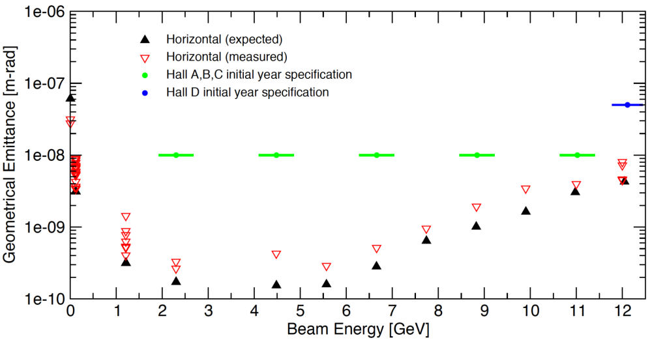
Main machine setup
12 GeV machine meet specifications for physics
Procedures vastly improved over 6GeV to allow for a reproducible setup close to design
Notes:
In this example, it is the transverse emittance.
We also worked on the longitudinal parameters such as bunch compression and energy spread specifications.
The energy measurement procedure has also been recommissioned.

Slide 5
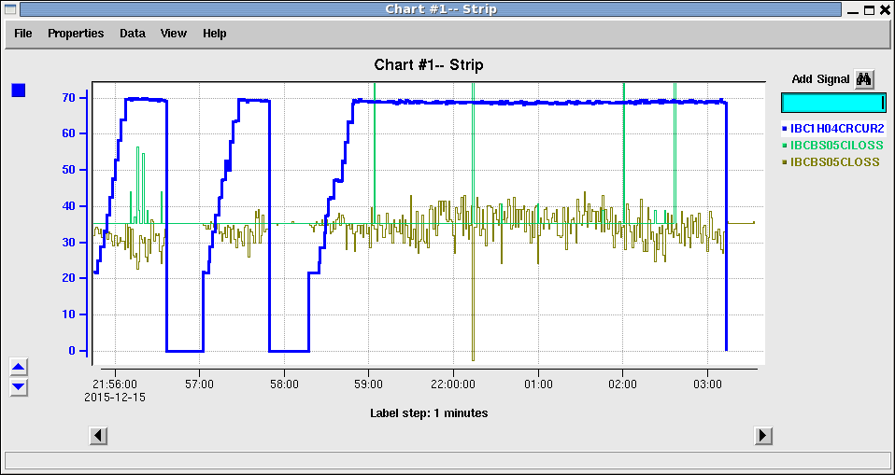
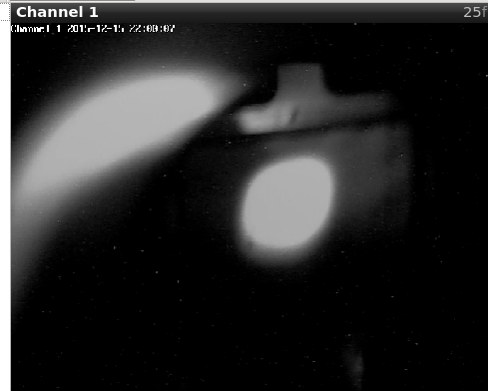
HALL A to 70 μA CW at 11GeV
70x11=770 kW of CW beam (dump limit).
At 4.4 GeV we can support:
4.4*120=480 kW
Notes:
We went right up to the machine envelope (800 kW). That’s 70*11=770 kW.
This had only be done once in the past in the lab.
Almost no losses, but quite a few RF trips. This gave us information on what to do to make the machine more stable.

Slide 6
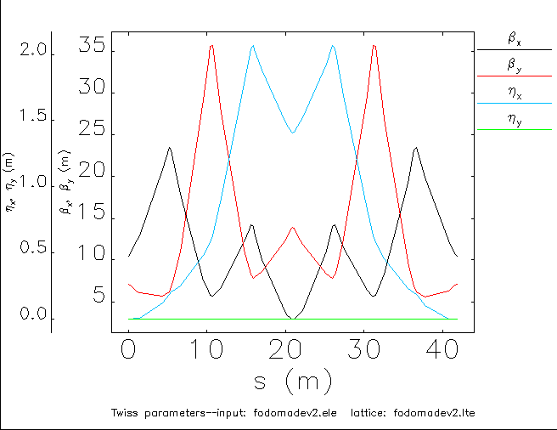
New HALL A optics
Low emittance growth, Low beta. We reached 800 kW with it.
<200 μm at target
Compton 110x70μm
Notes:
We used these to do a full power CW run in Hall A.
Low emittance, easy tunability optics.
Very small beta’s in ARC which reduces HALO formation
Beam is divergent after target to spread it onto diffuser and dump, lowering density of energy deposition.

Slide 7
HALL A beamline
Fast raster
septum
Shown from the end of Compton polarimeter towards dump.
We will go straight-thru Compton for this experiment.
Notes:
The actual 3D of the septum and target area will be shown in a a separate talk.

Slide 8
Raster commissioning
Four coils. Two X and two Y.
Max capacity of 50 Amps/coil.
Which is approximately 4300 G.cm/coil
Check wiring and polarities
Check power supplies
Validate with beam
Notes:
Can exactly predict the raster size and compare with OTR and spot++
It is accurate up to a beam size.
Maybe use the thick wire on the target ladder to get true size?

Slide 9
Raster checks(cont)-verify-polarity
Small pickup coils were added next to the big coils in order to check whether or not the coils are in phase or out of phase. This will cover us from:
We found an instance of mis-cabled coils (two Y coils canceling each other)
We found an instance of a power supply with reverse polarity (yielding coils canceling each other even thought cabling was correct..)
The procedure was strengthened to provide us with certainty that the hardware is functional before sending beam

Slide 10
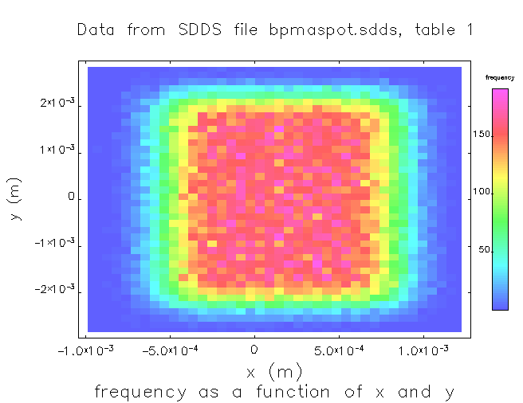
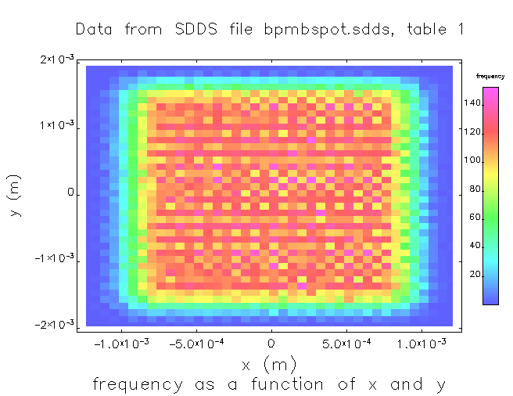
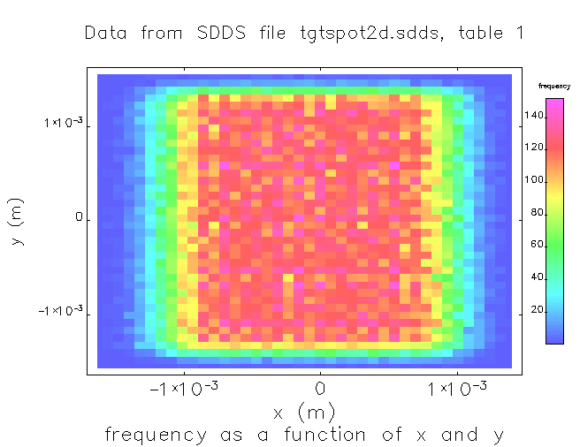
Raster checks with beam
This is for a 2mmx2mm raster. Optics model can predict raster size.
Notes:
8.843 GeV/c
In my model, I have a simple tv-raster uniform scan. The real one has triangular waves and a more complex pattern.
My model has infinite bandwidth. The BPMS are limited to 1000 Hz or so. They sample at 2Khz. Raster is 24 Khz.
Nevertheless, one can use that model to predict raster size. In practice, it is also adjusted by using spot++.

Slide 11
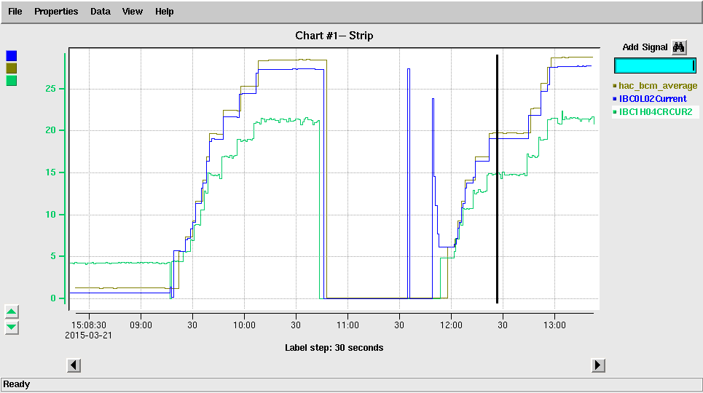
Current monitors
Need to perform BCM calibrations (we have standard procs)
1) establish CW beam to HALL A with no loss.
2) perform Unser versus BCM calibration
3) perform Injector BCM versus Hall A BCM calibration
Notes:
Standard stuff. We did it several times this run.

Slide 12
Beam position monitors
Essentially a RF pick up system providing
Beam position.
Functional testing
Relative calibration of antennas
Alignment of BPM relative to quads
2) Is done without beam during the hot checkout by injecting an analog signal
1) and 3) are done with beam.

Slide 13
Centering bpm cans to quadrupoles
AutoQuad: new algorithm to set BPM SOF so steering to zero on BPM is steering though center of nearby quad
SOF = “survey offset” (including electrical offset)
~5 minutes per quad (see TN-14-027 for algorithm details)
BPM center
Quad center
BPM
Quad
Todd Satogata
Many quad twiddles
+/- 1mm steering
Two quad twiddles
Many
steerings
Old Algorithm: Find steering that nulls
downstream orbit changes when quad twiddling
New Algorithm: Find center from asymmetric
orbit response of two symmetric twiddles
Notes:
Will do this for 1H01 quadrupole.

Slide 14
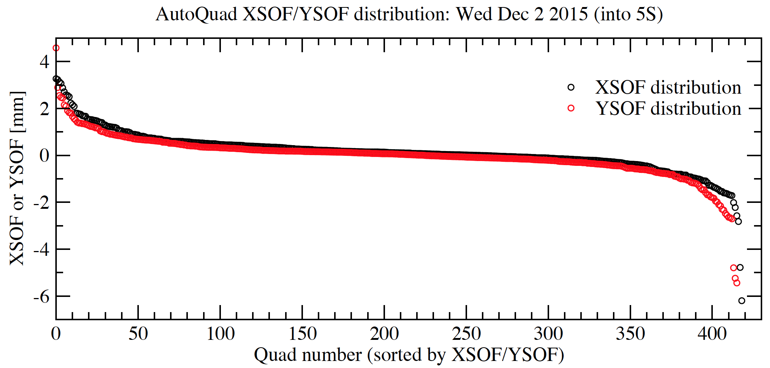
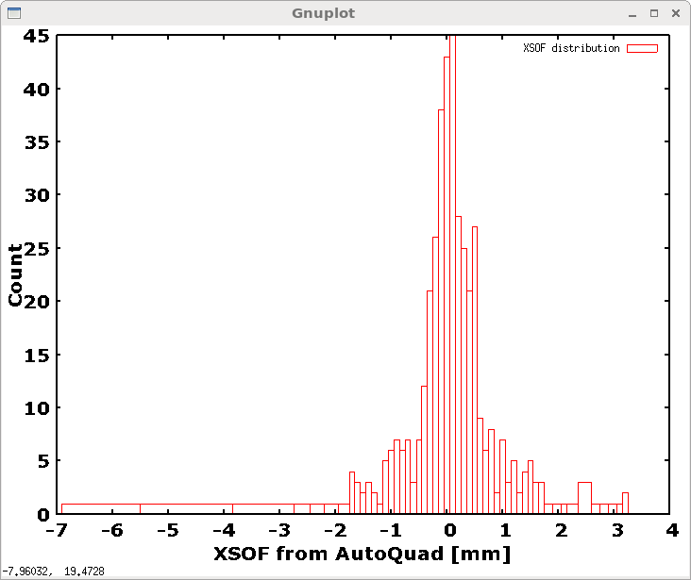
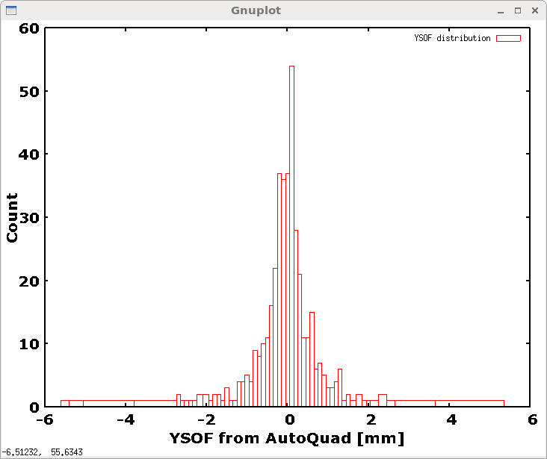
1A05
3A17, 2L08, 1R02, 5E02 > 2 mm
0L02, 1R08, 0L06, 3A13, 2L24, 1S09 > 2mm
1S08, 2A10, 1S10 < -2mm
1R08, 5S01, 3A15, 1S08, 1R04, 3S09, 0R04 < -2mm
2L22
2L22
1L05
3R10
0L03
Todd Satogata
XSOF
131+/- 887 um
YSOF
-15+/- 899 um
Notes:
Typical distribution of offsets

Slide 15
Aligning diagnostic girder bpms
Align bpm with 1C20 and 1H01 quads
Align 1H04 bpm with 1H04 quad
Turn off 1H04 quad
Turn off Moeller quadrupoles.
Send beam at zero on 1H01/1H04
Read off 1H04A/1H04E, this is the offset
Bpms
Quadrupoles
Moeller Quadrupoles
Notes:
Need to correct for earth field effects. At 1.2 Gev/c this will deflect the beam between 1H04 and 1H04E left by about 0.5 mm.
Effect of septum field on them is very small.

Slide 16
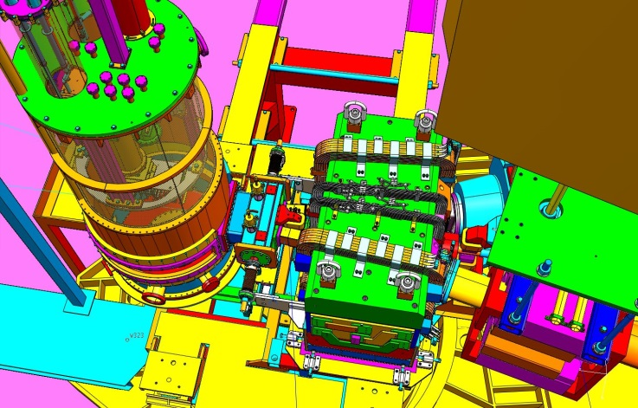
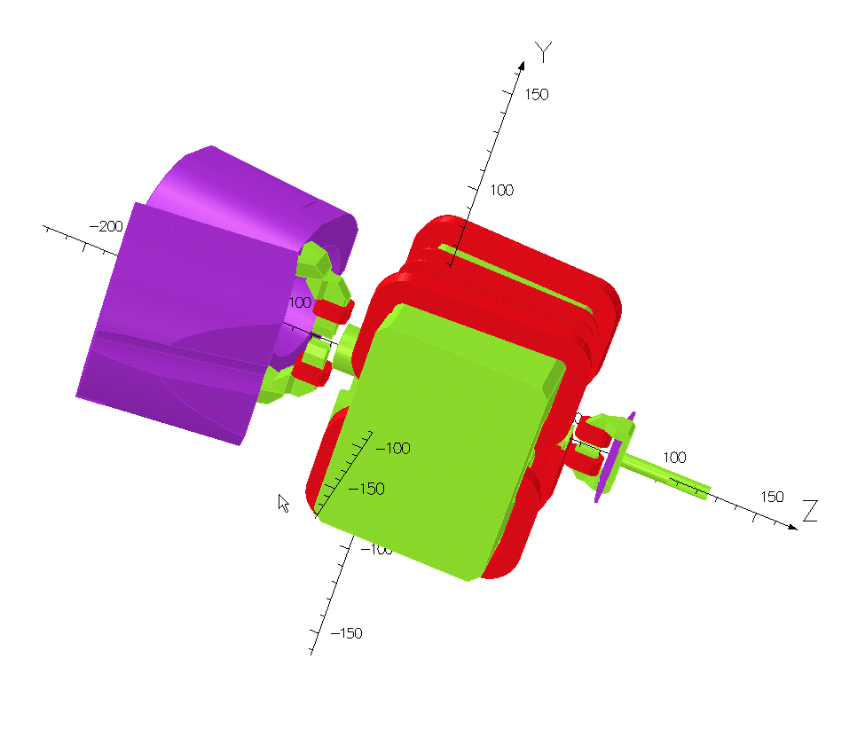
Septum magnet
TOSCA simulations provided a 3D field which we used to validate the design by tracking.

Slide 17
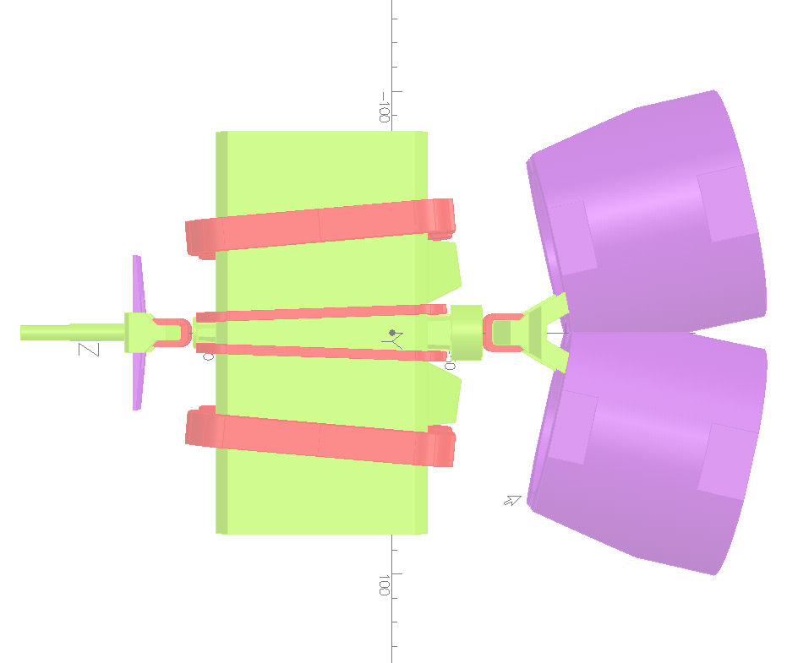
TOSCA calculations for beam on axis
Gauss
MAP with 8M elements
By
+/- 2 cm in X/Y
-4m/+2m in Z
Stepsize 2mm X,Y and Z
Correctors
Notes:
Main beam is on axis. The 3D field map we used in subsequent checks encompasses a region of +/2 cm around nominal beam trajectory.
The length of the map is 6 meters in order to account for all stray fields.

Slide 18
Tracking validation (in ELEGANT)
Main beam will exit with 0.7 mm offset in X and small angle. Will land exactly at center of dump.
Beam direction
Septum Field well compensated with the use of septum correctors.

Slide 19
Orbit stabilization
Fast feedback system in energy mode commissioned at 4.483 GeV/c will stabilize energy and position fluctuations
Slow target lock allows for centroid positioning
Beam very stable with locks engaged.

Slide 20
Commissioning with beam
Establish tune beam with raster off, septum off
Perform bpm/quad alignments
Perform girder alignment
Commission/check raster in tune mode
Find target center using usual methods, set position locks
Ramp up septum, set both correctors at design setpoint
Using IDW10D00 tune mode dump viewer locate beam
Adjust correctors if necessary
Engage FSD window comparator around correctors
Turn off a corrector, check that FSD trips beam.

Slide 21
Conclusion
The beamline configuration is ready for APEX:
The Septum magnet design compensates leakage fields very well
Procedures developed for girder alignment
Feed back and lock systems commissioned
High current runs previously demonstrated
Raster system commissioned.

Slide 22
Rastered beam thru target foils
Notes:
Focal point is on the target center. As we get further out, beam starts to defocus.
Ion chamber aperture is 3.5 inches at diffuser.
Viewer field of view at dump is 3x3 inches. Dump is at least 12 inches.

