Slide 1




Measurement of the Electric Form Factor of the Neutron at High Momentum Transfer
Jonathan Miller
University of Maryland
for E02013 and Hall A collaborations at Jefferson Lab
Wednesday, October 29, 2008
TexPoint fonts used in EMF.
Read the TexPoint manual before you delete this box.: AAAAAA
Notes:
4 logo jefferson lab, nsf, doe, university of maryland

Slide 2
Overview
Neutron Form Factors
High Q² Experiment
G_{E}^{n} Results
Interpretation
  Quark Orbital Angular Momentum
  Quark Form Factors – F_{d}/F_{u}
Conclusions
Notes:
Put footers everywhere

Slide 3
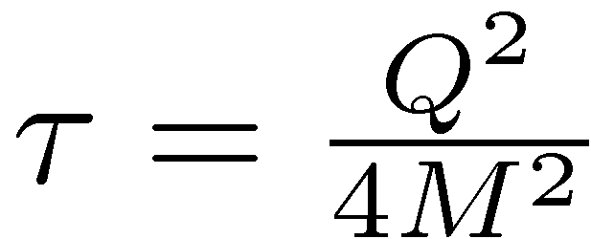
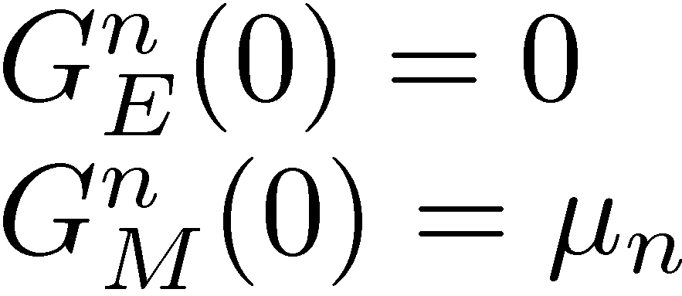
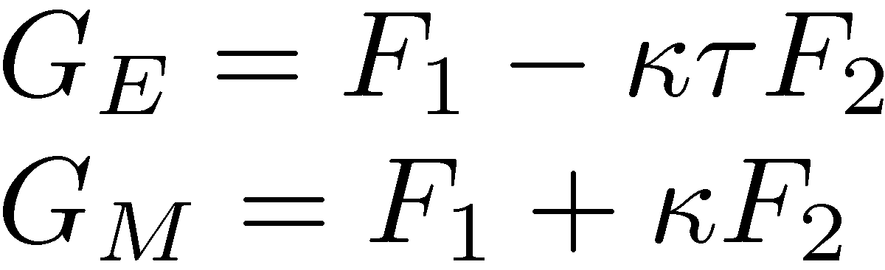
The Electric Form Factor of the Neutron
Above is the Rosenbluth formula for the differential cross section for a free nucleon. It is difficult to find G_{E}^{n} from the cross section because G_{E} is small compared to G_{M} for the neutron. The Mott cross section is the cross section for a structureless spin ½ particle.
Sachs form factors are related to the Dirac and Paul form factors and the magnetic moment.
Neutron
q
In these expressions κ is anomalous contribution to the nucleon's magnetic moment.
Electron
Notes:
Difficulty of measurement Gen in this method

Slide 4
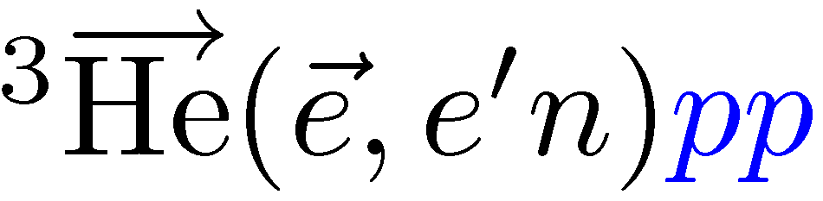
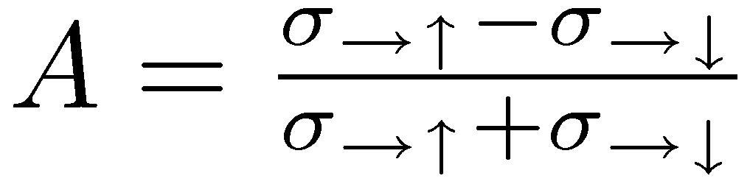
Double Polarization Method
In the experiment, polarized electrons scatter from polarized helium-3 and the final electron and hadron are detected.
The polarized cross section has helicity dependent term. The asymmetry determined from this is dependent on the form factor ratio and kinematic coefficients.
Notes:
Dependence on the angles explicit

Slide 5
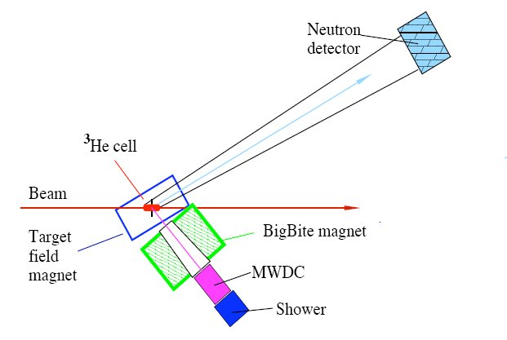
Experimental Setup
CEBAF provides a polarized (83%) electron beam.
The polarized ³He (45-50% polarization) acts as a free polarized neutron target.
Big Bite is a large acceptance spectrometer for scattered electrons.
The Neutron Arm, with an 11m² active area, detects and identifies protons and neutrons at a path length of up to 12m.
Notes:
Update picture, add neutron arm picture, define perpendicular missing momentum

Slide 6
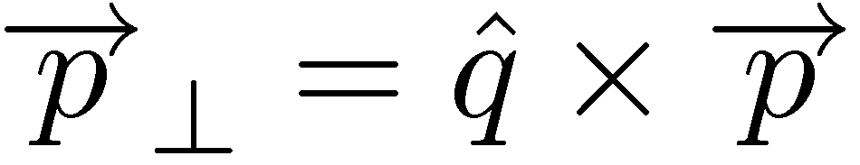
Selection of Quasi-elastic Events at Q²=2.5
Events are selected so that they are in time and so that they are parallel to the q. In black below is the invariant mass of charged events with only good events cuts while in blue is the quasi-elastic events.
Additionally, cuts on perpendicular missing momentum to suppress Final State Interactions (FSI).

Slide 7
Electric Form Factor of the Neutron
The electric form factor of the neutron pre E02013 data. Circled is what will not be presented here.

Slide 8
Electric Form Factor of the Neutron
New experimental data significantly lower than favored predictions.
Notes:
New plot – Not Correct Plot? Before an After Data. Work on Axis and Legend

Slide 9
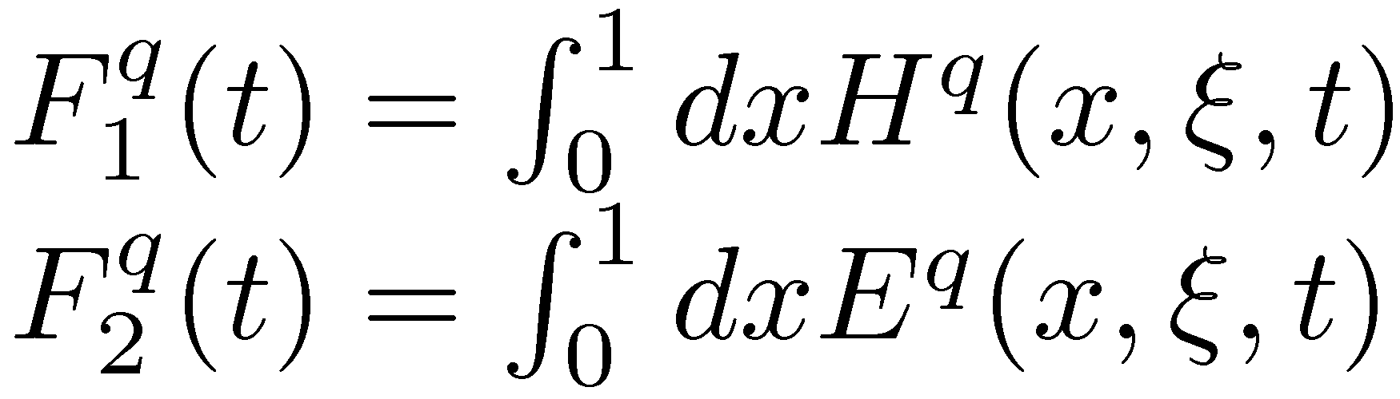
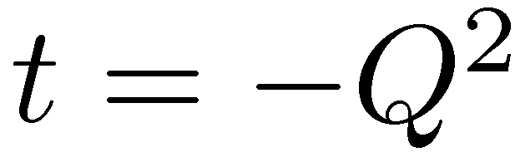
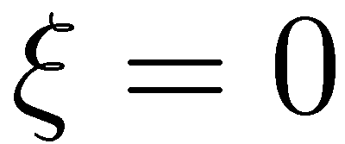
Generalized Parton Distributions
GPDs provide the quark contribution at a given x to the form factors:
GPDs parameterize the non-forward elements of the light cone operators. There is a GPD for every quark flavor. GPDs are functions of x which is the longitude momentum fraction, ξ which is the skewness or longitude momentum asymmetry, and t which is the transferred momentum squared.
GPD in DVCS process.
γ*
γ
X+ξ
X-ξ
N
N
Classes of processes:
  DIS
  Elastic Scattering
  DVCS
For Form Factors and orbital angular momentum, we can let
Notes:
Say what t is. Maybe mention skewness=0. More words desribing the GPD.

Slide 10
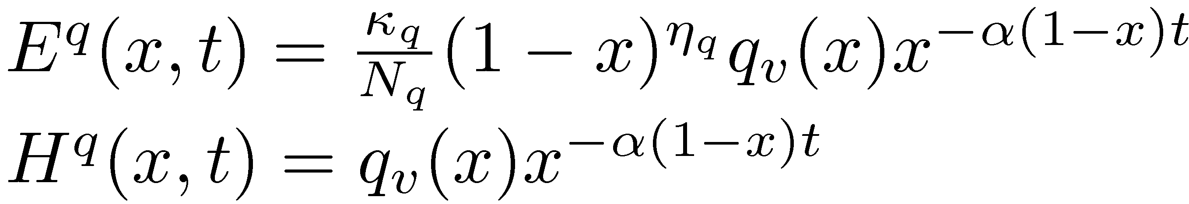
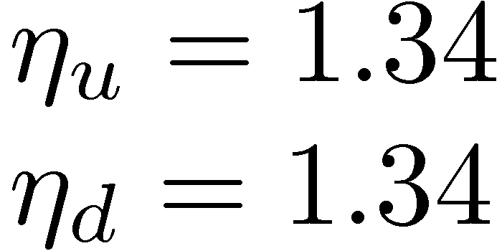
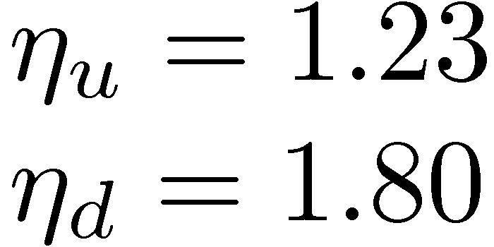
GPD Model
Guidal, Polyakov, Radyushkin, and Vanderhaeghen Phys Rev D 72, 054013 (2005)
Model depends on 3 parameters and the form of the q(x).
α is the Regge parameter defined by the Dirac mean squared radius of the proton.
The η are determined from the neutron and proton FF data, in the original parameters only the proton was used.
The model contains an extra (1-x) dependence for E compared to H because E scales faster with t at x≈1.
N is a normalization constant resulting from this (1-x) dependence.
Original Parameters
Fit to current data

Slide 11
New Fit of η Parameters
The new fit is in agreement with both the proton and neutron data, while the previous was not in agreement with the neutron data.

Slide 12
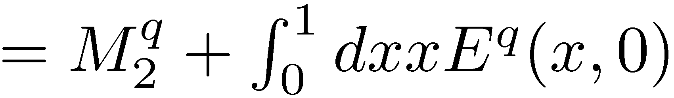
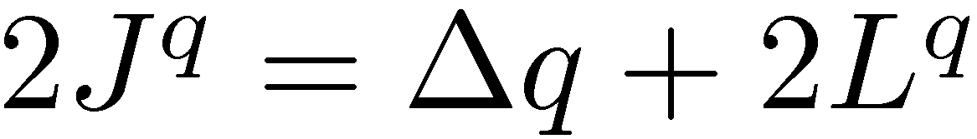
Quark Orbital Angular Momentum
Quark | Δq | M | Integral | 2J Guidal | 2J New Fit | 2L New Fit
u | 0.6 | 0.37 | 0.238 | 0.595 | 0.600 | 0.00
d | -0.25 | 0.20 | -0.207 | -0.031 | -0.016 | 0.234
s |  | 0.04 | 0 | 0.04 | 0.04
Total |  | 0.61 |  | 0.568 | 0.624
The values of M are calculated according to the NNLO fit.
In the framework of this GPD model, Ji’s sum rule can be evaluated.
Here the antiquark contributions are ignored.

Slide 13
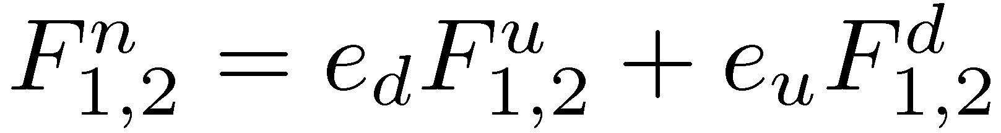
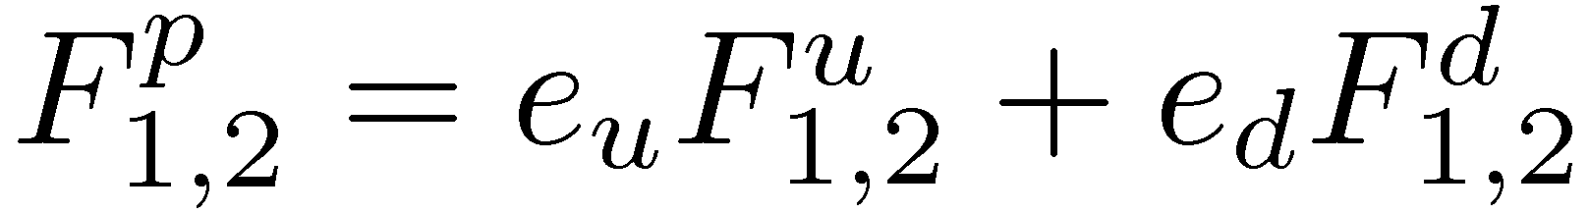
Quark Form Factors
Using measurements of the G_{E}^{n} including our data and traditional parameterizations for the form factors: G_{M}^{n} =μ_{n} G_{D}, G_{e}^{p} =(1.06-0.14 t) G_{D}, , and G_{M}^{p} =μ_{p} G_{D}, we calculated the up and down quark form factors.

Slide 14
Conclusions
The E02013 collaboration has measured G_{E}^{n} at Q² up to 3.5 GeV², more than doubling the range covered.
Our measurement provides new input for models to describe the physics of nucleon structure.
Including our data in a GPD model, we extracted the orbital angular momentum of the down quark and up quark, found to be 0.23 and 0 respectively.

Slide 15
List of Collaborators/Thanks
Spokespeople
  Bogdan Wojtsekhowski – Jefferson Lab
  Gordon Cates – University of Virginia
  Nilanga Liyanage – University of Virginia
Post Docs
  Seamus Riordan – 2008-Present – University of Virginia
  Robert Feurbach – 2006-2007 – William and Mary and Jefferson Lab
Students
  Seamus Riordan – Carnegie Mellon University
  Jonathan Miller – University of Maryland
  Tim Ngo – California State University, Los Angeles
  Aidan Kelleher – William and Mary
  Ameya Kolarkar – University of Kentucky
  Brandon Craver – University of Virginia
  Sergey Abrahamyan – Yerevan Physics Institute
Notes:
Supported

Slide 16
Quark Form Factors
Q² (GeV²) | F₁^{p} | F₁^{n} | F₂^{p} | F₂^{n}
1.72 |  | -0.034 ±0.022 |  | -0.139 ±0.046
2.47 |  | -0.032 ±0.019 |  | -0.065 ±0.027
3.47 |  | -0.020 ±0.014 |  | -0.033 ±0.015
Q² (GeV²) | F₁^{u} | F₁^{d} | F₂^{u} | F₂^{d}
1.72 | 0.233 ±0.025 | 0.066 ±0.045 | 0.105 ±0.047 | -0.157 ±0.091
2.47 | 0.135 ±0.020 | 0.020 ±0.038 | 0.068 ±0.028 | -0.063 ±0.054
3.47 | 0.082 ±0.015 | 0.011 ±0.029 | 0.037 ±0.016 | -0.030 ±0.029
*J. J. Kelly, Phys. Rev. C 70, 068202 (2004)
Notes:
Replace with 2-4 plots? Arrington and Sick - Phys Rev C 76 035201 2007 no good? – Extra Slide

Slide 17
Experiment Overview
Beam Energy (GeV) | Q² (GeV² ) | Statistical Expected
1.519 | 1.2 | 0.0025
2.079 | 1.7 | 0.0011
2.638 | 2.5 | 0.0015
3.290 | 3.5 | 0.0012
Measurements were undertaken at four different energies, included to the right was the expected statistical precision. Below the components to systematic uncertainty are tabulated as a fraction of G_{E}^{n}.
Analysis Element | 1.7 (GeV² ) | 2.5 (GeV² ) | 3.5 (GeV² )
Proton Contamination | 0.035 |  | 0.057
Target Polarization | 0.063 |  | 0.035
Beam Polarization | 0.020 |  | 0.011
Acc. Back. Contamination | 0.018 |  | 0.017
Neutron Polarization | 0.035 |  | 0.019
Nitrogen Contamination | 0.003 |  | 0.010
FSI Corrections | 0.080 |  | 0.043
S. Riordan. PhD thesis, Carnegie Mellon University, unpublished (2008).
Notes:
Include more details? Have Figure of Merit or something instead of Flight Path? Total Charge? Asymmetry and uncertainty. Another table with size of correction

Slide 18
Tomographic Picture of the Neutron
The transverse density of the nucleon is related to both the form factor of the nucleon and the quark density, which can be calculated from model dependent GPDs. Below is the region of parameter space allowed by positivity constraint.
New Parameterization
Old Parameterization
down
up
up
down

