Slide 1
Scintillator preliminary test results
Cunfeng Feng
Zhongquan Zhang
Ang Li

Slide 2
Test results before the New Year holiday
scintillator number | no reflector |  |  | tyvek | mylar
air gap lead | print paper | print paper
no narrowside | no narrowside | narrowside
1 | 5.5 | 5.8 | 6.6 | 9.5 | 5.9**
2 | 4.4 | 4.7 | 6.25 | 8.3 | 5.3**
3 | 5.5 |  | 5.5* | 9.8 | 6.1
4 |  |  |  | 8.75 | 5.8
*:this scintillator has no reflector
**:these scintillators have no narrow side packages
Test results after the New Year holiday
scintillator number | mylar | no reflector
no air gap lead | print paper | print paper*
no narrow side | no narrow side | no narrowside
1 | 5.3 | 4.4 | 4.8 | 6.1
2 | 4.5 | 3.1 | 4.5 | 5.2
3 | 5.6 |  | 5.5 | 5.5
4 | 5.6 | 5 | 5.2
*:these results come from what we did before the New Year holiday

Slide 3
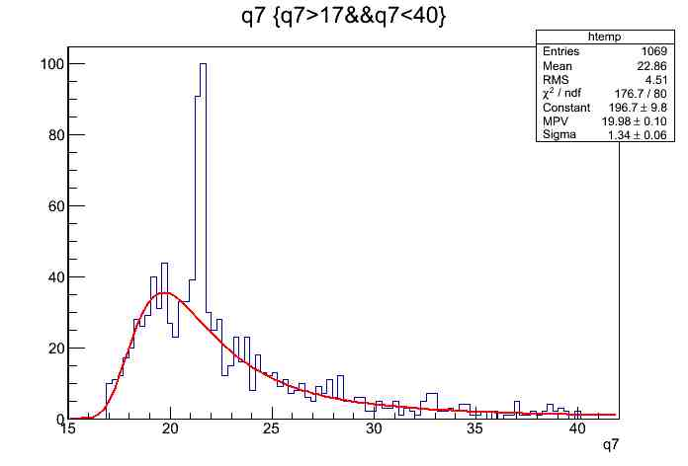
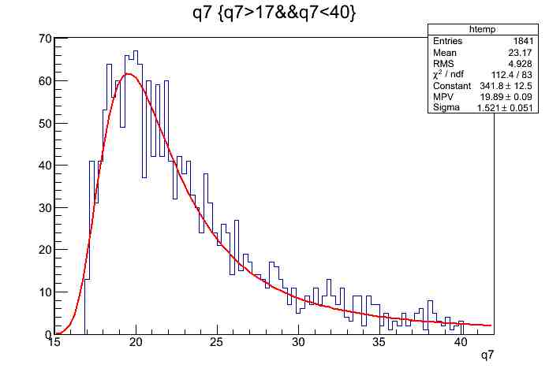
Fit results
No.4
Mylar reflector
and narrow side
Before holiday
After holiday

