Slide 1
Fiber irradiation test
Mengjiao Li
2021.04.15

Slide 2
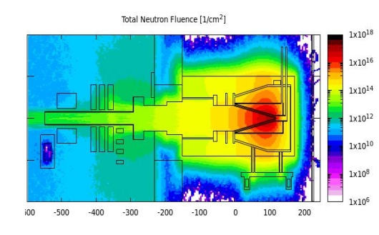
Irradiation conditions
Irradiation test at Institute of Modern Physics, Lanzhou
Sample 5
Sample 4
Sample 3
Sample 2
Sample 1
 | Sample 1 | Sample 2 | Sample 3 | Sample 4 | Sample 5
Total Irradiation（MeV/cm^2） | 8.569E+11 | 1.360E+12 | 2.807E+12 | 3.665E+13 | 1.070E+14
Test material | clear fiber | clear fiber BCF91A-MC scintillator | clear fiber BCF91A-MC scintillator | clear fiber BCF91A-MC scintillator | BCF91A-MC scintillator

Slide 3
Clear fiber (PMMA) test result
Fibers without irradiation for reference
PMMA(2m) | ADC channel | Average
1 | 1692 | 1695.5
2 | 1699
We repolished the irradiated fibers and tested them
PMMA(2m） | Total radiation dose（MeV/cm^2） | After irradiation (ADC channel) | Relative light yield | Average
Sample 1 | 8.569E+11 | 1683 | 0.993 | 0.990
 |  | 1660 | 0.979
 |  | 1695 | 1.000
Sample 2 | 1.360E+12 | 1656 | 0.977 | 0.978
 |  | 1662 | 0.980
 |  | 1657 | 0.977
Sample 3 | 2.807E+12 | 1626 | 0.959 | 0.967
 |  | 1655 | 0.976
 |  | 1640 | 0.967
Sample 4 | 3.665E+13 | 1611 | 0.950 | 0.946
 |  | 1612 | 0.951
 |  | 1590 | 0.938
Relative light yield = After irradiation /No irradiation

Slide 4
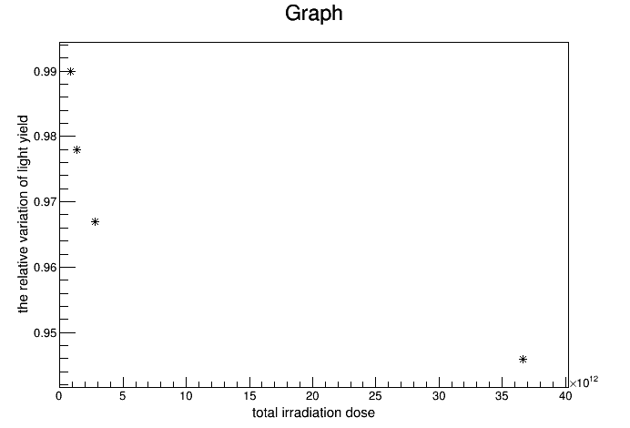
2m PMMA
Next step：Test BCF98-SC clear fiber

