Slide 1
Light loss at the new connector
Mengjiao Li
2021.06.17

Slide 2
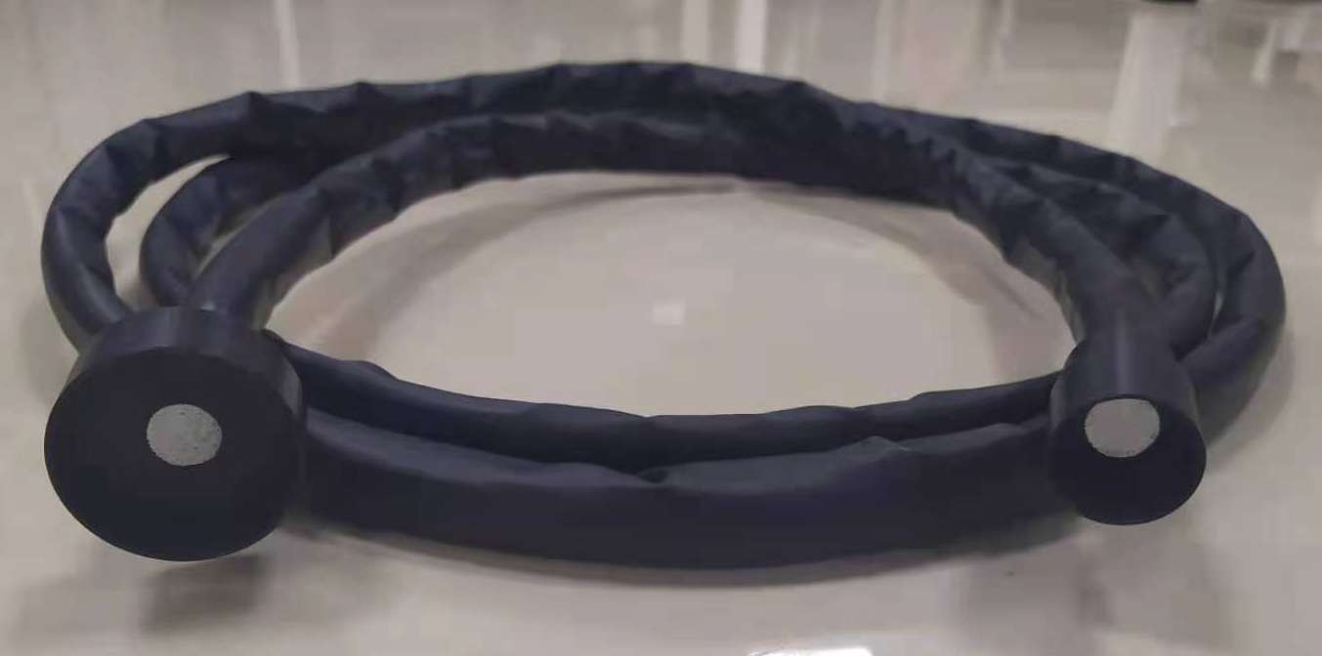
The new fiber connector of Chunhui company
Connect to Ecal tower
Connect to pmt
12mm
The clear fiber bundle is 3m long
Here are a bundle of 500 clear thin fibers(0.5 mm diameter).
Easy to install, only one piece for one Ecal tower
Soft, could be bend easily
Radiation resistance： the same as 1mm PMMA clear fiber

Slide 3
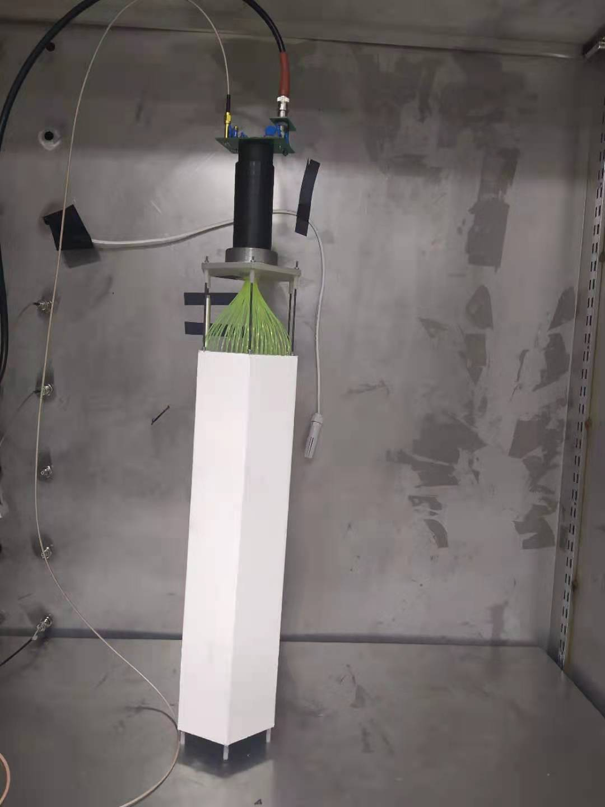
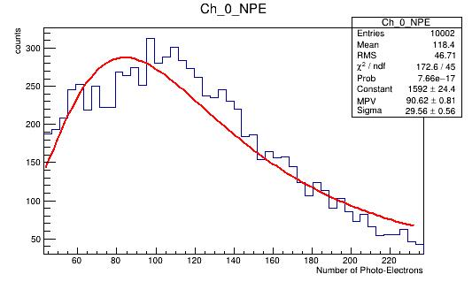
Number of photons before coupling is 91
The result of Landau fitting is 91

Slide 4
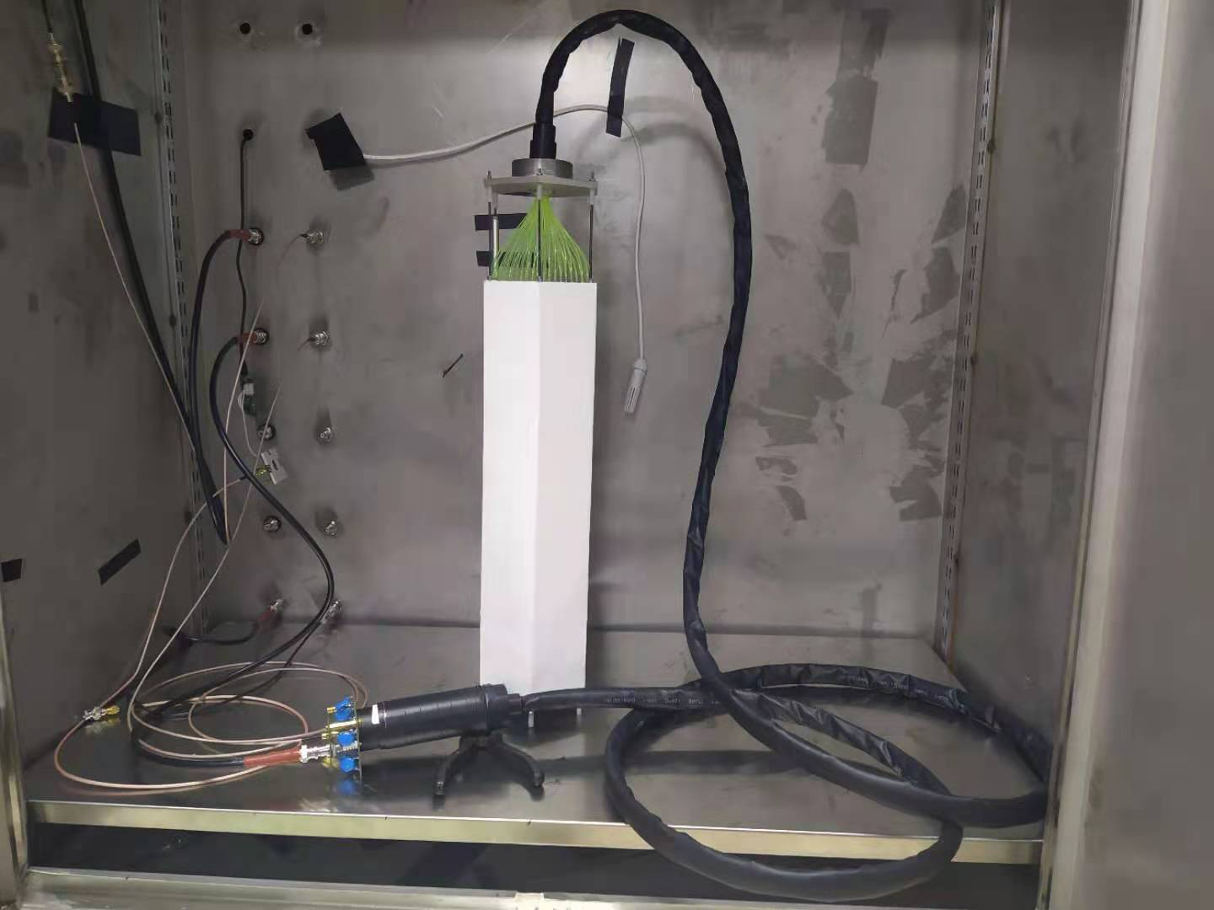
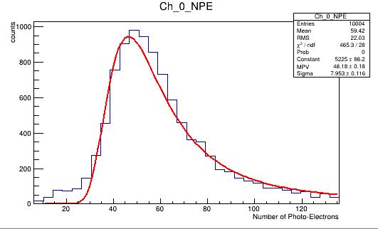
Number of photons after coupling is 48
The result of Landau fitting is 48
The light loss of green fiber to clear fiber is about 47% [(91-48)/91=0.47] ,the attenuation
length of the clear fiber is about 17.5m , considering the 3m clear fiber lead to 16% [1-exp(-3/17.5)]light
loss in transport ,we get final light loss from connector of this test is 37% [1-(1-47%)/(1-16%)]

Slide 5
Fiber SC and MC
The same diameter , multi-cladding core is smaller

