Slide 1
SRC Weekly Meeting June 26, 2012
Revisit Optics for LHRS,

Slide 2
LEFT Optics
Re-Calibration of phi

Slide 3
Sieve X & Y Reconstruction → Recalibration of Φ is needed

Slide 4
Sieve X Y before calibration
With scale Effect on the vertex Z, the change is made to target_Y calculation. This effect only the phi variable as the Sieve Y defined as:
Y_{sieve} = L*phi_{tg} + Y_{tg}

Slide 5
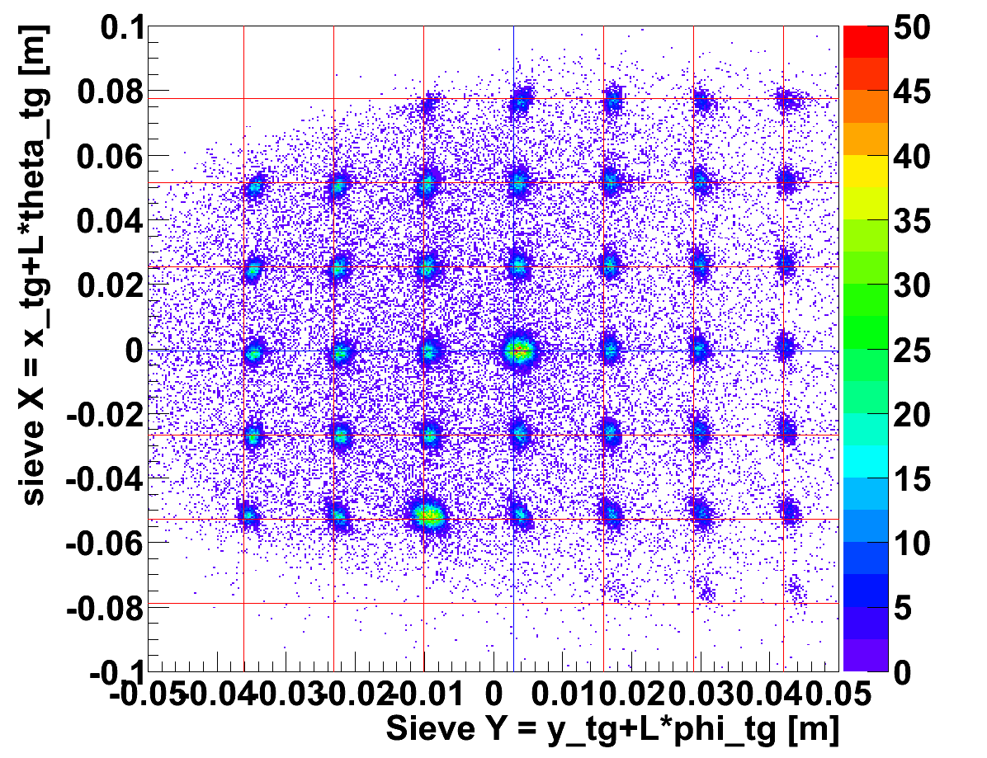
BEFORE
Note: offset in Sieve Y is to the right of the red lines

Slide 6
Sieve X Y, per foil before calibration
Run 1238
C12- 13foils
At 16.5 degree

Slide 7
Sieve X Y after calibration
Run 1238
C12- 13foils
At 16.5 degree
Sieve In

Slide 8
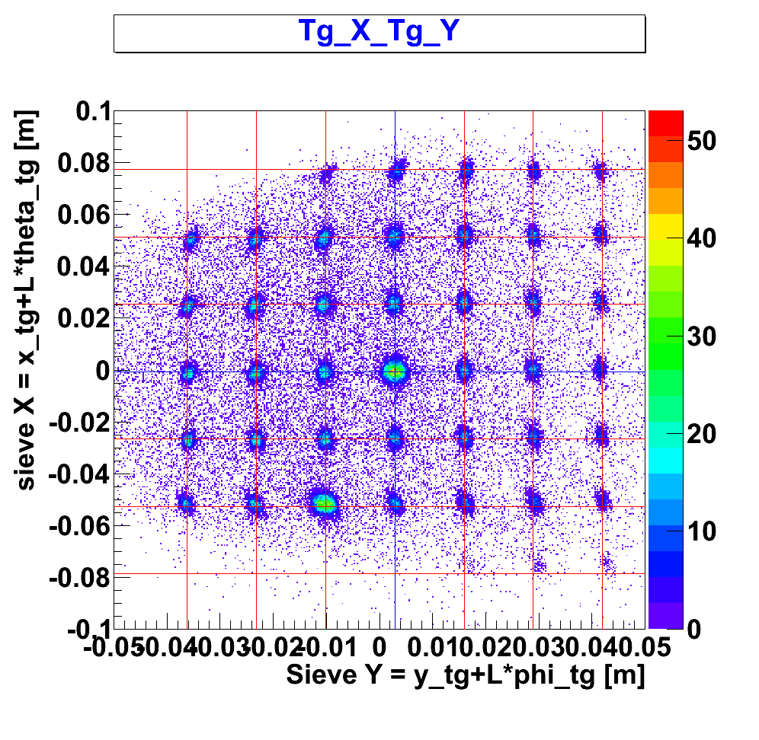

Slide 9
Sieve X Y, per foil after calibration
Run 1238
C12- 13foils
At 16.5 degree

Slide 10
Dp scan on Hydrogen

Slide 11
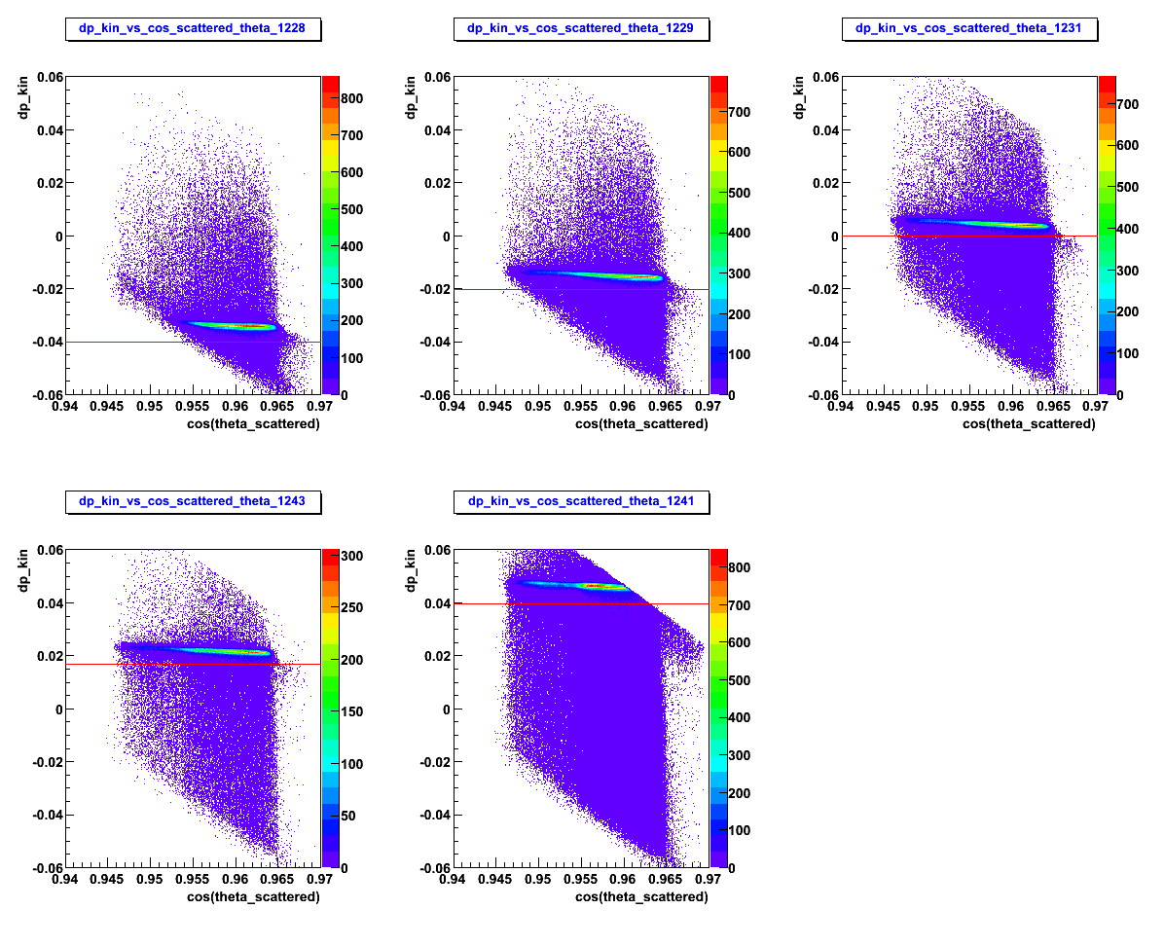
Hydrogen scan.
Redline is the momentum setting of the Dipole.

Slide 12
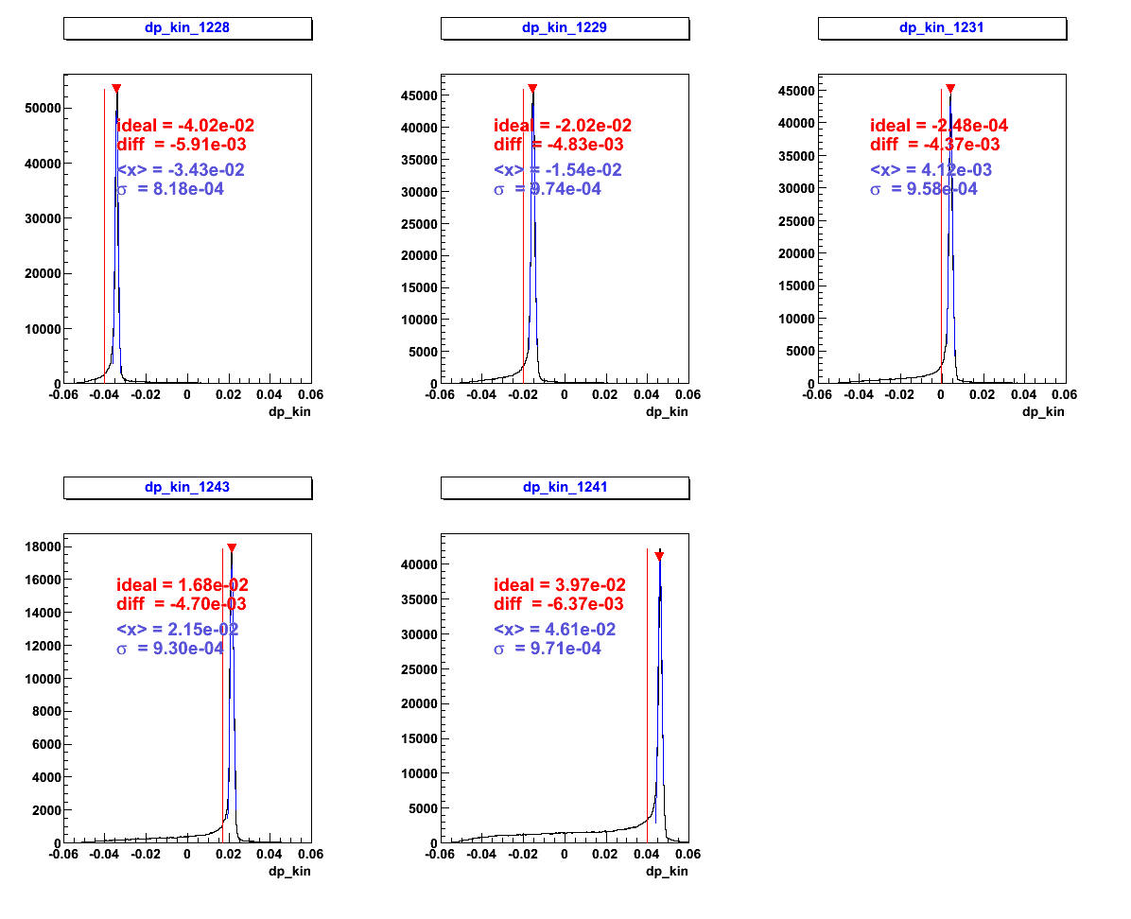
Hydrogen scan.
Redline is the momentum setting of the Dipole.
Focus on the run 1229, 1231, and 1243 where we have full acceptance, the ideal-mean is approximately the same

Slide 13
Left HRS optics summary
Vertex
Phi
Theta
Momentum (half done)
Phi & Theta
vertex

