Slide 1
Simulation Updates on PVDIS EC
Jin Huang
Los Alamos National Lab

Slide 2
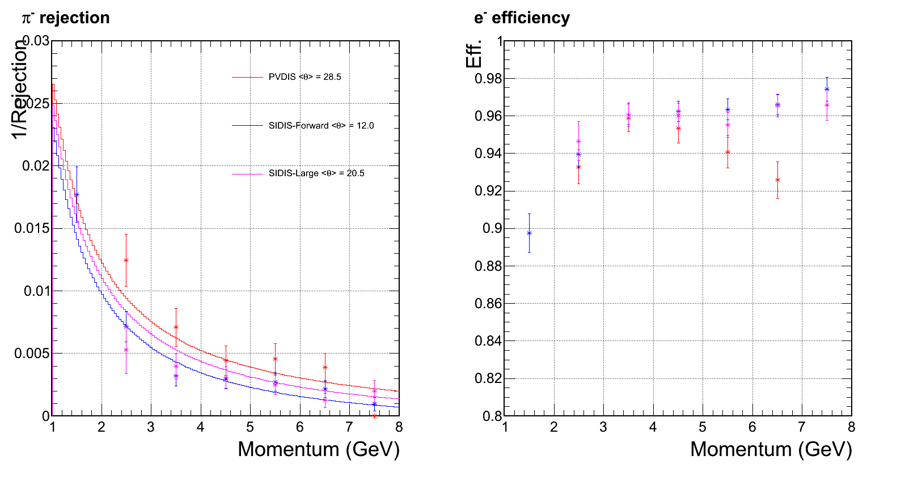
EC performance w/o background
Cited from March collaboration Meeting
Preshower ID power drop significantly at this bin

Slide 3
Forth update of CLEO background
Cutting 2cm away on 1st baffle inner radius
Received background simulation from Zhiwen on May 24

Slide 4
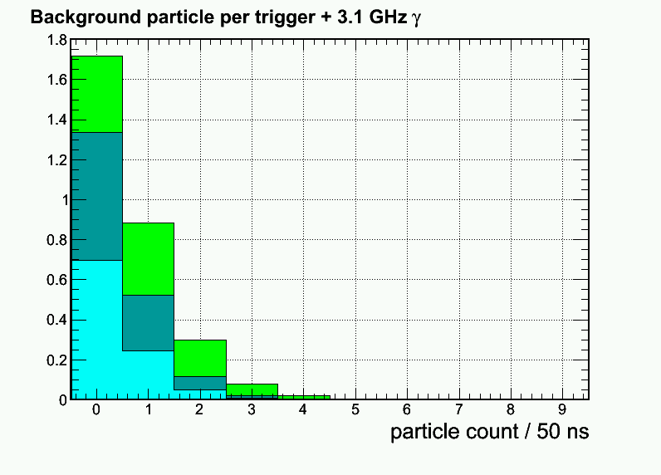
Updated: Per-event pion rate for 1+6 hexagon cluster at Mid radius, high radiation φ-slice
3rd Update
Electron (mostly absorbed in Pb)
Pion-
Pion+
New 4th Update

Slide 5
Updated radiation dose VS layers (High radiation φ slice)
Photon (EM) <- dominant!
Photon (Pi⁰)
Electron
Pion- Pion+ Proton
Improve by two-fold
Soft EM γ
Direct Pi⁰ γ
3rd Update
New: 4th Update

Slide 6
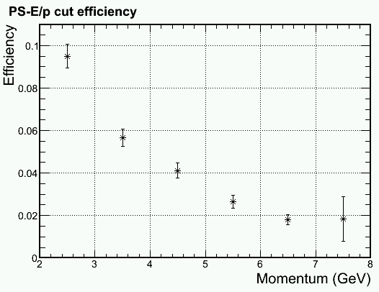
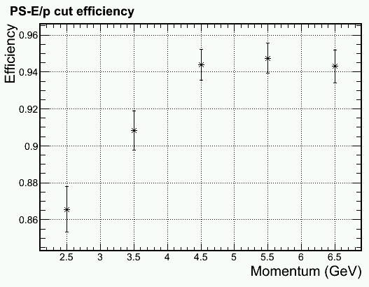
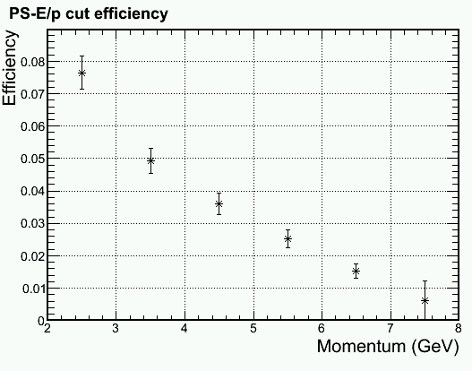
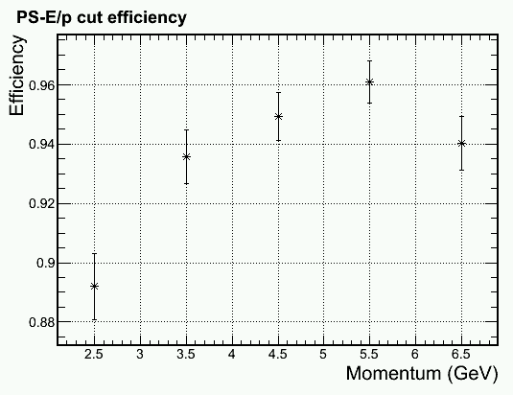
Update on PID Mid radius, higher γ φ-band shown Other configuration also simulated
Update
Improvement
Improvement
Pion Efficiency
Electron Efficiency

Slide 7
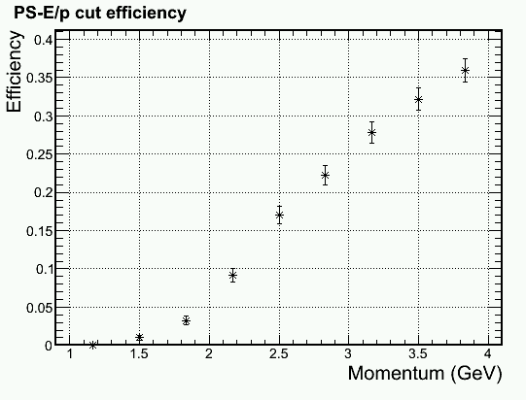
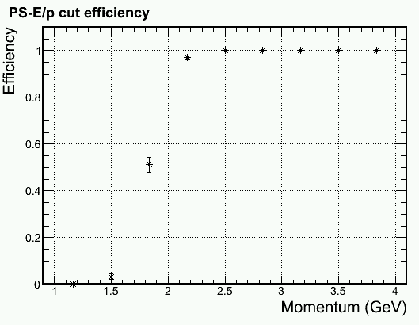
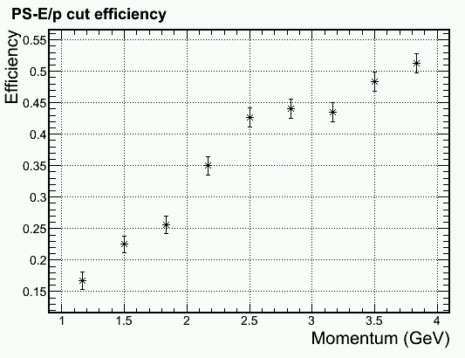
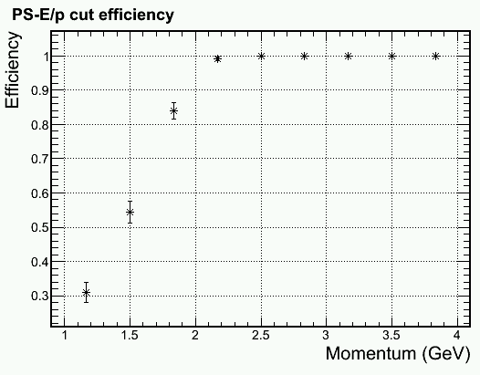
Trigger turn on curve for 2 GeV electron Shower Hex 1+6 trigger > 1.6 GeV
Outer radius, higher γ φ-band, full bgd
100% pass for ~250 events/bin
Physics
, full bgd
Middle radius, higer γ φ-band, full bgd
Physics
Pion Efficiency
Electron Efficiency

Slide 8
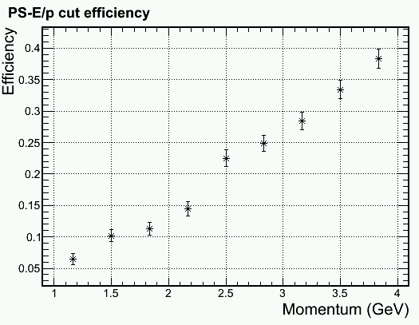
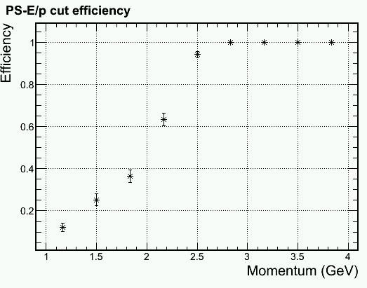
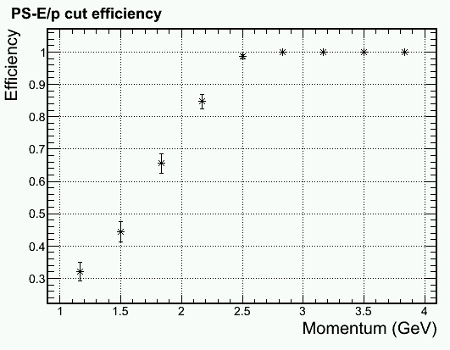
Trigger turn on curve for 2.5 GeV electron Shower Hex 1+6 trigger > 2.1 GeV
Middle radius, higher γ φ-band, full bgd
Physics
Inner radius, higer γ φ-band, full bgd
Physics
Pion Efficiency
Electron Efficiency

Slide 9
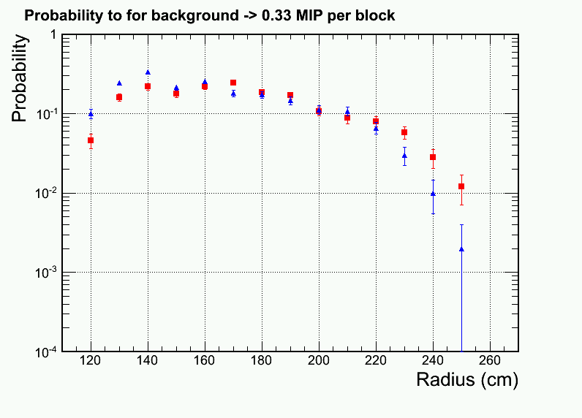
Readout occupancy per shower channel for ~75MeV zero suppression
Improvement
High radiation phi slice
Low radiation phi slice

Slide 10
Third update of CLEO background
Received background simulation from Zhiwen on May 19
Running background imbedding

Slide 11
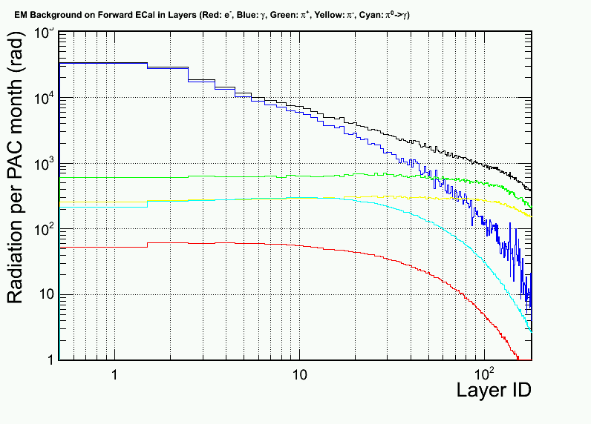
Updated radiation dose VS layers
Photon (EM) <- dominant!
Photon (Pi⁰)
Electron
Pion- Pion+ Proton
From 2nd Update
from 2nd update
Soft EM γ
Direct Pi⁰ γ
High radiation azimuthal region
Low radiation azimuthal region

Slide 12
Background imbedding and distribution Mid-R, High Radiation phi slice
Photon (6GHz/6+1 Hex cluster)
Electron
Pion- Pion+ Proton

Slide 13
Updated: Per-event pion rate for 1+6 hexagon cluster at Mid radius, high radiation φ-slice
Electron (mostly absorbed in Pb)
Pion-
Pion+
+ 6 GHz photon not shown (3GHz for lower φ-radiation )

Slide 14
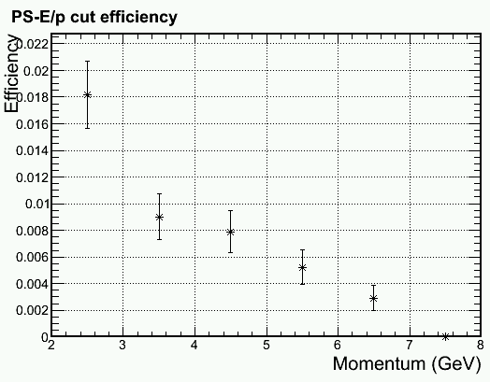
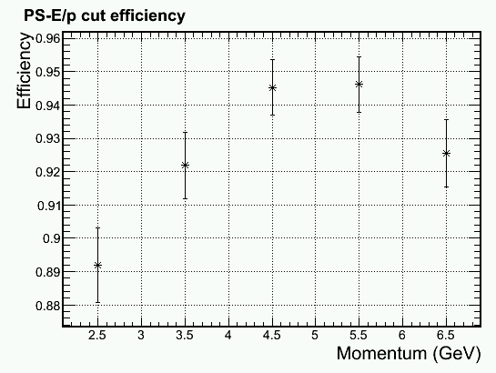
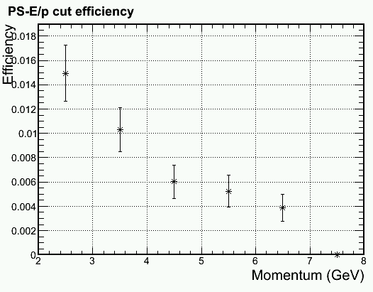
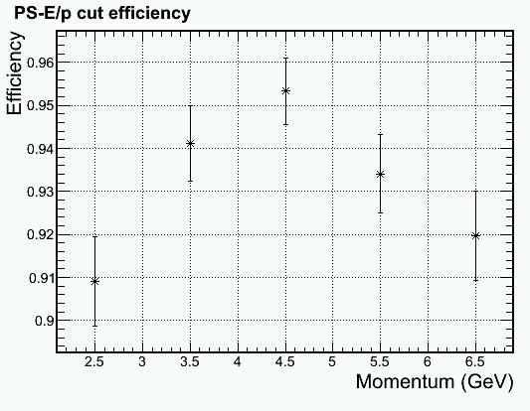
Update on PID with DC component removal (PS > MIP + Bgd + (2-3) σ)
Outer radius, higher γ φ-band
Due to Soft EM γ
Outer radius, lower γ φ-band
Pion Efficiency
Electron Efficiency

Slide 15
Update on PID with DC component removal (PS > MIP + Bgd + (2-3) σ)
Outer radius, higher γ φ-band
Mid radius, higher γ φ-band
Due to Hadron rate
Pion Efficiency
Electron Efficiency

Slide 16
More detail in PID cut Middle radius, lower γ φ-band, full bgd
Pion Efficiency
Electron Efficiency

Slide 17
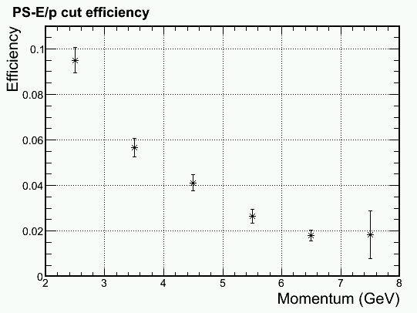
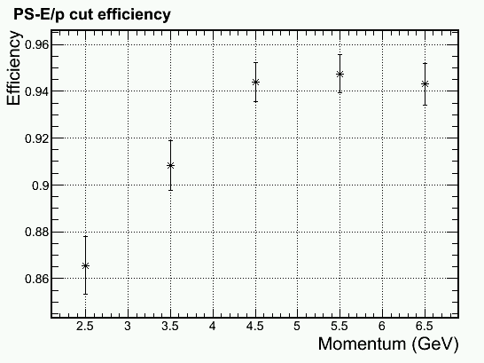
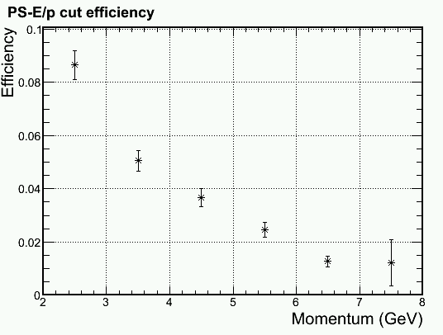
Update on PID with DC component removal (PS > MIP + Bgd + (2-3) σ)
Inner radius, higher γ φ-band
Inner radius, lower γ φ-band
Pion Efficiency
Electron Efficiency

Slide 18
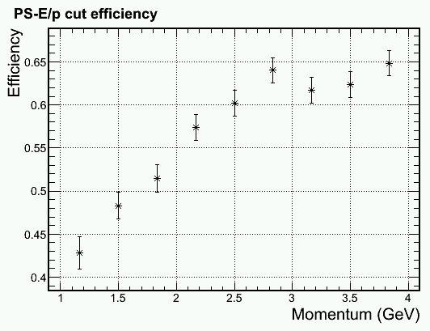
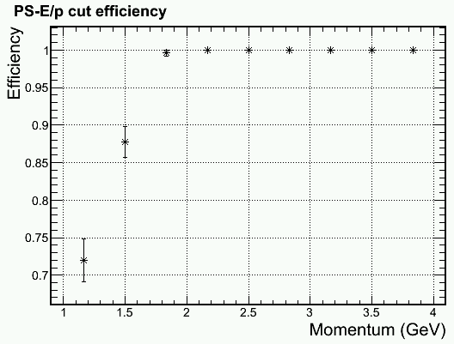
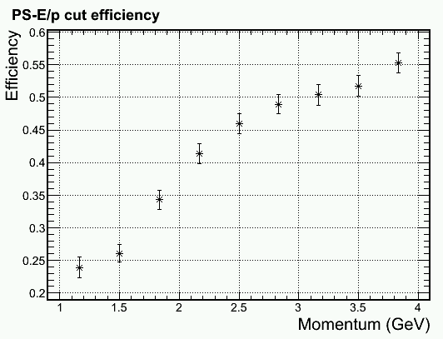
Trigger turn on curve for 2 GeV electron Shower Hex 1+6 trigger > 1.6 GeV
Inner radius, higher γ φ-band, full bgd
100% pass for ~250 events/bin
Physics
, full bgd
Middle radius, higer γ φ-band, full bgd
Physics
Pion Efficiency
Electron Efficiency

Slide 19
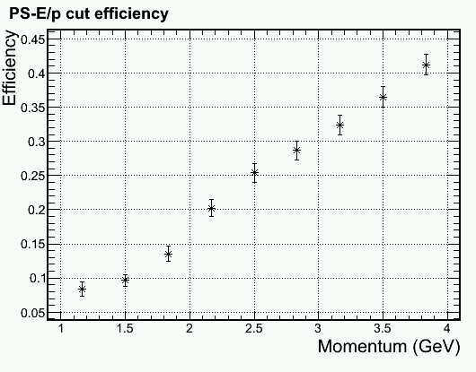
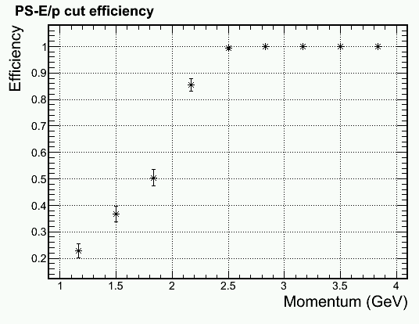
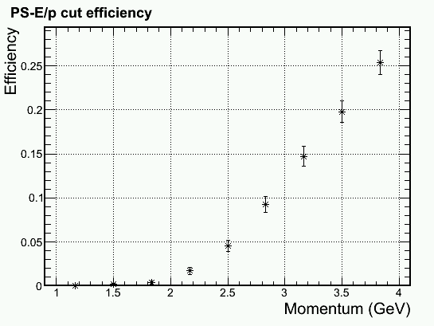
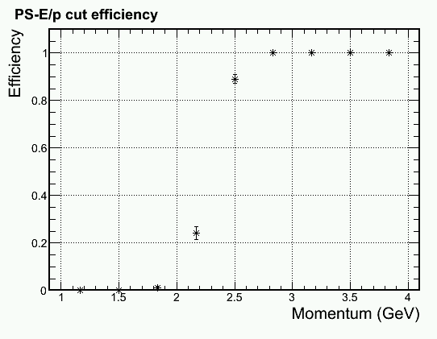
Trigger turn on curve for 2.5 GeV electron Shower Hex 1+6 trigger > 2.1 GeV
Middle radius, higher γ φ-band, full bgd
Physics
Outer radius, higer γ φ-band, full bgd
Physics
Pion Efficiency
Electron Efficiency

Slide 20
More detail in trigger cut Middle radius, higher γ φ-band, full bgd Shower Hex 1+6 trigger > 2.1 GeV
Pion Efficiency
Electron Efficiency

Slide 21
Readout occupancy per shower channel for ~75MeV zero suppression
High radiation phi slice
Low radiation phi slice

Slide 22
Trigger Study for Second update of CLEO background
Reported May 7 Calorimeter Meeting

Slide 23
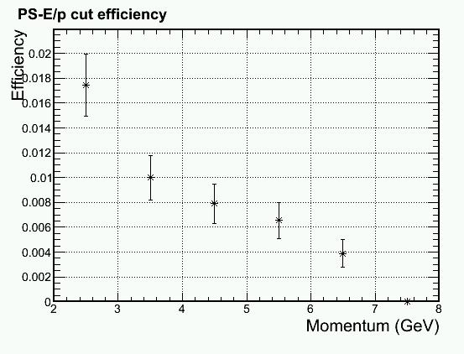
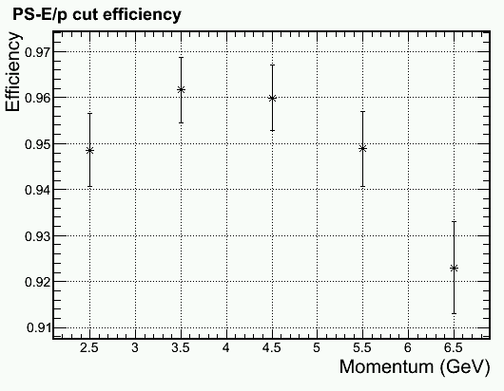
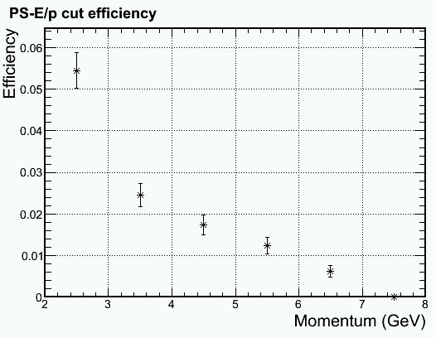
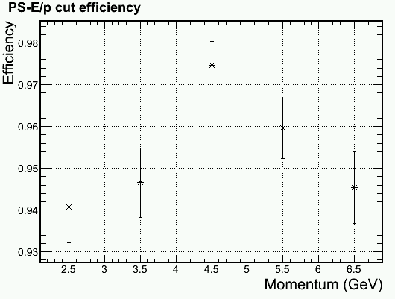
Update on PID with DC component removal (MIP + 2.5 σ)
Outer radius, higher γ φ-band
Mid radius, higher γ φ-band
Pion Efficiency
Electron Efficiency

Slide 24
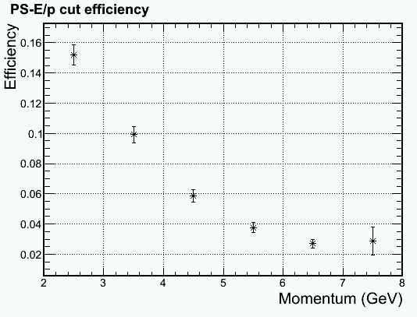
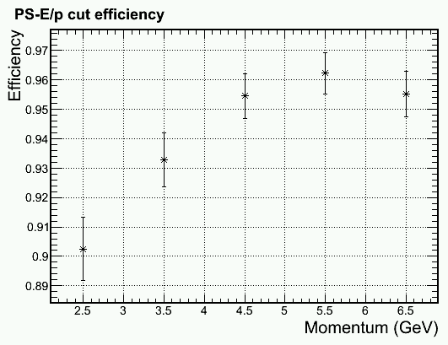
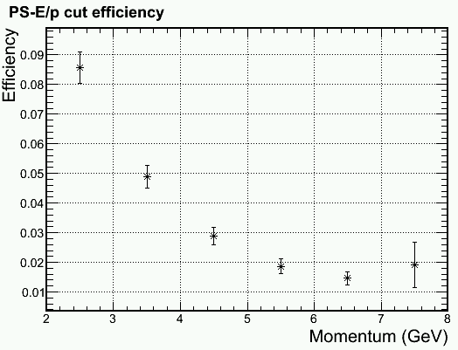
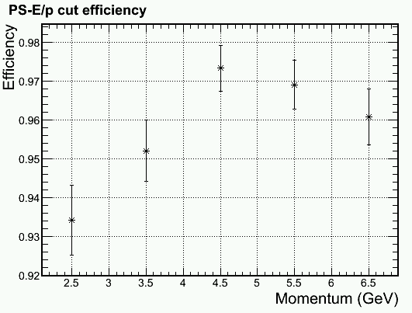
Update on PID with DC component removal (MIP + 2.5 σ)
Inner radius, higher γ φ-band
Inner radius, lower γ φ-band
Pion Efficiency
Electron Efficiency

Slide 25
Pion Trigger Turn-On Curve (No background), Electron Eff. > 97%
+ Preshower
-> x2 improve
Hex 1+6 Shower Trigger > 1.6GeV (for 2GeV electron)
+ Preshower Pad on top of central shower block > MIP + 1σ

Slide 26
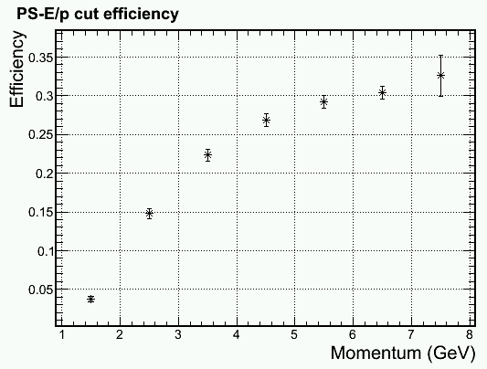
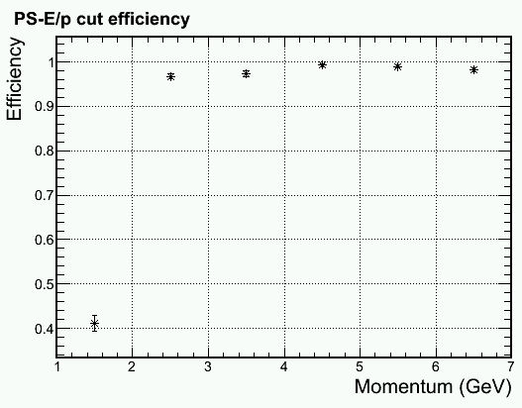
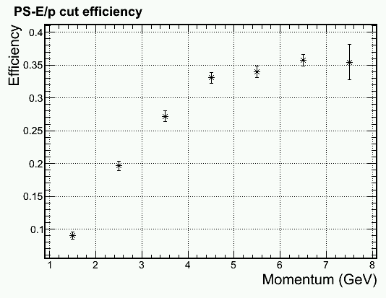
Trigger turn on curve with background
Middle radius, higher γ φ-band
Electron > 2GeV
Inner radius, higher γ φ-band
Electron > 2GeV
Pion Efficiency
Electron Efficiency

Slide 27
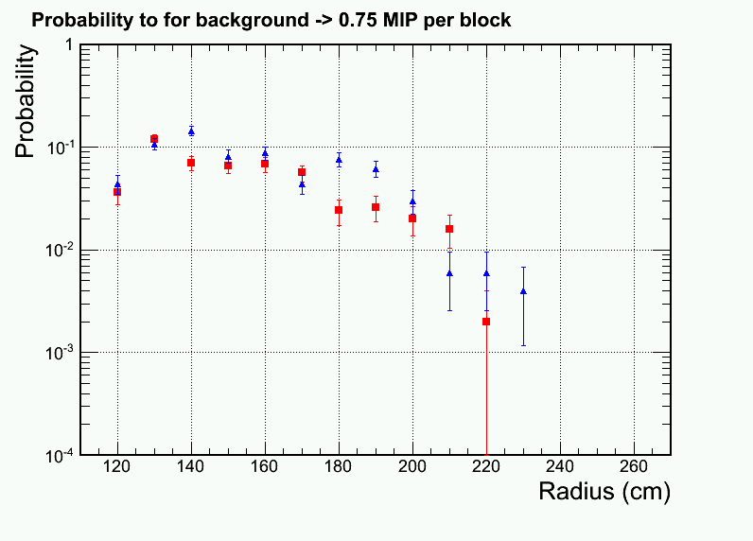
All background particle pile ups
Look at single Hexagon shower blocks which passed 0.75 MIP cut.
Full background spectrum used
ADC integration window = 50ns
~10% blocks will produce a 0.75MIP signal for clock trigger
Data readout is least 10% of modules
A shower MIP trigger is likely just trigger on lower energy particles
higher γ φ-band
lower γ φ-band

Slide 28
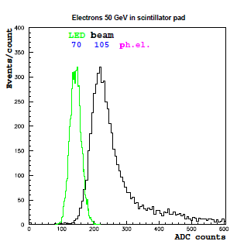
Quick estimation on impact of preshower radiation damage
Radiation on preshower is high for PVDIS
Last meeting we showed that preshower will show radiation damage in a few months run in PVDIS configuration (assuming no cure for photon bgd)
Estimated light loss is a fraction depending on the choice of scintillator and fibers
Our preshower was designed to produce high photon yield
Scint . thickness = 2cm with WLS imbedding
Expected photon / MIP = 140 e_{γ}
After 50% radiation damage (70 e_{γ}), MIP resolution from photon fluctuation = 12%
Intrinsic fluctuation on MIP sampling = 23%, PID cut on MIP + 2.5 σ
Therefore, effect on radiation damage to MIP resolution is expected to be minimal, as long as we calibrate the photon yield online
Beam test for LHCb pad (1.5cm thick)
From LHCb technical design report
1.5cm -> 105 e_{γ}

Slide 29
Second update of CLEO background
Reported Apr 30 Calorimeter Meeting

Slide 30
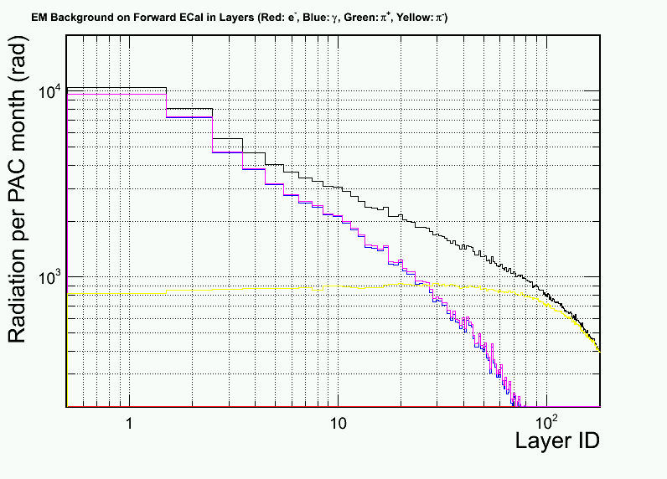
For each sector, background rate were calculated in high and low regions in phi
Babar baffle (for compare)
Photon (EM) <- dominant!
Photon (Pi⁰)
Electron
Pion- Pion+
Soft EM γ
Direct Pi⁰ γ
High radiation azimuthal region
Low radiation azimuthal region

Slide 31
Background distribution New: with photon and pi+, Mid R, High Rad phi slice
Photon (7 GHz/6+1 Hex cluster!)
Electron
Pion- Pion+

Slide 32
PID Performance (pion eff. w/ 94% elec. eff) w/o photon and pi+, Mid R, High Rad phi slice

Slide 33
PID Performance (pion eff. w/ 94% elec. eff) w/o photon, w/ pi+, Mid R, High Rad phi slice

Slide 34
PID Performance (pion eff. w/ 94% elec. eff) w/ photon, w/ pi+, Mid R, High Rad phi slice

Slide 35
Look elsewhere, Outer/Inner R PID Performance (pion eff. w/ 94% elec. eff)
w/ photon, w/ pi+, Outer R, High Rad phi slice
w/ photon, w/ pi+, Outer R, Low Rad phi slice
w/ o photon, w/ pi+, Inner R, High Rad phi slice
w/ o photon, w/ pi+, Inner R, Low Rad phi slice

Slide 36
First update of CLEO background
Reported Apr 23 Calorimeter Meeting

Slide 37
Zhiwen Updated background contribution for all configurations. PVDIS shown here:
Photon
Electron
Pion- Pion+

Slide 38
Updated: Per-event pion rate for 1+6 hexagon cluster at inner radius
Electron
Pion-
Pion+
Lower pi- rate in new simulation

Slide 39
Updated: electron efficiency Only electron and pi- background used
p>2GeV
Not much change in electron eff.

Slide 40
Updated: pion rejection Only electron and pi- background used
p>2GeV
x2 improved from last version

Slide 41
PVDIS trigger turn on curve 2GeV electron cut based on shower Hex1+6 cluster only

Slide 42
PVDIS – current baffle (with direct γ)
From Dec Collaboration Meeting
γ dominate
But attenuated quickly
Layer #1 is 2cm preshower scint.

Slide 43
PVDIS – preview for a baffle w/o direct γ
From Dec Collaboration Meeting
γ get reduced by ~5
π⁻ become important here
Layer #1 is 2cm preshower scint.

Slide 44
Last Version of Background Simulation (reported last week)

Slide 45
Why it is hard – lots of deep pions
Photon
Electron
Pion- Pion+

Slide 46
Per-event pion rate for 1+6 hexagon cluster at inner radius
Electron
Pion-
Pion+
High pi+ rate??
Need to be checked

Slide 47
Electron efficiency w/ background at inner radius. Ignore gamma and pi+ bgd
Background pile ups

Slide 48
Pion efficiency w/ background at inner radius. Ignore gamma and pi+ bgd
Significant drop in rejection

Slide 49
What we can further try
Position or kinematic dependent trigger threshold and cut threshold
Use track multiplicity to assist calorimeter cuts

