Slide 1
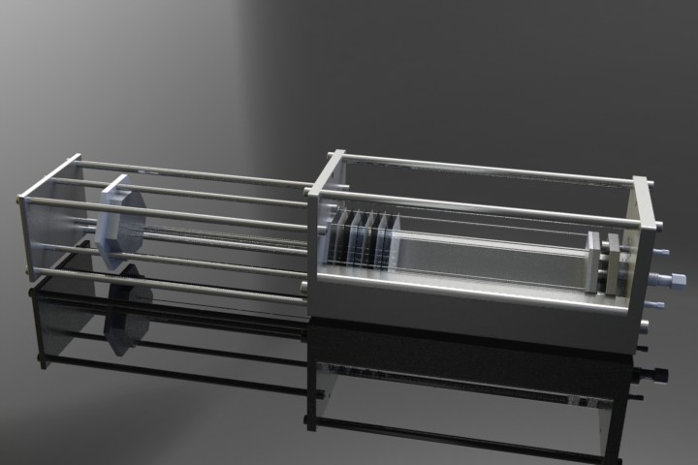
Primary idea for assemblage in SDU
Trapeziod ditch hold and position the tiles.
Push the all the 100 pins from the left side
Pressure provide from left side by one central screw stem and 3 auxiliary screws to adjust the pressure

