Slide 1
Pre-R&D Needs for SoLID
<number>

Slide 2
SoLID Apparatus
High Luminosity (10³⁷-10³⁹), high data rate, high background,
low systematics make every aspect of the apparatus a challenge.
Apparatus is comparable to large RHIC detector, but with high
radiation loads and all of the rate in the forward direction.
Many new technologies are required: GEM’s, pipeline and
dead-timeless DAQ, Shashlyk calorimeters, new PMT’s for Cerenkov’s.
<number>

Slide 3

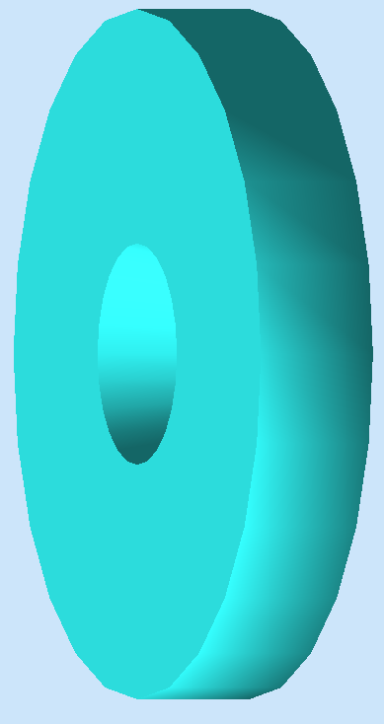
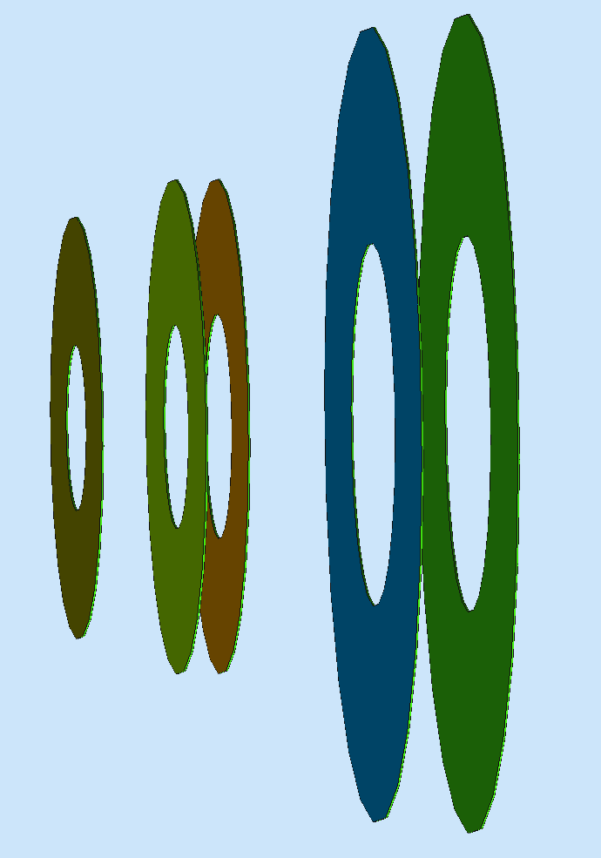
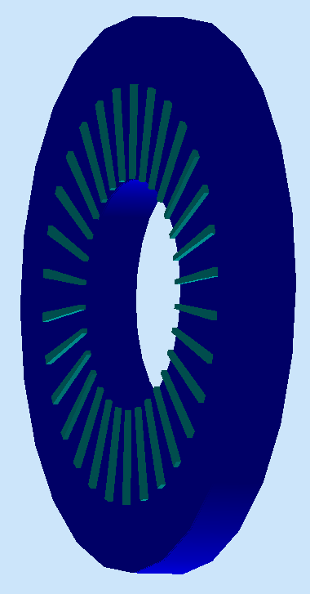
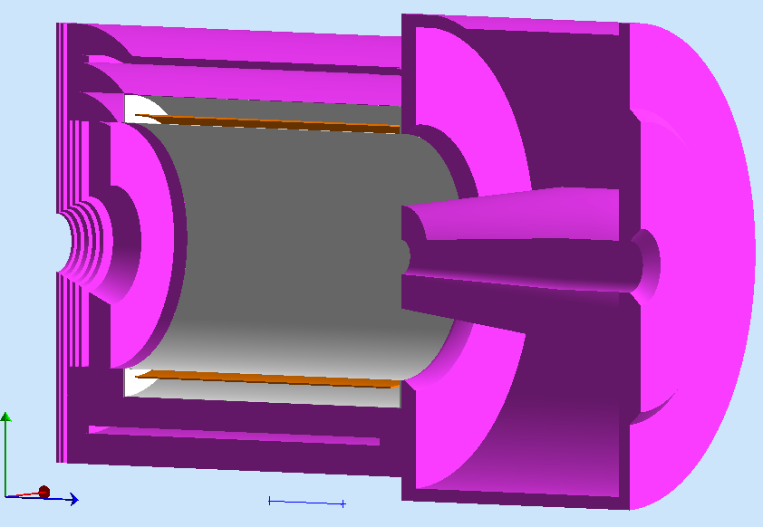
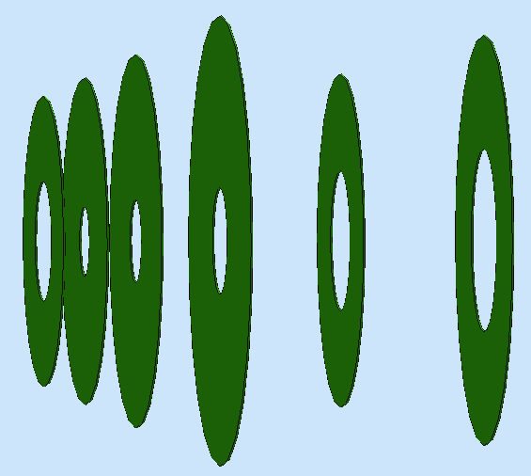


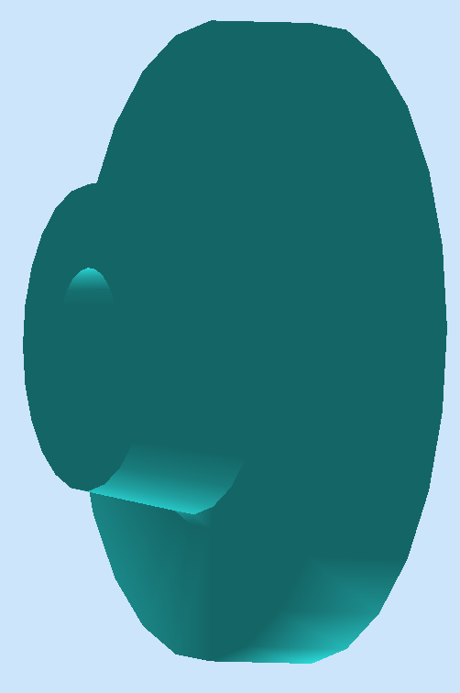
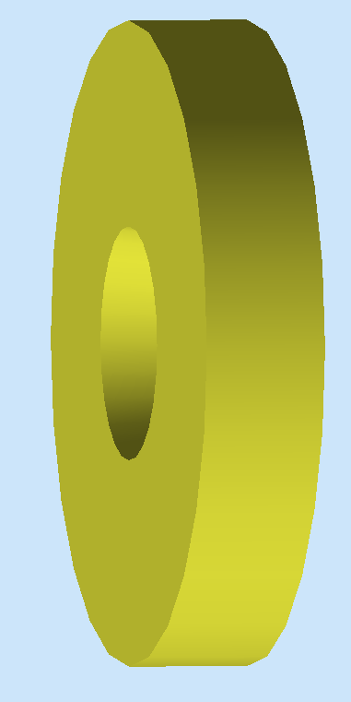


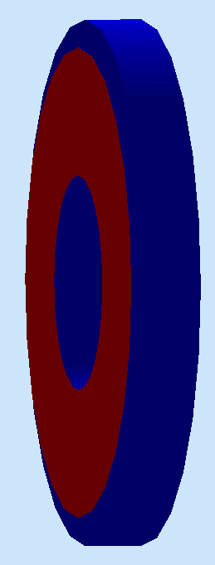
SoLID Detector Overview
PVDIS: Baffle LGC 5xGEMs EC
SIDIS&J/Psi:
6xGEMs LASPD LAEC LGC HGC FASPD MRPC FAEC
<number>
Notes:
We aim to build an advanced device which has high intensity and also have very large acceptance.
So they requires us to take advantage of new detector techniques, very faster electronics and DAQ system. We also need a close-to-realistic simulation tool for us to evaluate the experimental conditions and infrastructure requirements, such as the overall rate, background situation and radiation distribution. Besides, analysis software developments, for example, the tracking reconstruction of GEMs in strong magnetic field is also very important.
I took out individual detectors from the CLEO-II magnet as demonstration. There are two basic solid setups, and some of the detectors, like LGC and EC, can be shared in between two setups. Other infrastructures like targets, collimators and supporting structure are not shown here.
For PVDIS, we use the baffle, which contains 12 layers of thick lead plate to block most of neutral particles and heavier charged particle while only preserve high energy electronics. 4 layers of GEMs provide the tracking information, and Light Gas Cherenkov and electromagnetic calorimeter or EC will be used for triggering, particle identification and energy measurements.
For SIDIS and J/Psi, 6 GEM plates will be used for the tracking at large angle and at forward angle. At large angle, we use Scintillator-pad Detector (or SPD) to reject neutral particles and measure time, and EC to perform the PID. The electron trigger is given by the coincidence between SPD and EC. At forward angle, Light gas cherenov will provide the e/pi separation, heavy cherenov detectors for the pi/K separation. Multi-gap resistant plate chamber and forward angle SPD will provide timing measurement and reject neutral particles, most importantly, photons. Forward angle EC will provide PID. LGC+MRPC+EC will be used for electron triggers, EC itself can also provide hadron triggers.
There are a lot of activities going on for the Pre-R&D, R&D and MC simulation for each detector. We are going to develop prototypes of LGC at Temple and Heavy Gas Cherenkov at Duke.
In the next few slides I will give you updates for the magnet, GEMs, MRPC, EC, and SPD.
<number>

Slide 4
Critical Needs
Magnet:
Field near target and Č phototubes is critical
Fe design must be frozen before supports for detectors is done
Software:
Simulation of backgrounds, calibration methods critical
Need integrated software for a project of this size
DAQ:
High rates for both data and background make unique challenges
Individual Detectors:
Ecal, SPD (Radiation damage, backgrounds)
Čerenkov detectors (Magnetic fields, backgrounds)
GEM’s (Size, rates)
MRPC (Time resolution)
<number>

Slide 5
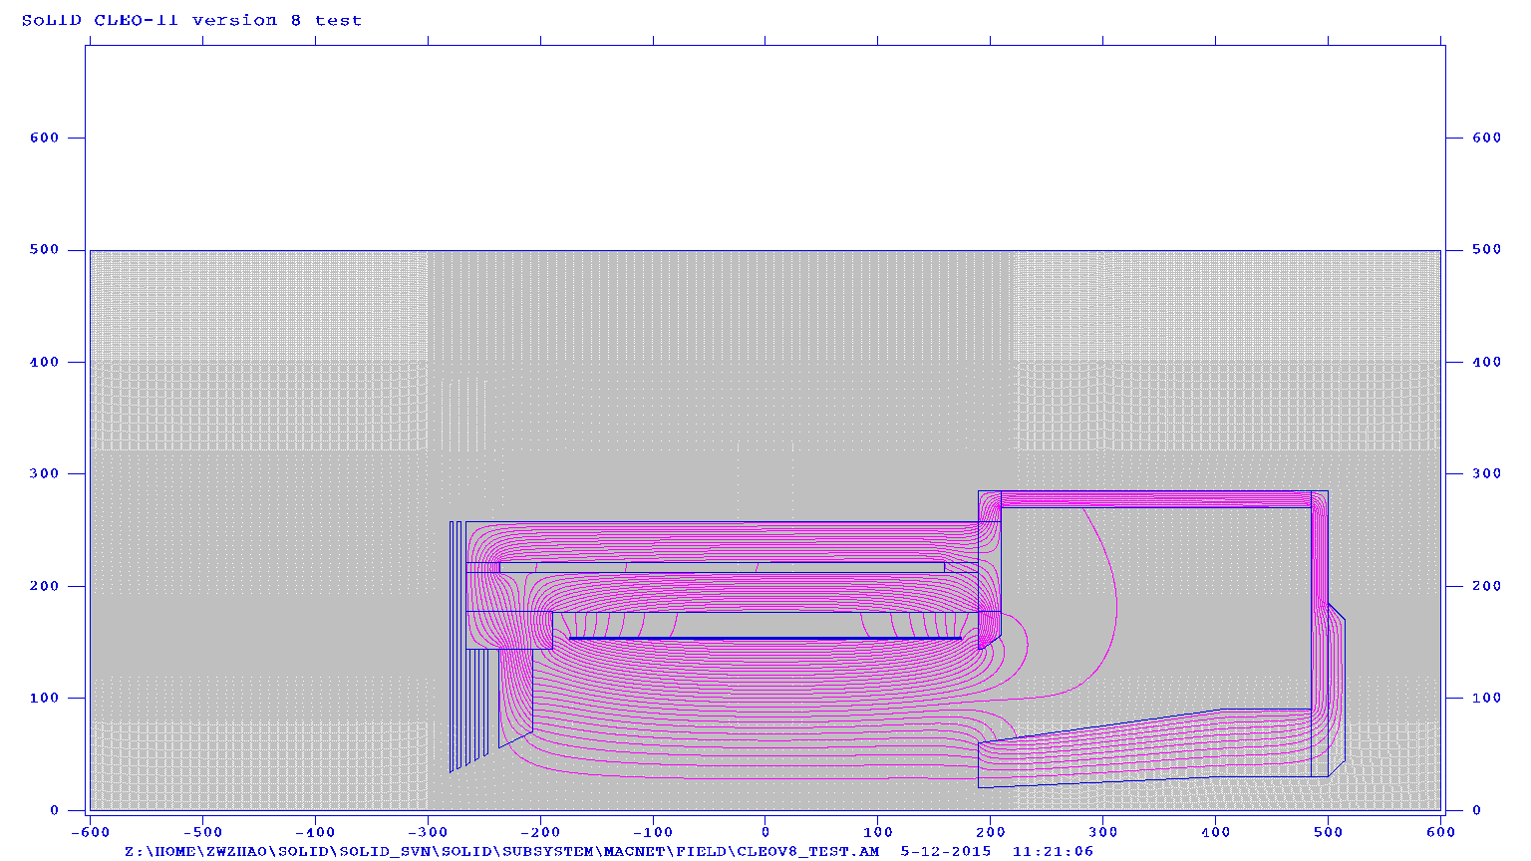
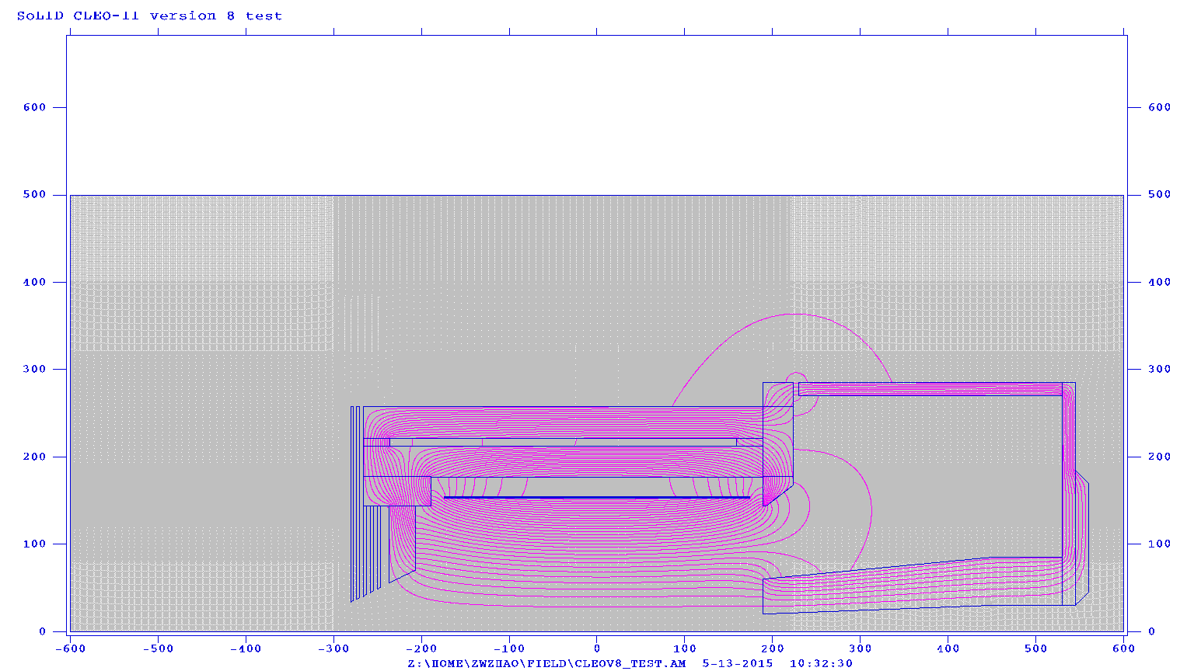
Magnet Modeling
Need Accurate 3D Field Map
Effects of saturation
Magnetic forces
Fields near target & PMT’s
Final placement of detectors
Effects on tracking
Design gaps for cables
Key Issue:
Prerequisite for full
simulation and detector
design
Request:
1 FTEY ASAP
<number>

Slide 6
Simulation and Software
Key Issues:
Main recommendation from
Directors Review
Framework is essential for a project of this size.
Full simulations must be completed before detectors can be finalized.
Assessing backgrounds and systematic errors in the high-rate environment
Goals:
Develop full simulations
Develop software framework that integrates simulations, reconstruction, and analysis
Develop and test algorithms
for tracking and detectors
4. Optimize detectors, baffles,…
Request: 3 FTE (postdoc) x 3 Yr=9FTEY
2 at Stony Brook, (Riordan, Deshpande, Hemmick) 1 at Duke (Gao/Zhao)
<number>

Slide 7
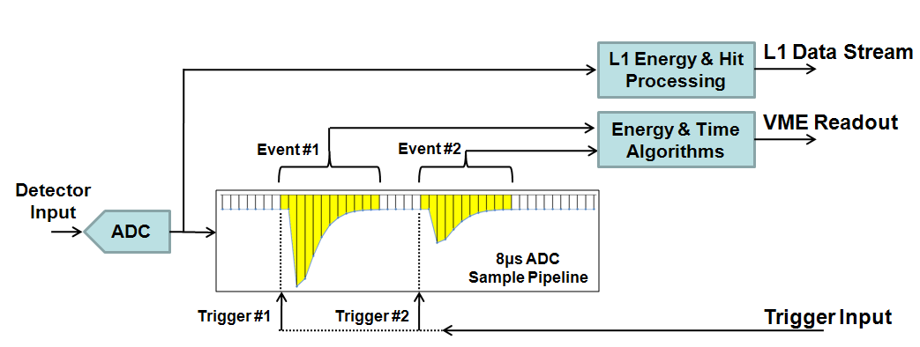
DAQ: Test Stand
Key Issues:
High Rate
Good Background rejection
Low systematics (dead time…)
Goals:
Test trigger rate capacity
Test triggering schemes
GEM APV rate capability
MRPC timing resolution
L# Farm performance
Request: (Stony Brook)
$72.5k + 1.25 FTEY
(Additional resources will be
provided by JLab)
<number>

Slide 8
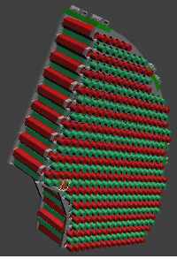
Electromagnetic Calorimeter (Ecal) and Scintillator Photon Detector (SPD)
Key Issues:
Radiation hardness
Ability to reject background in the noisy environment
Supporting this heavy device
Production capability
Goals:
Build and test 8-module assembly
Develop full simulations of Ecal
Assess backgrounds
Develop design for support
Find new supplier if Russian IHEP
group is unavailable
Request: UVA (Zheng)
$106k + 3.3 FTEY
<number>

Slide 9
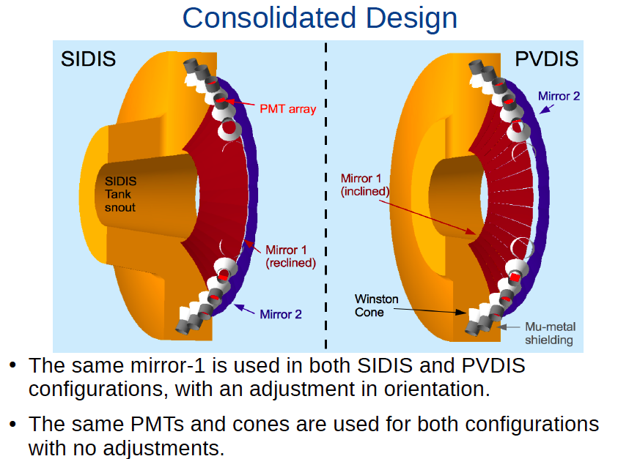
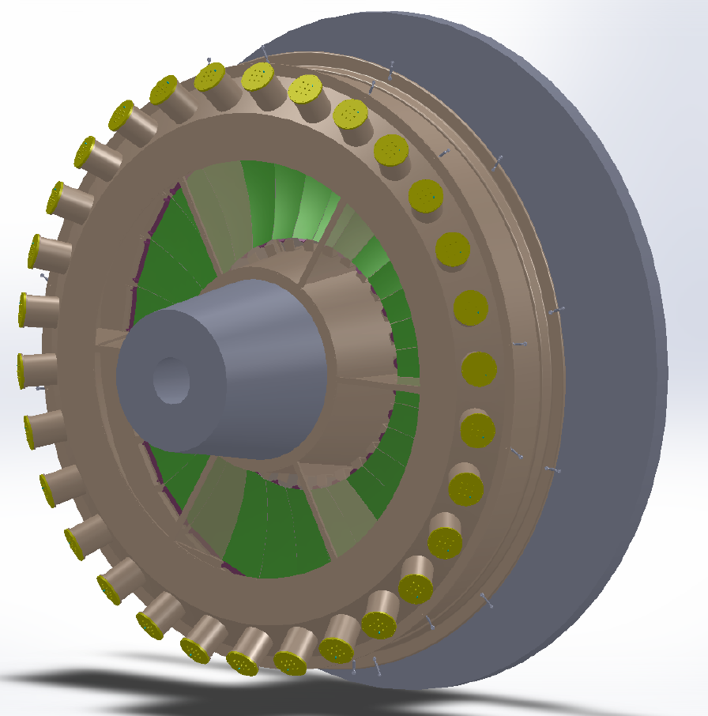
Čerenkov Counters (Light and Heavy)
Key Issues:
Magnetic fields
High Backgrounds
Efficient light collection
Goals:
Simulate background rejection
Build prototype
Test critical parts
Request: HGC (Duke)
$121k + 1.75 FTEY
Request: LGC (Temple)
$87.3k + 3FTEY
<number>

Slide 10
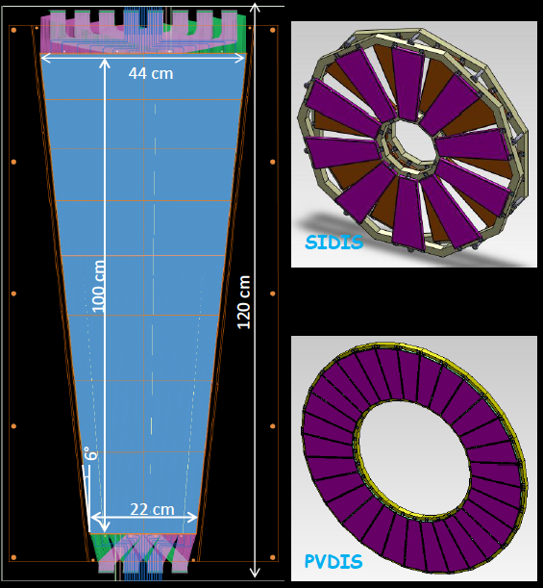
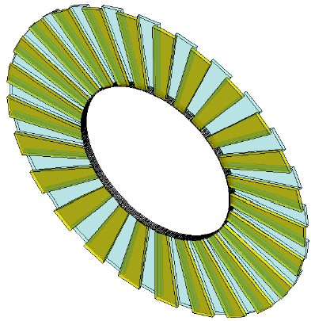
GEM’s and MPRC
Key Issue:
Schedule risk for foil production
Foster close interaction between US and China groups.
Key Issues:
Readout Electronics
Explore kaon ID
Request: GEM UVA (Liyanga) and Temple (Surrow)
$180k + 2.6 FTEY
Request: MRPC (Unnamed)
$91k + 0.9 FTEY
<number>

Slide 11
Summary
The SoLID spectrometer, with its high luminosity combined with
large acceptance can accomplish numerous first-rate experiments
that fully realize the potential of the JLab 12 GEV upgrade.
To do this, novel instrumentation is required, including large GEM’s,
a radiation-hard ECal, and compact Čerenkov counters, and a DAQ
system with high-rate capabilities that reduces systematic errors..
The scope of the project is large, requiring in integrated software
framework that can handle simulation, and data analysis.
We have requested the Pre R&D needs to move the concept
forward
Total Request: (Direct) $683k + 23.4 FTEY
<number>

