Slide 1
Effect of temperature on the ECAL's pressure
Xiwei Wang / Chendi Shen
2016.4.21

Slide 2
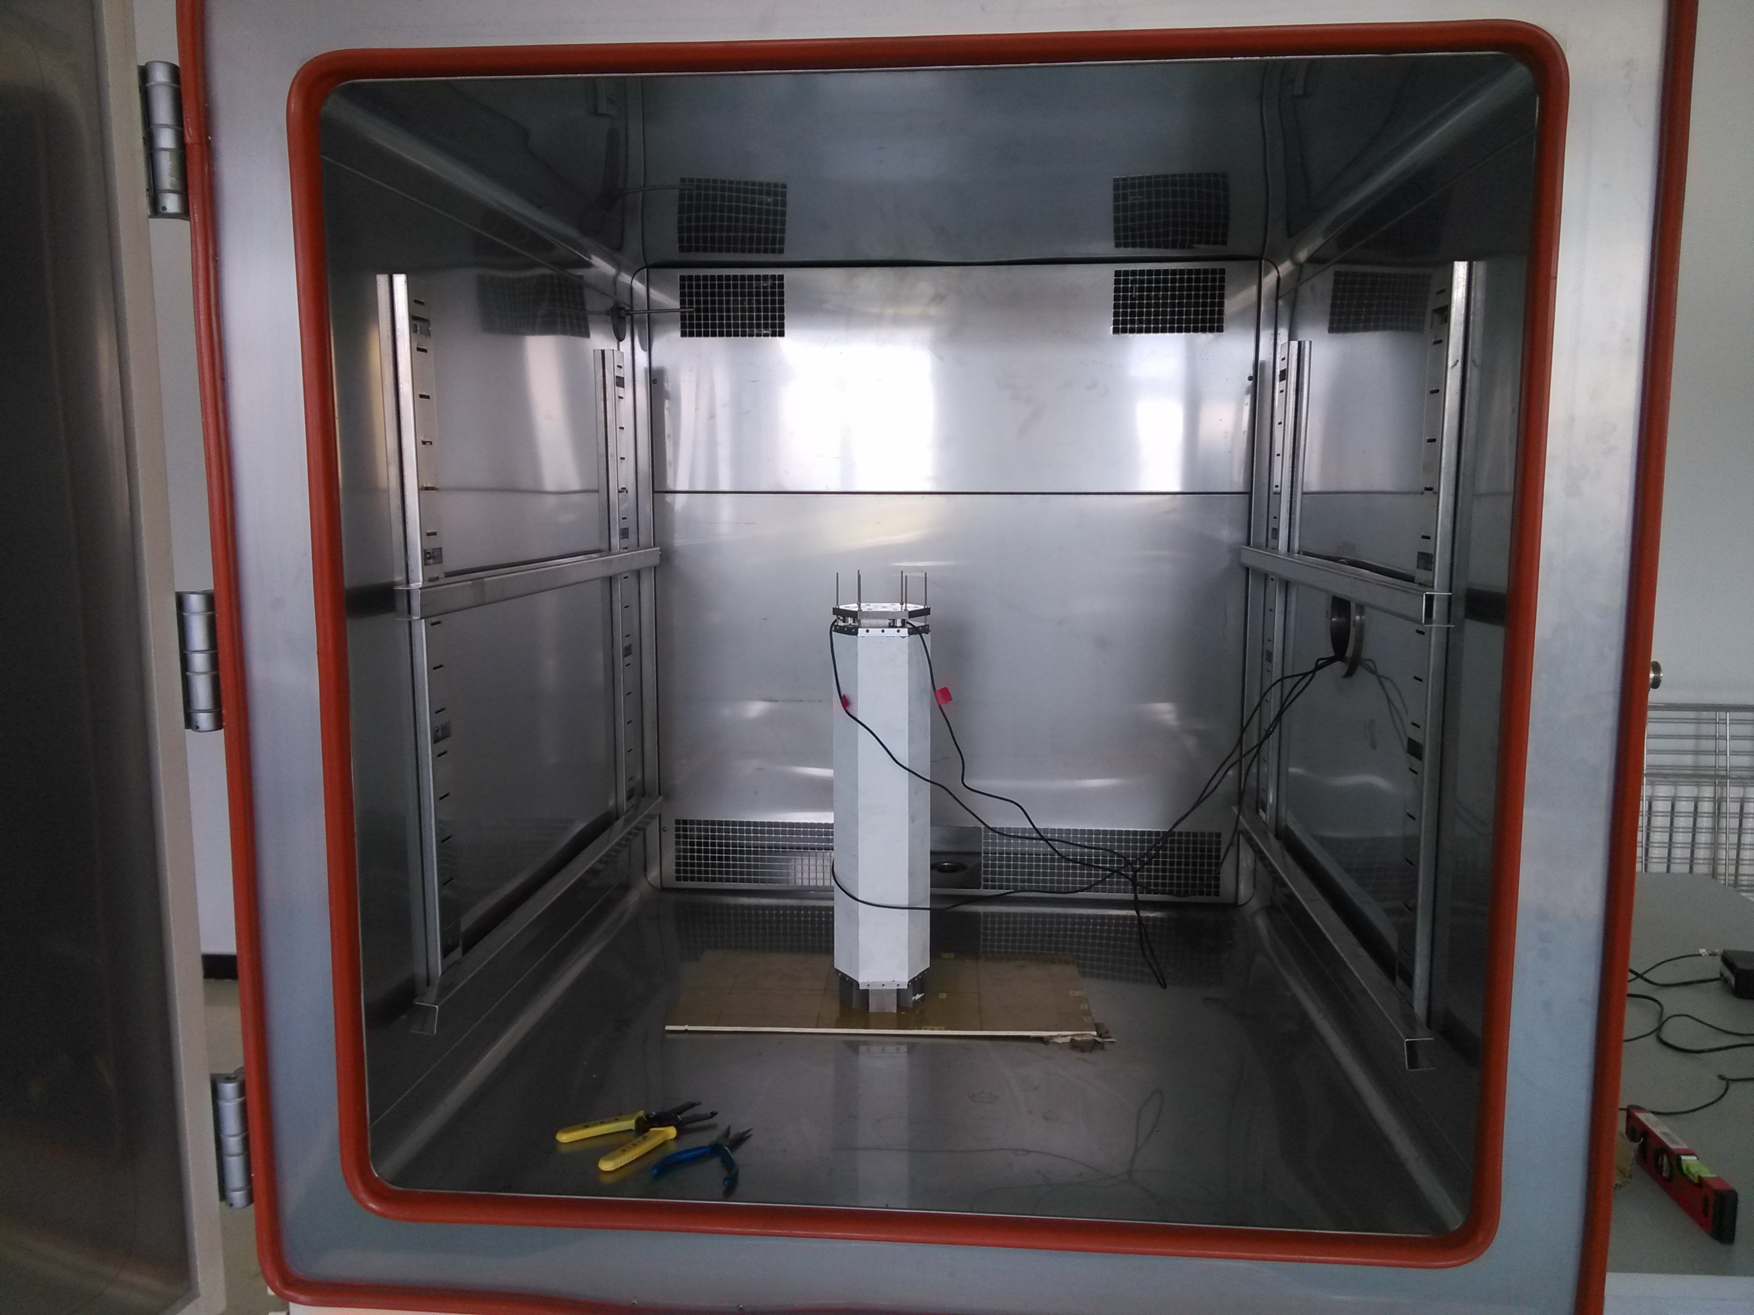
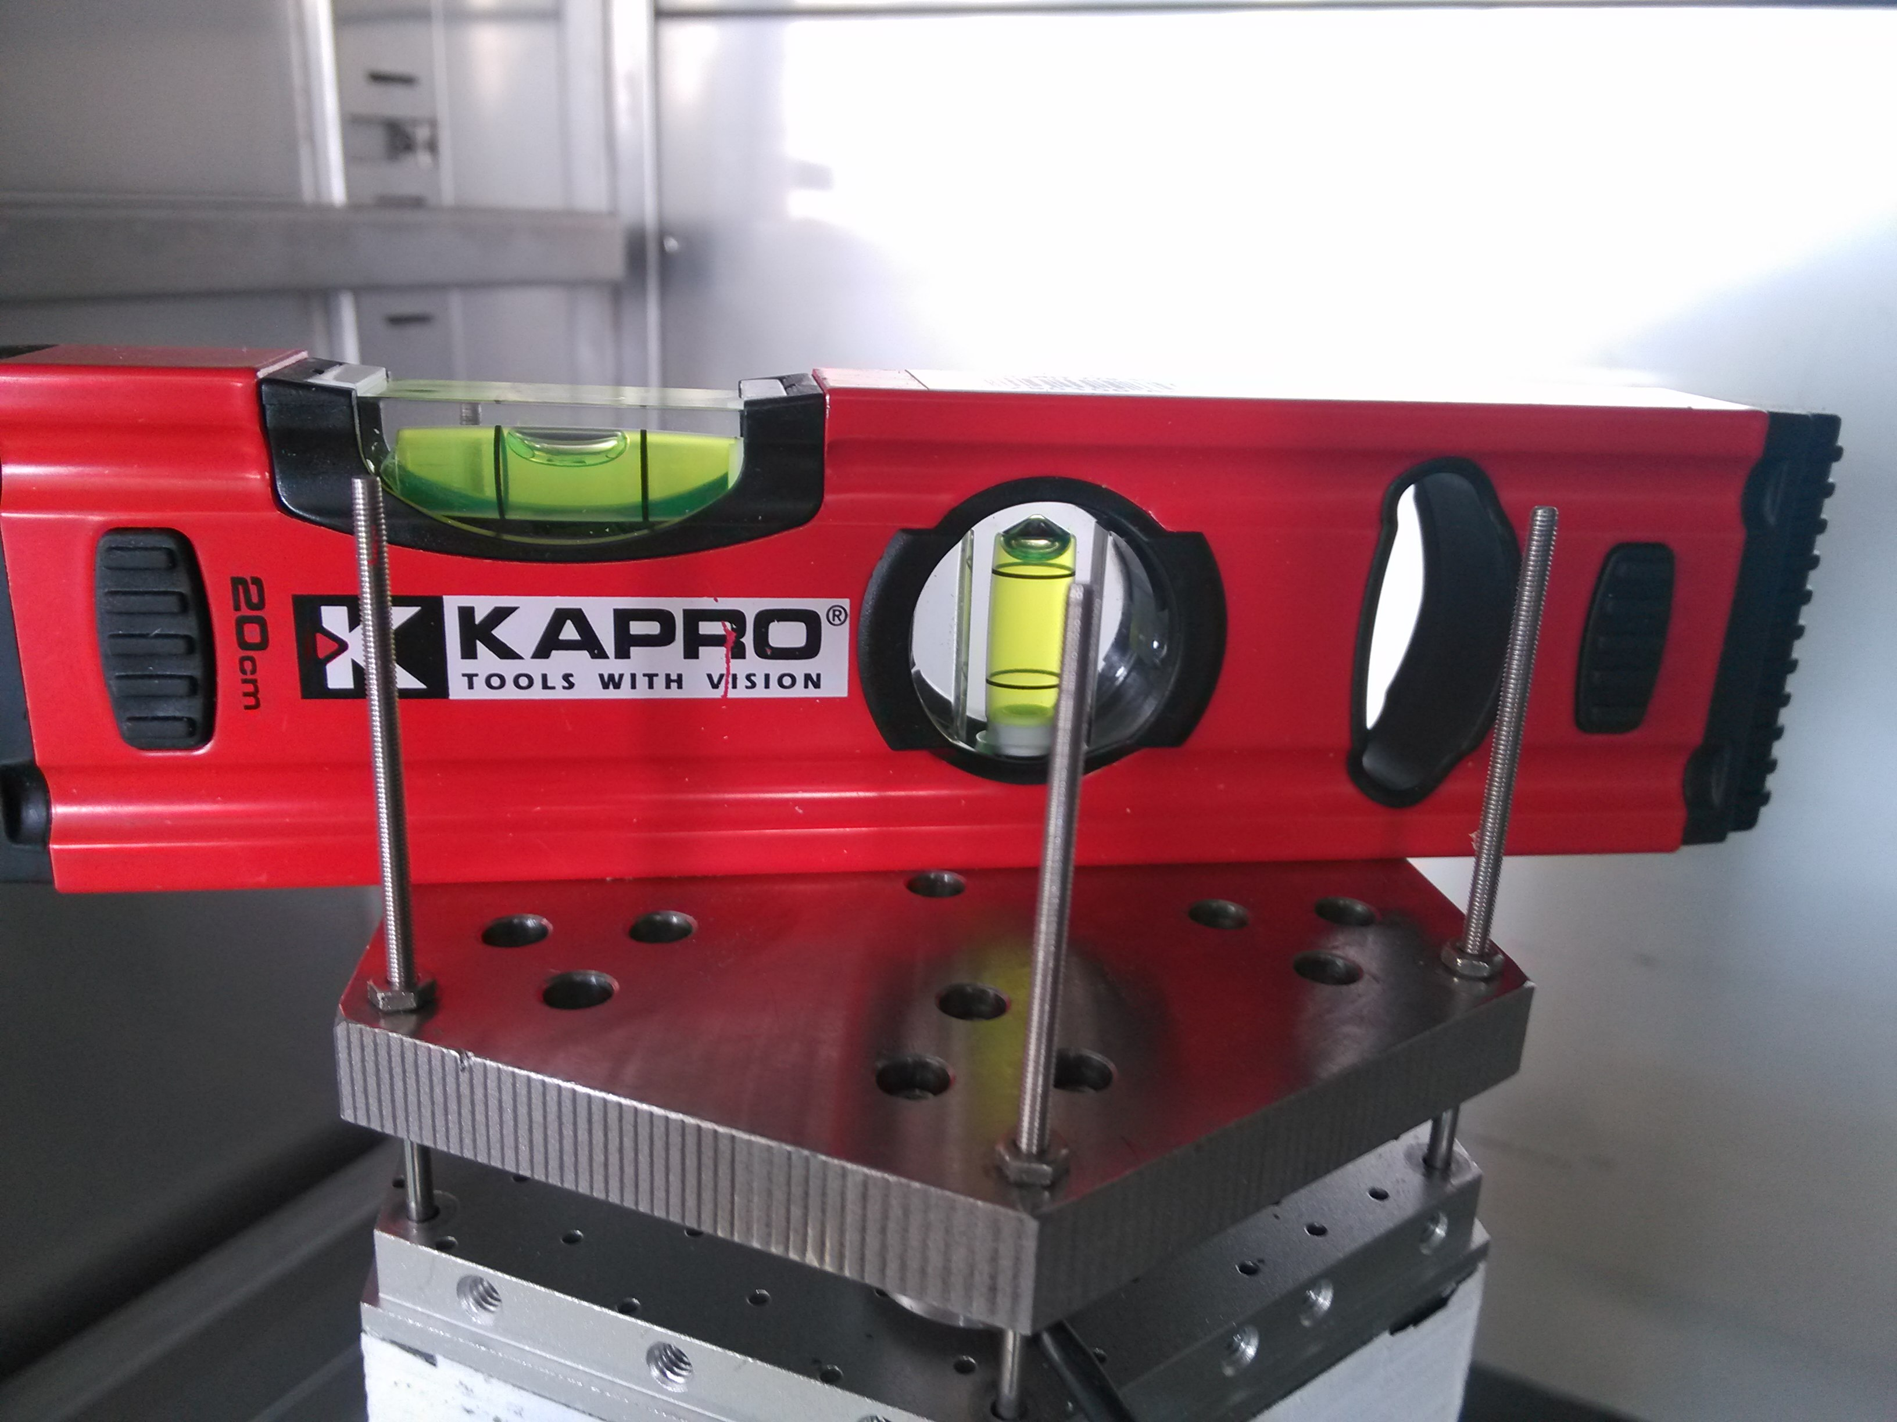
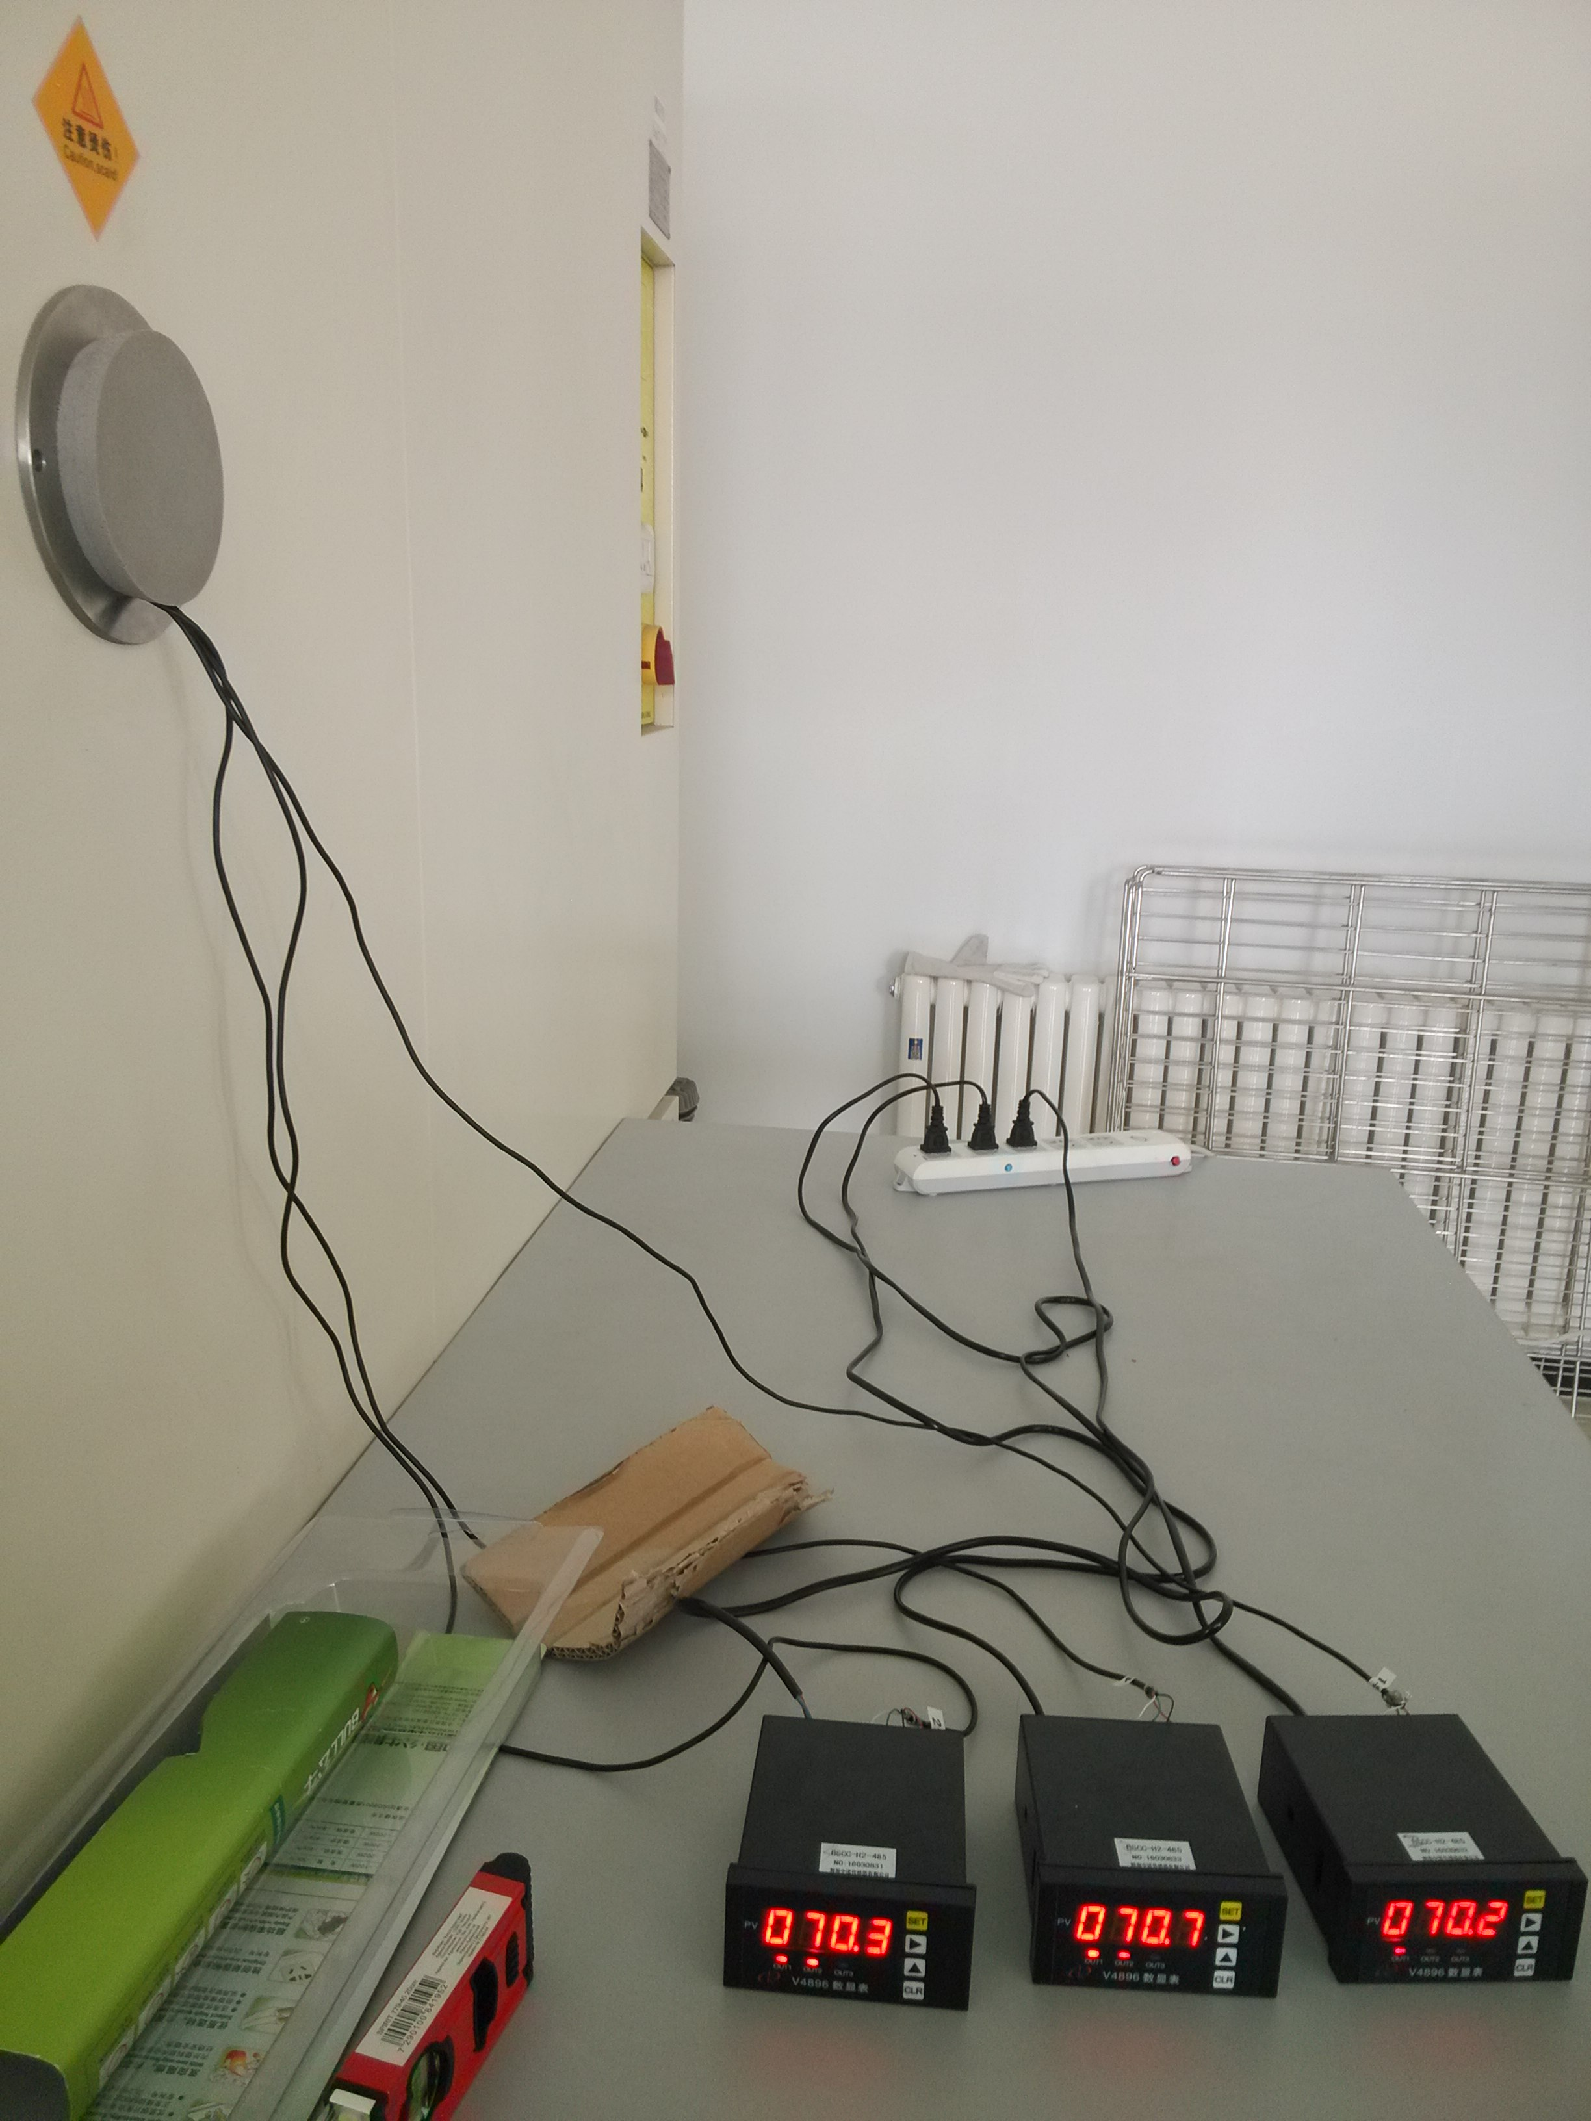
Experimental process
put the ECAL on the bottom piece, tighten the six nuts to make all the three sensors are 70kg(Total 210kg) and make sure the gradienter is horizontal.

Slide 3
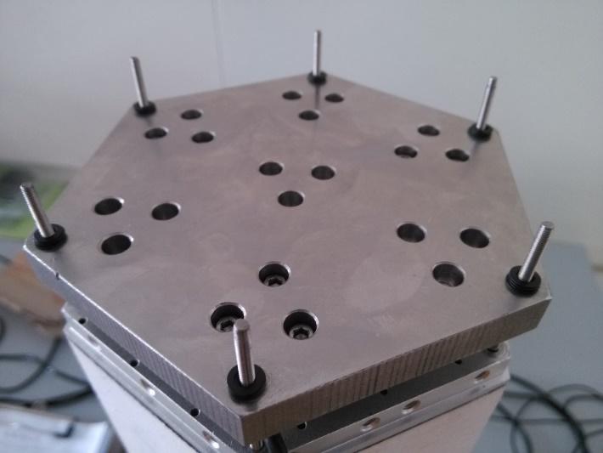
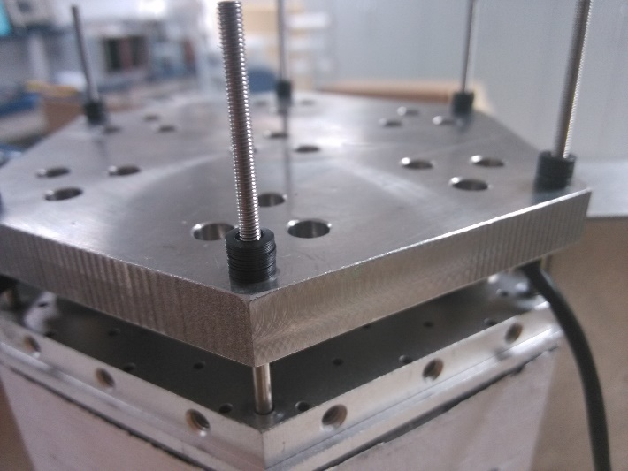
Explanation
There are three groups of datas which include no washer, five washers per screw and fifteen washers per screw respectively.
$F_{max}$=595N
$h_{max}$=0.115mm
$F_{max}$=595N
$h_{max}$=0.345mm
$h_{0}$=0.15mm
3.2mm
6mm
No washer
five washers
fifteen washers

Slide 4
No washer
Temperature was regulated from room temperature(22 ℃) to 30℃, then declined per 5℃ for a record. We recorded the data when three sensors didn’t change. On the other hand, the changing of every sensors is same.

Slide 5
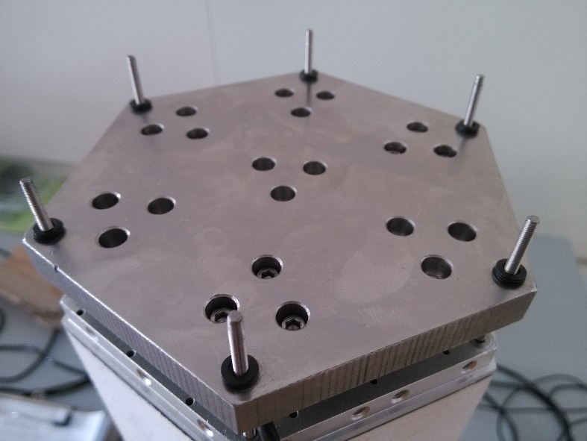
Five washers per screw
Temperature was regulated from room temperature(26.3 ℃) to 30℃, then declined per 5℃ for a record.
We implemented some data included in the form after it was -30℃ for contrasting.
$F_{max}$=595N
$h_{max}$=0.115mm
The pressure is same as before

Slide 6
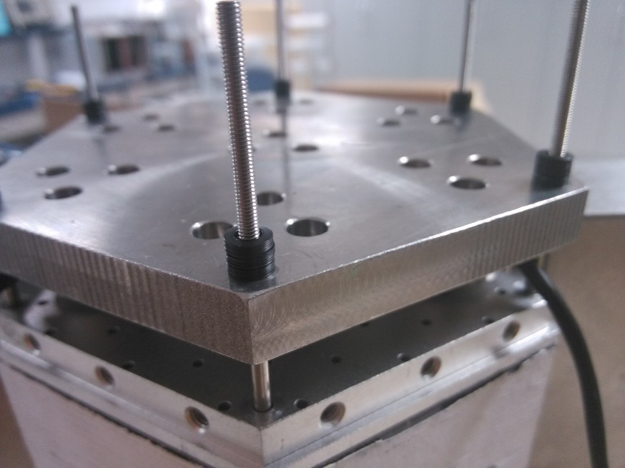
Fifteen washers per screw
Temperature was regulated from room temperature(26.3 ℃) to 30℃, then choose some tepterature for a record.
But when we increased the temperature , the pressure is bigger than before.
$F_{max}$=595N
$h_{max}$=0.345mm

Slide 7
Summary
The effective of washer is not obvious.
The pressure don’t disappear when the temperature is very low whether adding washers or not .
The problem we mentioned maybe due to the washer, we need to do another test which recording the pressure changing after increasing the temperature with no washer. If the pressure is same than before, we could confirm the problem due to washer.
The pressure is not lost completely by temperature changing.

