Slide 1


Ec and spd UpdatEs
Jianbin Jiao (Shandong Univ.) For
Solid EC Working Group
SoLID Collaboration Meeting
Newport News
Jan. 12-13, 2016

Slide 2
Outline
Introduction
Progress
Measurement & Assembly
First Pre-prototype
Outlook

Slide 3
Introduction

Slide 4
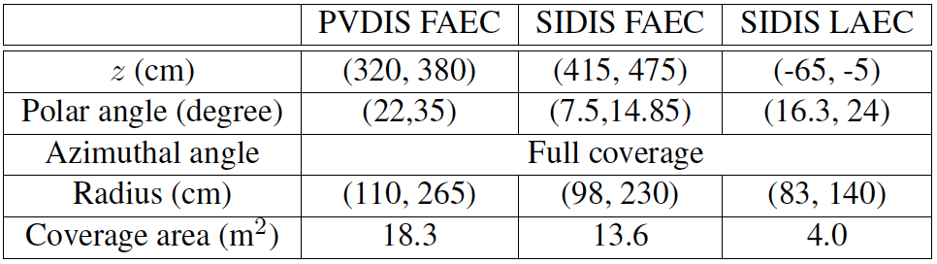
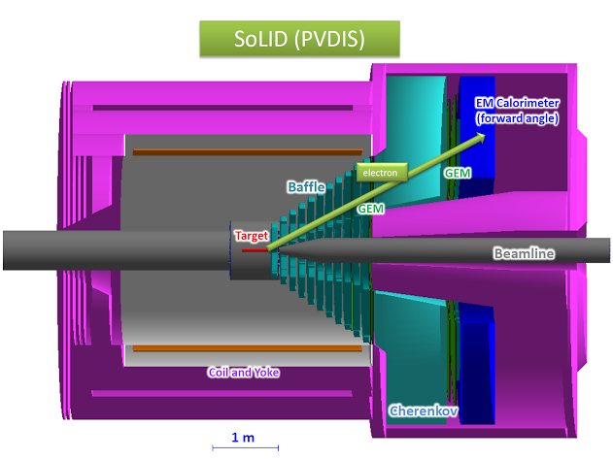
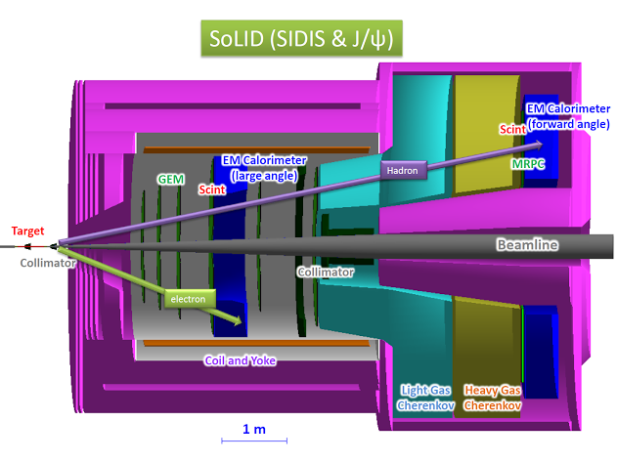
SoLID Coverage
Electromagnetic Calorimeters (EC) are used in PVDIS, SIDIS and J/$ψ$.

Slide 5
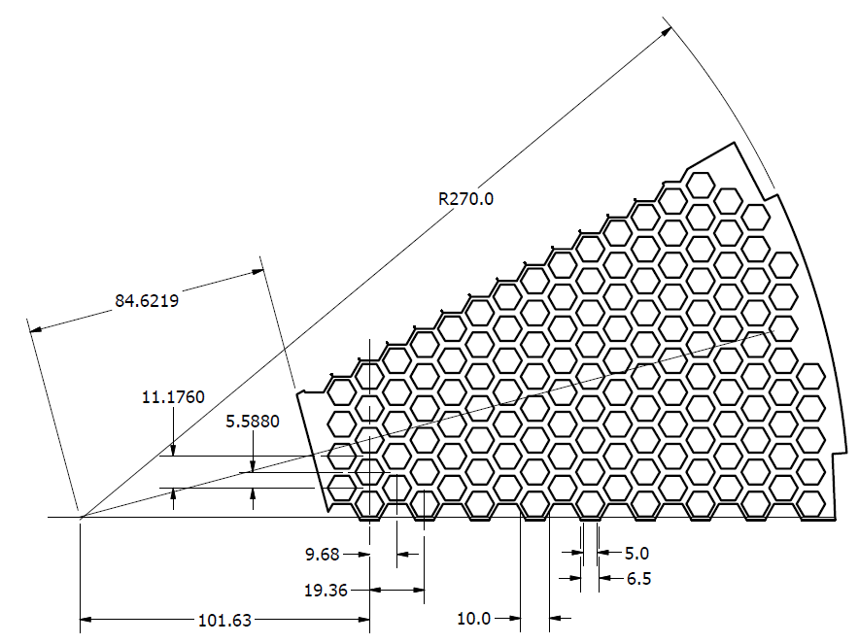
Layout Of EC Modules
The view of PVDIS FAEC (portion) along the beam direction
147 modules/30-degree wedge of the FAEC for the PVDIS configuration.
The cross section of module is hexagon-shaped/ area is 100 cm²/ side length is 6.25 cm
Modules from PVDIS FAEC will be split and rearranged into SIDIS FAEC and LAEC

Slide 6
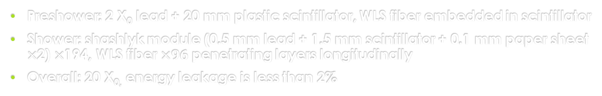
Stucture Of EC
Preshower: 2 X₀ lead + 20 mm plastic scintillator, WLS fiber embedded in scintillator
Shower: shashlyk module (0.5 mm lead + 1.5 mm scintillator + 0.1 mm paper sheet $×$2) $×$194, WLS fiber $×96$ penetrating layers longitudinally
Overall: 20 X_{0,} energy leakage is less than 2%

Slide 7
progress

Slide 8
Members From SDU & THU
More members from SDU and THU groups contribute to the EC research.
  SDU group: involved in SoLID EC since 2014
  Members: Cunfeng Feng (Prof.),
  Jianbin Jiao (Assoc. Prof.),
  Ye Tian (Grad.)
  THU group: involved in SoLID EC since 2015
  Members: Yi Wang (Prof.),
  Chendi Shen (Grad.),
  Xiwei Wang (Grad.)

Slide 9
Progress Of Universities
Both SDU and THU groups made great progress in prototyping Shashlyk modules. Currently plan is to build 4 modules each.
  Ordered lead and scintillator plates
  Measured hole positions using optical grating
  SDU assembly tested using regular plastic + lead; compression up to 500kg
  In close contact with Huazhong Normal Univ. (ALICE) group on learning their assembling experience.
Work in UVa.:
  FMPMT high field test using FROST magnet (July) – done, paper submitted
  Tests requiring beam → spring 2016
    FASPD uniformity test – awaiting GEM
    LASPD timing test
    Preshower prototype radiation resistance
  We do have the complete drawing of the ALICE modules from Wayne State University but dissecting it and design our own requires serious engineering effort.
  Continue working on the Module design/drawings (added side-plates)
  Resumed working with ANL/Chicago engineer on the Ecal support

Slide 10
Measurement & assembly

Slide 11
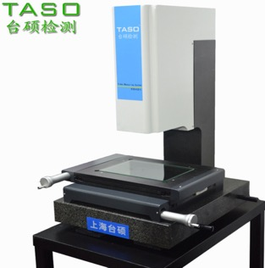
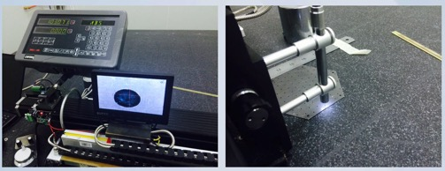


Measurement Tools
THU: Video measuring instrument
Resolution: 1-3$μ$m
SDU: Granting Scale
Resolution: 5$μ$m

Slide 12
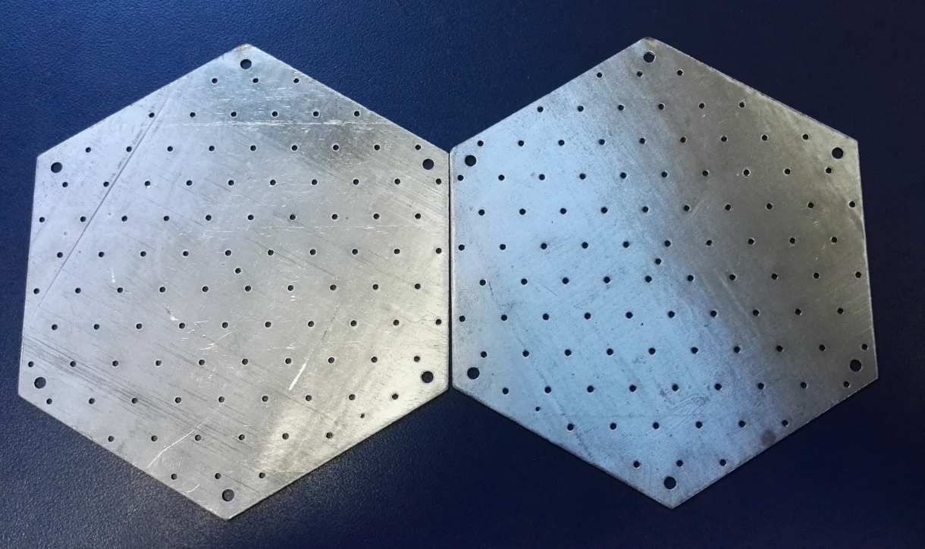
Lead Plate
US Kolgashield
  Ordered for 5 modules
  NOT received yet (placed an order in summer)
  $13/piece
In-Tech? (英泰克)
  600 pieces received
  ¥13/piece
CNNC (中国核工业集团)
  400 pieces received
  ~¥10/piece
Jiateng Machinery Manufacturing Co. (北京佳腾机械科技发展有限公司)
  200 pieces received
  ¥7/piece
The geometry size of lead plates are all fine

Slide 13
Measurement Results Of Sampling
Provided By THU
 |  |  |  | 11 | 12
 |  |  |  |  | 1.462
 |  |  | 21 | 22 | 23 | 24 | 25
 |  |  |  |  | 1.486 | 1.49 | 1.454
 | 31 | 32 | 33 | 34 |  | 35 | 36 | 37 | 38
 |  |  |  |  |  | 1.475 | 1.454 | 1.462 | 1.439
41 | 42 | 43 | 44 | 45 |  | 46 | 47 | 48 | 49
1.468 | 1.494 | 1.475 | 1.464 | 1.488 |  | 1.476 | 1.459 | 1.481 | 1.475
51 | 52 | 53 | 54 | 55 |  | 56 | 57 | 58 | 59 | 510
1.473 | 1.487 | 1.501 | 1.438 | 1.484 |  | 1.468 | 1.444 | 1.467 | 1.458 | 1.466
61 | 62 | 63 | 64 | 65 |  | 66 | 67 | 68 | 69
1.486 | 1.445 | 1.475 | 1.48 | 1.478 |  | 1.456 | 1.467 | 1.451 | 1.435
71 | 72 | 73 | 74 | 75 |  | 76 | 77 | 78 | 79 | 710 | 711
 |  |  |  |  |  | 1.468 | 1.462 | 1.46 | 1.478 | 1.481 | 1.444
81 | 82 | 83 | 84 | 85 |  | 86 | 87 | 88 | 89
 |  |  |  | 1.466 |  | 1.449 |  |  |  | 0.947
91 | 92 | 93 | 94 | 95 |  | 96 | 97 | 98 | 99 | 910
1.472 | 1.473 | 1.469 | 1.466 | 1.481 |  | 1.442 | 1.472 | 1.45 | 1.455 | 1.462
101 | 102 | 103 | 104 | 105 |  | 106 | 107 | 108 | 109
 | 1.463 | 1.466 |  | 1.47 |  | 1.449 | 1.456 | 1.451 | 1.477
 | 111 | 112 | 113 | 114 |  | 115 | 116 | 117 | 118
 |  | 1.478
 |  |  | 121 | 122 | 123 | 124 | 125
 |  |  |  |  | 1.443
 |  |  |  | 131 | 132
 |  |  |  | 1.459 | 1.43
Lead plate
Diameter Of holes
Hole spacing
12to23 | 12to24 | 23-24
10.816 | 10.819 | 10.829
99-910 | 99-109 | 910-109
10.841 | 10.825 | 10.842
41-42 | 41-52 | 42-52
10.837 | 10.825 | 10.815
102-103 | 102-112 | 103-112
10.843 | 10.831 | 10.815
Average value | Variance
1.465 | 0.00023
Average value | Variance
10.822 | 0.00053

Slide 14
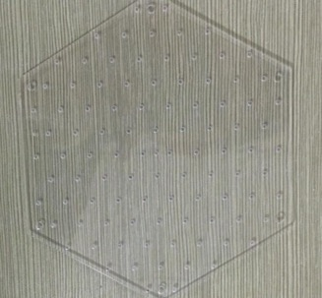
Scintillator Tile
Casting with special mold
>200 tiles received from Kedi Company
The geometry size of scintillator tiles are fine
Need to check the light yield (plan to measure light yield in UVa)

Slide 15
Measurement Results Of Sampling
Provided By THU
Scintillator Tile
Diameter Of holes
12 | 24 | 25 | 35 | 36 | 37 | 38 | 45 | 48 | 49 | 52
2.312 | 2.35 | 2.275 | 2.383 | 2.326 | 2.272 | 2.256 | 2.403 | 2.232 | 2.254 | 2.387
1.364 | 1.428 | 1.339 | 1.372 | 1.377 | 1.313 | 1.362 | 1.339 | 1.378 | 1.338 | 1.374
56 | 61 | 62 | 65 | 76 | 88 | 89 | 99 | 102 | 111 | 112
2.39 | 2.276 | 2.34 | 2.399 | 2.368 | 2.332 | 2.289 | 2.308 | 2.321 | 2.321 | 2.361
1.374 | 1.343 | 1.389 | 1.407 | 1.404 | 1.345 | 1.343 | 1.415 | 1.361 | 1.391 | 1.39
Average value | Variance
2.325 | 0.0025
1.37 | 0.00081
Hole spacing
38-48 | 38-49 | 48-49
10.817 | 10.828 | 10.809
52-61 | 52-62 | 61-62
10.851 | 10.843 | 10.831
Average value | Variance
10.837 | 0.00022
88-89 | 88-99 | 89-99
10.843 | 10.858 | 10.834
102-111 | 102-112 | 111-112
10.843 | 10.83 | 10.861

Slide 16
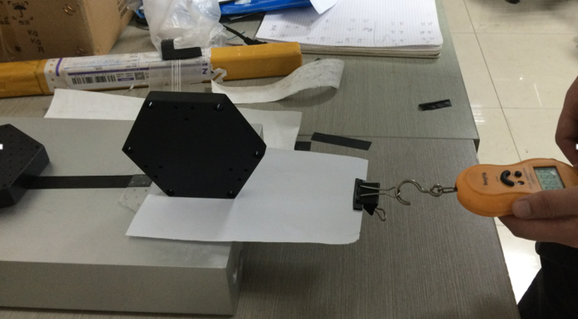
Paper Sheet
Change the friction between lead and scintillator
Increase the light collection by reflection?
Nucl. Instrum. Meth. A 584: 291-303, 2008
Choice:
  Print paper
  Tyvek
  others
SDU Machining Center produced 400 sheets
 | Reflection | Friction (lead) | Friction (scintillator)
Print paper | Worse？ | 0.3 | 0.2
Tyvek | >90% | 0.1 | 0.1

Slide 17
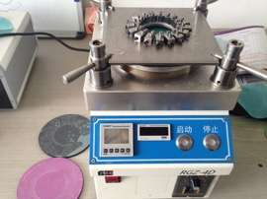
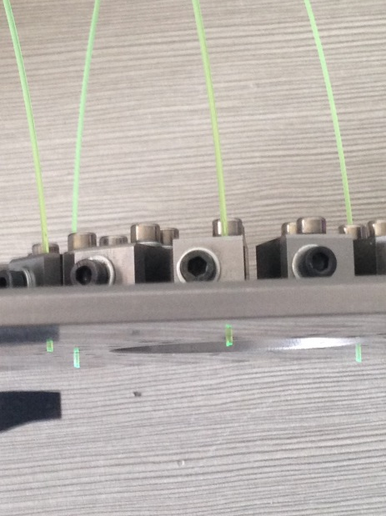

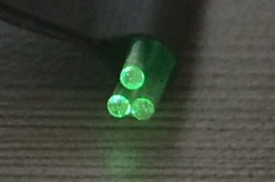
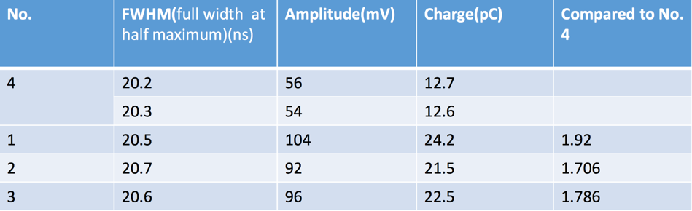
WLS Fiber
Tens of meters of Saint Gobain fiber in our lab
  Cut and polish
  Silver plated on one end to increase photon collection
  Placed an Order for 4 km more (awaiting delivery)
Investigation of Kuraray fiber
4: no plating
1,2,3: silver plating

Slide 18
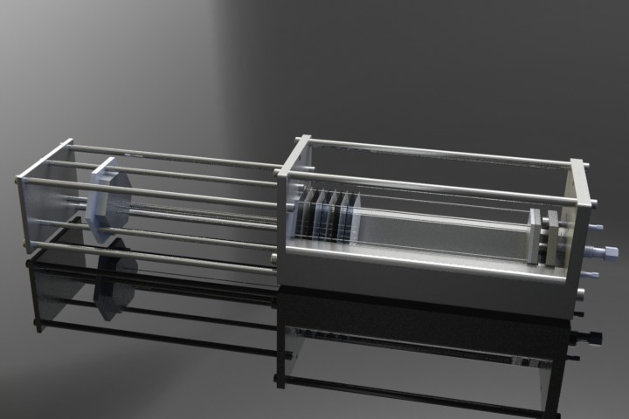
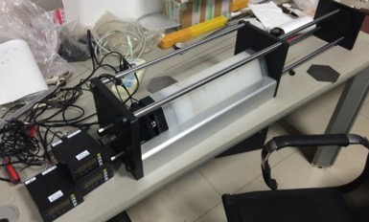
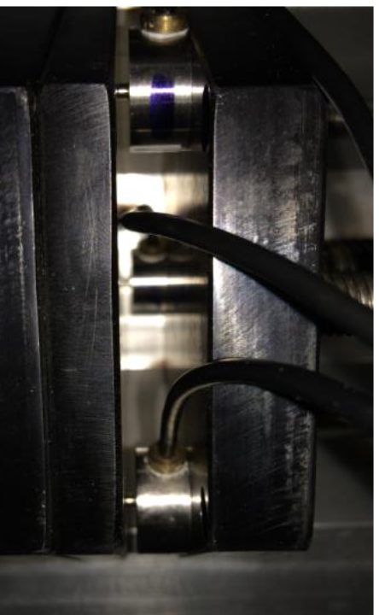
Assembly Tools
SDU Design
Real Device
Concept Design

Slide 19
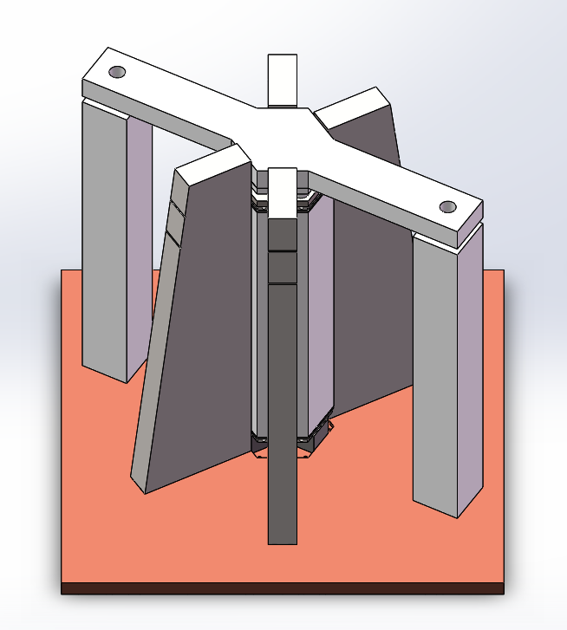
Assembly Tools
a top plate for compression
4 pillars for positioning
THU Design
2 supporting pillars
Optimized from version 1
It will be ready in a few days
Concept Design

Slide 20
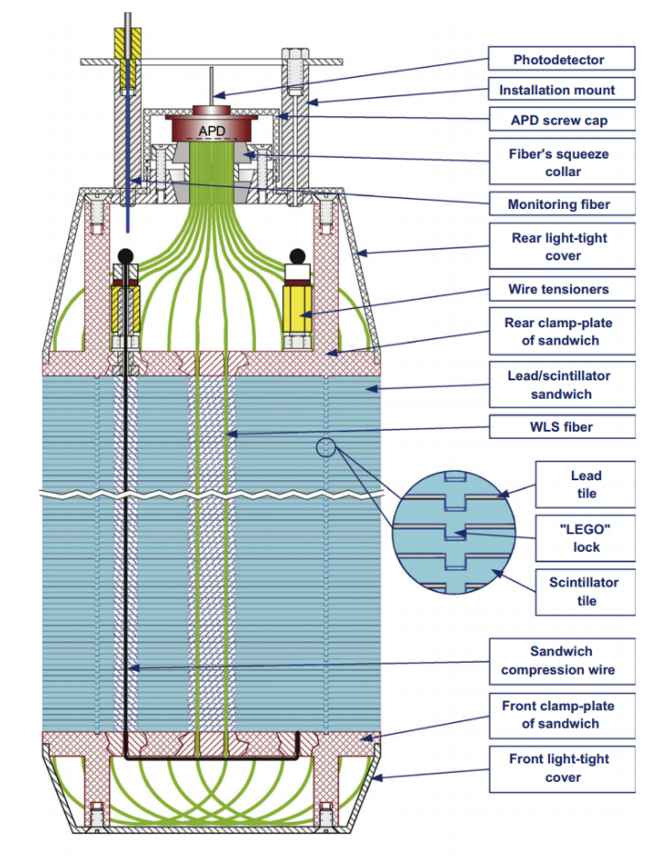
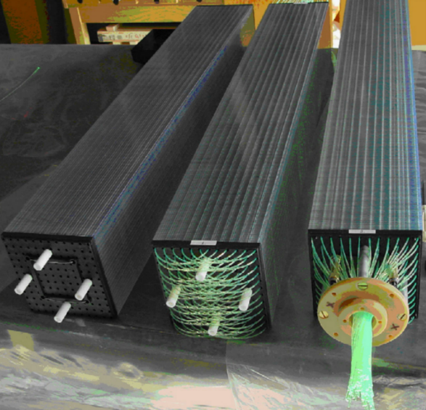
Assembly Tools
“LEGO”-type lock
These locks, four per tile, maintain the position of the scintillators and the gaps, providing sufficient room for the lead tiles without optical contacts between lead and scintillator.
This mechanical structure enables removal of the paper tiles that were in earlier modules.
Allows removal of the compressing steel tapes at the sides of the module
The module is 5cm shorter.
New Design of EC
The complete stack of all plates is held in compression by four 1-mm stainless steel wires.
We are designing a new scintillator layer which has four LEGO locks
We are also optimizing our assembly stand which has four stainless steel wires.
Nucl. Instrum. Meth .A 584: 291-303, 2008

Slide 21
First Pre-Prototype

Slide 22
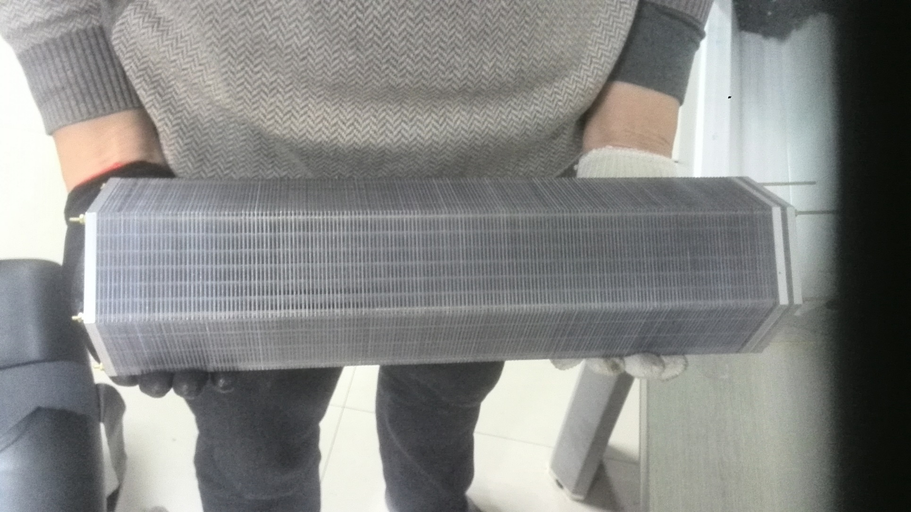
First Pre-prototype Module at SDU
The first pre-prototype module assembled by SDU assembly tools was released in several days ago (Jan. 07, 2016)

Slide 23
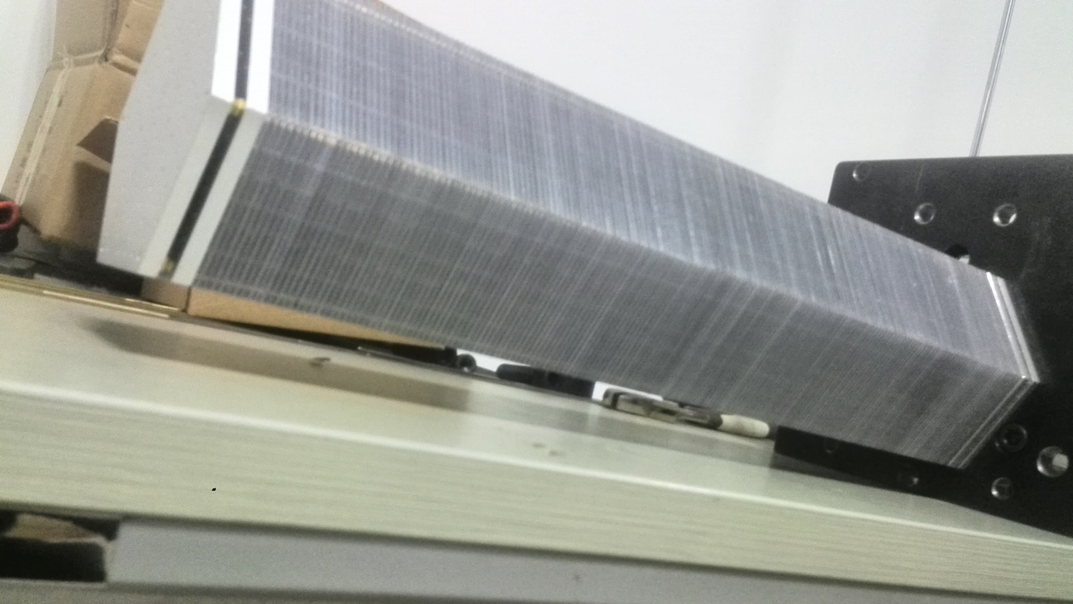
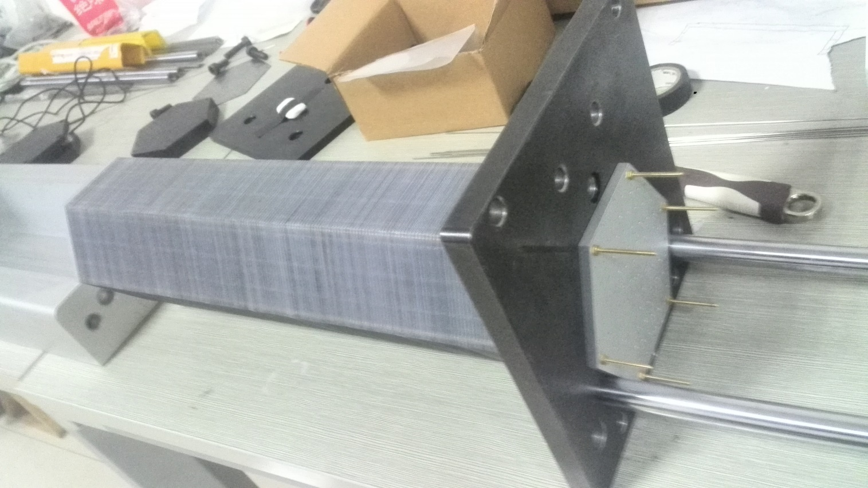
Hanging Test
The module was hung at the end side, and the nut and brass bar can stand the module weight.
However, did not test to failure and do not know what safety factor we have.

Slide 24
Outlook

Slide 25
Pre R&D Need
At least 1/2 postdoc to “develop an end‐to-end realistic simulation and reconstruction to further optimize cost and physics reach and derive clear performance requirements for the individual subdetectors.”
Shashlyk module prototyping well underway. Still need manpower for in-beam testing (but less of an issue).
Need serious engineering support on module + assembly design
  testing: partial postdoc, 1/2 grad student
Items underway and covered by UVa
  FASPD uniformity test
  LASPD timing test with GEM
  Radiation resistance test
  Continue working with ANL engineers on module & support
  Continue working with JLab detector group on PMT base design & testing
  Misc: fiber, fiber connector, … ...

Slide 26
What To Do Next ?
Determine the final design of module
  Side sheets / Rods / Steel cable?
  Use paper sheets or not, what kind of paper / Lego Lock ?
Most materials are ready (awaiting WLS fiber), more modules can be assembled soon
  Add real-time pressure and compression monitoring
  How to let fibers go through module
  Measure mechanical property of the scintillator
Cosmic test → Beam test
Resumed working with ANL/Chicago engineer on the Ecal support
Learn from other experiments
Funding application
Thank you!

