Slide 1
Beam test status update
11/17/2016
Ye Tian, SDU
Vincent Sulkosky, UVA
with in-meeting edit from Xiaochao

Slide 2
General Update
We don't have beam since last EC meeting. Beam will be delivered on Friday.
The hall changed to controlled access yesterday afternoon, which is one day early than expected. Mark wanted to move all detectors to a smaller angle yesterday, since the schedule changed, wait for next chance.
For SoLID detector, only three shashlyk modules used as trigger.(not include cosmic test)
Added all SoLID modules to scaler.
Changed a NIM crate to solve baseline not stable problem.
Need to check why the cosmic events with signal get less.

Slide 3
Summary of changes since last week:
1) THU shashlyk module HV is lowered by 200V
2) From Vince: The summing module has been moved from before FADC to after FADC, due to adding the individual shashlyk modules to the scalers. The summing modules has a x4 gain, which means the FADC signals should all be smaller by factor 4 for the shashlyk modules. For triggering, Mark did lower the threshold from -300mV to -90mV which compensate partially the gain change, and the trigger rate should be similar as before.
3) We could increase the PMT HV now if needed.

Slide 4
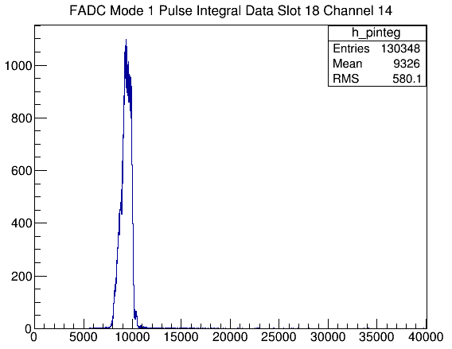
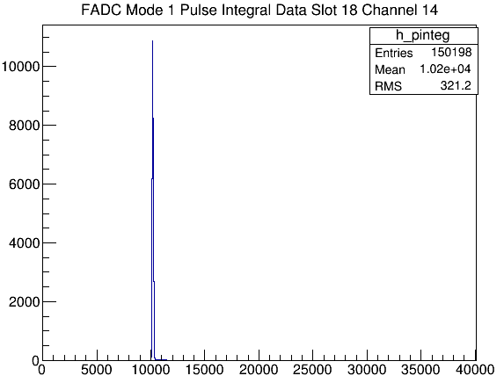
The pedestal difference after replacing to a new NIM crate (Problem solved)

Slide 5
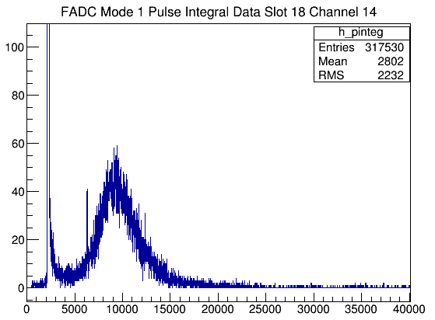
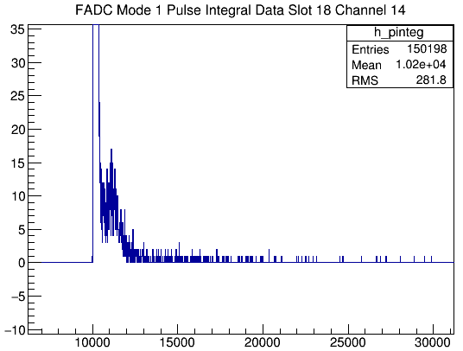
Low signal events after adding FAN-IN/OUT (problem?)
1) this is SDU#2
2) followup from Vince: The summing module has been moved from before FADC to after FADC, due to adding the individual shashlyk modules to the scalers. The summing modules has a x4 gain, which explains the smaller amplitude now. (Mark did lower the threshold from -300mV to -90mV which compensate for some of the gain change in the trigger.) We could increase the PMT HV now if needed.

Slide 6
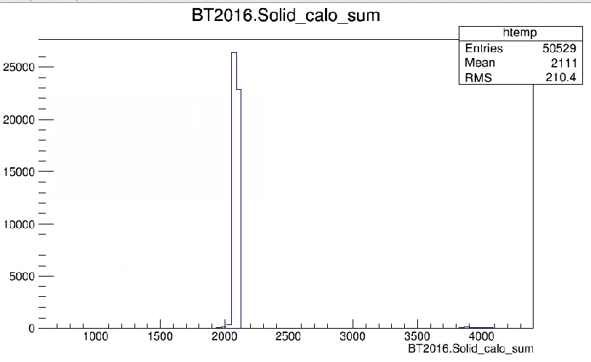
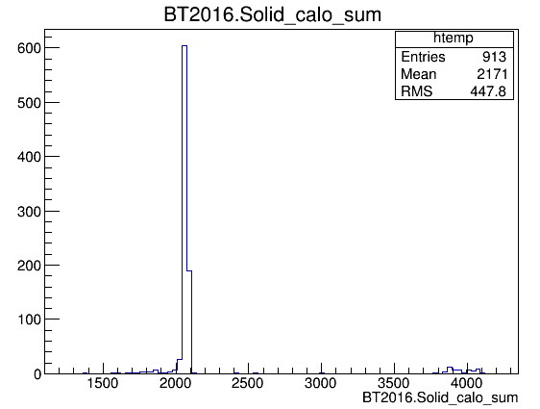
Less events show up in TDC after adding fan-in/out (problem)
Before adding fan-in/out, about 50% of events show up in TDC (shashlyk sum)
After adding, now only a very small fraction (913/150k events) shows up.
→ suspect shashlyk not in the trigger?
but THU HV lowered by 200V, perhaps that caused the problem???
TDC
SDU#2
before
(total ~100k)
TDC
SDU#2
after
(total ~150k)

Slide 7
PMT current problem
After I rewrap the preshower detector, the current of two modules get normal, but not the other one. There is still one module' current is positive 7.9 uA checked by picoammeter, comparing previous value 4.9uA(maybe positive).
Even if I use black cloth to cover everywhere, the value never changes, and I also think normal value should be negative. I can't find any unusual noise viewed by oscilloscope.
Vince told me to check it again, I don't have time yesterday and I'm not sure if it's a real problem since the previous result seems OK.

Slide 8
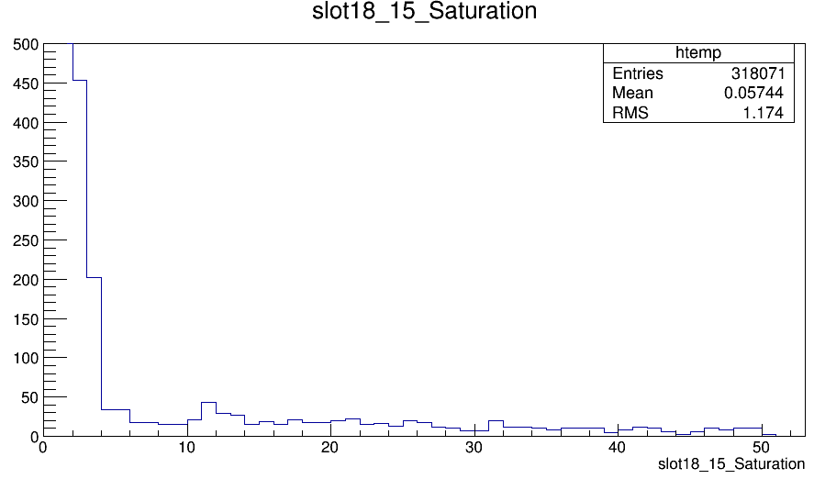
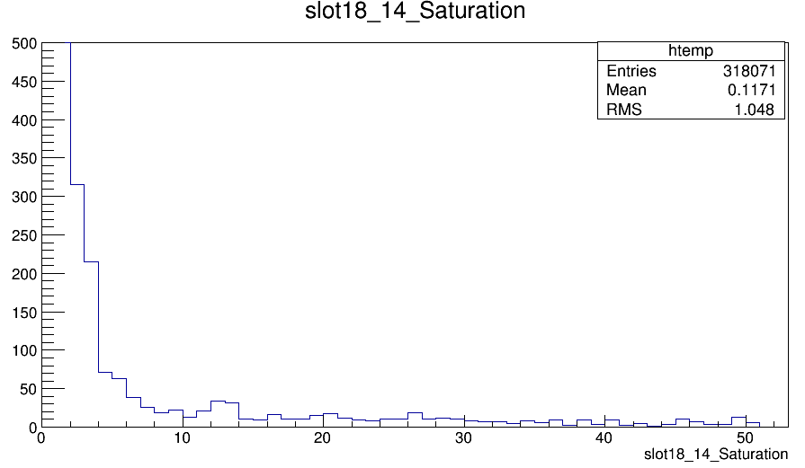
FADC Saturation points
Definition of # saturation: =0 if no signal; =1 if there is a signal but no saturation, >=2 if there are saturation point at 4096.
So what we are seeing here is the same as last week, there are many cosmic events with “flatlined” spectra. – Actually these are the same runs as reported last week.
The modules used are JLab 250, there are two, one used for SBS and one for mostly SoLID. Looks like many channels of the SoLID FADC (slot#18) have the saturation problem but none of the SBS channel (slot#17) has this problem. How can that be?

Slide 9
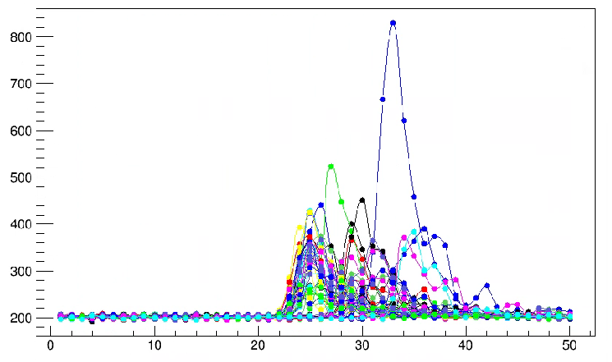
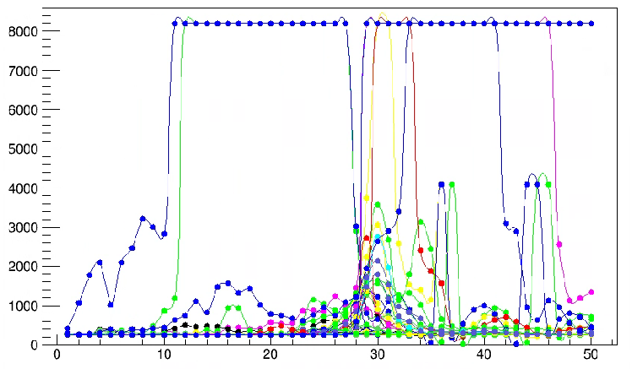
Lastest Cosmic Test Data
THU Preshower
THU Shashlyk
quick observation: Preshower looks much better, Shashlyk has less saturation, may be due to /4 gain, but still need to reduce gain or to understand overflowing.

Slide 10
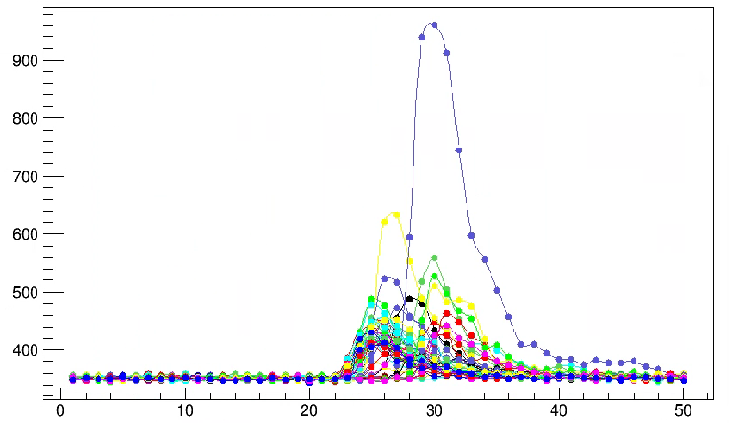
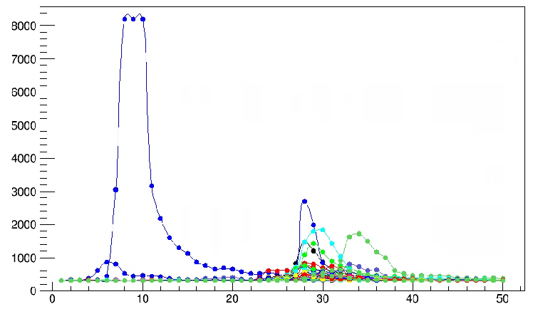
Lastest Cosmic Test Data
SDU#1 Preshower
SDU#1 Shashlyk
quick observation: Preshower looks much better, Shashlyk has less saturation, may be due to /4 gain, but still need to reduce gain or to understand overflowing.

Slide 11
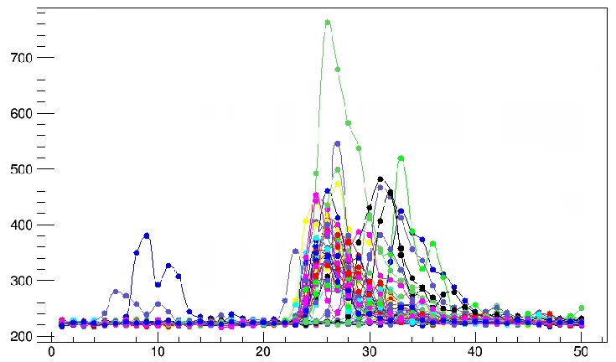
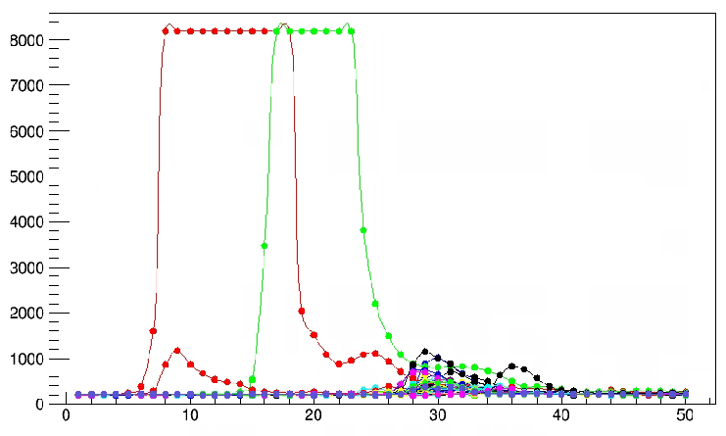
Lastest Cosmic Test Data
SDU#2 Preshower
SDU#2 Shashlyk
quick observation: Preshower looks much better, Shashlyk has less saturation, may be due to /4 gain, but still need to reduce gain or to understand overflowing.

Slide 12
Need FASPD and LASPD latest data, but the trigger for cosmic is the OR of the scintillators and the calorimeters, so not sure if there can even be signals in the SPDs.

Slide 13
To do for preparing the new beam test:
1) Determine HV for all detectors, especially the preshower (due to fixing the light leak) and the shashlyk (due to adding fan in/out and moving the summing module);
2) Check FADCs quickly for all channels to make sure the saturation/overflowing is gone. If not, lower the HV. If that does not improve the spectra, need to understand the problem urgently;
3) Check trigger rates. The three preshowers and the three shashlyk modules should show similar rates under beam conditions (except for the difference due to positioning).

