Slide 1
Beam test status update
12/01/2016
Ye Tian, SDU
Vincent Sulkosky, UVA

Slide 2
Status:
New beam data after added preshower and shashlik to Fan-in/out, use higher HV to make up the low signal without 4× amplifier.
Beam got back since last Wednesday, now the beam energy is 10.6GeV, and current is 20uA.
The beam is only delivered to HallA or HallD, because of the problem on separator. The beam will be delivered to HallD before Christmas Day for a few days, and if the problem isn’t be solved then, I’m afraid HallA will not get beam.

Slide 3
High voltage changing
Detector | Previous HV (V) | New HV (V)
EJEN SPD | 1675 | 2000
THU | 2000 | 2500
THU preshower(NCS5) | 1800 | 2150
SDU #1 | 1177 | 1294
SDU #1 preshower(NCS6) | 1500 | 1700
SDU #2 | 1200 | 1453
SDU #2 preshower(KEDI6) | 1650 | 1850
After using Fan-in/out and new SUM module, even if the HV get higher, the saturation events get obviously less, only the signal out of range. Maybe there is something problem with previous SUM module(why is their signal normal?).

Slide 4
Scaler rate after raising HV (high rate)
Type Counts Rate (Hz) Rate (KHz)
10 KHz pulser 0 nan nan
Front Top scint 10856131 inf inf
Front Mid scint 10198193 inf inf
Front Bot scint 17558670 inf inf
OR of Front scint 37933068 inf inf
Calorimeter Trigger 1654405 inf inf
L1A 14398 inf inf
TDC Common Stop 12105 inf inf
TI Busy 14398 inf inf
Trigger 87293 inf inf
S4 609915 inf inf
S5 4266891 inf inf
Solid calo 1653684 inf inf
Calo row 1 0 nan nan
Calo row 2 0 nan nan
calo row 3 0 nan nan
//////////////////////////////////////////////
EJEN spd 26405463 inf inf
SDU mod 1 shower 1880340 inf inf
NCS6 preshower 6206741 inf inf
SDU mod 2 shower 4033845 inf inf
KEDI6 preshower 3919748 inf inf
THU mod 1 shower 11377015 inf inf
NCS5 preshower 6978330 inf inf
hac_bcm_average 18.8152
The threshold for SoLID single detector is -70mV, but for trigger is -300mV.
The 10k pulser doesn’t work now, even repalce a new battery last night, need to replace pulser.
Counting time is about 60 seconds.
There is problem with TDC common stop, which should be the same value as TI busy.
Now the HV of EJEN SPD is raised from 1850 to 2000, and rate increased to 50M/60s.

Slide 5
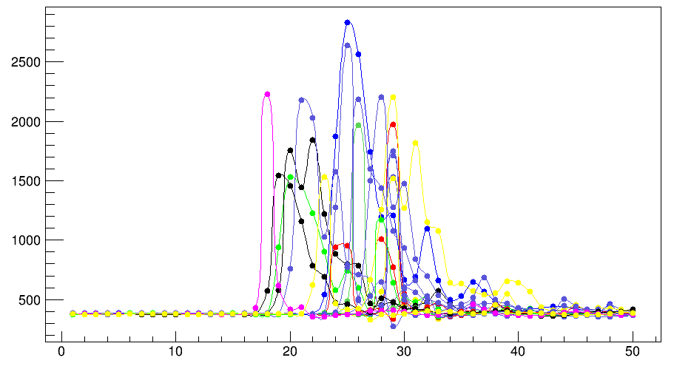
THU module
Single trigger test
Only use one shashlik module as trigger, turn off other calorimeter’s HV.
Pedestal is about 19000
Counting rate 300* 2(prescale)

Slide 6
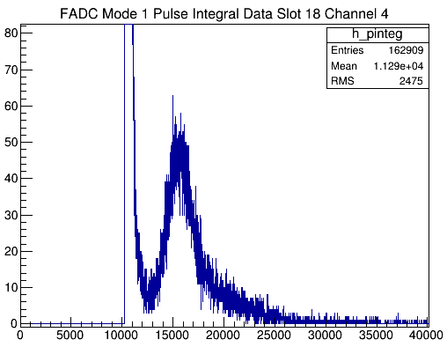
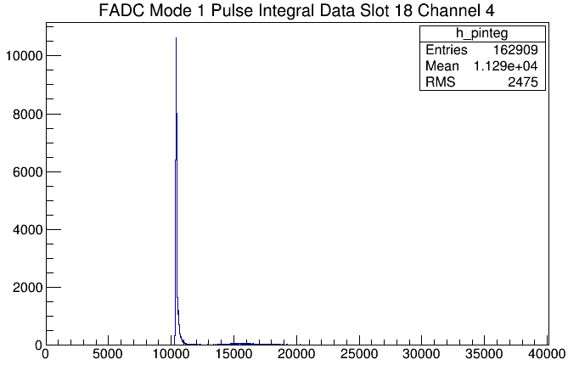
Preshower in front of THU

Slide 7
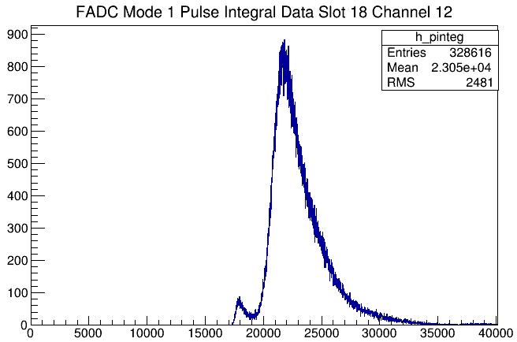
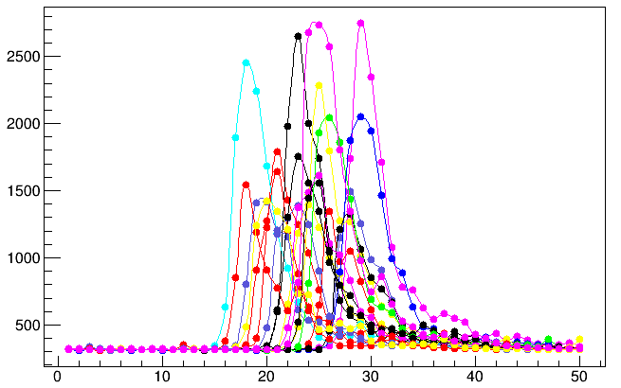
SDU #1
Pedestal 15800
Counting rate 50* 2(prescale)

Slide 8
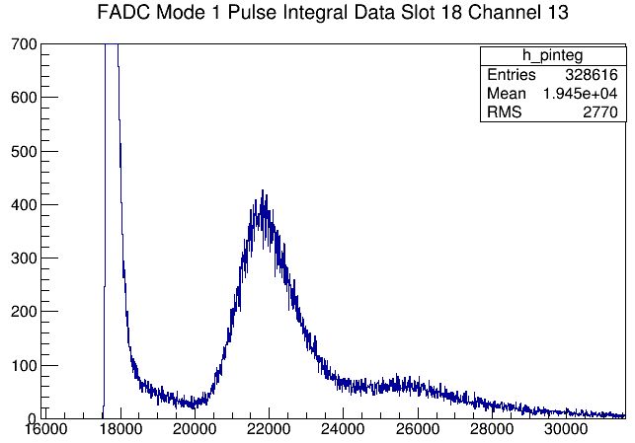
Preshower in front of SDU #1

Slide 9
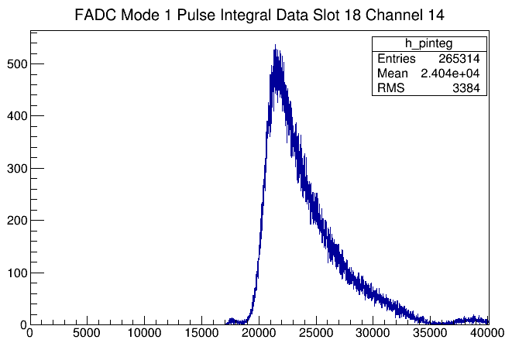
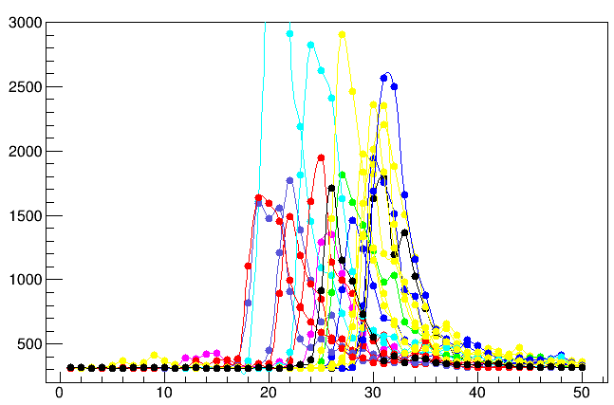
SDU #2
Pedestal 15800
Counting rate 170* 2(prescale)

Slide 10
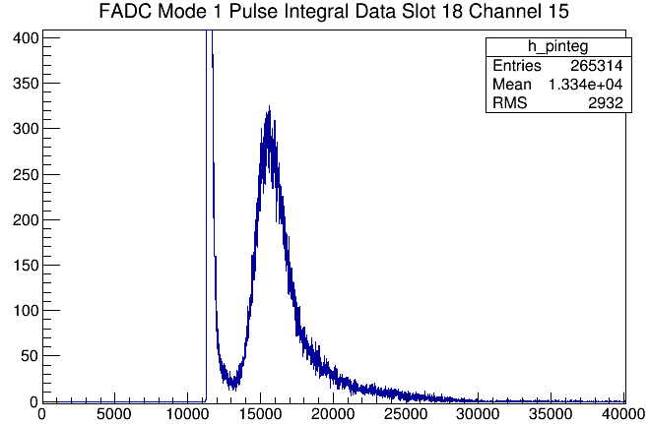
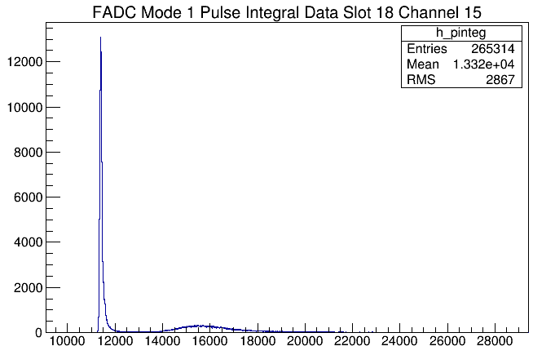
Preshower in front of SDU #2

Slide 11
Only SDU #2 and S2(front middle paddle) HV on (no difference in time distribution)

Slide 12
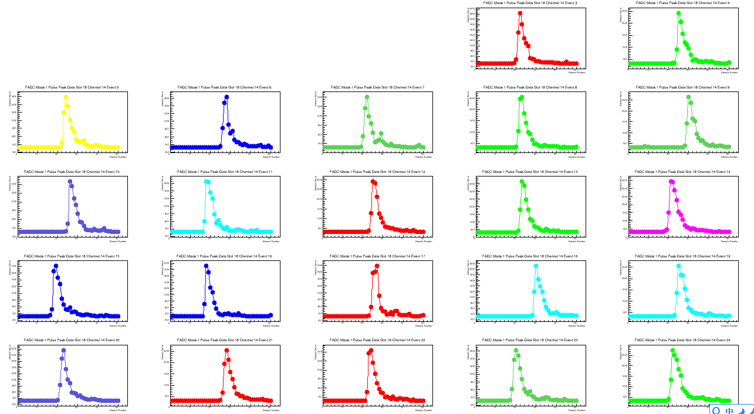
Single spectrum

Slide 13
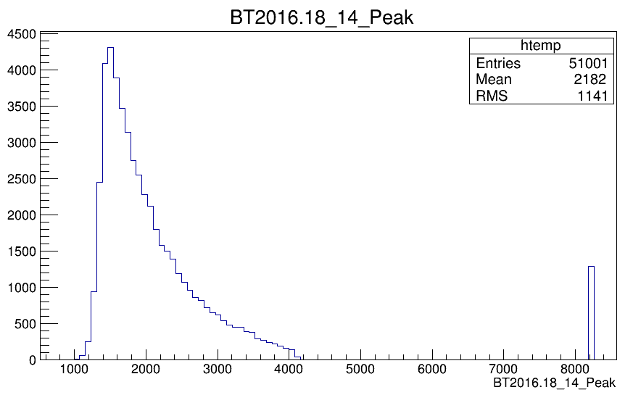
Peak information(only SDU #2 and S2 HV on)
Peak time
Peak ADC bin

Slide 14
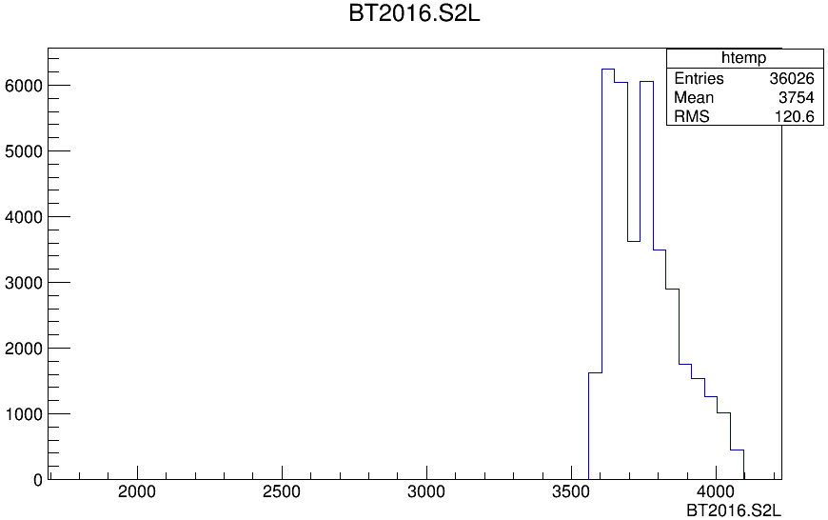
S2 time information
Considering the problem of TDC stop, which only miss less than 5% events in this run, there is still other time data missed.
Same problem use other trigger.

Slide 15
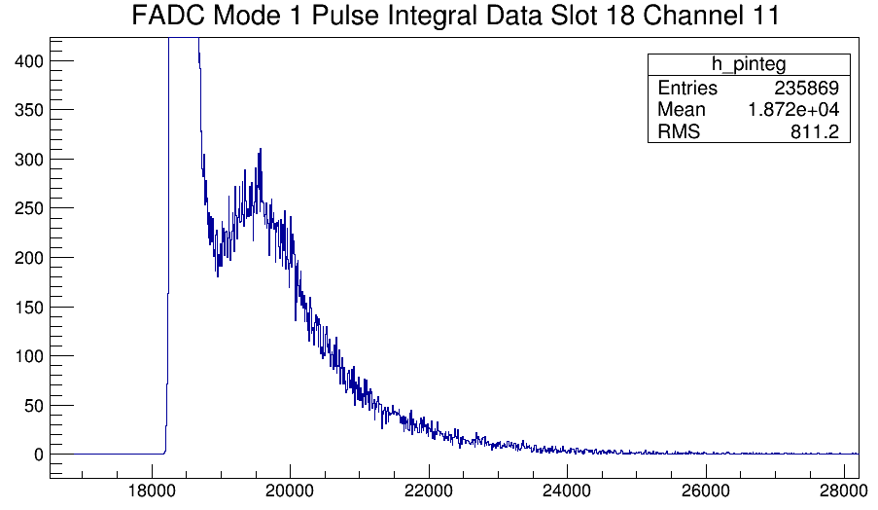
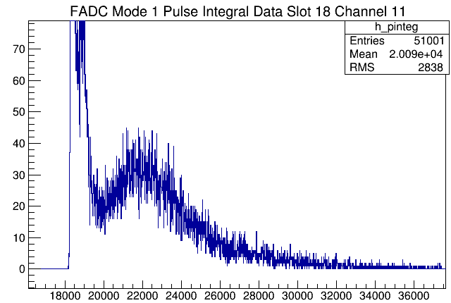
EJEN SPD HV(restricted by noise)
HV 1850V
HV 2000V

Slide 16
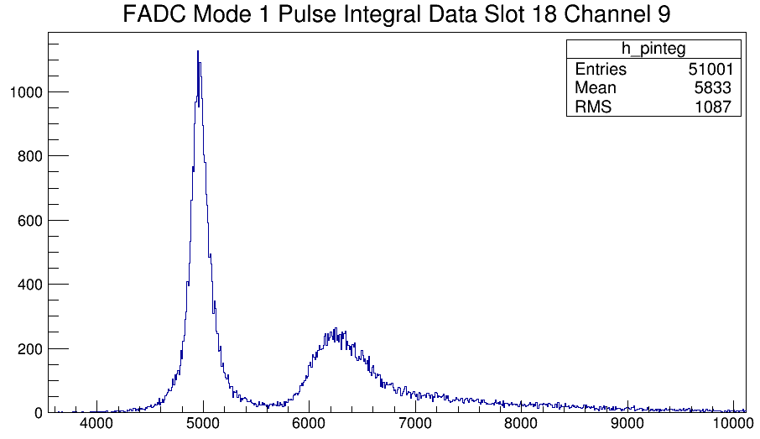
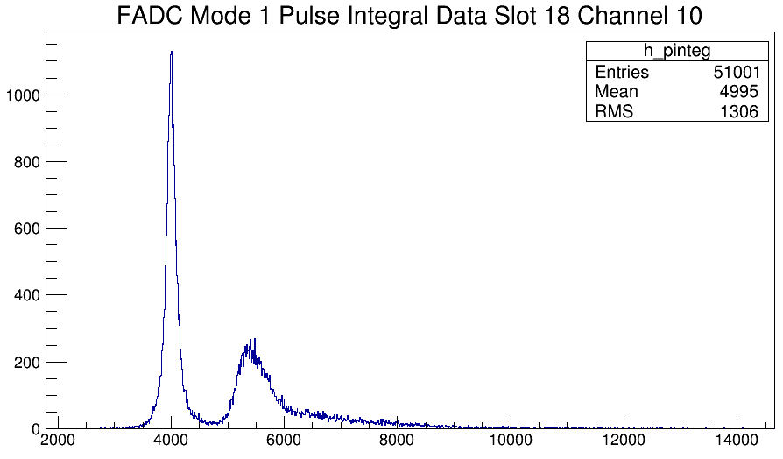
Large angle SPD

Slide 17
Problems need to solve
Missed TDC events
THU module PMT high noise
High noise rate for other detector
Replace a new pulser
To Do List
Make sure the configuration, and start to take useful data for analysis.

Slide 18
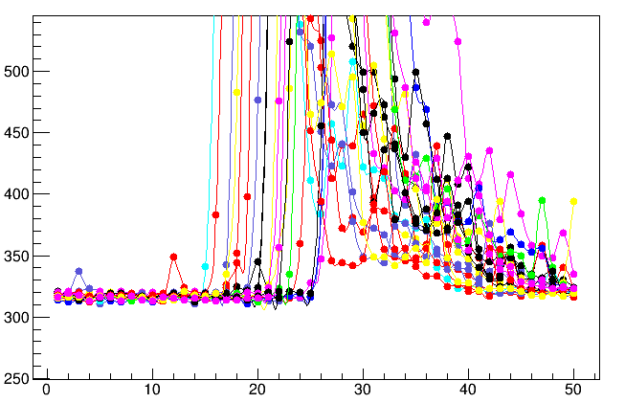
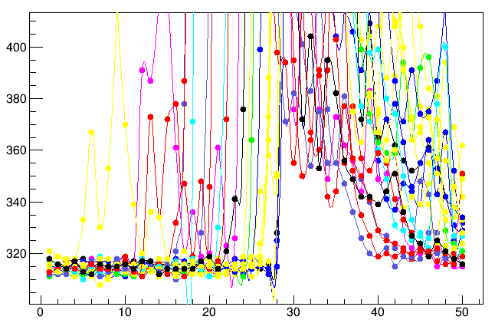
No pedestal point between 30 and 40? Triggered around time?
SDU #1
The peak of SBS calorimeter is around point 40.
Preshower SDU #2
SDU #2

