Slide 1
Beam test status update
12/08/2016
Ye Tian, SDU
Vincent Sulkosky, UVA

Slide 2
General test status update:
Router crashed on last Sunday, we replace it with a new router, but after solving that, the data taking computer can’t connect to internet which maybe something wrong with MAC address, and we don’t have enough time to deal with it. We will try to solve it next Monday when the access is available.
Could run tracking analysis script that got from Danning, and I’m still working with Danning’ help to understand and make sure the output.
Radiation damage….. Try to make sure

Slide 3
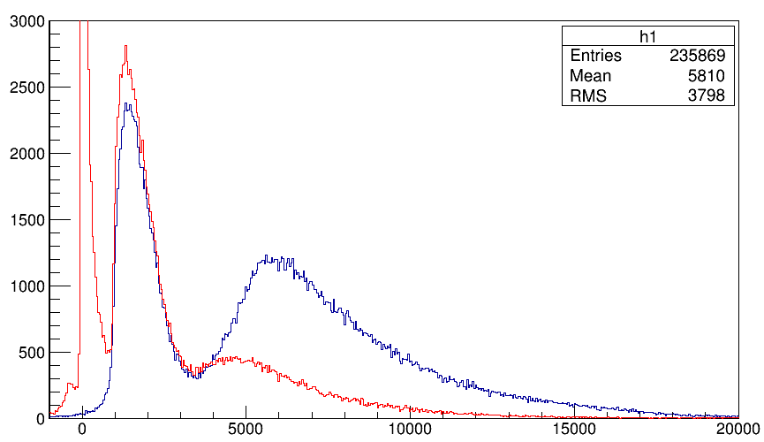
THU module Integral signal distribution (run 387, only three shashlik in trigger)
Red: THU module Integral signal distribution
Blue: Sum of three shashlik module

Slide 4
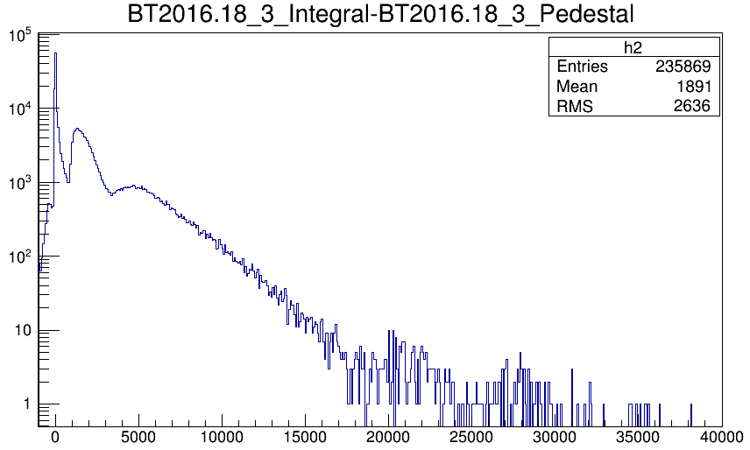
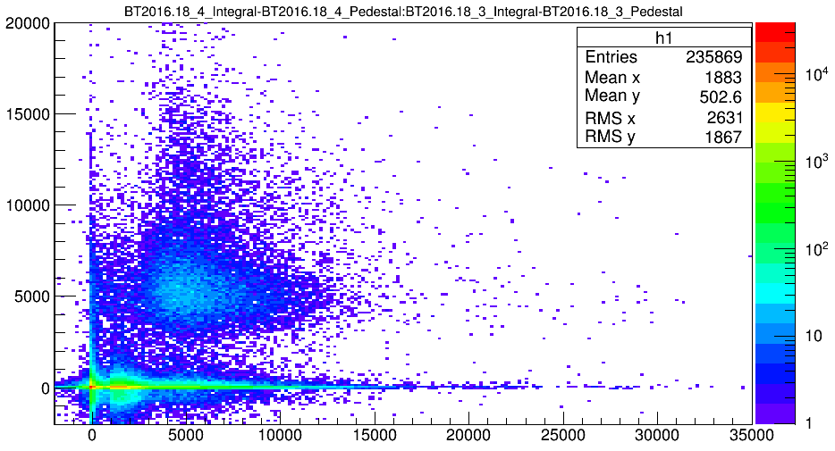
THU module
For 2D distribution, x axis shashlik signal, y axis is preshower signal
The first peak should be noise, but it’s OK to separate noise.

Slide 5
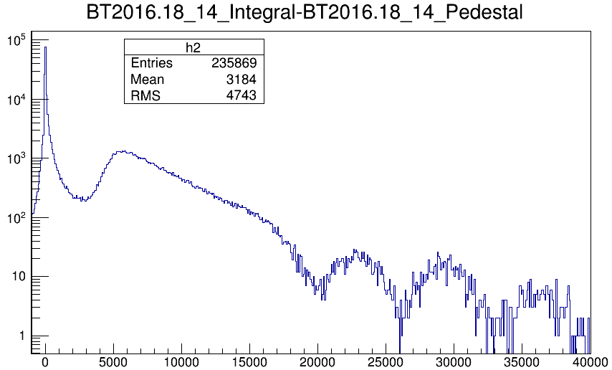
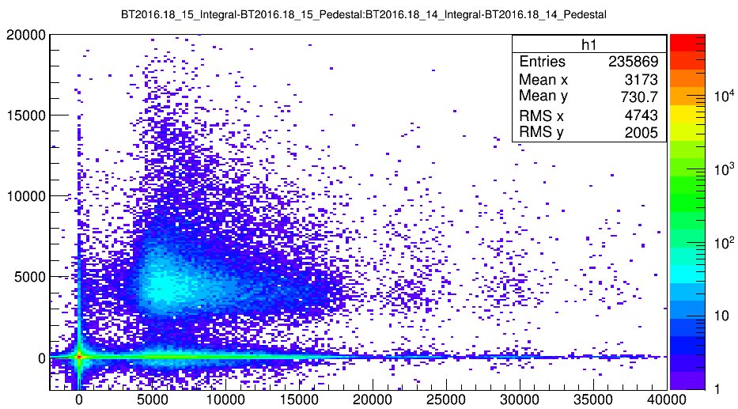
SDU #2
Apparently Peak in large signal area

Slide 6
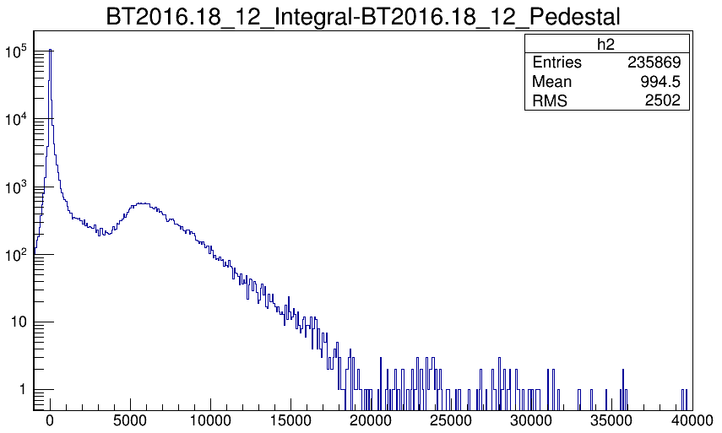
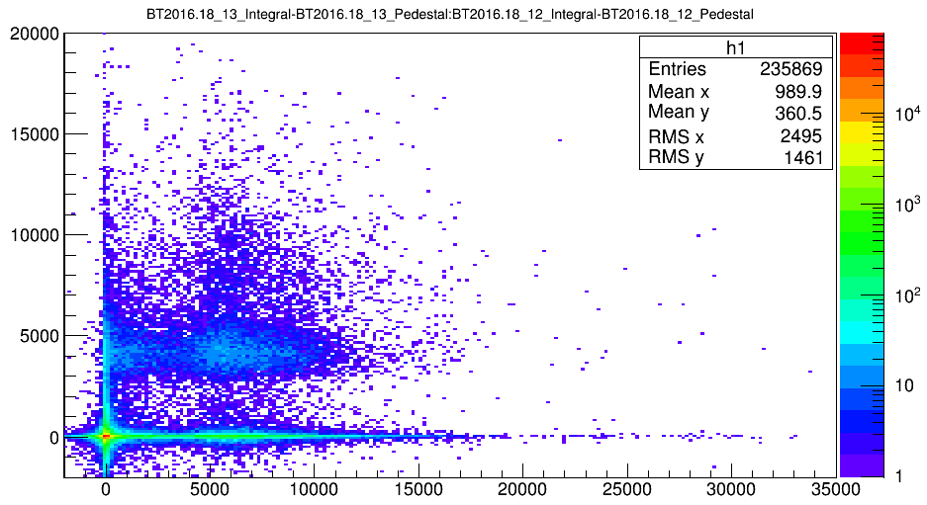
SDU #1
The peak signal magnitude of SDU #1 is similar compared with SDU #2, and the two PMT use same gain 5*10^6. But actually, with cosmic test result, SDU #2 should 80%（I forgot test value） better than SDU #1.

Slide 7
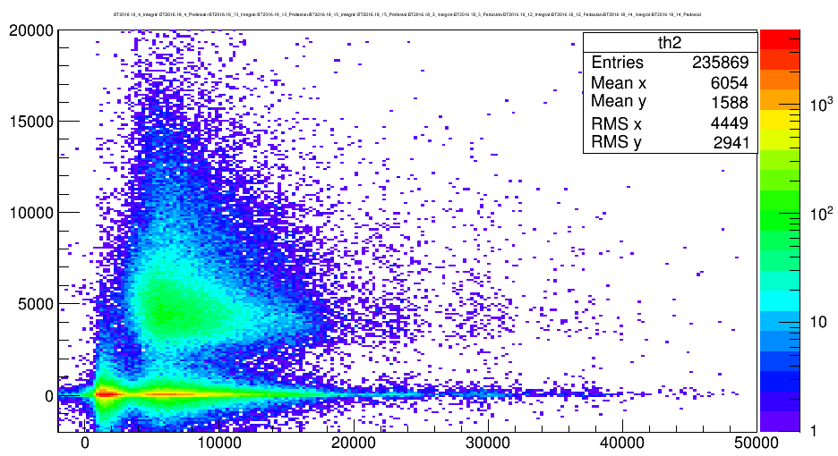
Sum of three preshower(Y) vs. Sum of shashlik(X)
Why dose preshower have no signal for most events?
Need tracking to make sure if the particle hit preshower and which preshower.

Slide 8
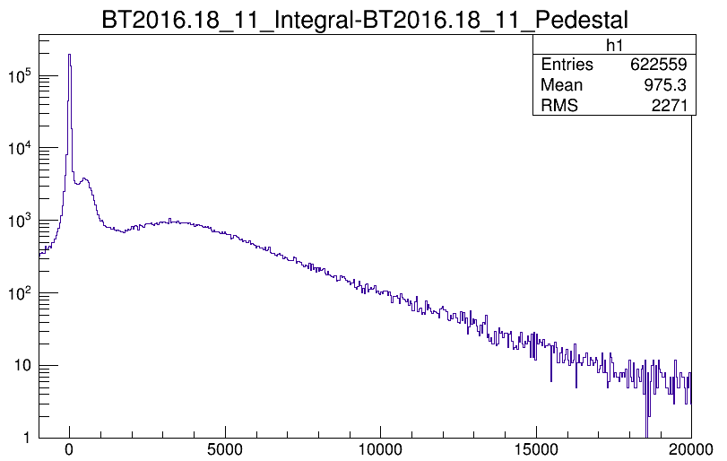
Considering SPD (run 411, SPD HV raised)

Slide 9
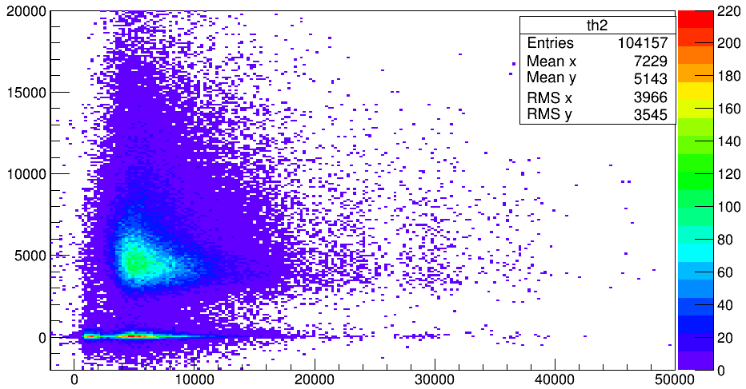
Integral of SPD >2000

Slide 10
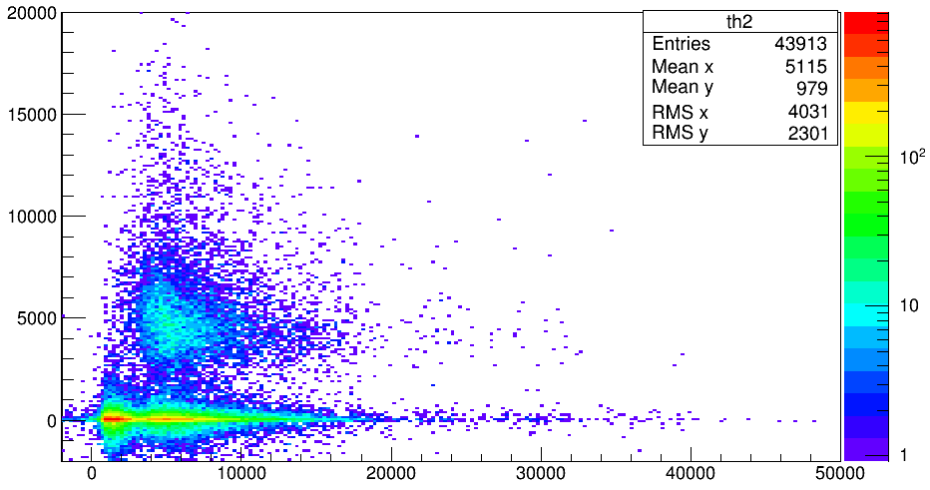
SPD>300&SPD<1000

Slide 11
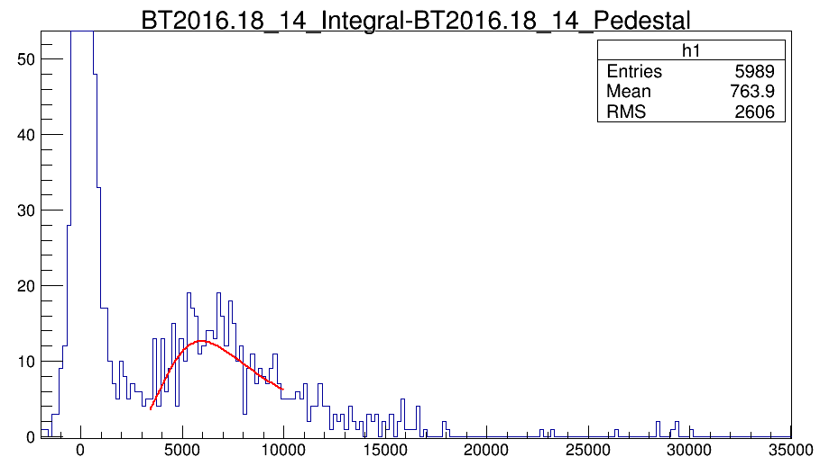
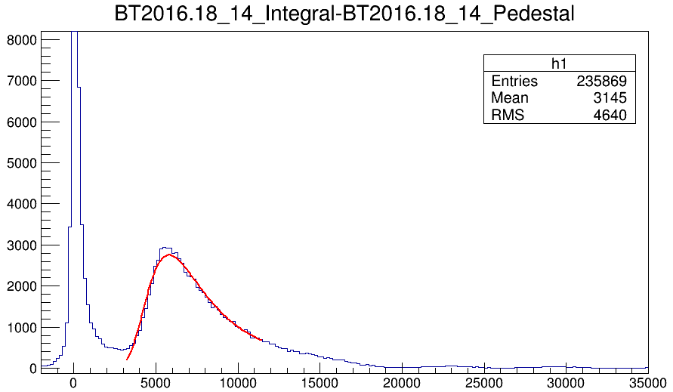
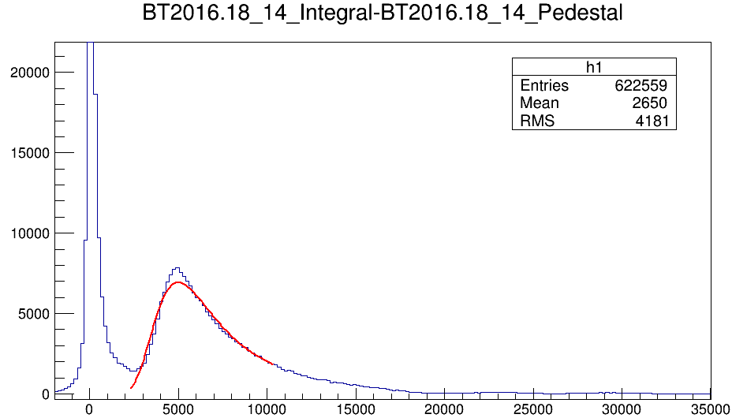
Radiation damage
11/27 11/30 12/02
Peak:6269
Peak:6060
Peak:5250

Slide 12
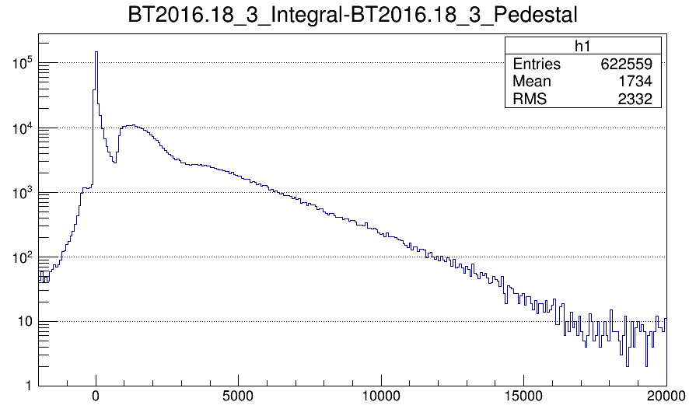
THU module

