Slide 1
Beam test status update
12/15/2016
Ye Tian, SDU
Vincent Sulkosky, UVA

Slide 2
General test status update
Network works now, continue take date
Threshold set to -150 mV, decreased from -300 mV
Beam energy 4 pass( about 8.6GeV), current 10uA.
Hall D has beam priority

Slide 3
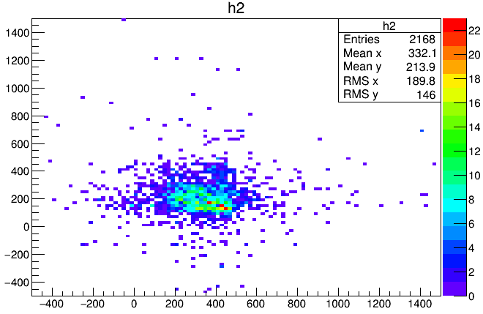
Tracking information(hit position on preshower plane, result not precise)
Using Danning’s script, tracking is not good, most events have no tracking or several trackings.
Supposing the distance between calorimeter and GEM is 35 centimeter.

Slide 4
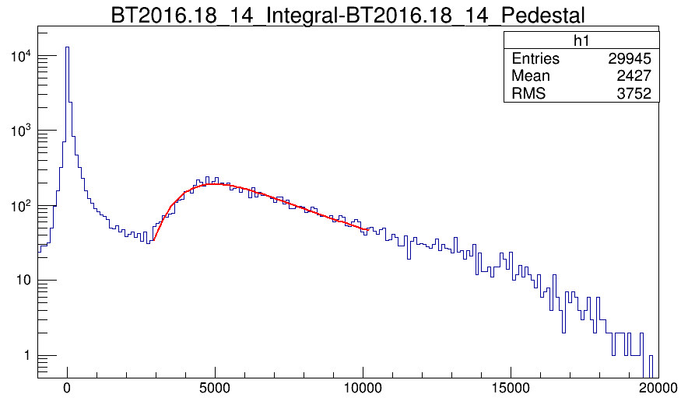
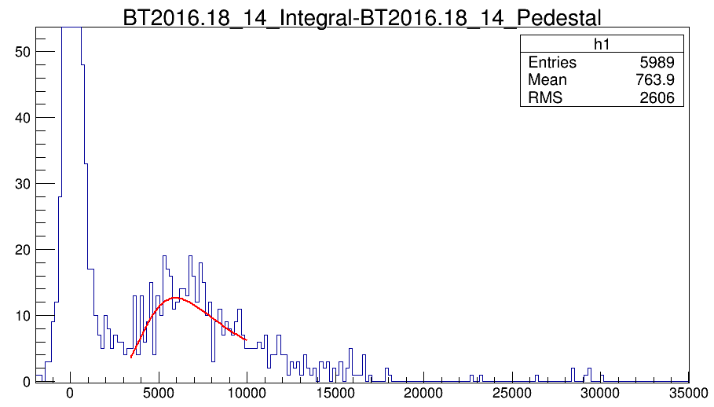
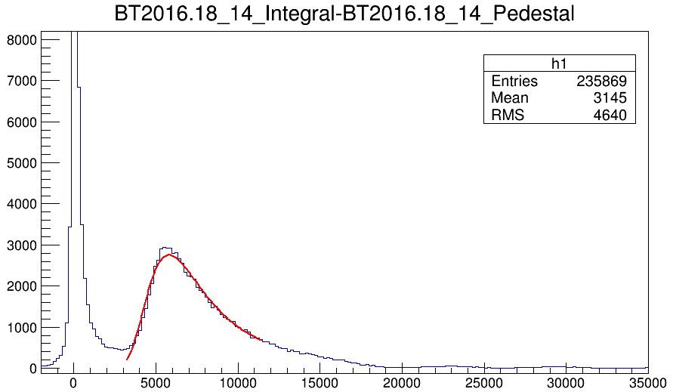
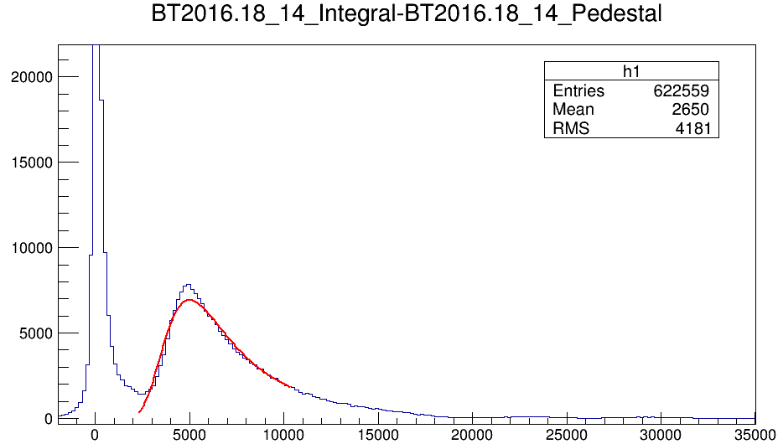
Radiation damage
Last run with threshold -300mV
Date:12/03
Peak: 5207
Still need to check the reason of changing.
11/27 11/30 12/02
Peak:6269
Peak:6060
Peak:5250

Slide 5
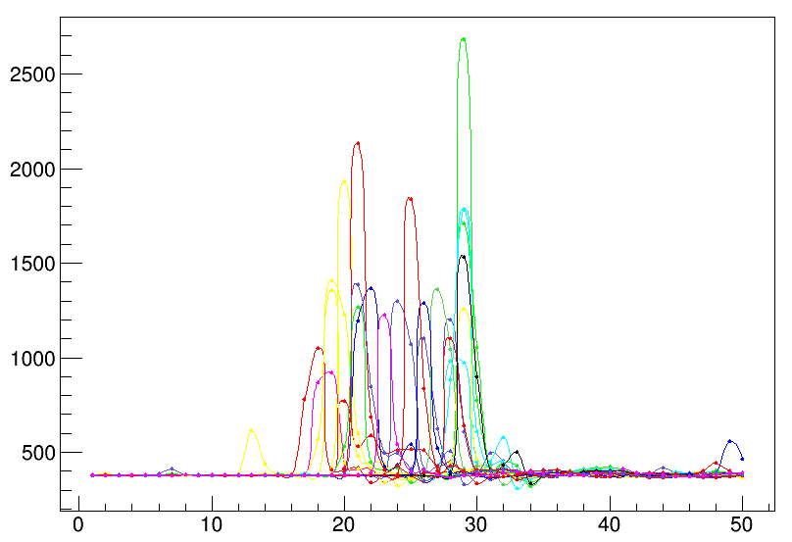
THU module FADC spectrum(first peak, signal cut: 1000-3000)

Slide 6
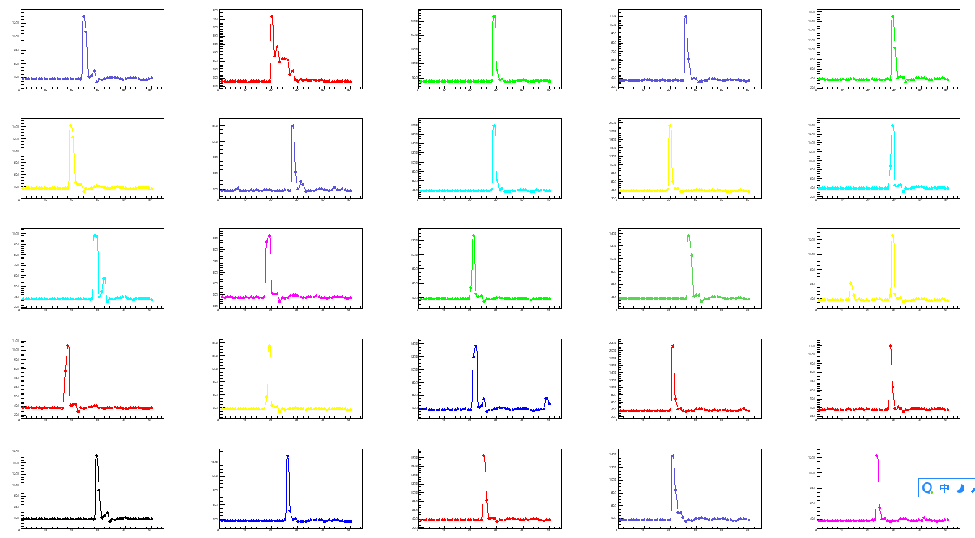

Slide 7
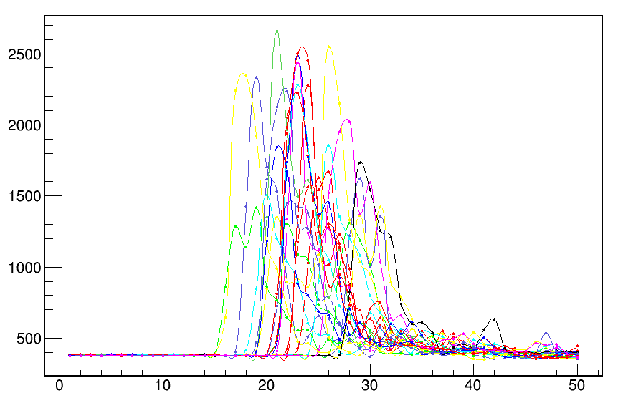
THU module FADC spectrum(second peak, signal cut: above 4000)

Slide 8
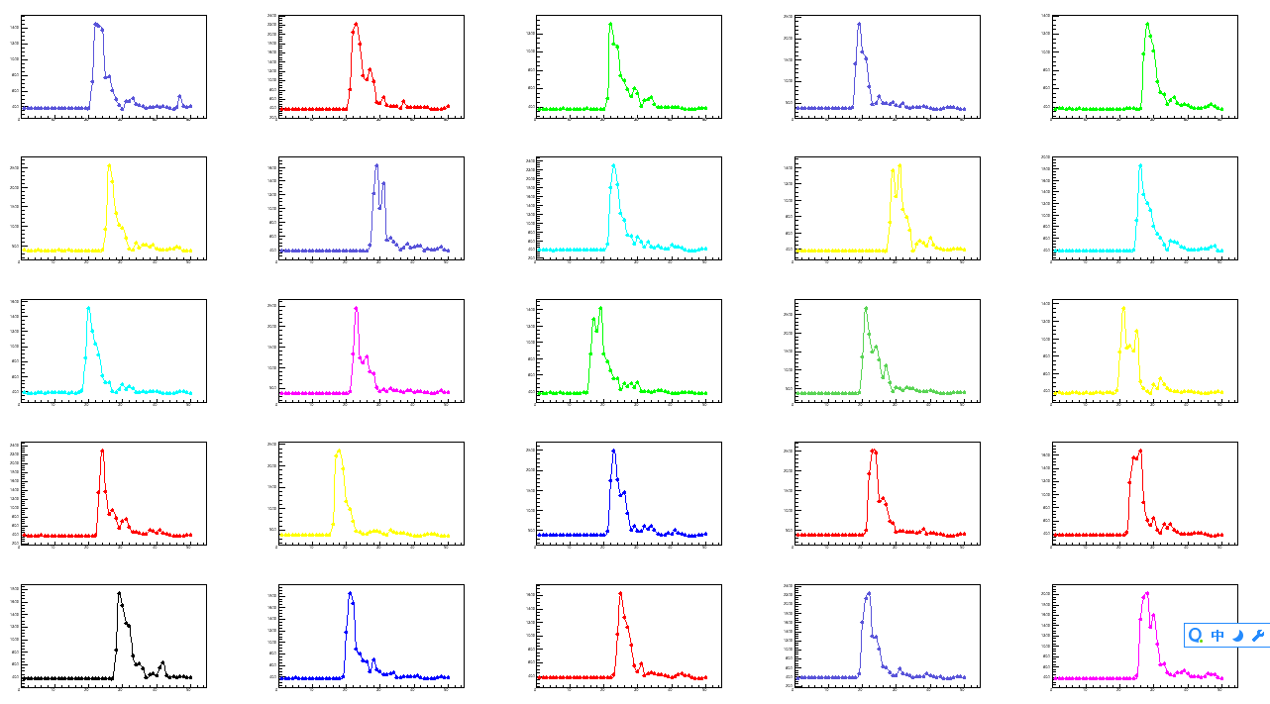

Slide 9
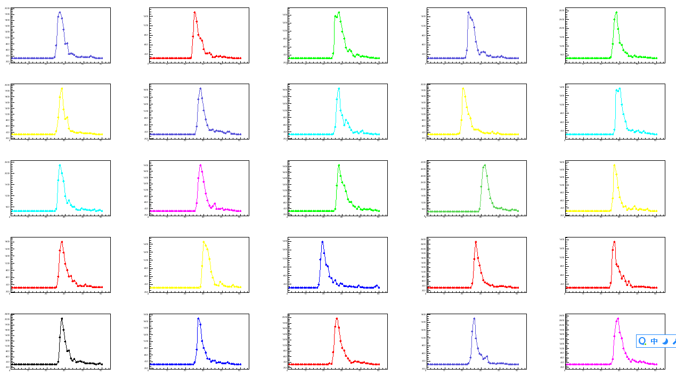
Compared to SDU #2 signal>3000

Slide 10
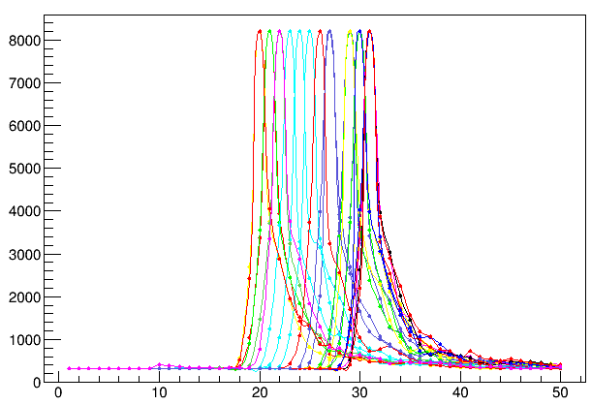
SDU #2 saturation peak(22000-24000)(one saturation point)

Slide 11
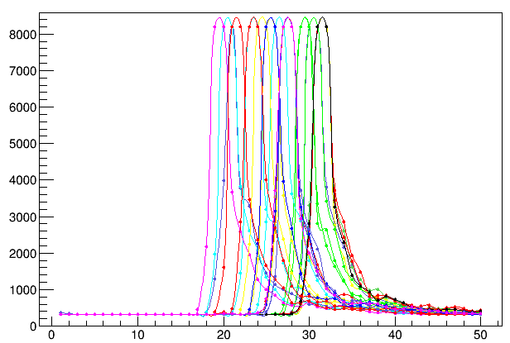
SDU #2 saturation peak(26000-31000)(two points)

Slide 12
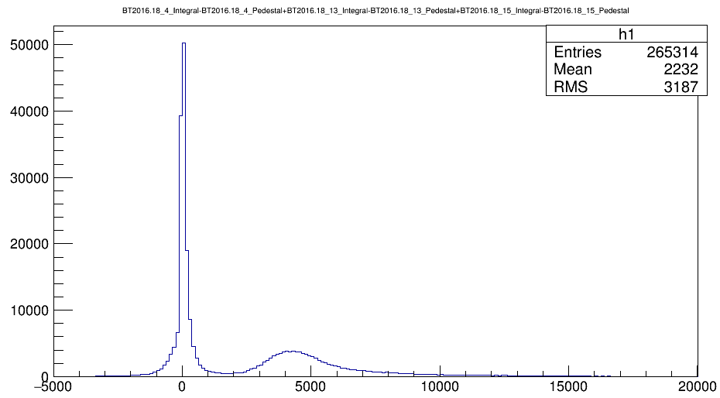
When only SDU#2 in trigger, SUM of three preshower(notice:not same run showed above)

Slide 13
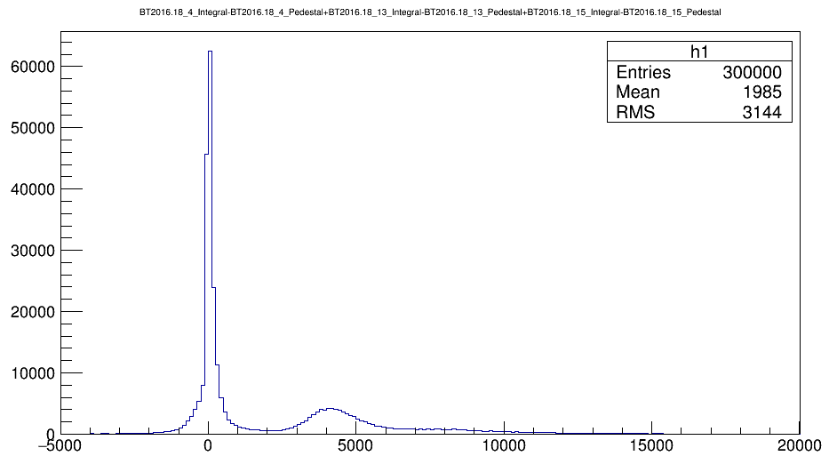
When only SDU#1 in trigger, SUM of three preshower

Slide 14
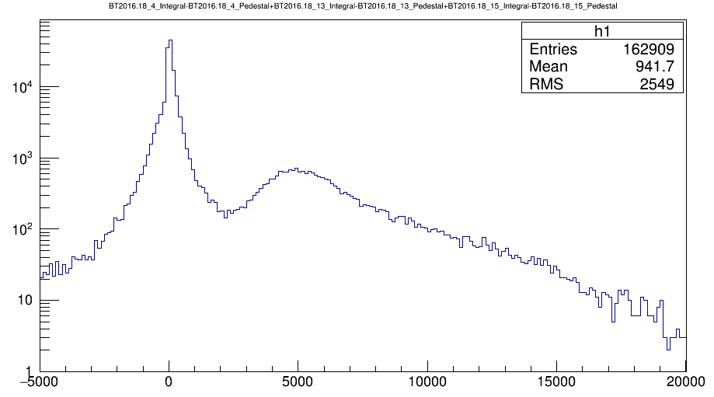
When only THU module in trigger, SUM of three preshower

