Slide 1
Situation from current simulationWhat to do to improve results
Radiation On the Calorimeter preliminary study
Outline
Situation from current simulation
2 What to do to improve
results
Lorenzo Zana
The University of Edinburgh
January 26, 2017
1

Slide 2
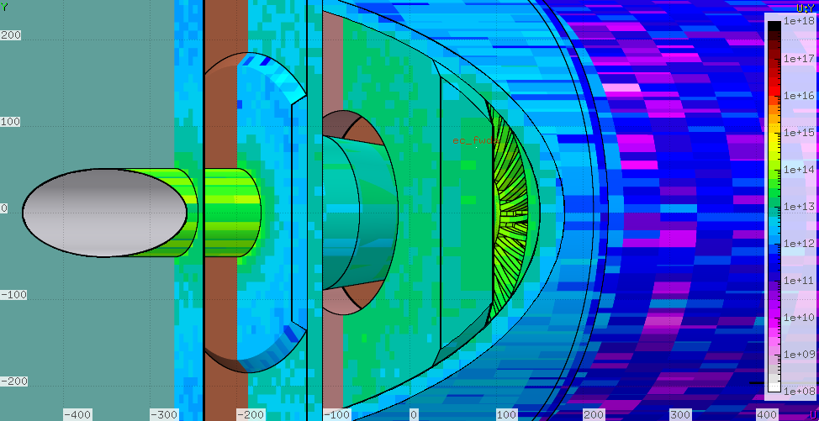
Situation from current simulation
Situation from current simulationWhat to do to improve results
. 1MeVeq Neutron .
cm²
PVDIS configuarion with Deuterium: Dose for 2000h at 100µA

Slide 3
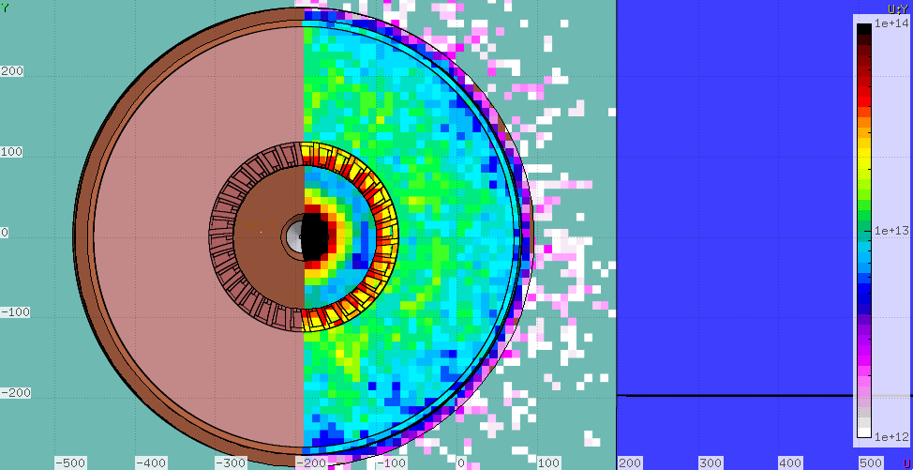
Situation from current simulation
Situation from current simulationWhat to do to improve results
^{. 1MeVeq Neutron .} Particular on flux on calorimeter
cm²
PVDIS configuarion with Deuterium: Dose for 2000h at 100µA

Slide 4
What to do to improve results
Situation from current simulationWhat to do to improve results
This simulation was done to map the radiation inside the Hall
Binning was too big (fluxes are averaged inside the bin) No phi simmetry (will speed up the result)
I did not care about the structure of the calorimeter, because I needed just to have the right amount on material in place.
All this one could improve with a dedicated simulation for this area of the EC

