Slide 1
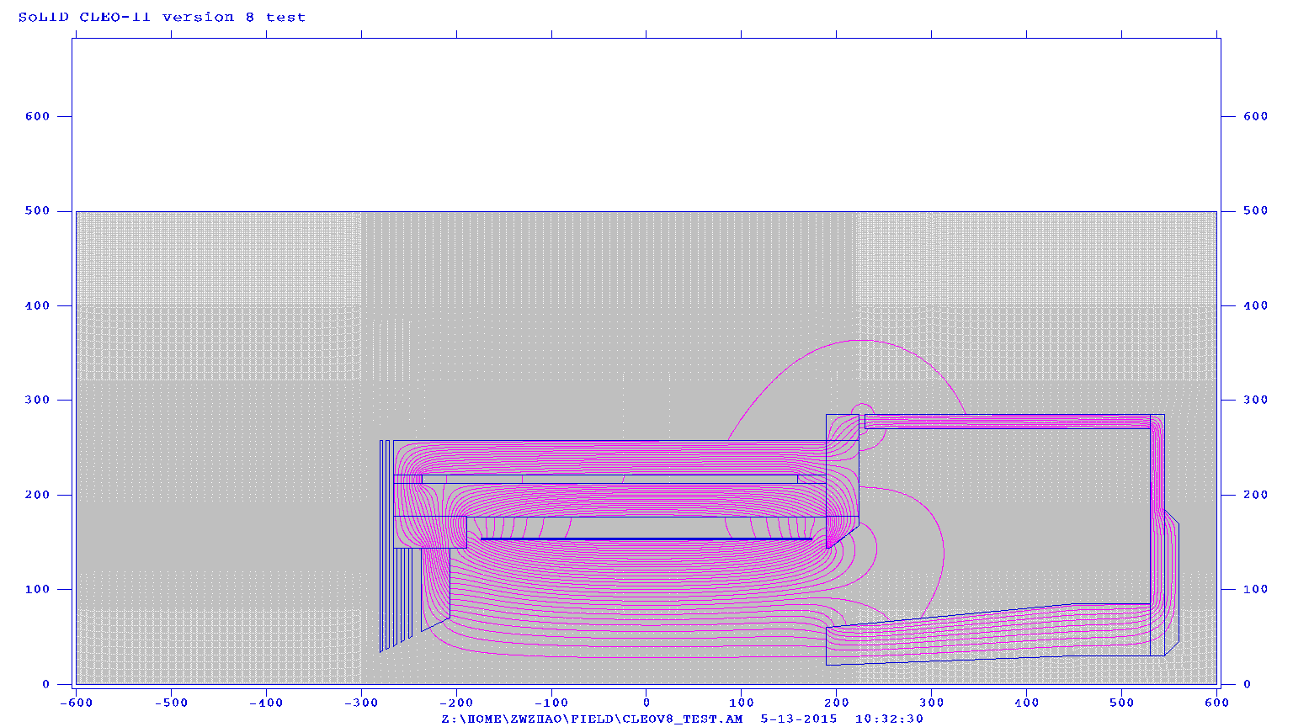
Proposed New Layout and Magnet
enlarge endcap space in Z by 35cm=(520-485)
increase endcap nose size in R from 60 to 70cm and from 90 to 95cm
(350+195)*tan(14.8/180*3.1416)=144
The picture is NOT
accurate,
Read the Color numbers!
Red number, detector boundary in Z
Yellow number, detector space in Z
Blue number, magnet boundary in Z
Brown number, magnet boundary in R
FASPD
225
4
270
199.4
189.4
LGC
FAEC
87
80
156
LASPD
HGC
144
113
6
LAEC
118
MRPC
SIDIS 25º
10
95
SIDIS 14.8º
PVDIS 36º
70
PVDIS 21º
33
SIDIS 2º
SIDIS 7.5º
PVDIS 3.5º
-350
-69
10
194
312
426
520
-280
-63
430
440
144cm Cryo Rin
70cm Endcap Nose tip Rout
95 cm Endcap Nose flat Rout
426cm Endcap Nose flat front Z
atan((95-70)/(426-189))/3.1416*180=6º Endcap Nose slope
(350-280)*tan(25/180*3.1416) =33cm front plug Rin
(350+440)*tan(7.5/180*3.1416) =104cm FAEC Rin(phys)
104 – 9 = 95cm FAEC Rin(eng)
(315+500)*tan(15.8/180*3.1416)=231cm FAEC SIDIS Rout(phy)
231+ 9 = 240cm FAEC SIDIS Rout(eng)
265cm FAEC PVDIS Rout
(350-63)*tan(14.8/180*3.1416) =76cm LAEC front Rin(eng)
(350-13)*tan(14.8/180*3.1416) =89cm LAEC rear Rin(eng)
3.1416*(265*265-95*95)/1e4 = 19.2 m² area FAEC PVDIS
3.1416*(240*240-95*95)/1e4 = 15.3 m² area FAEC SIDIS
3.1416*(140*140-80*80)/1e4 = 4.1 m² area LAEC SIDIS
atan(144/(195-10))/3.1416*180=35.8º PVDIS Max angle
atan(70/(189-10))/3.1416*180=21.4º PVDIS Min angle
atan(135/(350-63))/3.1416*180=25.2º SIDIS Max angle
atan(144/(350+195))/3.1416*180=14.8º SIDIS Middle angle
atan(70/(350+189))/3.1416*180=7.4º SIDIS Min angle
atan(135/(315-63))/3.1416*180=28.2º JPis Max angle
atan(144/(315+195))/3.1416*180=15.8º JPis Middle angle
atan(70/(315+189))/3.1416*180=7.9º JPis Min angle

Slide 2
Cables
 | Total area(cm2) | Location to go out | comment
FAEC (PVDIS) | 1800 | Endcap Back plate | 1800 1.1cmD fiber bundle, 1800 0.3cmD fiber bundle
LAEC (SIDIS) | 500 | near downstream collar? | 500 1.1cmD fiber bundle, 500 0.3cmD fiber bundle
LASPD | 2? | near downstream collar or solenoid front? | 60 HV, 60 BNC
LGC | 30 * 5? | Near downstream collar or endcap side? | 270 5mmD HV, 270 3mmD BNC
HGC | 30 * 10 | Endcap side | 480 HV, 480 BNC 2 gas line at top, 2 gas line at bottom
GEM (PVDIS) |  | Near downstream collar or endcap side?
GEM (SIDIS) |  | Near downstream collar or solenoid front?
MRPC |  | endcap side

Slide 3
Old slides

Slide 4
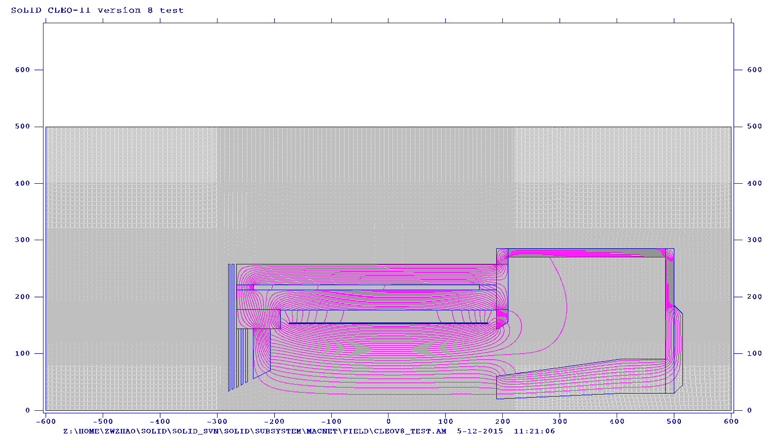
Just ideas here, but changes are clearly needed
Downstream collar enlarge by 15cm in z (needed for engineering)
Endcap enlarge 30cm (SIDIS setup needs room)
Endcap nose back reduce 5cm in r (EC hexagon module needs room)
6cm gap between downstream collar and endcap (let cable out, more cable out at back needed)
possible impact, PVDIS EC large angle performance
Need design with full 3D model and satisfy both physics and engineering requirement
needed by all subsystems to fix their design, must be a coherent effort
More realistic design now, More saving of man power, effort, cost, maybe even physics
Zhiwen's old slide
new
current

Slide 5
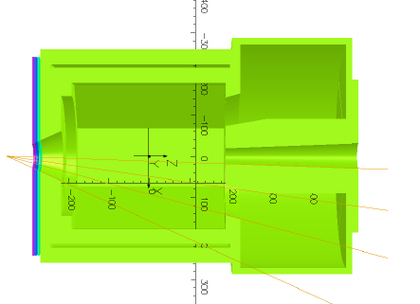
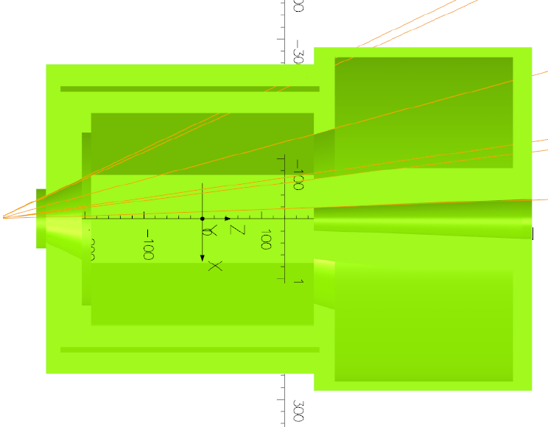
Jay’s new model
Model 1
SIDIS Opening 8-24 deg
Endcap nose outer_r=90cm
Endcap length_z=261cm
Downstream collar 15cm thicker
than current
Model 2
SIDIS Opening 7-25 deg
Endcap nose outer_r=85cm
Endcap length_z=304.8cm (10ft)
Downstream collar 15cm thicker
than current

Slide 6
Jay’s questions
1. how long should endcap interior be, including contingency for detector changes? The one shown is 304.8 cm. Zhiwen's model has 261 cm.
2. what should OD of endcap central cylinder be? Range 85-90 cm. One could slot a 90 cm cylinder and recess Thomson rails: intermediate steel case.
3. what size radial holes are needed at what endcap Z locations for cables? 24 2” diameter with external compensatory steel?
4. how much will ~2 G excursion in Bz over 60 cm He3 target affect it?

Slide 7
Zhiwen’s thoughts
1. “Downstream collar enlarge by 15cm”, will LGC can redesign tank and keep PMT at same location, thus preserve same performance?
2. HGC wants 10cm in Z to allow tolerance with pressured thin windows.
3. Is the current space good in Z and R for SPD, GEM, MRPC, baffle, EC at engineering level? If not, what change do you want?
4. What is the size of the crosssection area of cables of your detector going out? Where is the preferred location you want them to go out?

