Slide 1
Test of mirror painting & clear fiber
Chendi Shen
2017.04.13

Slide 2
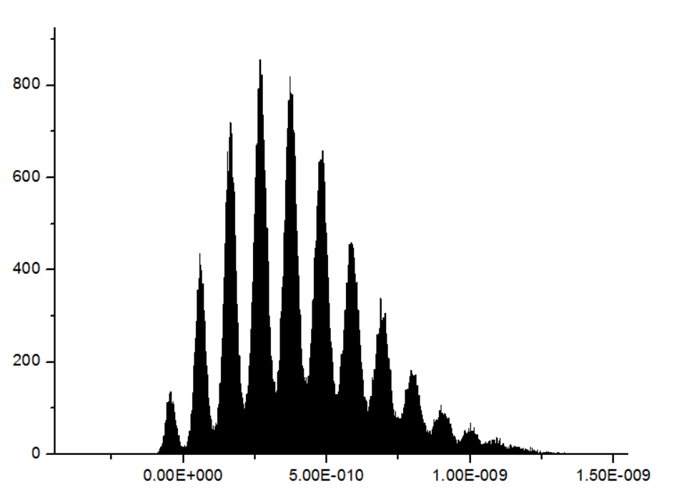
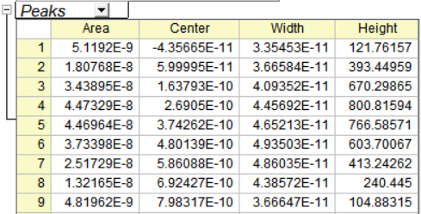
$$Gain= \frac{104.1pvs}{100∙R∙e}=1.3×{10}^{5}$$
Gain of the SiPM (SPE)
104.1pvs=1PE
Preamplifier
50Ω for oscilloscope

Slide 3
1. Test of mirror painting
Aluminum
or
Nothing
or
Silver shine
Get the data of Npe
SiPM+ Preamplifier
WLSF
Waveform sampling oscilloscope
Light spot
Fibers were fixed on the light spot
Test in the dark box
Filter sheet
spectroscope
laser intensity monitoring
Laser source
trigger
For laser source:
420 nm
1 MHz
For SiPM:
Gain : $1.3×{10}^{5}$
104.1pWb=1 pe
Voltage=25.0 V
For the fibers:
50 cm
Have been polished

Slide 4
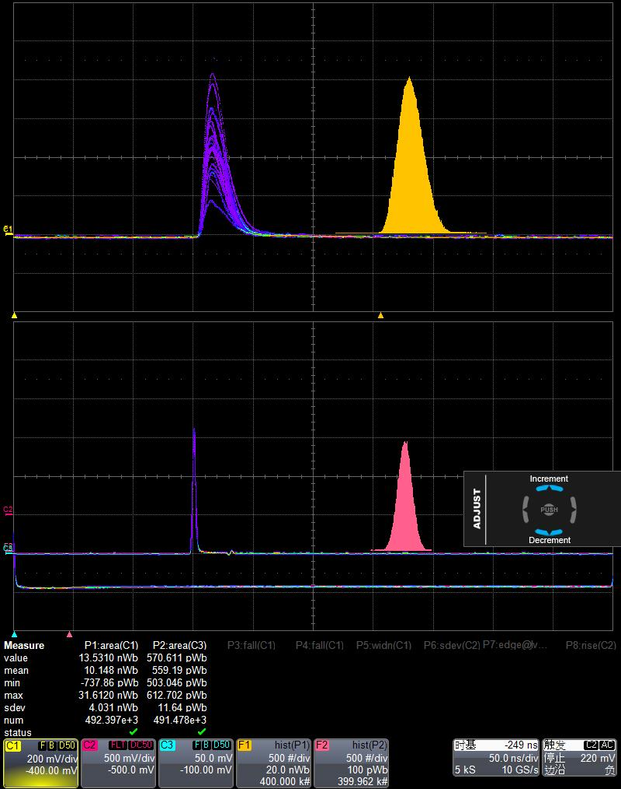
WLSF（Y11）+ Al
Npe$=\frac{10148pVs}{104.1pVs}$=$97.4$

Slide 5
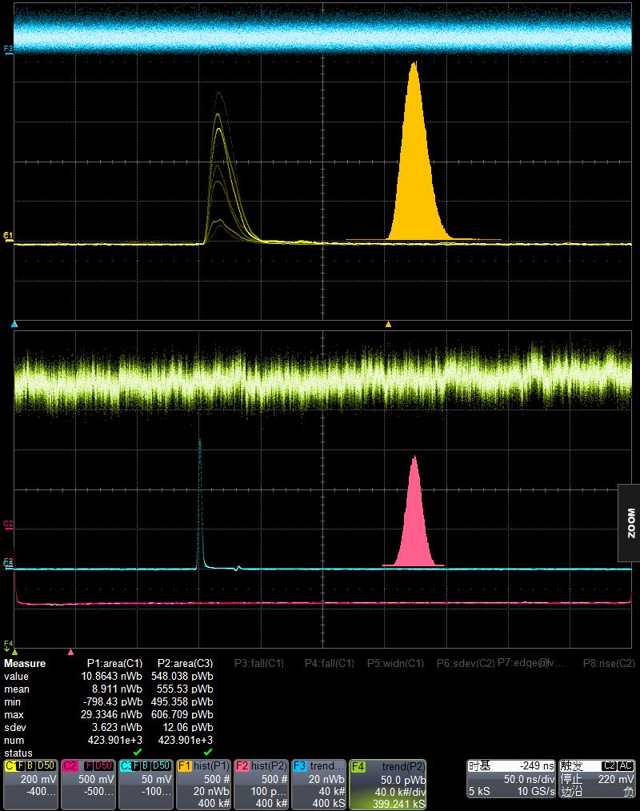
WLSF（Y11）（after polishing to remove Al）
Npe$=\frac{8911pVs}{104.1pVs}$=$85.6$

Slide 6
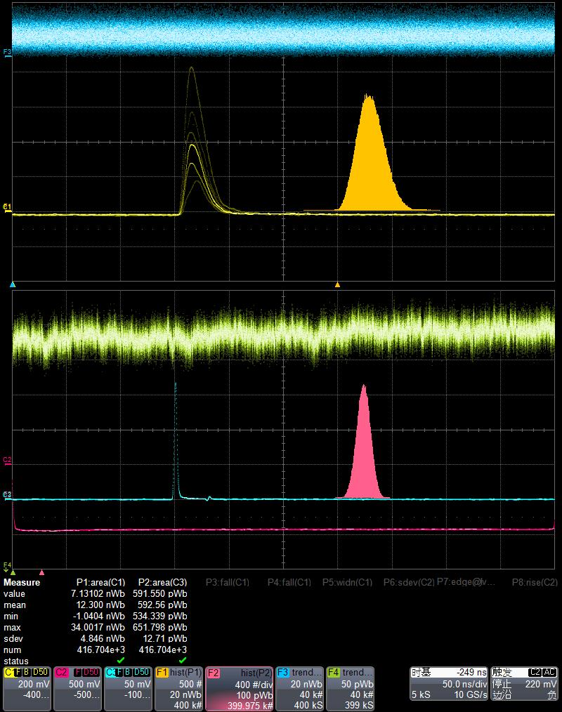
WLSF（Y11）+ silver shine 415001
Npe$=\frac{555×12300pVs}{592×104.1pVs}$=$110.7$

Slide 7
Compared results
 | Y11
No mirror painting | 85.6
Al | 97.4 (+13.8%)
Silver shine 415001 | 110.7 (+29.3%)
(Al —— light leakage)
So it is not the real proformance of this method. It should be better than 13.8%.

Slide 8
2. Test of clear fiber
Get the data of Npe
SiPM+ Preamplifier
clear fiber
Waveform sampling oscilloscope
Light spot
Filter sheet
spectroscope
laser intensity monitoring
Laser source
trigger
For laser source:
420 nm
1 MHz
For SiPM:
Gain : $1.8×{10}^{5}$
143.6pWb=1 pe
Voltage=25.0 V
For the fibers:
1m, 2m, 3m, 4m, 5m, 7m and 9m
Have been polished

Slide 9
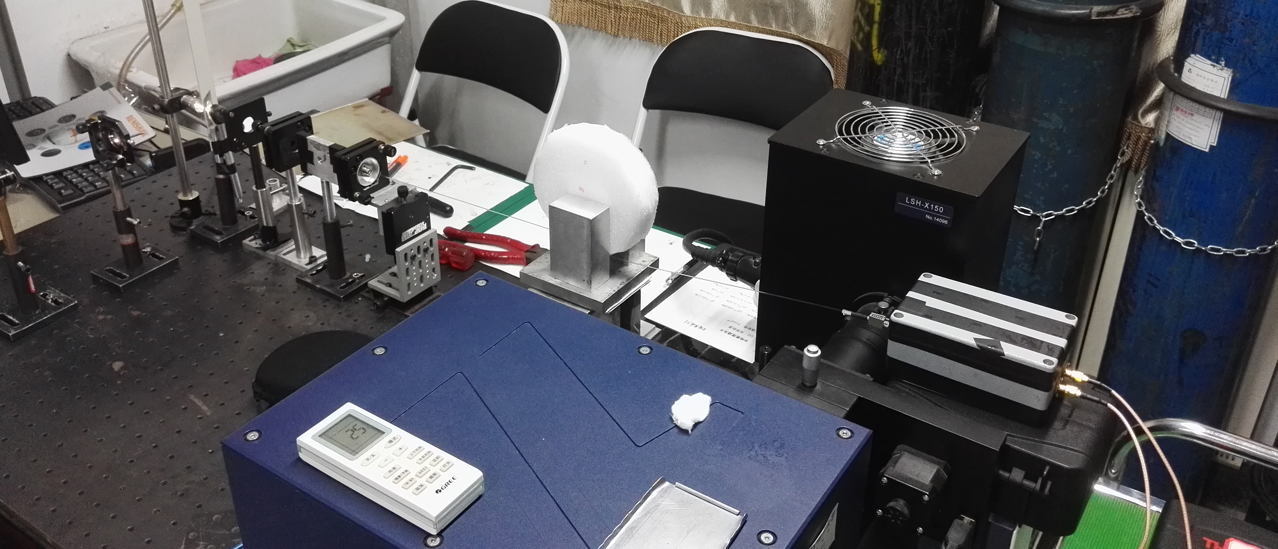
2.1 measure the light loss due to bending
Bending tool
1m of clear fiber

Slide 10
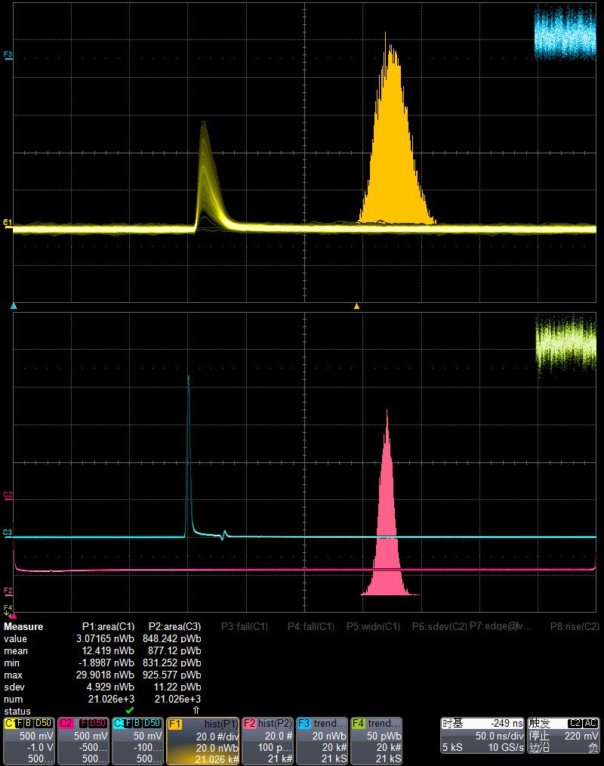
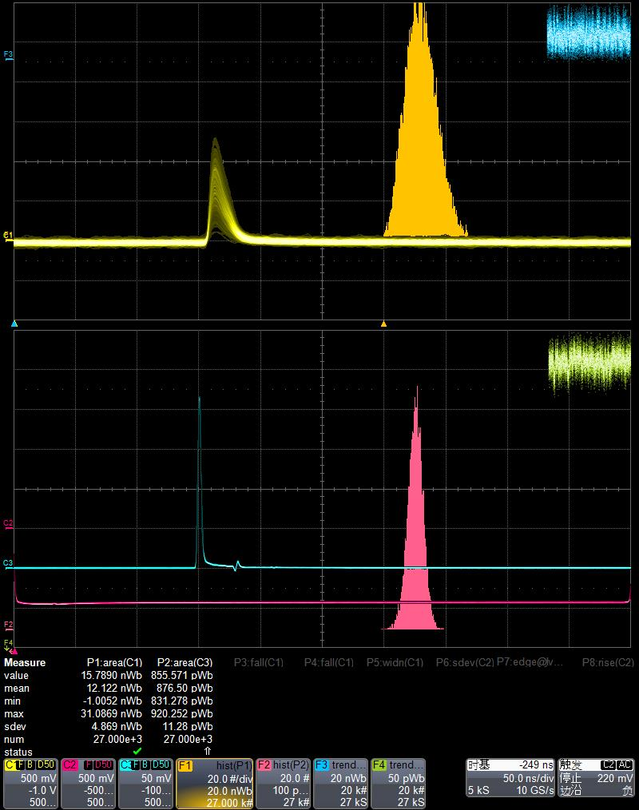
No bending$=\frac{12419pVs}{104.1pVs}$=$119.3$
$φ20cm=\frac{12122pVs}{104.1pVs}$=$116.4$

Slide 11
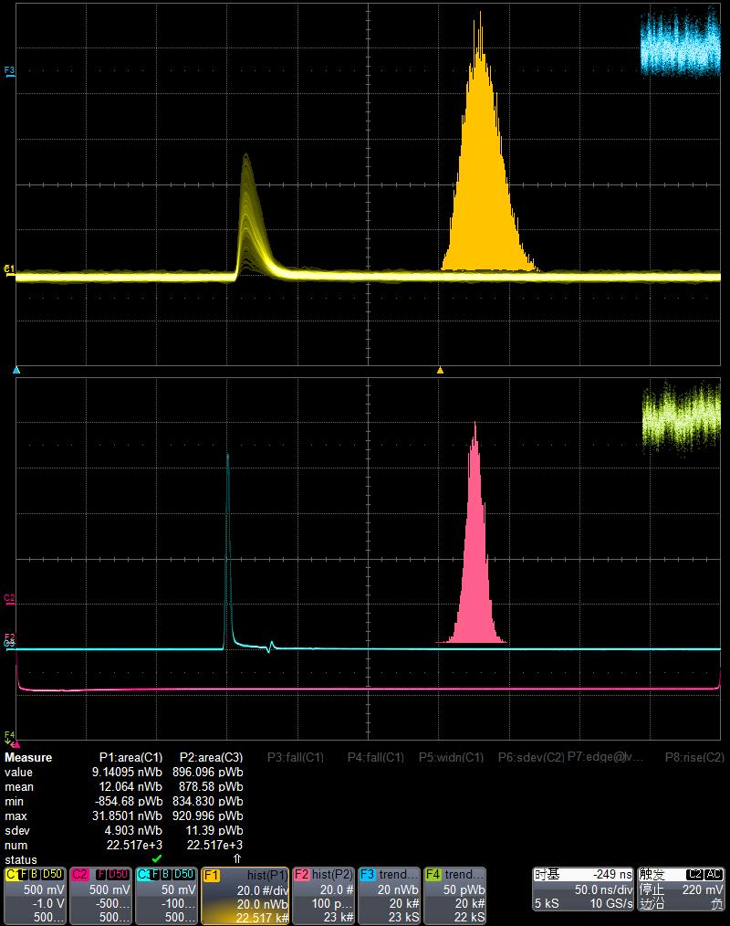
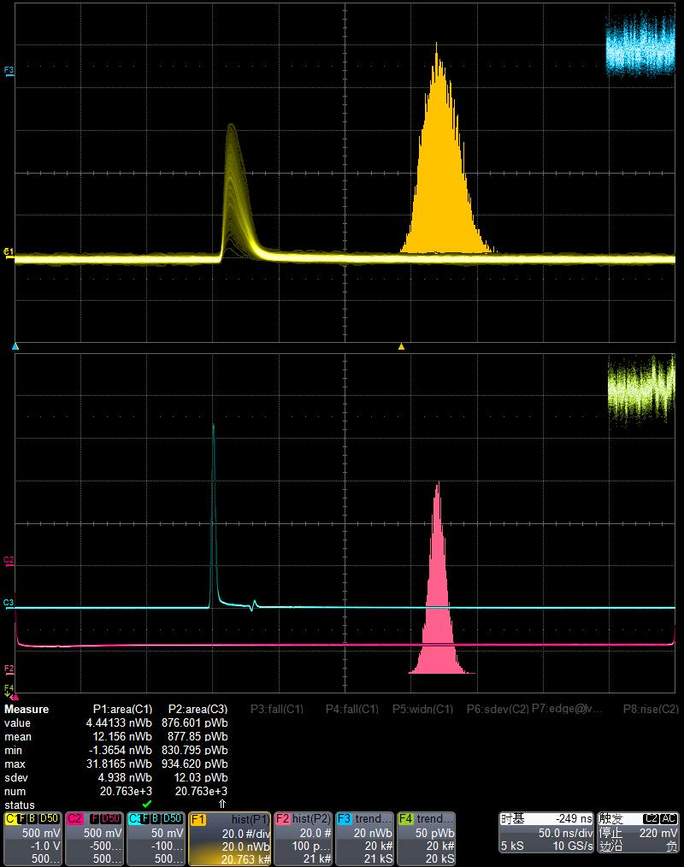
φ$11cm=\frac{12064pVs}{104.1pVs}$=$115.9$
$φ8cm=\frac{12156pVs}{104.1pVs}$=$116.8$

Slide 12
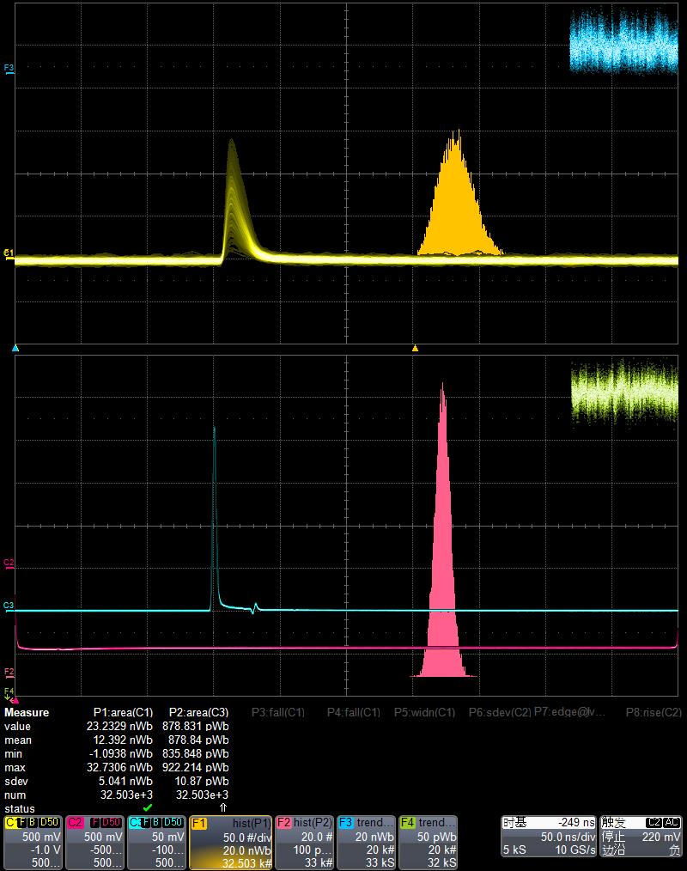
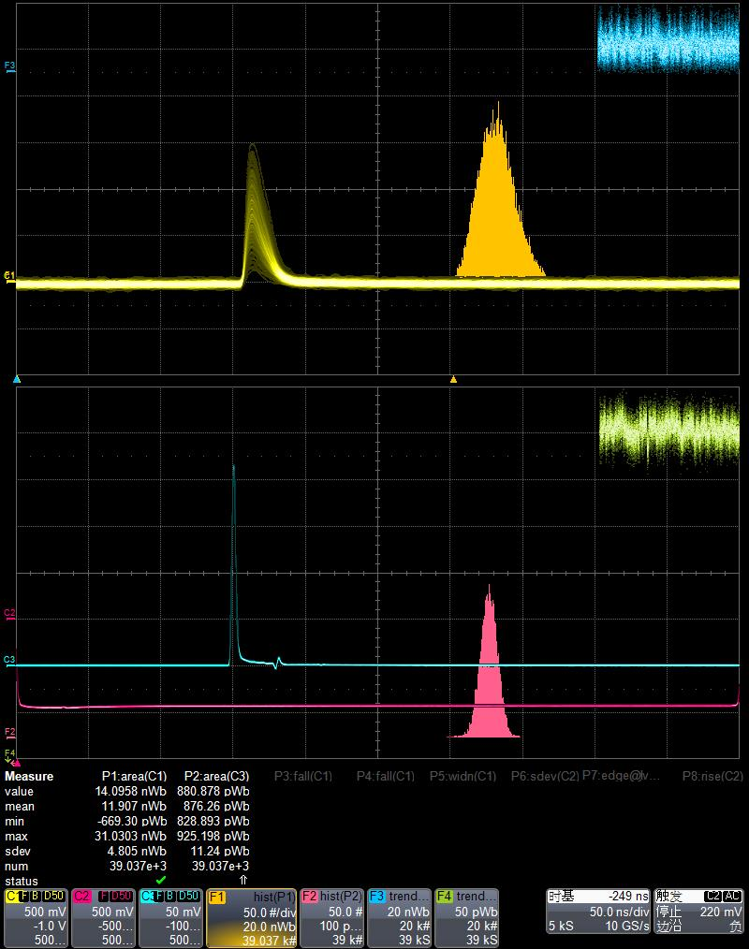
$φ6cm =\frac{12392pVs}{104.1pVs}$=$119$
$φ4cm=\frac{11907pVs}{104.1pVs}$=$114.3$

Slide 13
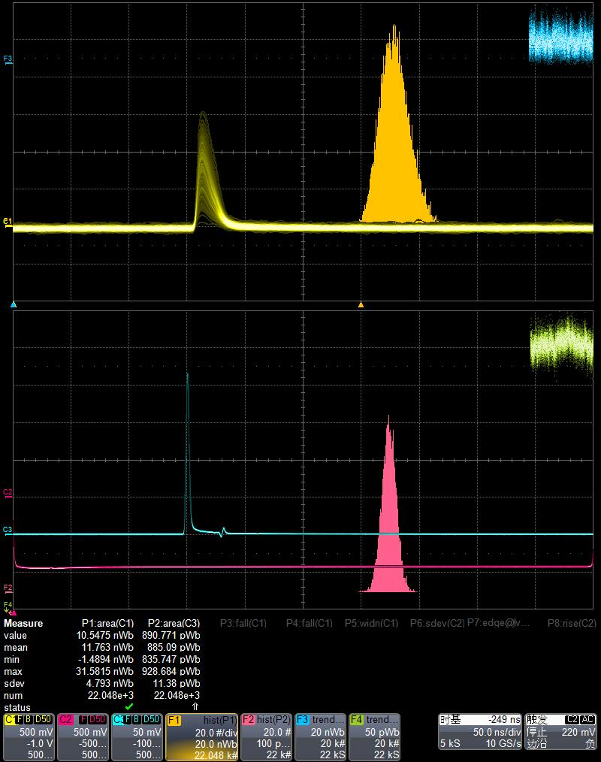
$φ2.7cm =\frac{11763pVs}{104.1pVs}$=$113$
The effect of bending on the clear fiber can be ignored

Slide 14
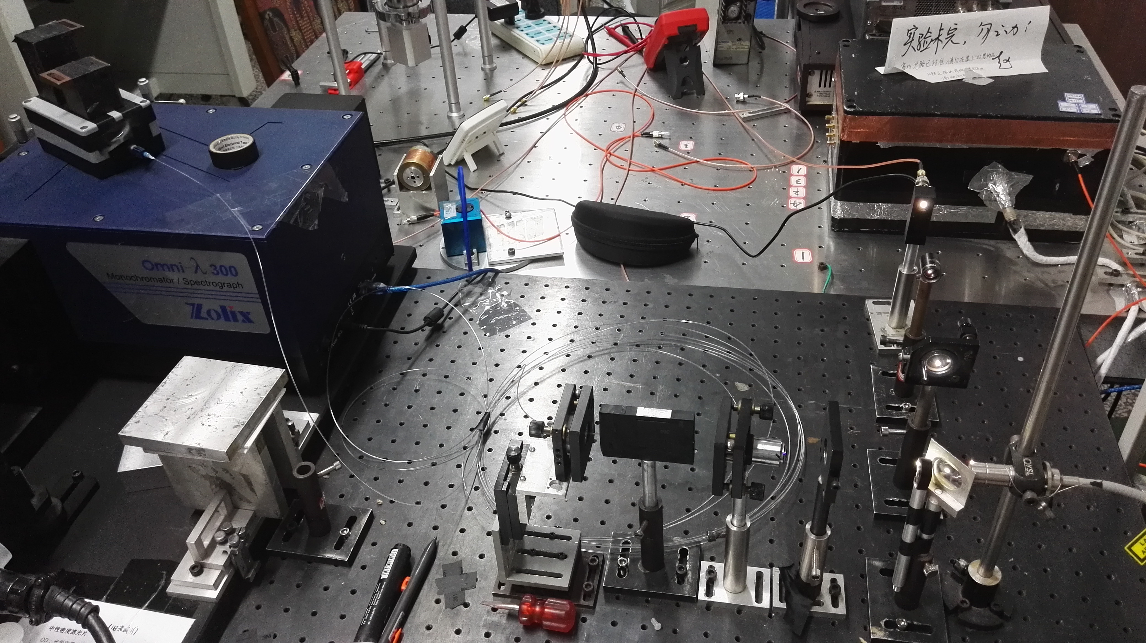
2.1 measure the light loss due to length
End of the fiber

Slide 15
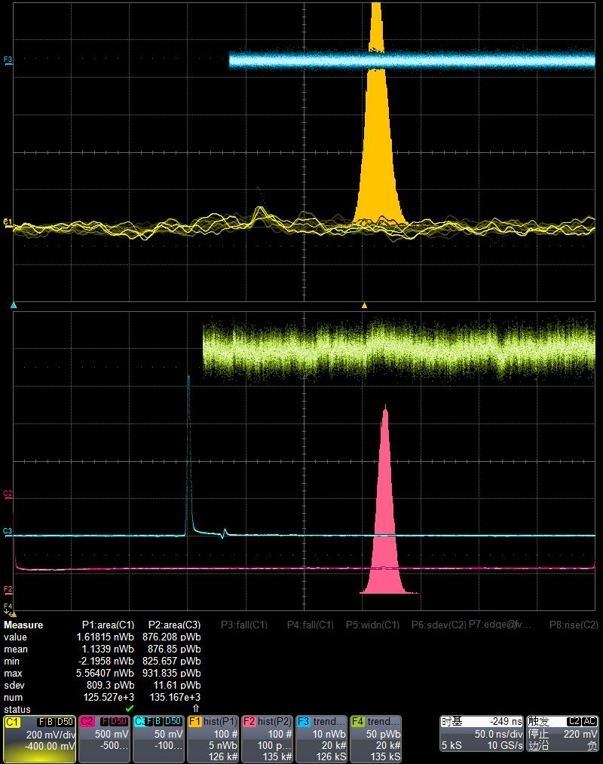
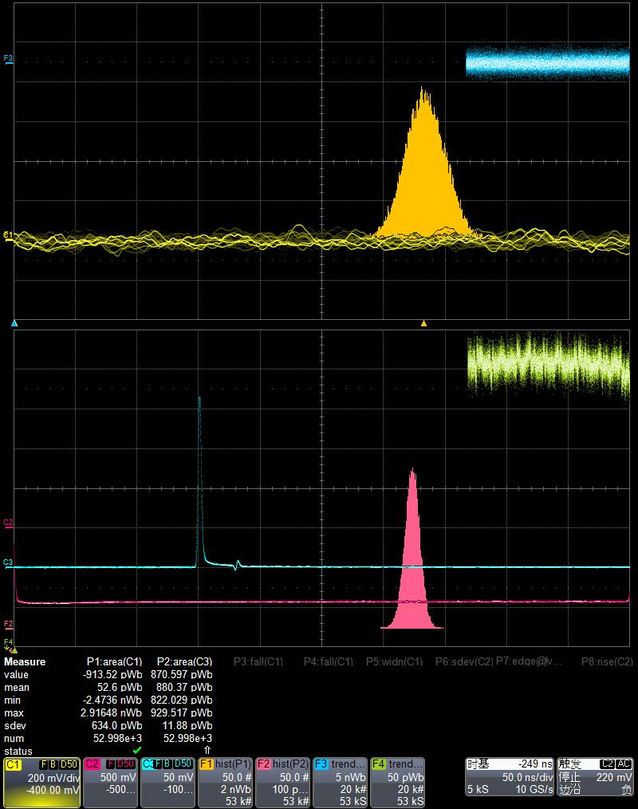
$Npe(9m) =\frac{1133.9−52.6pVs}{104.1pVs}$=$10.38$
Background (9m)

Slide 16
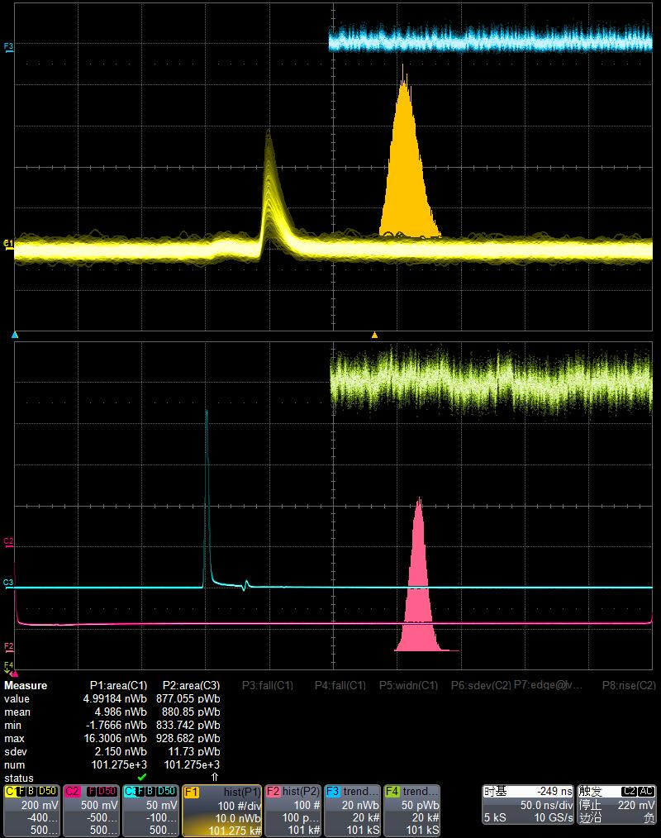
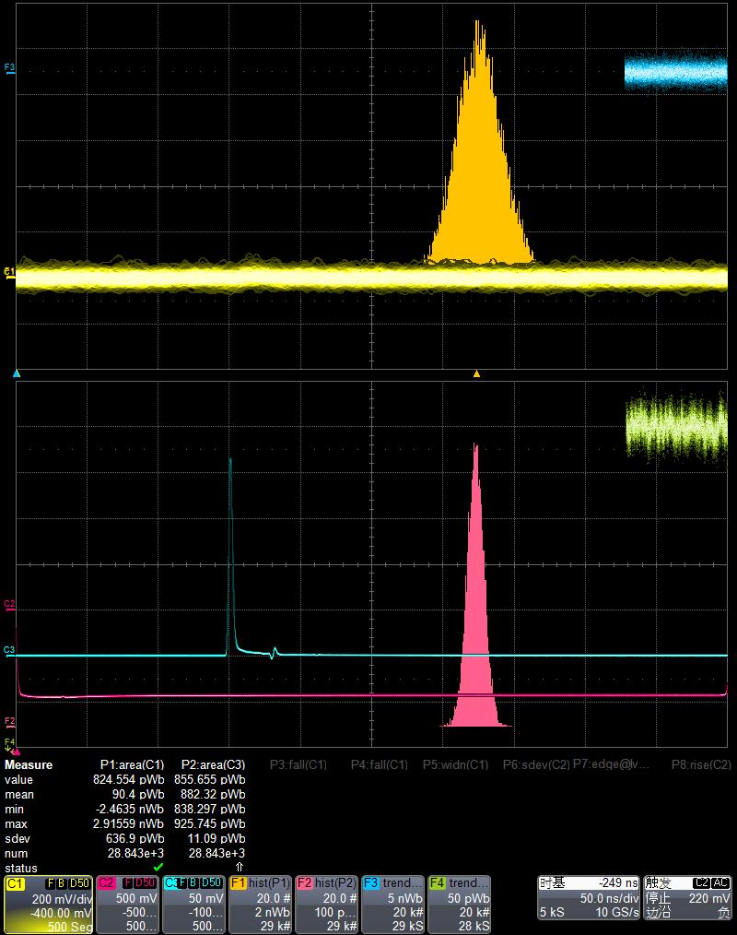
$Npe(7m) =\frac{4986−90.4pVs}{104.1pVs}$=$47.03$
Background (7m)

Slide 17
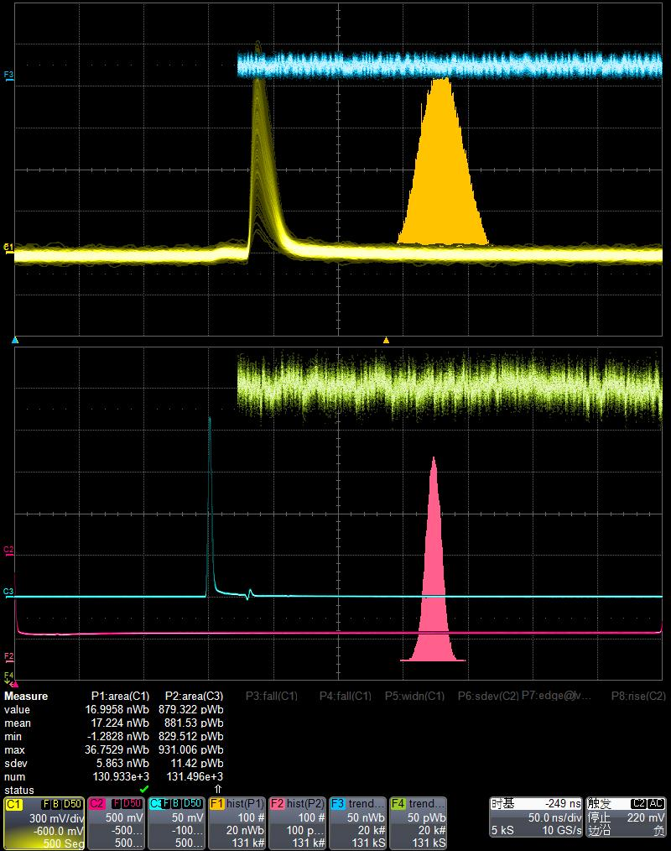
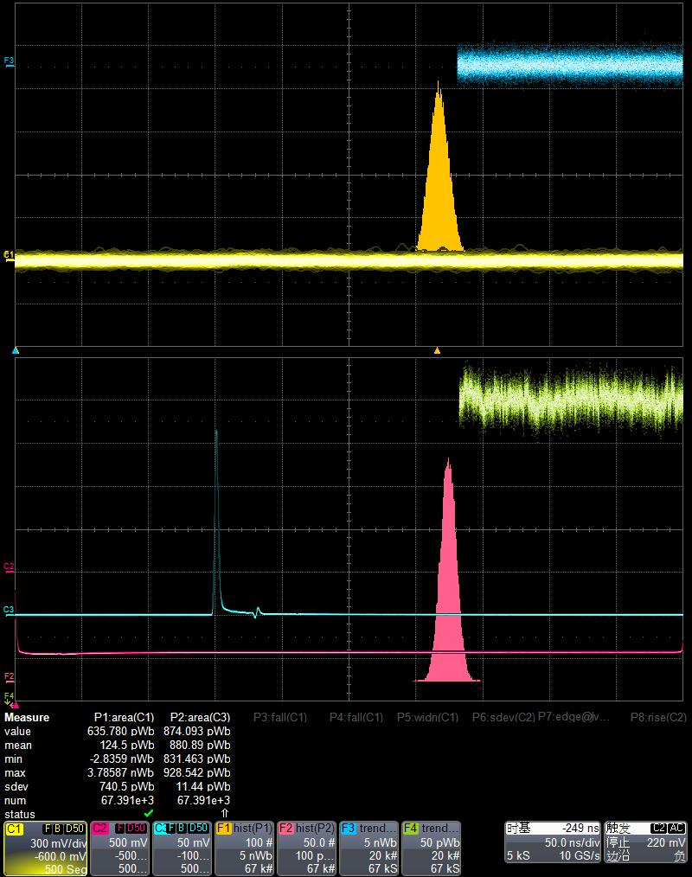
$Npe(5m) =\frac{17224−124.5pVs}{104.1pVs}$=$164.26$
Background (5m)

Slide 18
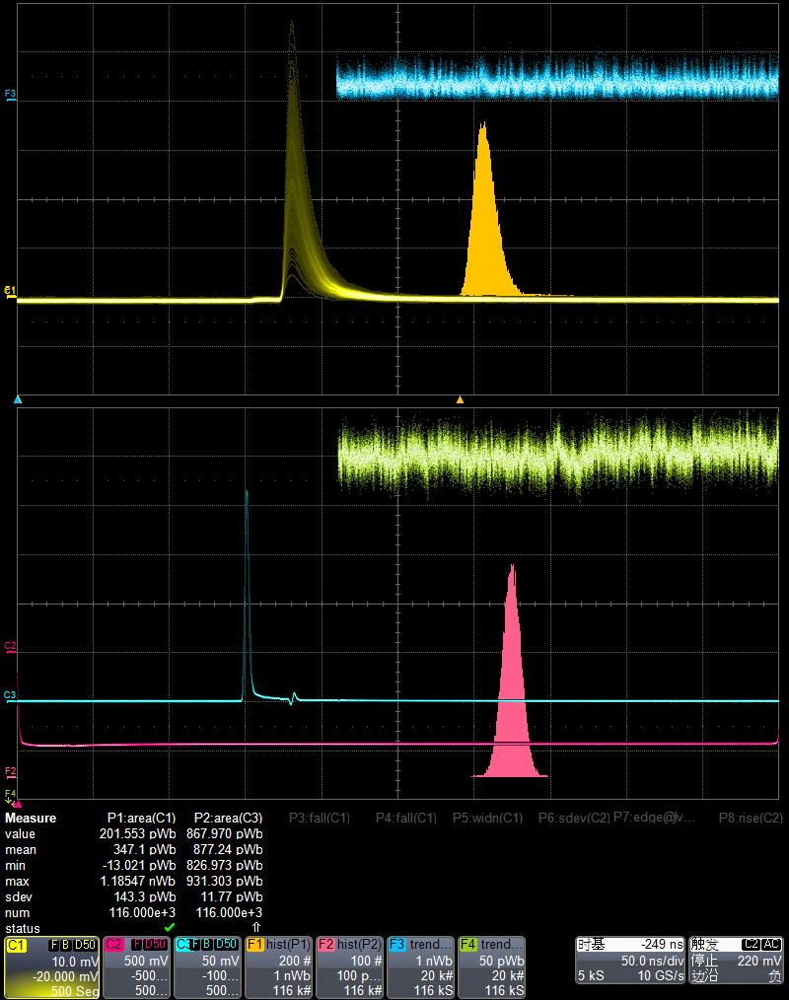
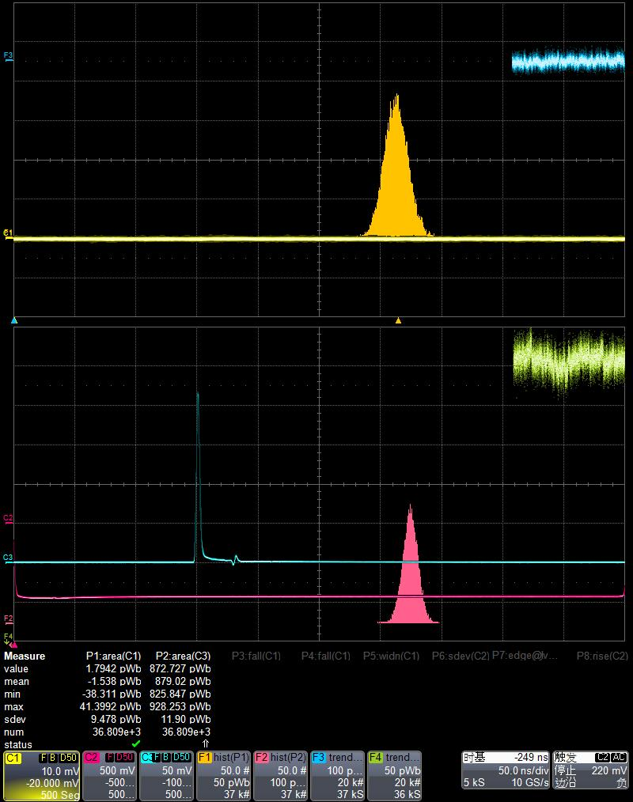
As the signal is too large, so when the length is less than 4m, we removed the preamplifier.
That means 1.041pVs=1PE
$Npe(4m) =\frac{347.1+1.538pVs}{1.041pVs}$=$334.91$
Background (4m)

Slide 19
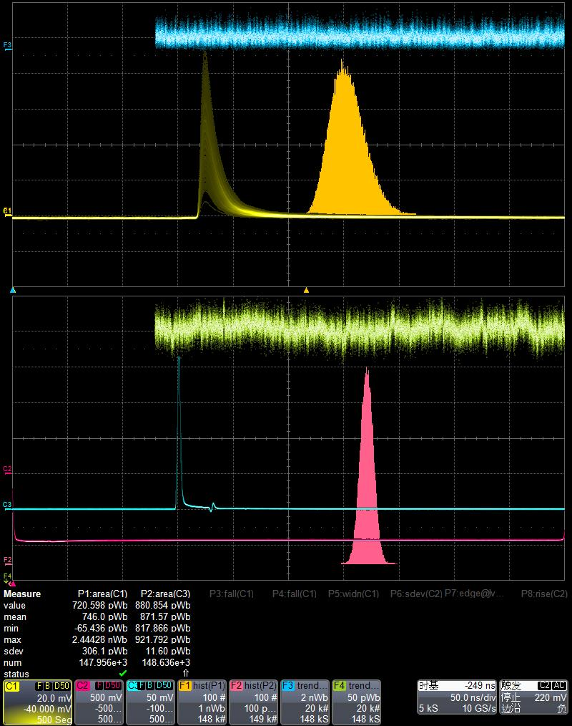
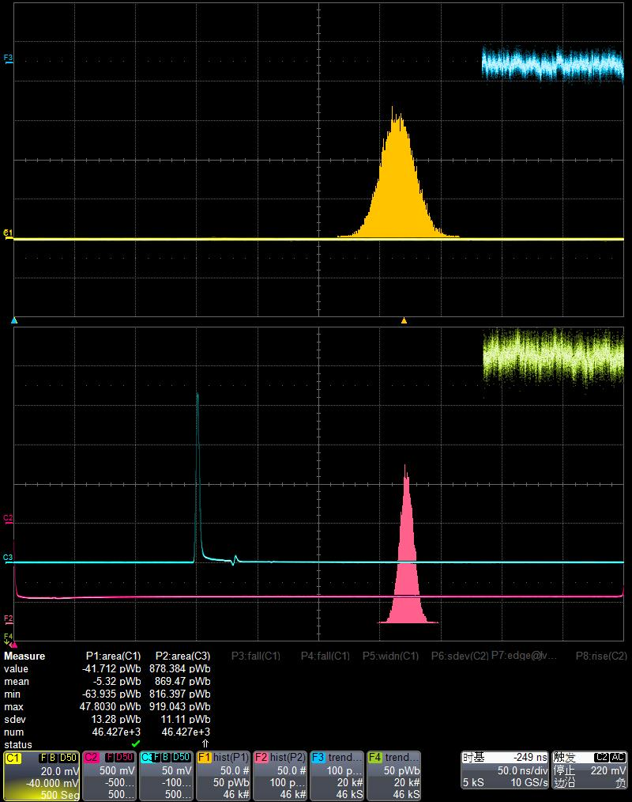
$Npe(3m) =\frac{746+5.32pVs}{1.041pVs}$=$721.73$
Background (3m)

Slide 20
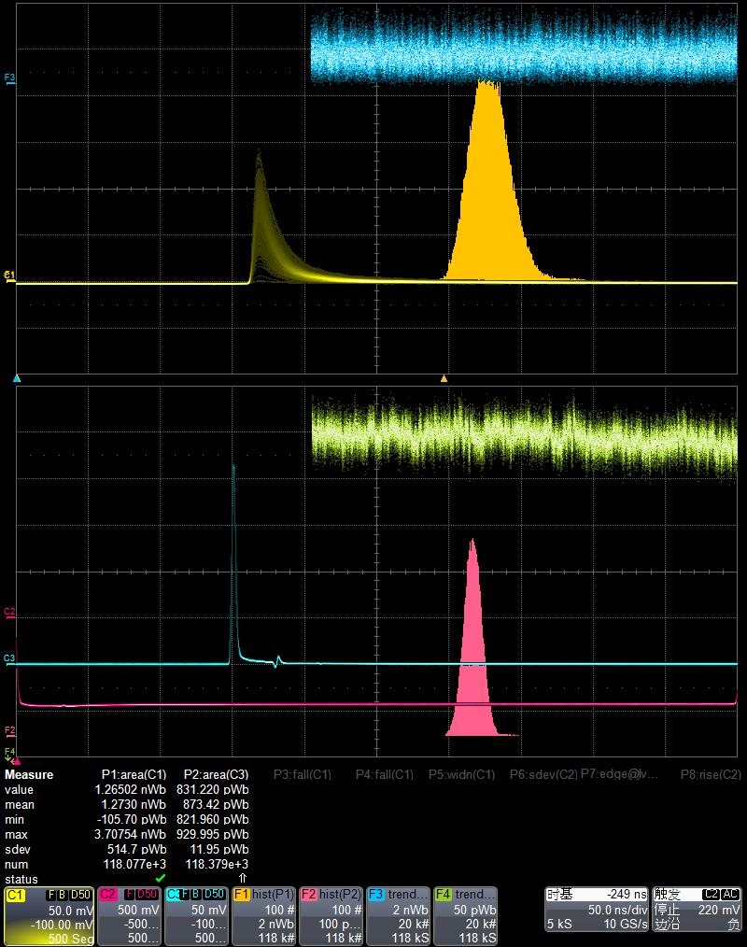
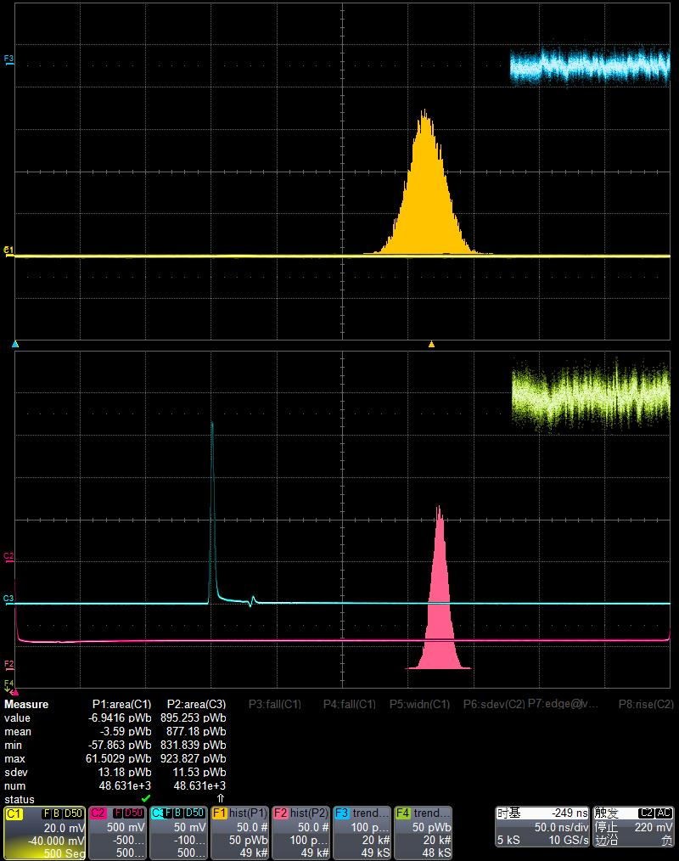
$Npe(2m) =\frac{1273+3.59pVs}{1.041pVs}$=$1226.31$
Background (2m)

Slide 21
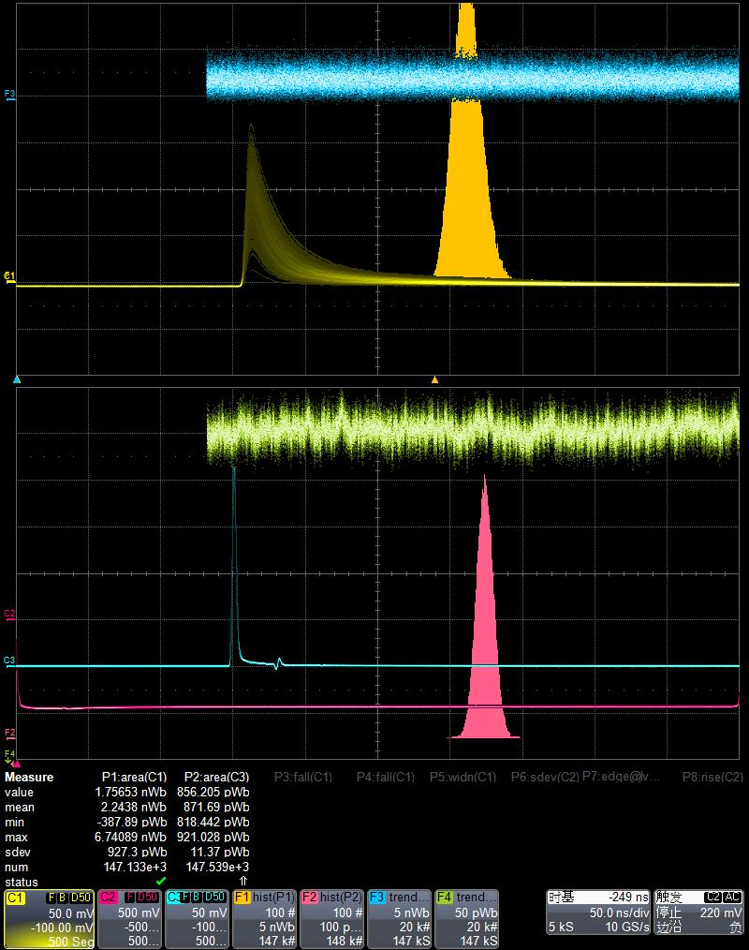
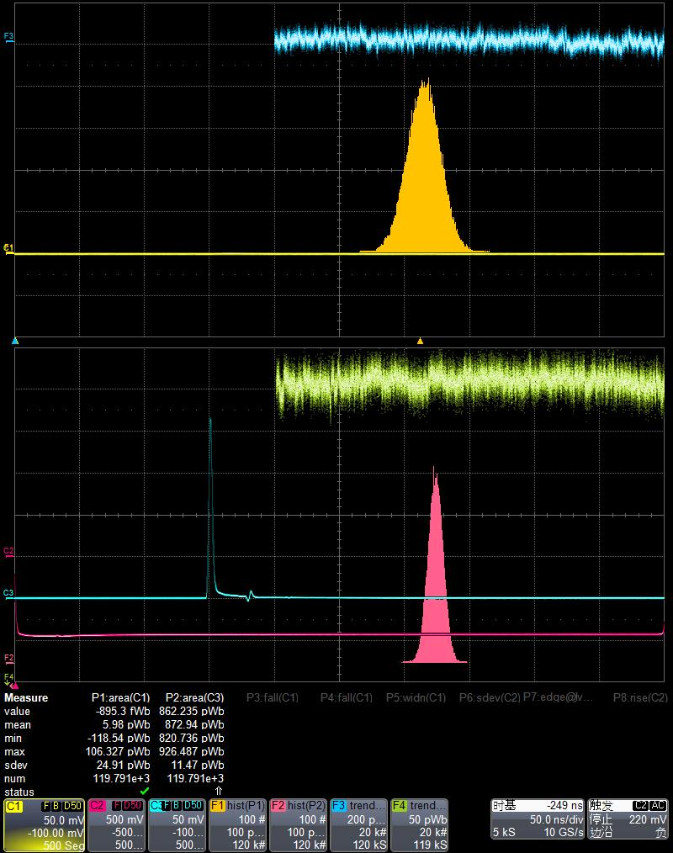
$Npe(1m) =\frac{2243.8−5.98pVs}{1.041pVs}$=$2149.68$
Background (1m)

Slide 22
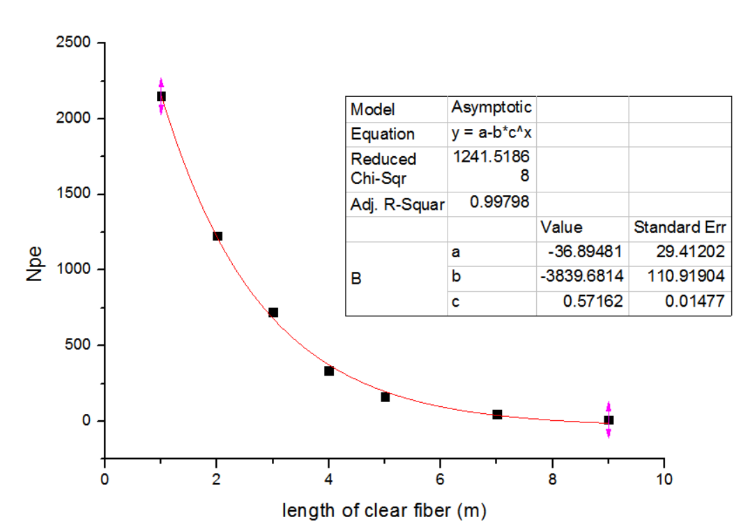
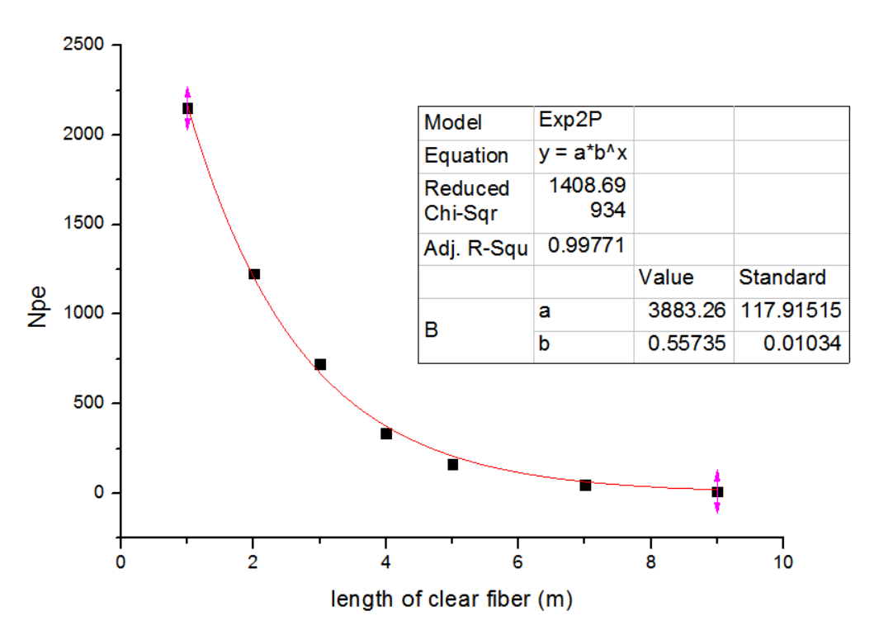
Two kinds of exponential fitting with different function
$$y=−37+3840×{0.57}^{x}$$
$$y=3883×{0.56}^{x}$$

