Slide 1
THU module test
Ye Tian
Shandong University
4-20-2017

Slide 2
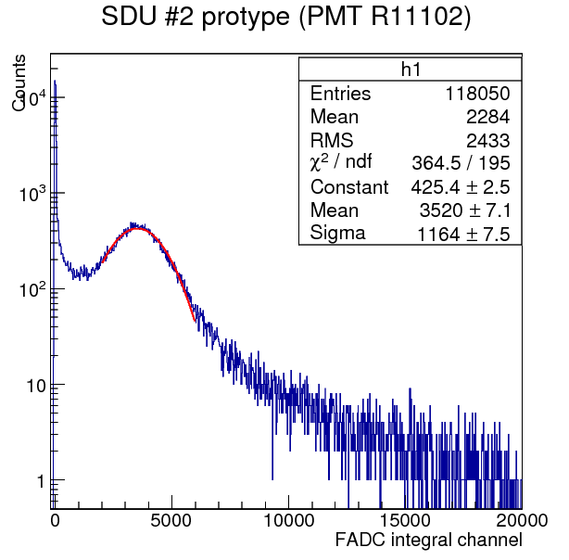
SDU #2 module horizontal cosmic ray test in JLab
Specification of test
Horizontal cosmic ray test
Triggered by two scintillator bar on module
PMT: original PMT in SDU #2(R11102, Gain:5.1 *10^6)
Result
Peak:3520
Npe=86.25
(reference value from previous result at SDU in 2016: 77 Npe)
Note: PMT gain determined at SDU in 2016 using LED and the single p.e. peak method.

Slide 3
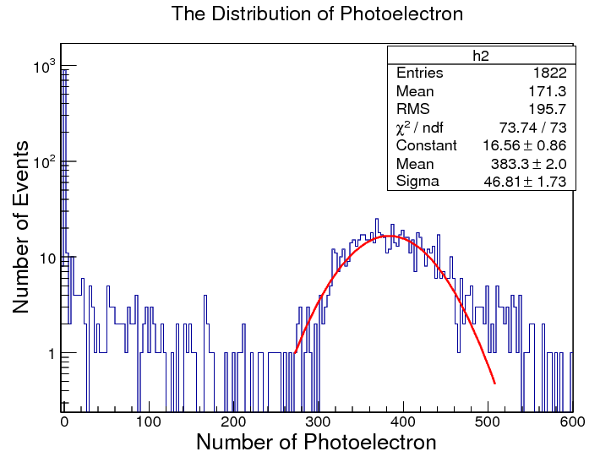
review of SDU#2 cosmic test result at SDU in 2016
Note: There were two sets of test done on this module at SDU in 2016: first with sides unpainted an loosely covered in Tyvek (both horizontal and vertical), and then with sides painted in TiO2 (vertical only because we needed the module to be shipped to JLab). However, the TiO2 painting quality was not very good.
The vertical test of the SDU#2 with TiO2 coating on the side is 383, the earlier results (covered by Tyvek) were better: 426.5 (v) and 83(h)
If we assume the ratio 1/5 is unchanged, then we expect the vertical of the module in its state now (TiO2 coating) to be 383/5=77
Difference compared with JLab test:
Triggered by two preshower scintillators(average track is shorter than test in JLab)
Attenuation from delay cable: 3% (No delay in JLab test)

Slide 4
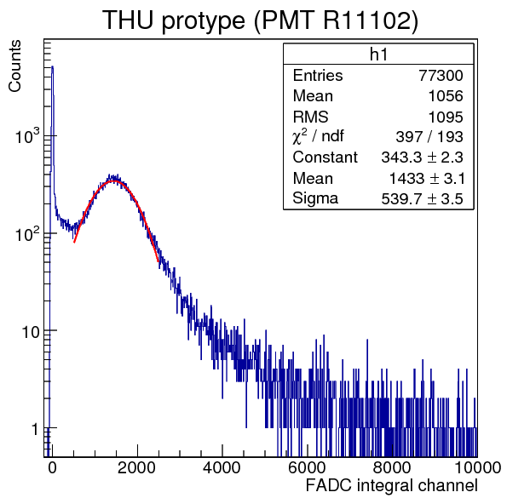
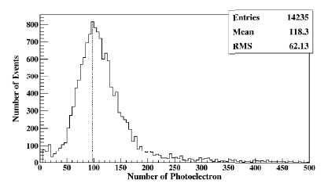
THU module horizontal cosmic ray test using SDU #2 PMT
Same test method as SDU #2 module
Peak: 1433
Npe=35.12
(Previous test in THU shows horizontal result ~96 Npe)
Note: In THU report by Chendi on 2016/09/08, an R11102-type PMT was used but the gain was not measured. The report that claimed 96 p.e. assumed the factory-provided gain vs. HV chart

Slide 5
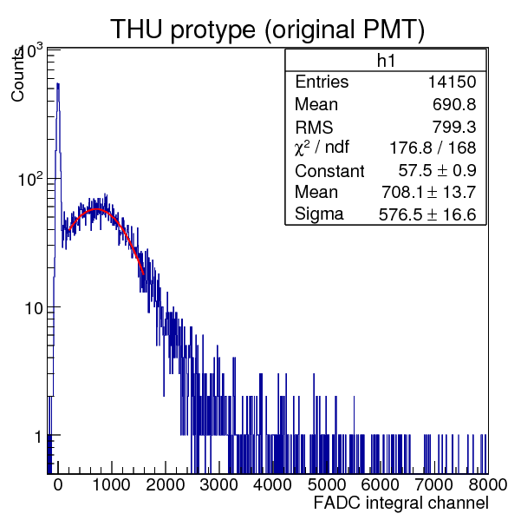
THU module horizontal cosmic ray test(Original PMT)
Peak: 708
Supposing the two test of THU module have same Npe (same PMT Q.E.), and the only difference is PMT gain. We could get
THU PMT Gain=2.52*10⁶

Slide 6
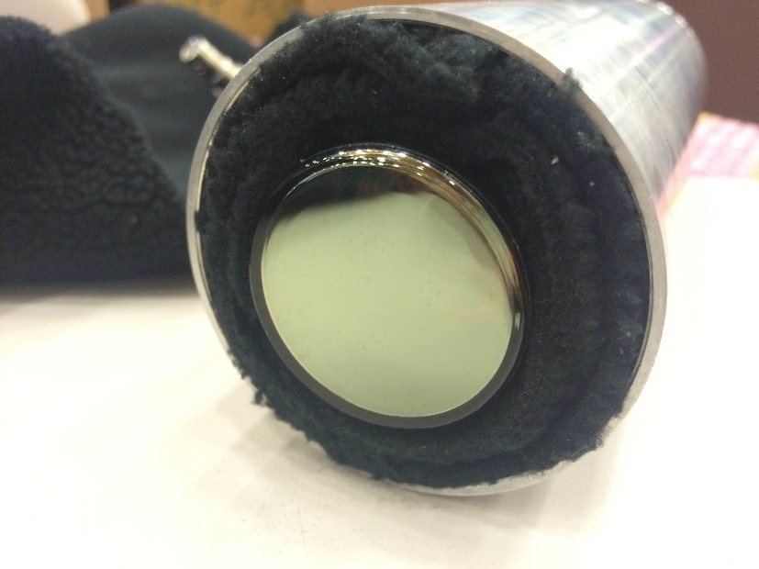
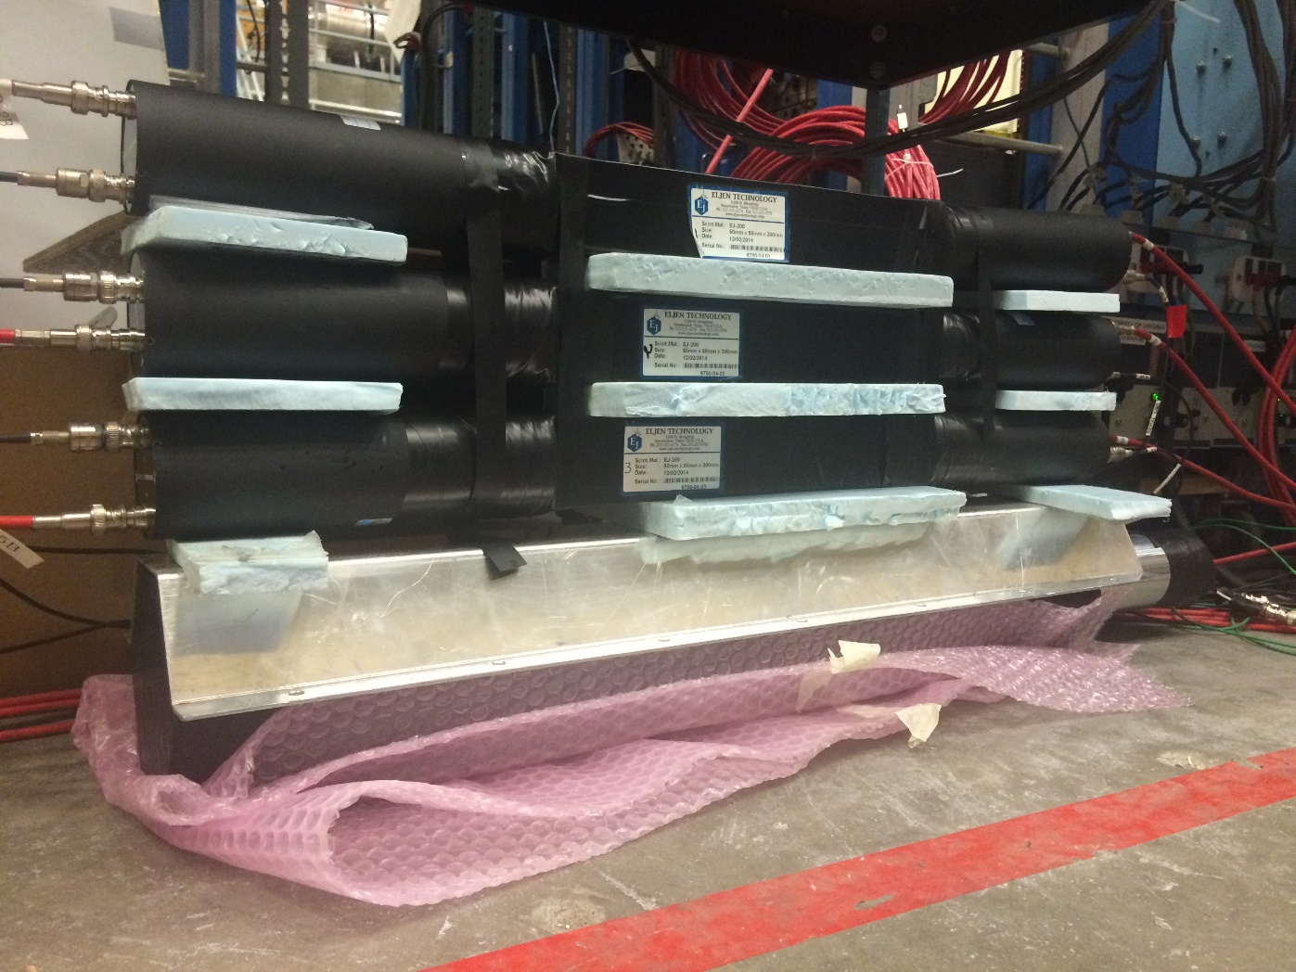
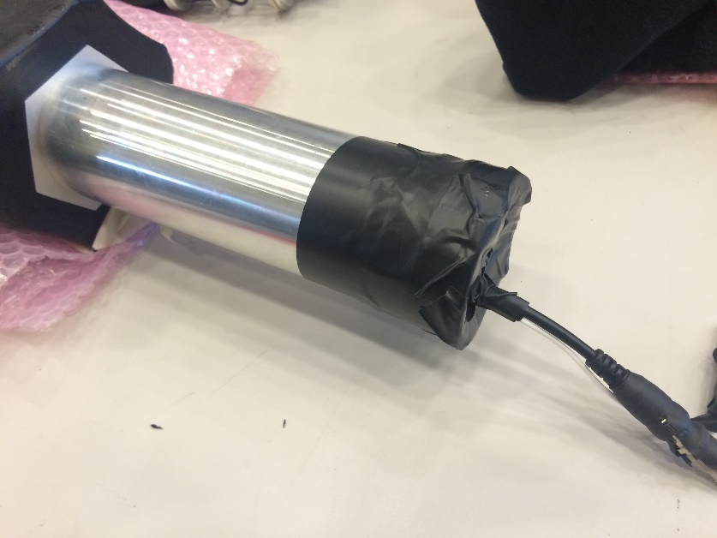
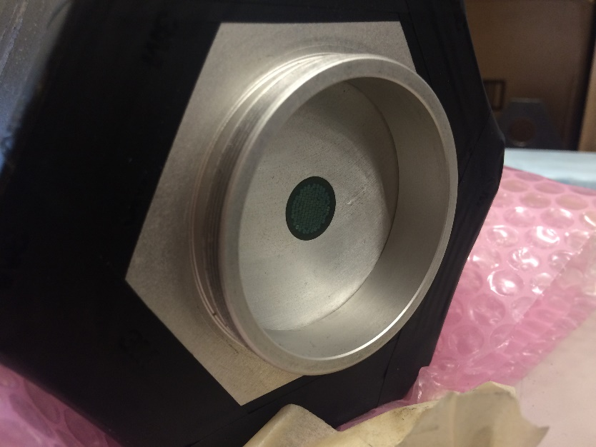
Test setup and THU module

