Slide 1
THU2 cosmic test results (2)
Chendi Shen
2017.8.24

Slide 2
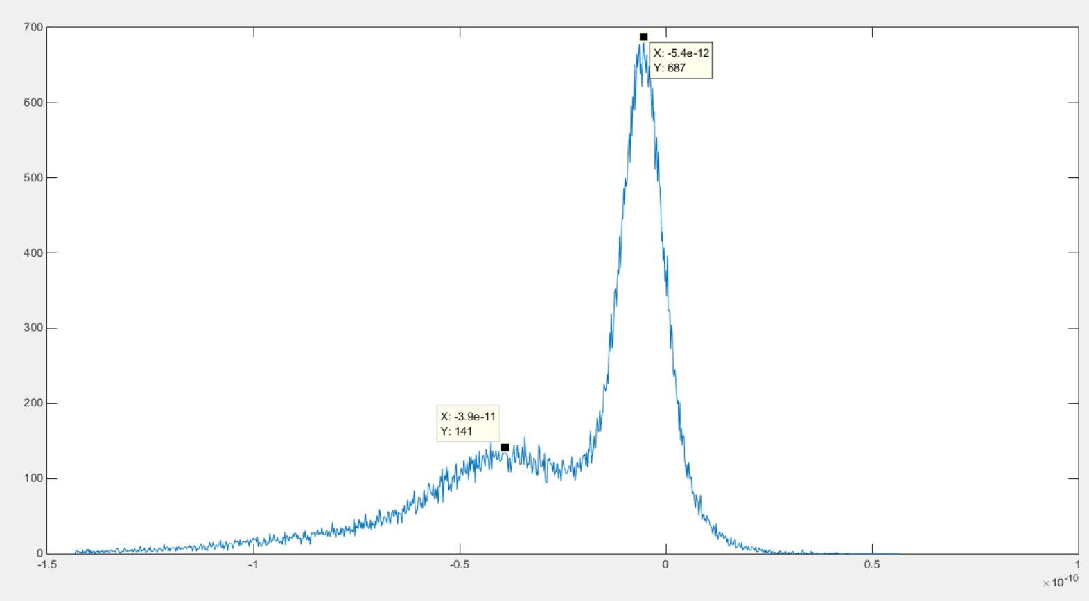
1100V PMT Gain

Slide 3
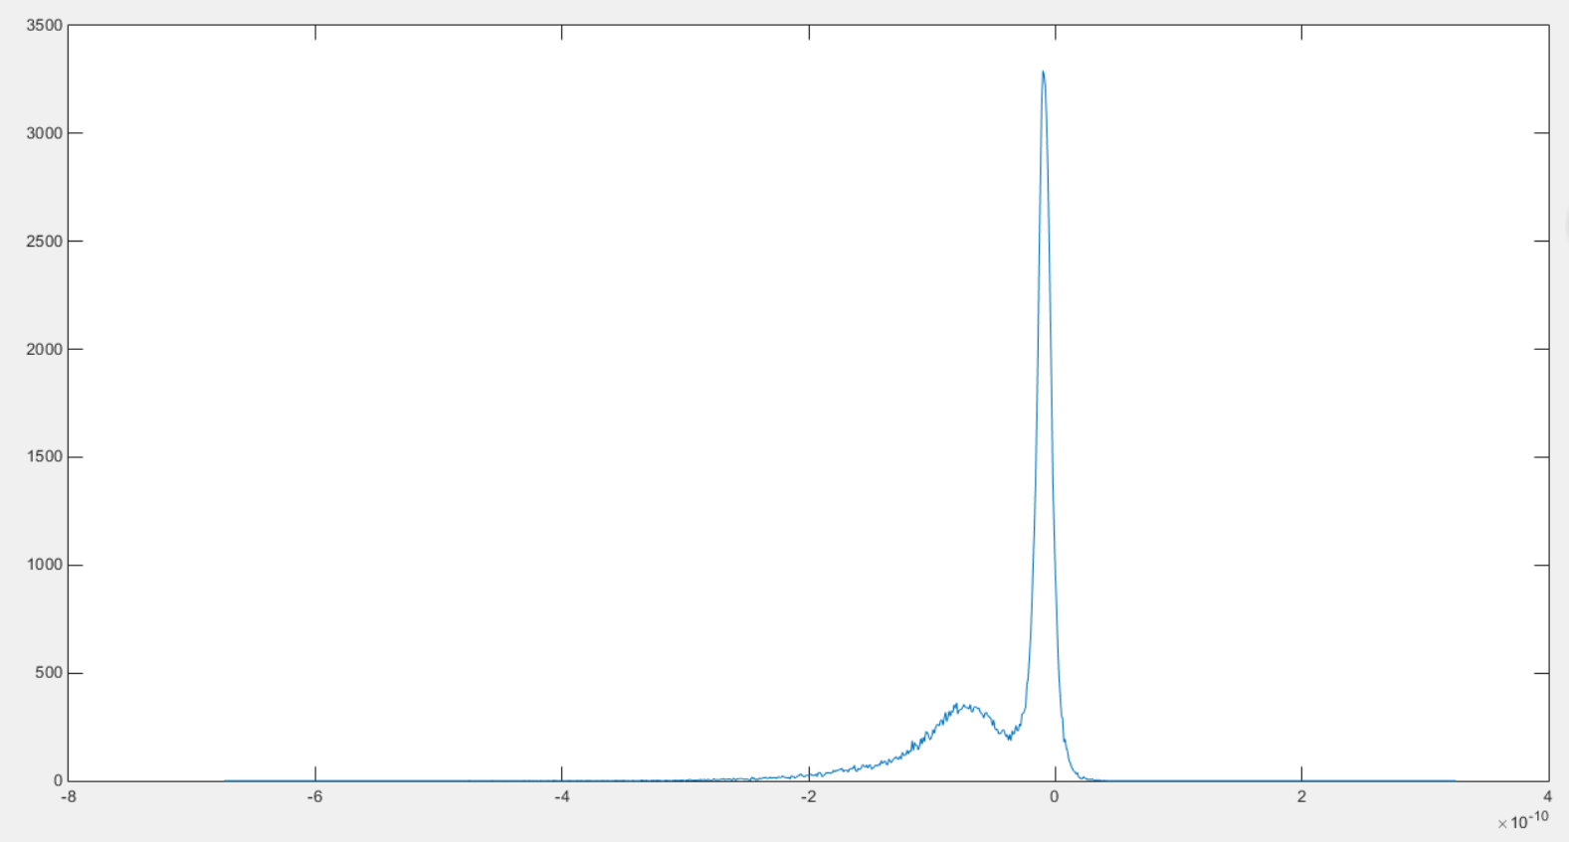
1200V PMT Gain

Slide 4
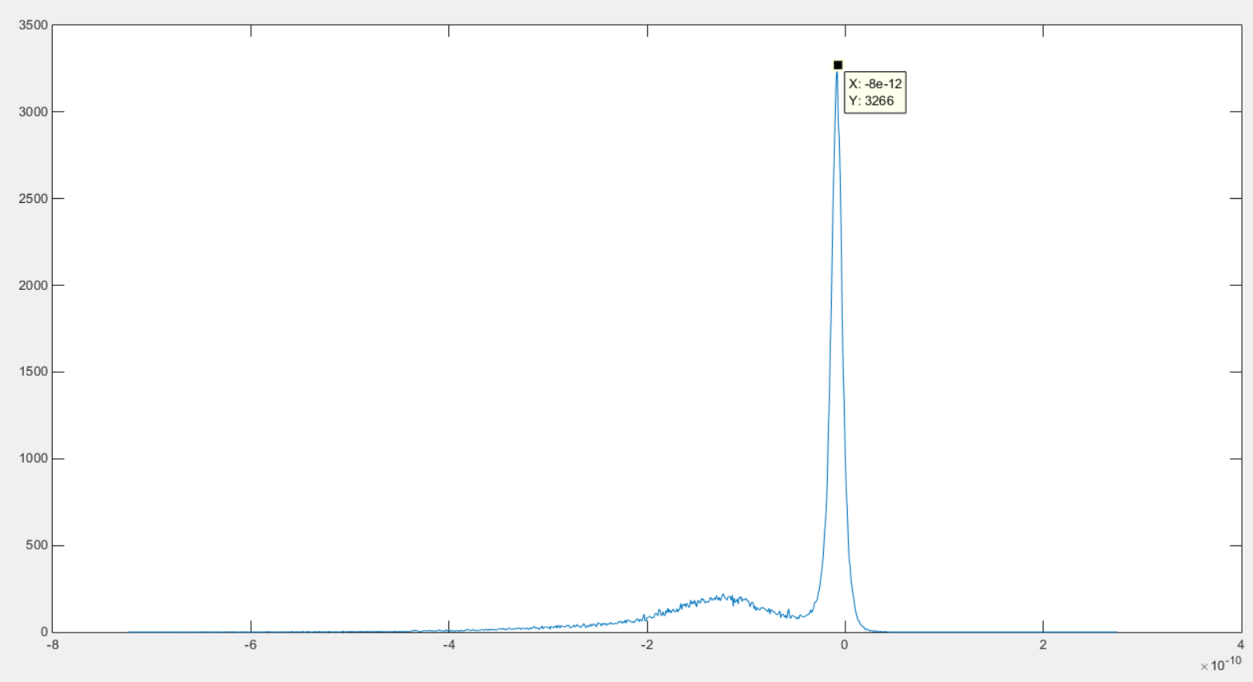
1300V PMT Gain

Slide 5
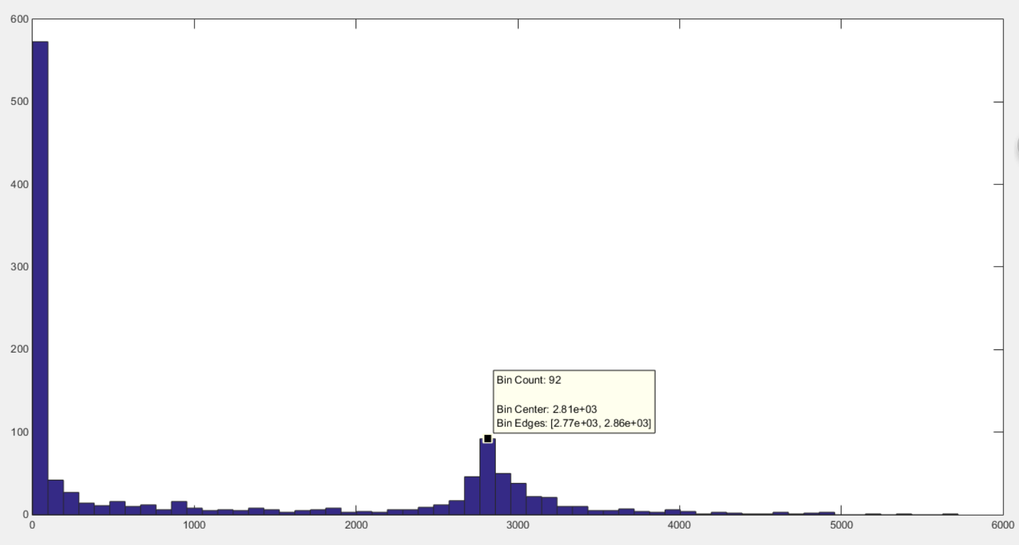
Y: number of events
X: Npe*Gain*10⁻⁶
Npe=X/Gain*10⁻⁶
1100V

Slide 6
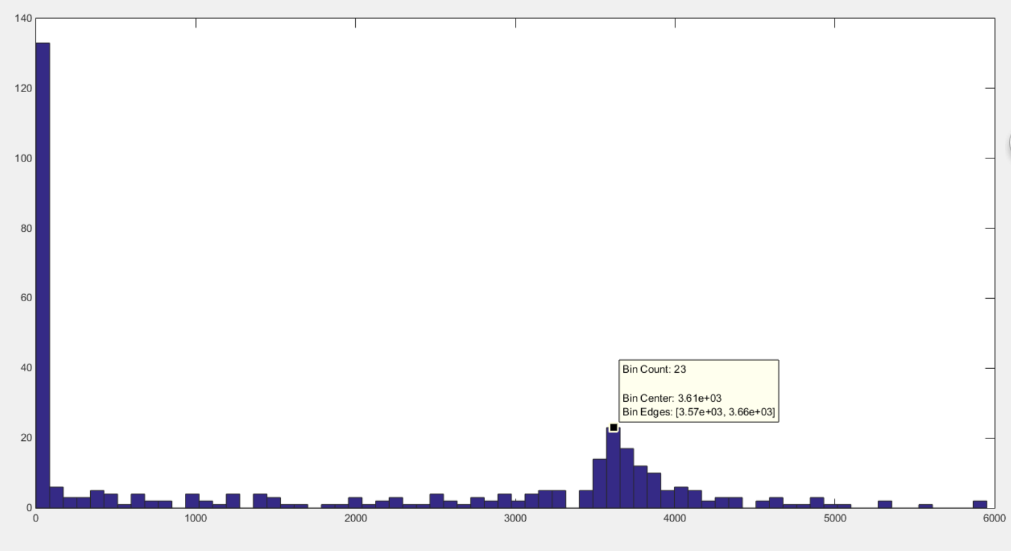
1200V

Slide 7
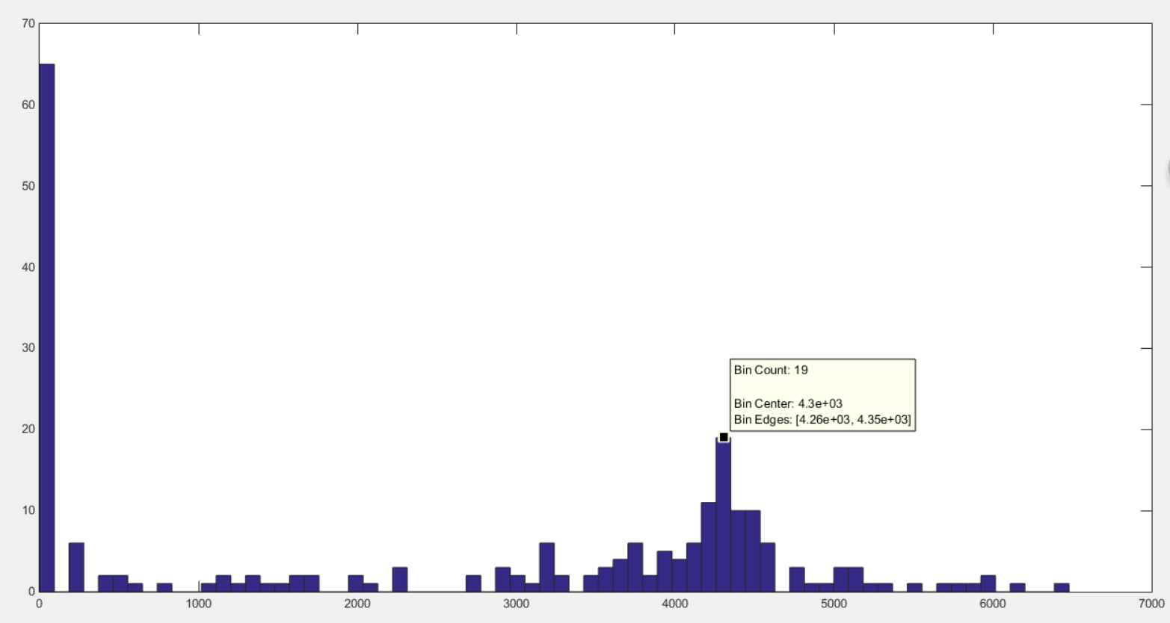
1300V

