Slide 1
THU2 cosmic test results (3)
Chendi Shen
2017.8.31

Slide 2
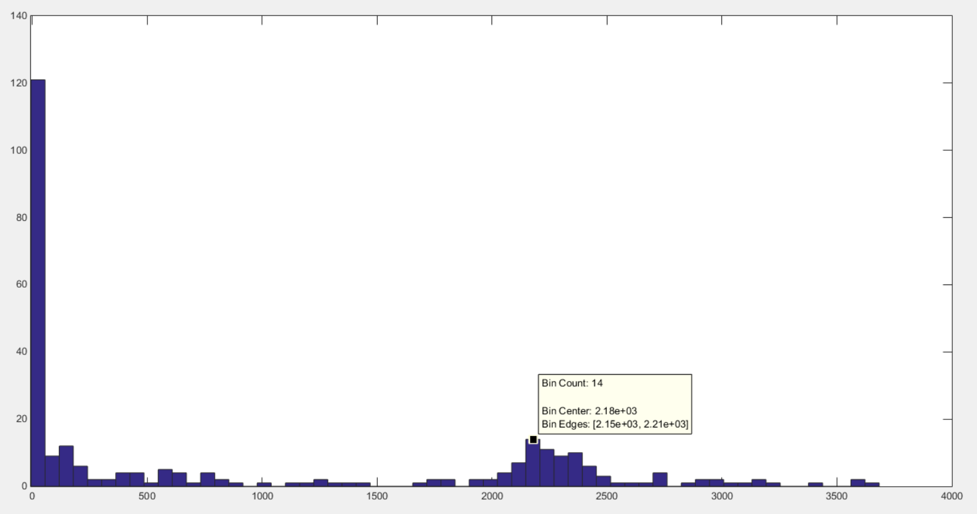
Y: number of events
X: Npe*Gain*10⁻⁶
Npe=X/Gain*10⁻⁶=2180/2.1=1038
X=2180 (1000V)
Hamamatsu company told us the Gain of PMT we use is 2.1*10⁶ (1000V). If it is reasonable, The Npe of THU2 for vertical cosmic test should be 1038. Now we're still collecting data.
They want to help us to test the gain of this PMT. So I will bring this PMT to their company to test the Gain after I finishing this test.

Slide 3
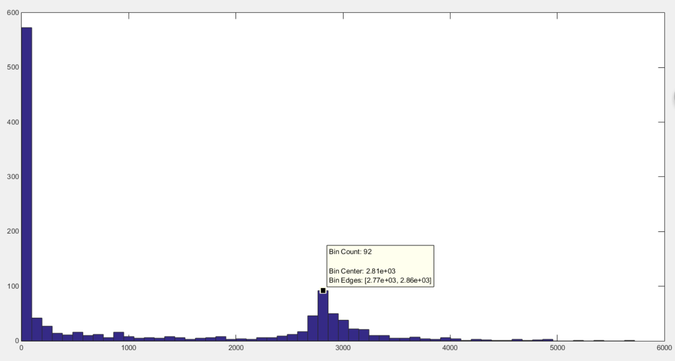
Y: number of events
X: Npe*Gain*10⁻⁶
Npe=X/Gain*10⁻⁶
X=2810 (1100V)

Slide 4
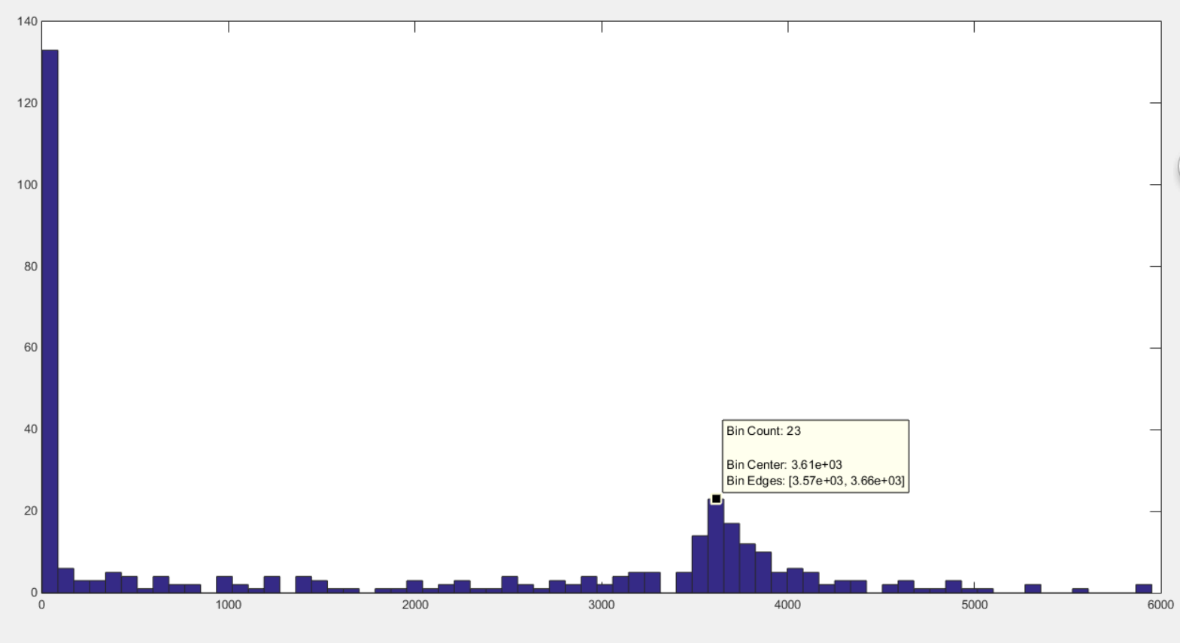
Y: number of events
X: Npe*Gain*10⁻⁶
Npe=X/Gain*10⁻⁶
X=3610 (1200V)

Slide 5
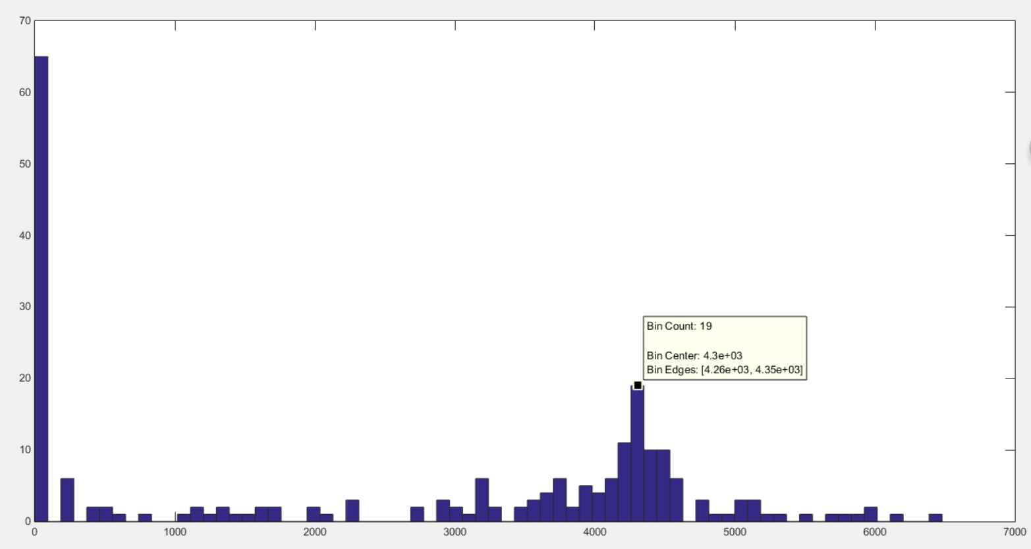
Y: number of events
X: Npe*Gain*10⁻⁶
Npe=X/Gain*10⁻⁶
X=4300 (1300V)

Slide 6
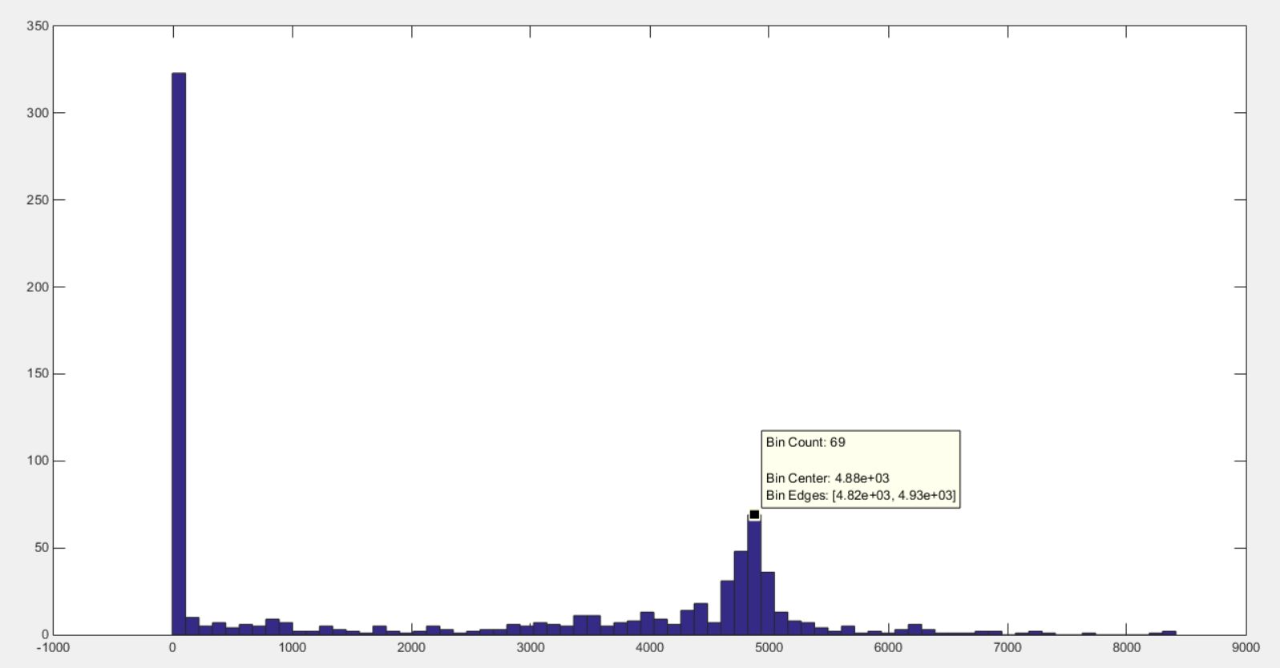
Y: number of events
X: Npe*Gain*10⁻⁶
Npe=X/Gain*10⁻⁶
X=4880 (1400V)

Slide 8
Clear fiber test

Slide 9
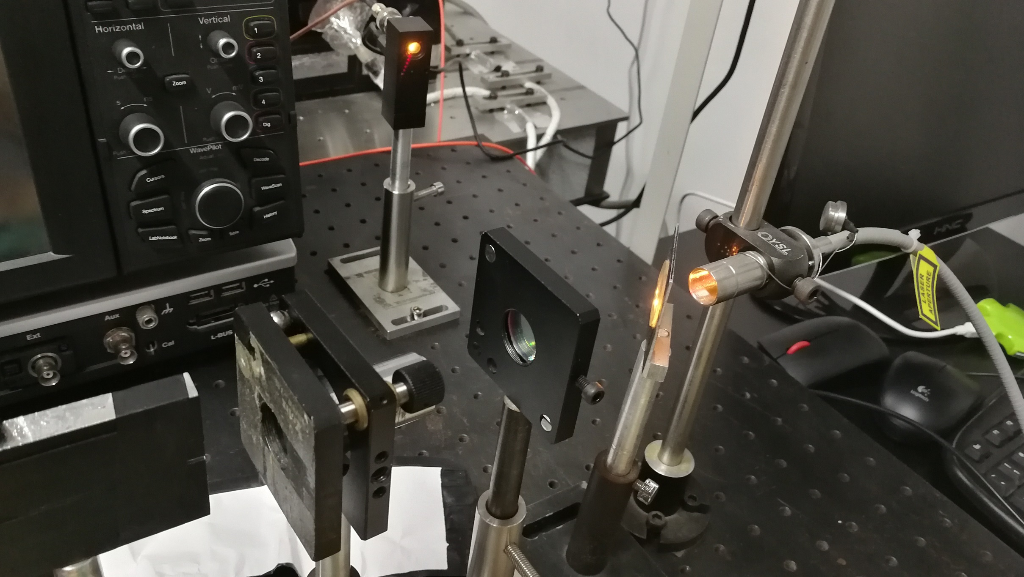
monitor
Convex lens
(facular)
Filter sheet
(531nm)
Laser source
(white light)
Clear fiber
spectroscope

Slide 10
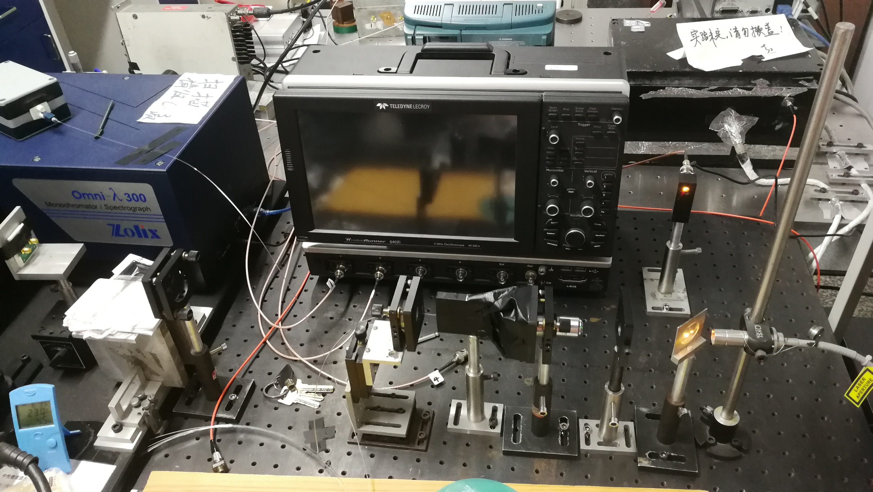
We want to use black tape to prevent light leakage. However, Convex lens would be moved when we change the length of the fiber again and again. We found that the signal of 6m is smaller that 7m. So the result is not reasonable. I will do this test again after I improving the set up.

Slide 11
Thank you !!!

