Slide 1
LASPD time resolution test update
Ye Tian(SDU), Jixie Zhang
09/21/2017

Slide 2
Test setup
LASPD
PMT0 and PMT2
Trigger bar
0.75”
2”
2”
1.75”
Narrow side
PMT4
Wide side
PMT1
PMT3 and PMT5
Test result shows in this presentation

Slide 3
Low efficiency
Event rate: 3Hz
For run 1155
Original events: 53000
Pass (track==1) cut: 7323
Pass (triggered by main trigger) cut: 1189
With signal in SPD cut: 399
FADC low signal cut: 280

Slide 4
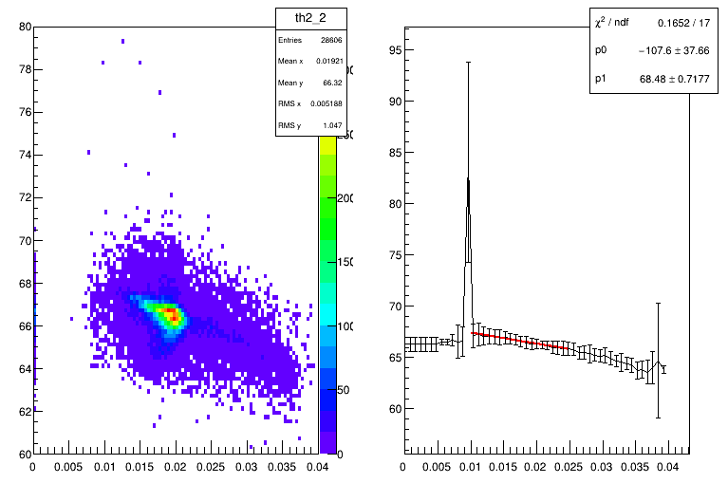
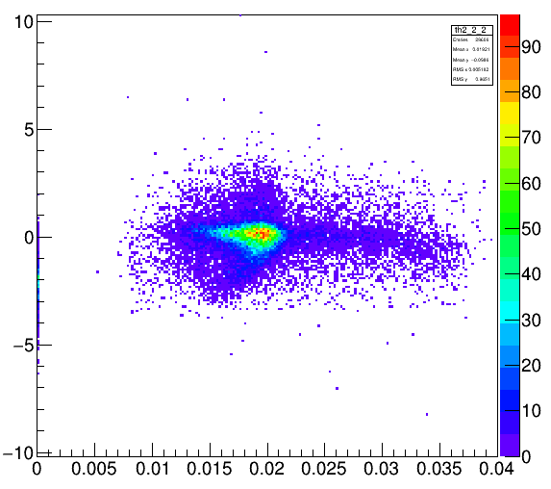
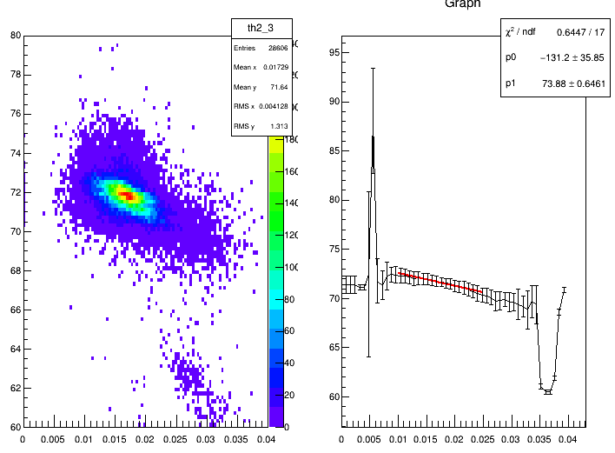
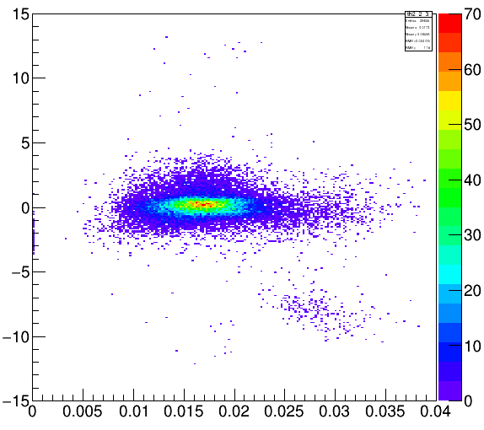
Time walk correction X axis: 1/$\sqrt{FADC channel}$, Y axis: time(ns)
After time walk correction

Slide 5
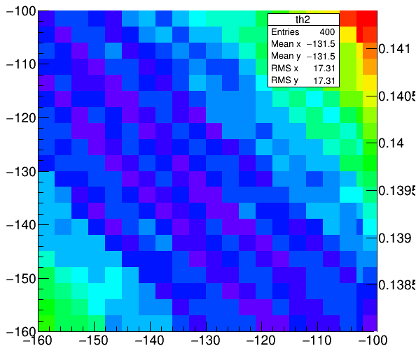
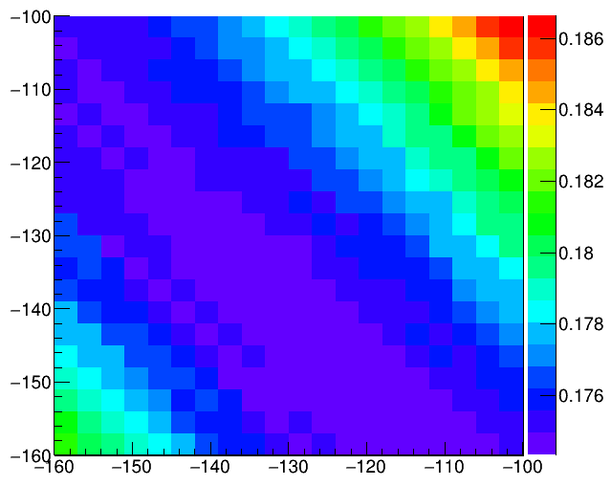
Time walk correction for trigger bar
Time resolution is calculated as
$T=\frac{t0+t3+t2+t5}{4}$ - $\frac{t1+t4}{2}$
X and Y axis are slopes of two PMTs in trigger bar,
time resolution unit: ns
Result without FADC integral signal cut

Slide 6
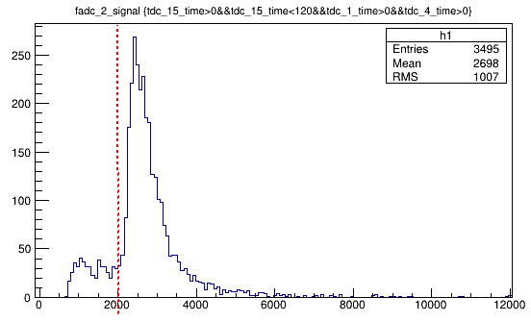
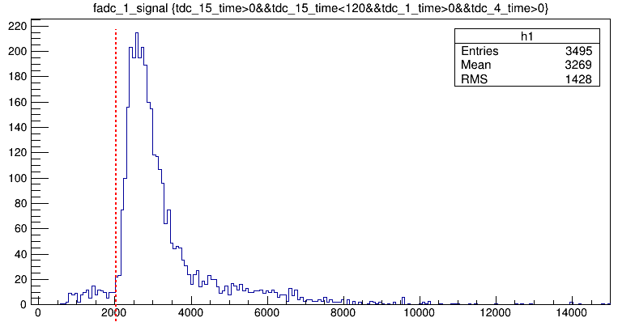
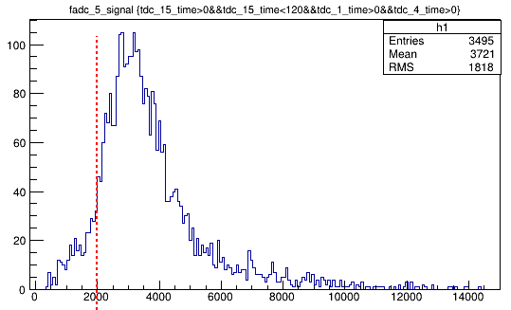
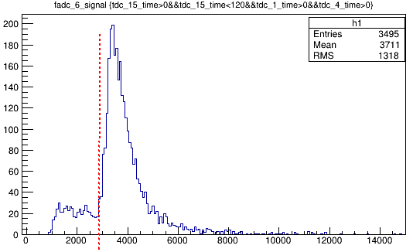
FADC channel Integral cut need all 6 PMTs satisfy the cut
>2000
>2000
>2000
>2800

Slide 7
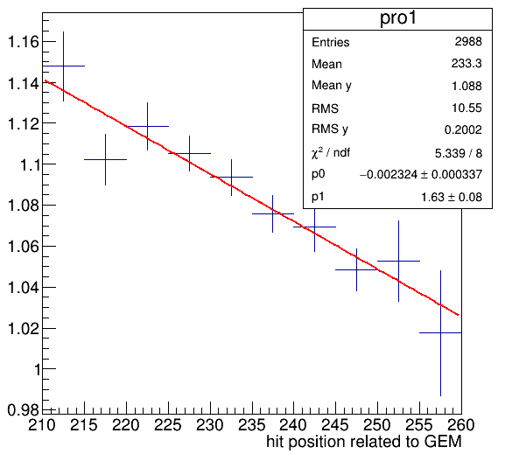
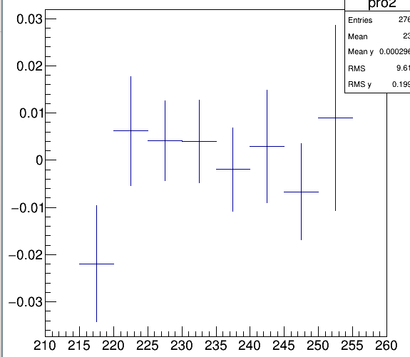
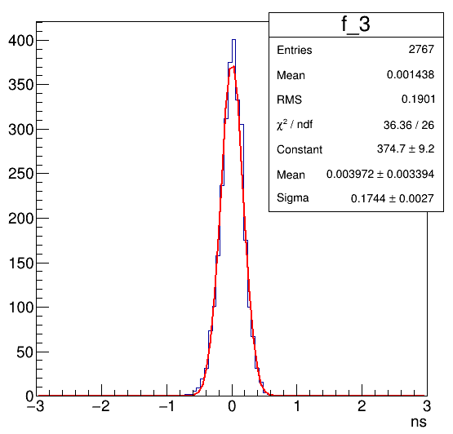
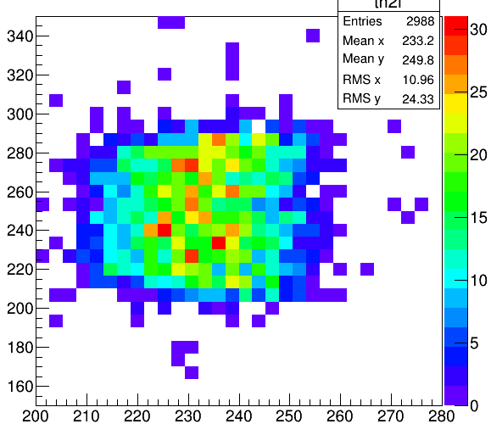
Time resolution of single PMT readout(wide side)
$Y=\frac{t0+t3+t2+t5}{4}$ -t1
After correction
Fitting: Y=p0*X+p1
Time resolution after correction
Hit position on SPD

Slide 8
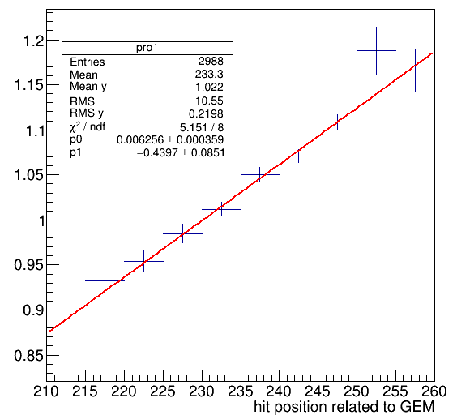
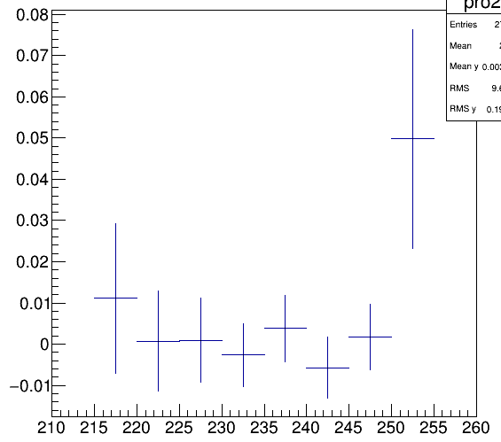
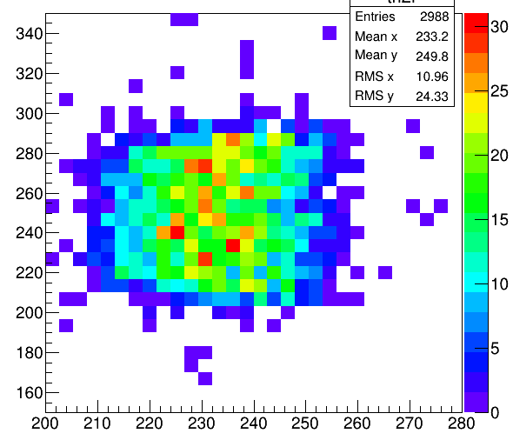
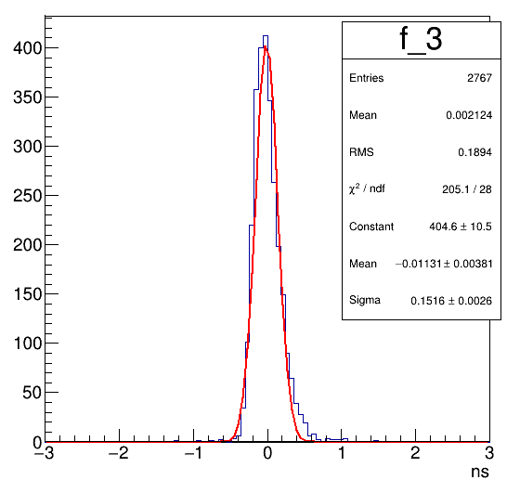
Time resolution of single PMT readout(narrow side)
$Y=\frac{t0+t3+t2+t5}{4}$ -t4

