Slide 1
THU2 cosmic test results (6)
Chendi Shen
2017.9.21

Slide 2
Horizontal Test

Slide 3
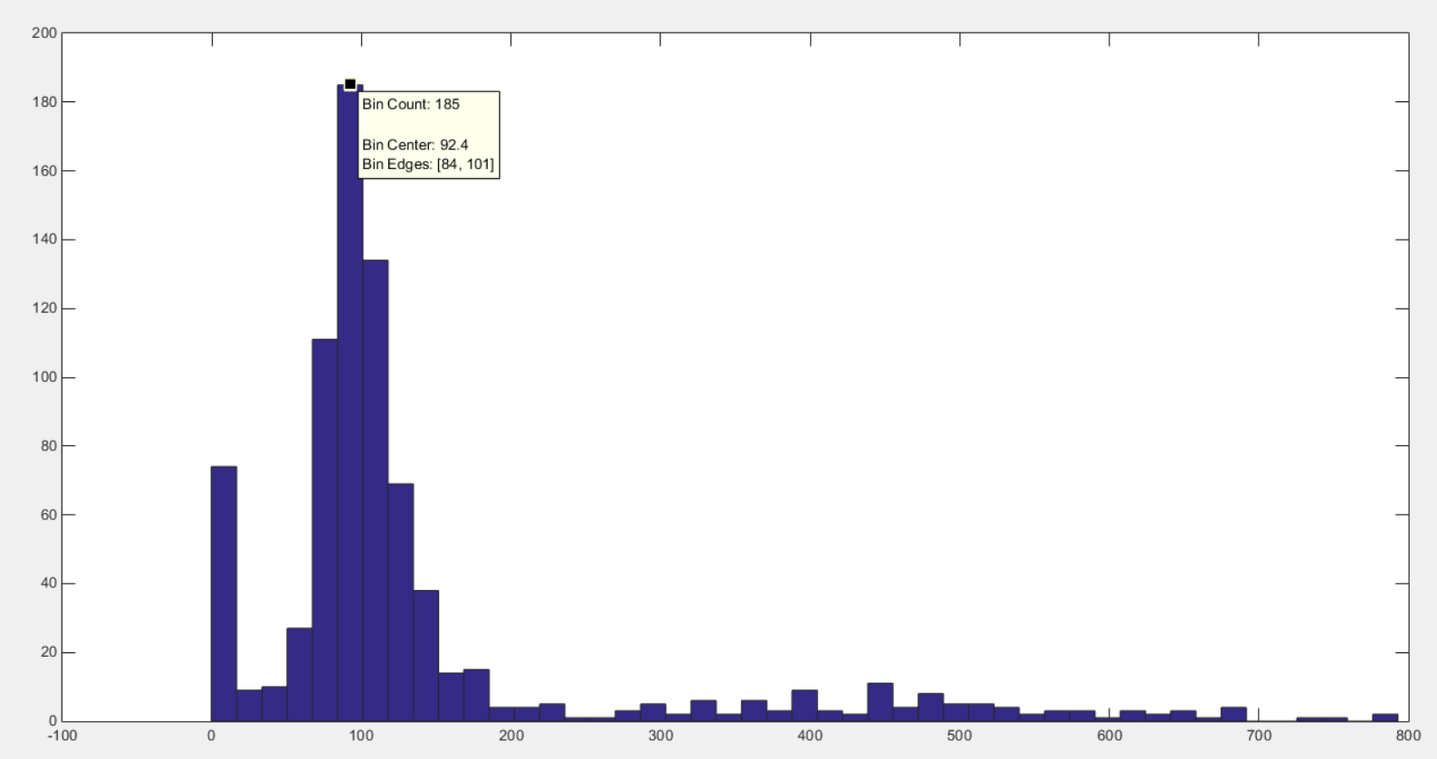
Experiment 01
HV=1000V scintillator for trigger(up: 10cm*5cm*5cm down: 3cm*3cm*3cm)
No attenuator
Npe=[(QDC-ped)*0.1*10⁻¹²]/(1.6*10⁻¹⁹*3.1*10⁶)
Npe=92.4
ECal
Total Number of events 805
ECal
Move backwards by 10cm
ECal
Move forward by 10cm
Npe

Slide 4
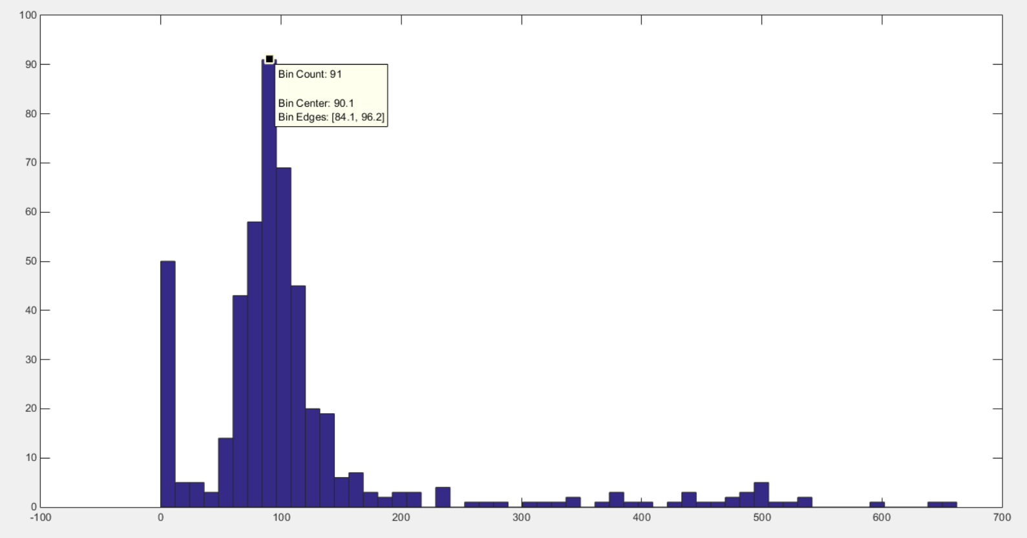
Experiment 02
HV=1000V scintillator for trigger(up: 10cm*5cm*5cm down: 3cm*3cm*3cm)
No attenuator
Npe=[(QDC-ped)*0.1*10⁻¹²]/(1.6*10⁻¹⁹*3.1*10⁶)
Npe=90.1
ECal
Total Number of events 487
ECal
Move backwards by 10cm
ECal
Move forward by 10cm
Npe

Slide 5
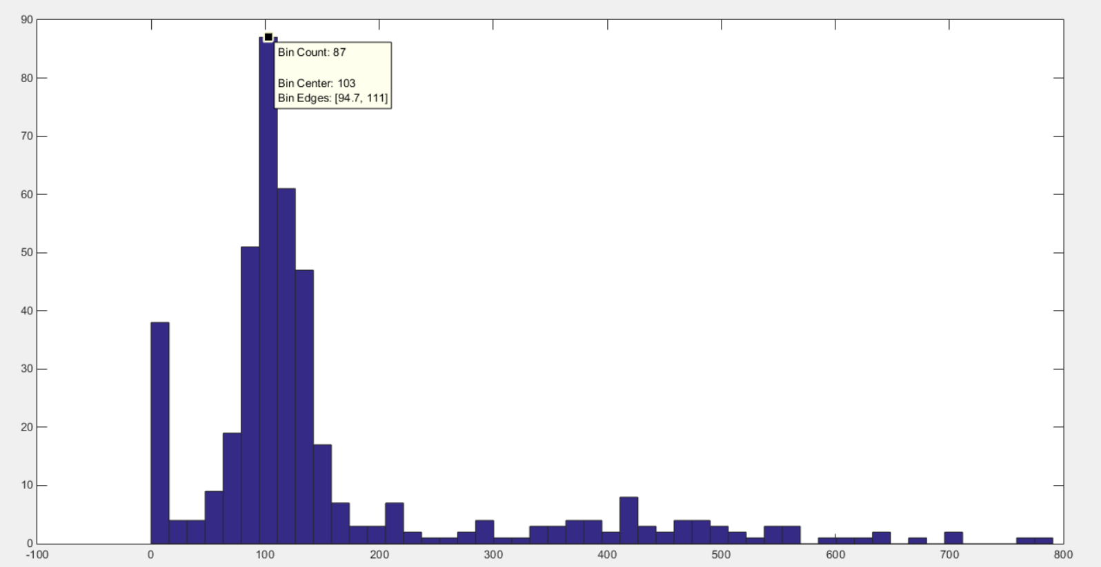
Experiment 03
HV=1000V scintillator for trigger(up: 10cm*5cm*5cm down: 3cm*3cm*3cm)
No attenuator
Npe=[(QDC-ped)*0.1*10⁻¹²]/(1.6*10⁻¹⁹*3.1*10⁶)
Npe=103
ECal
Total Number of events 428
ECal
Move backwards by 10cm
ECal
Move forward by 10cm
Npe

Slide 6
10cm
10cm
ECal
Npe=90.1
Move backwards by 10cm
The farther away from PMT, the smaller the NPE
The efficiency of the detector in horizontal test all is about 93%
Npe=92.4
ECal
ECal
Npe=103
Move forward by 10cm

Slide 7
Gain of the PMT (SPE)
Because we want to complete the scale of the gain and continue the cosmic ray test as soon as possible, so we finished this experiment at the IHEP in Beijing.
Their research is development of the PMT for Jiangmen neutrino experiment, so they have a wealth of experience with the PMT gain scale

Slide 8
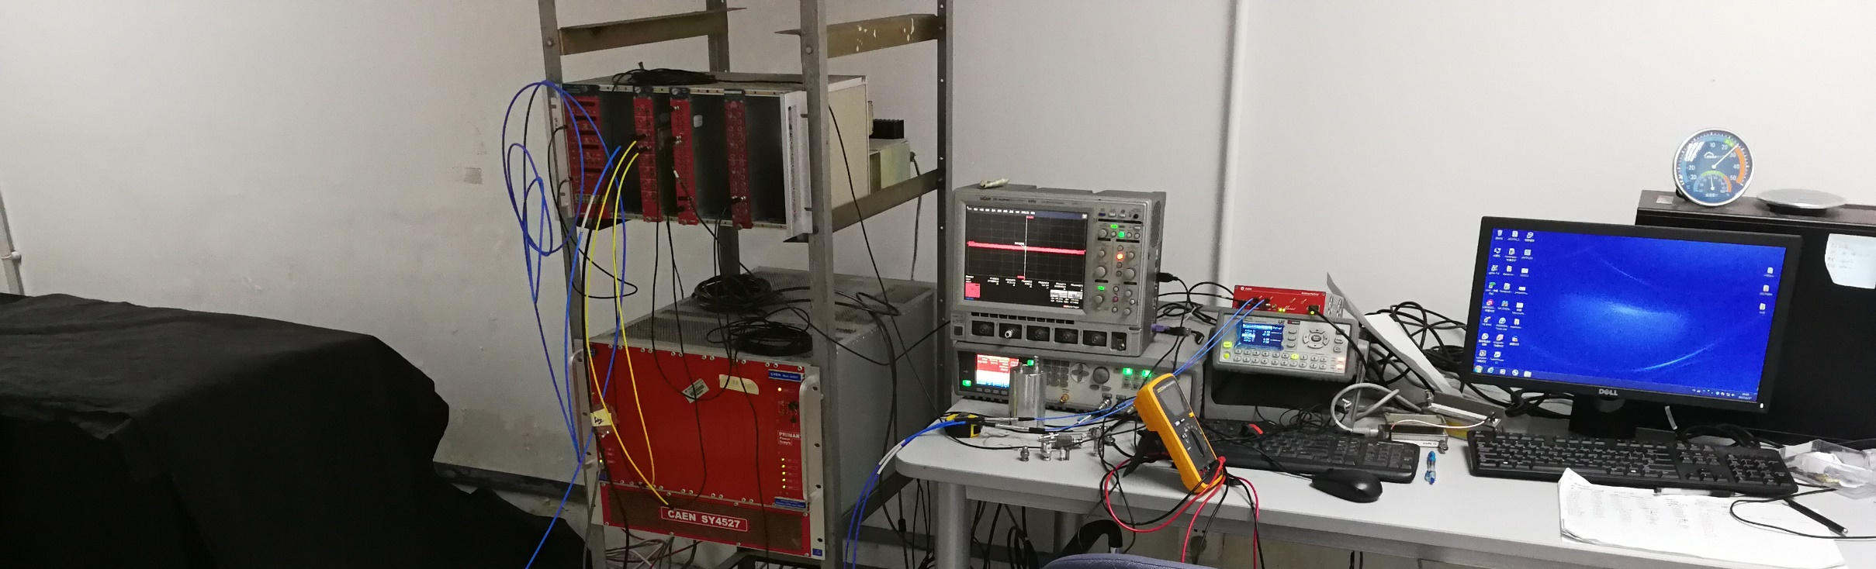
Signal generator
Trigger (300HZ)
FADC (DT5751)
PC
LED
PMT
Amplifier (x11)
Dark Box

Slide 9
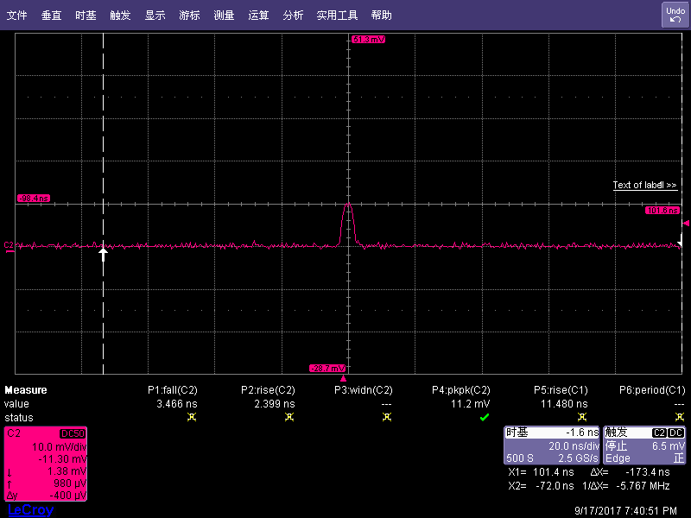
Calibration of Amplifier
Before adding the amplifier（10mv）
x11
After adding the amplifier (110mv)
Signal generator
Oscilloscope
Signal generator
Amplifier
Oscilloscope

Slide 10
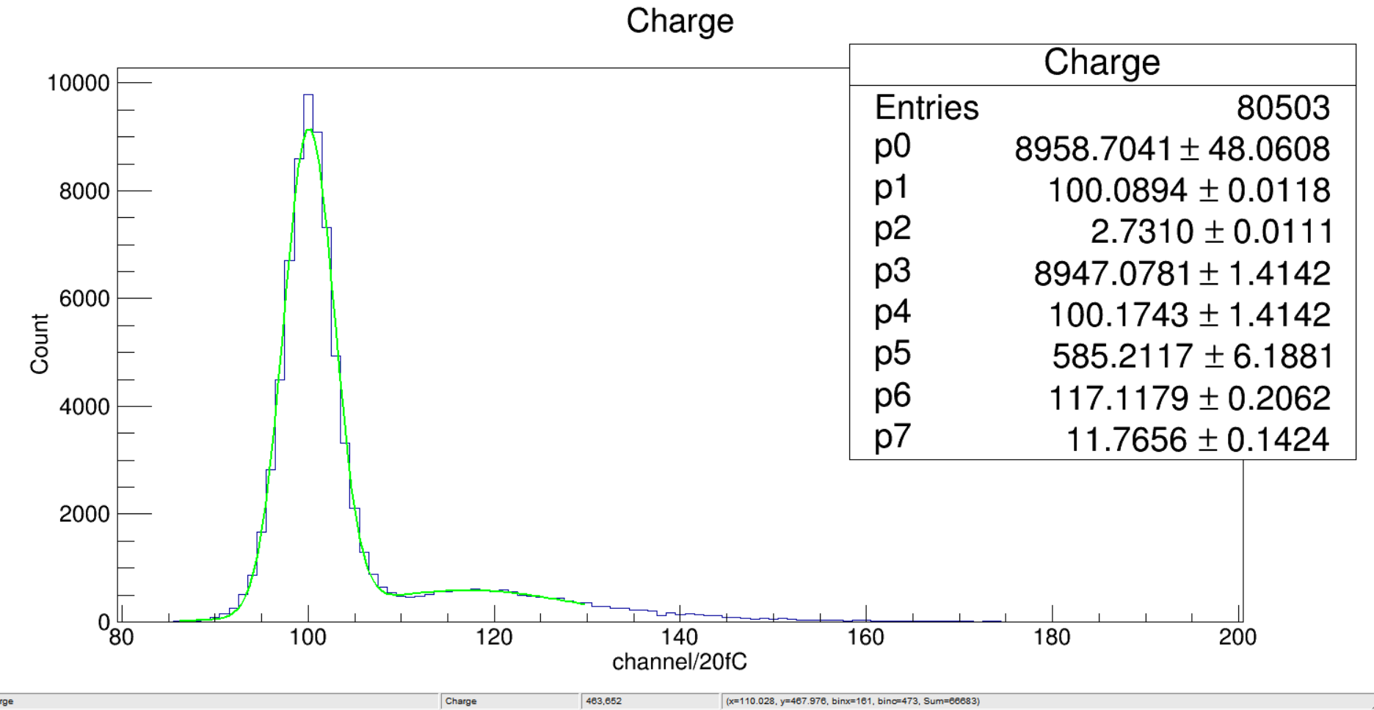
Exponential
Gain
1000V
Gaussian 1
Gaussian 2
Eff$=$13820/80503=17%
P( 0, 0.17) = 84%
P( 1, 0.17) = 14%
1-P( 0, 0.17)-P( 1, 0.17) = 2%
P(SPE)/P(PE) = 14%/(14%+2%)
= 87.5%
Gain=[(p6-p1)*20*10⁻¹⁵]/(1.6*10⁻¹⁹)
=2.2*10⁶
Gain(sp/sk)=3.1*10⁶
Events: 66683
Events: 13820

Slide 11
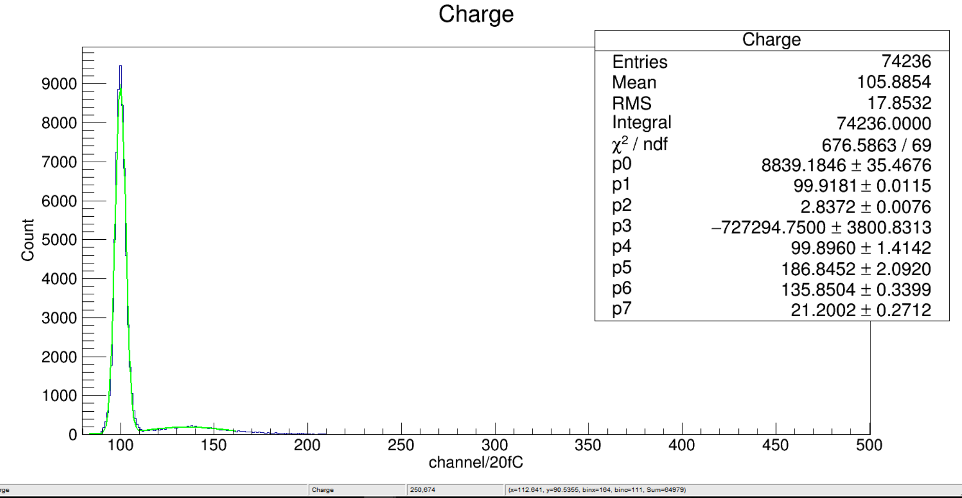
Gaussian 1
Exponential
Gain
1100V
Gaussian 2
Eff$=$13820/80503=13%
P( 0, 0.13) = 88%
P( 1, 0.13) = 11%
1-P( 0, 0.13)-P( 1, 0.13) = 1%
P(SPE)/P(PE) = 11%/(11%+1%)
= 91.6%
Gain=[(p6-p1)*20*10⁻¹⁵]/(1.6*10⁻¹⁹)
=4.5*10⁶
Gain(sp/sk)=6.5*10⁶
Events: 64979
Events: 9257

Slide 12
Summary
The farther away from PMT, the smaller the NPE
The efficiency of the detector in horizontal test all is about 93%
The gain is obtained by NPE method. 2.2*10⁶ (1000V), 4.5*10⁶ (1100V)
Next to do
Now we have back to the vertical test and will get the Npe at 900V and 1000V.

