Slide 1
THU2 Cosmic test with SDU PMT
Chendi Shen
2017.11.16

Slide 2
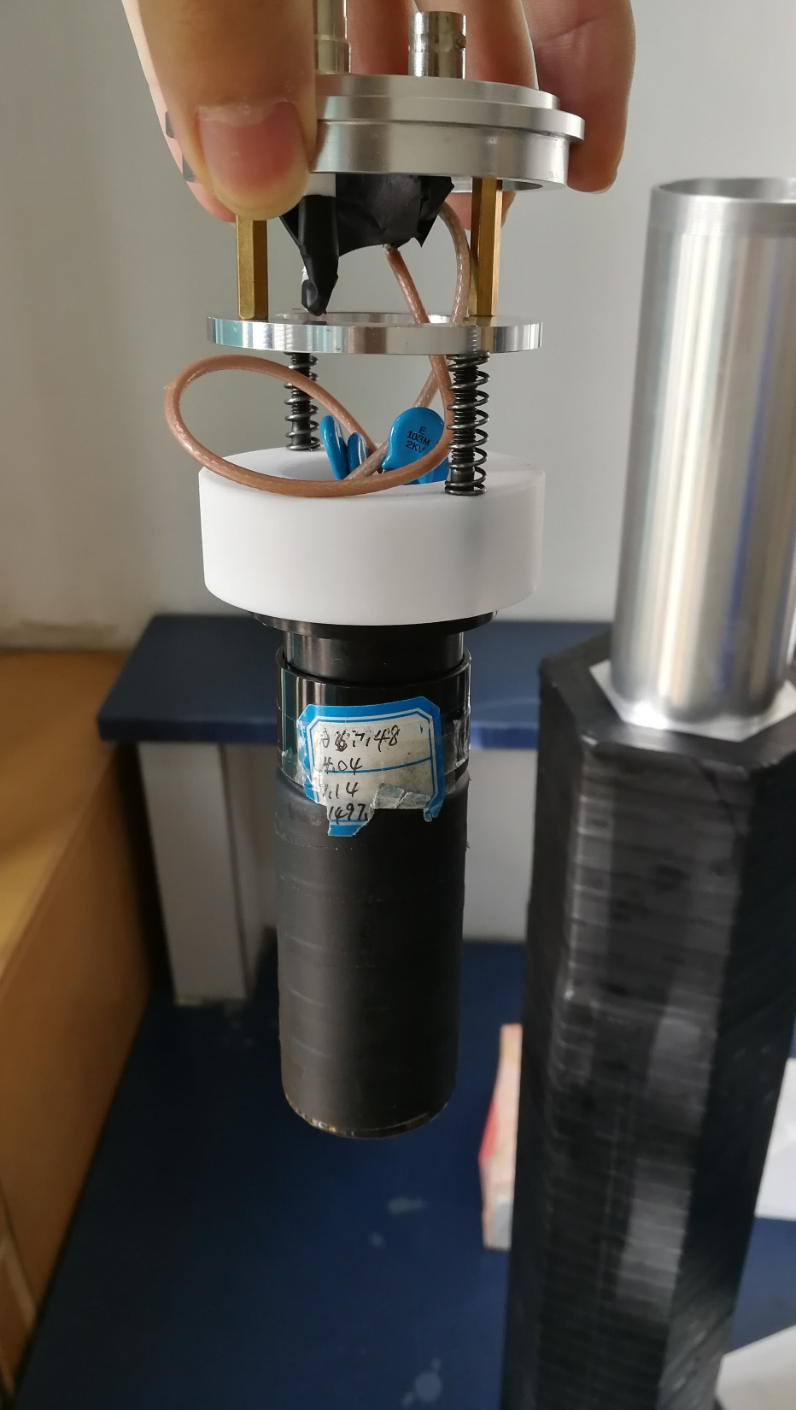
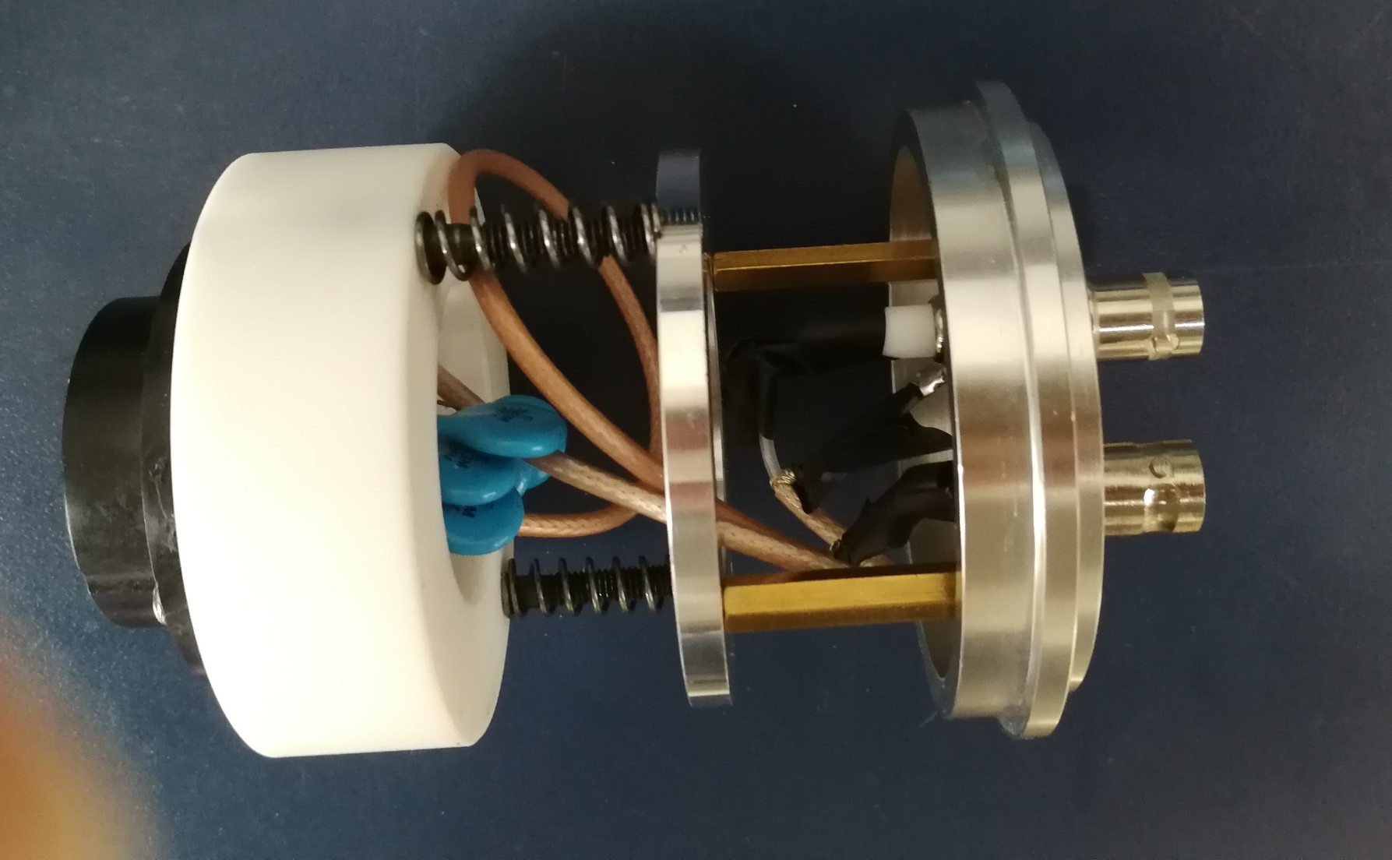
SDU PMT and SDU base

Slide 3
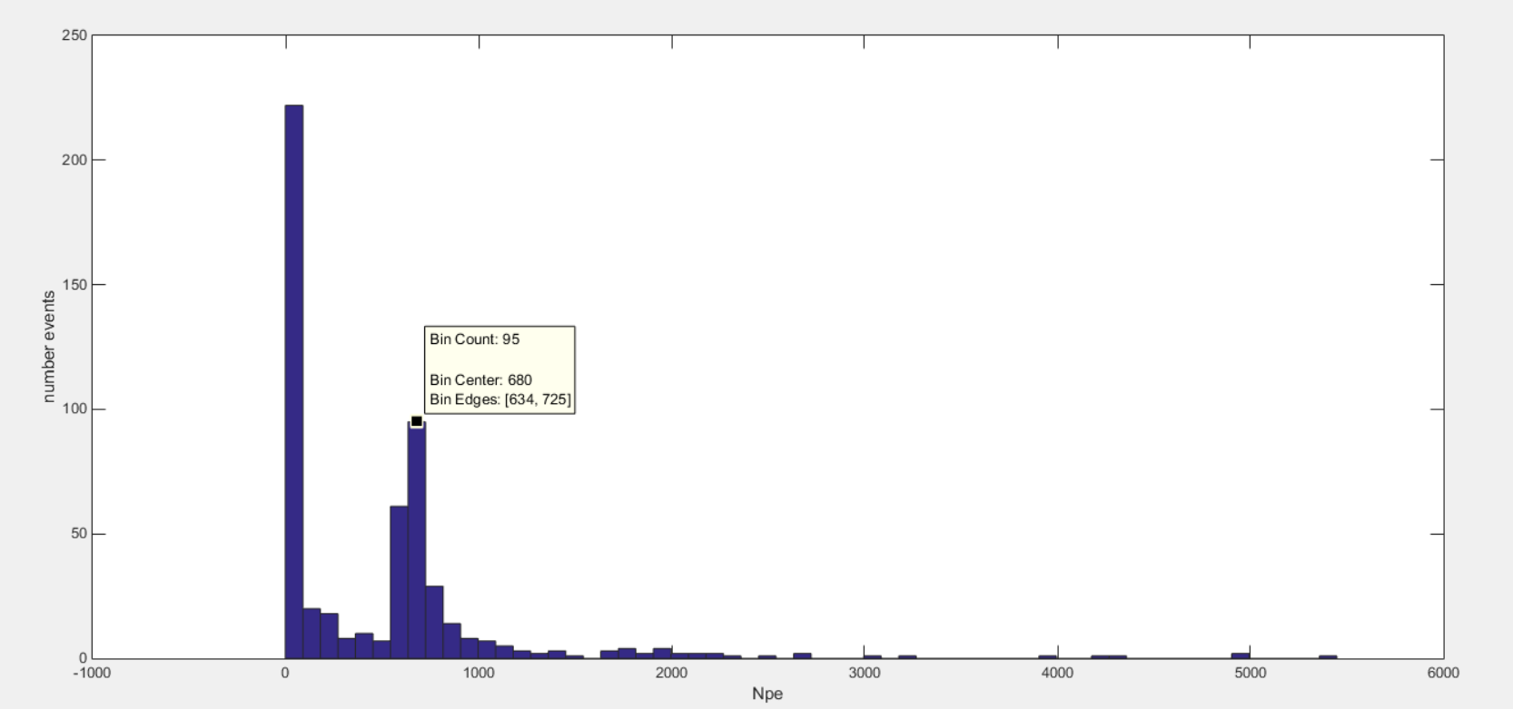
1050V (total number of events: 550) npe=680

Slide 4
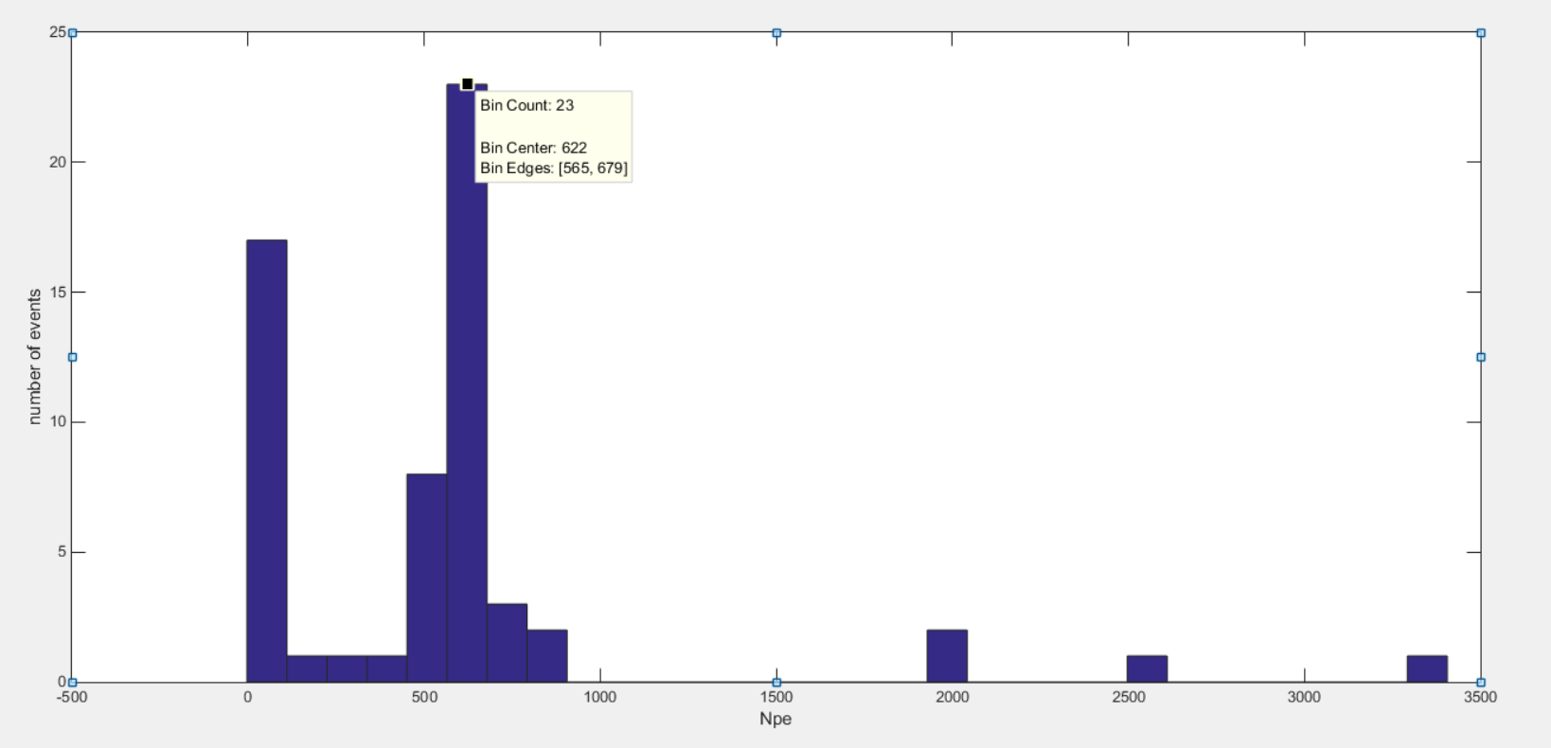
1100V (total number of events: 50)
Npe=622
The speed of data taking is very slow (2 events/hour)
I will use one week to get 500 events

Slide 5
Gain of PMT
 | THU PMT |  | SDU PMT
HV | hamamatsu | IHEP | SDU
900 | 1.3*10⁶
1000 | 3.1*10⁶ | 2.2*10⁶
1050 |  |  | 4.11*10⁶
1100 | 6.5*10⁶ | 4.5*10⁶ | 5.997*10⁶
1200 | 13.3*10⁶ |  | 11.227*10⁶
1300 | 26.1*10⁶

Slide 6
Test results
The SDU PMT is saturated at 1100V, we don’t know whether it is also saturated at 1050V
We need to get Gain of the SDU PMT under 1000V and 900V to compare with the results what we have got.

