Slide 1
THU2 Cosmic test with SDU PMT （3）
Chendi Shen
2018.2.1

Slide 2
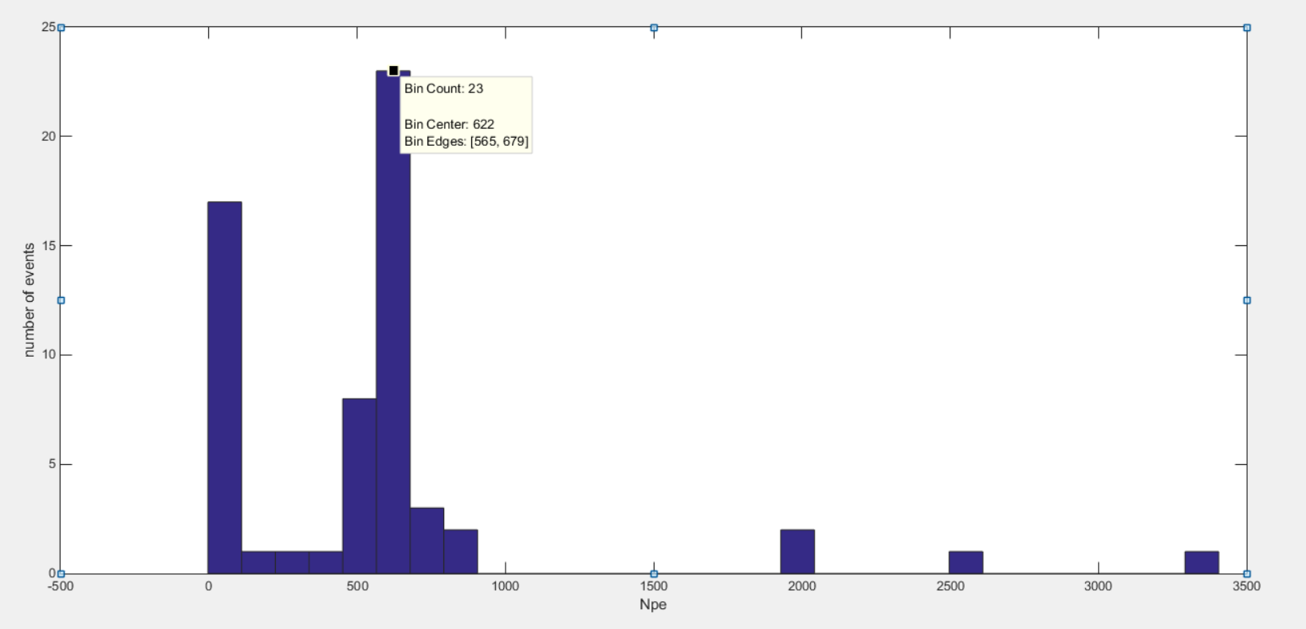
1100V (total number of events: 50)
Npe=622

Slide 3
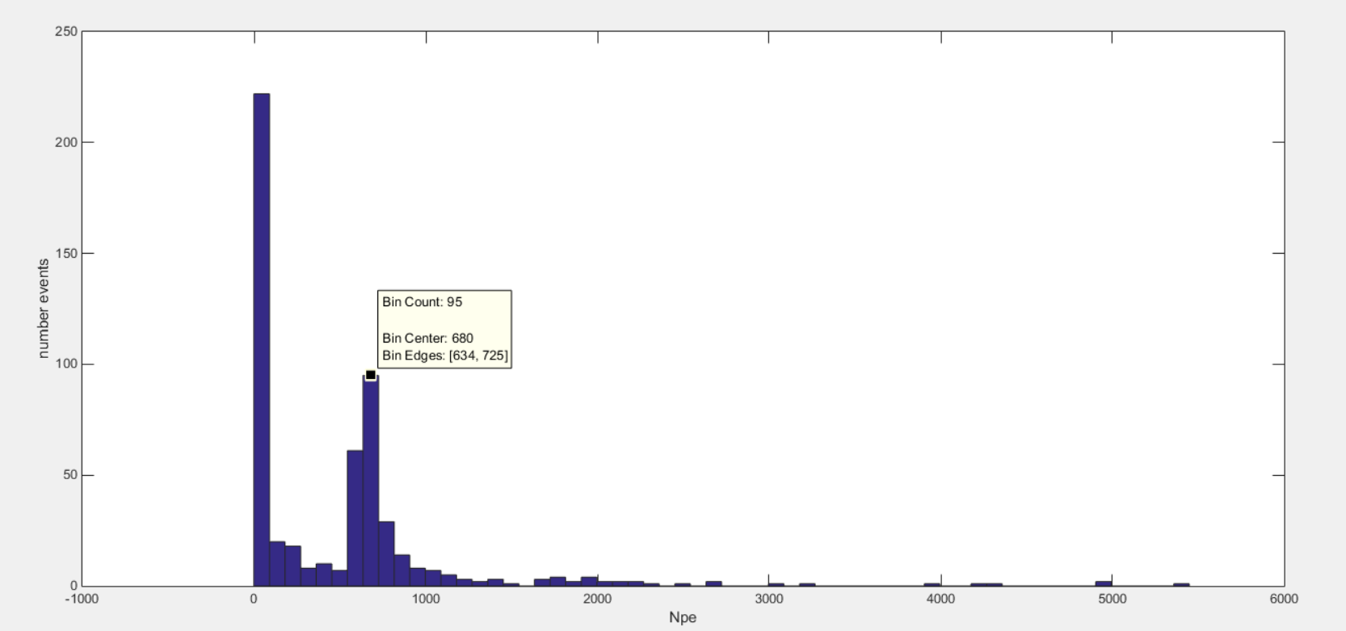
1050V (total number of events: 550) npe=680

Slide 4
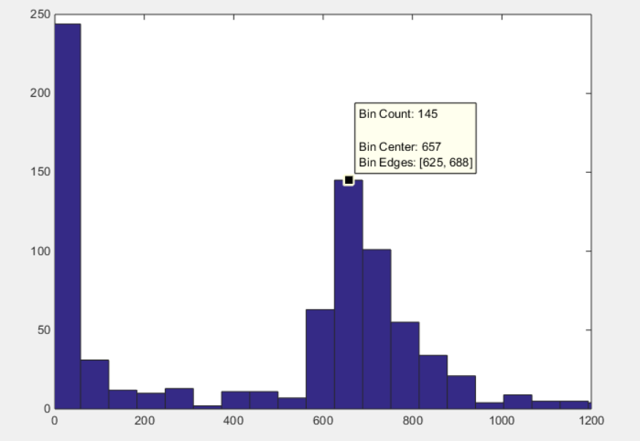
HV=1000 V
number of events 870
Npe=657

Slide 5
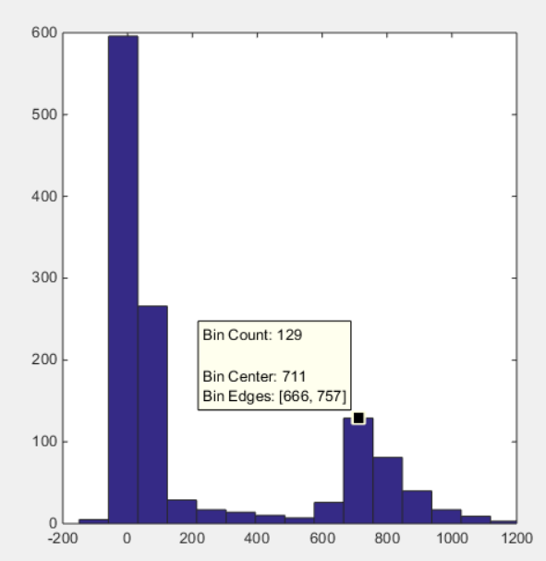
HV=900 V
number of events 1330
Npe=711

Slide 6
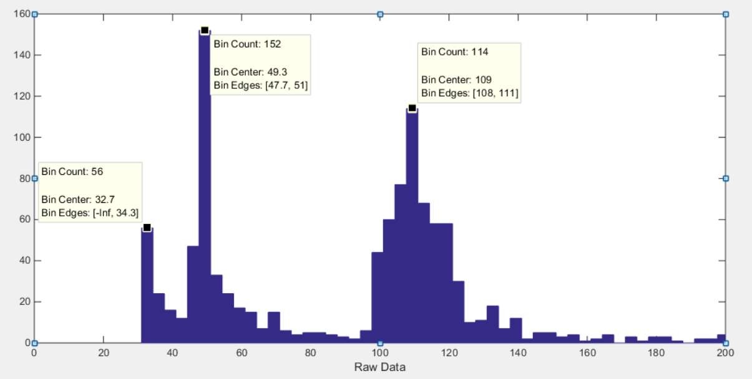
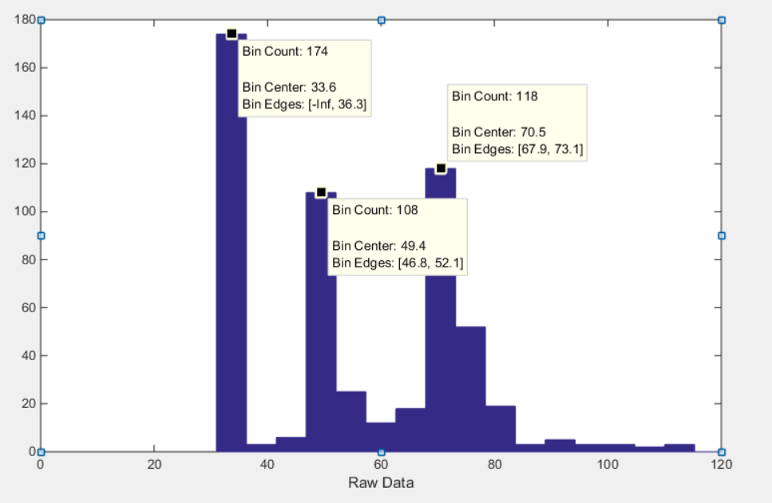
Raw Data
HV=800 V
number of events 1160
Raw Data
HV=700 V
number of events 590
109
70.5
49.3
49.4
Npe = [(Raw data – ped) * 0.1pc/chanel * 10⁻¹² * 9.4] / (Gain * e)
The first peak (49.3/49.4) has nothing to do with high pressure,
So the problem is that long time testing can cause ped to shake.

Slide 7
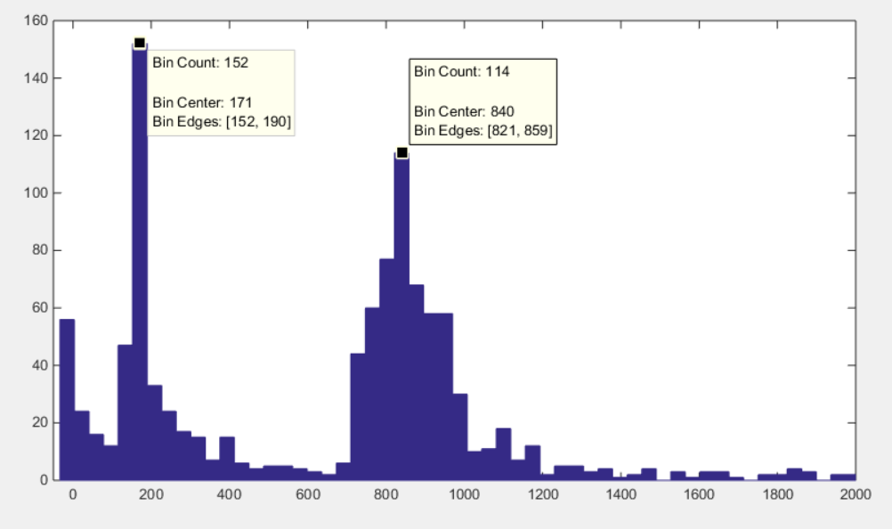
HV=800 V
number of events 1160
For this long time (70 days) test, DAQ generated shaking, which led to the appearance of the first peak.
Npe=840-171=669
Npe=669

Slide 8
Gain of PMT
 | THU PMT |  | SDU PMT
HV | hamamatsu | IHEP | SDU
800 |  |  | 0.527*10⁶
900 | 1.3*10⁶ |  | 1.295*10⁶
1000 | 3.1*10⁶ | 2.2*10⁶ | 2.9*10⁶
1050 |  |  | 4.11*10⁶
1100 | 6.5*10⁶ | 4.5*10⁶ | 5.997*10⁶
1200 | 13.3*10⁶ |  | 11.227*10⁶
1300 | 26.1*10⁶

Slide 9
Test results
SDU PMT is stable and the result is more reasonable, so Npe of THU2 is around 680.

