Slide 1
Shashlik module and PMT test
Ye Tian
02/01/2018
Shandong Univesity

Slide 2
Outline
PMT in THU#2 linearity test
THU powder paint test
SDU#3 test with higher voltage
Shashlik cosmic ray test in JLab

Slide 3
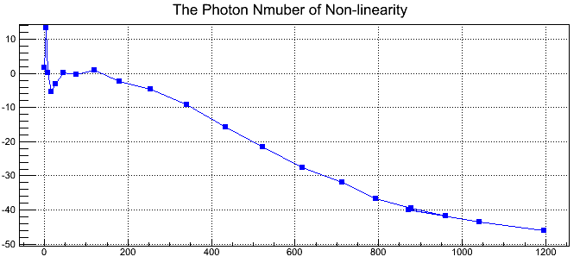
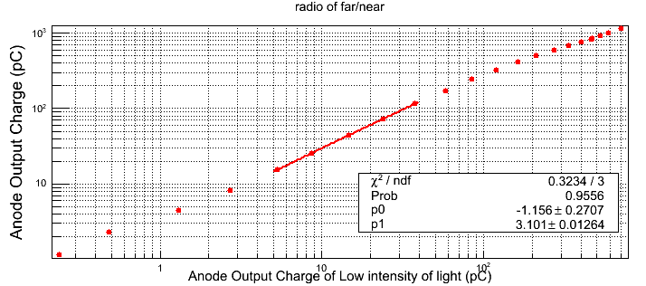
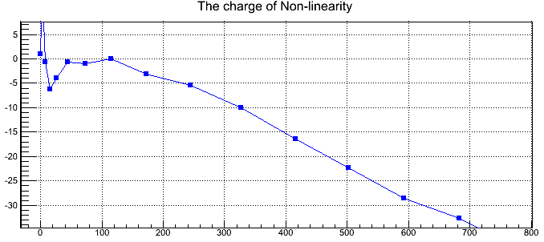
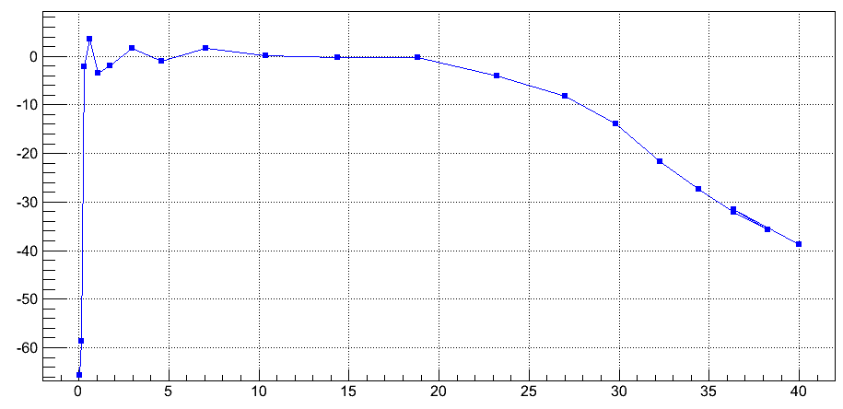
SDU PMT(67748) in THU#2 linearity test(20ns LED pulse) HV: 1100V(5.997*10^6)
300
Photon number
Charge(pC)

Slide 4
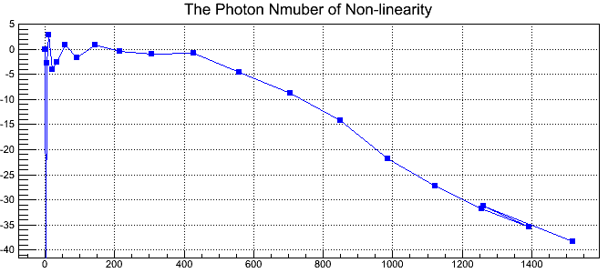
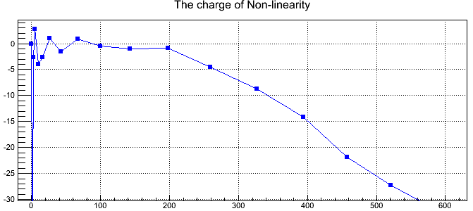
HV: 1000V(2.9*10^6)
550
Photon number
Charge(pC)

Slide 5
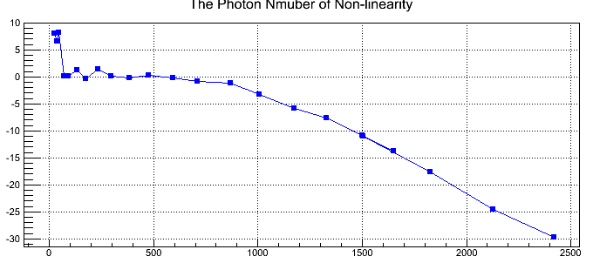
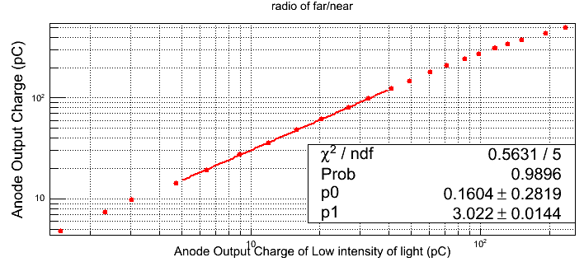
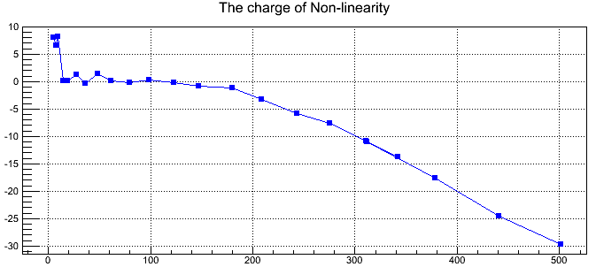
HV: 900V(1.295*10^6)
1100
Photon number
Charge(pC)

Slide 6
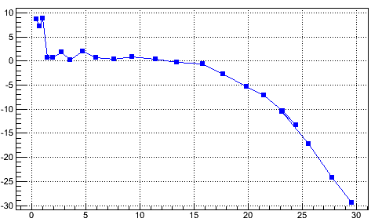
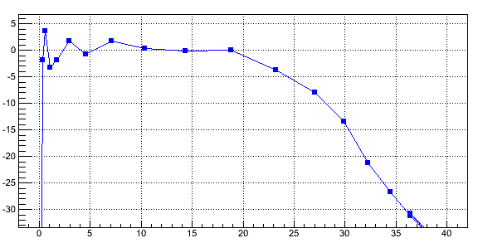
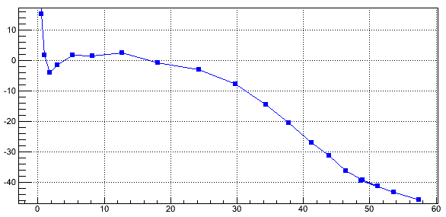
The max current(calculated from amplitude)
900V
1000V
1100V
20mA
24mA
26mA

Slide 7
Problems in linearity test:
All HVs has the max charge 250pC(-5%), the max NPEs are only influenced by the gain
For 1100V, 300 photon electrons would exceed linearity range, not corresponding to Chendi’s result
The width of LED pulse will influence the linearity range
The problems will be check soon

Slide 8
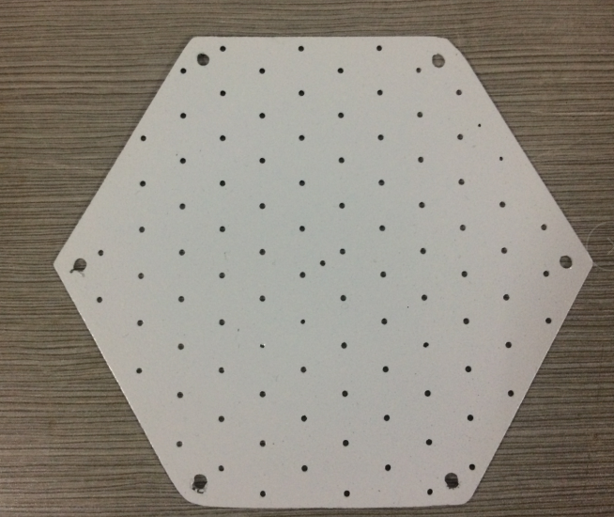
THU powder paint reflectivity test
Receive three layers of powder paint from THU, test with similar test setup as previous five layers test(only 4 scintillator layers in test now).
Test setup
comparing with same setup that only powder paint layer replaced with Tyvek-lead-tyvek
Lead
Tyvek
Scintillator
Power paint layer

Slide 9
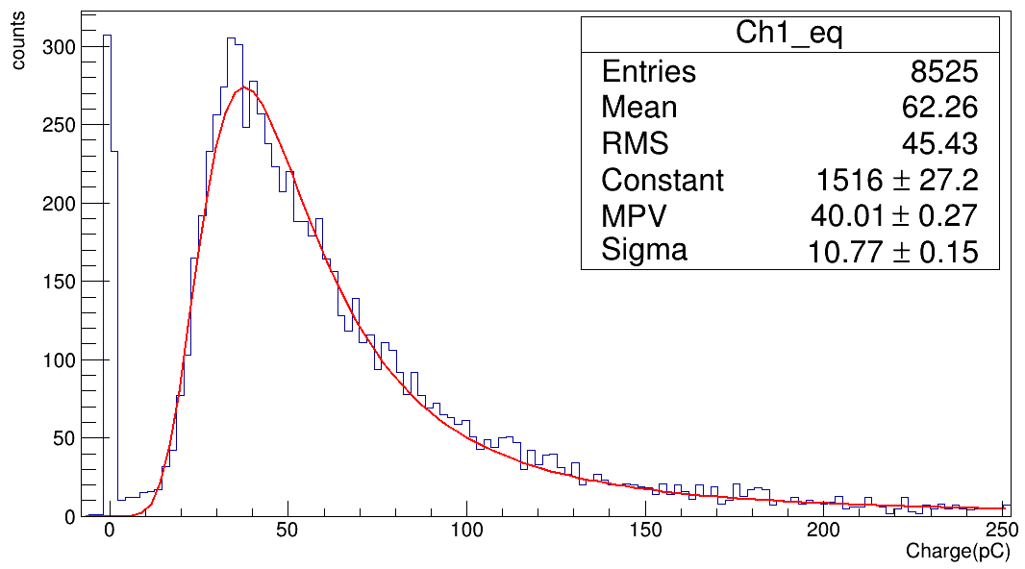
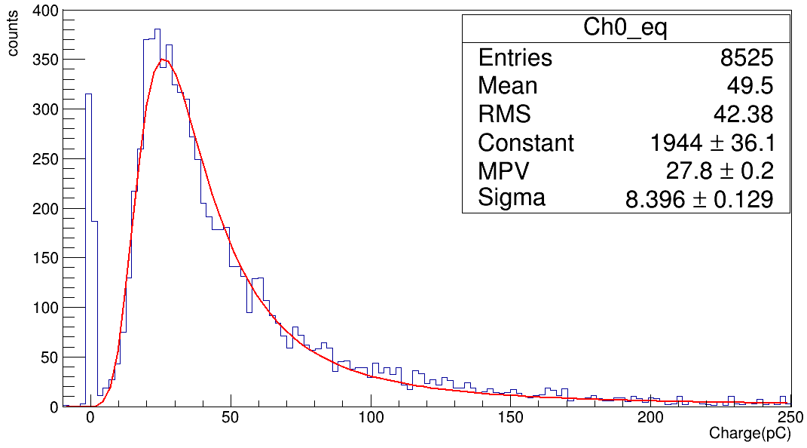
Test Result
Material | PMT | HV(V) | Gain*10^6 | Charge | NPE
powder paint | 67702 | 1100 | 5.40 | 40.1 | 46.3
tyvek | 67749 | 1000 | 5.12 | 27.8 | 33.9
powder paint
Assuming:
Power paint reflectivity =b
Tyvek reflectivity =a
We get:
$$\frac{2a+6b}{8a}=\frac{46.3}{33.9}$$
So: b/a = 1.475
Which improve much comparing with SDU modules.
tyvek

Slide 10
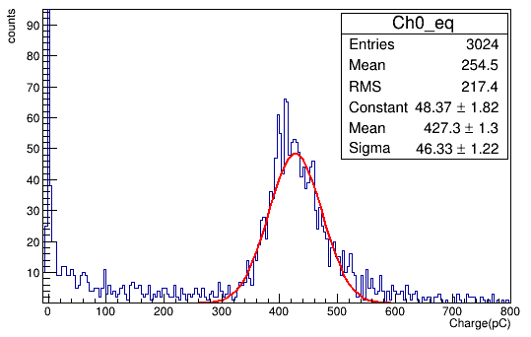
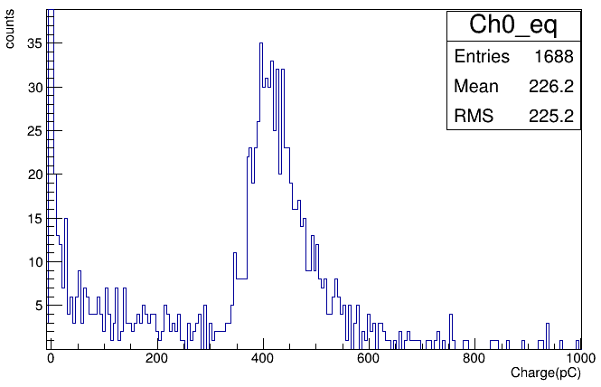
SDU#3 Higher HV test
1100V
HV | Gain(*10^6) | Charge(pC) | NPE
900 | 1.35 | 106.1 | 491.2
950 | 2.01 | 155.4 | 483.2
1000 | 2.93 | 223.9 | 477.6
1100 | 5.4 | 427.3 | 494
1200 | 9.995
1200V
Data may have problem

Slide 11
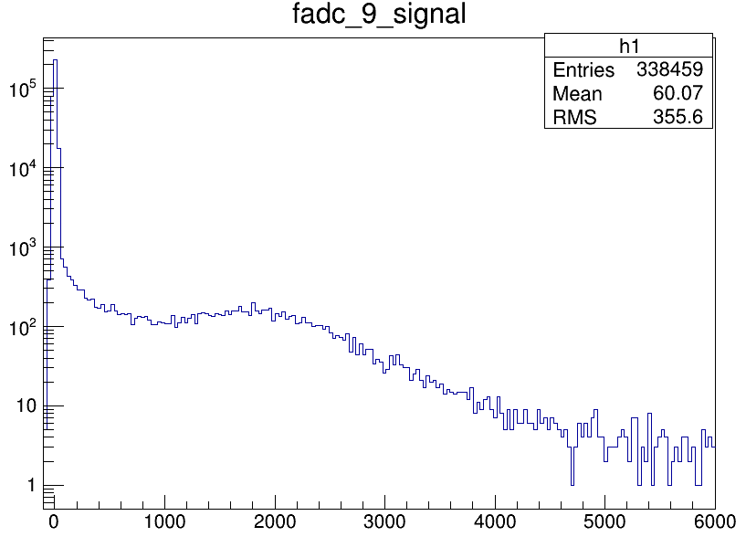
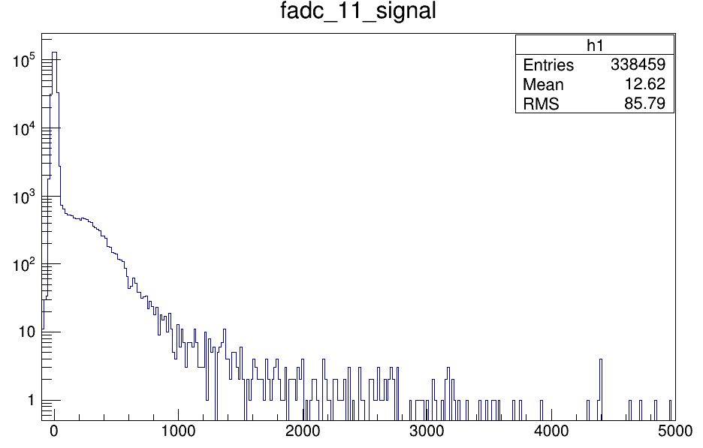
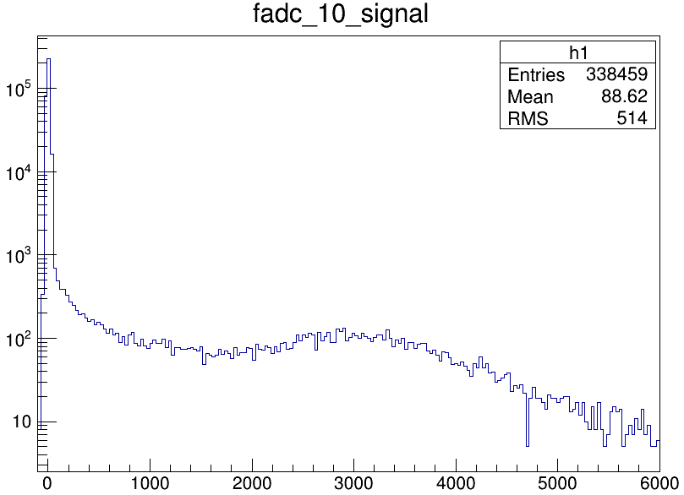
Shashlik signal in JLab cosmic test
SDU#1
Shashlik Module | HV(start from run 1140) | Gain(10^6）
THU | 1700 | ?
SDU#1 | 1453 | 5
SDU#2 | 1294 | 5
fadc channel
THU(low signal)
SDU#2
fadc channel
fadc channel

