Slide 1
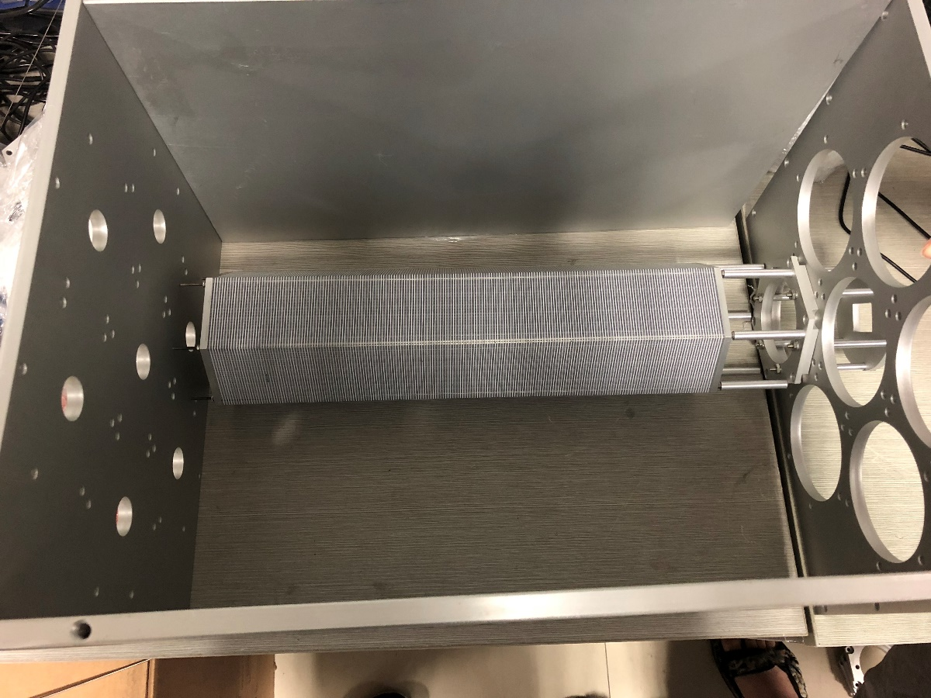
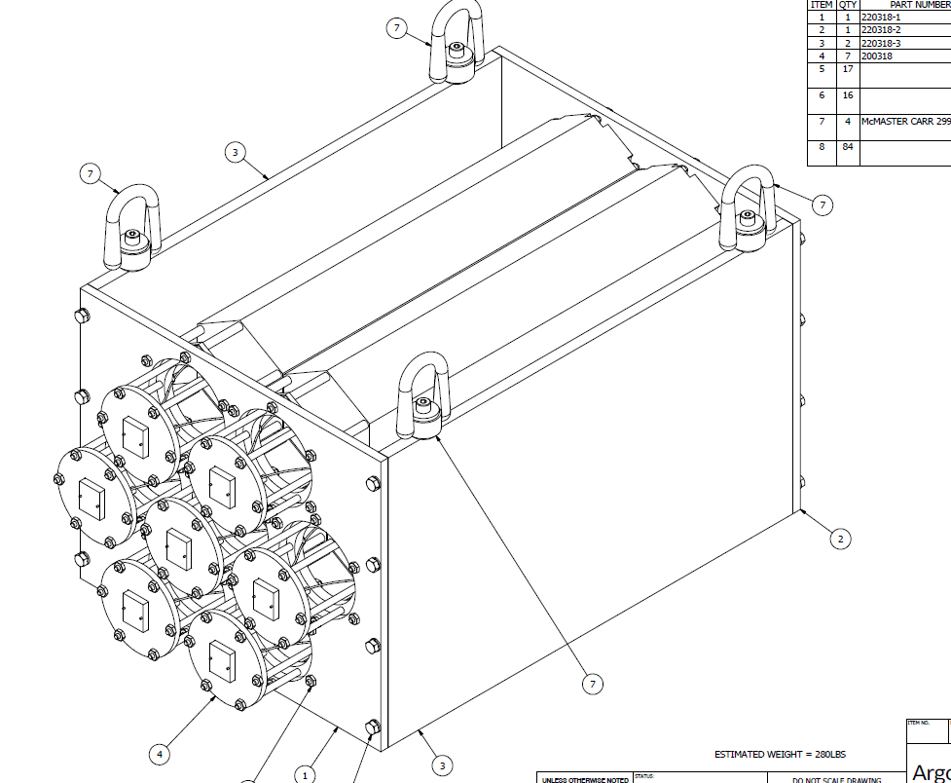
Beam test module support arrived in SDU
The support is made following the design exactly……
The main material is aluminum.
The gap between two modules is about 2.5mm.

Slide 2
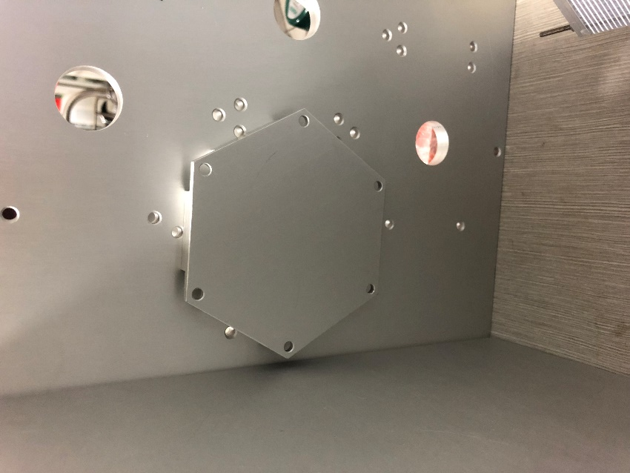
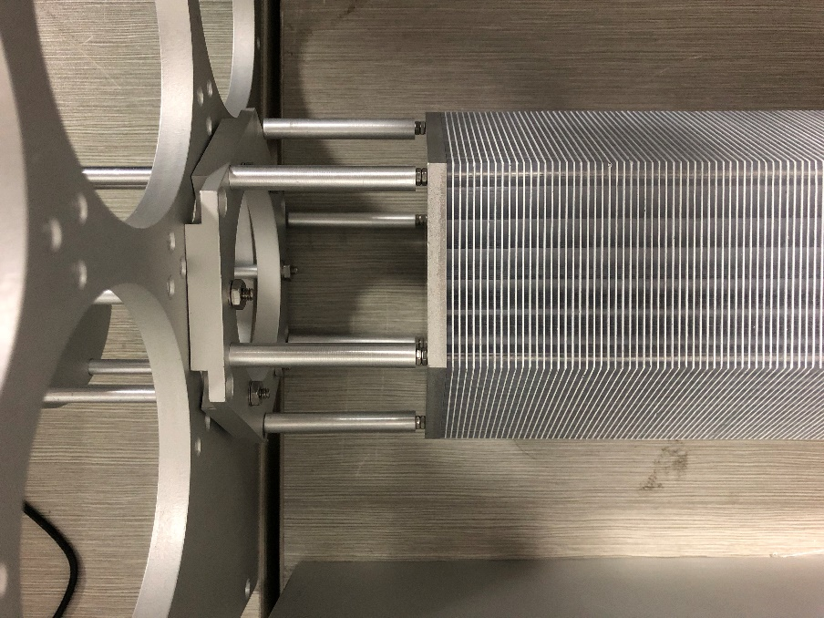
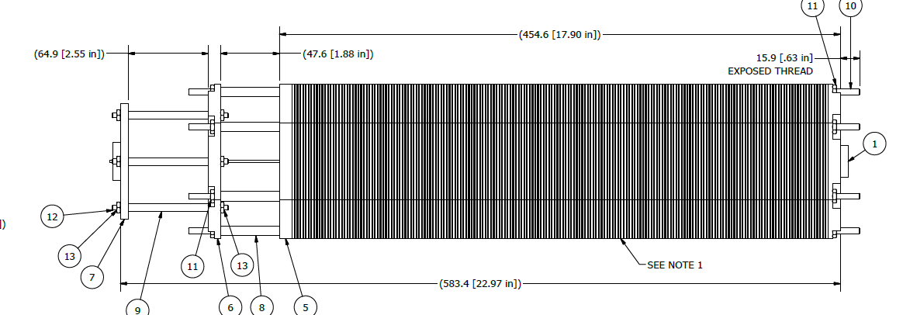
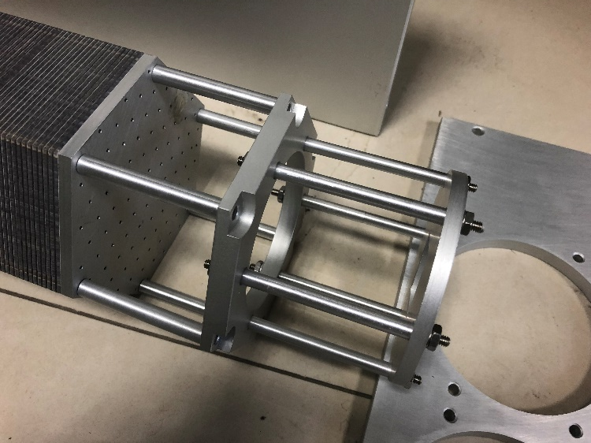
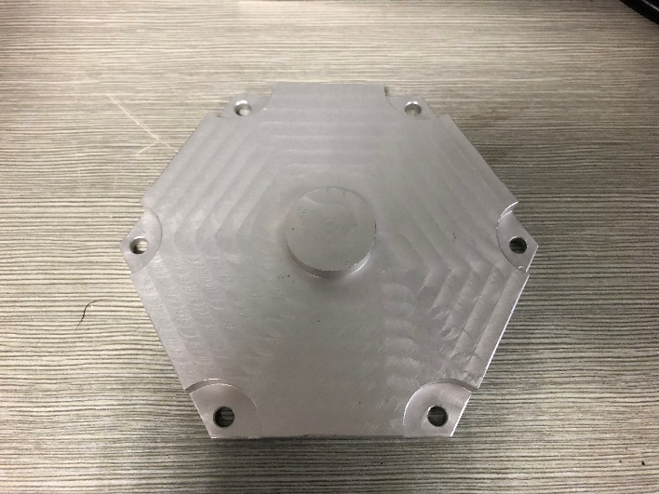
The problem of support matching with SDU module
1. Longer than module. The length of rod in module is 50cm, but to hold the module in this design, we need at least 54cm. Need to decrease the length of support.
3. No holes in front panel, and total thickness of panel is 2cm
screws
2. The diameter of rod in design is 5mm, not match with the diameter in use now, which is only 2.5mm.

