Slide 1
fiber reflectivity test
Chendi Shen
2018.10.18

Slide 2
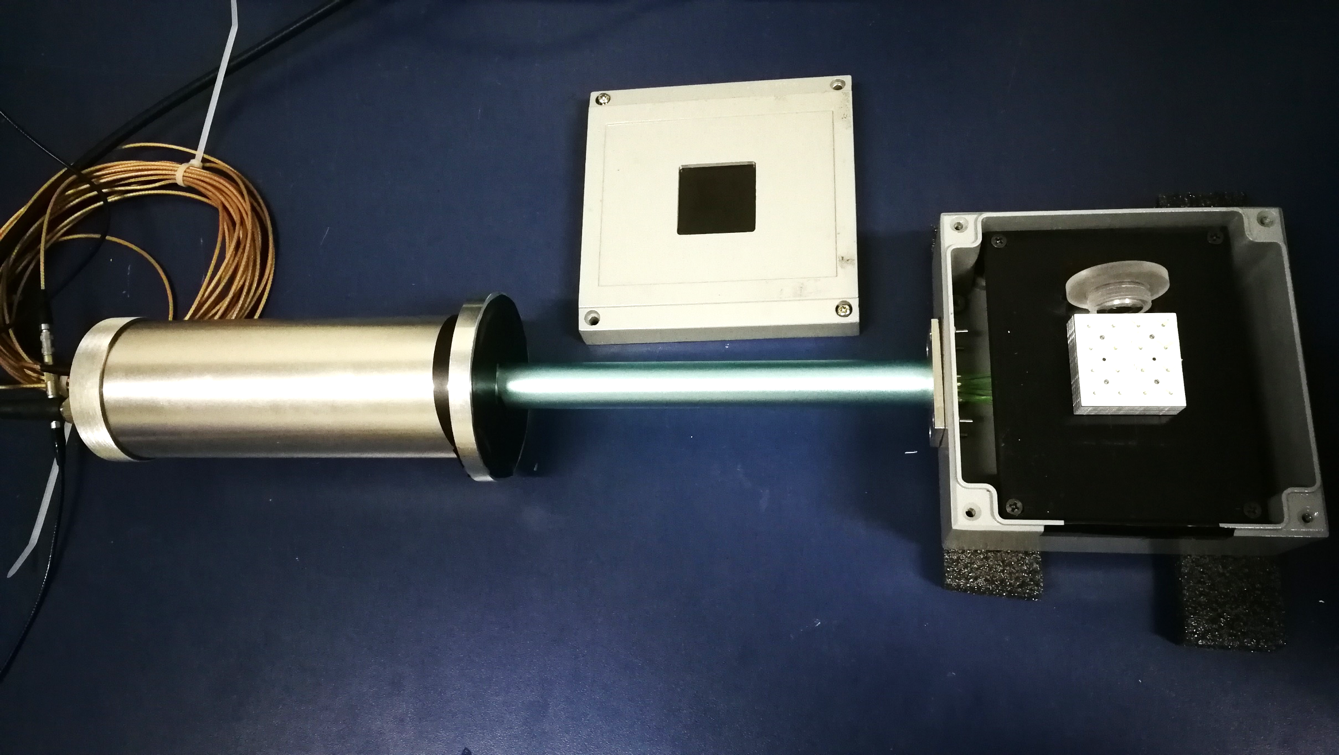
Reflective materials
Test setup
beta source
16 WLSF
BCF91A
HV
PMT
MPD_Scintillator
6 layers
multimeter
Lead without powderpainting

Slide 3
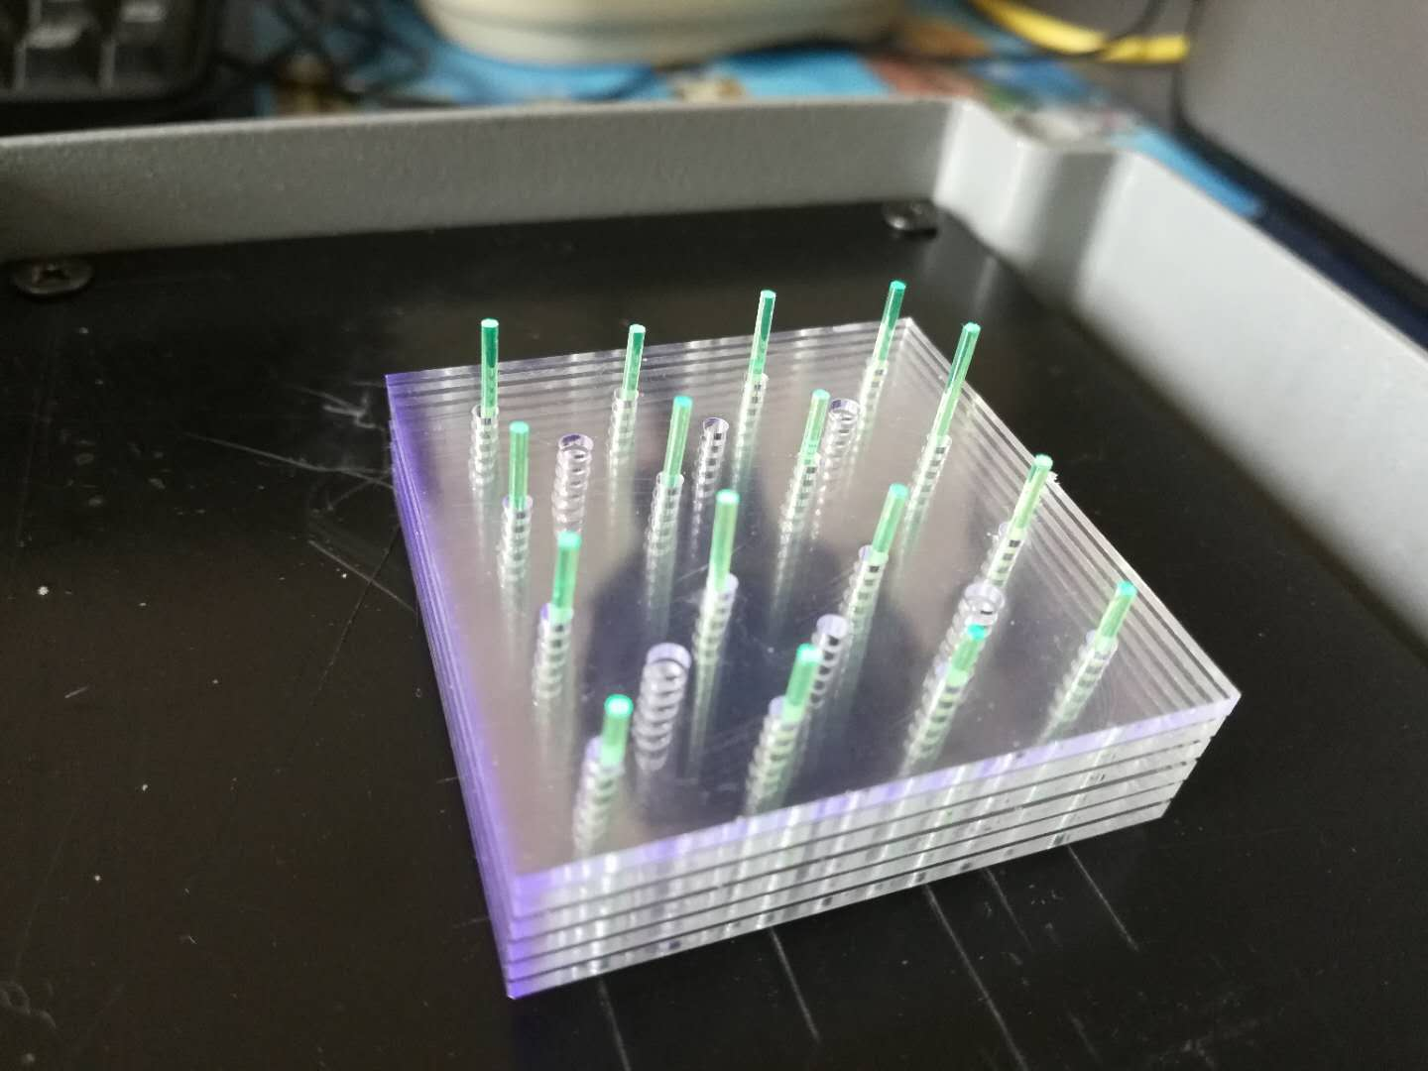
Position of Fibers vs. Light yield
position | Voltage (mV)
The fiber slightly exposes the scintillator | 38.5
The fiber is exposed to the scintillator 3mm | 39
The fiber exposes the scintillator to the greatest extent (~1cm) | 41
The results show that the slight change in position of the fibers has little effect on the experiment.

Slide 4
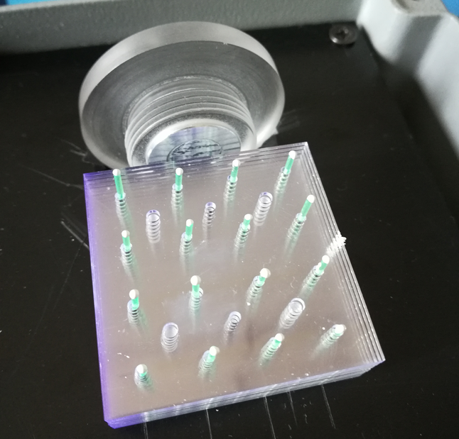
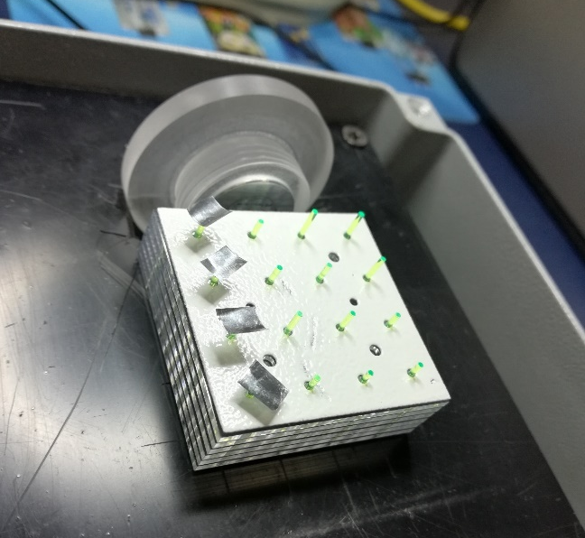
Test result
Silver ink: Silver Shine 415001
6 scintillator
TiO₂ + Epoxy Resin
6 scintillator
Silver tape
6 scintillator + 1 powder lead
No Source | Source | Voltage (mV)
Without ink |  | 3
With ink |  | 3
 | Without ink | 45.5
 | With ink | 55 （+21%）
No Source | Source | Voltage (mV)
Without TiO₂ |  | 3
With TiO₂ |  | 3.5
 | Without TiO₂ | 45
 | With TiO₂ | 63（+42%）
No Source | Source | Voltage (mV)
Without tape |  | 3
With tape |  | 3
 | Without tape | 45
 | With 4 tapes | 50.5 (+13%)
 | With 8 tapes | 59 (+33%)
 | With 12 tapes | 66 (+50%)
 | With 16 tapes | 72 (+64%)

Slide 5
Next to do
Continue to find different materials for fiber reflectivity test.
If silver tape is adopted, we must look for a fixed method.
By the way, We will look for similar silver tape in China.
We will test the reflective materials used to wrap the module with the same setup, such as Tyvek paper, silver paper, TiO₂+glue
After that, we will assemble other 2 moudules (THU3 and THU4).

