Slide 1
Microscope examination of multi-cladding fiber BCF91A-MC and BCF98-MC
We examined the fiber end of both BCF91A-MC and BCF98-MC that received in SDU with microscope camera, but not found the second structure, so both fibers should be the single cladding.
The fiber "BCF91A-MC" we received has the property:
Similar light yield as BCF91-SC
Single cladding from microscope view.
1.01mm diameter that larger than the 1.00mm of BCF91A-SC
A little worse polishing quality, which may mean the core material is different.
The property of BCF98-MC is similar as single cladding fiber.

Slide 2
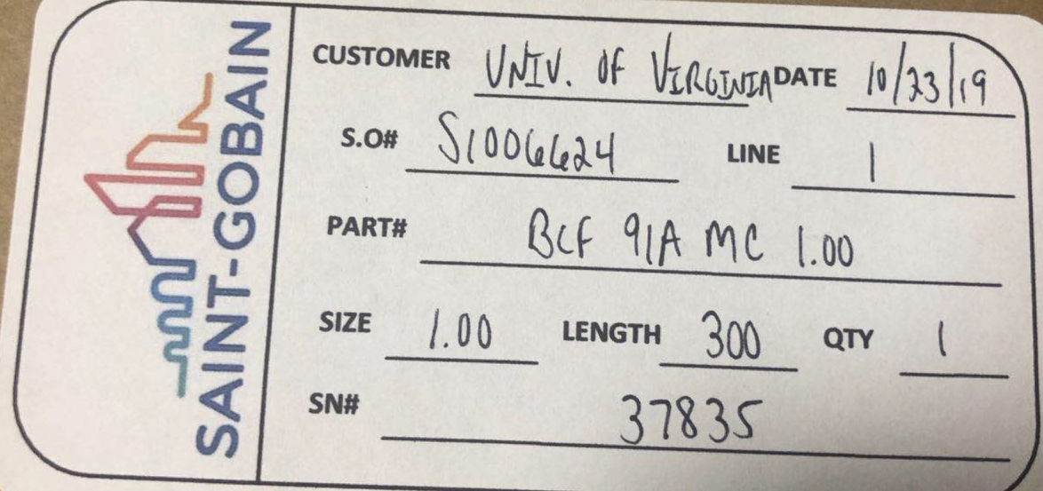
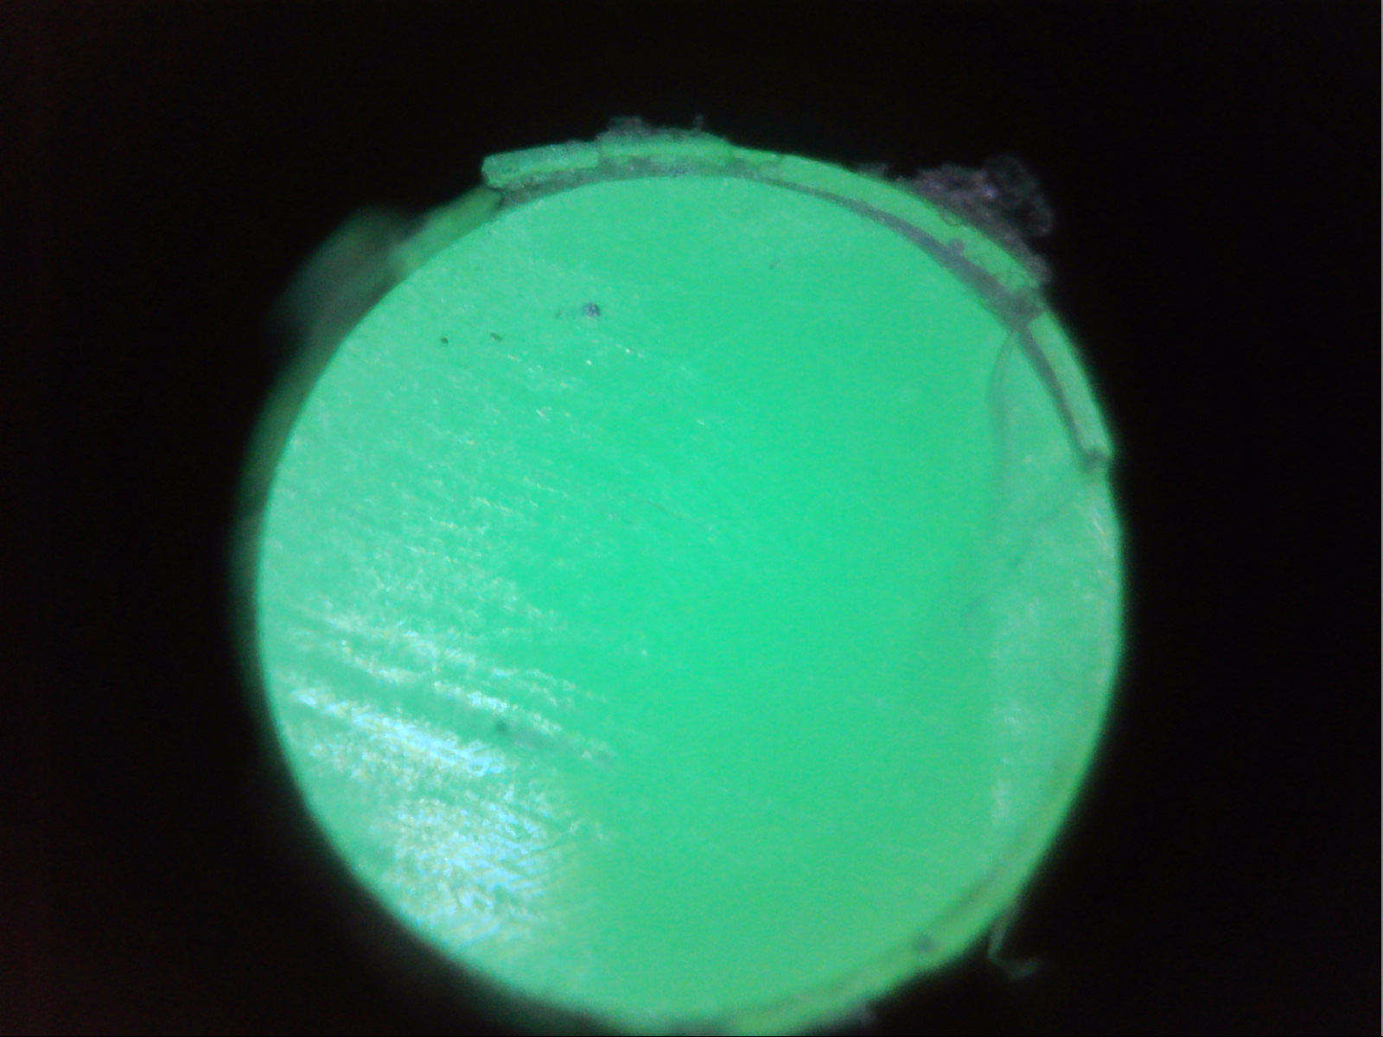
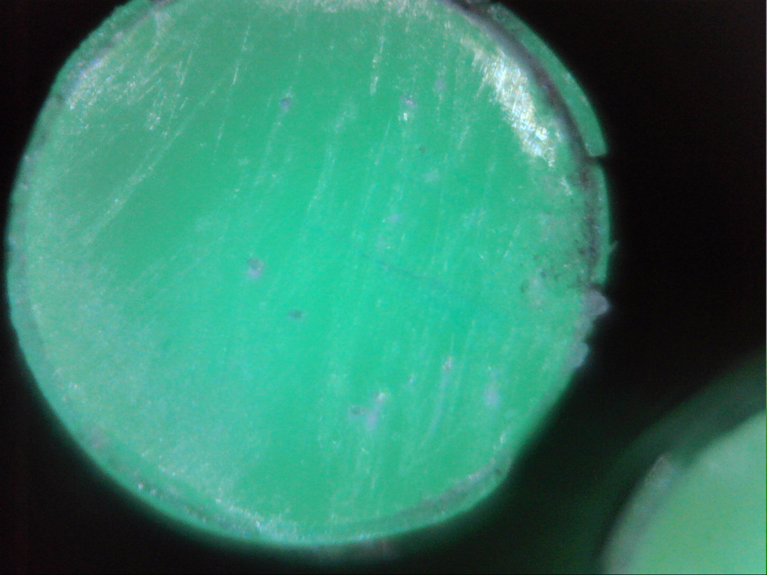
”BCF91A-MC”

Slide 3
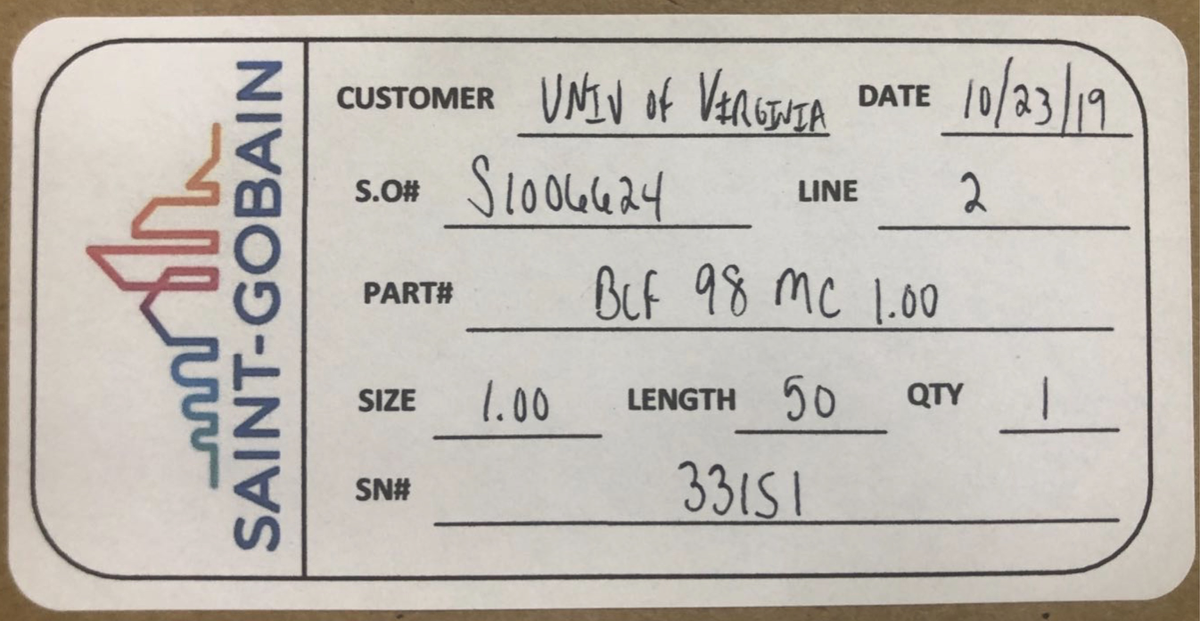
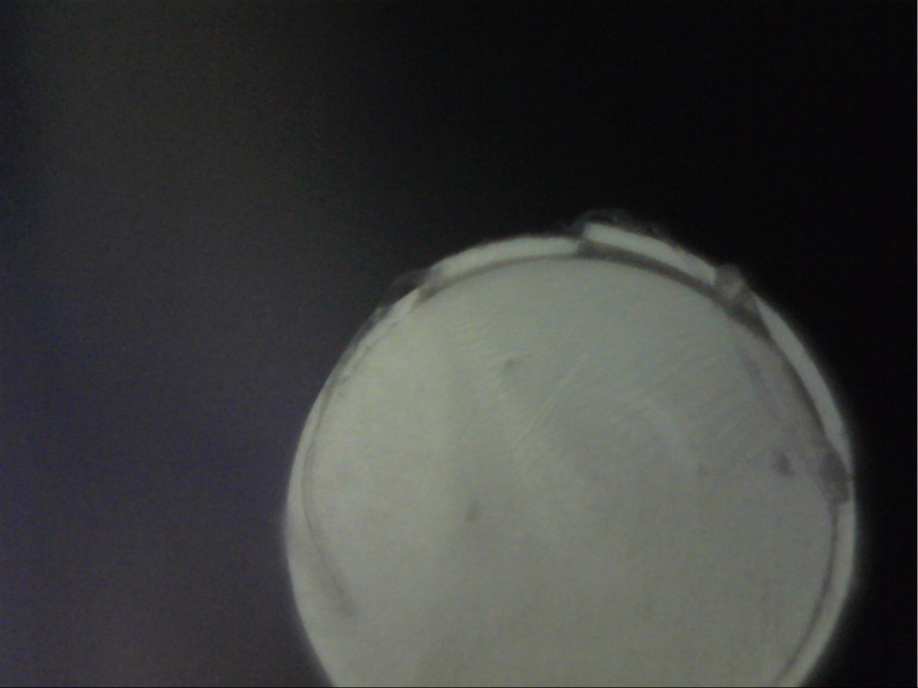
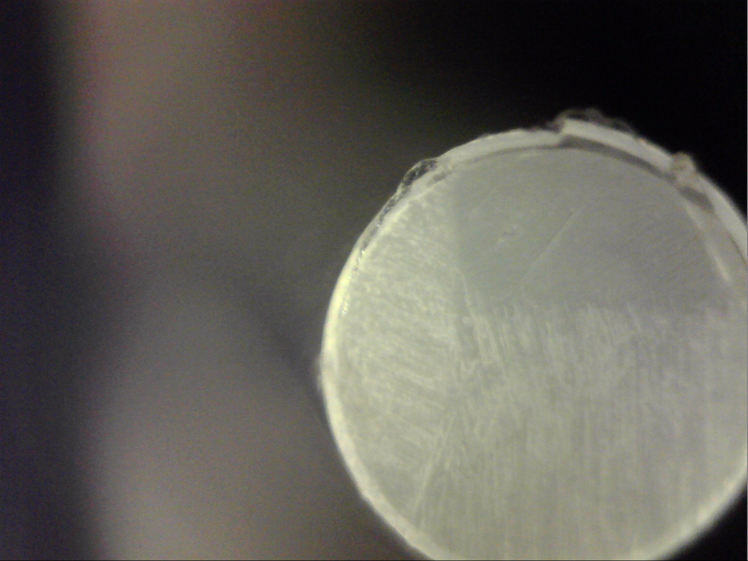
“BCF98-MC”

Slide 4
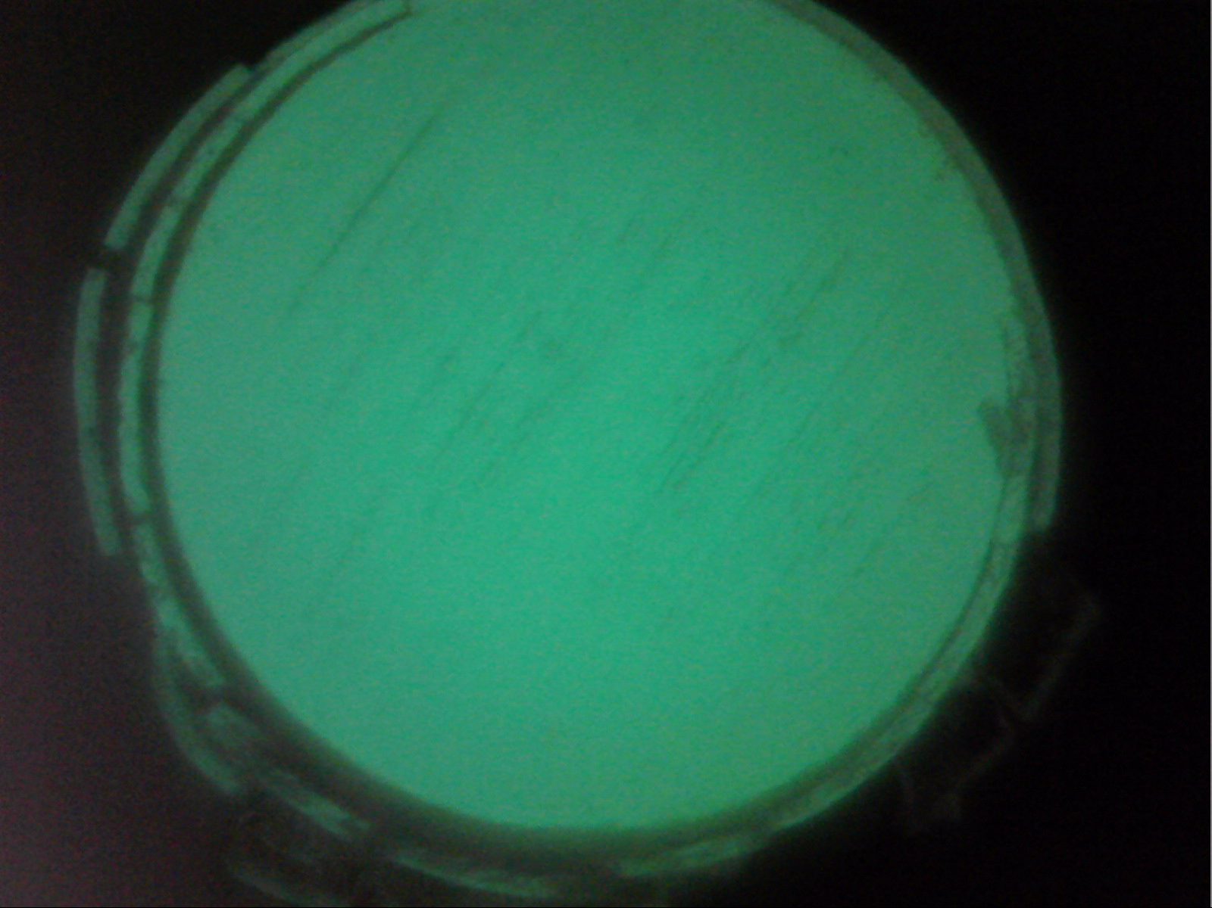
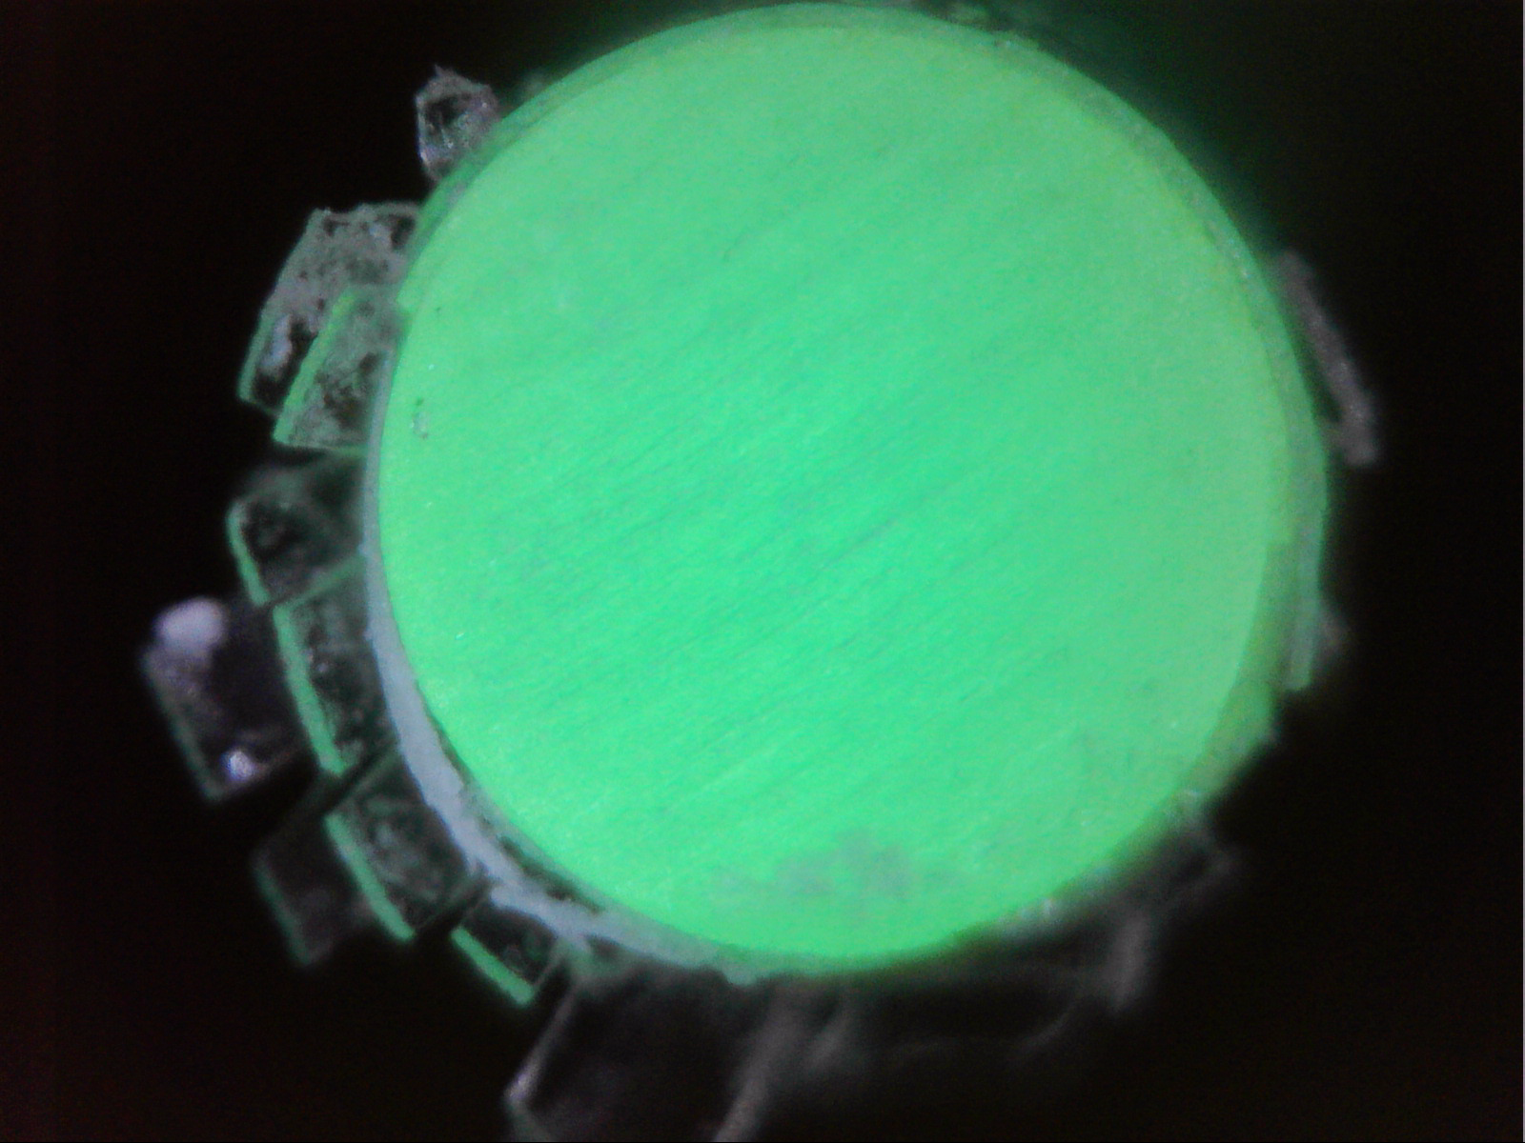
Y11-MC

Slide 5
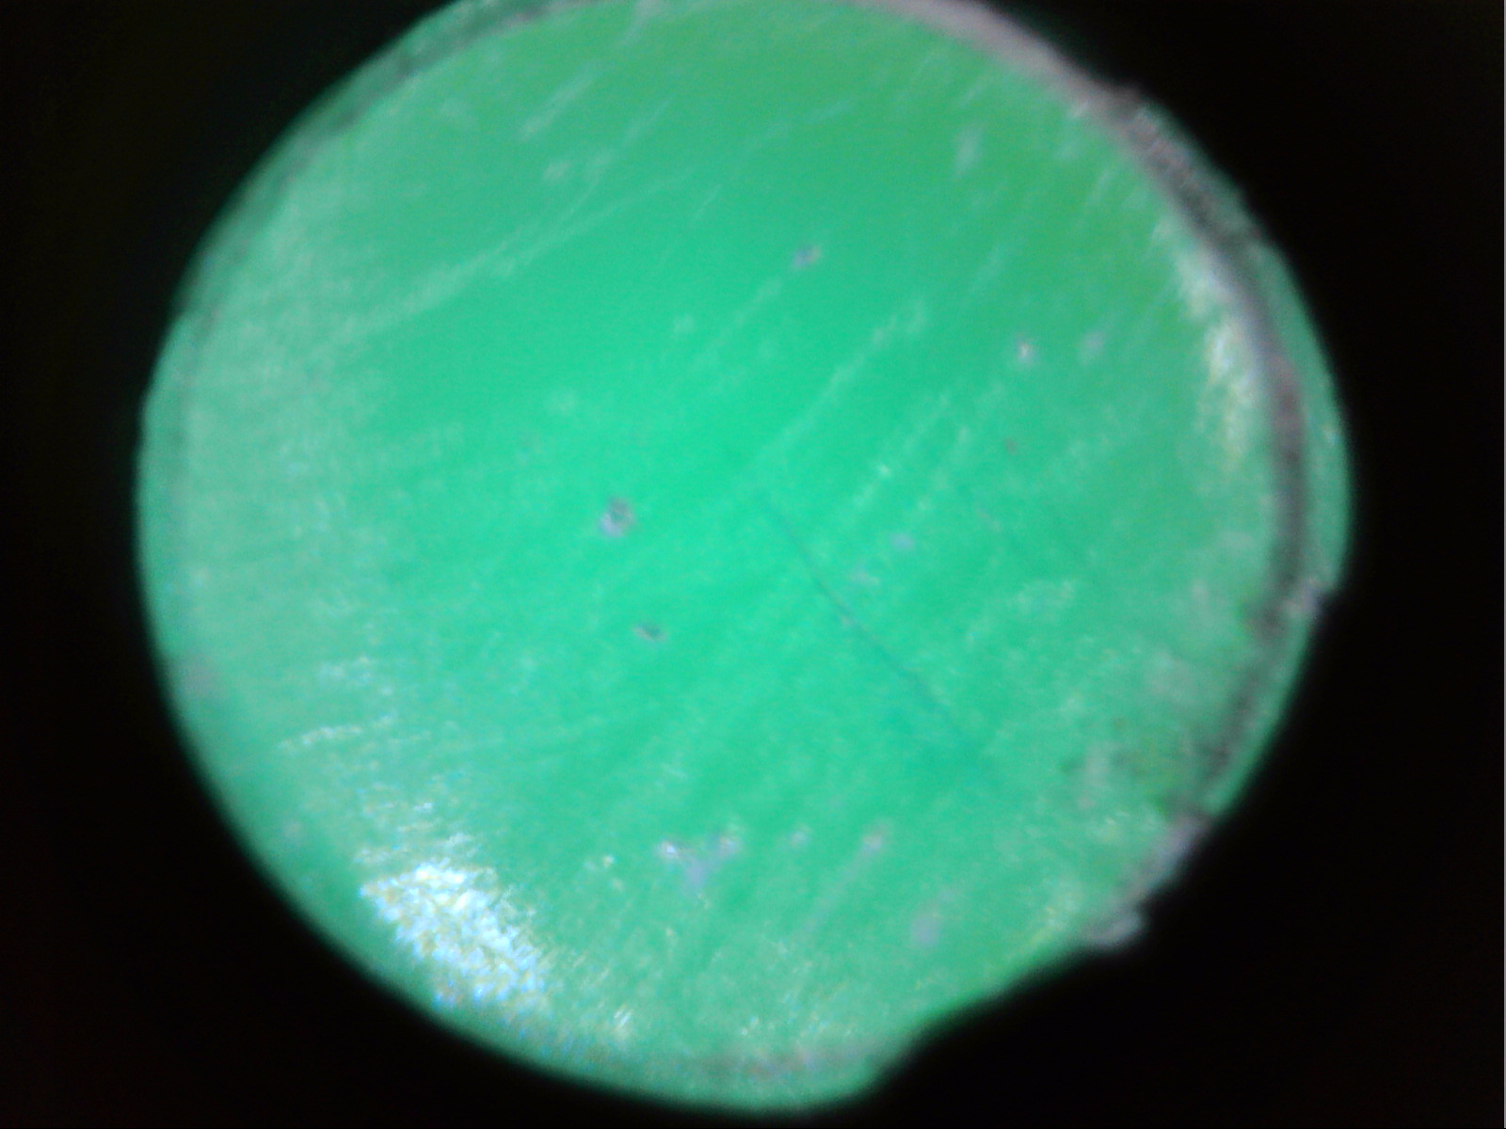
BCF91A-SC

