Slide 1
Fiber connector light loss test
Mengjiao Li(李孟娇）
limengjiao@mail.sdu.edu.cn
2020.10.07

Slide 2
Without silicone grease(air coupling)
Fiber No | WLS light yield | Connected to 1m Chunhui clear fiber | Light loss
1 | 2734 | 1759 | 0.36
2 | 2681 | 1905 | 0.29
3 | 2762 | 1780 | 0.35
4 | 2684 | 1818 | 0.32
5 | 2724 | 1785 | 0.34
6 | 2687 | 1724 | 0.36
7 | 2681 | 1785 | 0.33
8 | 2703 | 1883 | 0.30
9 | 2683 | 1860 | 0.31
10 | 2664 | 1813 | 0.32

Slide 3
Add the silicone grease
Fiber No | WLS light yield | Connected to 1m Chunhui clear fiber | Light loss
1 | 2716 | 1889 | 0.30
2 | 2696 | 2056 | 0.24
3 | 2750 | 2030 | 0.26
4 | 2682 | 1983 | 0.26
5 | 2768 | 2030 | 0.27
6 | 2728 | 1919 | 0.30
7 | 2717 | 1970 | 0.27
8 | 2701 | 1936 | 0.28
9 | 2761 | 1901 | 0.31
10 | 2690 | 1824 | 0.32

Slide 4
Fiber connector is polished by Chunhui Company

Slide 5
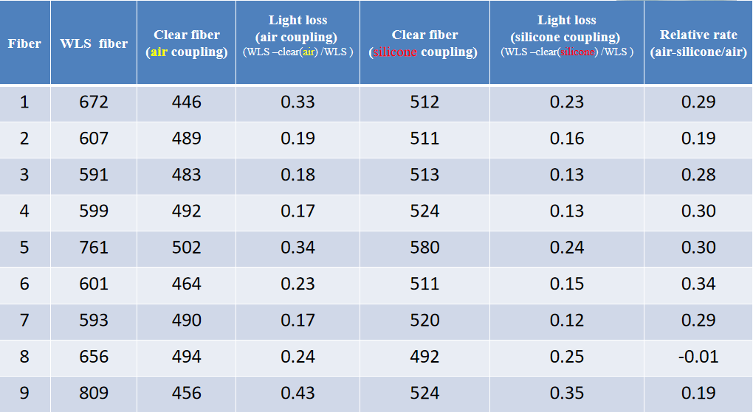
Previous results
The fiber is polished by ourselves

