Slide 1
Fiber connector light loss test
Mengjiao Li
limengjiao@mail.sdu.edu.cn
2020.11.04

Slide 2
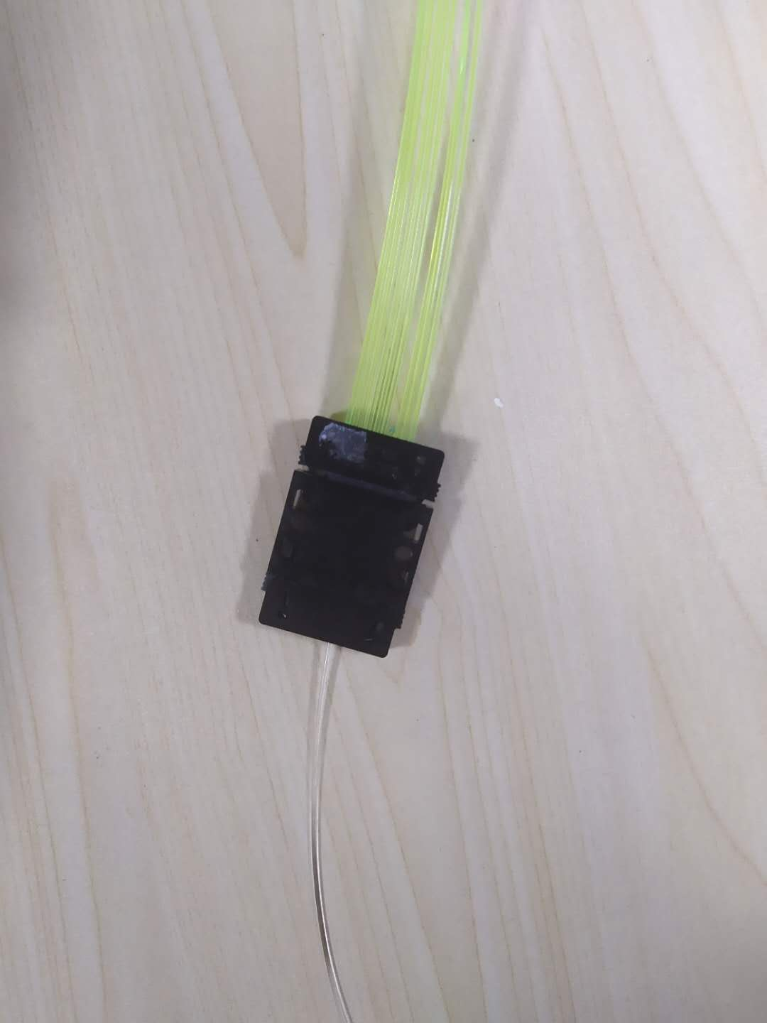
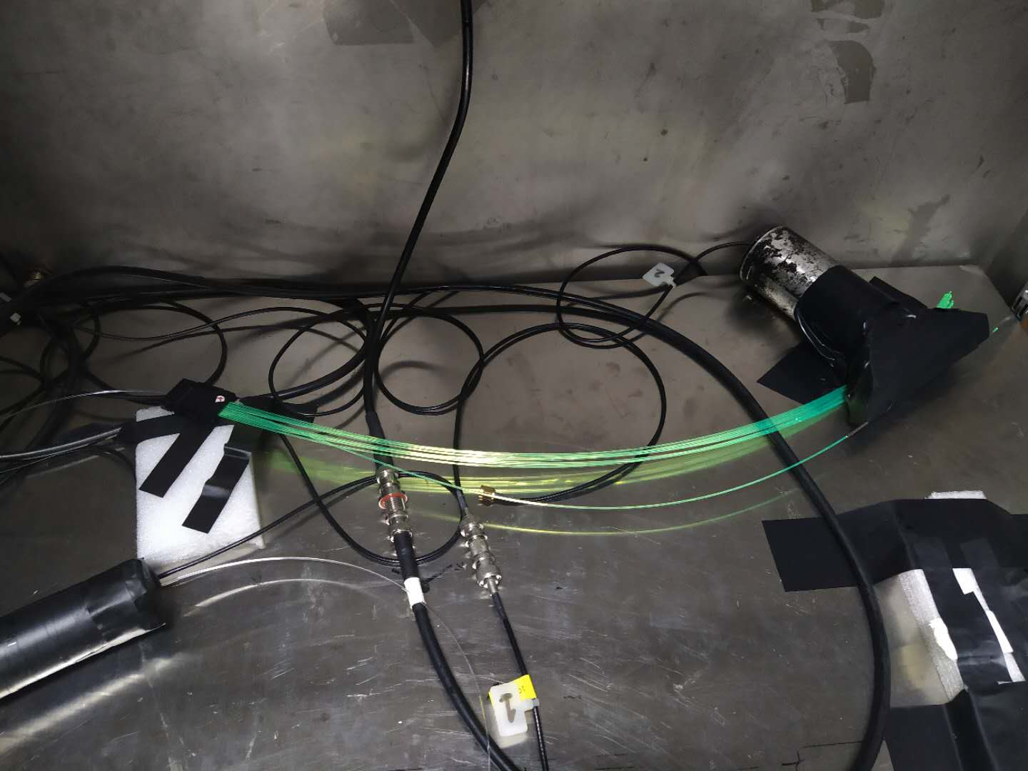
Testing configuration

Slide 3
The clear fiber is polished by ourselves The WLS fiber is polished by Chunhui company
Fiber No | WLS light yield | Connected to 1m Chunhui clear fiber | Light loss
1 | 2469 | 1747 | 0.29
2 | 2561 | 1846 | 0.28
3 | 2552 | 1786 | 0.30
4 | 2611 | 1781 | 0.31
5 | 2536 | 1771 | 0.30

Slide 4
The clear fiber and the WLS fiber are all polished by ourselves
Fiber No | WLS light yield | Connected to 1m Chunhui clear fiber | Light loss
1 | 2281 | 1700 | 0.25
2 | 2205 | 1747 | 0.21
3 | 2146 | 1672 | 0.22
4 | 2208 | 1671 | 0.24
5 | 2235 | 1610 | 0.28
The light attenuation loss of green fiber to clear fiber is about 24%,the attenuation length of the clear fiber is about 21.5m , considering the 1m clear fiber lead to 5% light loss in transport ,we get final light loss from connector of this test is 20% [1-(1-24%)/(1-5%)]

Slide 5
The clear fiber and WLS fiber are all polished by ourselves
Fiber No | WLS light yield | Connected to 0.4m Chunhui clear fiber | Light loss
1 | 1954 | 1546 | 0.21
2 | 1989 | 1659 | 0.17
3 | 1980 | 1672 | 0.16
4 | 2031 | 1572 | 0.22
5 | 1961 | 1591 | 0.19
The light attenuation loss of green fiber to clear fiber is about 19%,
the attenuation length of the clear fiber is about 21.5m,considering
the 0.4m clear fiber lead to 2% light loss in transport, we get final
light loss from connector of this test is 17% [1-(1-19%)/(1-2%)].

Slide 6
Back up

Slide 7
