Slide 1
Fiber connector light loss test and BCF91A fiber
Mengjiao Li
2020.12.02

Slide 2
contents
1 light loss vs light intensity
2 light yield of new Saint-Gobain BCF91A-MC fiber

Slide 3
Last test result
The WLS fiber connector is polished by Chunhui company
LED drive voltage(V) | Photon number | Light loss
2.4 | 620 | 0.26
2.5 | 746 | 0.24
2.6 | 864 | 0.22
2.7 | 979 | 0.20
2.8 | 1079 | 0.18
The WLS fiber connector is polished by ourselves
LED drive voltage(V) | Photon number | Light loss
2.4 | 526 | 0.19
2.5 | 644 | 0.18
2.6 | 756 | 0.16
2.7 | 866 | 0.15
2.8 | 970 | 0.14

Slide 4
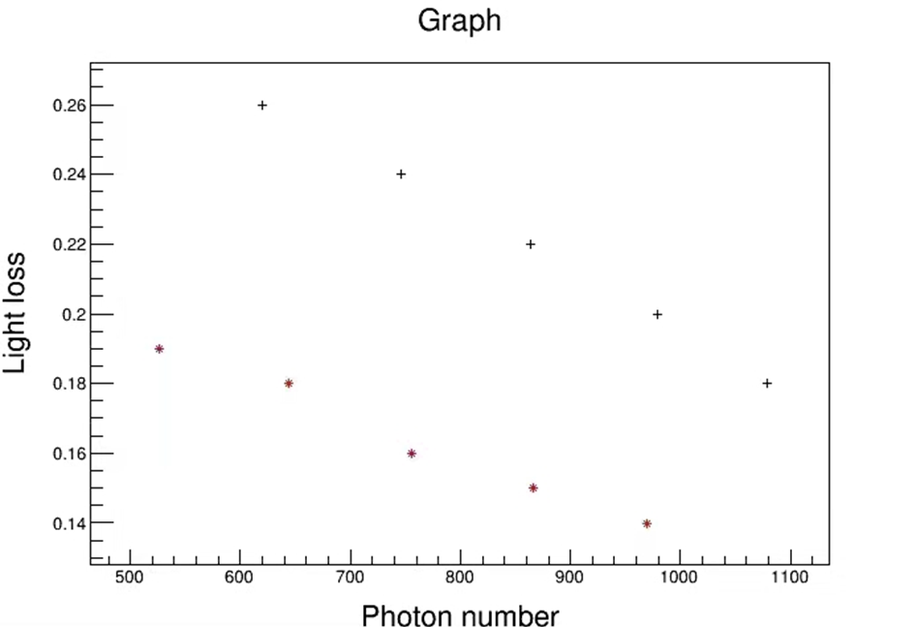
The fiber connector is polished by Nanjing
The fiber connector is polished by ourselves

Slide 5
The WLS fiber connector is polished by Chunhui company
LED drive voltage(V) | Photon number | Light loss
1.8 | 54 | 0.33
1.9 | 102 | 0.33
2.0 | 174 | 0.33
2.1 | 268 | 0.33
2.2 | 384 | 0.33
2.3 | 511 | 0.31
2.4 | 640 | 0.28
2.5 | 776 | 0.26

Slide 6
The WLS fiber connector is polished by ourselves
LED drive voltage(V) | Photon number | Light loss
1.8 | 43 | 0.22
1.9 | 85 | 0.22
2.0 | 140 | 0.21
2.1 | 215 | 0.21
2.2 | 309 | 0.21
2.3 | 419 | 0.20
2.4 | 534 | 0.18
2.5 | 652 | 0.17

Slide 7
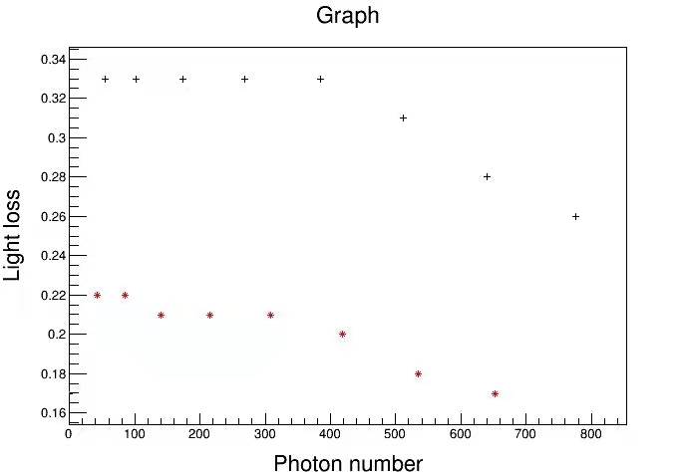
The fiber connector is polished by Nanjing
The fiber connector is polished by ourselves
These data are reserved for only two decimal places, so here is also a downward trend

Slide 8
This is the previous result (2020.09.09)
Fiber | Test result (ADC channel)
BCF91A-SC | 1593
BCF91A-MC previous | 1591
This is the new result
Fiber | Test result (ADC channel)
BCF91A-SC | 2588
BCF91A-MC new | 3219
BCF91A-MC previous | 2577
BCF91A-MC new
The diameter of the new BCF91A-MC is larger, is 1.06mm.
The diameter of the BCF91A-SC and the previous BCF91A-MC are 1mm.

