Slide 1
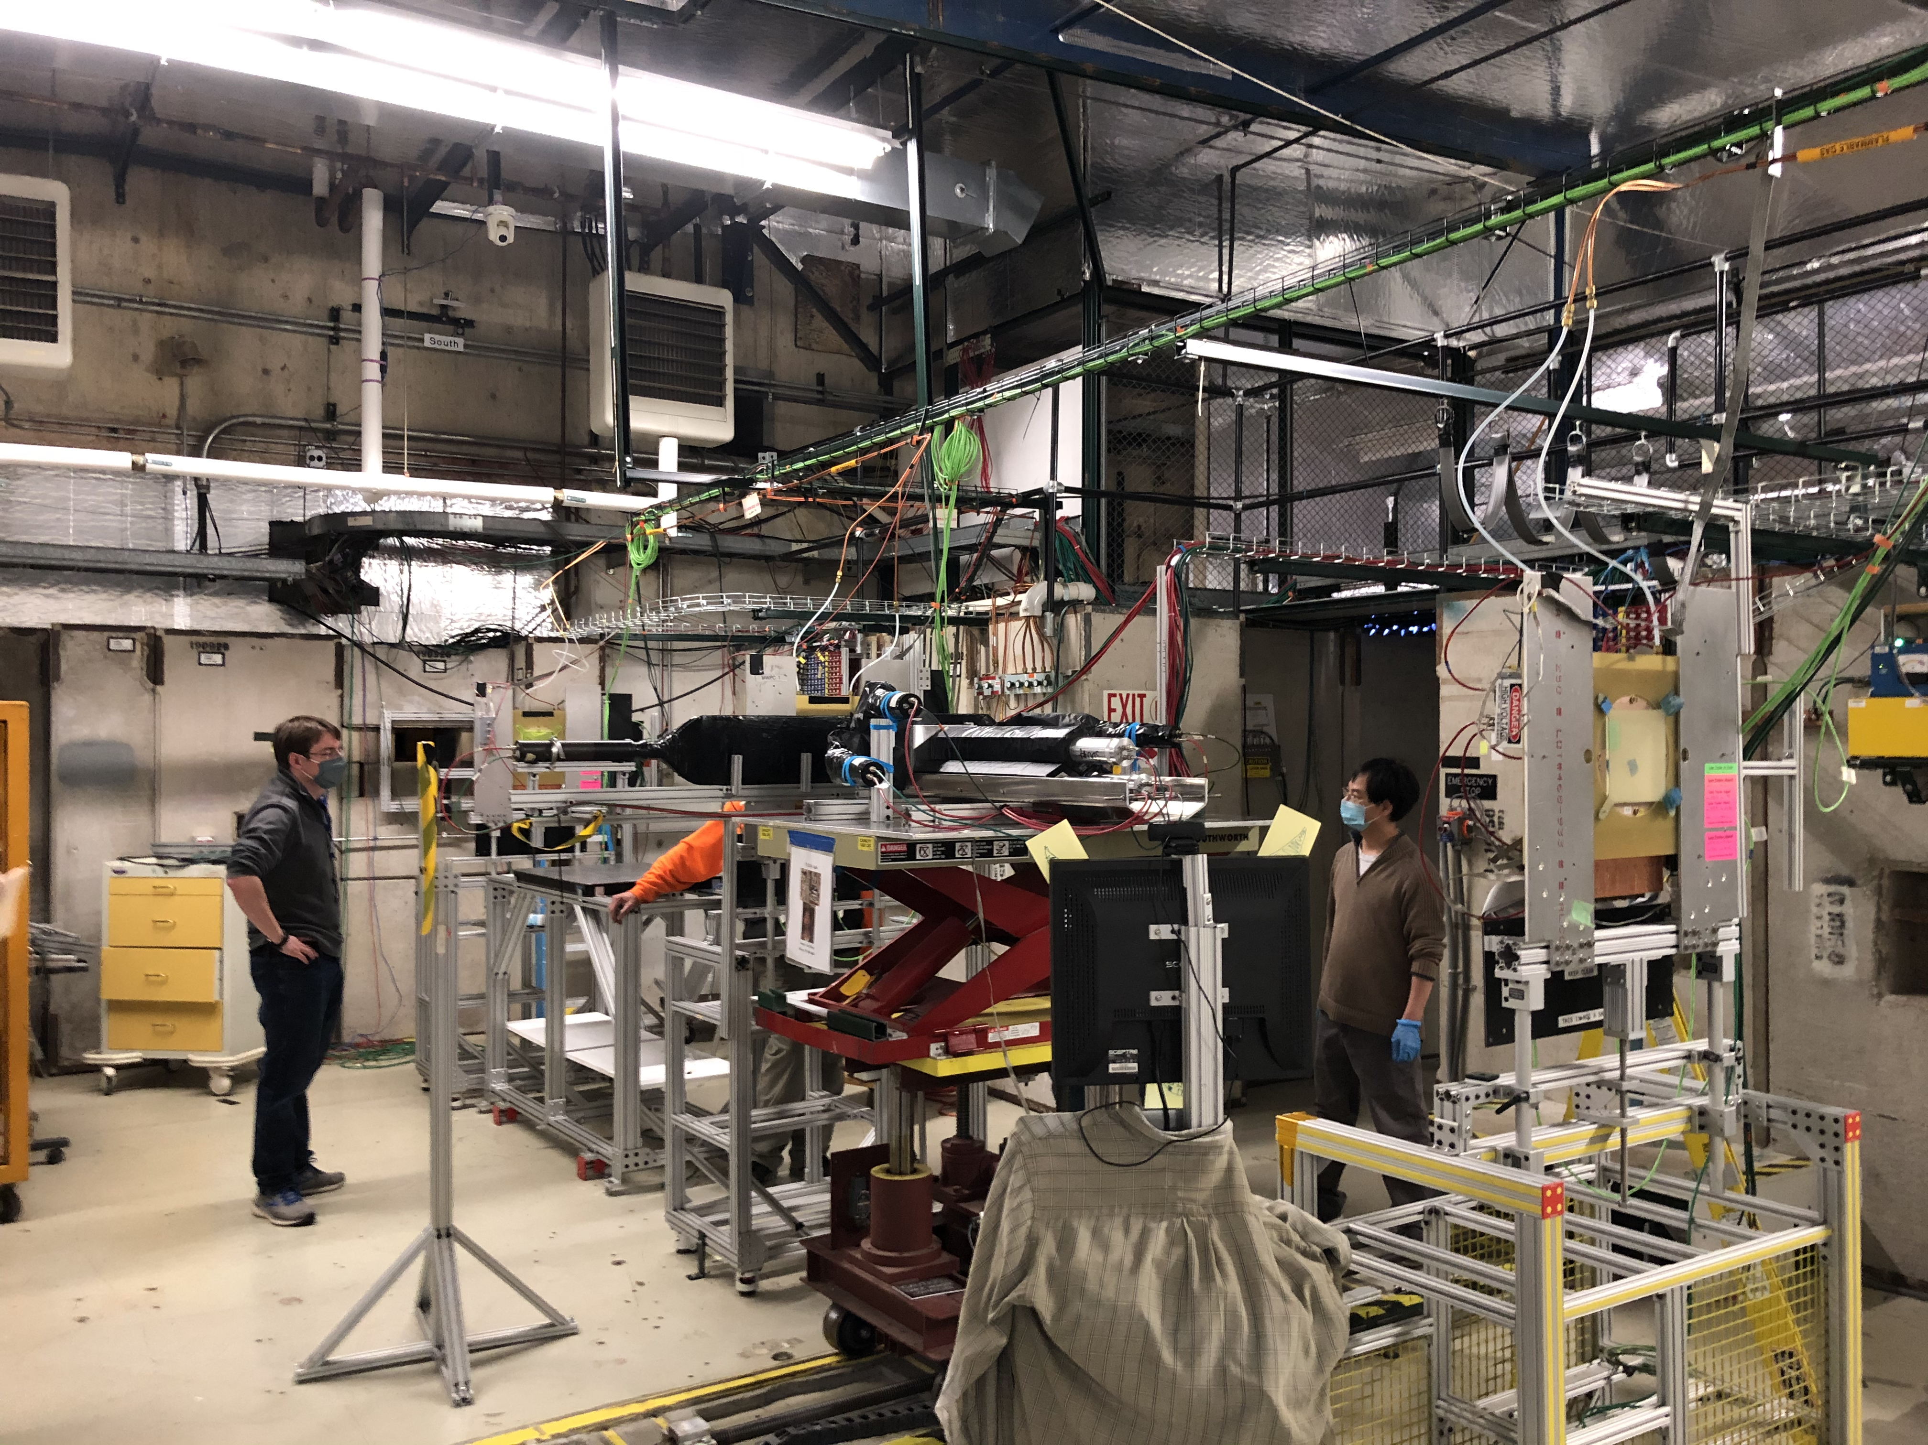
ECal Test at Fermilab Test Beam Facility
Jan 13—27, 2021
Goal: Determine the detector resolution and efficiency of preshower and shower calorimeter modules
Detectors:
Preshower: 2-cm thick Pb blocks (x3)
Shower: Shashlyk (Pb + scintillator layers), 80-cm long (x3)
Scintillator used for triggering
FNAL beam parameters
Composition: Mixture of e-, π-
Energies: 1, 2, 4, 6, 8, 10, 12, 16 GeV
Preshower Calorimeter
Beam direction
(into plane of scintillator)
Scintillator
Shashlyk Calorimeter

