Slide 1
Hall C Beam Test Data
vtpPulser trigger
Central module is shown
C9-1, one sub-channel of the central HERA module
High rate data from small angle MaPMT test
Low rate data from large angle LAPPD test

Slide 2
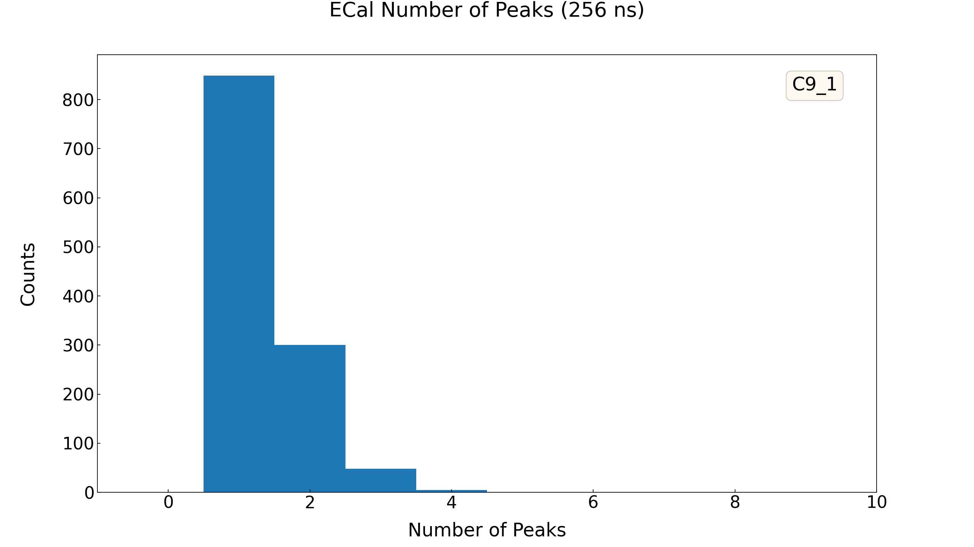
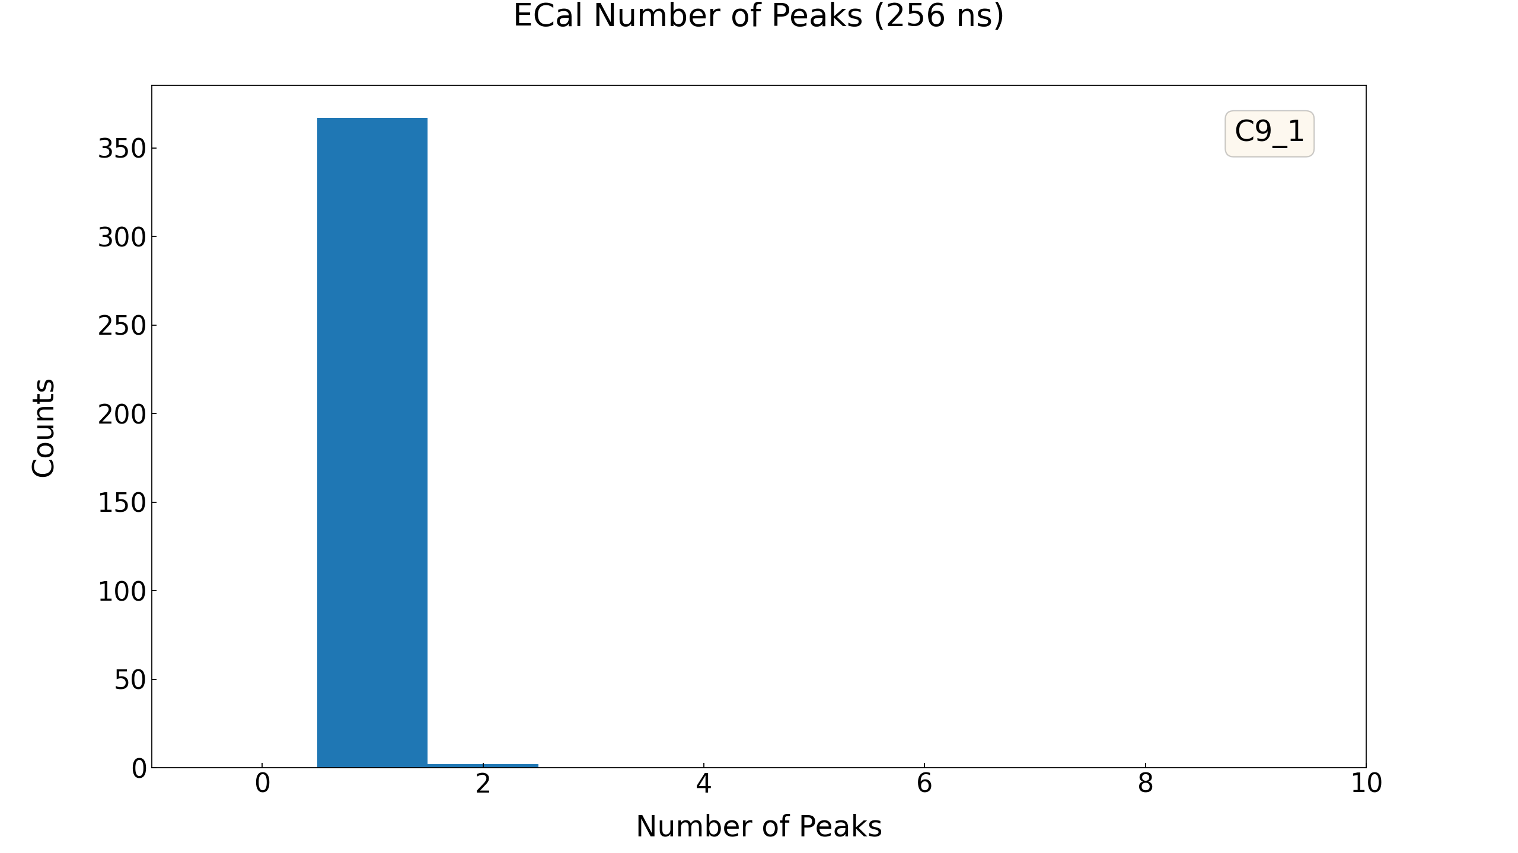
ECal Npeaks
Number of identified peaks within 256 ns time window
High Rate
Low Rate

Slide 3
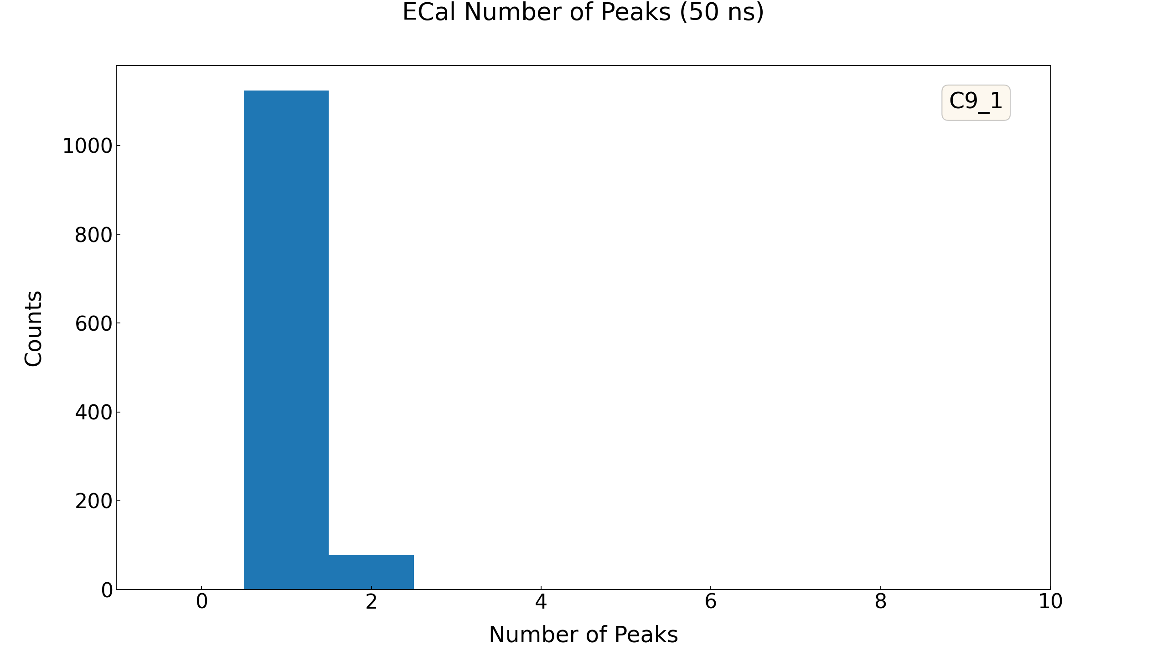
ECal Npeaks (50 ns window)
Number of identified peaks within 50 ns time window
Window begins with the peak with the maximum height
50 ns is chosen because the peak finding algorithm may not have good resolution with 30 ns
High Rate
Low Rate

Slide 4
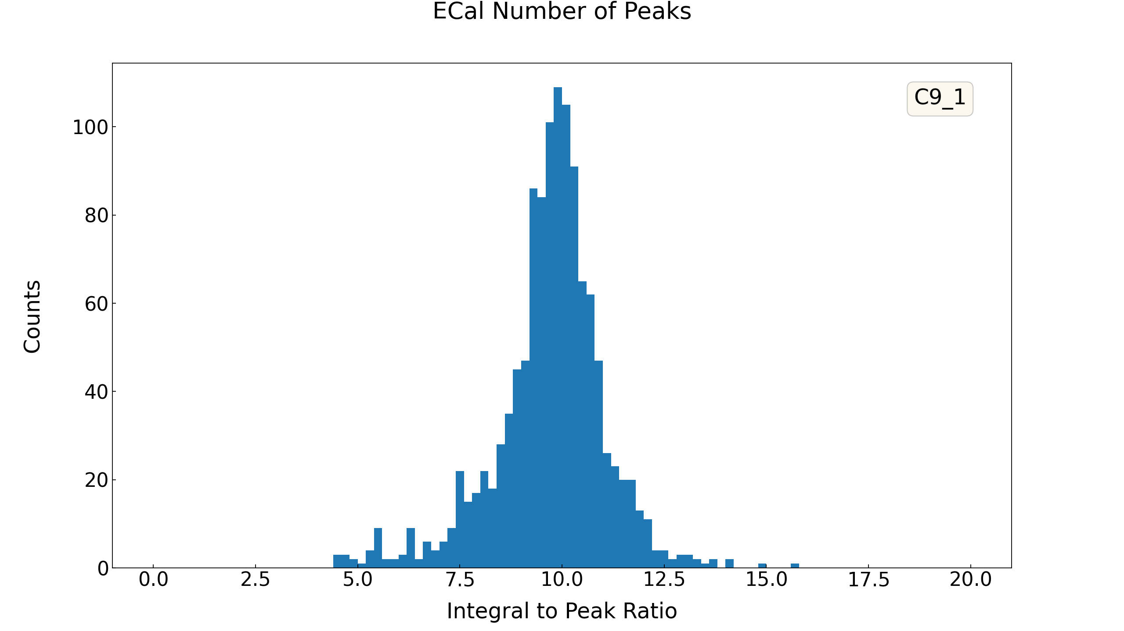
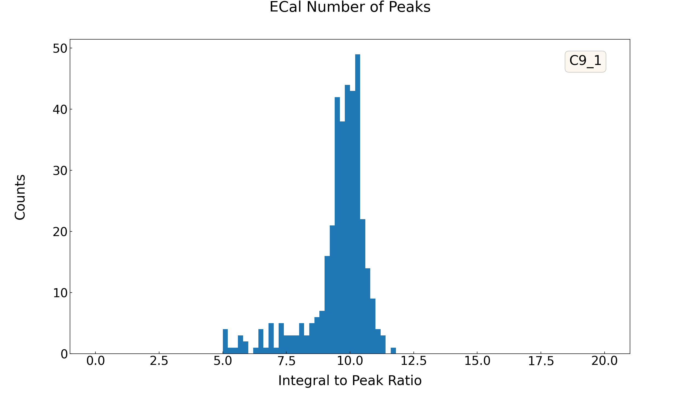
ECal Integral/Peak
This indicates the pile-ups effect (pile-up event will increase integral value but not affect peak much)
High Rate
Low Rate

Slide 5
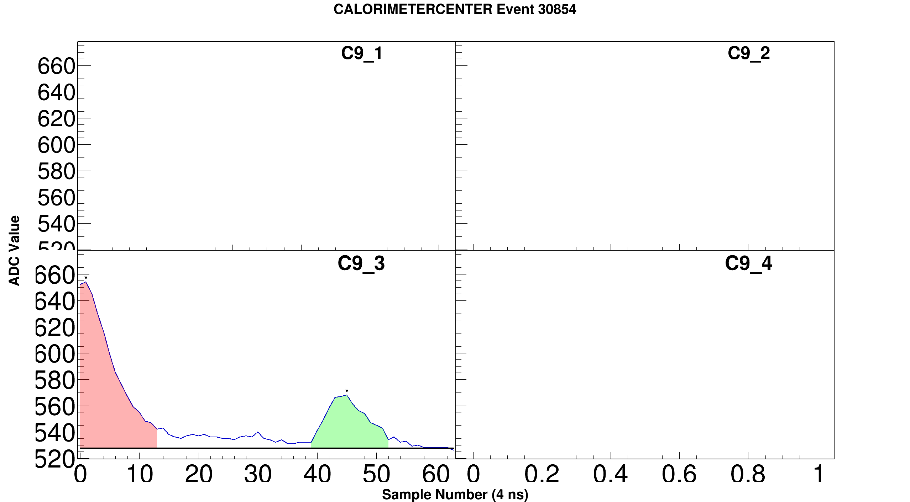
High Rate Data Samples

Slide 6
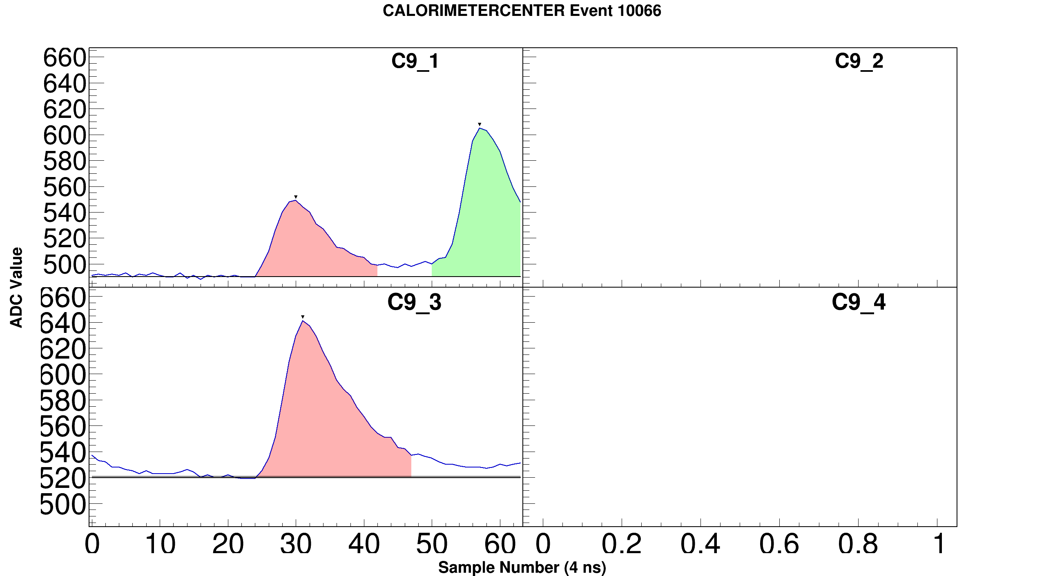
High Rate Data Samples

Slide 7
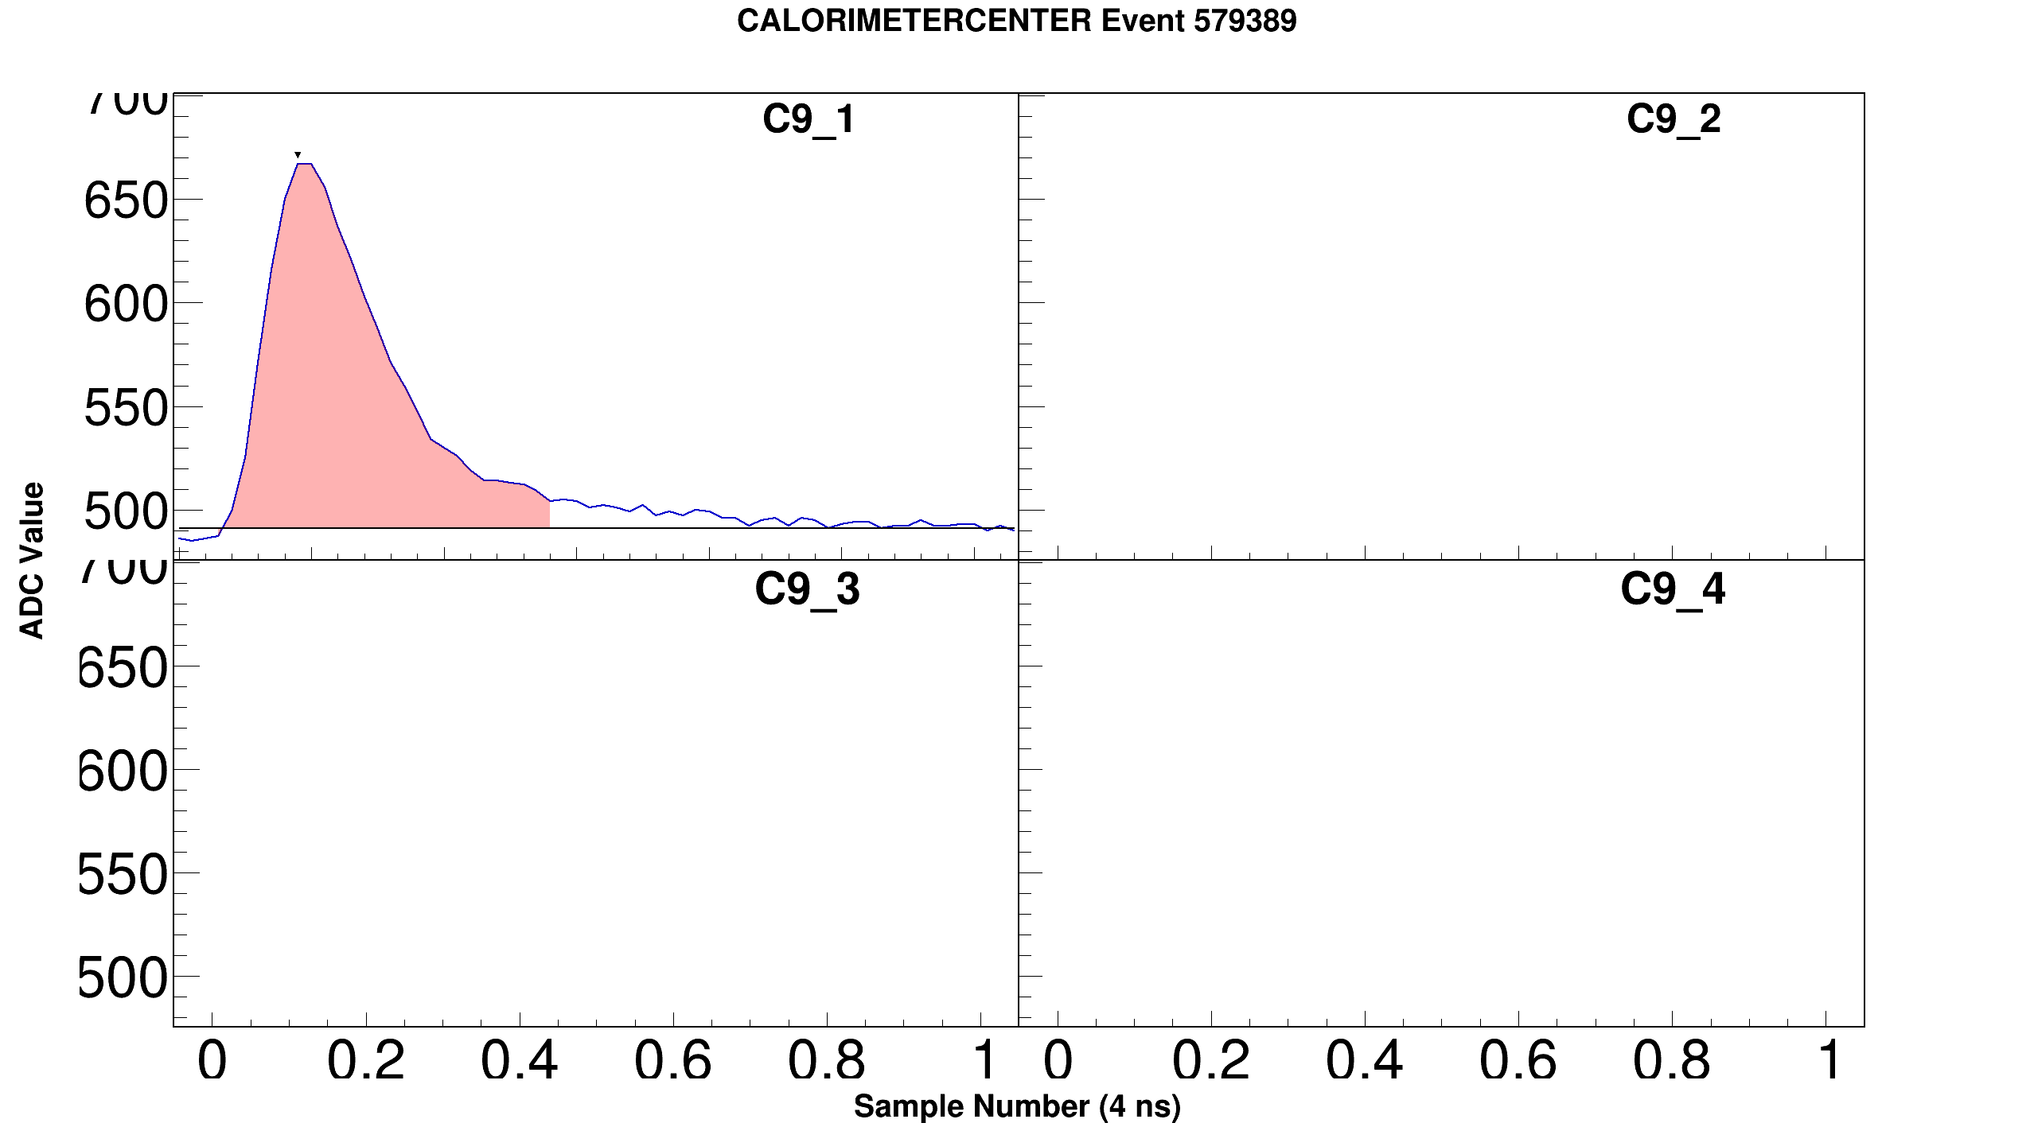
Low Rate Data Samples

Slide 8
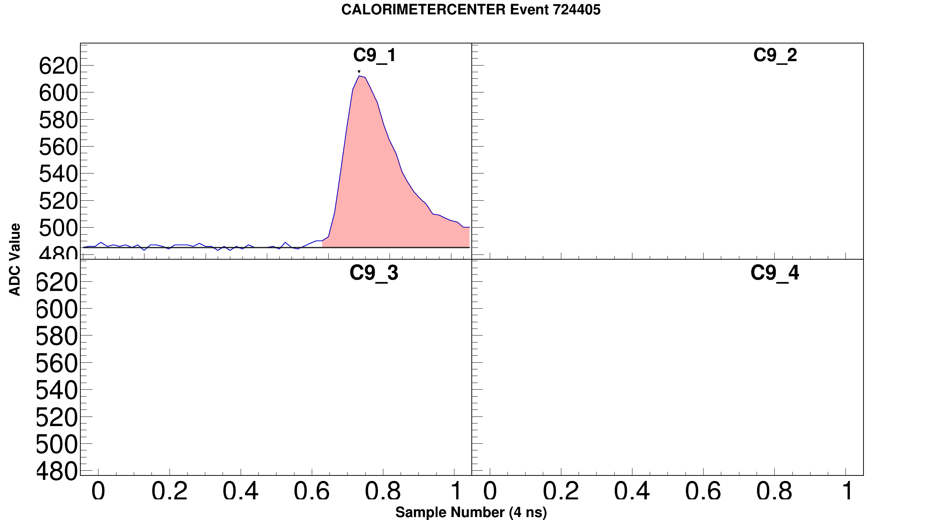
Low Rate Data Samples

Slide 9
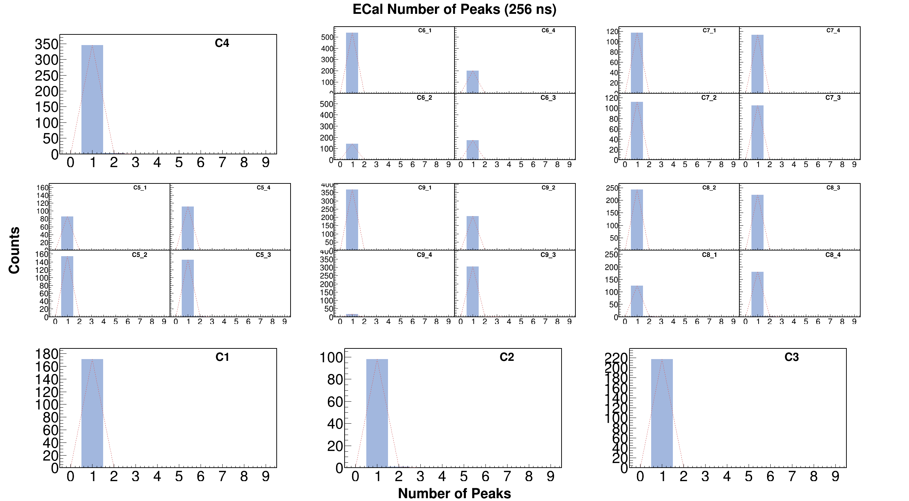
Low Rate

Slide 10
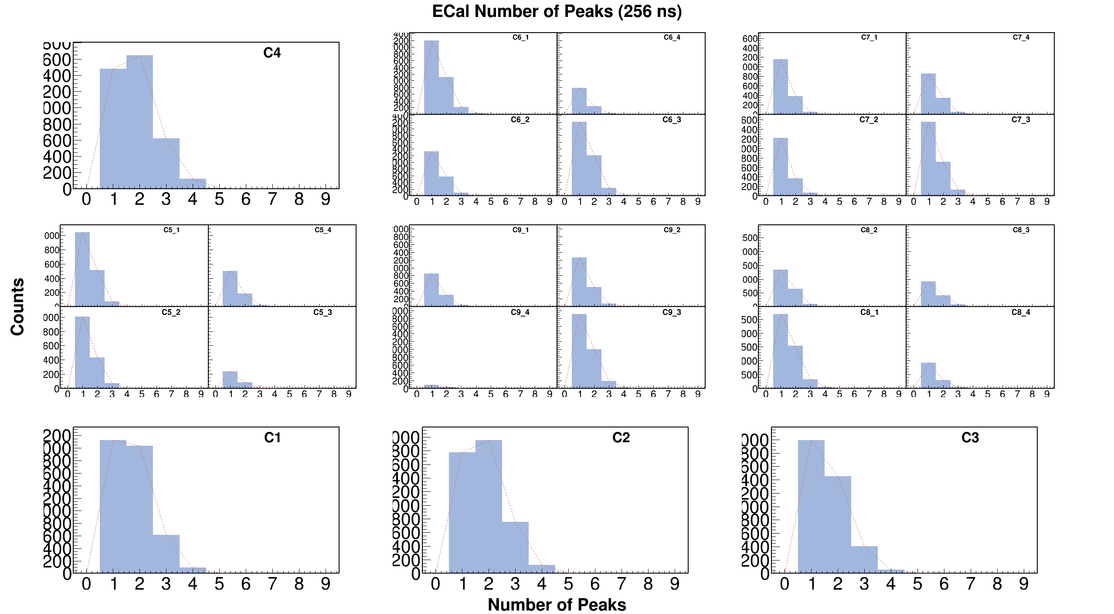
High Rate

Slide 11
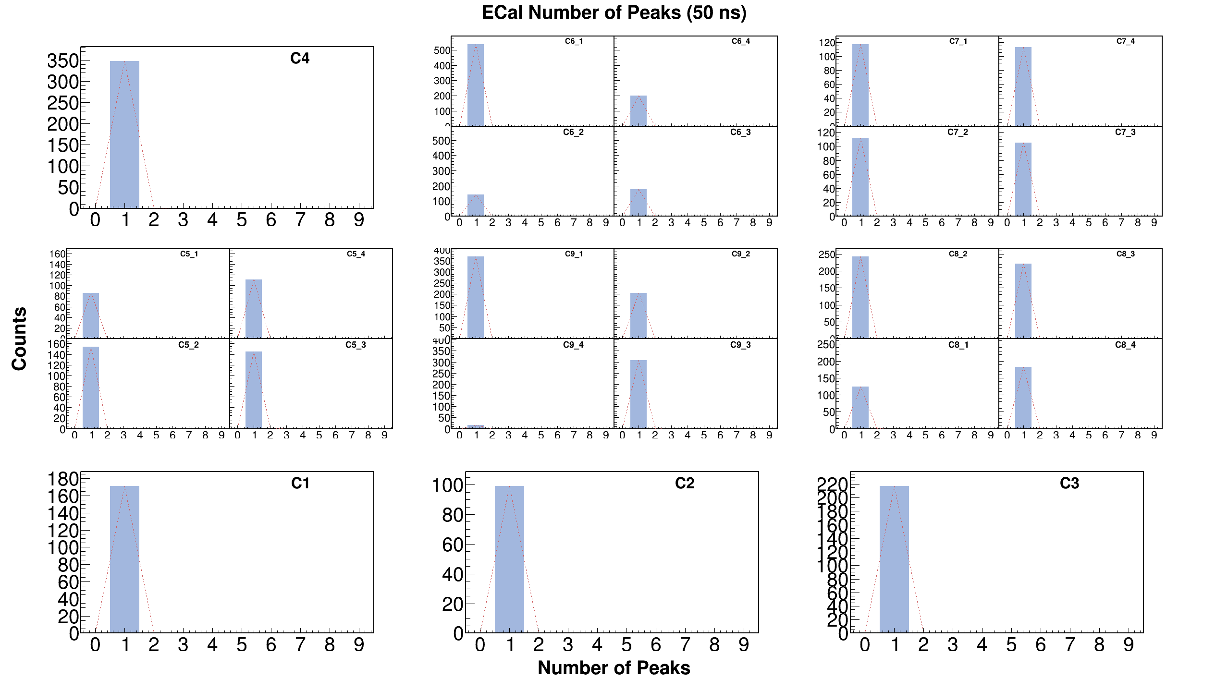
Low Rate

Slide 12
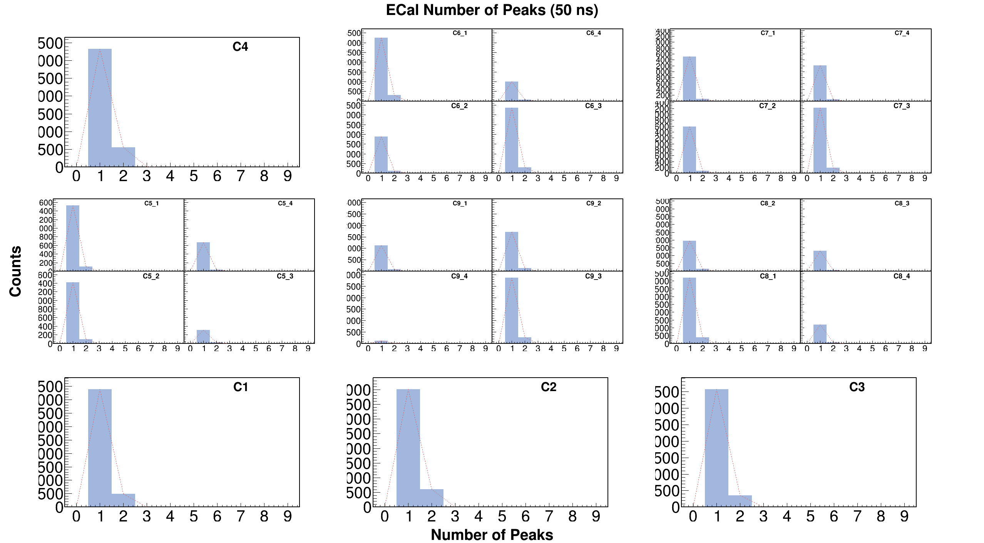
High Rate

Slide 13
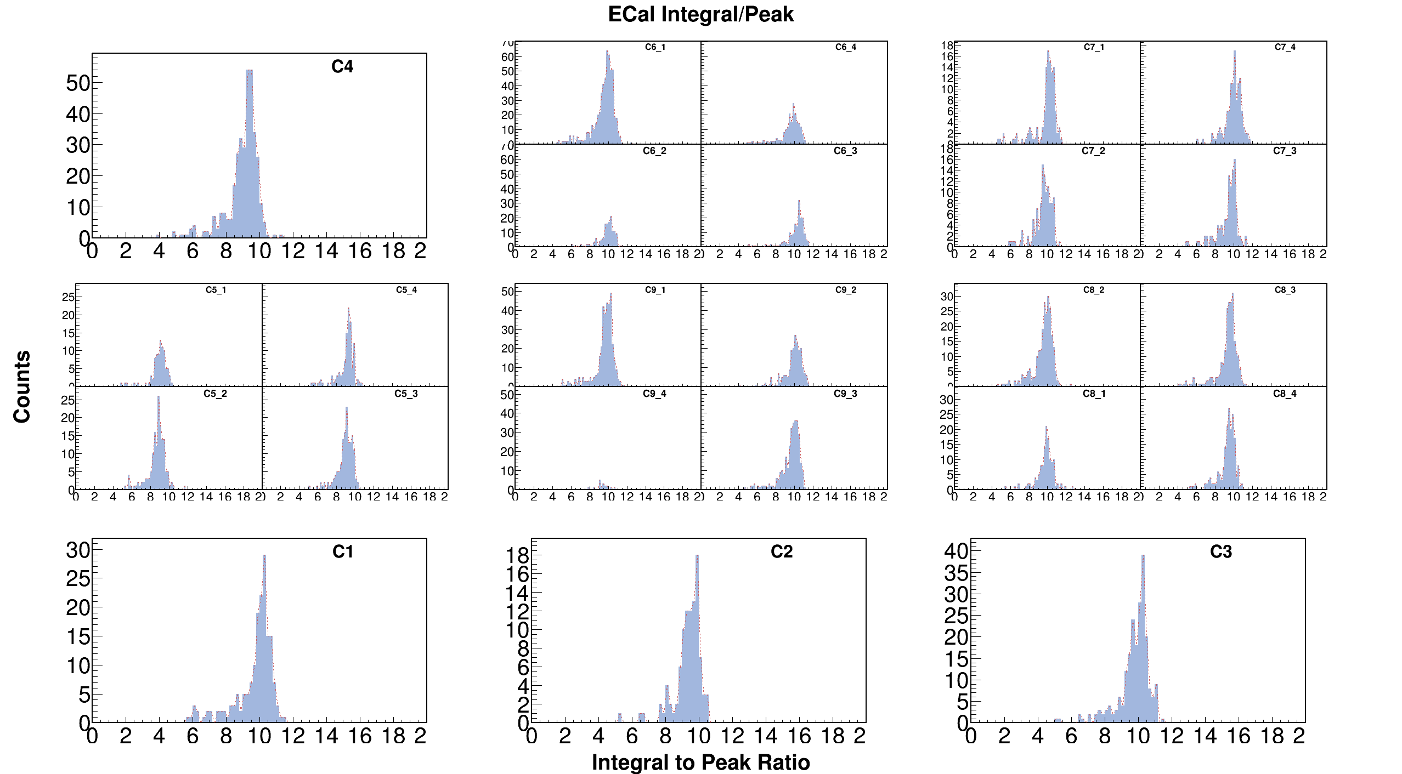
Low Rate

Slide 14
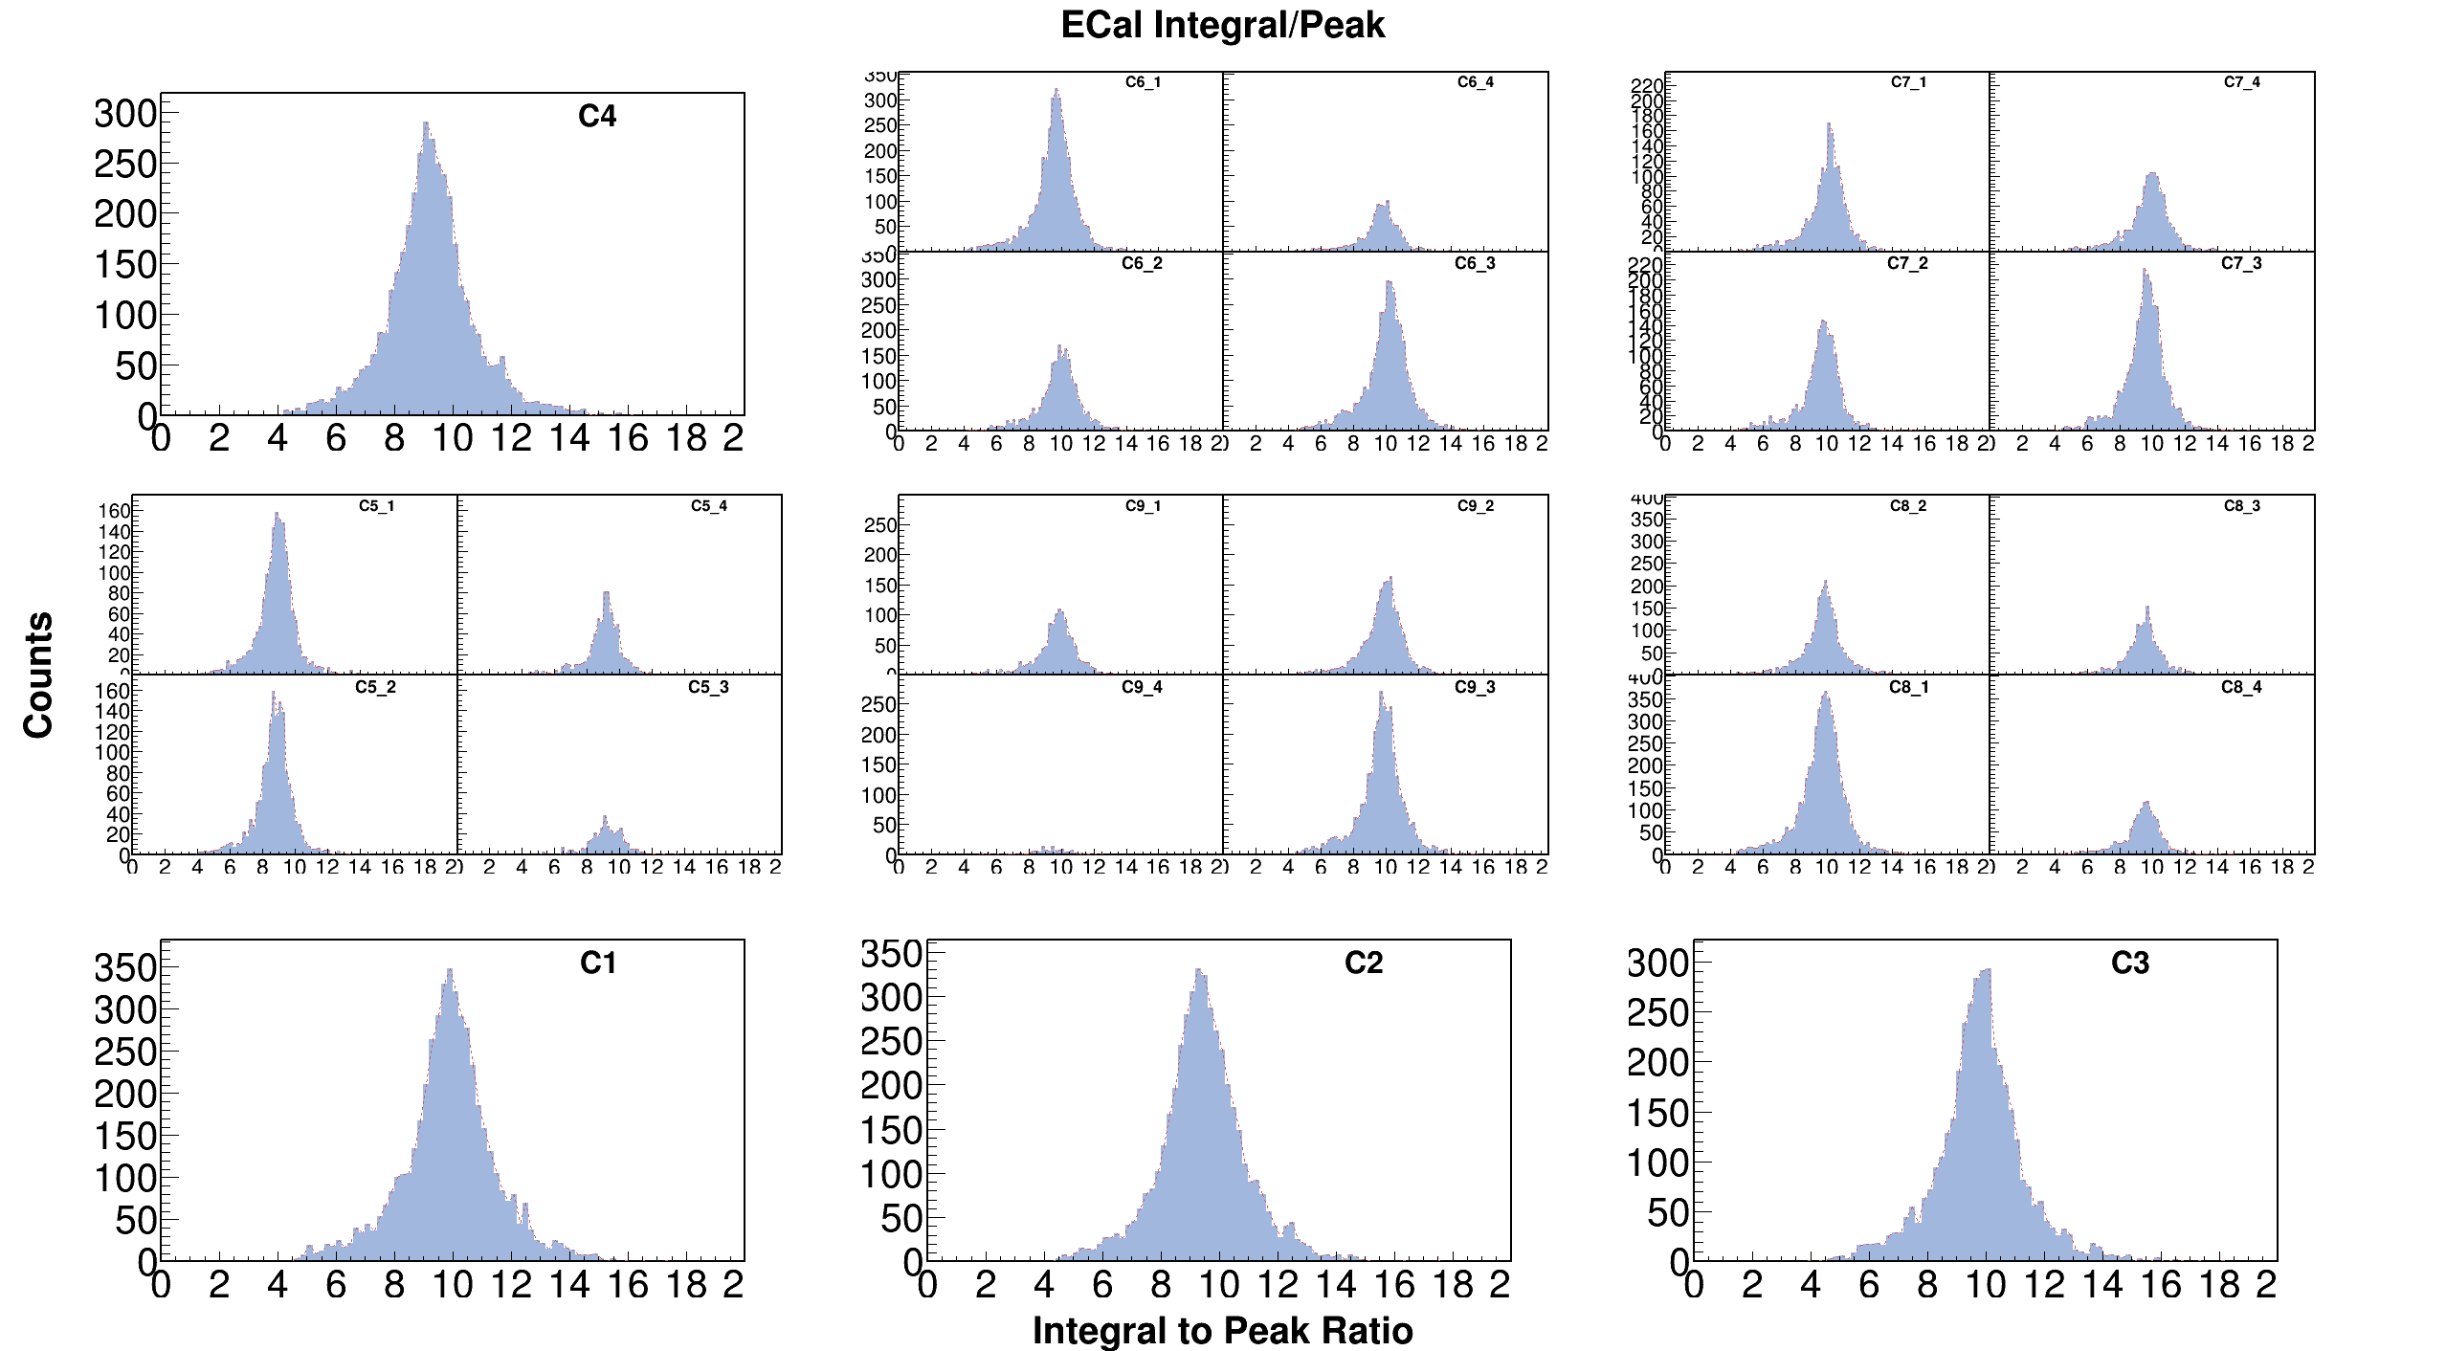
High Rate

Slide 15
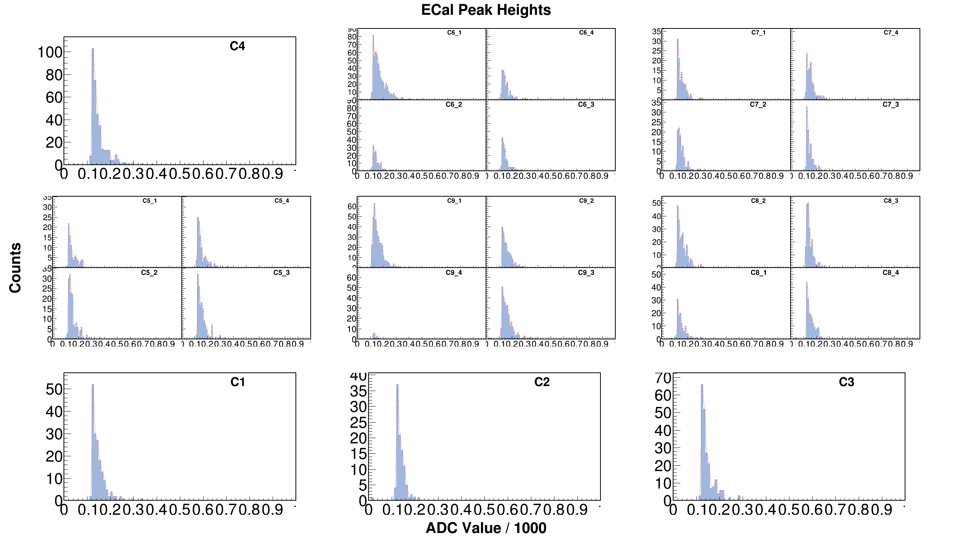
Low Rate

Slide 16
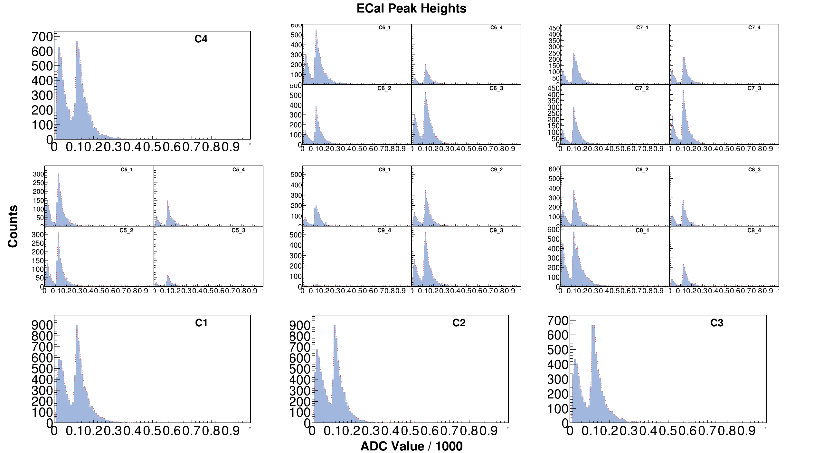
High Rate

Slide 17
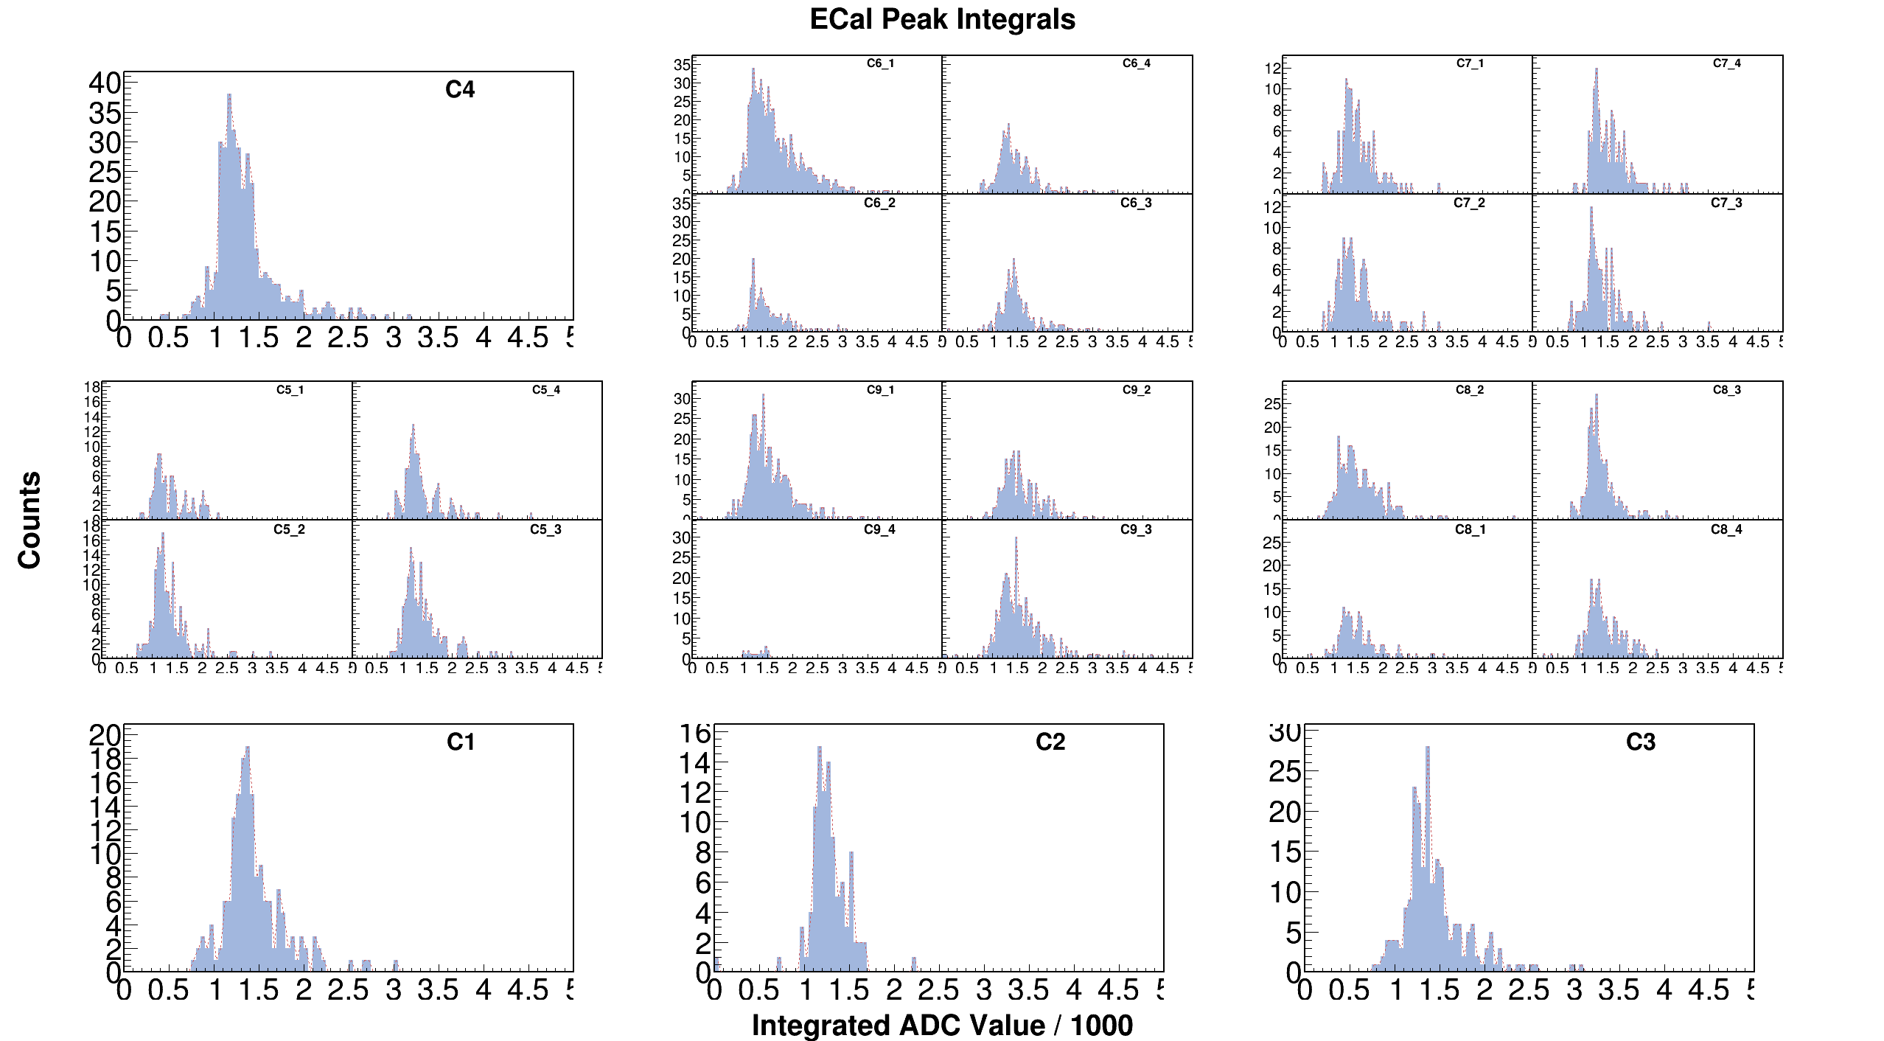
Low Rate

Slide 18
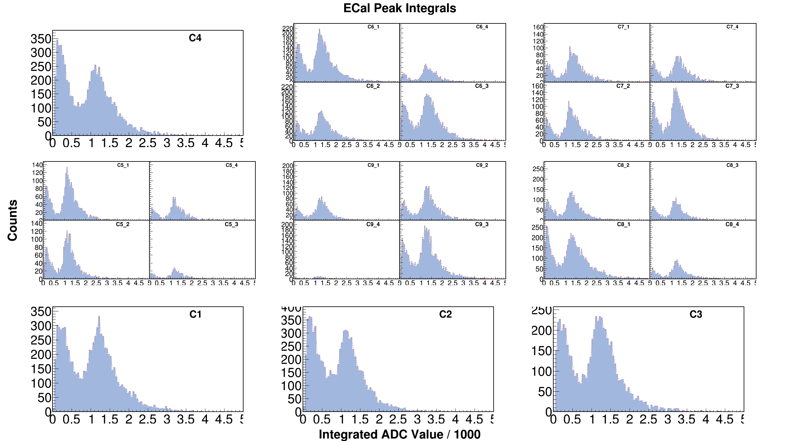
High Rate

Slide 19
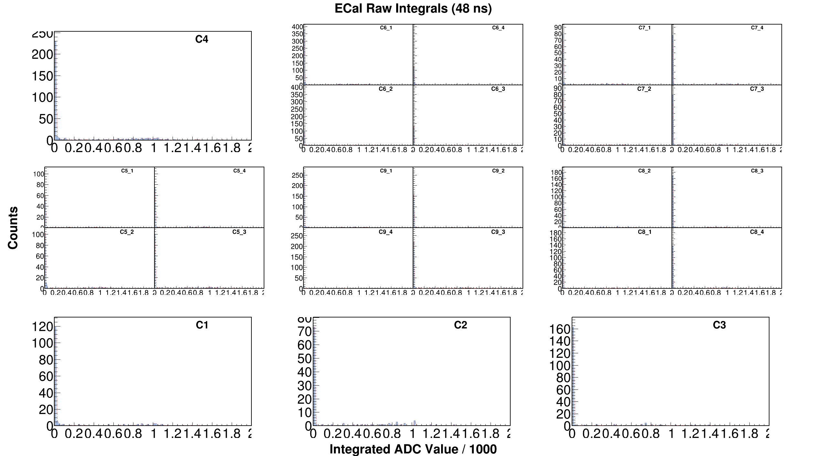
Low Rate

Slide 20
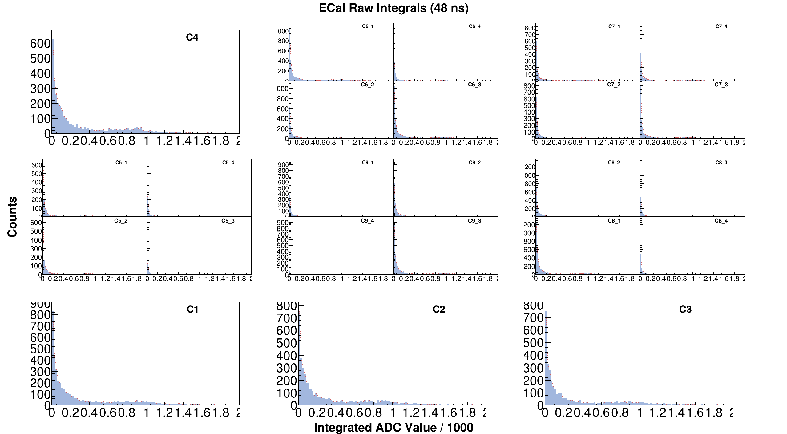
High Rate

Slide 21
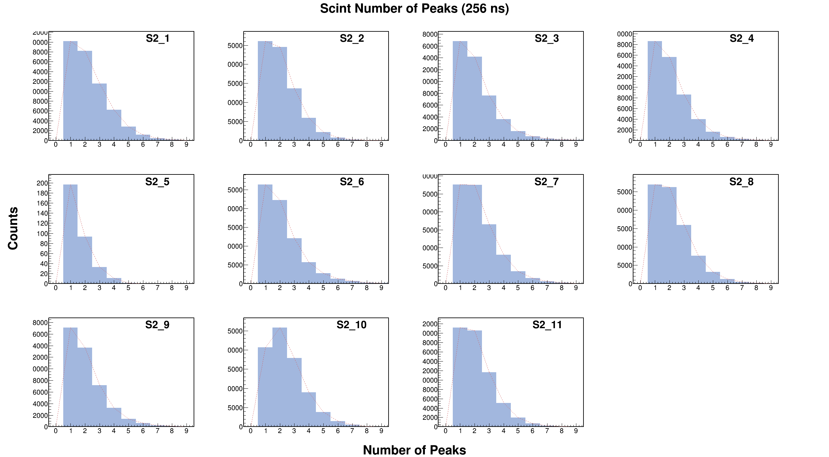
Low Rate

Slide 22
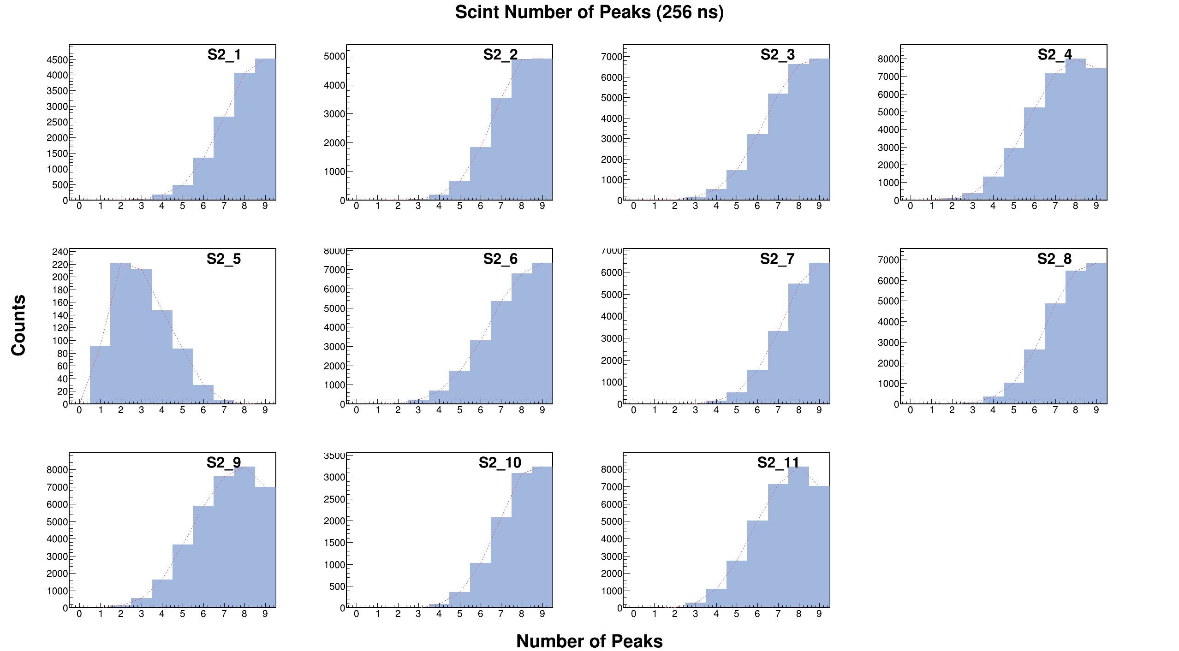
High Rate

Slide 23
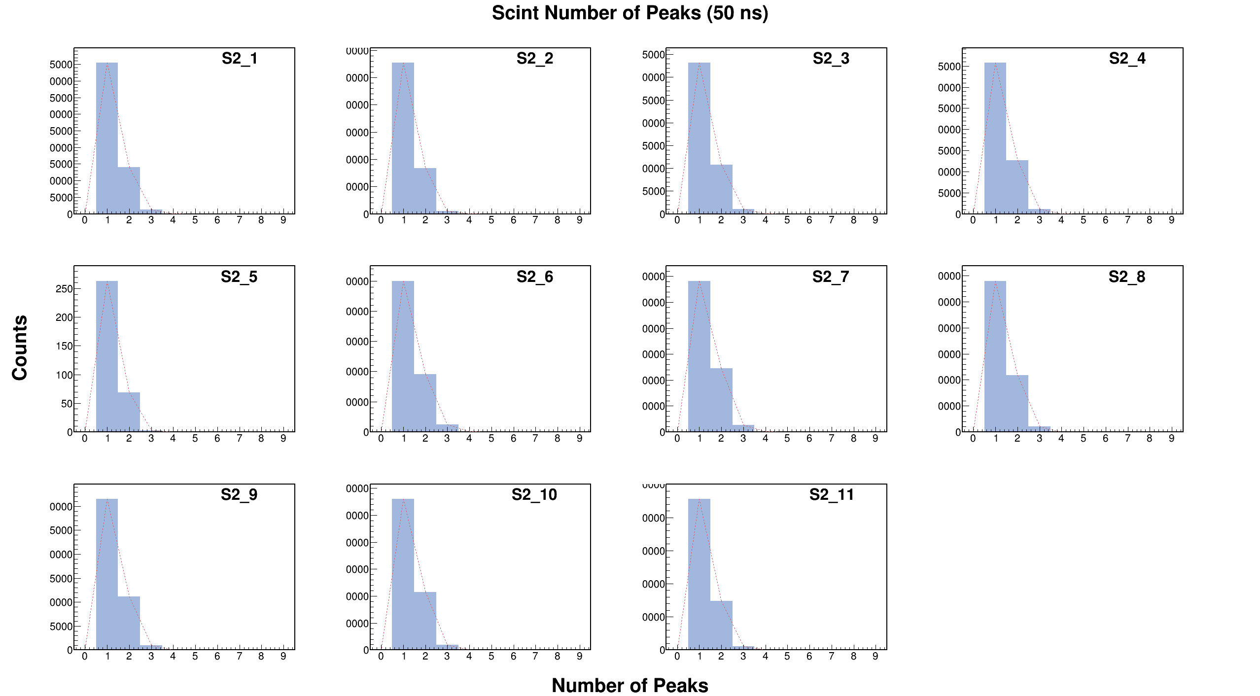
Low Rate

Slide 24
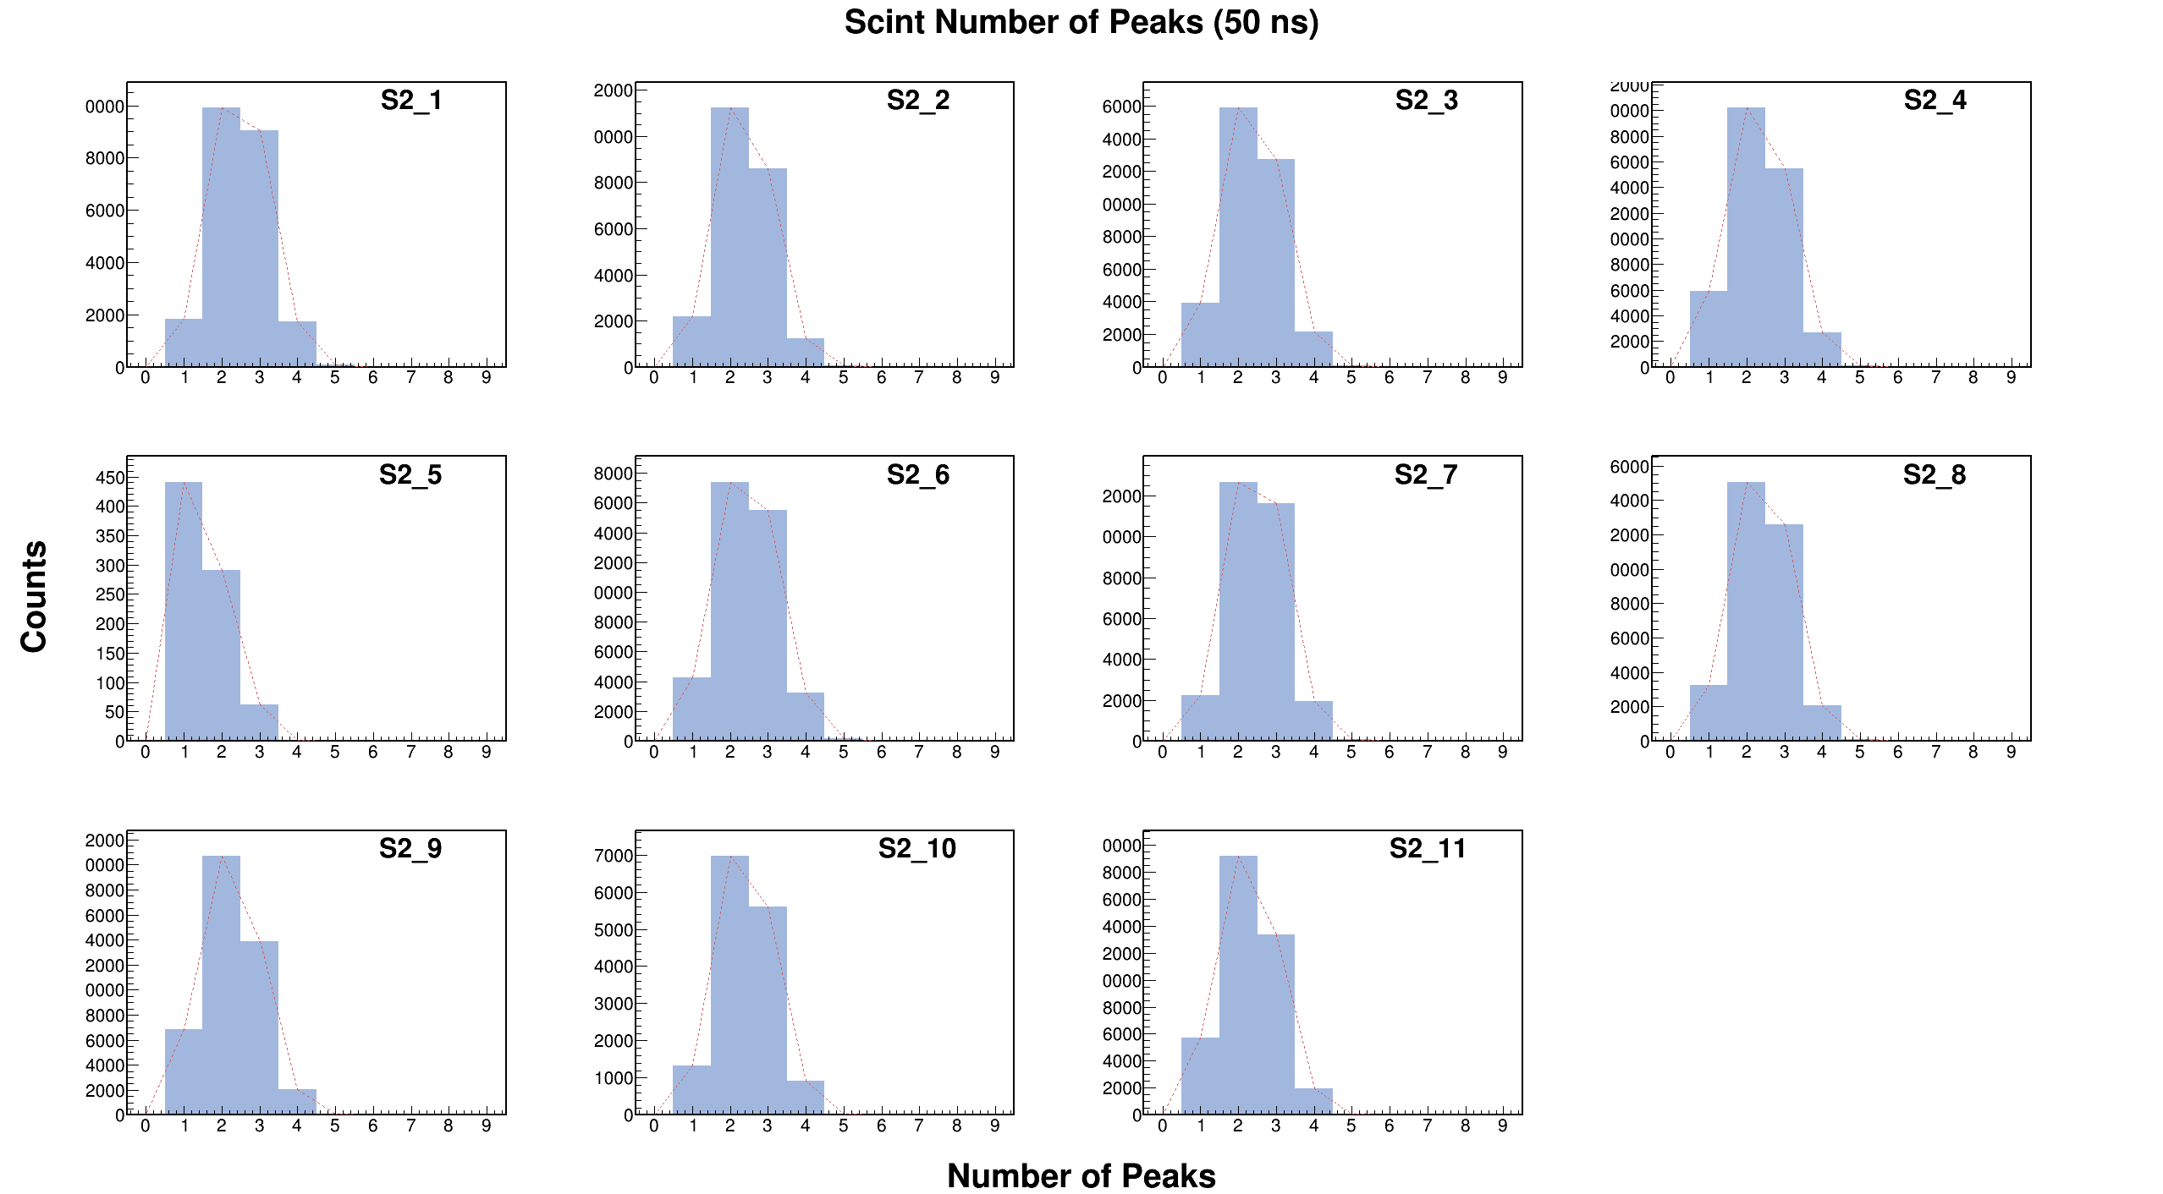
High Rate

