Slide 1
Correlations between modifications and improvement in Energy Resolution
Nonlinear and linear methods, run 1066
Zheng Huang, Sep. 22nd
University of Illinois at Chicago

Slide 2
General outline
With gain-calibrated data
Nonlinear: 1. Previous: Modified AdcSum = ECal_Cluster_AdcSum * position_gap factor * preshower factor All factors were calculated base on the mean of ECal_Cluster_AdcSum. 2. Check if there is any correlation between those modifications: New: ECal_Cluster_AdcSum * preshower factor = ECal_Cluster_AdcSum_P Modified AdcSum = ECal_Cluster_AdcSum_P * position_gap factor (mean is based on ECal…P, instead of ECal_Cluster_AdcSum)

Slide 3
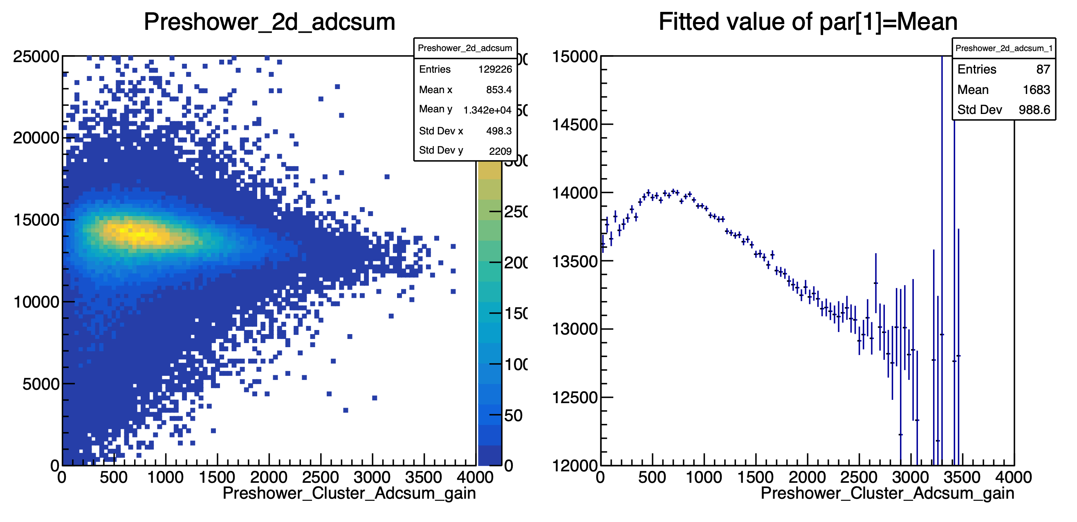
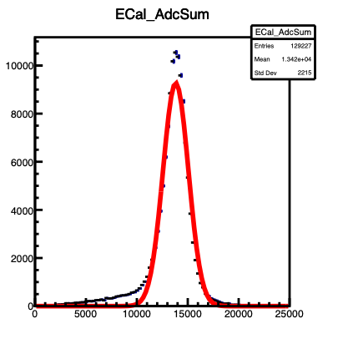
Preshower modification
Nonlinear, run 1066 = 10GeV
ECal_Cluster_Adcsum_gain
Preshower modification factor = mean of ECal_Cluster_AdcSum_gain / Fitted mean of each bin

Slide 4
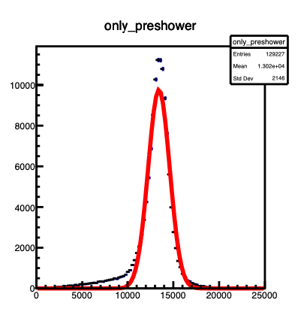
Position modification factor
Nonlinear, run 1066
ECal_Cluster_Adcsum_gain
ECal_Cluster_Adcsum_Preshower
Position modification factor = (mean of ECal_Cluster_Adcsum_Preshower)^2 / (mean of fitted radius * mean of fitted theta) Filled with certain theta angle ignored

Slide 5
Energy resolution of each step
ER: 0.096343 0.090597 0.087695 0.064030 Previous: 0.064561

Slide 6
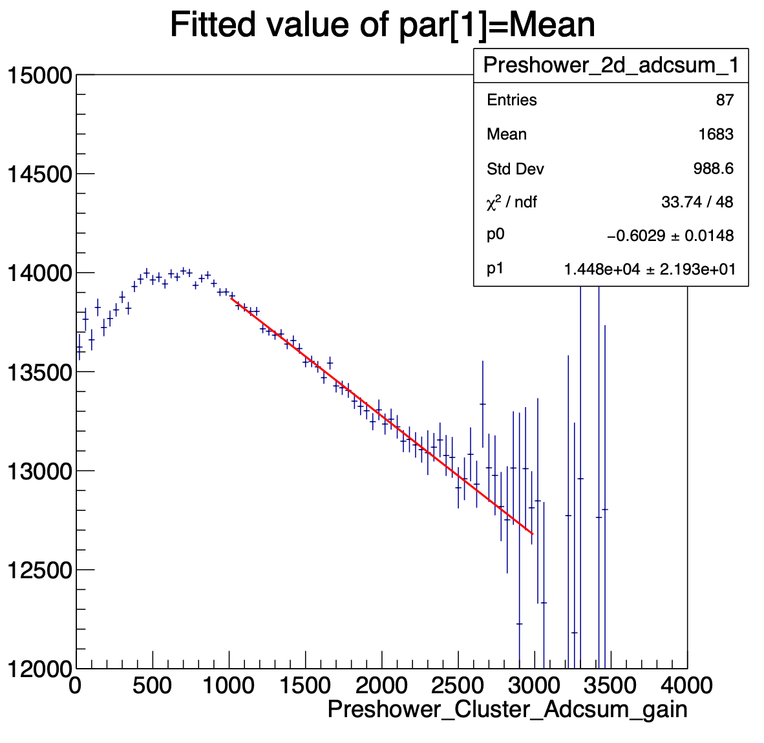
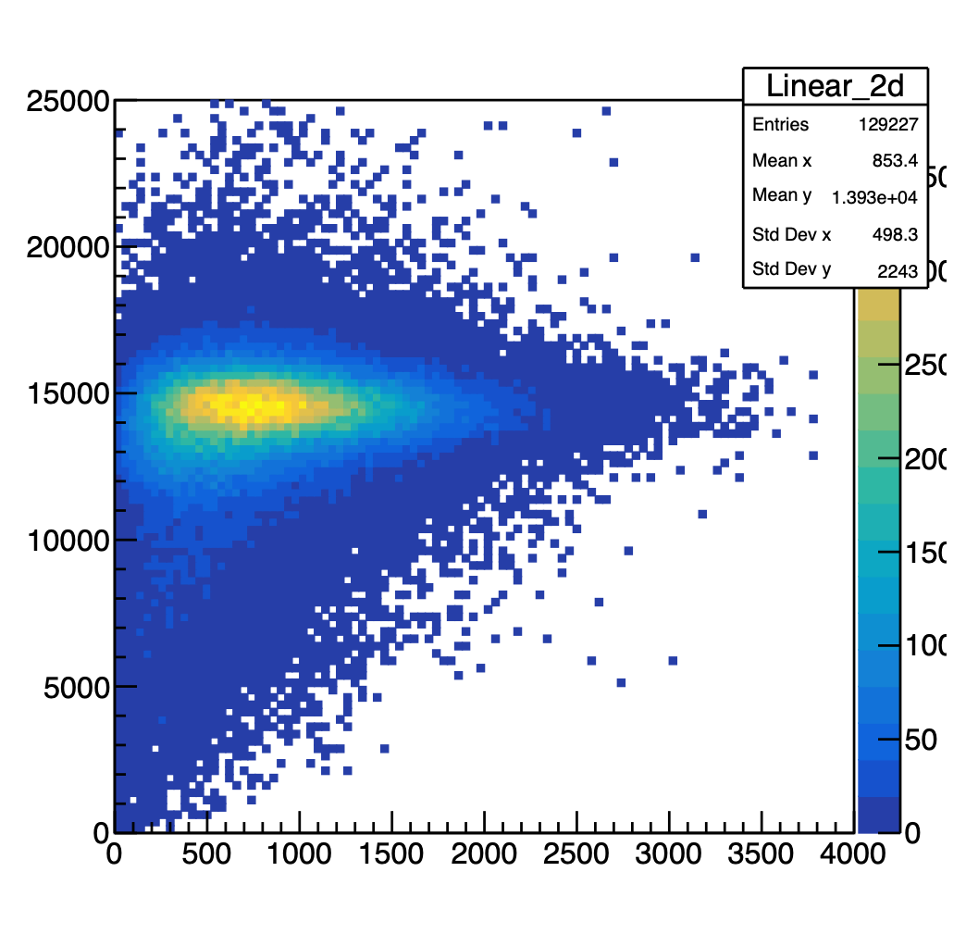
Preshower modification
linear, run 1066
Linear_ECal_Adcsum = ECal_Cluster_AdcSum_gain + (-1)*slope*(Preshower_Cluster_AdcSum_gain)
ECal_Cluster_Adcsum_gain
Linear_ECal_Adcsum
Fitting function = p1+x*p0
lower limit=1000, upper limit = 3000

Slide 7
Position modification factor
linear, run 1066
ECal_Cluster_AdcSum_total_linear = Linear_ECal_Adcsum * Position modification factor
Position modification factor = (Linear_mean)^2 / (Adc_Sum_radius * Adc_Sum_theta)
Final histogram was filled with certain theta ignored.
Previous: using the mean of original ECal_Cluster_AdcSum_gain

Slide 8
Energy resolution comparison
Nonlinear total and linear total
Linear_total
0.064030
0.057888

Slide 9
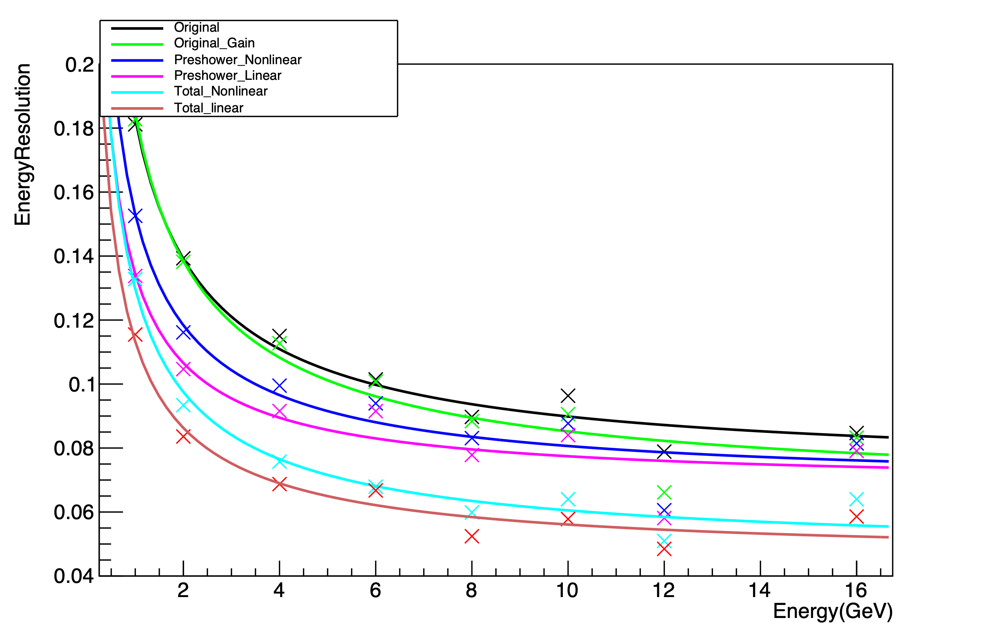
 | P0 | P1
Original | 0.072±0.003 | 0.168±0.005
Gain | 0.065±0.006 | 0.173±0.008
Preshower (nonlinear) | 0.068±0.006 | 0.137±0.009
Position | 0.047±0.004 | 0.121±0.006
$F(x)=\sqrt{P0^{2}+\frac{(P1^{2})}{x}}$
 | P0 | P1
Original | 0.072±0.003 | 0.168±0.005
Gain | 0.065±0.006 | 0.173±0.008
Preshower (linear) | 0.068±0.005 | 0.116±0.005
Position | 0.046±0.003 | 0.104±0.005
Energy resolution for run 1066 (10 GeV)
Original : 0.096, New Gain: 0.091 (-6%), Preshower_Nonlinear: 0.088 (-3%), Position Dependence: 0.064 (-27%)
Original : 0.096, New Gain: 0.091 (-6%), Preshower_Linear: 0.084 (-7%), Position Dependence: 0.058 (-31%)
~10% improvement in energy resolution by gain and preshower correction
~30% additional improvement from position dependence correction

Slide 11
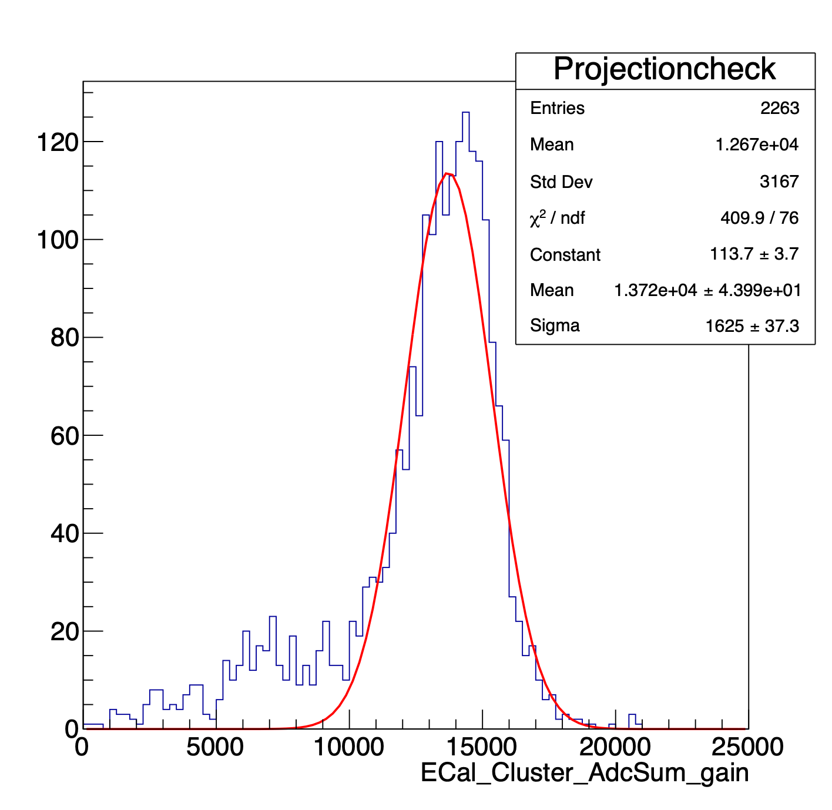
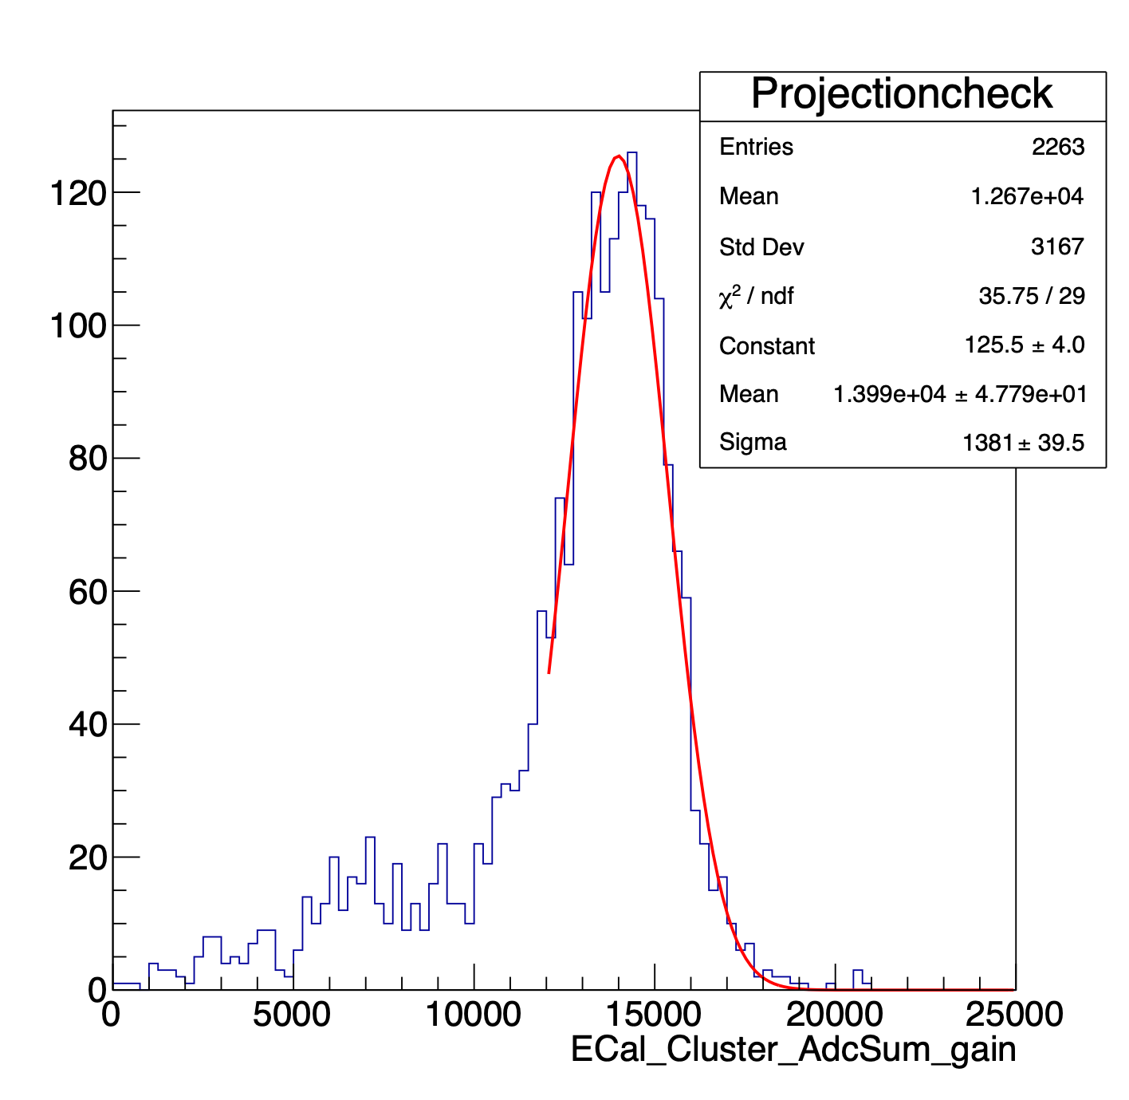
Fifth Xbin, run 1066, projected from Preshower_2D_gain
Fifth Xbin, run 1066, by limiting the domain to be 12000-25000

Slide 12
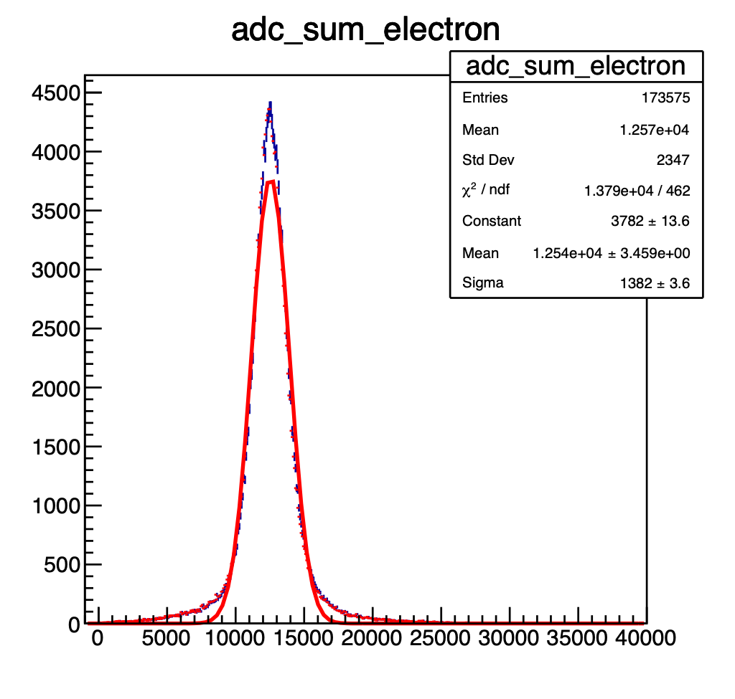
Run 1063
Run information: 6GeV, requested lower rate after 5 spills.
Run 1063,1064,1065.
1D Histogram of AdcSum over all data
Fitted adc_sum over full data
2D ECal in Cartesian coordinate
Energy resolution = Sigma/Mean = 11.02%

Slide 13
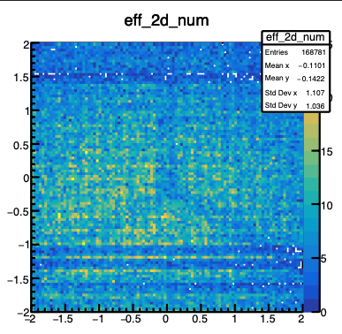
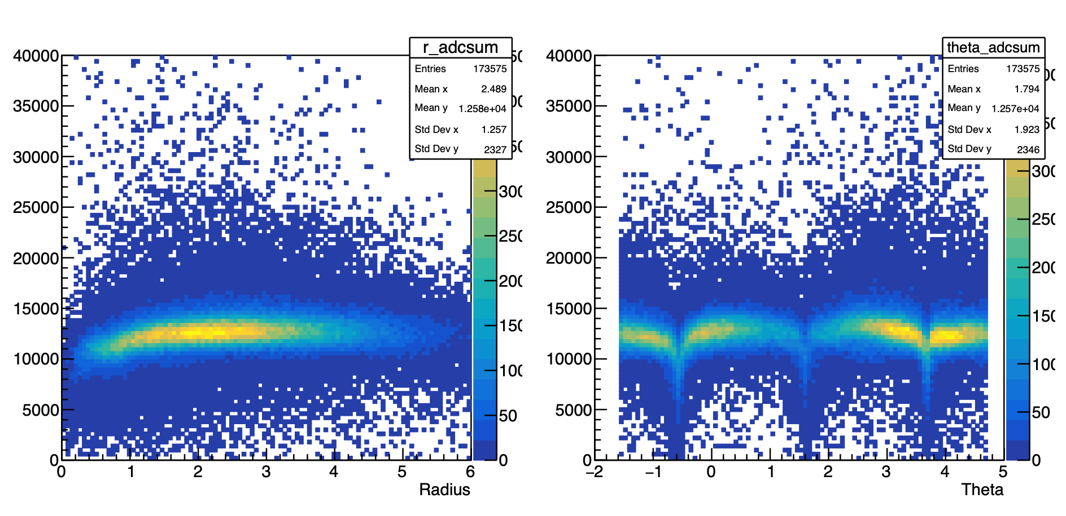
Run 1063
Shift the coordinate system so that the intersected point is the origin.
2D ECal in Cartesian coordinate
Convert the x/y to the corresponding radius and theta.
Plot 2D histogram of adcsum vs. radius and theta.
Use FitSlicesY() method to compare the radius and angle dependence.

Slide 14
Run 1063

Slide 15
Run 1063
1. New_ECal_Cluster_AdcSum-> ECal_Cluster_AdcSum * Mean of AdcSum_Electron / Fitted Mean of AdcSum at corresponding radius/angle/both.
2. Perform the plotting using New AdcSum vs. radius and angle using the same FitSlicesY() method, and check if the radius and angle dependency reduce.

Slide 16
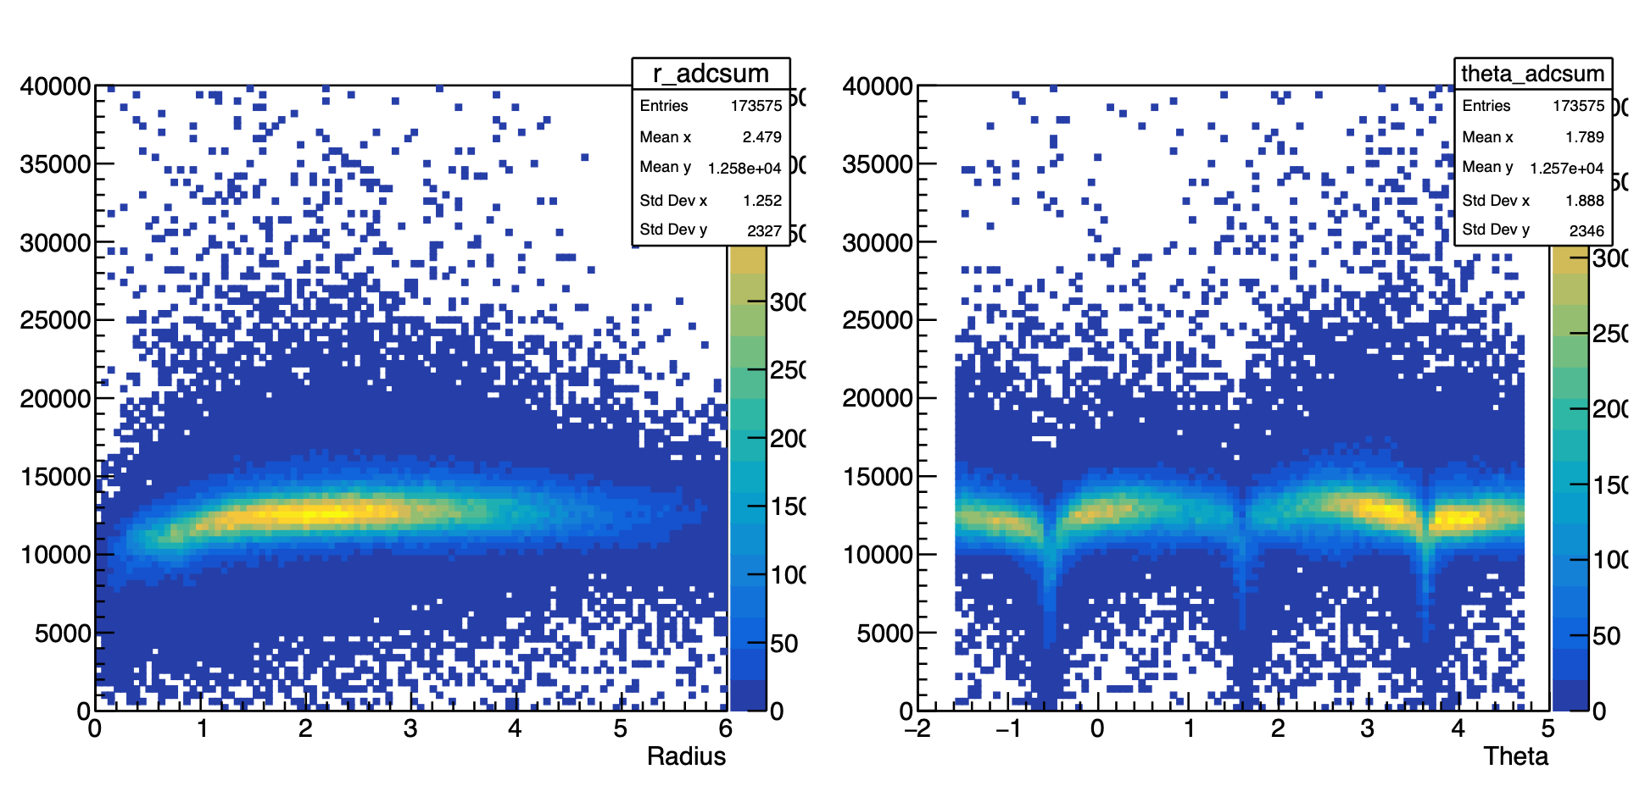
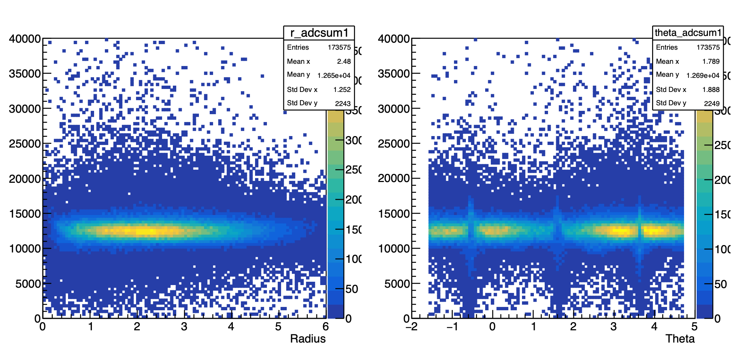
Run 1063
Without modification
With modification

Slide 17
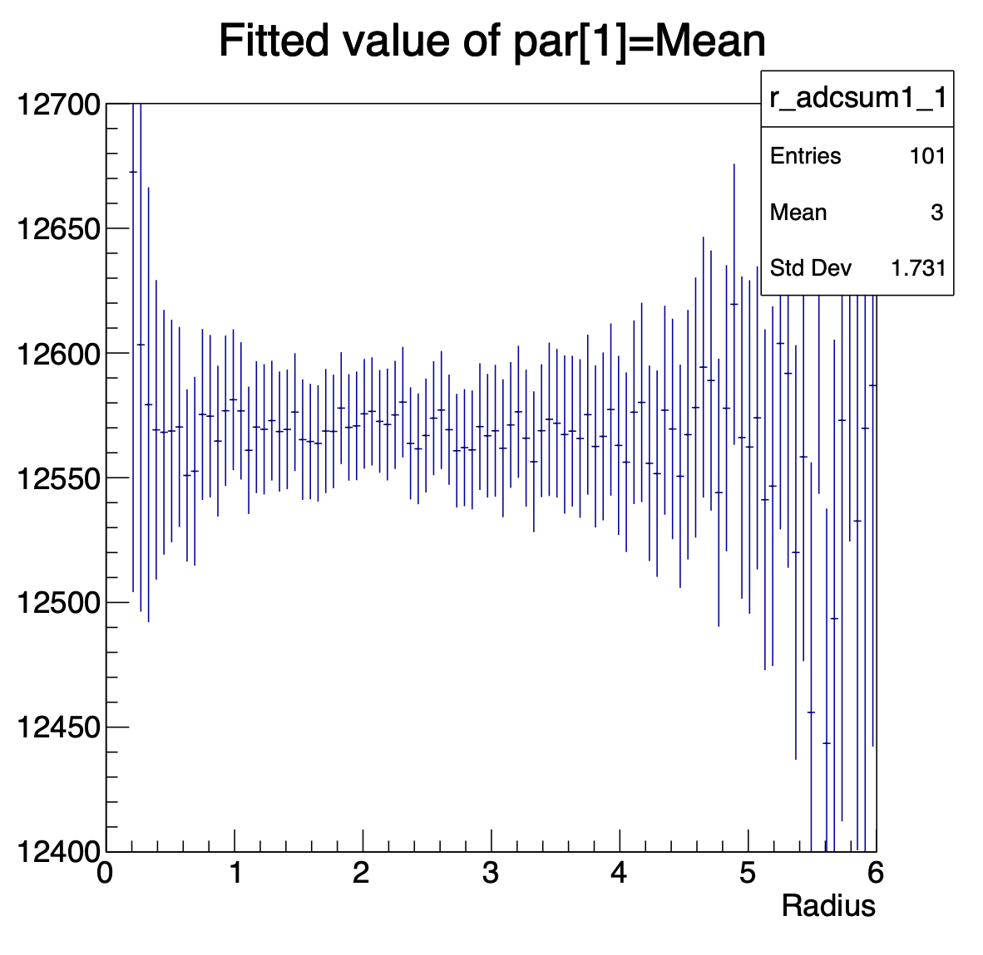
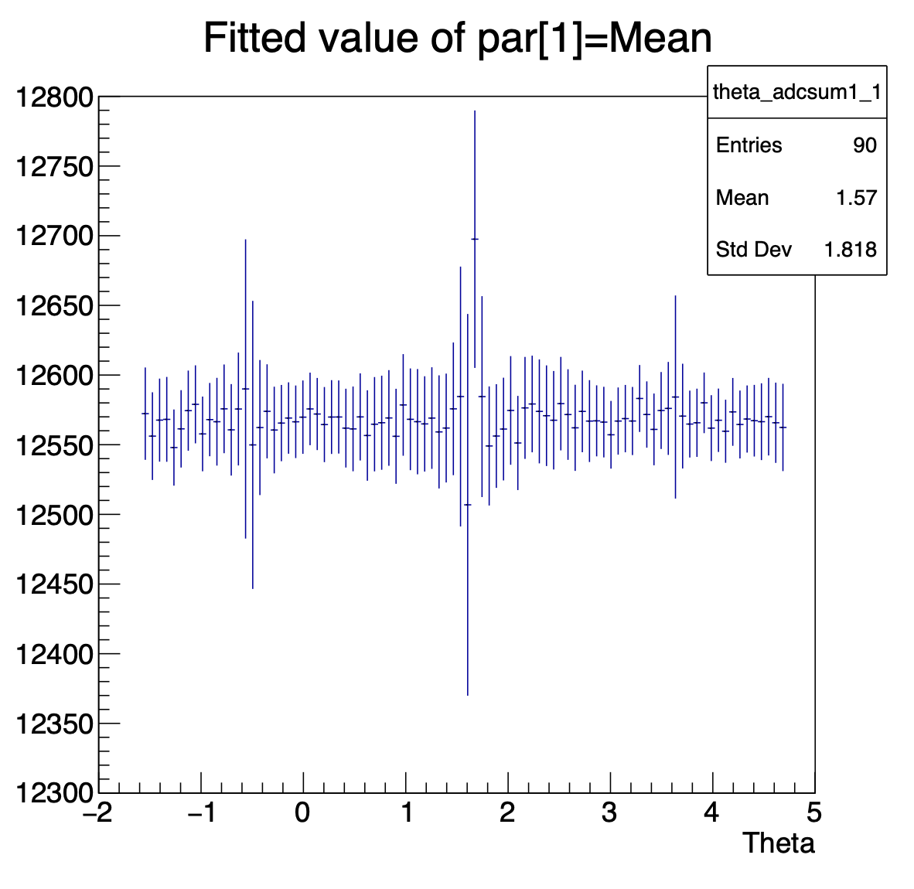
Run 1063
Mean value of fittedSliceY() before modification
Mean value of fittedSliceY() after modification

Slide 18
Run 1063
Energy resolution = 10.02%
Energy resolution = 10.29%
Energy resolution = 9.21%
Original Energy resolution (without any modification on ECal_Cluster_AdcSum)= 11.02%

Slide 19
Run 1063
Skip certain theta (all three gaps)
Energy resolution = 10.06%
Skip certain theta(all three gaps)
Skip all gaps and with modifications on both
Energy resolution = 8.531%
Original Energy resolution (without any modification on ECal_Cluster_AdcSum)= 11.02%

