Slide 1
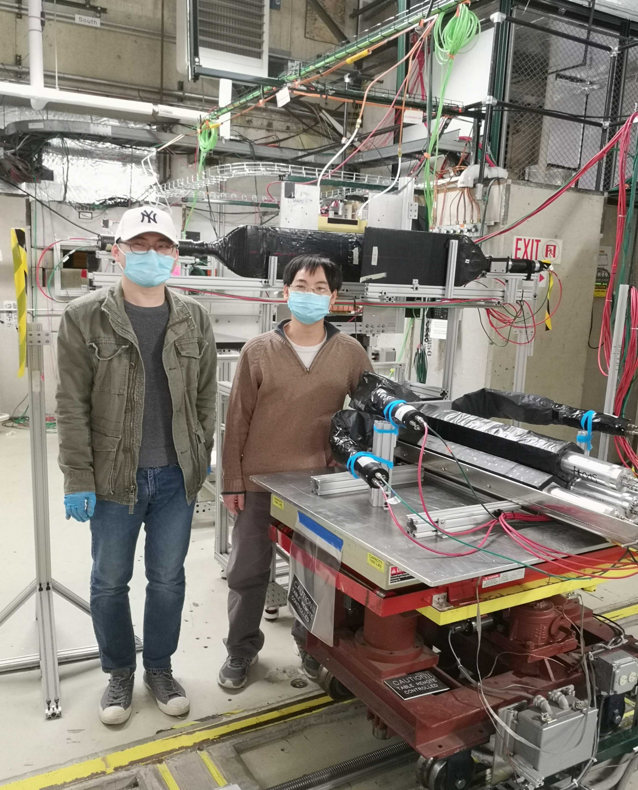
SoLID FY22 Research Rampup Plan
Beamtest in FY22 – high rate beam test of GEM+Cherenkov+ECal (recommended by Feb 2019 Director’s review) and high radiation DAQ test
Artificial Intelligence/Machine Learning – possible multi-institution proposal responding to open FOA, or new AI-focused FOA in 2022.
Other topics from SoLID collaboration institutions PIs:
  Cherenkov mirror testing and prototyping (M. Paolone)
  End-to-end simulation (recommended by Feb 2019 Director’s review) (add name?)
  DAQ Streaming readout (add name?)

Slide 2
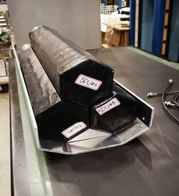
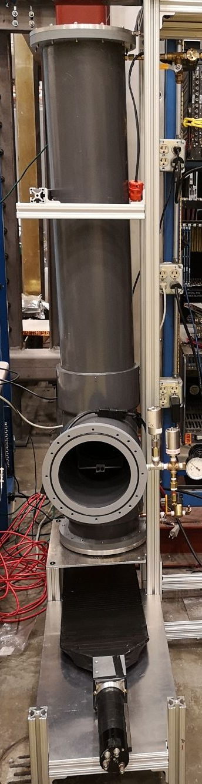
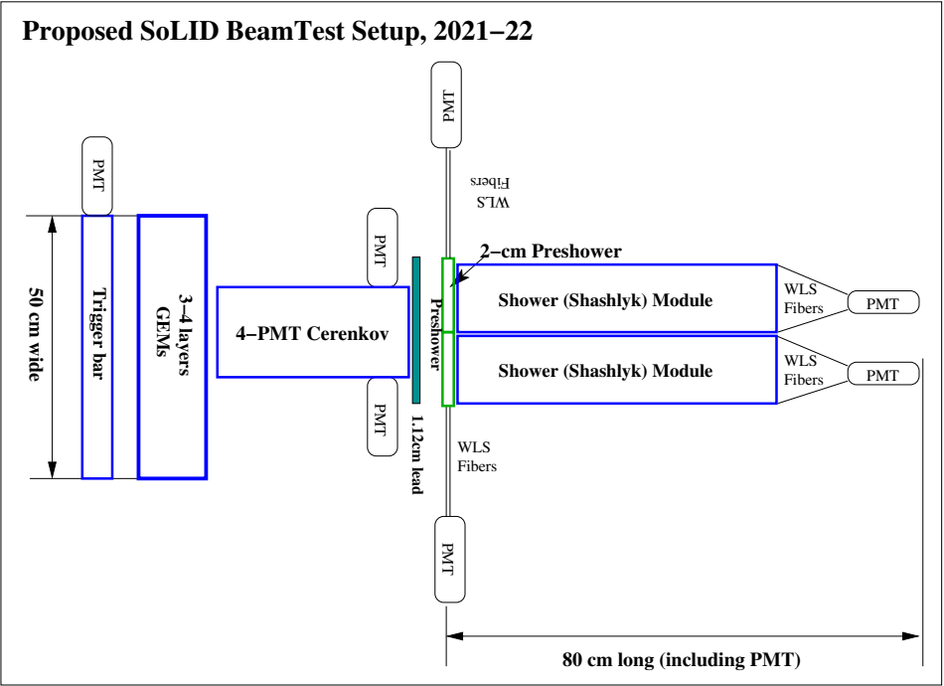
Beam test
High rate beam test of GEM+Cherenkov+ECal – in responding to Director’s Review recommendation Feb. 2019
Provide data for future AI/ML development for high rate, high background signal processing and data analysis

Slide 3
Beam test – location and DAQ test
High background, high radiation test:
  SBS program in Hall A will have beam conditions close to SoLID running, detectors can be placed at small angles pointing to the target to record data with high background. Radiation detector and dosimeter can be installed;
  Also looking into Hall C running conditions;
Test in HRS:
  UMass group tested DAQ with pulser, need to be confirmed with a physical measurement;
  During ³He target run, LHRS is not being used and our SoLID electronics can be setup there to measure physics asymmetry using LHRS detectors.
new VMM3 electronics will be available

Slide 4
Beam test – Resources
Resources needed:
  UVA can re-prioritize → 0.3 FTE (Jixie), but need 0.7 more (0.25 FTE Mike? + 0.45 FTE new?)
  need inputs
  7 FADCs ($70 k)

Slide 5
Artificial Intelligence/ Machine Learning
Need specific algorithm and optimization for SoLID’s high rate, high background running condition:
  AI for GEM tracking using momentum, track direction, hits, and track quality; need fast, high-efficiency track-finding algorithm;
  AI for PID using ECal signal (amplitude, waveform, cluster identification) and Cherenkov;
“Classic” machine learning approach: neural network, deep network, boosted decision tree, etc provide a good starting point;
SoLID-specific AI/ML study and optimization will provide feedback to GEM, ECal, Cherenkov design, and end-to-end simulation
SoLID-specific implementation
We will utilize existing simulation tool and FTBF test data, along with new data expected from the upcoming high-rate beam test → possible multi-institution proposal responding to open FOA, or AI-focused FOA in 2022.

Slide 6
End-to-end simulation with AI/ML integration
End-of-end simulation recommended by Feb. 2019 Director’s Review
Need to develop framework that works for SoLID’s entire life cycle, that includes:
  event generation (physics and background)
  detector simulation (GEANT-based), signal digitization
  signal processing and event decoder
  data analysis and extraction of physics results
  interface to AI/ML algorithm
Lead institution/PI: to be added – need inputs

Slide 7
Cherenkov Mirror Study
High cost of CFRP (carbon fiber reinforced polymer) polished mirror blanks pushed collaboration to seek alternative mirror fabrication methods:
  attach reflective plastic-lexan film to polished carbon-fiber blanks, need: mirror blank testing, lexan-film adhesion and radiation hardness testing
  alternative 3D-printing CFRP blanks
MAPMT and WLS coating radiation testing
HGC Mirror mounting prototyping and readout gas tightness testing
Microchannel plate (MCP)-PMT testing
Lead institution/PI: to be added – need inputs

Slide 8
Streaming DAQ
Simulation of event size and data processing will be performed to evaluate the amount of resources needed
A streaming version of the VMM prototype could be built and tested in streaming mode
Lead institution/PI: to be added – need inputs

