Slide 1
FY22 Research Ramp-up Plan
SoLID Collaboration
September 8th, 2021

Slide 2
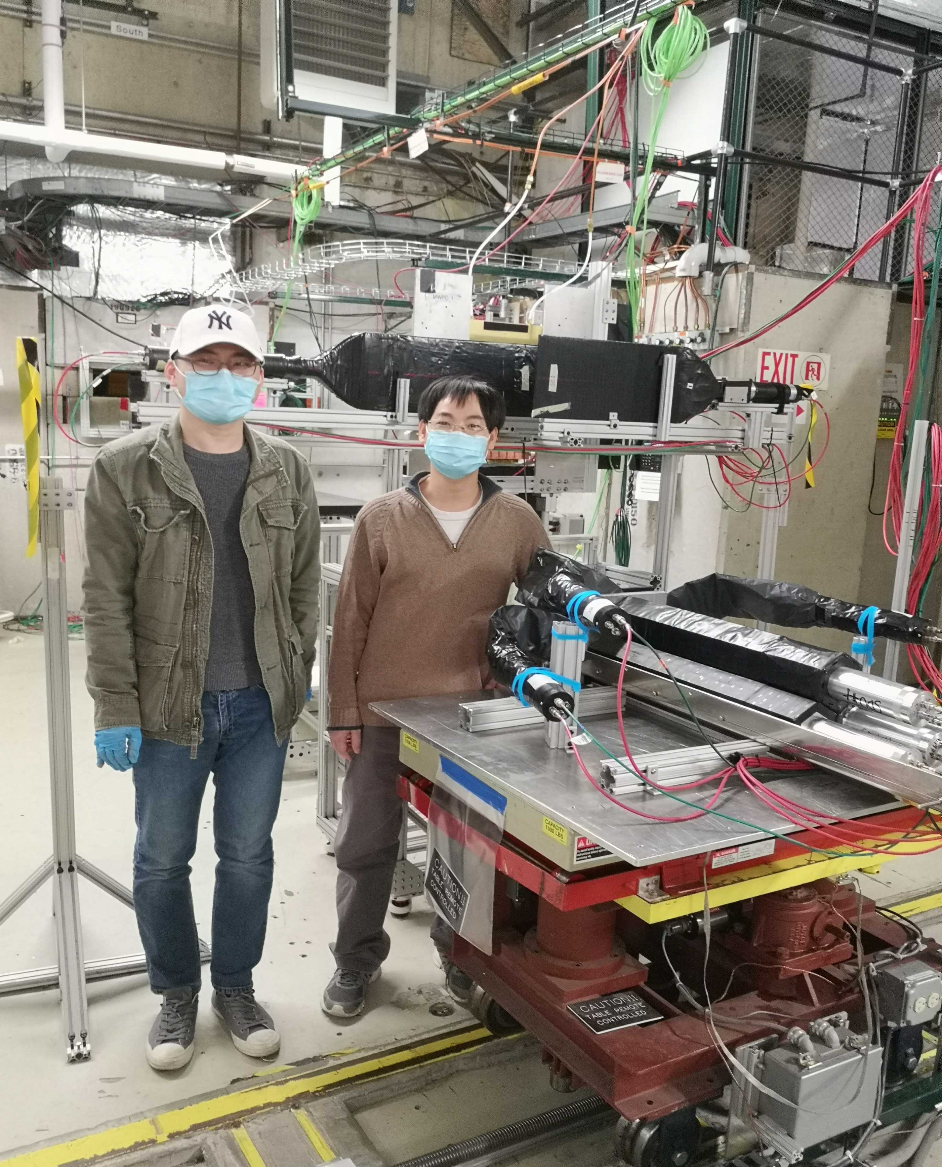
SoLID FY22 Research Rampup Plan
Beamtest in FY22 – high luminosity (high rate and high radiation) beam test of detector setup and DAQ system, as suggested by the Feb 2021 Director’s Review of SoLID
Cherenkov detectors had high rate tests in 2020
ECal had calibration tests at FTBF, while simulations showed no show-stopper, need high rate beam test
GEM with new VMM readout is currently being bench tested with (x-ray mimic) high rate. Needs high radiation test with beam.
Focus will be high rate on ECal and GEM VMM3 readout
Beam test of detector and DAQ at high luminosity will help to identify issues, optimize design choice, thus reduce cost and scheduling risks.

Slide 3
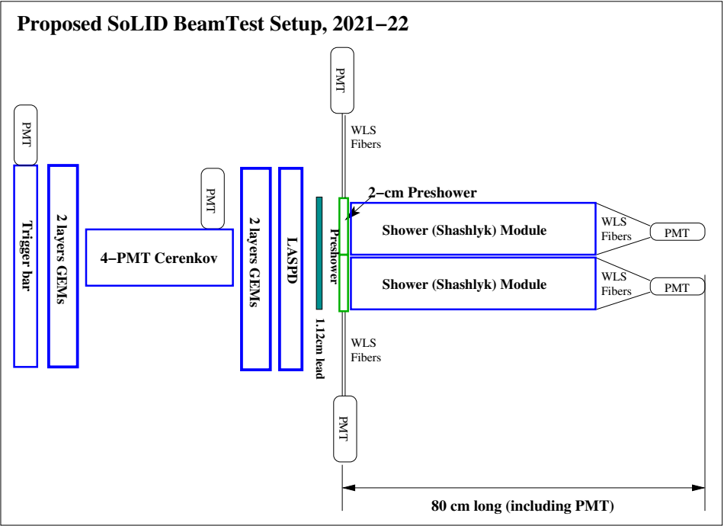
Beam test
Realistic detector setup using existing prototypes

Slide 4
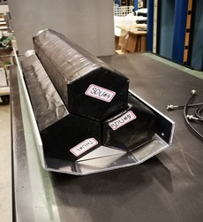
Beam test
3x shashlyk modules
Realistic detector setup using existing prototypes
4-PMT Cherenkov
10cmx10cm GEMs

Slide 5
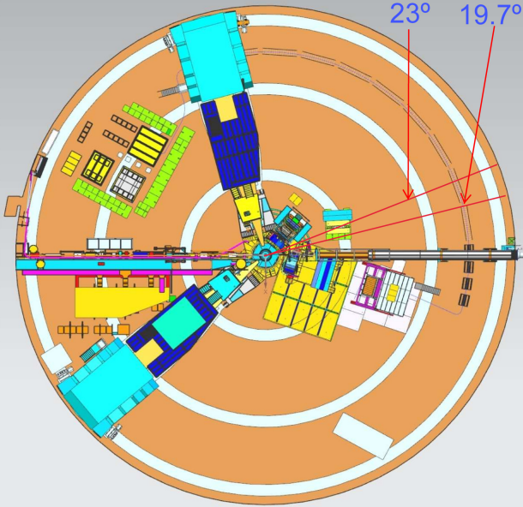
Beam test – Location
SBS program in Hall A close to SoLID running
Hall C also possible;
BB
SBS
Hall A floorplan

Slide 6
Beam test – Resources
Resources needed:
JLab: total 1.5 FTEs, Physics Division provide 0.5 FTE, request 1 FTE
User: 2.5 FTEs, existing re-direct effort 1 FTE, request 1.5 FTE
Procurement: $200 k

Slide 7
Other Topics (FY22 and/or beyond) – Overview
Other topics from SoLID collaboration institutions PIs:
Cherenkov testing and prototyping (cost saving and risk mitigation) (Michael Paolone/New Mexico State U., Haiyan Gao, Zhiwen Zhao/Duke U.)
End-to-end simulation (recommended since Feb 2015 Director’s review) (TBD)
DAQ Streaming readout (suggested during 2021 Science Review) (TBD)
Artificial Intelligence/Machine Learning – possible multi-institution proposal responding to new AI-focused FOA in 2022.

Slide 8
Backup Slides

Slide 9
Other Topics – Overview
Other topics from SoLID collaboration institutions PIs:
Cherenkov testing and prototyping (cost saving and risk mitigation) (M. Paolone/New Mexico State U., Haiyan Gao/Duke U.)
End-to-end simulation (recommended since Feb 2015 Director’s review) (TBD)
DAQ Streaming readout (suggested during 2021 Science Review) (TBD, Yuri ? + J. Arrington/LBNL, R. Gilman/Rutgers?)
Artificial Intelligence/Machine Learning – possible multi-institution proposal responding to new AI-focused FOA in 2022.

Slide 10
Beam test – Resources
Resources needed:
JLab: need 3x2 hours survey
JLab: need 0.5 design/engineering (or 0.1, 0.2?)
Collaboration: 2.0 FTE setup/test/analysis, 0.4 FTE DAQ, simulation 0.4 FTE
(0.5 existing UVA, need ??? new)
Material: 7 FADCs ($70 k), need more stuff (compact support structure, design/machining cost)

Slide 11
Cherenkov testing and prototyping
Cherenkov Mirror Study
High cost of CFRP (carbon fiber reinforced polymer) polished mirror blanks pushed collaboration to seek alternative mirror fabrication methods, to reduce cost and scheduling risks
attach reflective plastic-lexan film to polished carbon-fiber blanks, need: mirror blank testing, lexan-film adhesion and radiation hardness testing
alternative 3D-printing CFRP blanks
MAPMT and WLS coating radiation testing
Microchannel plate (MCP)-PMT testing
Lead institution/PI: New Mexico State U./Michael Paolone
Prototyping of HGC mirror mounting and testing of gas tightness for readout
Study how to mount large HGC mirrors of 137x33 cm for optical alignment
Test gas tightness for electronic readout at 1.7atm
Lead institution/PI: Duke U./Haiyan Gao, Zhiwen Zhao

Slide 12
End-to-end software
A unified end-to-end software framework covering SoLID's entire life cycle is crucial to the success of the project
Recommended since 2015 Director’s Review to develop “with high priority and increased resources"
Provide important guidance to detector design
Focus on researching and adopting existing HEP/NP software packages
Existing efforts cover some components below, but additional efforts are needed to choose and convert into end-to-end software
event generation (physics and background)
detector simulation (GEANT4-based)
signal digitization
data analysis and extraction of physics results
interface to AI/ML algorithm and compatible with heterogeneous computing environment
Lead institution/PI: TBD

Slide 13
Streaming DAQ
Suggested during March 2021 Science Review
Simulation of event size and data processing will be performed to evaluate the amount of resources needed
A streaming version of the VMM prototype could be built and tested in streaming mode
Lead institution/PI: TBD

Slide 14
Artificial Intelligence/ Machine Learning for SoLID
AI/ML has power of recognizing patterns within vast amounts of data generally surpasses traditional methods in terms of speed and accuracy
It is ideal for SoLID’s high rate and high background at luminosity 10³⁷ – 10³⁹ cm⁻²s⁻¹
AI for GEM tracking and AI for PID of combined ECal and Cherenkov
Improve efficiency and speed
Optimization from multiple input variables more than traditional methods can handle
SoLID-specific AI/ML study and optimization will provide feedback to detector design
Be an integrated part of the end-to-end software
We will utilize existing simulation tool and FTBF test data, along with new data expected from the upcoming high-rate beam test → possible multi-institution proposal responding to AI-focused FOA in 2022

Slide 15
2015 Director’s Review Report:
1. Physics Relevance and Risks
1a. Findings:End-to-end physics simulations for the core measurements are lacking.
Recommendations: End-to-end simulations with realistic subsystem responses and material budgets, and complete track finding and reconstruction should be developed.
1b. Findings: The SoLID simulation framework is in the beginning stages of development.
Recommendations: The development of a simulation framework with realistic reconstruction and analysis should be pursued with high priority and increased resources.
2021 Director’s Review Report:
3. The new experimental and theoretical research efforts and technical capabilities needed to accomplish the proposed scientific program.
Comments:
From the presentations it was not possible to understand how far the R&D on the different detectors has been progressed to ensure the chosen technologies are able to perform to the physics requirements, especially to the occupancy expected due to the high luminosity of 10³⁷ – 10³⁹ cm⁻²s⁻¹

