Slide 1
FY22 Research Ramp-up Plan
SoLID Collaboration
September 8th, 2021

Slide 2
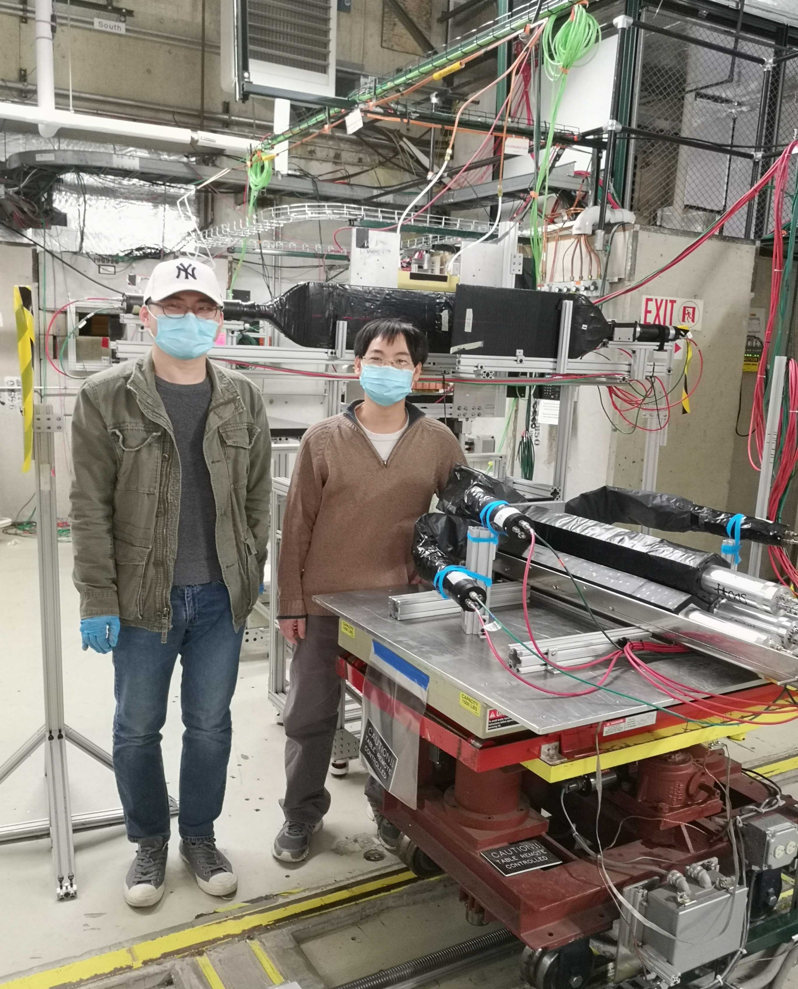
SoLID FY22 Research Rampup Plan
Beamtest in FY22 – high luminosity (high rate and high radiation) beam test of detector setup and DAQ system, as suggested by the Feb 2021 Director’s Review of SoLID
  Cherenkov detectors had high rate tests in 2020
  ECal had calibration tests at FTBF, while simulations showed no show-stopper, need high rate beam test
  GEM with new VMM readout is currently being bench tested with (x-ray mimic) high rate. Needs high radiation test with beam in an actual hall environment (SBS lessons learned)
  Focus will be high rate on ECal and GEM VMM3 readout
Beam test of detector and DAQ at high luminosity will help to identify issues, validate pre-conceptual design, thus reduce cost and scheduling risks.

Slide 3
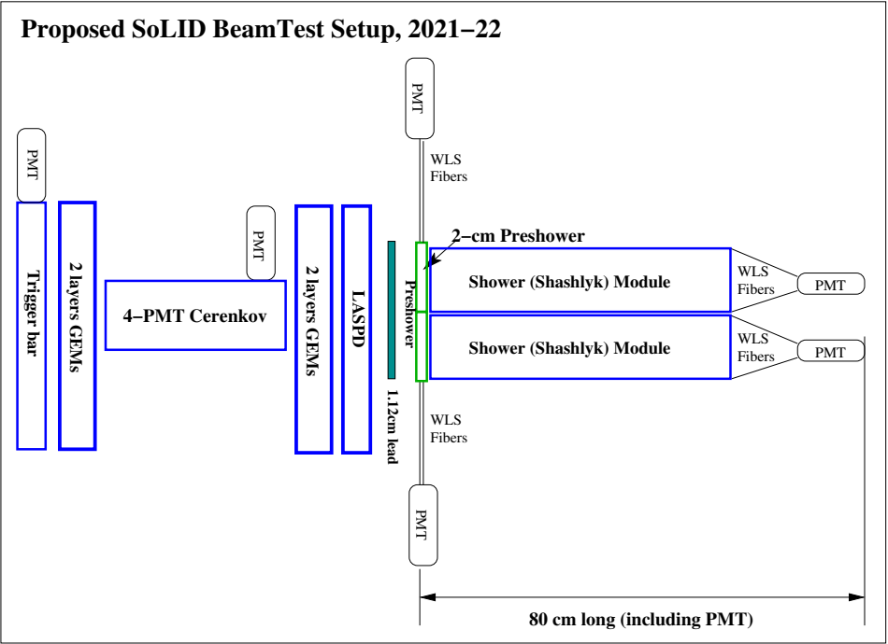
Beam test
Realistic detector setup using existing prototypes
particle direction

Slide 4
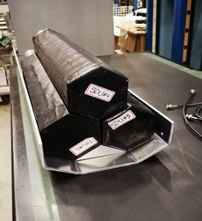
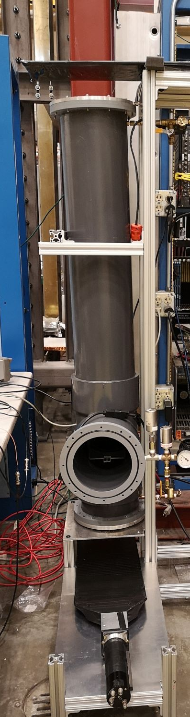
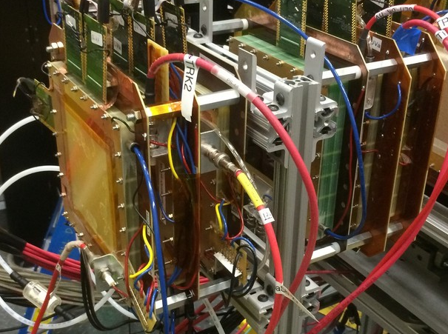
Beam test
3x shashlyk modules
Realistic detector setup using existing prototypes
4-PMT Cherenkov
10cmx10cm GEMs

Slide 5
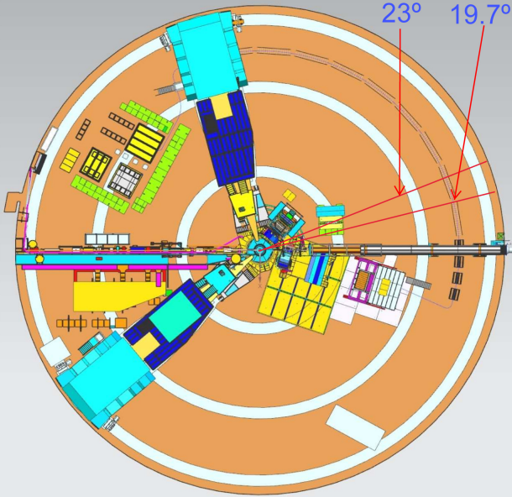
Beam test – Location
SBS program in Hall A close to SoLID running
Hall C unlikely except >40 deg, could sit on (S)HMS platform?
BB
SBS
Hall A floorplan

Slide 6
Beam test – Resources
Resources needed:
  Total 4.0 FTE, possibly:
    Physics Division provide support at 0.5 FTE, Users redirect 1 FTE effort
    need JLab overall support at the level of 1 FTE
    User: need 1.5 FTE
  Procurement: $200 k

Slide 7
Other Topics (FY22 and/or beyond) – Overview
Other topics from SoLID collaboration institutions PIs:
  Cherenkov testing and prototyping (cost saving and risk mitigation) (Michael Paolone/New Mexico State U., Haiyan Gao, Zhiwen Zhao/Duke U.)
  End-to-end simulation (recommended since Feb 2015 Director’s review) (TBD)
  DAQ Streaming readout (suggested during 2021 Science Review) (TBD)
Artificial Intelligence/Machine Learning – possible multi-institution proposal responding to new AI-focused FOA in 2022.

Slide 8
Backup Slides

Slide 9
Cherenkov testing and prototyping
Cherenkov Mirror Study
  Pursue mirror fabrication methods to advance pre-conceptual design
    attach reflective plastic-lexan film to polished carbon-fiber blanks, need: mirror blank testing, lexan-film adhesion and radiation hardness testing
    alternative 3D-printing CFRP blanks
  MAPMT and WLS coating radiation testing
  Microchannel plate (MCP)-PMT testing
Lead institution/PI: New Mexico State U./Michael Paolone
Prototyping of HGC mirror mounting and testing of gas tightness for readout
  Study how to mount large HGC mirrors of 137x33 cm for optical alignment
  Test gas tightness for electronic readout at 1.7atm
Lead institution/PI: Duke U./Haiyan Gao, Zhiwen Zhao

Slide 10
End-to-end software
A unified end-to-end software framework (integrating AI/ML) covering SoLID's entire life cycle is crucial to the success of the project
Recommended since 2015 Director’s Review to develop “with high priority and increased resources"
Provide important guidance to detector design
Focus on researching and adopting existing HEP/NP software packages
Existing efforts cover some components below, but additional efforts are needed to choose and convert into end-to-end software
  event generation (physics and background)
  detector simulation (GEANT4-based)
  signal digitization
  data analysis and extraction of physics results
Lead institution/PI: TBD

Slide 11
Streaming DAQ
Suggested during March 2021 Science Review
Tracking in high background and high rate is a large hurdle for SoLID
  build and test a streaming version of the VMM prototype
simulation of event size and data processing will be performed to evaluate the amount of computing and storage resources needed
Lead institution/PI: TBD

Slide 12
Artificial Intelligence/ Machine Learning for SoLID
AI/ML has power of recognizing patterns within vast amounts of data generally surpasses traditional methods in terms of speed and accuracy
It is ideal for SoLID’s high rate and high background at luminosity 10³⁷ – 10³⁹ cm⁻²s⁻¹
  AI for GEM tracking, PID of combined ECal and Cherenkov, and background reduction
  Improve efficiency and speed
  Optimization from multiple input variables more than traditional methods can handle
SoLID-specific AI/ML study and optimization will provide feedback to detector design
Be an integrated part of the end-to-end software
We will utilize existing simulation tool and FTBF test data, along with new data expected from the upcoming high-rate beam test → possible multi-institution proposal responding to AI-focused FOA in 2022

Slide 13
2015 Director’s Review Report:
1. Physics Relevance and Risks
1a. Findings:End-to-end physics simulations for the core measurements are lacking.
Recommendations: End-to-end simulations with realistic subsystem responses and material budgets, and complete track finding and reconstruction should be developed.
1b. Findings: The SoLID simulation framework is in the beginning stages of development.
Recommendations: The development of a simulation framework with realistic reconstruction and analysis should be pursued with high priority and increased resources.
2021 Director’s Review Report:
3. The new experimental and theoretical research efforts and technical capabilities needed to accomplish the proposed scientific program.
Comments:
From the presentations it was not possible to understand how far the R&D on the different detectors has been progressed to ensure the chosen technologies are able to perform to the physics requirements, especially to the occupancy expected due to the high luminosity of 10³⁷ – 10³⁹ cm⁻²s⁻¹

