Slide 1
FY22 Research Ramp-up Plan
SoLID Collaboration
September 17th, 2021

Slide 2
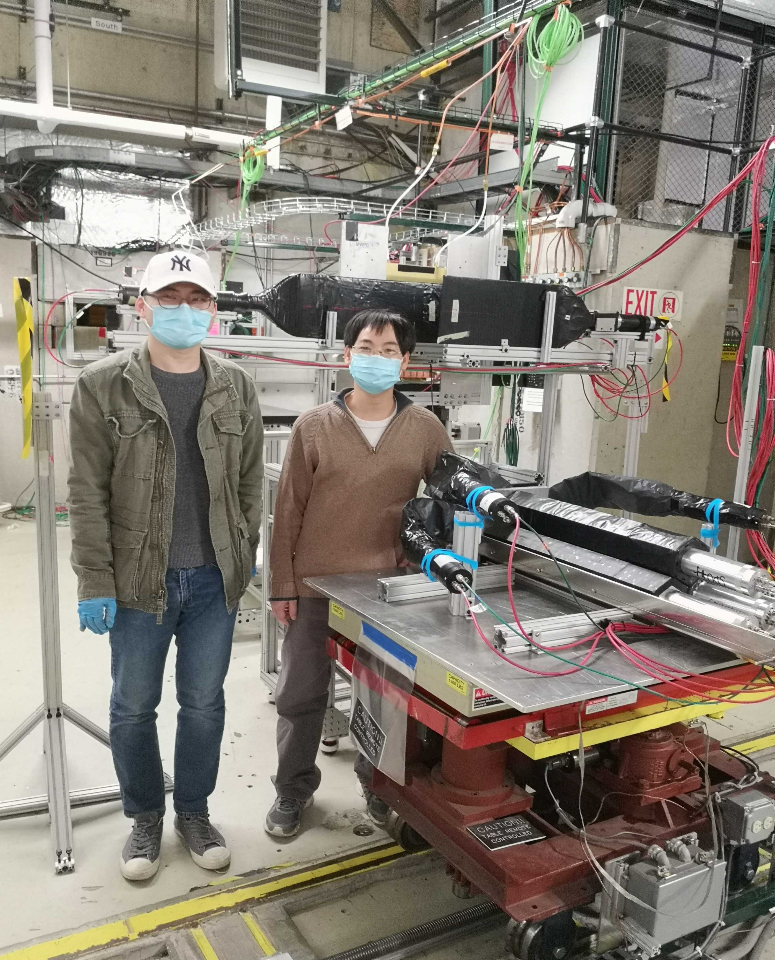
SoLID FY22 Research Rampup Plan
Beamtest in FY22 – high luminosity (high rate and high radiation) beam test of detector components and DAQ system, as suggested by the Feb 2021 Director’s Review of SoLID
Cherenkov detectors had high rate tests in 2020 as part of pre-R&D
ECal had calibration tests at FTBF, need high rate beam test
GEM with new VMM readout is currently being bench tested with (x-ray mimic) high rate. Need high radiation and high rate test with beam in an actual hall environment (SBS lessons learned)
Focus will be high rate on ECal and GEM VMM3 readout
Beam test of detector and DAQ at high luminosity will help to identify issues and to advance pre-conceptual design.

Slide 3
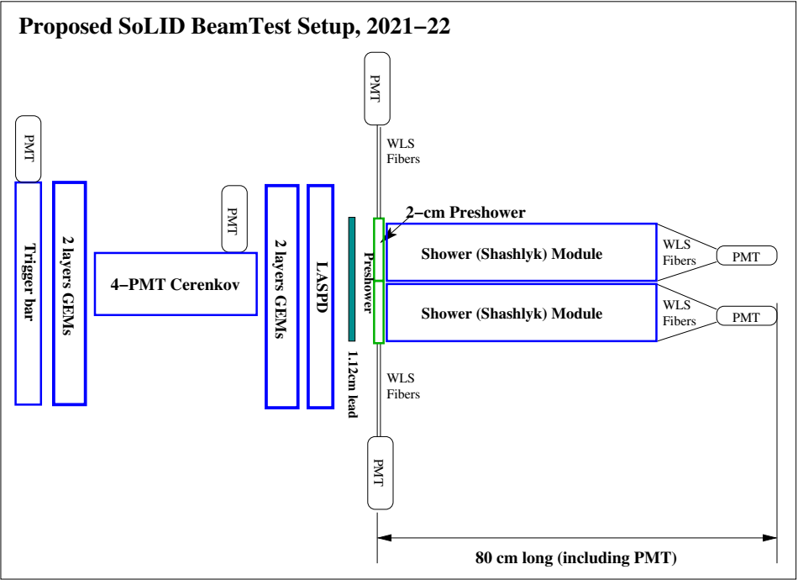
Beam test
Realistic detector setup using existing prototypes
particle direction

Slide 4
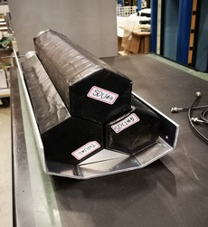
Beam test
3x shashlyk modules
Realistic detector setup using existing prototypes
4-PMT Cherenkov
10cmx10cm GEMs

Slide 5
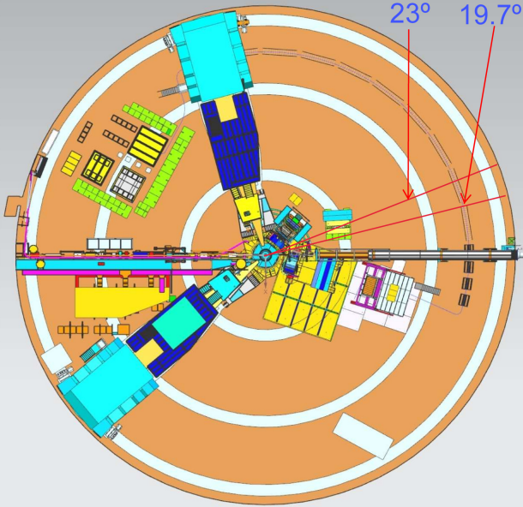
Beam test – Location
SBS program in Hall A close to SoLID running
Hall C also possible
BB
SBS
Hall A floorplan

Slide 6
Beam test – Resources
Resources needed:
Total 4 FTEs
User redirect and JLab Physics Division provide support → 2 FTE
Request 2 FTE
Procurement: $200 k

Slide 7
Other Topics (FY22 and/or beyond) – Overview
Other topics from SoLID collaboration institutions PIs:
Cherenkov testing and prototyping (to advance pre-conceptual design) (Michael Paolone/New Mexico State U., Haiyan Gao, Zhiwen Zhao/Duke U.)
End-to-end simulation (recommended since Feb 2015 Director’s review) (multiple groups)
DAQ Streaming readout (suggested during 2021 Science Review) (Ron Gilman/Rutgers U.)
Artificial Intelligence/Machine Learning – possible multi-institution proposal responding to new AI-focused FOA in 2022.

Slide 8
Backup Slides

Slide 9
End-to-end software
A unified end-to-end software framework covering SoLID's entire life cycle from design to construction to physics analysis
Recommended since 2015 Director’s Review to develop “with high priority and increased resources"
Provide important scientific guidance to detector design
Integration of streaming readout and use of AI/ML in SoLID commissioning and data taking, to ultimately high-level physics data analysis and expedient extraction of physics results
Existing efforts cover some components below, but additional efforts are needed to choose and convert into end-to-end software
event generation (physics and background)
detector simulation (GEANT4-based)
signal digitization
data analysis and extraction of physics results
Lead institution/PI: TBD

Slide 10
Cherenkov testing and prototyping
Cherenkov Mirror Study
Pursue mirror fabrication methods to advance pre-conceptual design
attach reflective plastic-lexan film to polished carbon-fiber blanks, need mirror blank testing, lexan-film adhesion and radiation hardness testing
alternative 3D-printing carbon-fiber reinforced polymer blanks
MAPMT and WLS coating radiation testing
Lead institution/PI: New Mexico State U./Michael Paolone
Prototyping of HGC mirror mounting and testing of gas tightness for readout
Study how to mount large HGC mirrors of 137x33 cm for optical alignment
Test gas tightness for electronic readout at 1.7atm
Lead institution/PI: Duke U./Haiyan Gao, Zhiwen Zhao

Slide 11
Streaming DAQ
Suggested during March 2021 Science Review
Tracking in high background and high rate is a large hurdle for SoLID
build and test a streaming version of the VMM prototype
Simulation of event size and data processing will be performed to evaluate the amount of computing and storage resources needed
Lead institution/PI: Rutgers U./ Ron Gilman

Slide 12
Artificial Intelligence/ Machine Learning for SoLID
AI/ML has power of recognizing patterns within vast amounts of data generally surpasses traditional methods in terms of speed and accuracy
It is ideal for SoLID’s high rate and high background at luminosity 10³⁷ – 10³⁹ cm⁻²s⁻¹
AI for GEM tracking, PID of combined ECal and Cherenkov, and background reduction
Improve efficiency and speed
Optimization from multiple input variables more than traditional methods can handle
SoLID-specific AI/ML study and optimization will provide feedback to detector design
Be an integrated part of the end-to-end software
We will utilize existing simulation tool and FTBF test data, along with new data expected from the upcoming high-rate beam test → possible multi-institution proposal responding to AI-focused FOA in 2022

Slide 13
2015 Director’s Review Report:
1. Physics Relevance and Risks
1a. Findings:End-to-end physics simulations for the core measurements are lacking.
Recommendations: End-to-end simulations with realistic subsystem responses and material budgets, and complete track finding and reconstruction should be developed.
1b. Findings: The SoLID simulation framework is in the beginning stages of development.
Recommendations: The development of a simulation framework with realistic reconstruction and analysis should be pursued with high priority and increased resources.
2021 Director’s Review Report:
3. The new experimental and theoretical research efforts and technical capabilities needed to accomplish the proposed scientific program.
Comments:
From the presentations it was not possible to understand how far the R&D on the different detectors has been progressed to ensure the chosen technologies are able to perform to the physics requirements, especially to the occupancy expected due to the high luminosity of 10³⁷ – 10³⁹ cm⁻²s⁻¹

