Slide 1
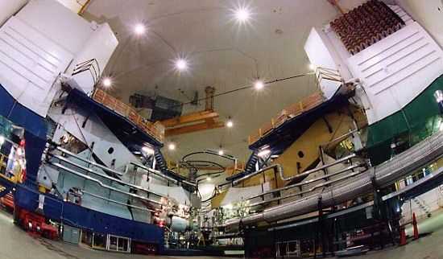
put some kind of snappy title here and maybe some pictures of Hall A
Melissa Cummings
blah blah blah
Design of a Nuclear Physics Experiment
Melissa Cummings
The College of William and Mary
Advisor: Dr. Todd Averett

Slide 2
Outline
A bit of theory
Motivation
Experimental Technique
Error Budget
Experimental Setup
2
M. Cummings HUGS 2013 06/12/13

Slide 3
Inclusive Electron Scattering
N(e,e’)X
Energy Transfer:
p’ = (E’,k’)
p = (E,k)
θ
Momentum Transfer:
q = (ν,q)
Invariant Mass:
W
P = (M,0)
Bjorken Scaling:
3
M. Cummings HUGS 2013 06/12/13

Slide 4
Inclusive Electron Scattering
N(e,e’)X
Scattering from a point-like particle is simple:
p’ = (E’,k’)
p = (E,k)
θ
4
M. Cummings HUGS 2013 06/12/13

Slide 5
Inclusive Electron Scattering
N(e,e’)X
To describe scattering from a nucleon requires structure functions:
p’ = (E’,k’)
p = (E,k)
θ
q = (ν,q)
Inclusive inelastic
unpolarized cross section
W
P = (M,0)
5
M. Cummings HUGS 2013 06/12/13

Slide 6
Inclusive Electron Scattering
N(e,e’)X
Inclusive polarized
cross sections
p’ = (E’,k’)
p = (E,k)
θ
q = (ν,q)
W
g₁,g₂ are related to the spin distribution
P = (M,0)
6
M. Cummings HUGS 2013 06/12/13

Slide 7
Quark-Parton Model
Can write F₁, F₂, g₁ in terms of quark distribution functions:
7
M. Cummings HUGS 2013 06/12/13
Notes:
Can write unpolarized structure functions in terms of quark distribution functions
the nucleon is made out of non-interacting point-like particles called partons.
Infinite-momentum frame:
- Partons are point-like non-interacting particles
- No time for interactions between particles

Slide 8
Quark-Parton Model
Can write F₁, F₂, g₁ in terms of quark distribution functions:
No simple interpretation for g₂!
g₂ includes contributions from quark gluon interactions
8
M. Cummings HUGS 2013 06/12/13
Notes:
Can write unpolarized structure functions in terms of quark distribution functions
the nucleon is made out of non-interacting point-like particles called partons.
Infinite-momentum frame:
- Partons are point-like non-interacting particles
- No time for interactions between particles

Slide 9
What is g₂?
9
M. Cummings HUGS 2013 06/12/13
Notes:
Can write unpolarized structure functions in terms of quark distribution functions
the nucleon is made out of non-interacting point-like particles called partons.
Infinite-momentum frame:
- Partons are point-like non-interacting particles
- No time for interactions between particles

Slide 10
What is g₂?
Wandzura–Wilczek Relation:
Leading twist-2 term
10
M. Cummings HUGS 2013 06/12/13
Notes:
Can write unpolarized structure functions in terms of quark distribution functions
the nucleon is made out of non-interacting point-like particles called partons.
Infinite-momentum frame:
- Partons are point-like non-interacting particles
- No time for interactions between particles

Slide 11
What is g₂?
h_{T}: Arises from quark transverse polarization distribution
ζ: Arises from quark-gluon interactions (twist-3)
11
M. Cummings HUGS 2013 06/12/13
Notes:
Can write unpolarized structure functions in terms of quark distribution functions
the nucleon is made out of non-interacting point-like particles called partons.
Infinite-momentum frame:
- Partons are point-like non-interacting particles
- No time for interactions between particles

Slide 12
Motivation
Unpolarized structure functions very well known
g₁^{p} very well known
12
M. Cummings HUGS 2013 06/12/13
Notes:
Can write unpolarized structure functions in terms of quark distribution functions
the nucleon is made out of non-interacting point-like particles called partons.
Infinite-momentum frame:
- Partons are point-like non-interacting particles
- No time for interactions between particles

Slide 13
Motivation
Unpolarized structure functions very well known
g₁^{p} very well known
No need for global plot for g₂^{p}…
12
M. Cummings HUGS 2013 06/12/13
Notes:
Can write unpolarized structure functions in terms of quark distribution functions
the nucleon is made out of non-interacting point-like particles called partons.
Infinite-momentum frame:
- Partons are point-like non-interacting particles
- No time for interactions between particles

Slide 14
Motivation
g₂^{p} still relatively unknown!
13
M. Cummings HUGS 2013 06/12/13
Notes:
Can write unpolarized structure functions in terms of quark distribution functions
the nucleon is made out of non-interacting point-like particles called partons.
Infinite-momentum frame:
- Partons are point-like non-interacting particles
- No time for interactions between particles

Slide 15
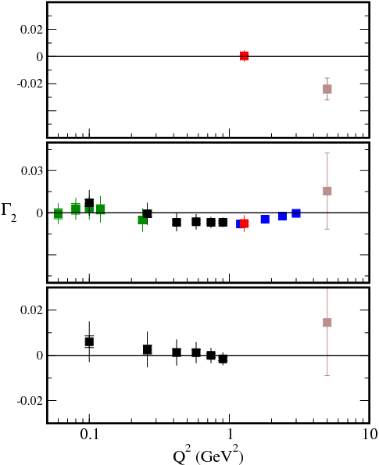
Burkhardt-Cottingham Sum Rule
P
BC sum rule will fail if:
g₂^{p} exhibits non-Regge behavior at low x
g₂^{p} exhibits a delta function singularity at x=0
Violation is suggested for the proton at large Q²
N
³He
15
M. Cummings HUGS 2013 06/12/13
Notes:
Can write unpolarized structure functions in terms of quark distribution functions
the nucleon is made out of non-interacting point-like particles called partons.
Infinite-momentum frame:
- Partons are point-like non-interacting particles
- No time for interactions between particles

Slide 16
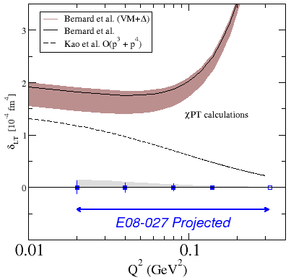
Spin Polarizability - δ_{LT}
Longitudinal-Transverse Spin Polarizability
Benchmark test of Chiral Pertubation Theory
Issue with calculations is how to include the nucleon resonance contributions
δ_{LT} is a nucleon observeable that is insensitive to the Δ resonance!
16
M. Cummings HUGS 2013 06/12/13
Notes:
Can write unpolarized structure functions in terms of quark distribution functions
the nucleon is made out of non-interacting point-like particles called partons.
Infinite-momentum frame:
- Partons are point-like non-interacting particles
- No time for interactions between particles

Slide 17
Summary of Run Period
Our goal is to provide the first measurement of g₂^{p} in the resonance region at low Q²
Kinematic Coverage
W < 2 GeV
0.02 < Q² < 0.2 GeV²
Ran from 3/2/12 – 5/18/12
Concurrent with E08-007 (GEp)
14
M. Cummings HUGS 2013 06/12/13
Notes:
Can write unpolarized structure functions in terms of quark distribution functions
the nucleon is made out of non-interacting point-like particles called partons.
Infinite-momentum frame:
- Partons are point-like non-interacting particles
- No time for interactions between particles

Slide 18
What is g₂?
How do we measure g₂^{p}?
short answer: cross section differences!
19
M. Cummings HUGS 2013 06/12/13
Notes:
Can write unpolarized structure functions in terms of quark distribution functions
the nucleon is made out of non-interacting point-like particles called partons.
Infinite-momentum frame:
- Partons are point-like non-interacting particles
- No time for interactions between particles

Slide 19
Experimental Technique
e⁻
e⁻
e⁻
e⁻
Δσ|| measured during EG4 experiment in Hall B: will extract g₁^{p} at low Q²
Δσ| obtained from g₂^{p} experiment
20
M. Cummings HUGS 2013 06/12/13
Notes:
Can write unpolarized structure functions in terms of quark distribution functions
the nucleon is made out of non-interacting point-like particles called partons.
Infinite-momentum frame:
- Partons are point-like non-interacting particles
- No time for interactions between particles

Slide 20
Experimental Technique
measured during experiment
21
M. Cummings HUGS 2013 06/12/13
Notes:
Can write unpolarized structure functions in terms of quark distribution functions
the nucleon is made out of non-interacting point-like particles called partons.
Infinite-momentum frame:
- Partons are point-like non-interacting particles
- No time for interactions between particles

Slide 21
Experimental Technique
22
M. Cummings HUGS 2013 06/12/13
Notes:
Can write unpolarized structure functions in terms of quark distribution functions
the nucleon is made out of non-interacting point-like particles called partons.
Infinite-momentum frame:
- Partons are point-like non-interacting particles
- No time for interactions between particles

Slide 22
Experimental Observables
N± = Number of accepted events
LT± = correction for computer deadtime
Q± = total charge
with beam helicity = ±1
f = dilution factor
P_{t} = target polarization
P_{b} = beam polarization
23
M. Cummings HUGS 2013 06/12/13
Notes:
Can write unpolarized structure functions in terms of quark distribution functions
the nucleon is made out of non-interacting point-like particles called partons.
Infinite-momentum frame:
- Partons are point-like non-interacting particles
- No time for interactions between particles

Slide 23
Experimental Observables
Source | %
Target Polarization | 3-4
Beam Polarization | 2-3
Dilution Factor/Packing Fraction | ~1
24
M. Cummings HUGS 2013 06/12/13
Notes:
Can write unpolarized structure functions in terms of quark distribution functions
the nucleon is made out of non-interacting point-like particles called partons.
Infinite-momentum frame:
- Partons are point-like non-interacting particles
- No time for interactions between particles

Slide 24
Experimental Observables
N = Number of scattered electrons
ps₁ = prescale factor (trigger type 1)
N_{in} = Q/e = number of incident electrons
ρ = target density
LT = livetime correction
ε_{det} = product of all detector efficiencies
ΔΩ = solid angle acceptance
ΔΕ’ = momentum acceptance
ΔZ = target length
accounts for impurity of proton target
25
M. Cummings HUGS 2013 06/12/13
Notes:
Can write unpolarized structure functions in terms of quark distribution functions
the nucleon is made out of non-interacting point-like particles called partons.
Infinite-momentum frame:
- Partons are point-like non-interacting particles
- No time for interactions between particles

Slide 25
Experimental Observables
Source | %
Acceptance/Optics | ~3
Dilution Factor/Packing Fraction | ~1
Density | 2-3
Beam Charge | 1-2
Position & Angle Determination | 2-4
Detector Efficiencies | ~1
Background (pions) | < 1
Radiative Corrections | 1-4
26
M. Cummings HUGS 2013 06/12/13

Slide 26
Error Budget
Systematic Error Budget for Polarized Cross Section Difference
Source | %
Cross Section | 5-7
P_{b}P_{t} | 4-5
Radiative Corrections | 3
Parallel Contribution | < 1
Total | 7-9
27
M. Cummings HUGS 2013 06/12/13
Notes:
Can write unpolarized structure functions in terms of quark distribution functions
the nucleon is made out of non-interacting point-like particles called partons.
Infinite-momentum frame:
- Partons are point-like non-interacting particles
- No time for interactions between particles

Slide 27
Statistics
Rates
Time
L = Luminosity
ΔΩ = Angular Acceptance
ΔE’ = Momentum Bite
σ = Proton Cross Section
f = Dilution Factor
P_{b} = Beam Polarization
P_{t} = Beam Polarization
Our goal is δA| = 0.004
27
M. Cummings HUGS 2013 06/12/13
Notes:
Must determine how long you need to run for to achieve the desired precision. Production data is one thing, time to beat down systematics is another.
Other sources of overhead – time to change target material

Slide 28
Experimental Setup
Septum Magnet
Slow/Fast Raster
Beam Current Monitors
Left - HRS
6°
12.5°
Chicane Magnets
Target
Beam Profile Monitors
Right - HRS
Local Dump
28
M. Cummings HUGS 2013 06/12/13
Notes:
Can write unpolarized structure functions in terms of quark distribution functions
the nucleon is made out of non-interacting point-like particles called partons.
Infinite-momentum frame:
- Partons are point-like non-interacting particles
- No time for interactions between particles

Slide 29
Experimental Setup
Septum Magnet
Slow/Fast Raster
Beam Current Monitors
Left - HRS
6°
12.5°
Chicane Magnets
Target
Beam Profile Monitors
Right - HRS
Local Dump
29
M. Cummings HUGS 2013 06/12/13
Notes:
Can write unpolarized structure functions in terms of quark distribution functions
the nucleon is made out of non-interacting point-like particles called partons.
Infinite-momentum frame:
- Partons are point-like non-interacting particles
- No time for interactions between particles

Slide 30
Polarized Ammonia Target
Several advantages to using NH₃ as a proton target:
Can reach high polarizations
Polarizes quickly (~30 minutes)
Good resistance to radiation damage
30
M. Cummings HUGS 2013 06/12/13
Notes:
Look up some other possible materials, for comparison.

Slide 31
Thermal Equilibrium Polarization
Material placed in a high magnetic field and cooled to low temperatures will polarize according to Boltzmann Statistics:
At 1K in 2.5T field:
P_{TE} = 0.25% for protons
P_{TE} = 92% for electrons
31
M. Cummings HUGS 2013 06/12/13
Notes:
magnetic moment of electron = ~660*magnetic moment of the proton
Can we use the high polarization of the electrons to polarize the protons??

Slide 32
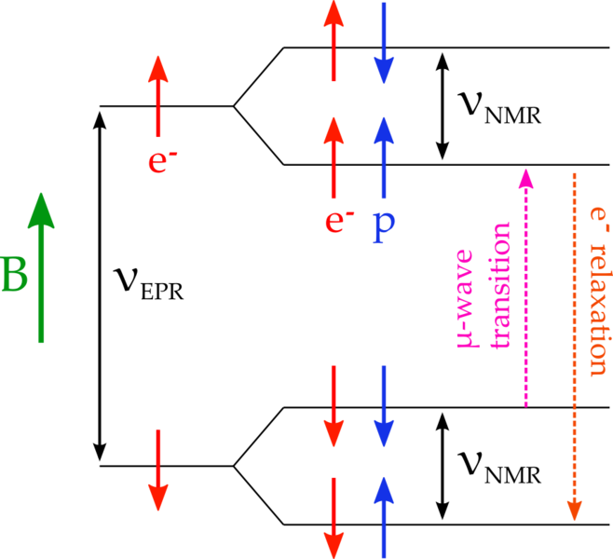
Dynamic Nuclear Polarization
Takes advantage of e-p spin coupling
Use microwaves to induce “forbidden” transitions
Both positive and negative proton polarizations can be achieved with the same magnetic field
Relaxation Time:
Proton: tens of minutes
Electron: milliseconds
32
M. Cummings HUGS 2013 06/12/13
Notes:
in a material with a suitable number of unpaired electron spins, hyperfine splitting from the spin-spin interaction of proton and electron in magnetic field gives four discrete energy levels.
Hamiltonian contains the Zeeman energy for both the electron and the proton, and a spin-spin interaction term.
Simple dipole rules forbid the simultaneous flipping of both spins -> the Hss term creates mixing through which we can access forbidden transitions
Electrons will relax into the lowest energy state and re-used to polarize another proton.
Relaxation time of

Slide 33
Dynamic Nuclear Polarization
Material was irradiated at the NIST 10MeV linac prior to the run to produce extra radicals for use in DNP
“warm dose” irradiations produce NH₂
“cold dose” irradiations produce atomic hydrogen
Material must be annealed during the run to recover high polarization
33
M. Cummings HUGS 2013 06/12/13
Notes:
in a material with a suitable number of unpaired electron spins, hyperfine splitting from the spin-spin interaction of proton and electron in magnetic field gives four discrete energy levels.
Hamiltonian contains the Zeeman energy for both the electron and the proton, and a spin-spin interaction term.
Simple dipole rules forbid the simultaneous flipping of both spins -> the Hss term creates mixing through which we can access forbidden transitions
Electrons will relax into the lowest energy state and re-used to polarize another proton.
Relaxation time of

Slide 34
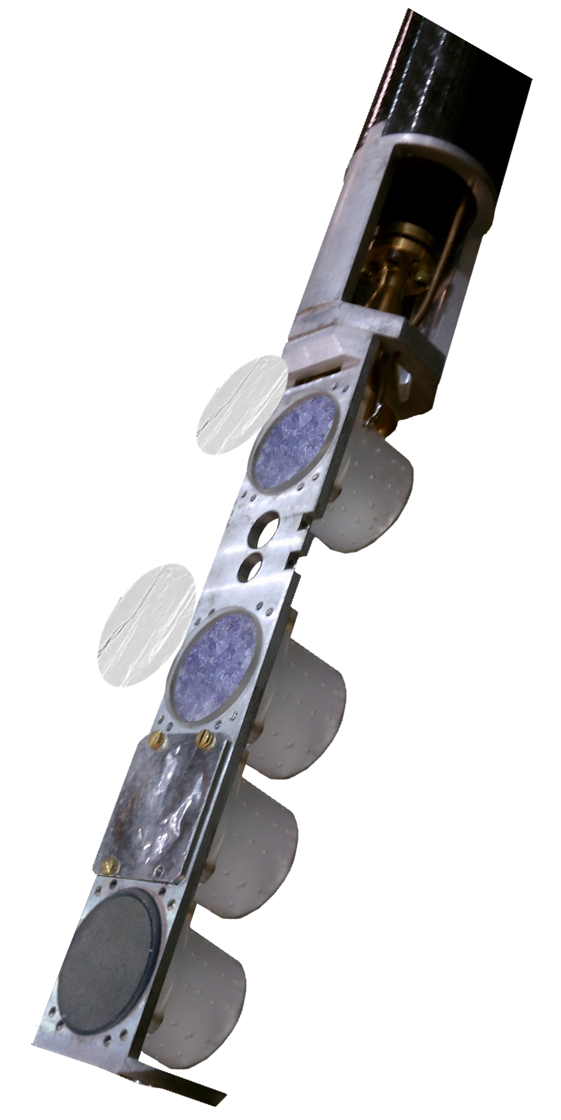
Target Insert
Solid Ammonia
Empty Cup
Carbon
34
M. Cummings HUGS 2013 06/12/13
Notes:
in a material with a suitable number of unpaired electron spins, hyperfine splitting from the spin-spin interaction of proton and electron in magnetic field gives four discrete energy levels.
Hamiltonian contains the Zeeman energy for both the electron and the proton, and a spin-spin interaction term.
Simple dipole rules forbid the simultaneous flipping of both spins -> the Hss term creates mixing through which we can access forbidden transitions
Electrons will relax into the lowest energy state and re-used to polarize another proton.
Relaxation time of

Slide 35
Target Insert
Solid Ammonia
Used to Determine Dilution Factor
Empty Cup
Carbon
35
M. Cummings HUGS 2013 06/12/13
Notes:
in a material with a suitable number of unpaired electron spins, hyperfine splitting from the spin-spin interaction of proton and electron in magnetic field gives four discrete energy levels.
Hamiltonian contains the Zeeman energy for both the electron and the proton, and a spin-spin interaction term.
Simple dipole rules forbid the simultaneous flipping of both spins -> the Hss term creates mixing through which we can access forbidden transitions
Electrons will relax into the lowest energy state and re-used to polarize another proton.
Relaxation time of

Slide 36
Design Challenges
Last minute failure of original (UVa/JLab) magnet
Hall B magnet was able to be modified as a replacement
Magnet needed to be able to rotate to different field configurations
Redesigned target insert
Less cumbersome
More reliable
36
M. Cummings HUGS 2013 06/12/13
Notes:
in a material with a suitable number of unpaired electron spins, hyperfine splitting from the spin-spin interaction of proton and electron in magnetic field gives four discrete energy levels.
Hamiltonian contains the Zeeman energy for both the electron and the proton, and a spin-spin interaction term.
Simple dipole rules forbid the simultaneous flipping of both spins -> the Hss term creates mixing through which we can access forbidden transitions
Electrons will relax into the lowest energy state and re-used to polarize another proton.
Relaxation time of

Slide 37
Target Polarization
NMR Signal
NMR used to measure polarization
Subtract baseline measurement
Fit residual background and remove it
Sum under the remaining signal
Calibrated with signal known at thermal equilibrium
Courtesy of T. Badman
37
M. Cummings HUGS 2013 06/12/13
Notes:
in a material with a suitable number of unpaired electron spins, hyperfine splitting from the spin-spin interaction of proton and electron in magnetic field gives four discrete energy levels.
Hamiltonian contains the Zeeman energy for both the electron and the proton, and a spin-spin interaction term.
Simple dipole rules forbid the simultaneous flipping of both spins -> the Hss term creates mixing through which we can access forbidden transitions
Electrons will relax into the lowest energy state and re-used to polarize another proton.
Relaxation time of

Slide 38
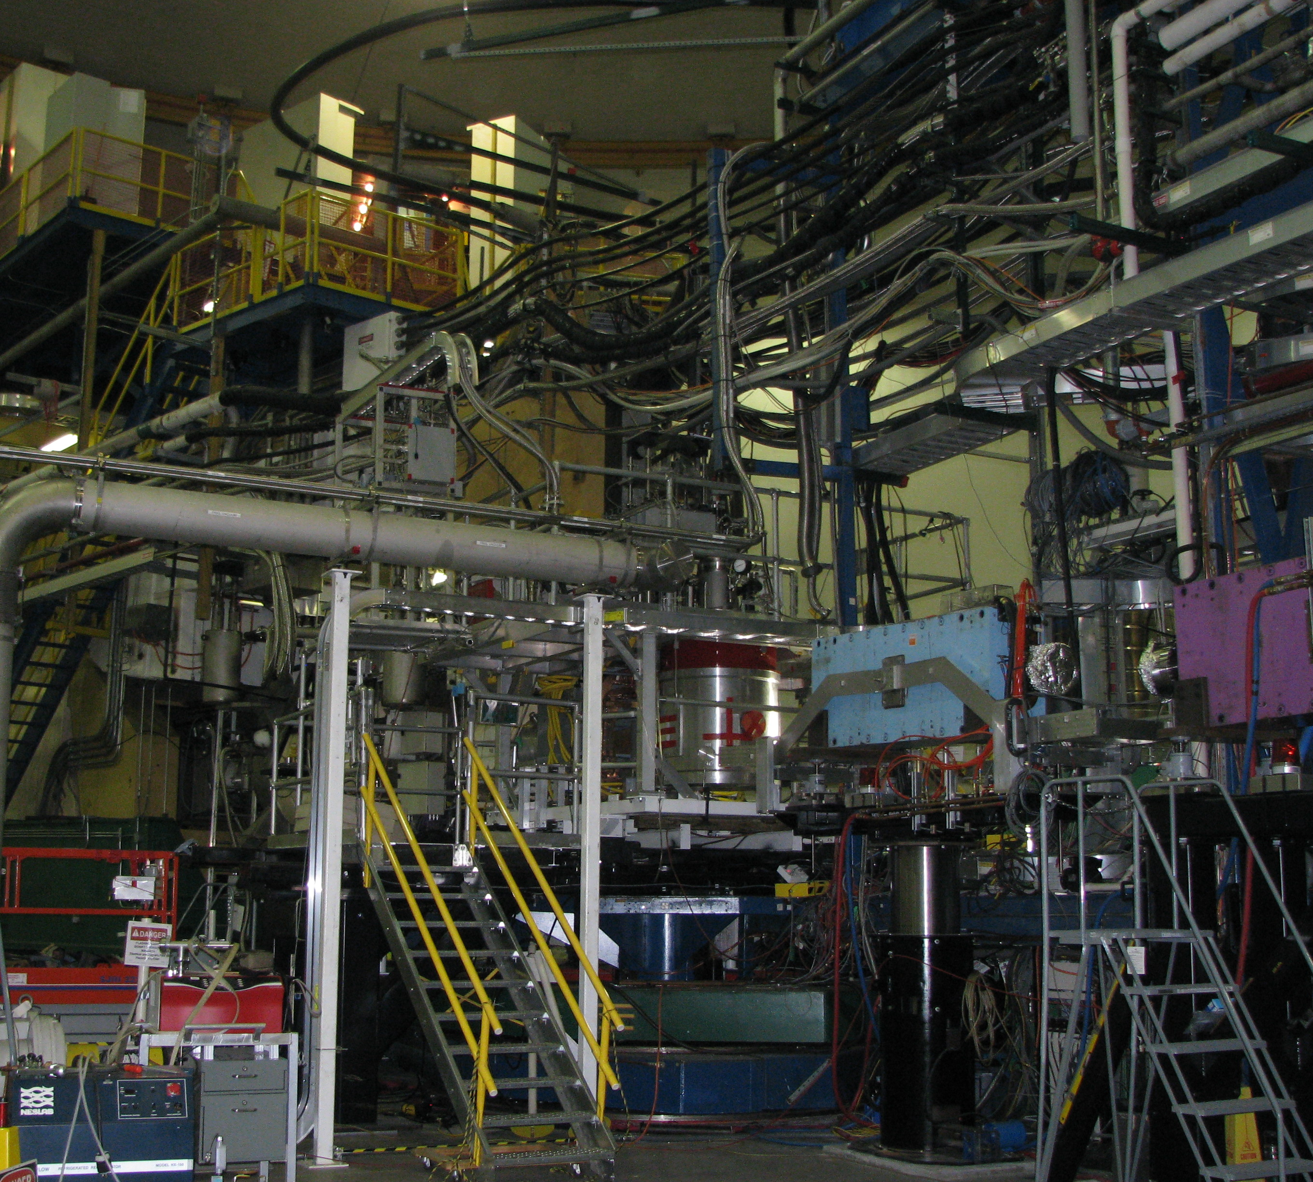
Target Setup
38
M. Cummings HUGS 2013 06/12/13
Notes:
in a material with a suitable number of unpaired electron spins, hyperfine splitting from the spin-spin interaction of proton and electron in magnetic field gives four discrete energy levels.
Hamiltonian contains the Zeeman energy for both the electron and the proton, and a spin-spin interaction term.
Simple dipole rules forbid the simultaneous flipping of both spins -> the Hss term creates mixing through which we can access forbidden transitions
Electrons will relax into the lowest energy state and re-used to polarize another proton.
Relaxation time of

Slide 39
Slow/Fast Raster
Septum Magnet
Slow/Fast Raster
Beam Current Monitors
Left - HRS
6°
12.5°
Chicane Magnets
Target
Beam Profile Monitors
Right - HRS
Local Dump
39
M. Cummings HUGS 2013 06/12/13
Notes:
in a material with a suitable number of unpaired electron spins, hyperfine splitting from the spin-spin interaction of proton and electron in magnetic field gives four discrete energy levels.
Hamiltonian contains the Zeeman energy for both the electron and the proton, and a spin-spin interaction term.
Simple dipole rules forbid the simultaneous flipping of both spins -> the Hss term creates mixing through which we can access forbidden transitions
Electrons will relax into the lowest energy state and re-used to polarize another proton.
Relaxation time of

Slide 40
Slow/Fast Raster
Fast Raster: generates a 4mm x 4mm (square) pattern
Slow Raster: increases the final size up to 2.5 cm x 2.5 cm
Used to minimize damage to target
Density fluctuations from beam heating are limited to a few %
Low current (50-100 nA) is used to minimize de-polarization of the target
Fast Raster Patten
Slow Raster Patten
40
M. Cummings HUGS 2013 06/12/13
Notes:
- slow raster is located just upstream of the target
- slow raster increases the final size up to 2.5cm x 2.5cm, but we will use a small spot size???
- A 2 inch wide beam pipe will be used starting after the slow raster.
With rastered beam, the density fluctuations from beam heating are limited to a few percent at a beam current of 100 mA:
-that last bullet point…should it be here???

Slide 41
Chicane Magnets
Septum Magnet
Slow/Fast Raster
Beam Current Monitors
Left - HRS
6°
12.5°
Chicane Magnets
Target
Beam Profile Monitors
Right - HRS
Local Dump
41
M. Cummings HUGS 2013 06/12/13
Notes:
- slow raster is located just upstream of the target
- slow raster increases the final size up to 2.5cm x 2.5cm, but we will use a small spot size???
- A 2 inch wide beam pipe will be used starting after the slow raster.
- With rastered beam, the density fluctuations from beam heating are limited to a few percent at a beam current of 100 mA:

Slide 42
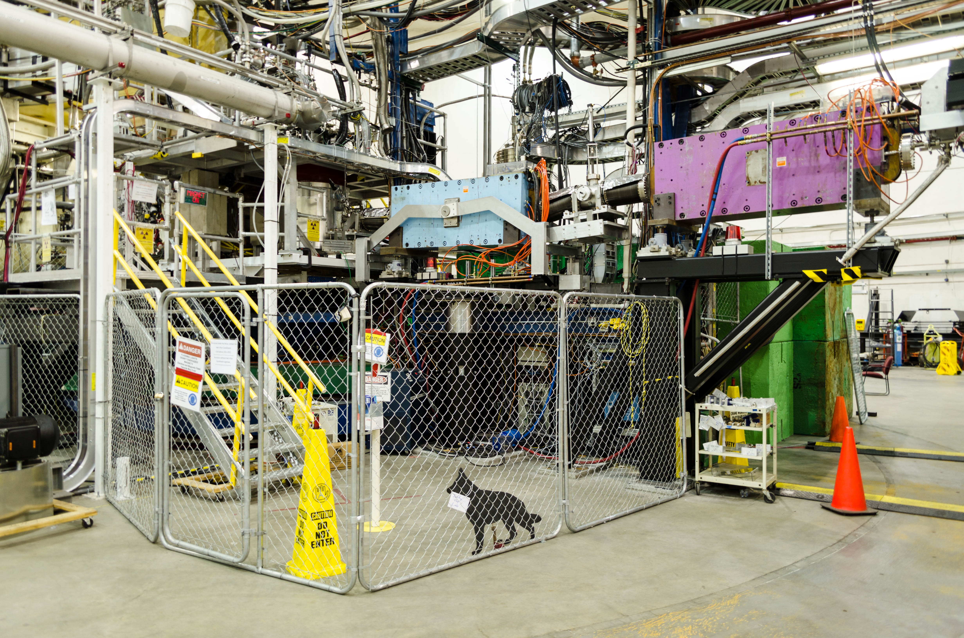
Chicane Magnets
Remember – polarization direction is perpendicular to the beam axis for most of the experiment!
Significant deflection of low energy electrons
Chicane magnets are used to accounts for this
42
M. Cummings HUGS 2013 06/12/13
Notes:
- slow raster is located just upstream of the target
- slow raster increases the final size up to 2.5cm x 2.5cm, but we will use a small spot size???
- A 2 inch wide beam pipe will be used starting after the slow raster.
With rastered beam, the density fluctuations from beam heating are limited to a few percent at a beam current of 100 mA:
-that last bullet point…should it be here???

Slide 43
Chicane Magnets
Gives the beam a kick out of the horizontal plane
Used to bend the beam back on to the target with the required angle to compensate for the magnetic field
Energy (GeV) | Deflection Angle (deg)
1.1 | 11.7
1.7 | 7.6
2.2 | 5.9
3.3 | 3.9
43
M. Cummings HUGS 2013 06/12/13
Notes:
- slow raster is located just upstream of the target
- slow raster increases the final size up to 2.5cm x 2.5cm, but we will use a small spot size???
- A 2 inch wide beam pipe will be used starting after the slow raster.
With rastered beam, the density fluctuations from beam heating are limited to a few percent at a beam current of 100 mA:
-that last bullet point…should it be here???

Slide 44
Local Dump
Septum Magnet
Slow/Fast Raster
Beam Current Monitors
Left - HRS
6°
12.5°
Chicane Magnets
Target
Beam Profile Monitors
Right - HRS
Local Dump
44
M. Cummings HUGS 2013 06/12/13
Notes:
- slow raster is located just upstream of the target
- slow raster increases the final size up to 2.5cm x 2.5cm, but we will use a small spot size???
- A 2 inch wide beam pipe will be used starting after the slow raster.
With rastered beam, the density fluctuations from beam heating are limited to a few percent at a beam current of 100 mA:
-that last bullet point…should it be here???

Slide 45
Local Dump
Beam cannot make it to the Hall A Dump for some energy/target field settings
Instead the beam is deposited in a local dump, located immediately downstream of the target
45
M. Cummings HUGS 2013 06/12/13
Notes:
helium bag???

Slide 46
Beam Position/Current Monitors
Septum Magnet
Slow/Fast Raster
Beam Current Monitors
Left - HRS
6°
12.5°
Chicane Magnets
Target
Beam Position Monitors
Right - HRS
Local Dump
46
M. Cummings HUGS 2013 06/12/13
Notes:
helium bag???

Slide 47
Beam Position Monitors
4 antenna, situated at 90° to one another
Perpendicular to the beam for high resolution measurement of beam position
Difficult to calibrate due to low current used throughout experiment
BPMX
BPMY
47
M. Cummings HUGS 2013 06/12/13
Notes:
text??

Slide 48
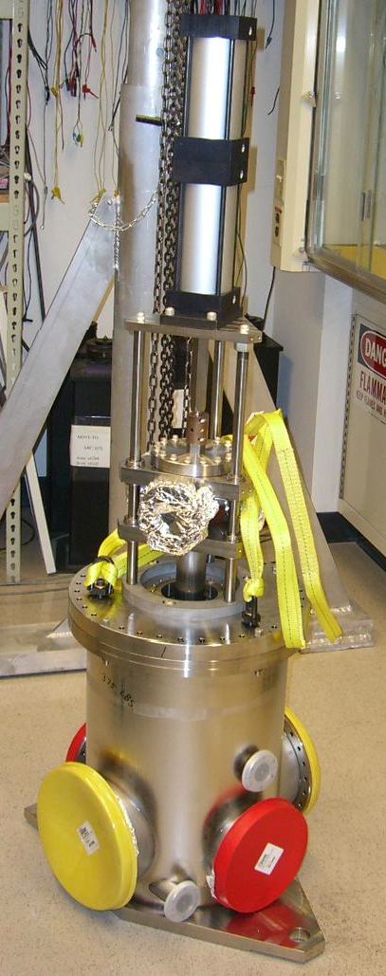
Beam Current Monitors
Resonant cavities with antenna tuned to beam frequency
Needed BCMs designed to work at low current
Calibrated using a Tungsten Calorimeter
Tungsten Calorimeter
BCMs
48
M. Cummings HUGS 2013 06/12/13
Notes:
text??

Slide 49
High Resolution Spectrometers
Septum Magnet
Slow/Fast Raster
Beam Current Monitors
Left - HRS
6°
12.5°
Chicane Magnets
Target
Beam Profile Monitors
Right - HRS
Local Dump
49
M. Cummings HUGS 2013 06/12/13
Notes:
text??

Slide 50
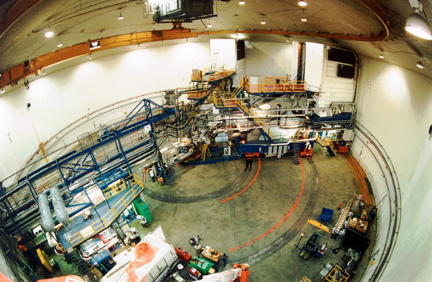
High Resolution Spectrometers
50
M. Cummings HUGS 2013 06/12/13
Notes:
text??

Slide 51
High Resolution Spectrometers
Momentum Range: 0.3 - 4.0 GeV/c
Momentum Acceptance: +/- 4.5%
Momentum Resolution (FWHM): 1 x 10⁻⁴
VDCs
Q₃
Target
4
Dipole
Q₁
Q₂
51
M. Cummings HUGS 2013 06/12/13
Notes:
text??

Slide 52
High Resolution Spectrometers
Detector Stack
Gas Cherenkov
d
d
d
Lead Glass Calorimeters
VDCs
Scintillators
Q₂
52
M. Cummings HUGS 2013 06/12/13
Notes:
text??

Slide 53
Vertical Drift Chambers
4 total planes of wire chambers
368 wires in each plane
Planes are rotated 90 deg
Negative voltage is applied to the chamber
Positive ions drift towards cathode planes
Negatively charged ions drift towards ground wires
Used for tracking information
Side View
v2
u2
v1
u1
Top View
53
M. Cummings HUGS 2013 06/12/13
Notes:
text??

Slide 54
Scintillators (s1 and s2m)
Scintillate: “to sparkle”
2 planes, located ~2m apart made of thin scintillator plastic
s1: 5mm
s2m: 50mm
2 photomultiplier tubes (PMTs) on either side of paddle
Each set of PMTs forms an “AND”
The set of paddles in each plane form an “OR”
~ 2m
54
M. Cummings HUGS 2013 06/12/13
Notes:
plastic needs to be thin to minimize absorption
time resolution per paddle is ~0.30ns

Slide 55
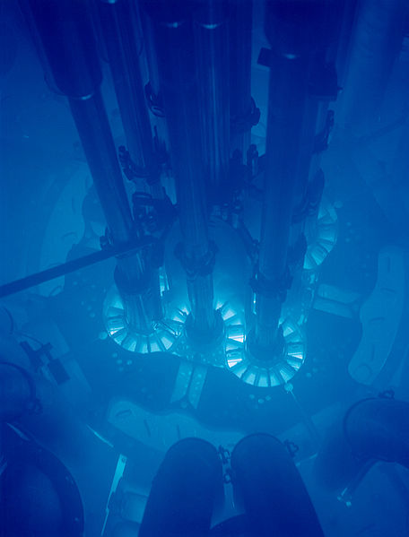
Gas Cherenkov
Based on the principle of Cherenkov radiation:
Occurs when a particle passes through a medium with a speed greater than the speed of light in that medium
Choice of gas sets the threshold: C0₂ has n=1.00041
Electron: P_{thres}~0.017 GeV/c
Pion: P_{thres}~4.8 GeV/c
Made up of 10 mirrors, which reflect the light onto 10 PMTs
θ
βct
PMTs
Spherical Mirrors
55
M. Cummings HUGS 2013 06/12/13
Notes:
The threshold for a CO₂ Cerenkov counter at STP is , meaning that for an electron the threshold is just over 17 MeV, while for a pion the threshold is just over 4 GeV/c momentum

Slide 56
Lead Glass Calorimeters
2 planes of lead glass blocks with PMTs
Charged particles will create a shower of electrons
Detected light is linearly proportional to the energy lost by the incident particle
Electromagnetic showers are completely absorbed in the calorimeter
hadronic showers are not
LHRS
RHRS
Total Deposited Energy
e-
π
(E1+E2)/p0
56
M. Cummings HUGS 2013 06/12/13
Notes:
Shower counters measure the energy deposited by the incoming particle. The detected light output is linearly proportional to the energy lost by the incoming particle. Electromagnetic showers are stopped in the counters, whereas hadronic showers, due to the longer hadronic mean free path, are not. Looking at the longitudinal distribution of the energy deposited in the calorimeter differentiates between electromagnetic and hadronic showers and therefore identifies the incident particle.

Slide 57
Triggers
Singles Trigger:
S1 && S2m
d
e-
d
Efficiency Trigger:
d
(S1 && GC) || (S2m && GC)
s1
s2m
gas Cherenkov
57
M. Cummings HUGS 2013 06/12/13
Notes:
text??

Slide 58
Triggers
Trigger Efficiences for Left HRS
Courtesy of R. Zielinski
58
M. Cummings HUGS 2013 06/12/13
Notes:
this slide is just awful

Slide 59
Particle Identification
Gas Cherenkov Spectrum
cherenkov spectrum here
e-
Leadglass Energy Spectrum
Preshower
gas
Cherenkov
Shower
Preshower
Shower
59
M. Cummings HUGS 2013 06/12/13
Notes:
include the dashed lines for cuts???

Slide 60
Septum Magnet
Septum Magnet
Slow/Fast Raster
Beam Current Monitors
Left - HRS
6°
12.5°
Chicane Magnets
Target
Beam Profile Monitors
Right - HRS
Local Dump
60
M. Cummings HUGS 2013 06/12/13
Notes:
this slide is just awful

Slide 61
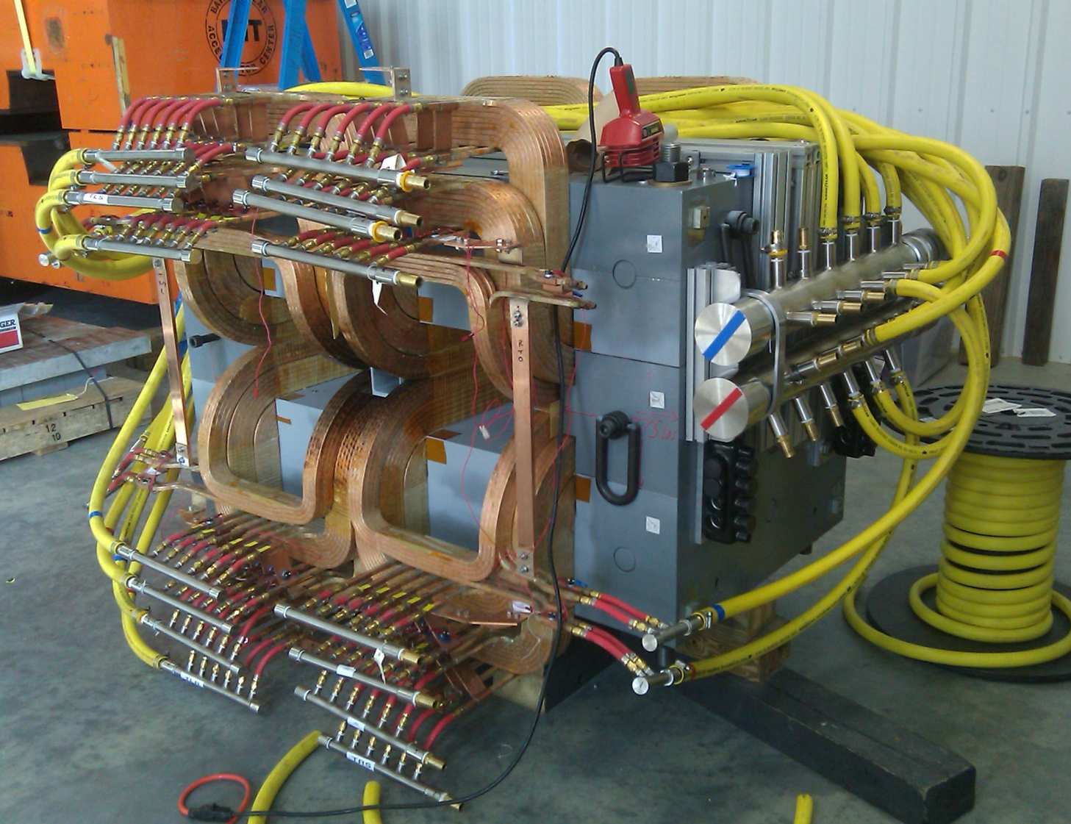
Septum Magnet
Needed to bend scattered electrons horizontally from 6° to 12.5° into the HRS
Endless source of headaches
Septum Coil Configuration
1 (ideal) | 2 | 3
48-48-16 | 40-32-16 | 40-0-16
61
M. Cummings HUGS 2013 06/12/13
Notes:
dipole magnet

Slide 62
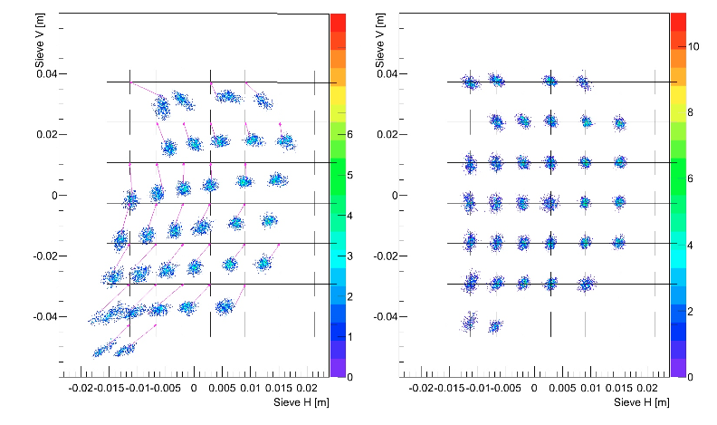
Optics
Use tracking information from VDCs to reconstruct kinematic variables of scattered electrons
Goal is to determine the scattering angle with 0.5% systematic uncertainty (2% contribution to the cross section)
Sieve Slit
Before Optimization
After Calibration
sieve V [m]
sieve V [m]
sieve H [m]
sieve H [m]
Courtesy of C. Gu
62
M. Cummings HUGS 2013 06/12/13
Notes:
dipole magnet

Slide 63
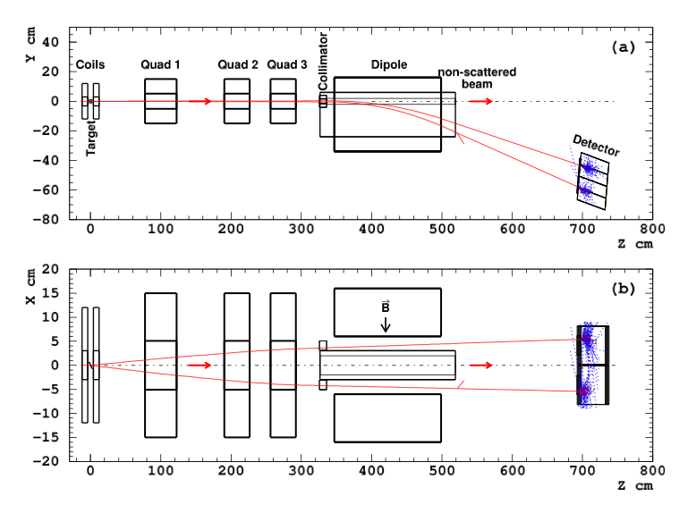
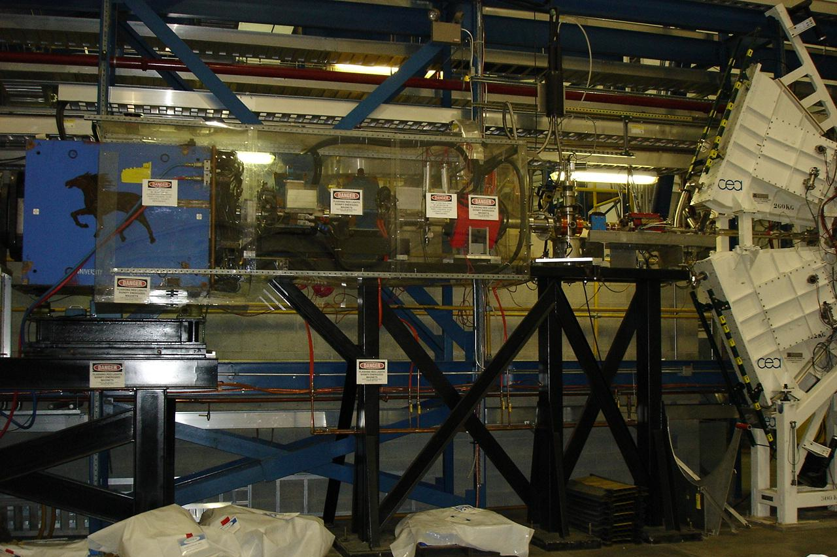
Møller Polarimeter
Exploits Møller scattering of polarized electrons off polarized atomic electrons in a magnetic field
Achieved beam polarization ~80-90%
side view
top view
63
M. Cummings HUGS 2013 06/12/13
Notes:
dipole magnet

Slide 64
Analysis
Courtesy of K. Allada
63
M. Cummings HUGS 2013 06/12/13
Notes:
dipole magnet

Slide 65
Summary
Physics motivation – what do you want to measure?
g₂^{p} is relatively unknown and is necessary to calculate proton polarizabilities – an effective test of QCD
What observables are sensitive to this theory?
We extract g₂^{p} using cross section differences – we measure the asymmetry and unpolarized cross section
What precision can you achieve? What are the limiting factors?
Our goal is a systematic uncertainty of 7-9%
Experimental setup – can you build an apparatus to achieve your precision goals?
Required a large scale installation in Hall A
Unexpected problems during the run period
So many problems…so little time.
Analysis
Check back soon(ish) for g₂^{p} results!
64
M. Cummings HUGS 2013 06/12/13
Notes:
Recipe for a nuclear physics experiment

Slide 66
The End. (and thanks!)
Spokespeople
Alexandre Camsonne
JP Chen
Don Crabb
Karl Slifer
Post Docs
Kalyan Allada
James Maxwell
Vince Sulkosky
Jixie Zhang
Graduate Students
Tobias Badman
Chao Gu
Min Huang
Jie Liu
Pengjia Zhu
Ryan Zielinski
JLab Target Group
Hall A Collaboration
65
M. Cummings HUGS 2013 06/12/13

Slide 67
Backup
64
M. Cummings HUGS 2013 06/12/13
Notes:
dipole magnet

Slide 68
Hyperfine Splitting of Hydrogen
Splitting expressed in terms of Fermi Energy E_{F}:
Nucleus ~ 10⁻¹⁵
Where:
Atom ~ 10⁻¹⁰
QED radiative correction
Accounts for recoil effects
Hadronic and muonic vacuum polarizations & the weak interaction correction
Proton structure correction (largest uncertainty)
17
M. Cummings HUGS 2013 06/12/13
Notes:
Can write unpolarized structure functions in terms of quark distribution functions
the nucleon is made out of non-interacting point-like particles called partons.
Infinite-momentum frame:
- Partons are point-like non-interacting particles
- No time for interactions between particles

Slide 69
Proton Charge Radius
Proton charge radius from μP disagrees with eP scattering result by ~7σ
Main uncertainties arise from the proton polarizability and different value of the Zemach radius
<R_{p}> = 0.84184 ± 0.00067 fm Lamb shift in muonic hydrogen
<R_{p}> = 0.897 ± 0.018 fm World analysis of eP scattering
<R_{p}> = 0.8768 ± 0.0069 fm CODATA world average
18
M. Cummings HUGS 2013 06/12/13
Notes:
Can write unpolarized structure functions in terms of quark distribution functions
the nucleon is made out of non-interacting point-like particles called partons.
Infinite-momentum frame:
- Partons are point-like non-interacting particles
- No time for interactions between particles

