Slide 1
LHRS Optics Calibration Straight-through, perfect septum
Min Huang
09/25/2012

Slide 2
Try
1000 events / hole → 100 events / hole
Increase matrix index
T002 T100 T101 (Theta_tg: fp(theta,y,phi))
See the file

Slide 3
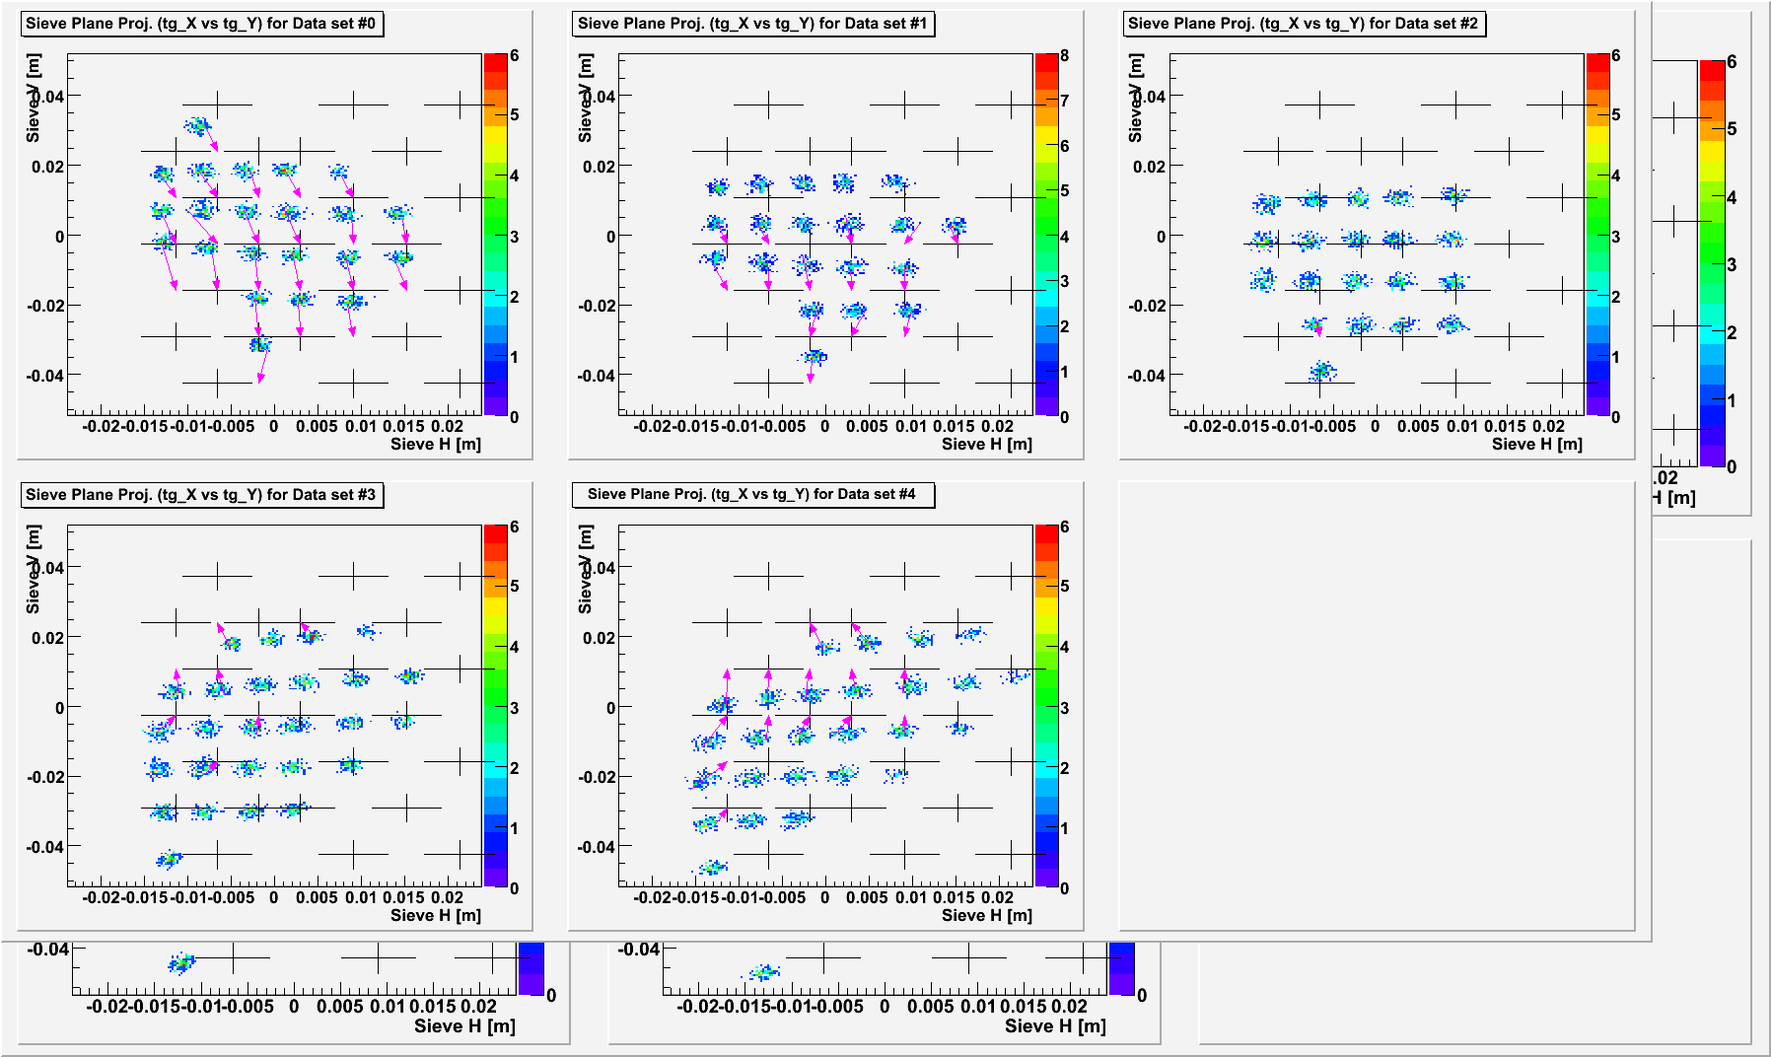
Matrix Angle Calibration
Initial projections on sieve

Slide 4
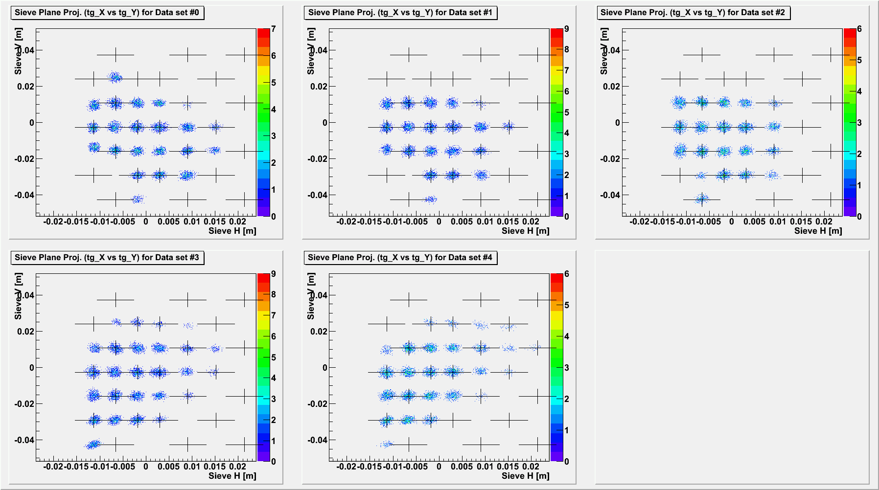
Matrix Angle Calibration
1st optimized projections
1k per hole & lowest matrix index

Slide 5
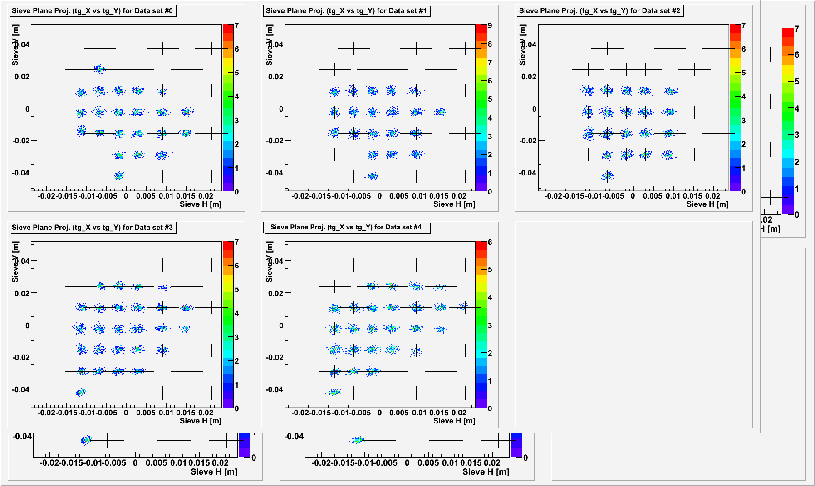
Matrix Angle Calibration
Optimized projections
Better
Still have problem

Slide 7
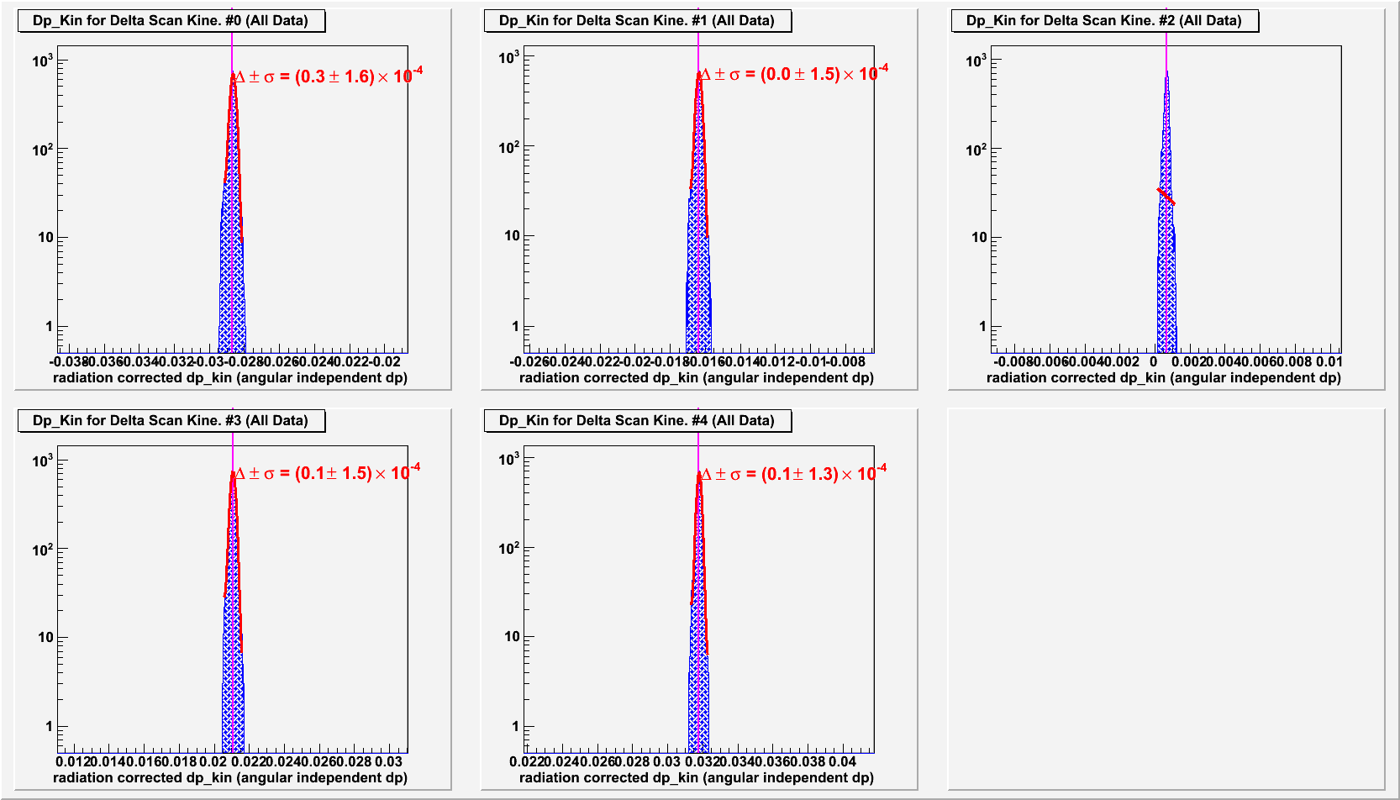
Matrix Angle Calibration

