Slide 1
LHRS Optics Calibration Straight-through, good septum
Min Huang
10/23/2012

Slide 2
Straight-thru Optics
Settings
Beam energy 2.253GeV
0T target field at 6 deg, Gep target magnet config
Good septum
Optics runs
Full delta scan on both arms (-3%, -2%, 0, 2%, 3%)

Slide 3
Straight-thru Optics
Used Tg_y instead of VertexZ
The previous problem perhaps comes from other material contamination, tried to select only carbon (elastic) events

Slide 4
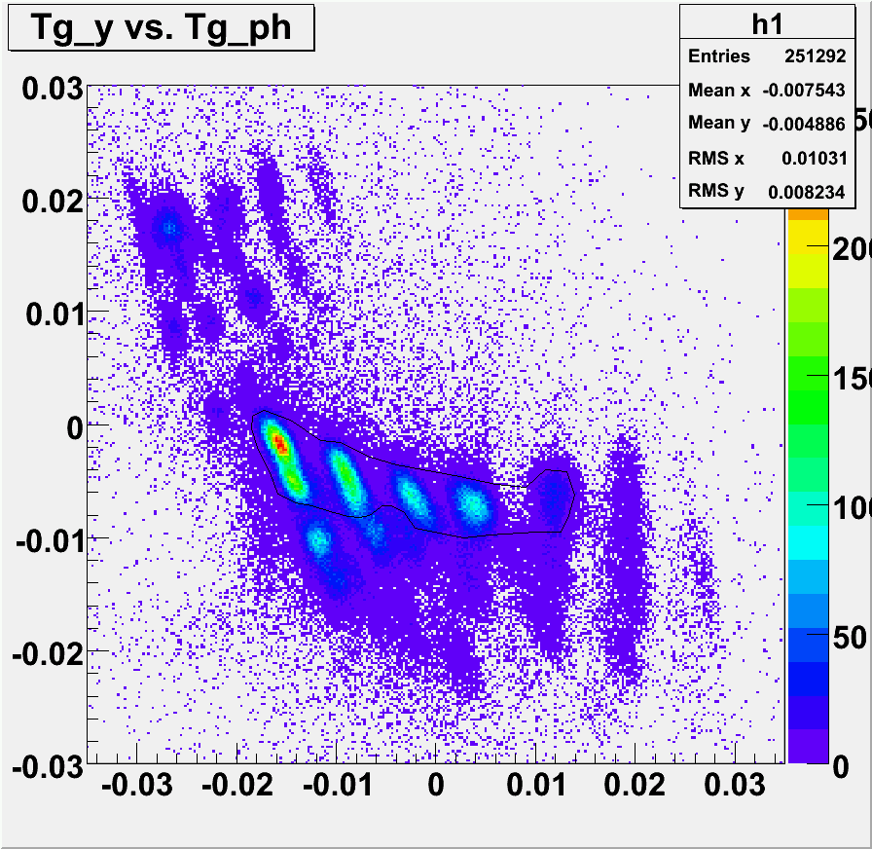
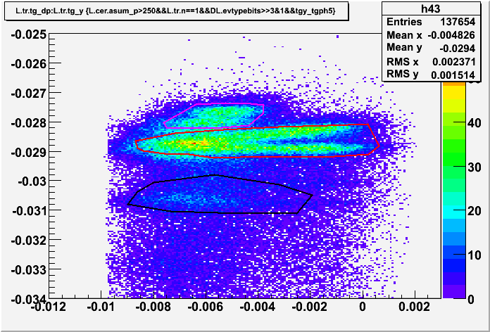
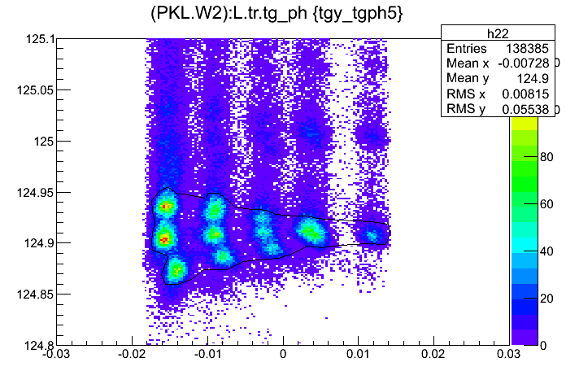
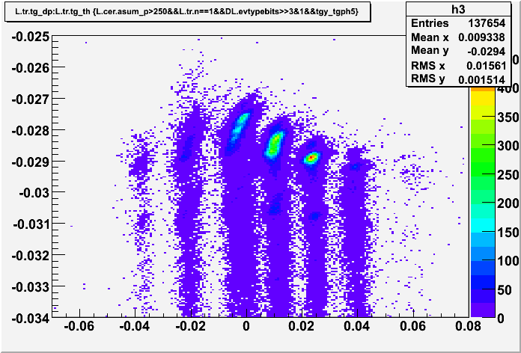
Steps Tried
Dp vs. tg_y
Dp vs. tg_th
And a few other focal plane plots…

Slide 5
Matrix Calibration
Jin suggested look at these plots with part of the acceptance, since it’s a multi-dimension problem
Cut each hole, and looked at dp vs. target phi/y/theta plots
Then decided to use dp vs. target theta

Slide 6
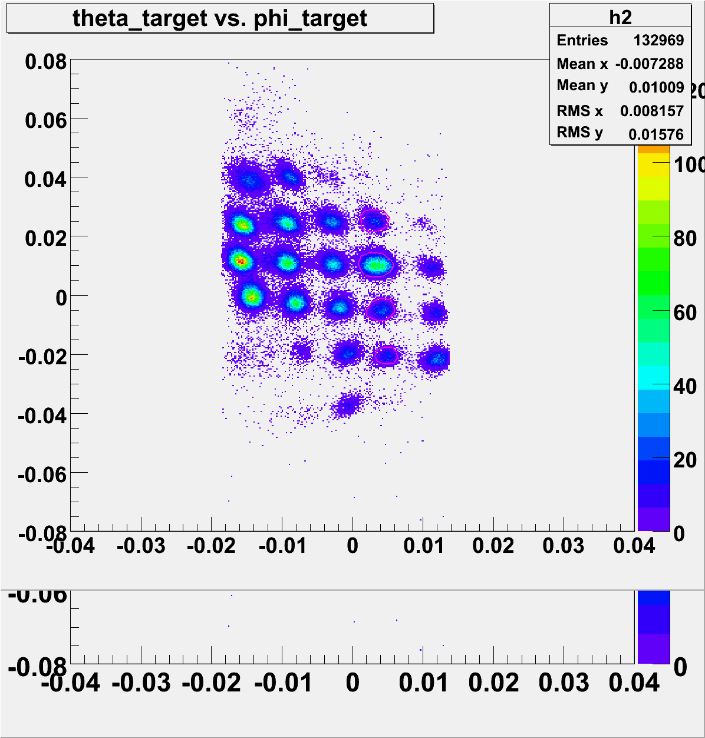
Steps of cuts
Tg_y vs. Tg_ph vetex cut for the whole run
Cut on each hole
These two are from #3181 dp=-3%

Slide 7
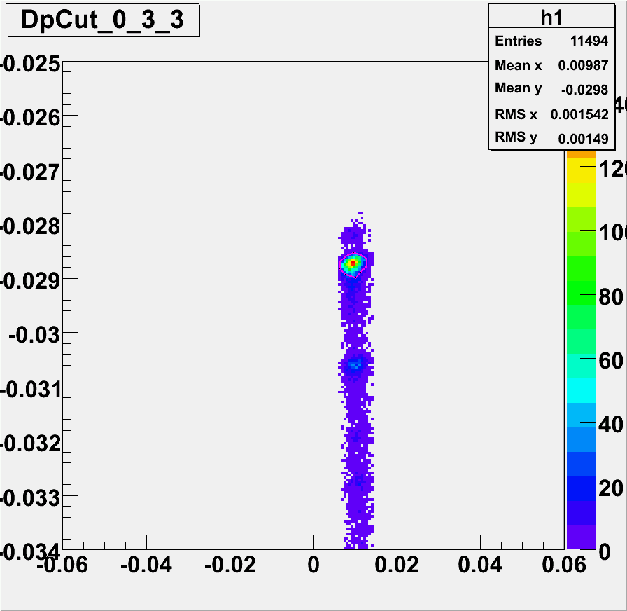
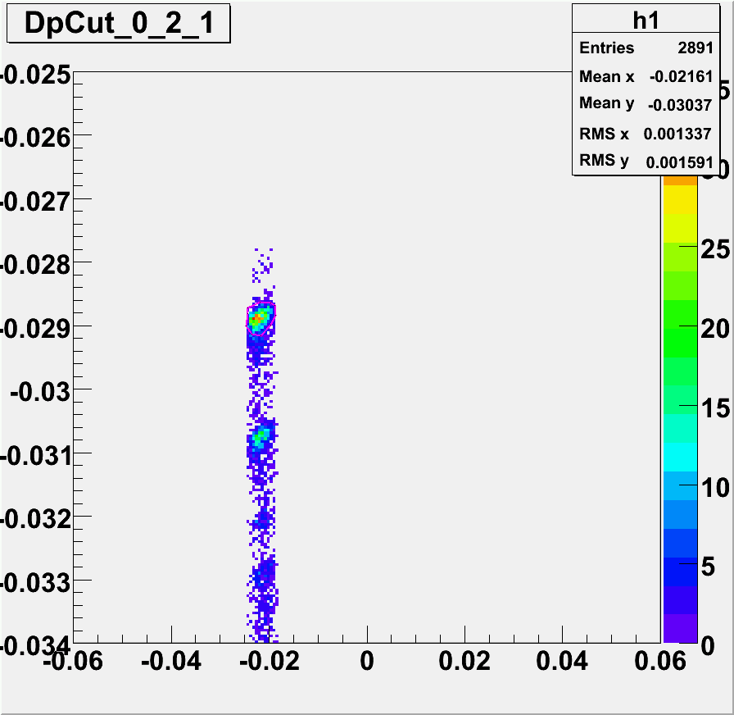
Steps of cut
3. Cut carbon elastic for each hole
These two are from #3181 dp=-3%

Slide 8
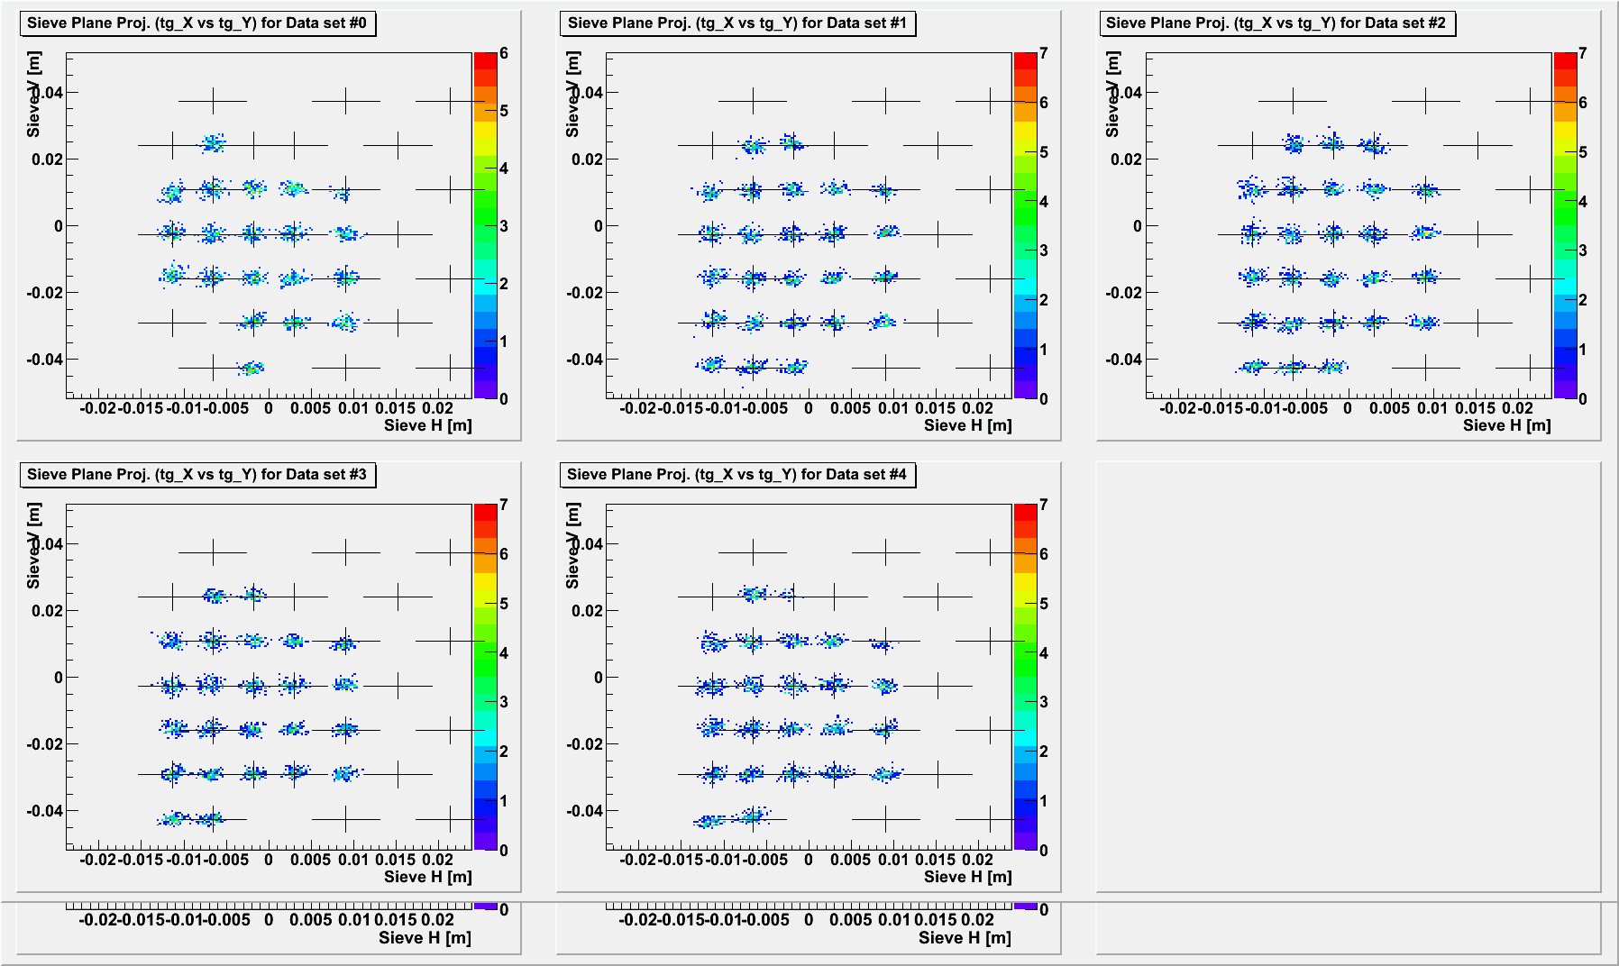
Matrix Angle Calibration

Slide 9
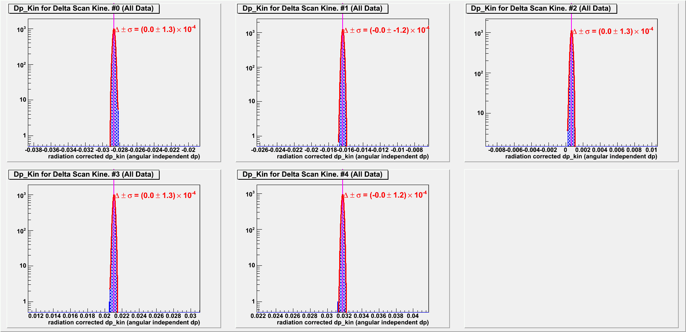
Matrix Dp calibration

Slide 10
Next
Any suggestions from this meeting
Looks good enough to me, a good base for more realistic situations later

Slide 11
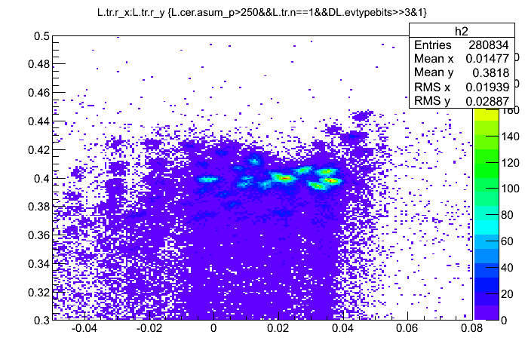
Backup
Focal plane x vs. y

