Slide 1
Angular Acceptance
---2 GeV scattered e- @ 5T

Slide 2
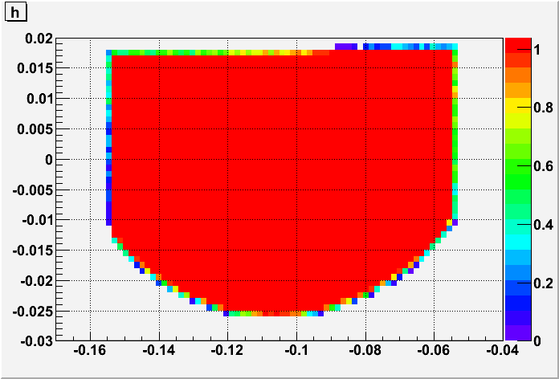
Acceptance Dist. of δ=0 (2 GeV)
Accep = 3.95177 msr
Phi (rad)
Theta (rad)

Slide 3
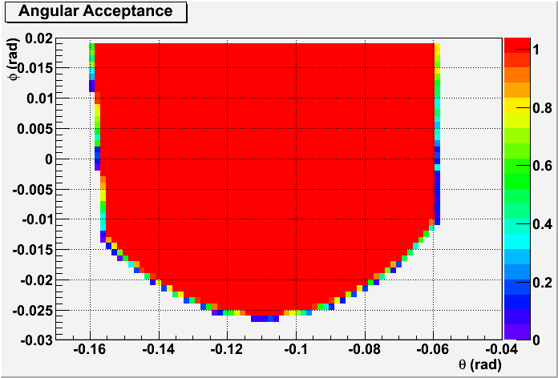
Acceptance Dist. of δ=0 (2 GeV)
-- Most update target & septa field map
Accep = 3.98891 msr Almost stays the same.
But theta_tg coverage has slightly shifted to larger value.

