Slide 1
Scattered e- momentum
RHRS run20978,20980, 20989, 20999. HRS p0 settings are written on the plot. From this, you will see the shift of the peak.
Normalized the distribution as N*prescale/(1-DT)/current/time, assuming other factors are same for each run as Karl said
3 cuts: trigger T1, track #=1, Cerenkov cut (particle PID) to exclude particles other than e-

Slide 3
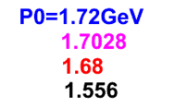

Slide 4
Carbon OUT runs
The distributions do not change much with carbon OUT runs (only He4 in target)

Slide 5
LHRS #1812 #1820
Centered elastic peak runs, P0=1.7028 GeV
Septa current scan from 480A to 380A
Run 1812: 480A
Run 1820: 380A

Slide 6
LHRS #1812 focal variables
If cut on elastic peak at dp plot, x will have only the peak on right too.
1812

Slide 7
LHRS #1820 focal variables
If cut on elastic peak at dp plot, x will have only the peak on right too.
1820

Slide 8
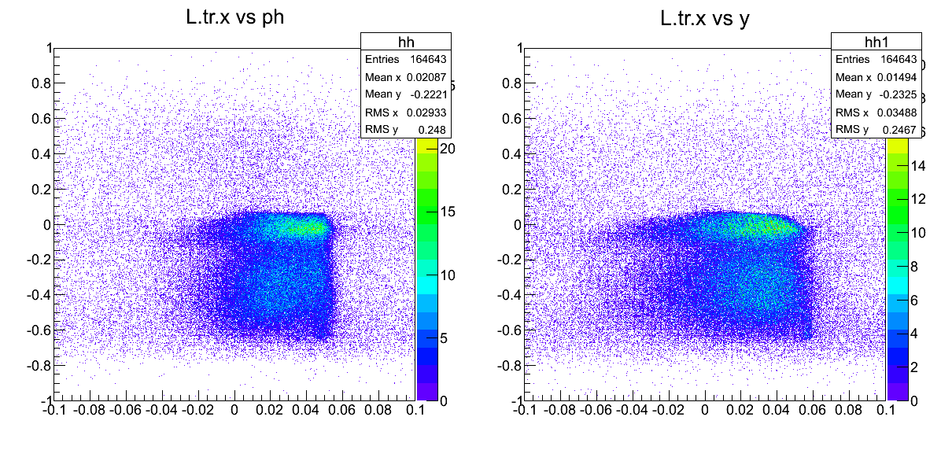
x_focal vs phi_focal (left) & x_focal vs y_focal (right)
1812
It’s too bad, I did not take enough statistics in this setting!!
1820

Slide 9
dp vs phi_tg
1812
1820

Slide 10
backup

Slide 11
RHRS vdc variables | #20977
Run 20977
P0=1.7028 GeV
Septa current 380A
If cut on elastic peak at dp plot, x will have only the peak left too.

