Slide 1
Lessons learned for summer 09 down.

Slide 2
Installation requirements
Remove the Big bite spectrometer and magnet, and remove the polarized 3He target
Fabricate, test, assemble, and install new 25 cm race track cryo target cells
Remove all the lead glass from the detectors and install the Happex III detectors
Communication
Repair the Compton polarimeter
Replace the Moller polarimeter
General stuff

Slide 3
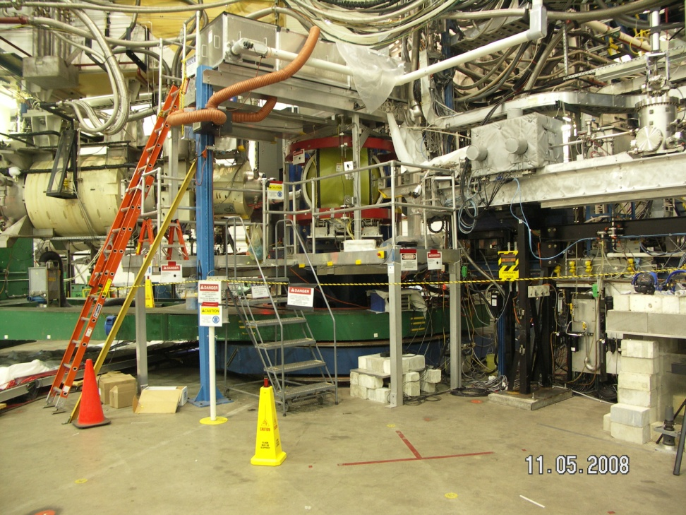
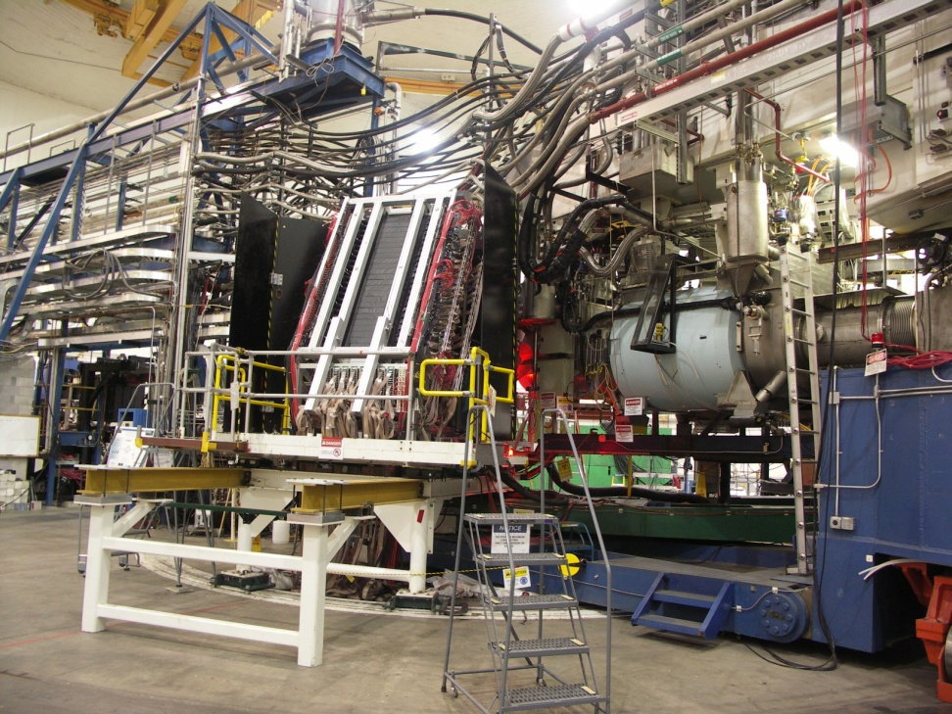
Disassembly of the Big Bite family went just as smoothly as the installation and runs. Good planning and execution with plenty of manpower and user help.

Slide 4
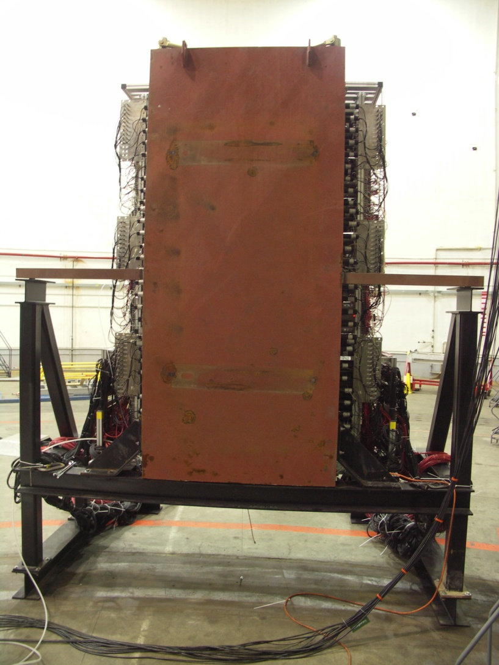
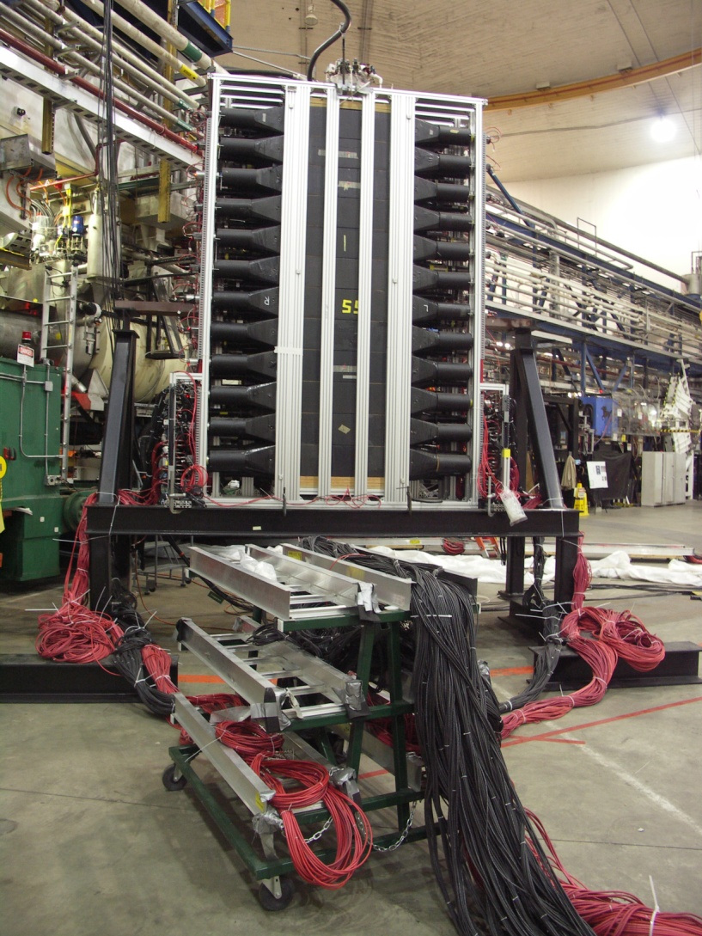

Slide 5
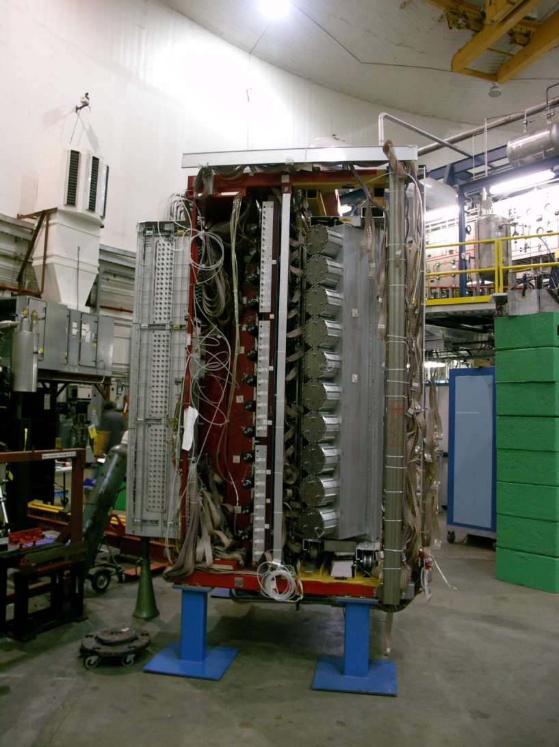
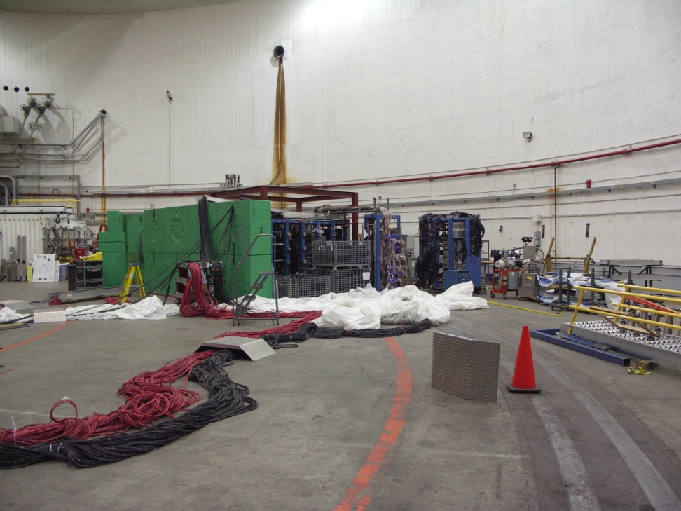

Slide 6
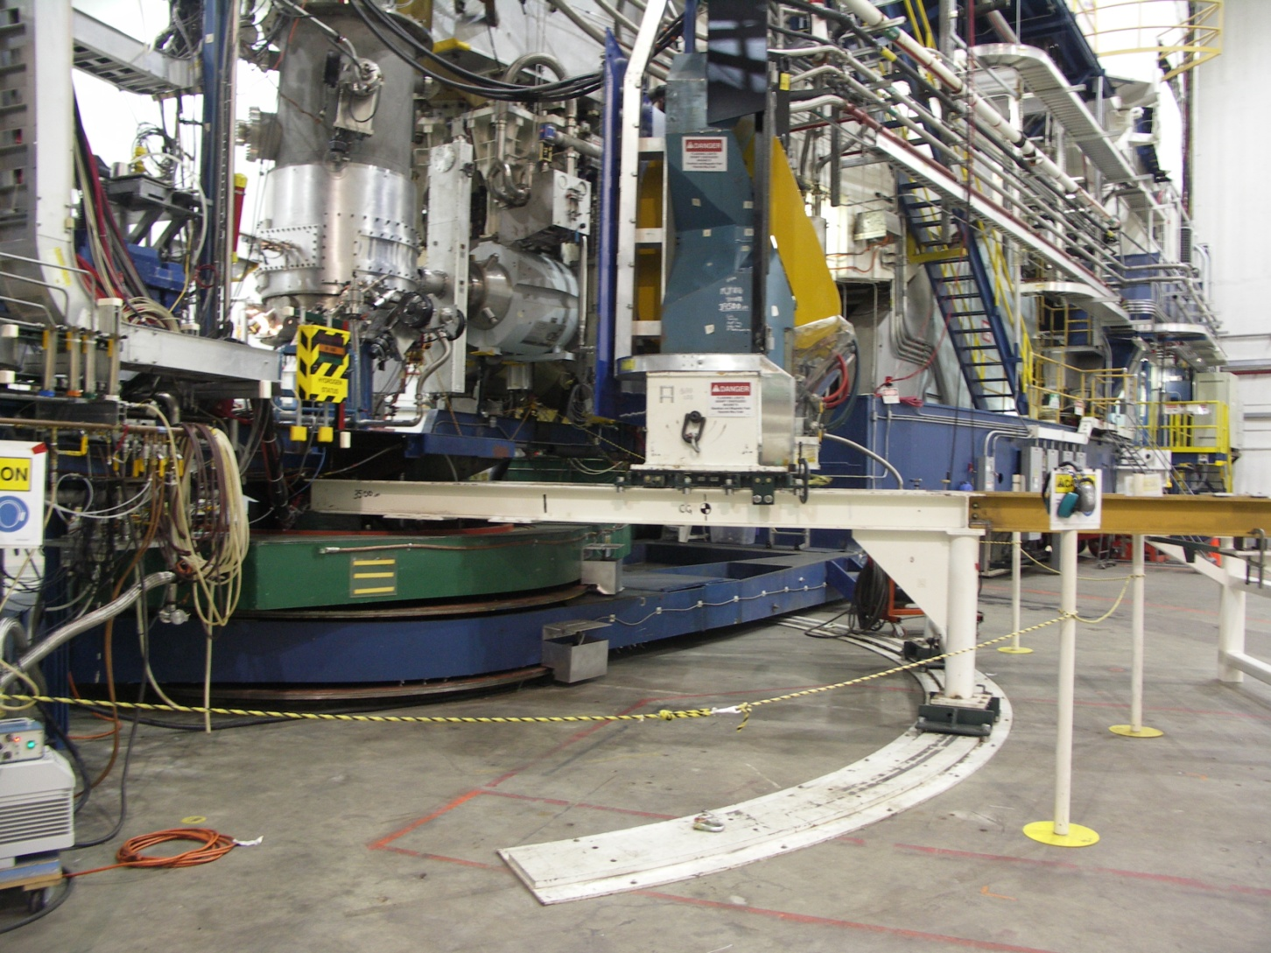
Cryo target needed to be defined, approved and funded earlier. Though the project was brought in on time, only one cell was viable and if more time was available the second cell could have been replaced.

Slide 7
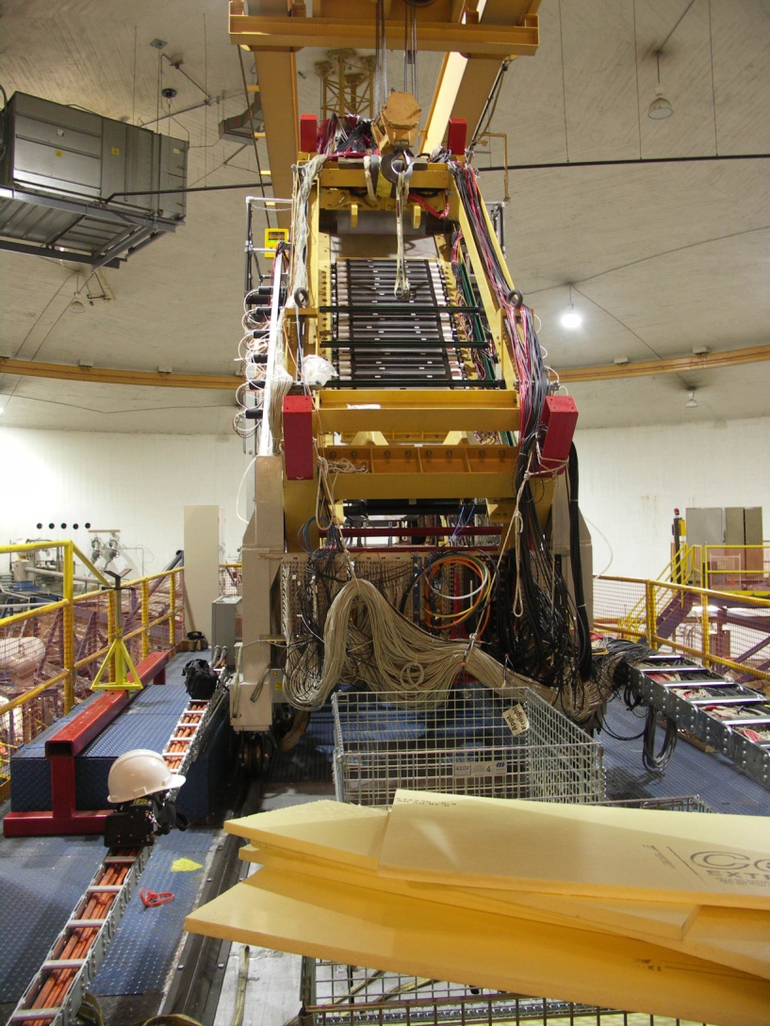
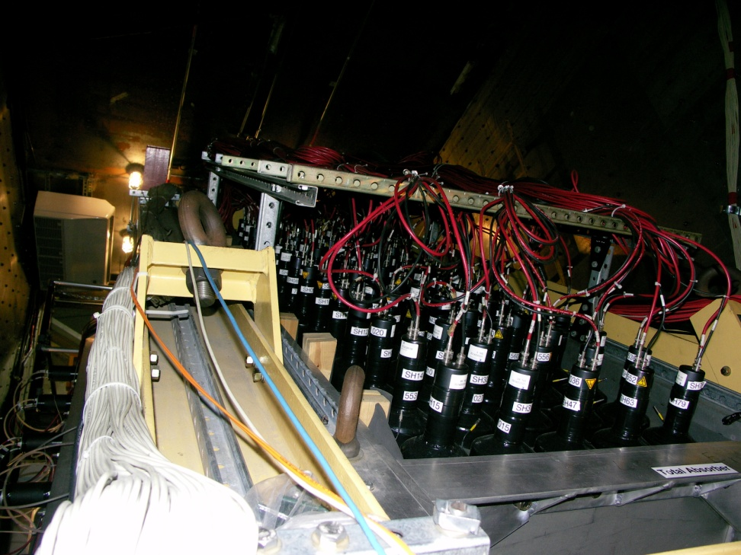
Removal of the lead glass went well but the Happex detectors were not ready prior to the beginning of the down and required tech manpower due to the delay.

Slide 8
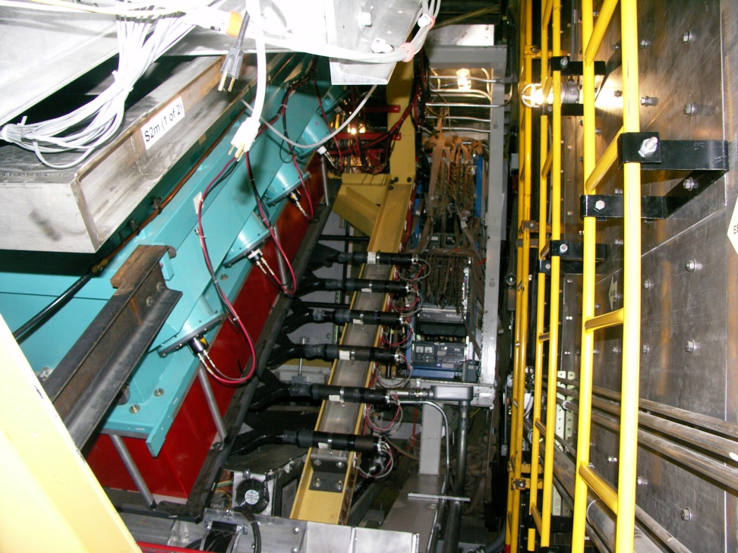
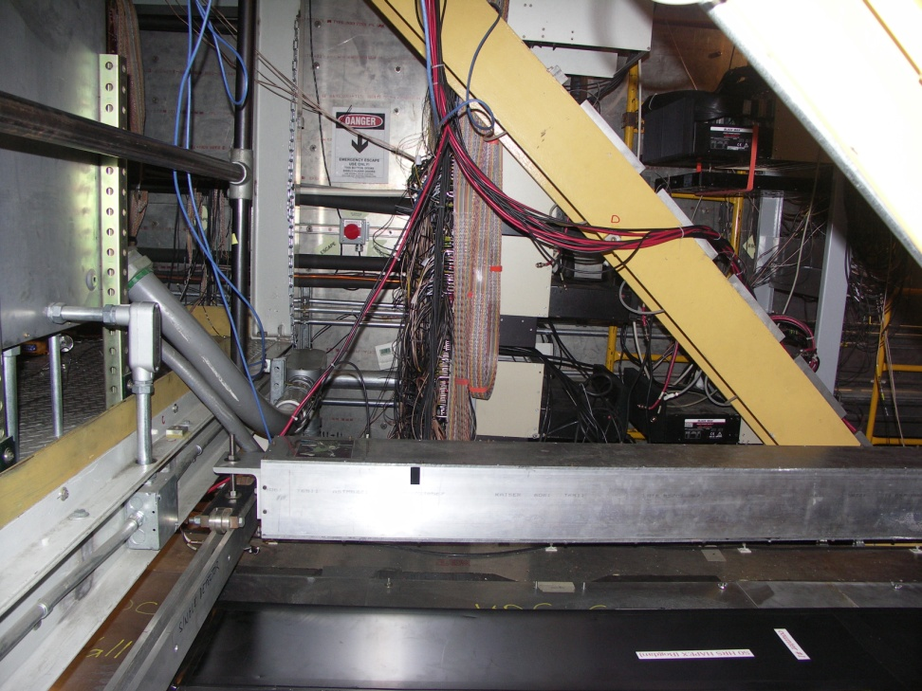

Slide 9
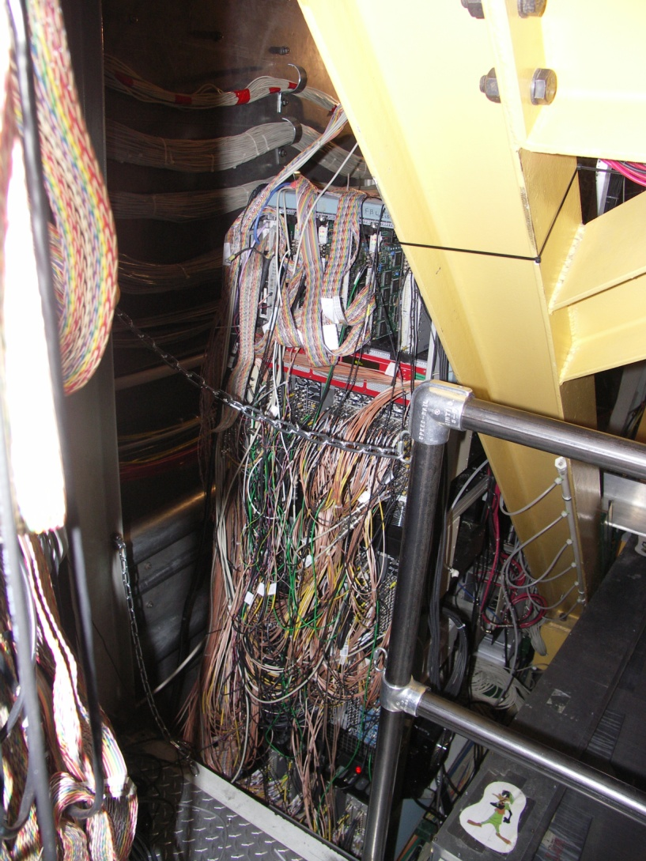
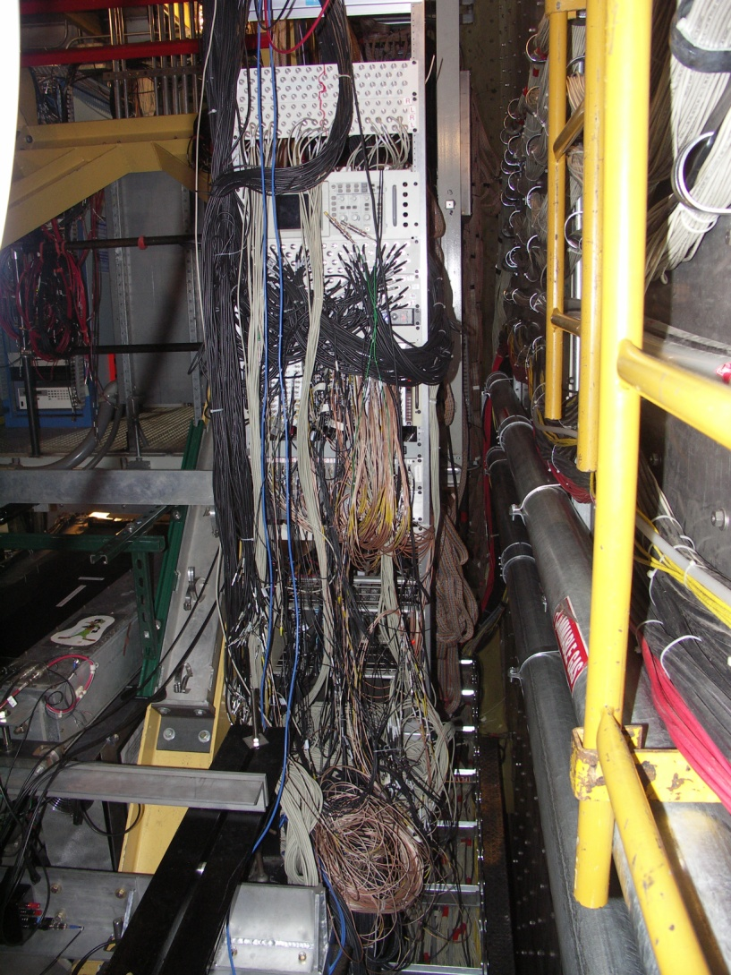
More communication from the Happex collaboration would have alleviated a bit of confusion throughout the installation process. More attention to the target progress, earlier preparatory work for the detectors, and more clearly conveying desired operating parameters would have been good.

Slide 10
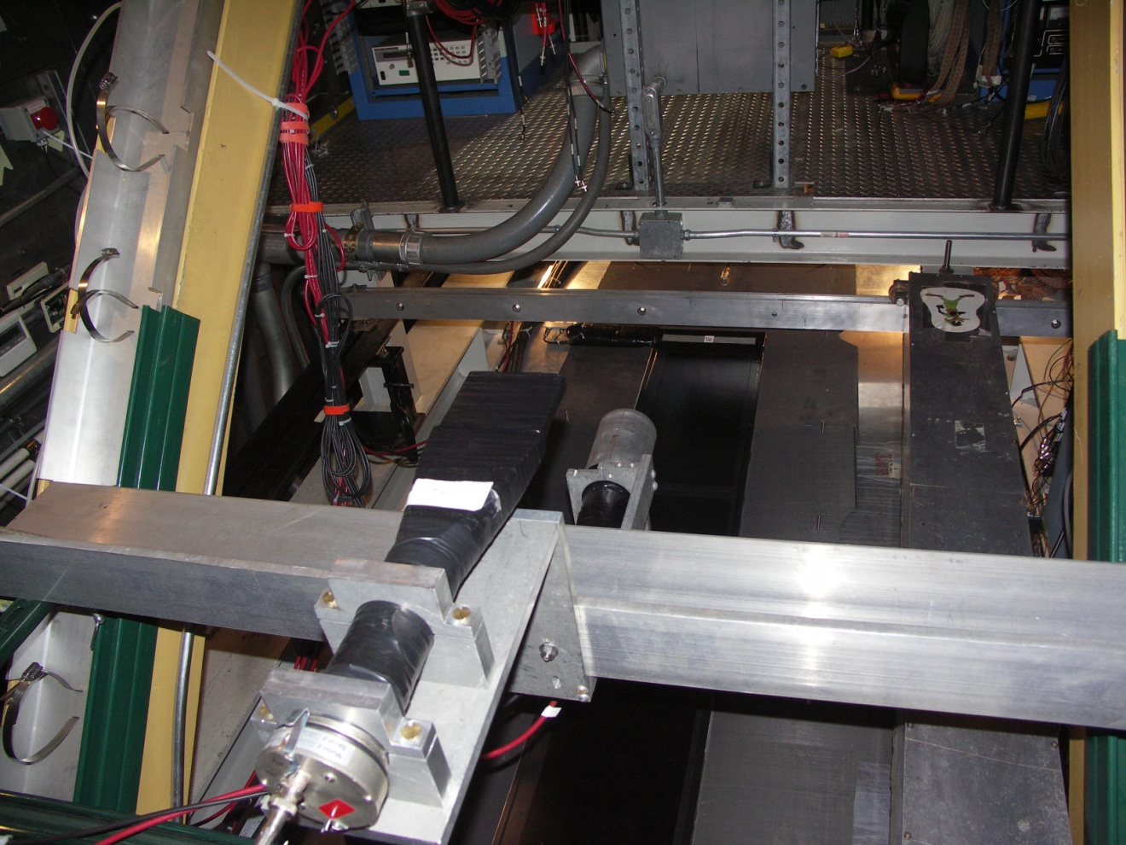

Slide 11
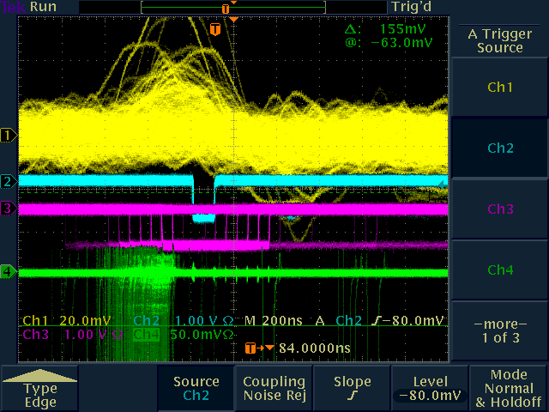
Work continues on the Compton Polarimeter

Slide 12
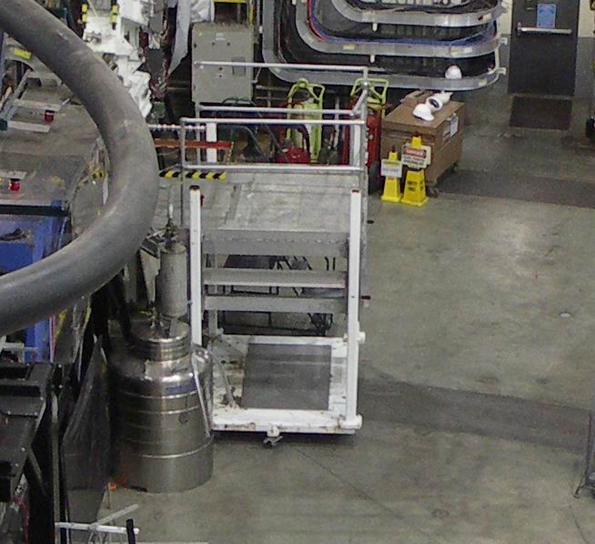
Failure to plan and implement monitoring of all the test parameters of the Moller target caused the failure of the LN2 reservoir. One high pressure dewar was delivered in an order of low pressure dewars and was not noticed. The expansion of the reservoir caused a thermal short between the N2 and the He reservoirs and would not allow the magnet to fill with LHe. Though the magnet was repaired, there was no time for installation.

Slide 13
General stuff
There was no design time allocated or available for the cryogenics system for the new moller target. A modification was made to an existing U tube, but at the end of the maintenance period the cryogenics system was also not completed.
As usual with a new experiment, we had to indoctrinate the new people on the Hall safety rules because they didn’t understand them at in-processing. Also as usual, we had to retrain some of the old timers on the same inconvenient rules that we have to retrain them on every time; things such as no open-toed shoes and not passing into a hard hat area without wearing a hard hat. We have strengthened our signage and have authorized all the technical staff to eject anyone from the Hall that is not in compliance with these rules. These rules are called out in the technical work permit and will be in the forthcoming maintenance COO.

