Slide 1
Superconducting detector prototype development
Hall A meeting
October 9th 2015
Alexandre Camsonne

Slide 2
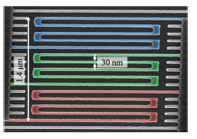
Superconducting nanowire technique
Thin superconducting stripe of 5 to 10 nm thickness
Meander geometry to maximize surface, typical width of strip few tens nm and length a few hundreds nm
Signal speed depends on material, substrate and geometry ( inductance )
Energy sensitivity depends on width and thickness
Mostly developed for astrophysics and telecommunication with IR sensitivity : Nasa Jet Propulsion Laboratory, Lincoln Laboratory ….
Also used for molecules, alpha time of flight : recoil detector

Slide 3
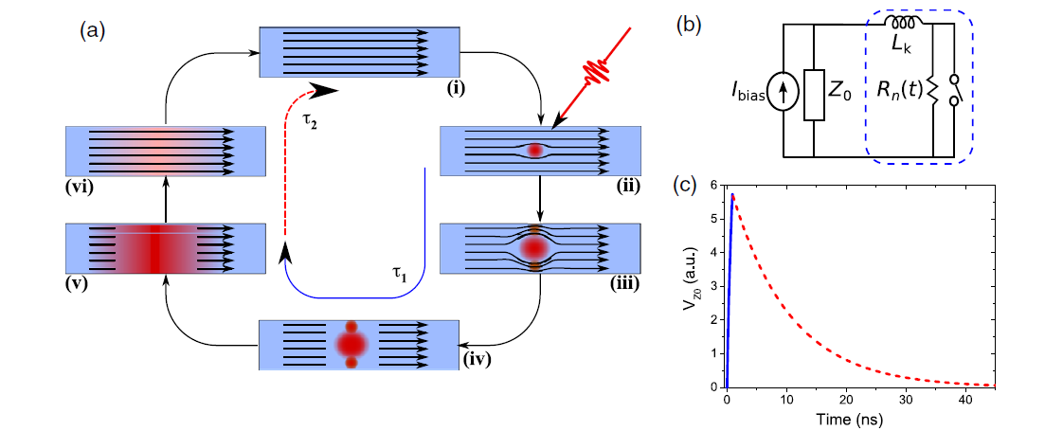
Superconducting detector principle
Review : Chandra M Natarajan et al 2012 Supercond. Sci. Technol. 25 063001 doi:10.1088/0953-2048/25/6/063001
Detector biased close to critical current
Single Superconducting Nanowire Photon Detectors : SNSPD

Slide 4
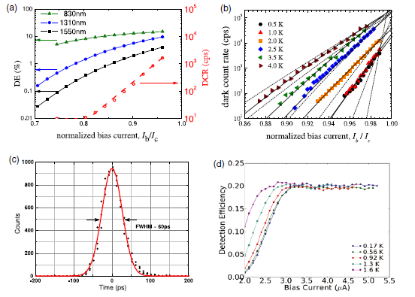
SNSPD typical properties
detection efficiency as function of
Wavelength and critical current
Dark count rate as function of critical current
for different temperatures
Typical timing resolution of a NbN SNSPD
Detector efficiency as a function of bias current for different temperatures

Slide 5
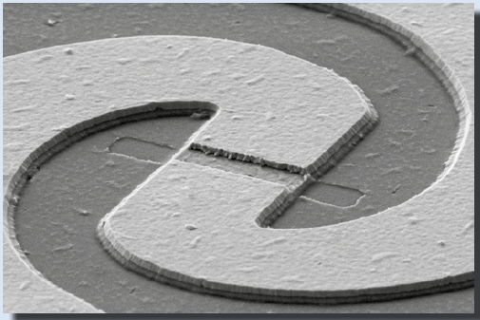
YBaCuO detector
Superconducting nanobridge : direct observation of bunch length of THz radiation in the ANKA storage ring
Ultra-fast YBa2Cu3O7-x direct detectors
for the THz frequency range
P. Thoma

Slide 6
Features of SNSPD
Fast : Typical 10 to 1 ns wide ( highly dependent on material and geometry )
potentially few picoseconds pulse width ( YBaCuO microbridge) much faster than photomultiplier
Not based on ionization ( different aging properties ) most likely longer lifetime than PMTs
Better radiation hardness than silicon detectors
Sensitivity can be tuned by varying thickness and width : X-ray sensitivity to IR, detection of low energy particles which stops in detector
Detection efficiency
  20 % typical around 50 % with optical cavity and up to 93 % with WSi_{x} (Detecting Single Infrared Photons with 93% System Efficiency F. Marsili et al )
Very good timing resolution : at least 100 ps up to 30 ps maybe better limited by readout electronics
(Dauler E A, Kerman A J, Robinson B S, Yang J K W, Voronov B, Goltsman G, Hamilton S A and Berggren K K 2009 Photon-number-resolution with sub-30-ps timing using multi-element)

Slide 7
Possible applications
Direct measurement
  Recoil detector nDVCS, dDVCS, he4DVCS
    Size optimized for deuton, alpha : MIP blind recoil detector
PMT replacement DVCS, SoLID Cerenkov :
  need multipixels detector
  Dedicated superconducting readout
Cryogenic detector using radiator ( could be He)
Need to investigate use in magnetic field for polarized target
Feasibility of MIP detector

Slide 8
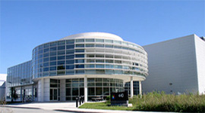
Center of Nanoscale Materials
User facility in Argonne
One of 5 DOE Nanoscale Science Research Centers
Started in 2007
451 users
Clean room class 100 to 1000
Optical and electron lithography techniques
Metal deposition
Electron microscopy
… other nano sciences techniques

Slide 9
Argonne CNM proposal 42861
JLAB
  Alexandre Camsonne, Anne Marie Valente, Drew Weisenberger, Carl Zorn
Argonne
  Physics : Kawtar Hafidi, Whitney Armstron
  CNM : Leonidas Ocola, Ralu Divan
Temple University
  Zein-Eddine Meziani, Nikolaos Sparveri
ODU :
  Gon Namkoong

Slide 10
Argonne CNM proposal 42861
Produce detector prototype similar to currently produce detectors
Optimize for UV/visible and speed
Test radiation damage
Approved April 2015

Slide 11
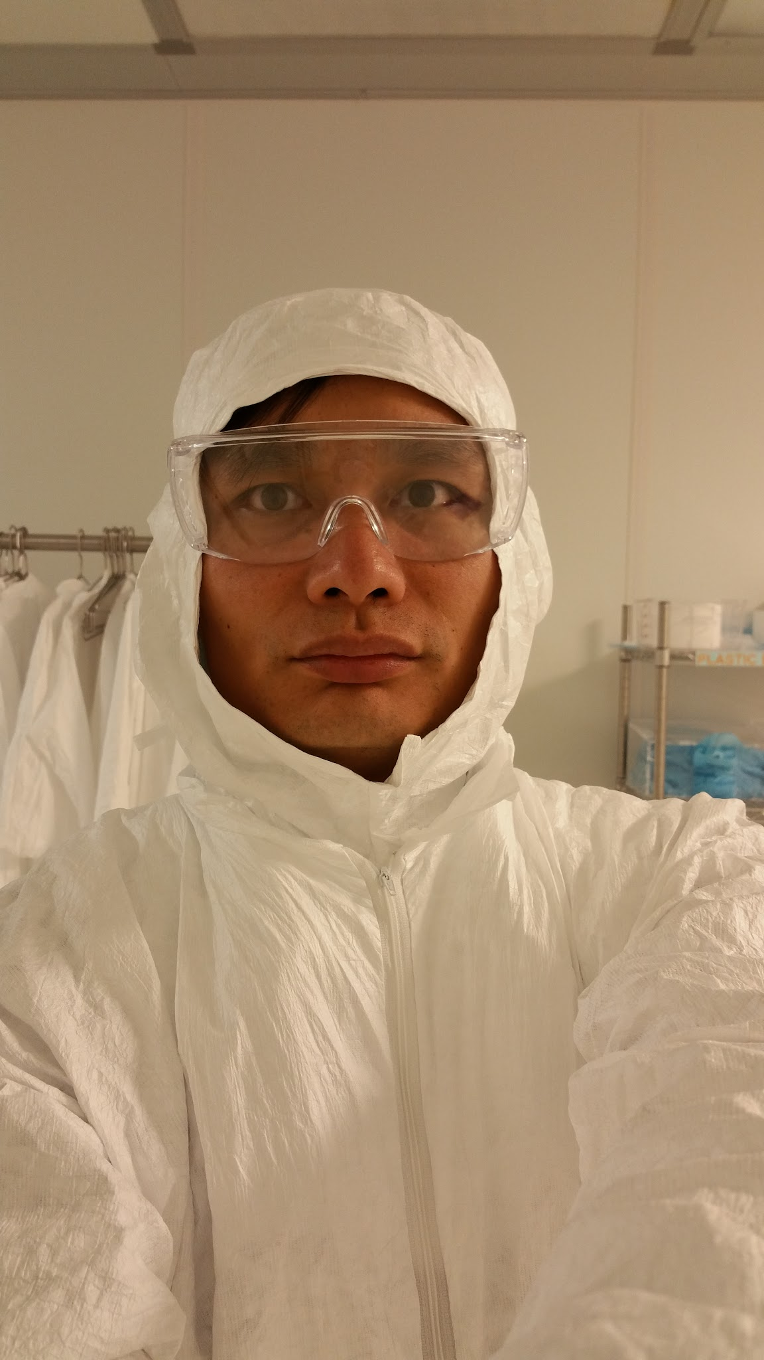
Visit summary
Clean room orientation
Substrate cleaning process
Metal deposition substrates
Resist spin coating
Electron beam lithography
Scanning electron microscopy

Slide 12
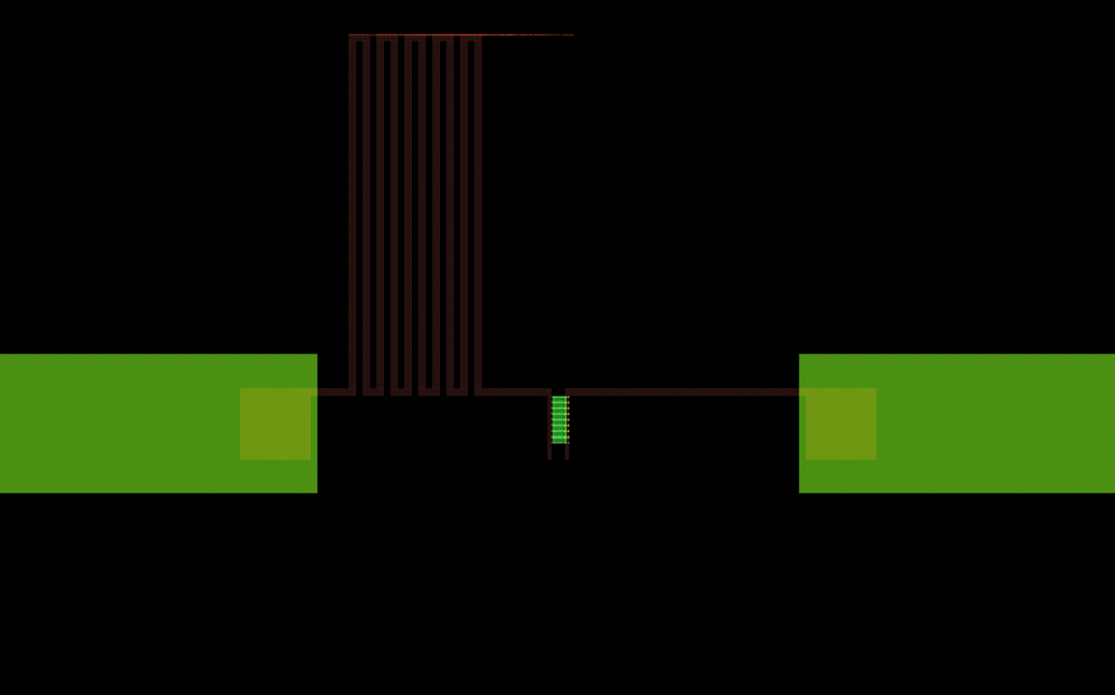
Detector design
Use Layout software to create the detector pattern

Slide 13
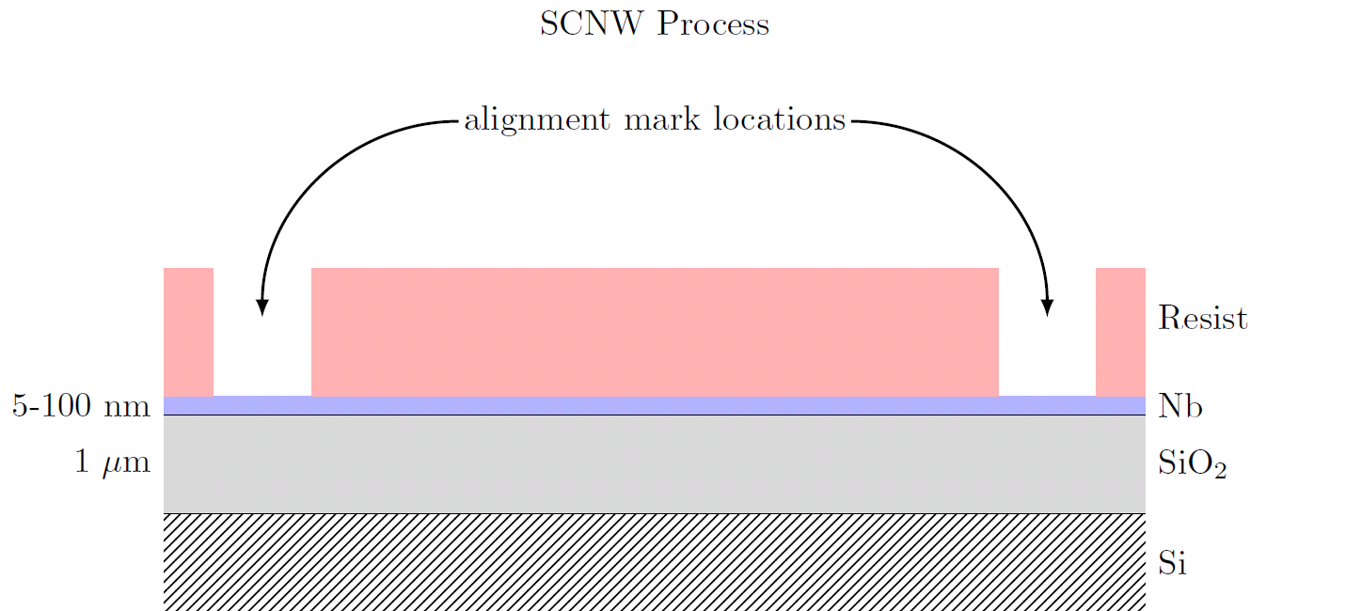
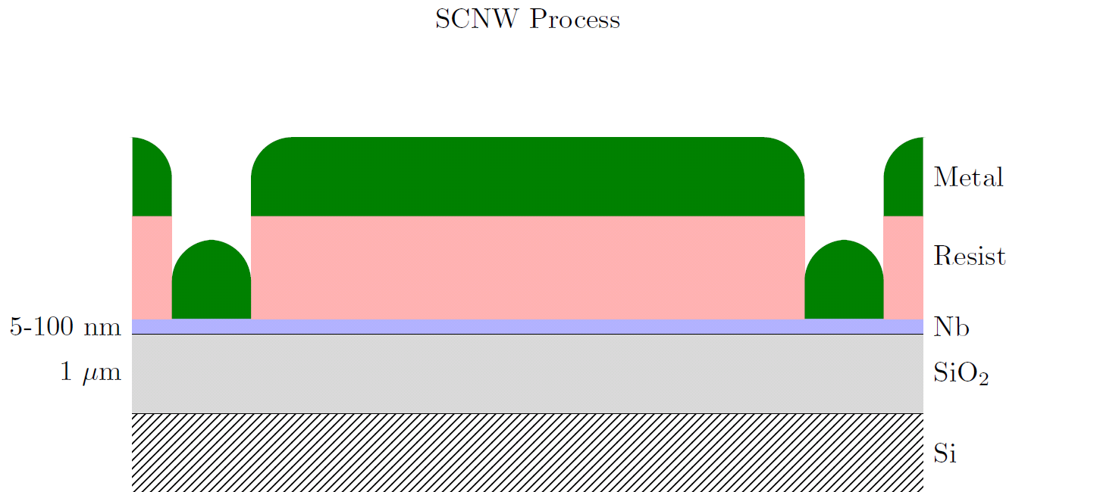
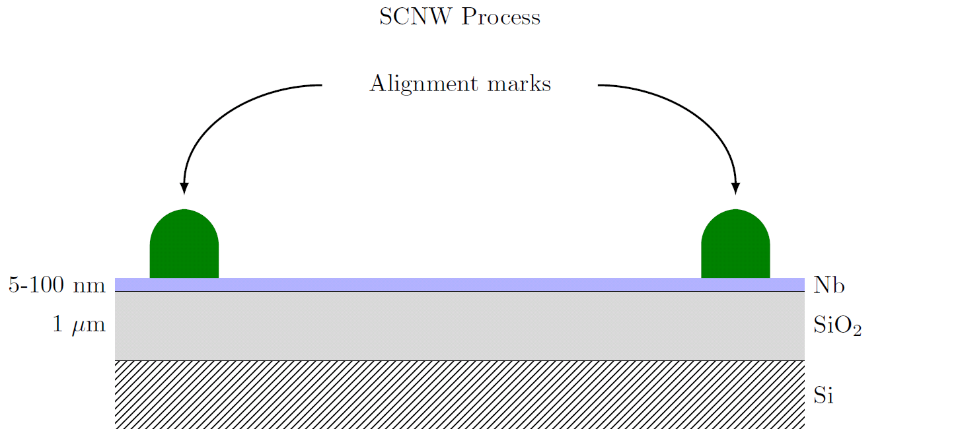
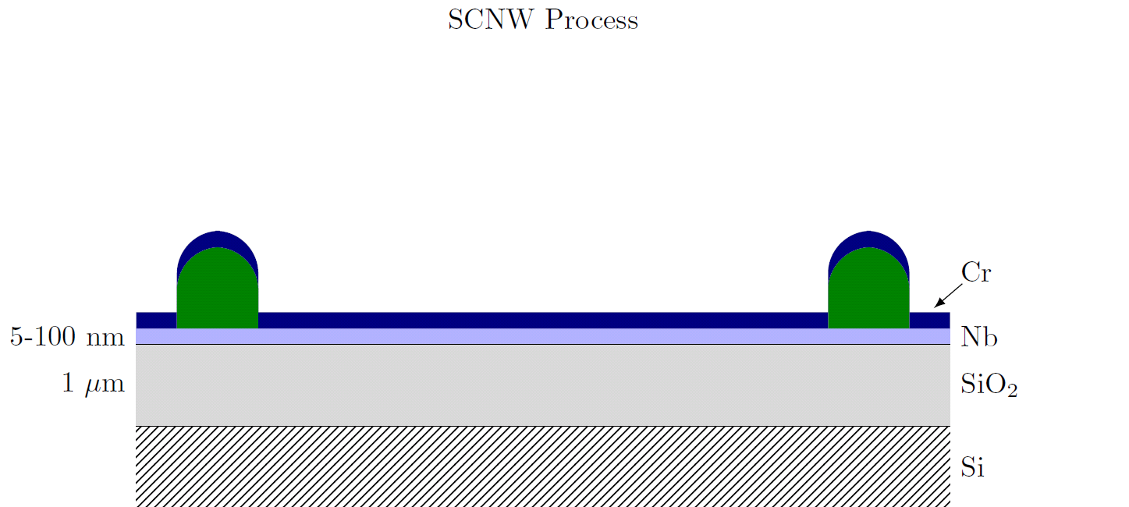
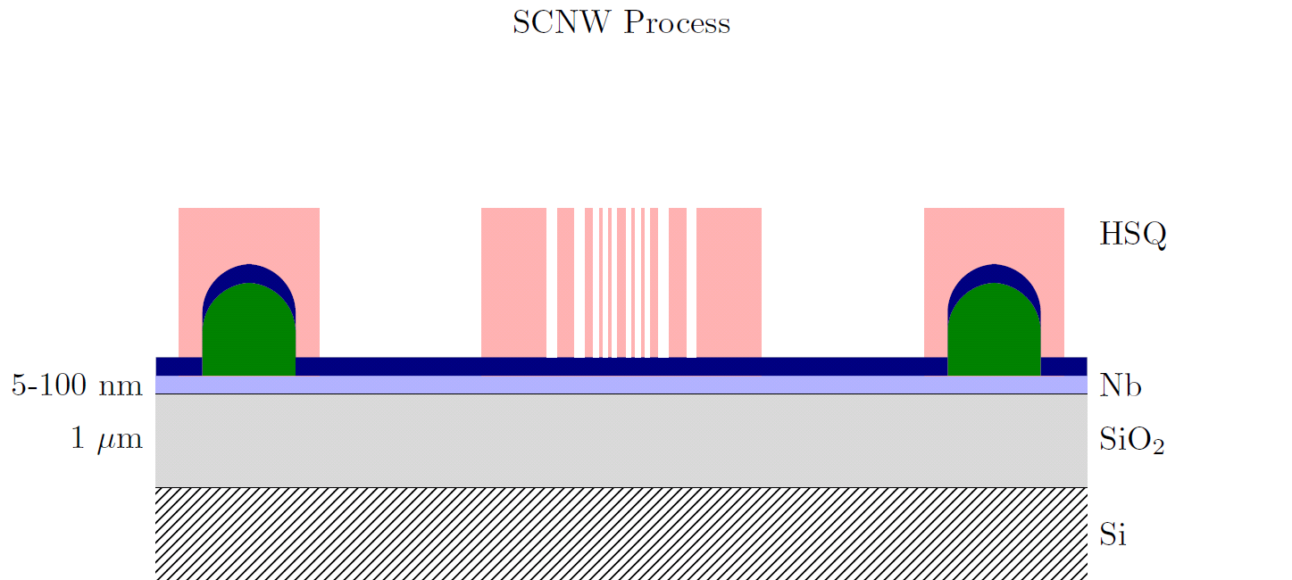
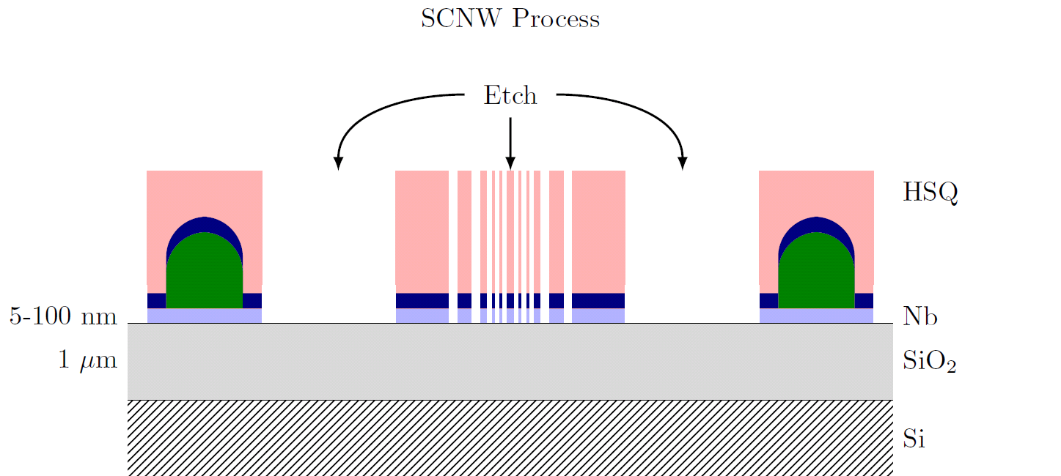
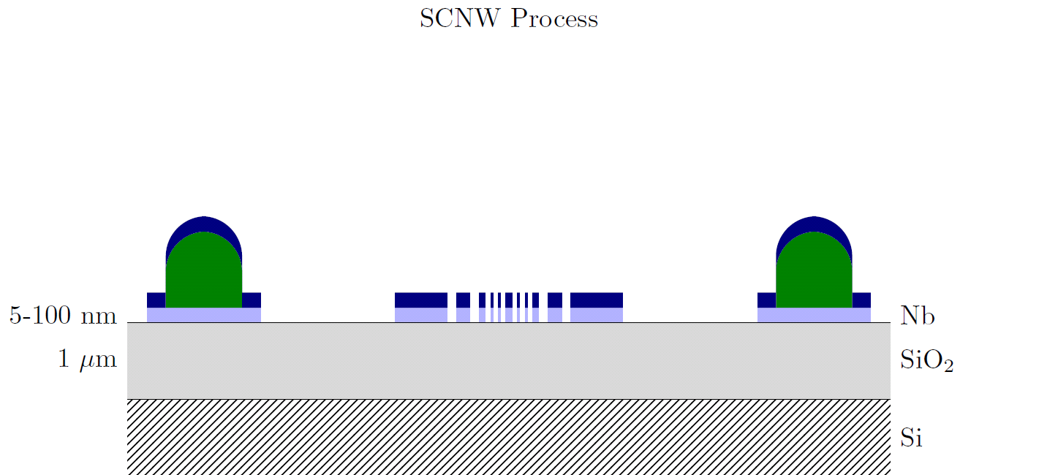
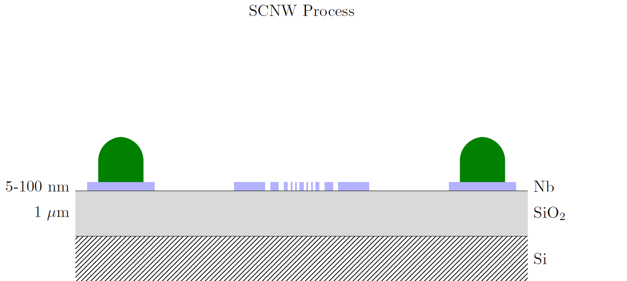
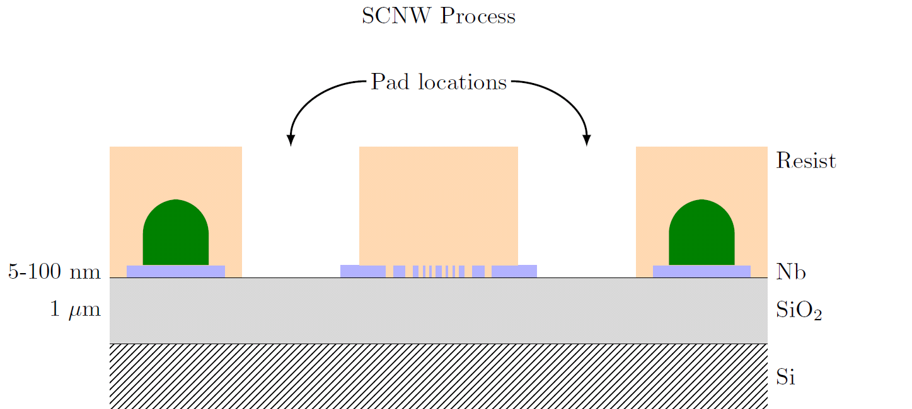
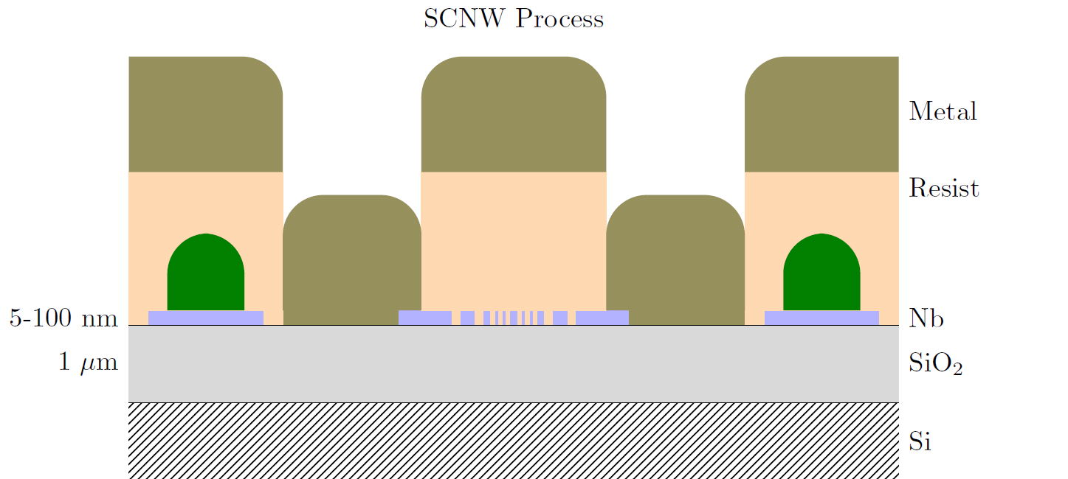
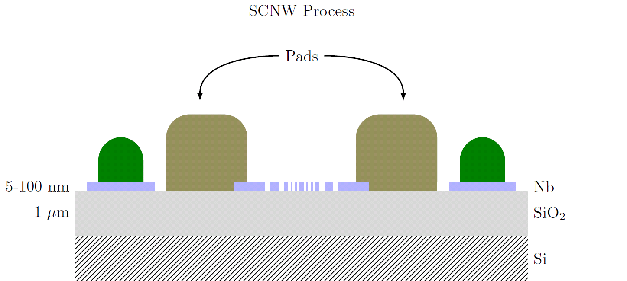
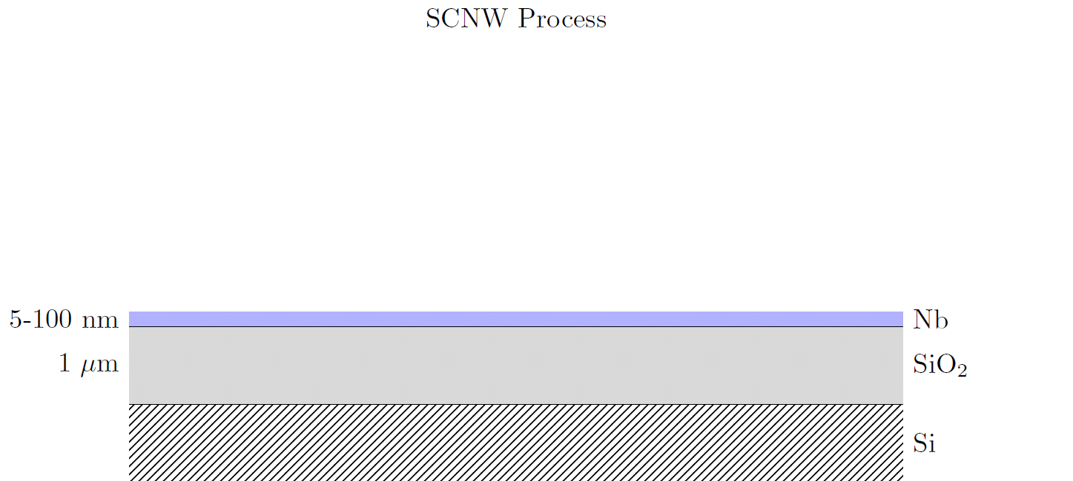
Process

Slide 14
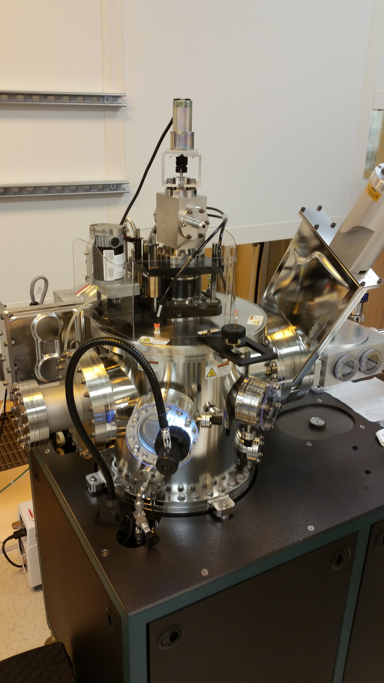
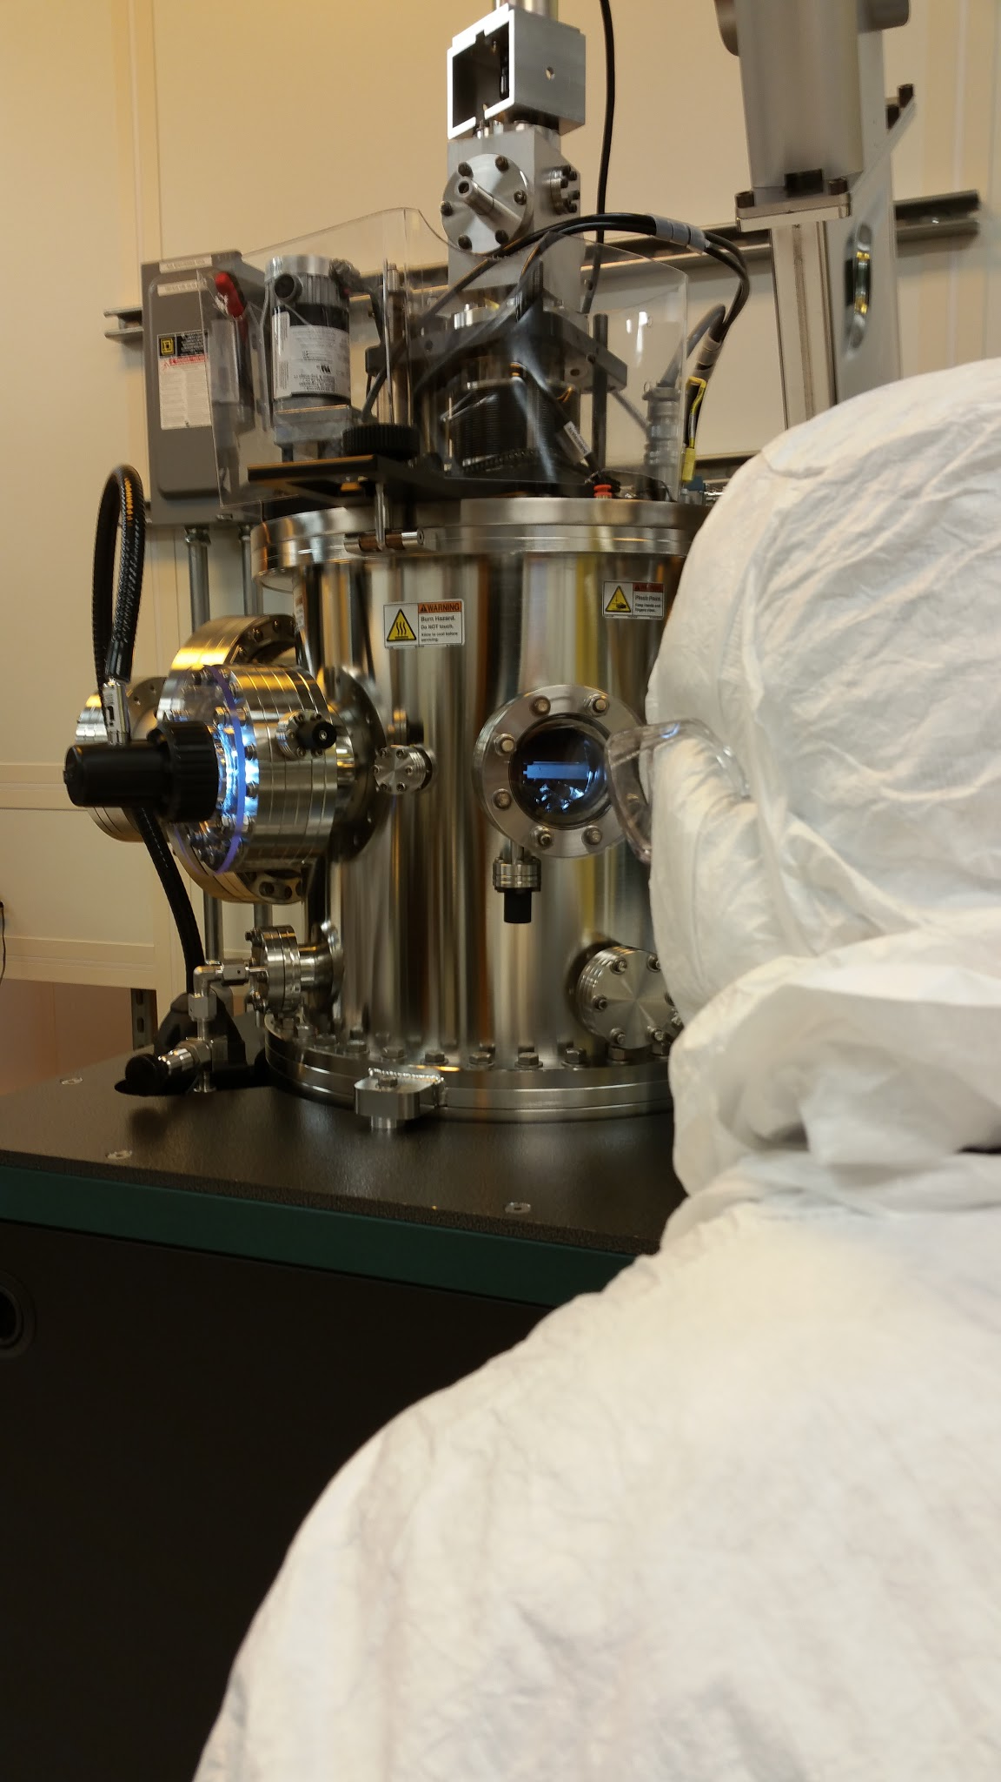
Metal deposition
Test on dummy sample Si and W to simulate NbTiN
Metal sputtering
  Tungsten
  Chromium

Slide 15
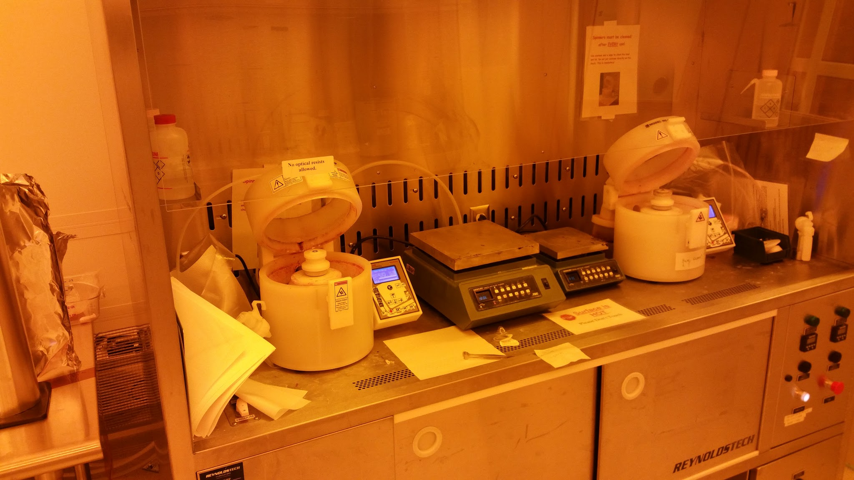
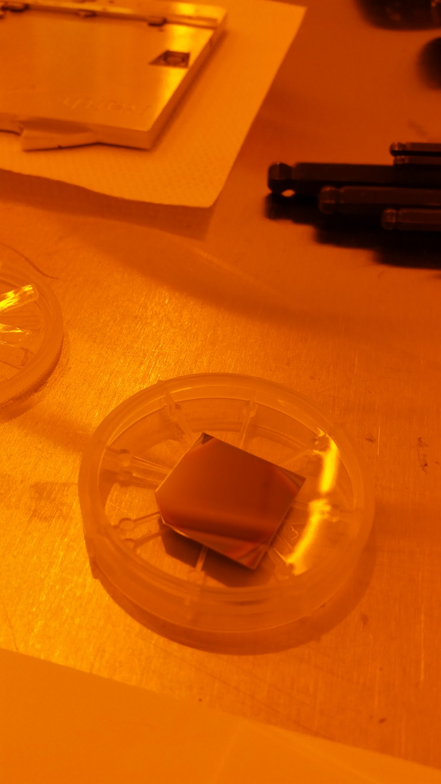
Spin coating
Fox 22 HSQ
Spin coater
  4000 RPM for 1 min
Resist layer about 120 nm high measured by profilometry
Testing diluted mix to reduce height to 60 nm for improved resolution

Slide 16
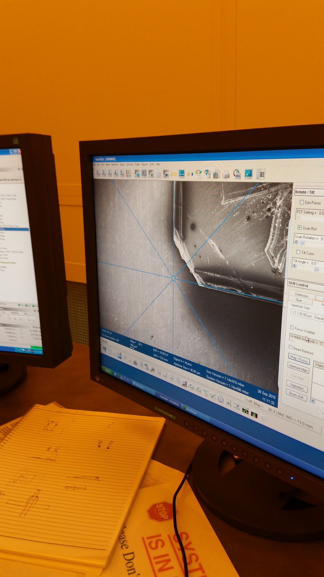
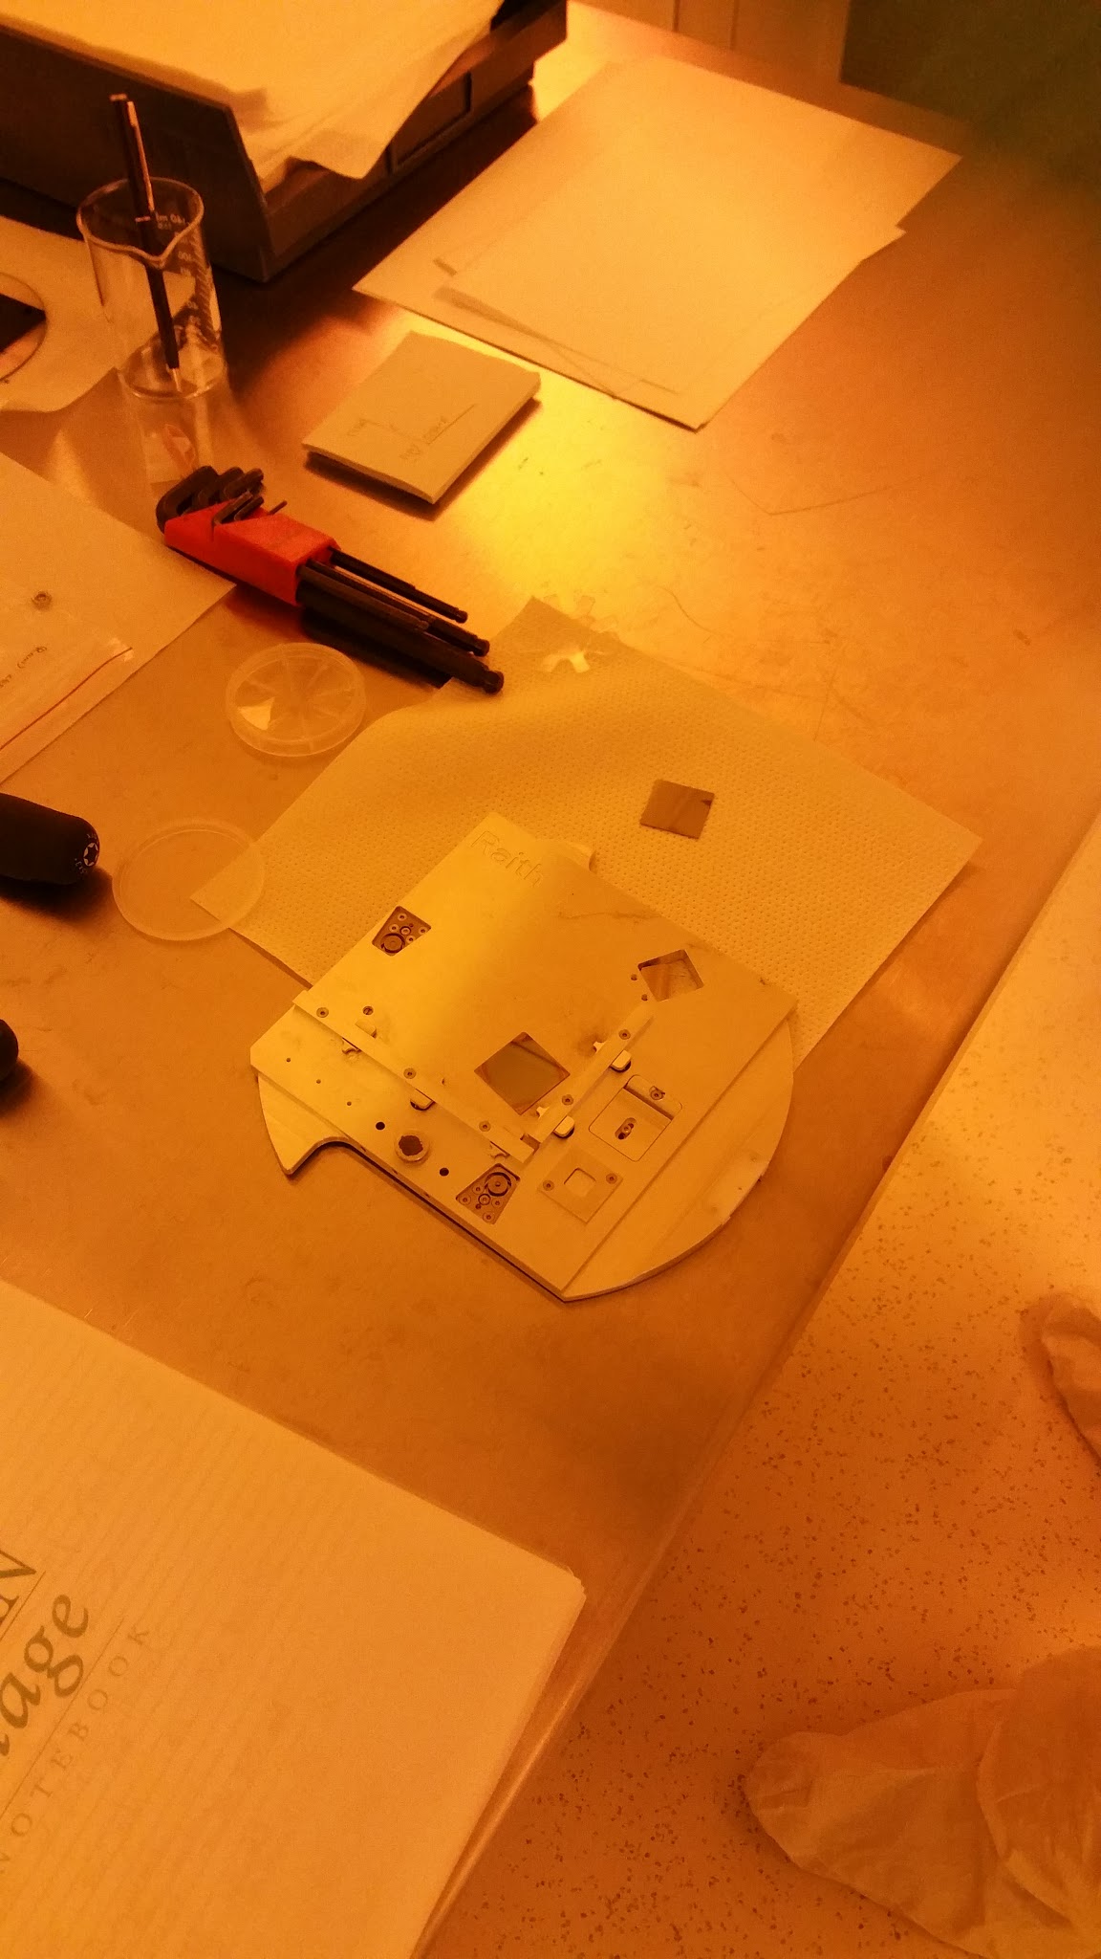
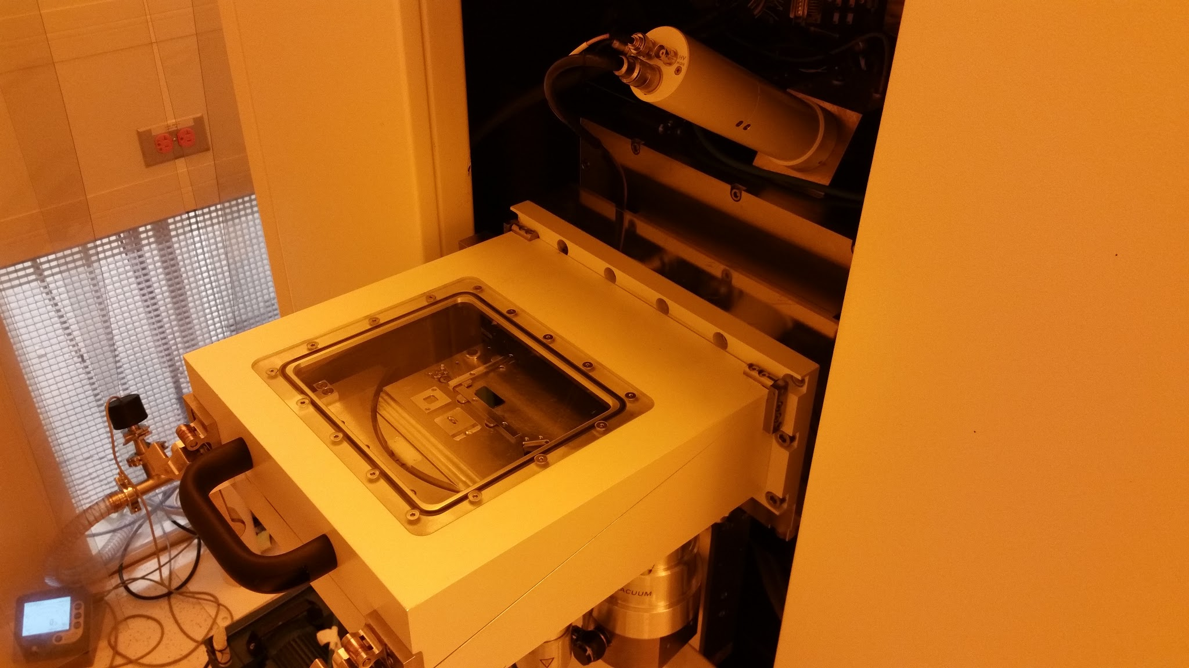
Electron beam lithography
Raith 150 30 keV SEM and e-beam lithography

Slide 17
Electron beam lithography
Use Fox22 resist
Test with 30 keV electron beam lithography Raith 150
JEOL 100 keV beam lithography not available
Dose array to optimize exposition time
Started to explore parameters to optimize Proximity Effect Correction ( electron diffusion and electron backscattering )

Slide 18
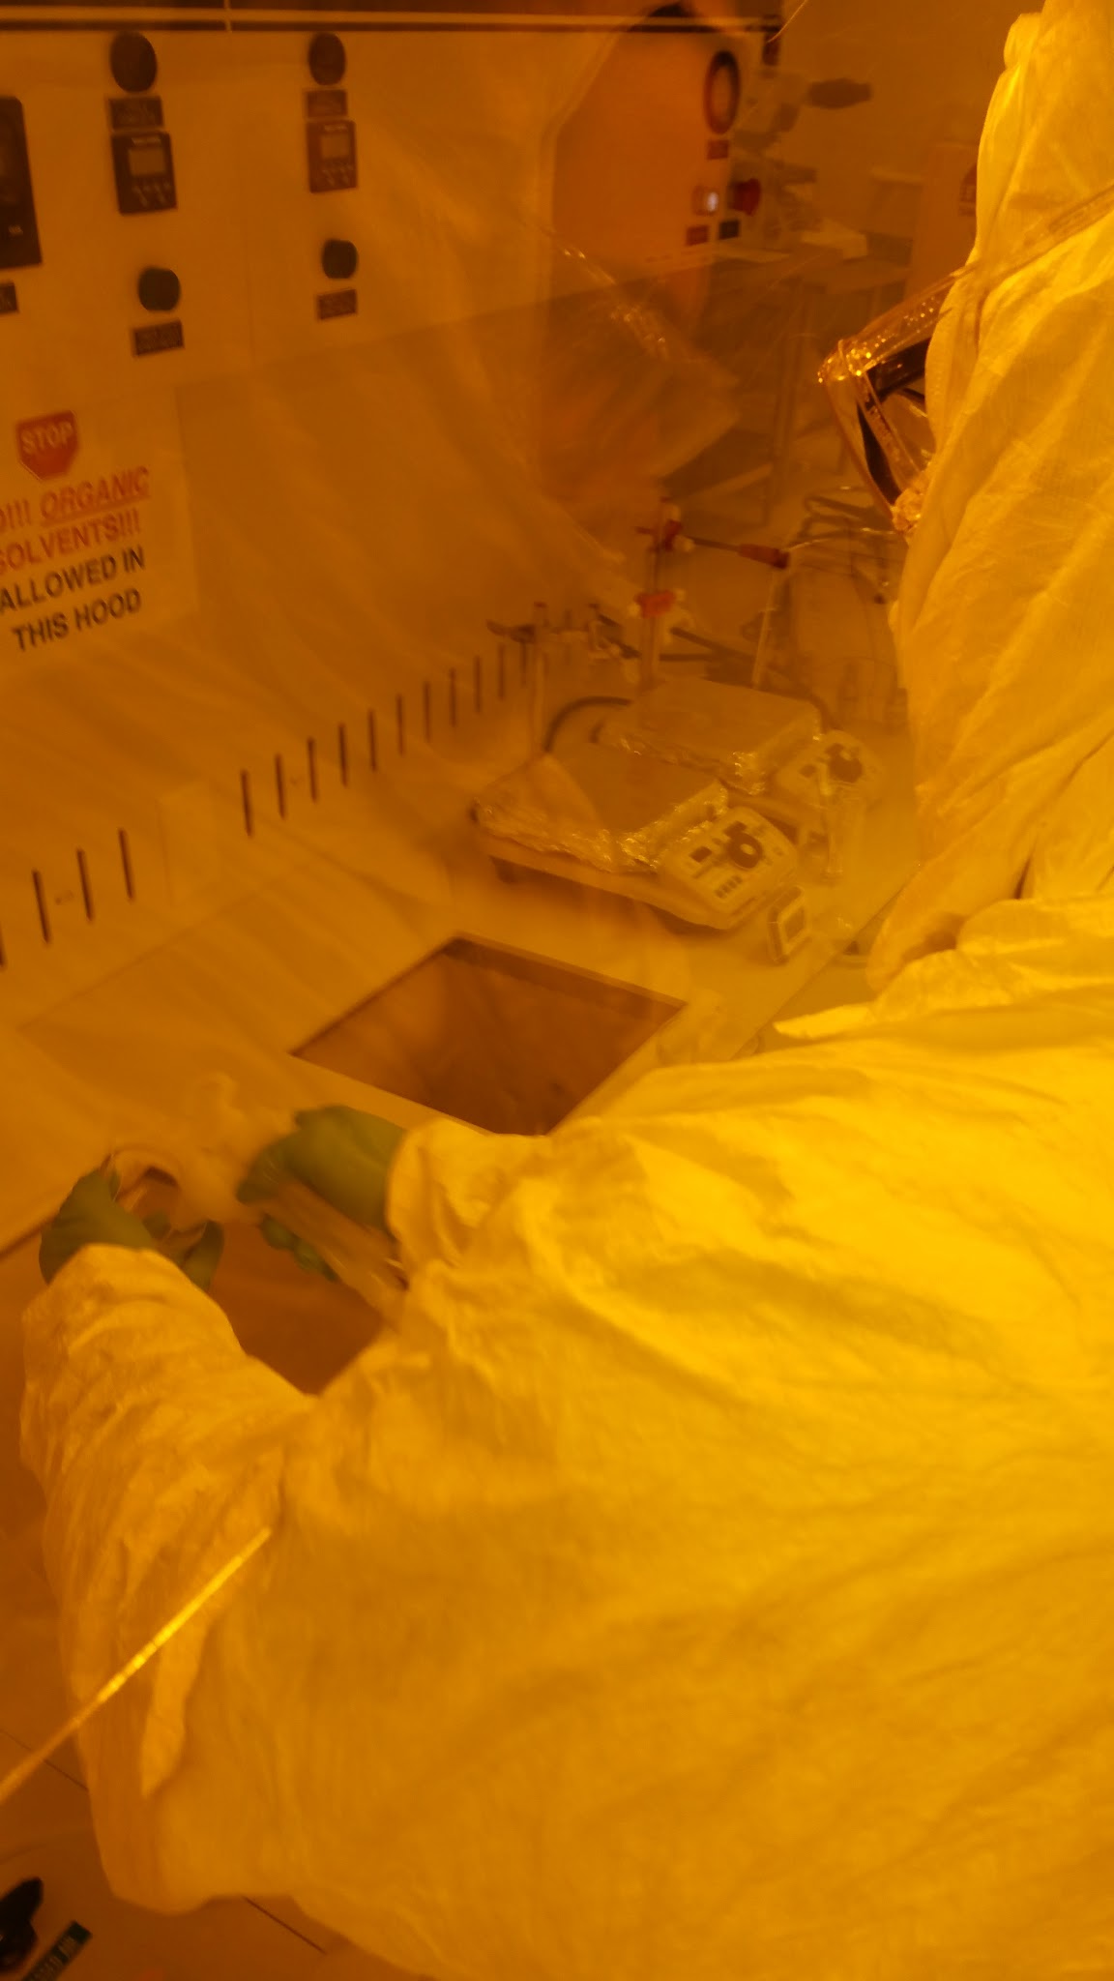
Resist development
NaOH solution
( 351 developer )
for 1 minute in chem lab
Will test at higher temperature
( 50 degrees C ) to improve resolution

Slide 19
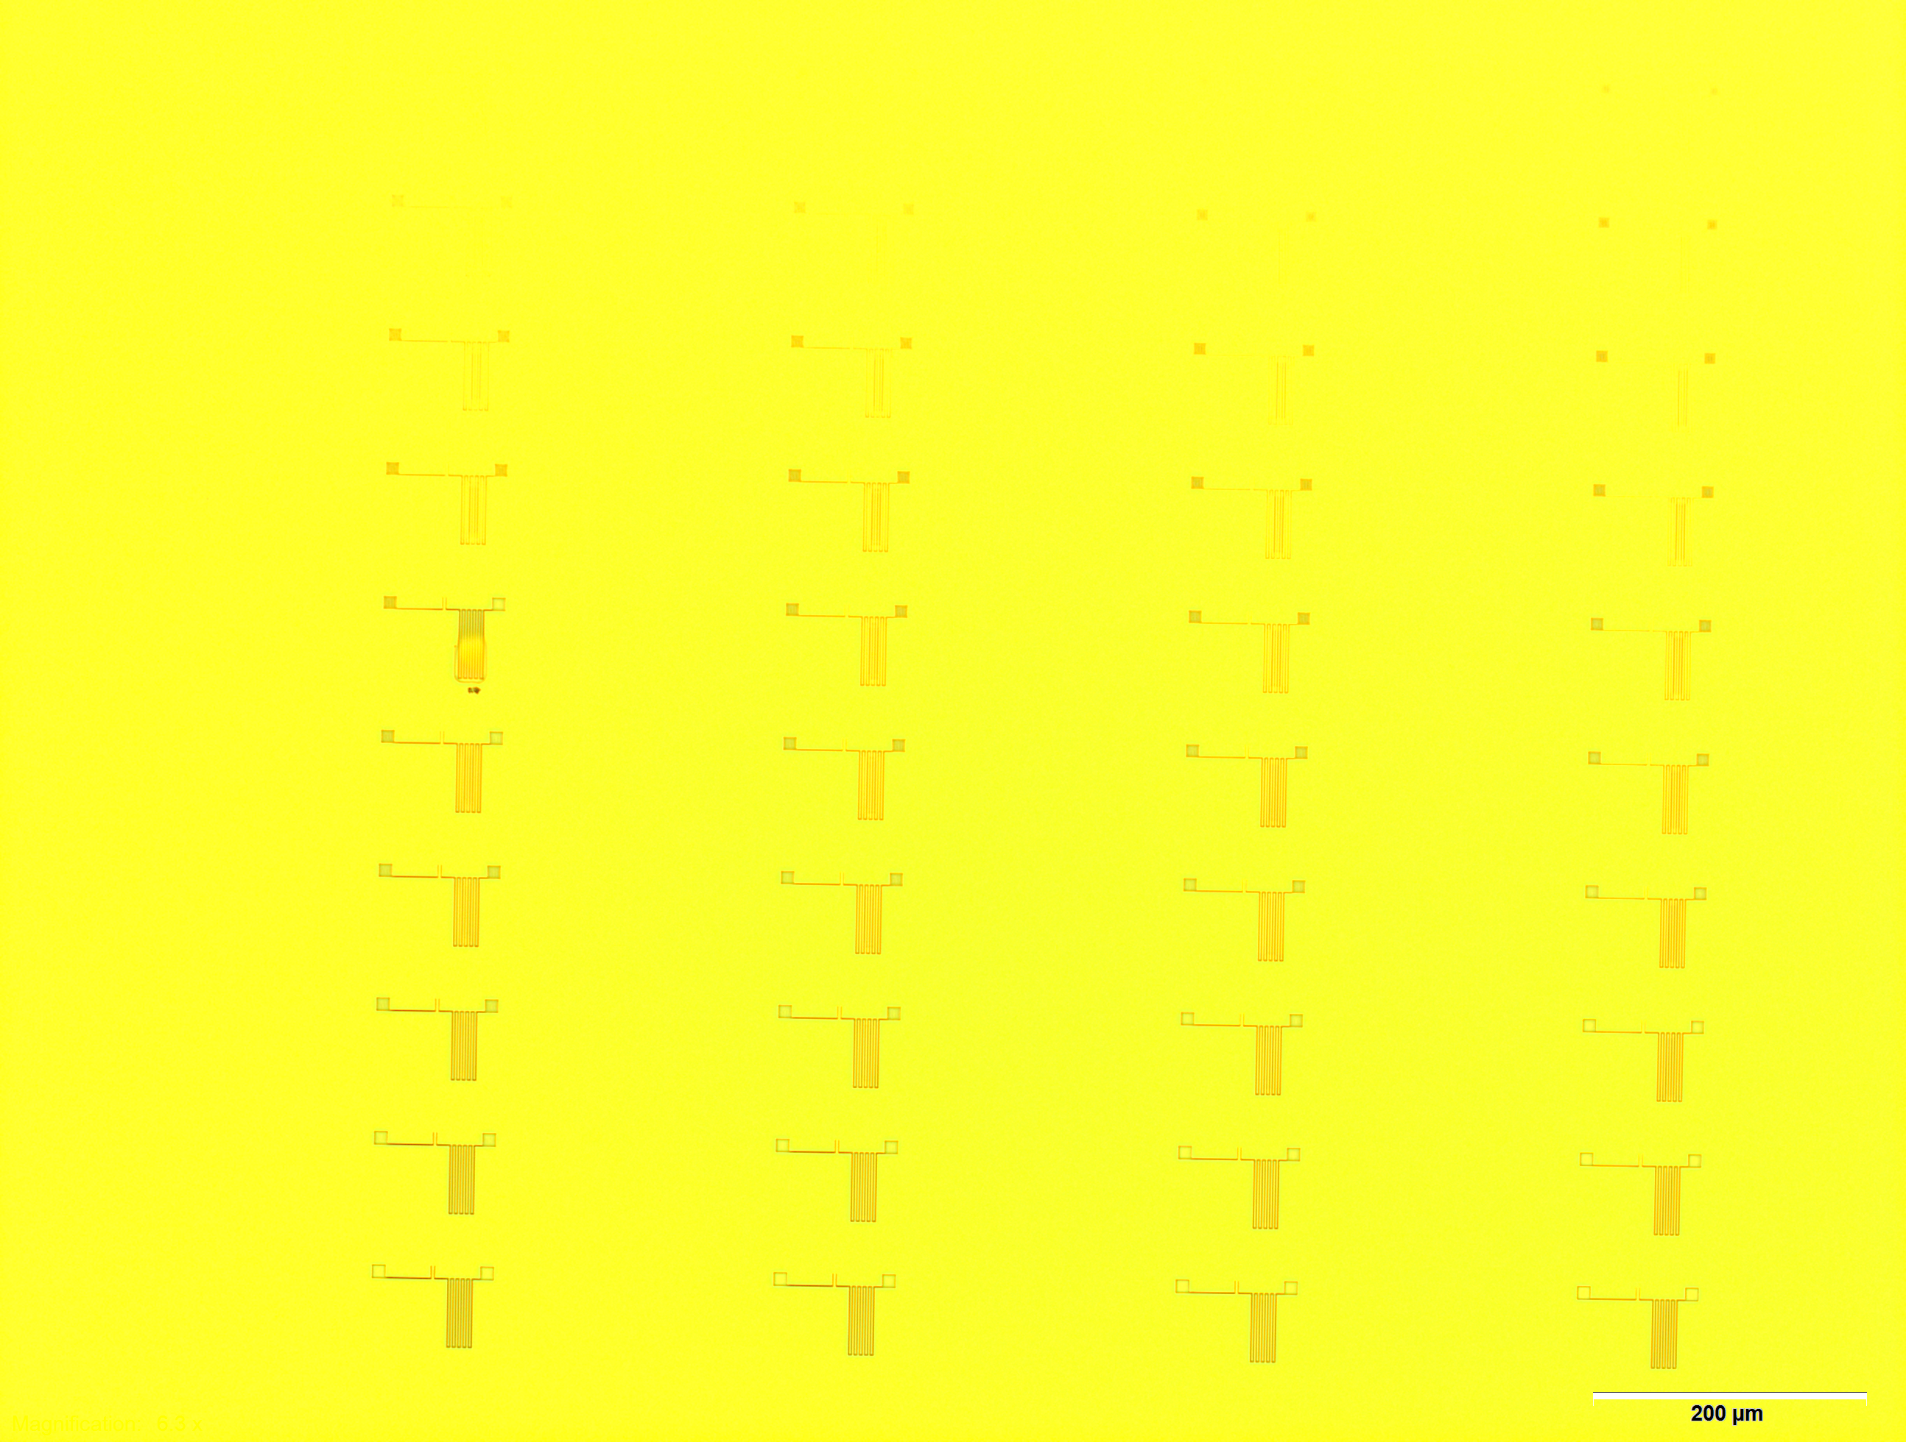
Dose array

Slide 20
Proximity corrections effects
Optimize parameters for dose distribution to take into account diffusion and electron backscattering from substrates

Slide 21
Future plan
Achieve best resolution with E-beam lithography with tungsten on Silicon by tuning PEC parameters
Test reactive ion etching on W and Si and then on NbTiN samples from JLab SRF
Cool down and test Tc, critical current and photosensitivity
Measure efficiency timing resolution
Irradiate
Redo test
Test Nanoimprint technique for mass production

Slide 22
Conclusion
CNM has tools and expertise to produce superconducting detector prototype
Working on achieving best resolution with E-beam lithography
Next step : etching and cool down
Should be able to determine optimal size for UV/visible, timing resolution, efficiency and radiation hardness

Slide 23
Backup

Slide 24
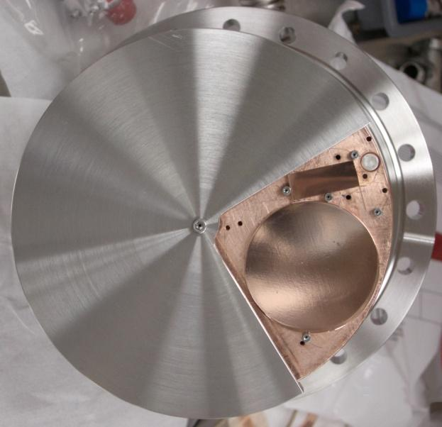
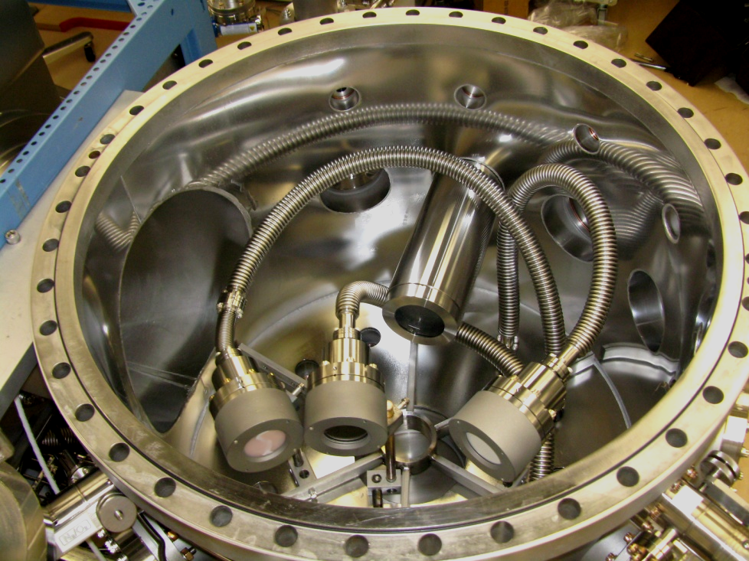

Jlab SRF
A unique, versatile thin film deposition system
enabling multiple coating techniques in-situ
Designed to enable rapid exploration of the production parameter space of:
  Nb films
      Alternative material films like NbN, NbTiN
      S-I-S multilayer structures based on these compounds
From Dr. Anne-Marie Valente-Feliciano
NbTiN, NbN, Mo₃Re, V₃Si coatings with Reactive Sputtering and
High Power Pulse Magnetron Sputtering in self-sputtering mode
& MgO coating with RF sputtering

Slide 25
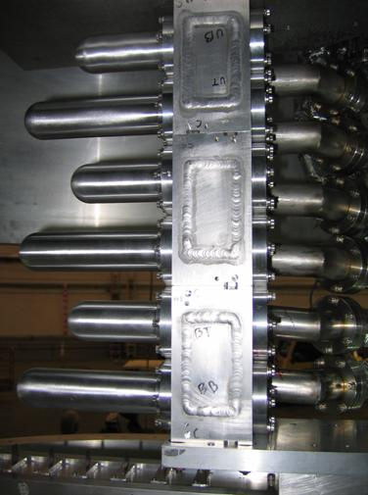
General detector requirements
Detector close to target to detect coherent deuteron
  Cryotarget at 21 K : need to operate at low temperature
  Direct view of target : high rate of photon, electrons, protons and neutron
    Need to be fast
    Radiation hard
    Possibly inside target for very low momentum recoil
Investigated silicon detector but speed ( 1 μs shaping )and radiation hardness not sufficient to run at a reasonable luminosity. Large acceptance detector is typical limiting factor to increase of luminosity ( Hall B, Hall A DVCS,…)
Need fast and radiation hard detector
Cryotatget ladder

Slide 26
Recoil detector for coherent DVCS
γ ∗ +D
γ ∗ + He4-> He4 + γ
D + γ
Cryotarget cell
e-
e-
Superconducting detectors inside and outside target cell
Recoil deuterium or He4

Slide 27
Detectors
Liquid Helium Rich / scintillator PID detector
Compton
Nuclei Deeply Virtual Compton Scattering
Doubly Virtual Compton Scattering
Deeply Virtual Compton Scattering on transversely polarized target

Slide 28
Liquid Helium detector
Helium has very fast UV scintillation and slower component
Helium is transparent to UV
RICH + scintillation + Time of flight
Liquid helium flow
Ionization, scintillation and Cerenkov
SNSPD array

Slide 29
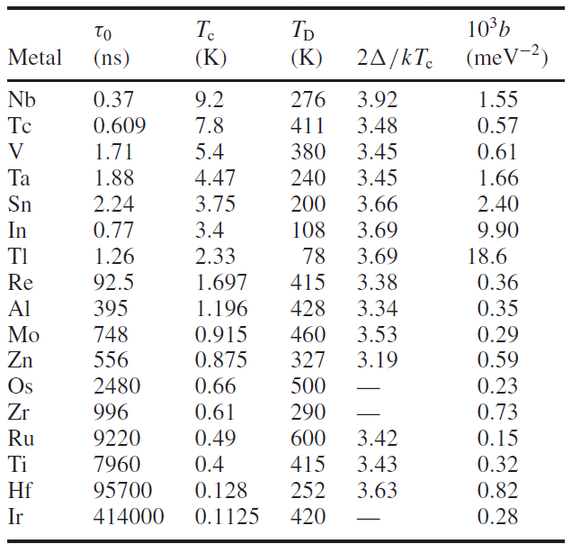
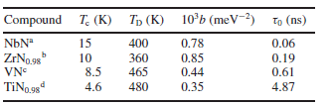
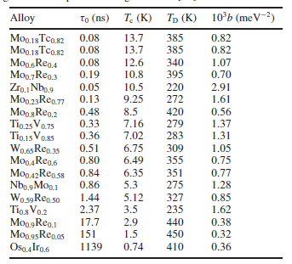

Superconductors properties
L Parlato et al 2005 Supercond. Sci. Technol. 18 1244 doi:10.1088/0953-2048/18/9/018
In boxes : active or future R&D at SRF group

